Slide 1
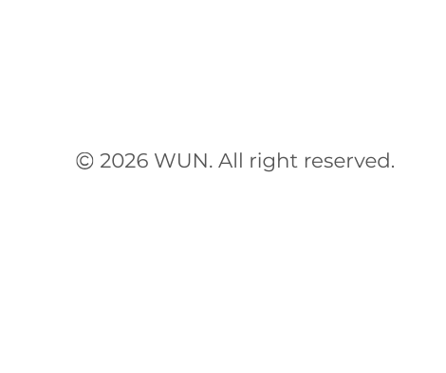
WUN Thrive Programme
"There is no limit to what we, as women, can accomplish..." Michelle Obama

Slide 2
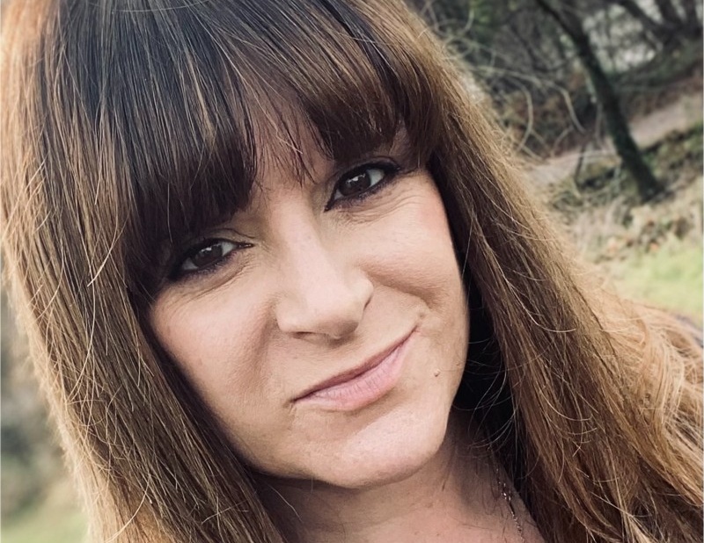
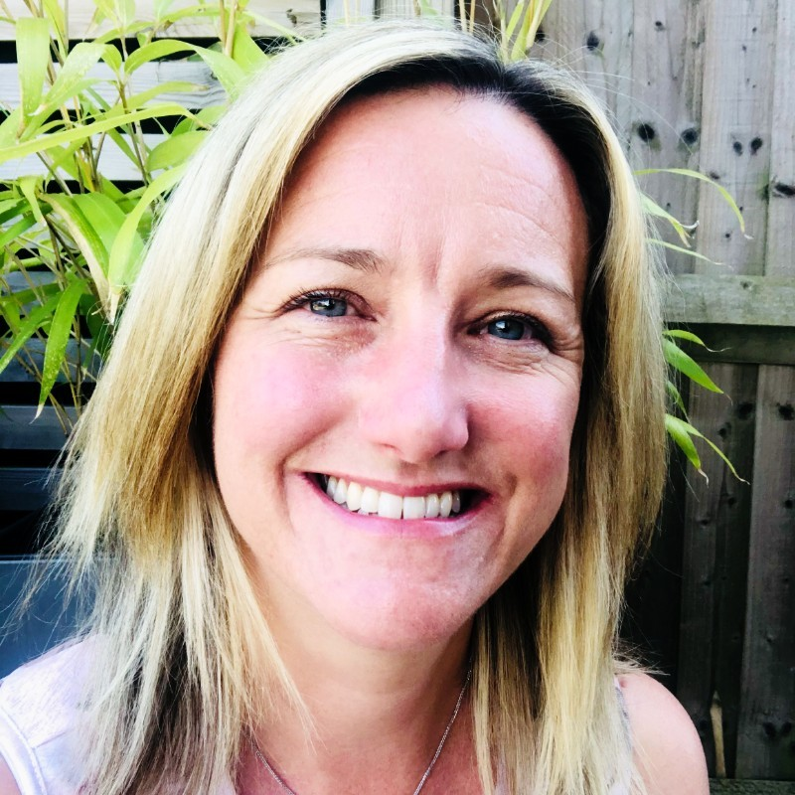

The WUN Thrive Team
Sarah Hopkins
Juliet Summers
Sallyann Weston-Scales

Slide 3

Your time to Thrive
WUN's bespoke Leadership Programme
Uniquely built for women leaders in utilities
Learning
Community
Performance

Slide 4
WUN Thrive Programme
Leadership Foundations
Coaching as a Leadership Skill
Unleashing Your Potential
Inclusive Leadership
Leading with Confidence
Creating Your Impact

Slide 5
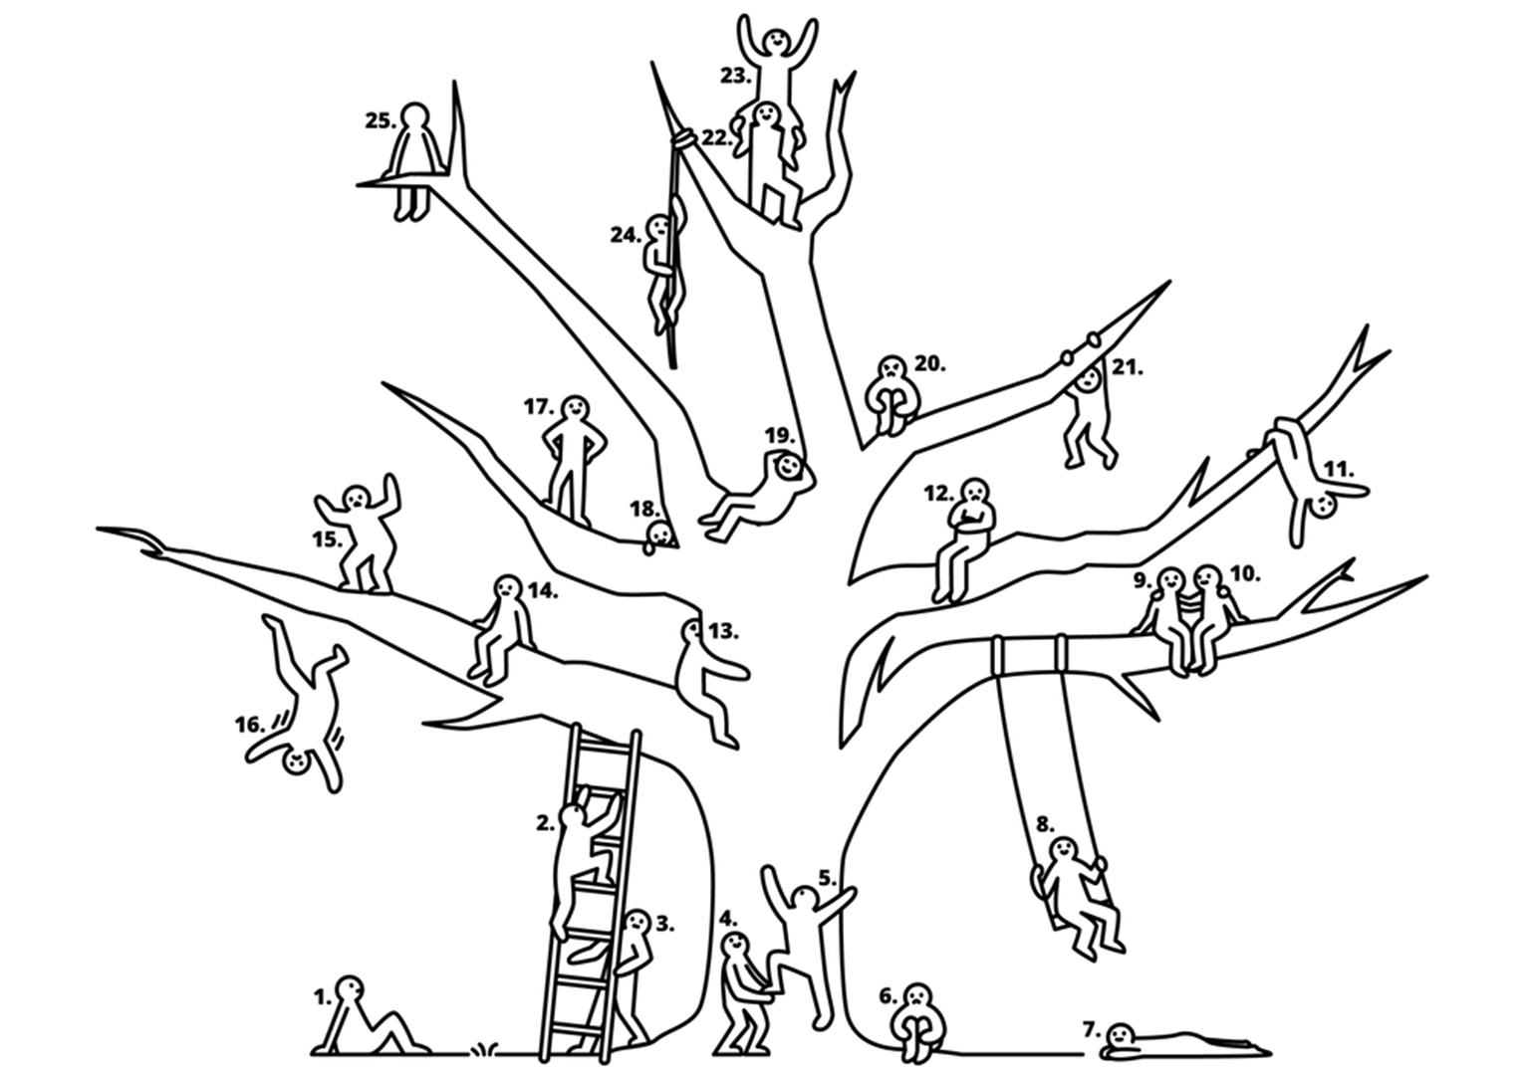
Getting to know each other

Slide 6
Building Your Leadership Foundation
Sarah Hopkins
Sallyann Weston-Scales

Slide 7
WUN Thrive Programme
Module One purpose
Building self-awareness
Setting purposeful intentions
Aligning values and strengths with leadership style
Visualising the future
The Thrive Journal

Slide 8
Today's topics
The Thrive Journey & The Thrive Leadership Ladder
Personal Values
Self-Discovery and DiSC
Our Strengths
Growing Trees & Building Bridges
Reflections
7pm - Dinner at Devonshire Terrace, Liverpool Street

Slide 9


Why Thrive?
Thrive Journal
Page 7
GROUP DISCUSSION

Slide 10
What are the specific challenges for female leaders in our sector?
GROUP DISCUSSION

Slide 12
Our Contract
GROUP DISCUSSION

Slide 13
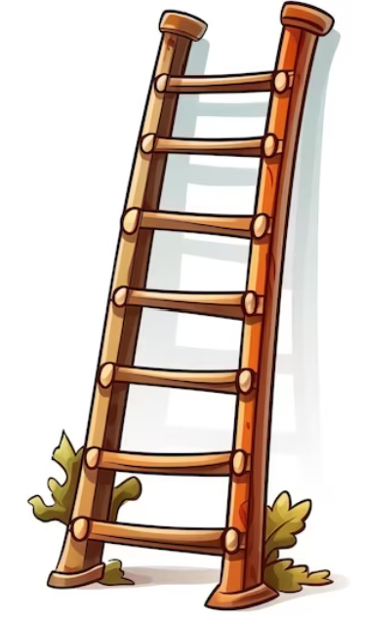
WUN Leadership Ladder
Leading Yourself: Building Personal Awareness
Leading Teams: Creating an Inclusive Culture
Leading Across Functions: Driving Influence
Leading the Business: Shaping Strategy
Leading the Industry: Becoming a Changemaker

Slide 14

Starting with the end in mind
INDIVIDUAL REFLECTION

Slide 15
STARTING WITH THE END IN MIND
SEE
HEAR
FEEL
RESULTS

Slide 16
Starting with the end in mind
PAIRED DISCUSSION

Slide 17
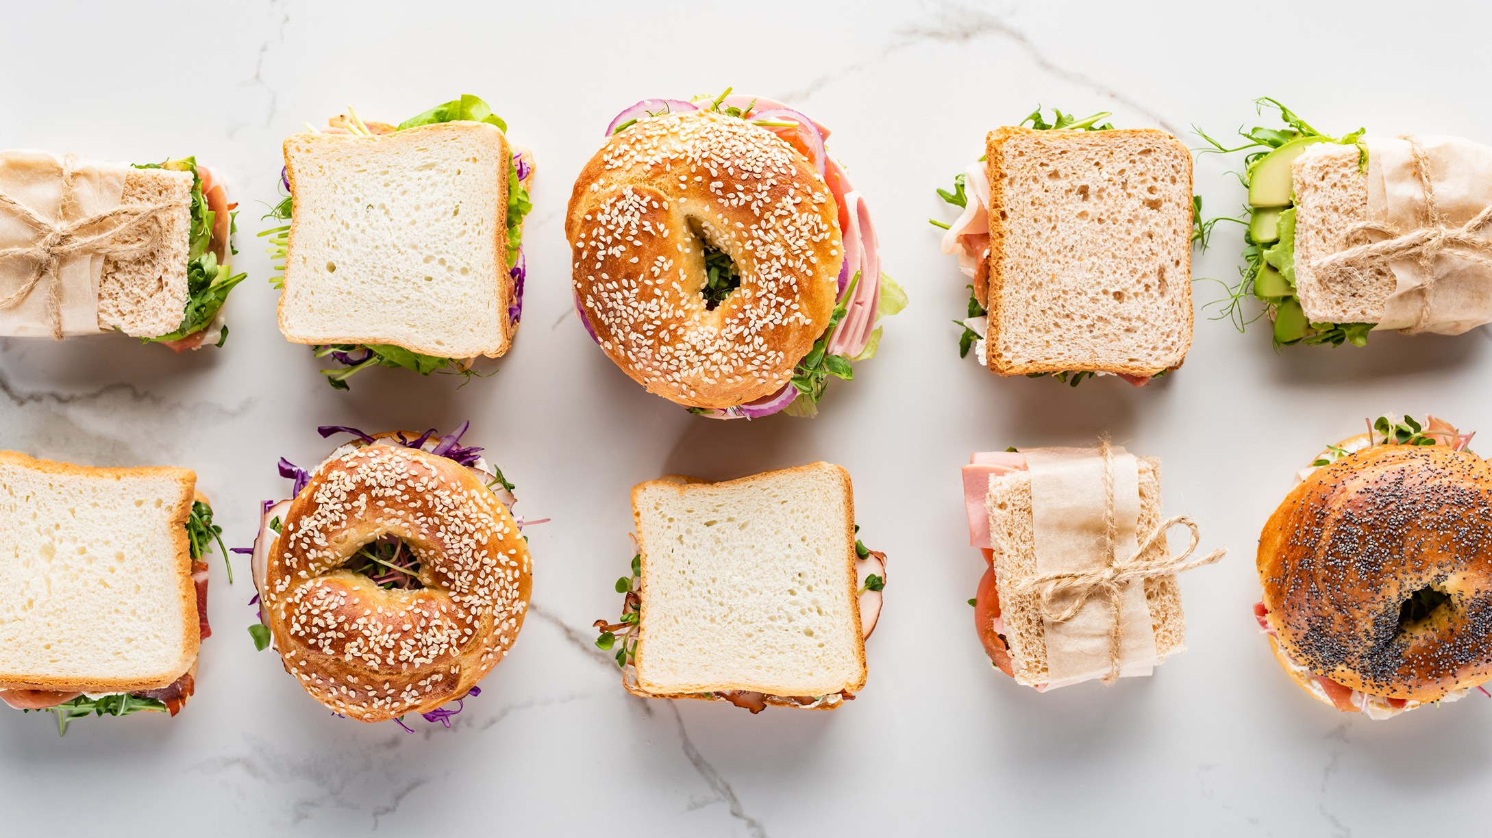


Slide 18
PERSONAL VALUES
Thrive Journal
Page 3
GROUP DISCUSSION

Slide 19
PERSONAL VALUES
Thrive Journal
Page 3
IN PAIRS:
Share your values with your partner
Make a note of any others that stand out
Discuss the following questions:
Why did you choose these?
How do your values influence you as a leader?
How do your values shape your decision making?
When has your one of your values been challenged and how did you uphold it?

Slide 20
Why self-exploration matters
Sophia Goring, Head of ESG, Business Stream and WIUA Mentor of the Year 2024
Sophia Goring Business.mp4

Slide 21

HOW YOU SEE YOURSELF
Fast-paced & Outspoken
Cautious & Reflective

Slide 22
HOW YOU SEE YOURSELF
Skeptical & Questioning
Accepting & Warm

Slide 23
HOW YOU SEE YOURSELF
Fast-paced & Outspoken
Skeptical & Questioning
Accepting & Warm
Cautious & Reflective

Slide 24
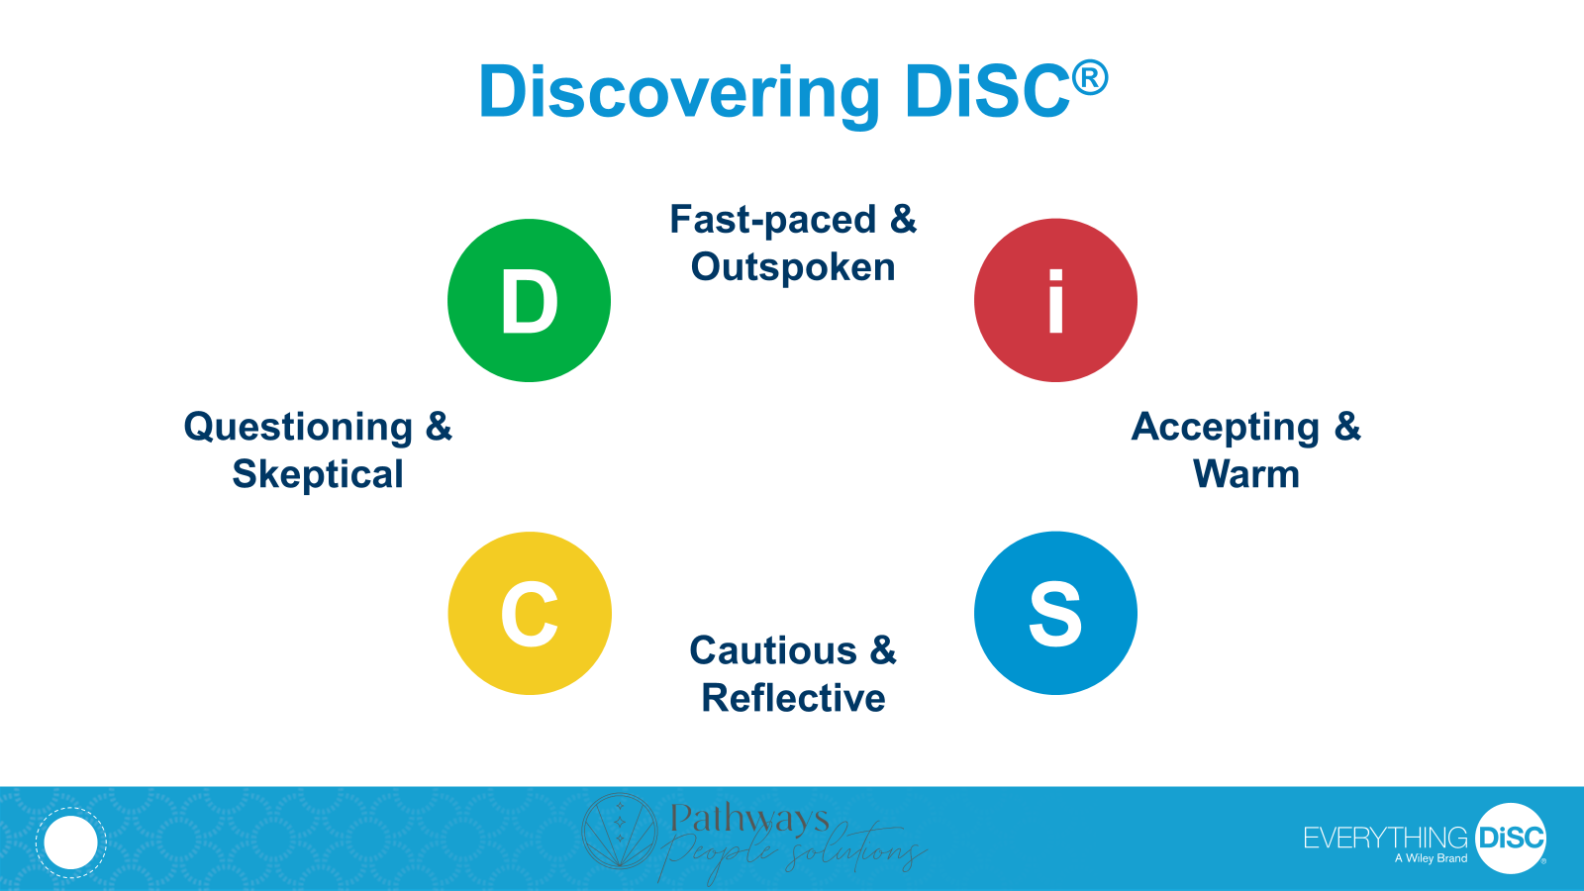

Discovering DiSC®
Fast-paced &
Outspoken
D
i
Questioning &
Skeptical
Accepting &
Warm
C
S
Cautious &
Reflective

Slide 25
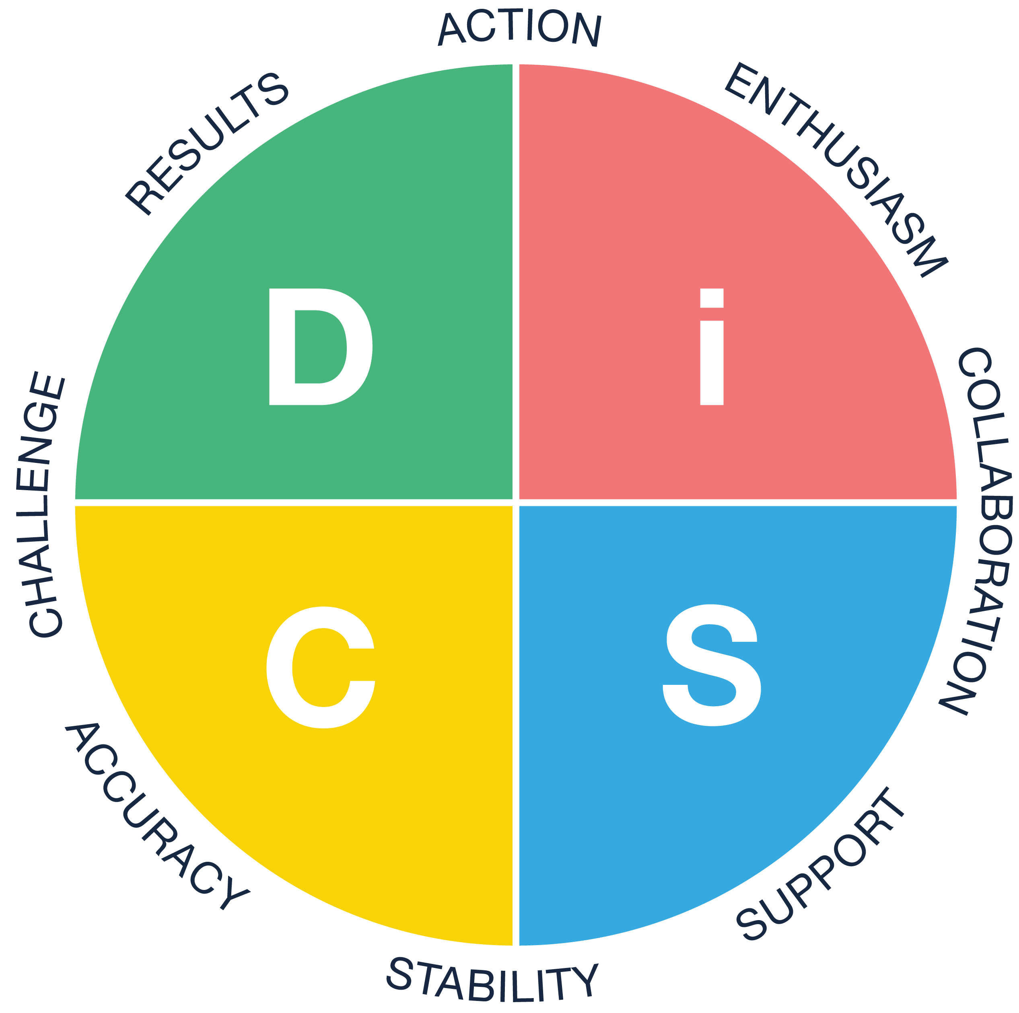
“A model of human behaviour that helps people understand why they do what they do”
It describes the typical behavioural styles of individuals
© John Wiley & Sons, Inc. All rights reserved.

Slide 26
People usually have one of these dimensions (D, i, S or C) as their core behavioural style
Each person develops a unique behavioural design through nature and nurture
People’s observable behaviour is a combination of all four dimensions
We all have the ability to adapt our behaviour and mask our natural behavioural style
People tend to find behaviour that is similar to their own as acceptable or normal behaviour
People with the same core style can (and do) exhibit very different behaviour

Slide 27
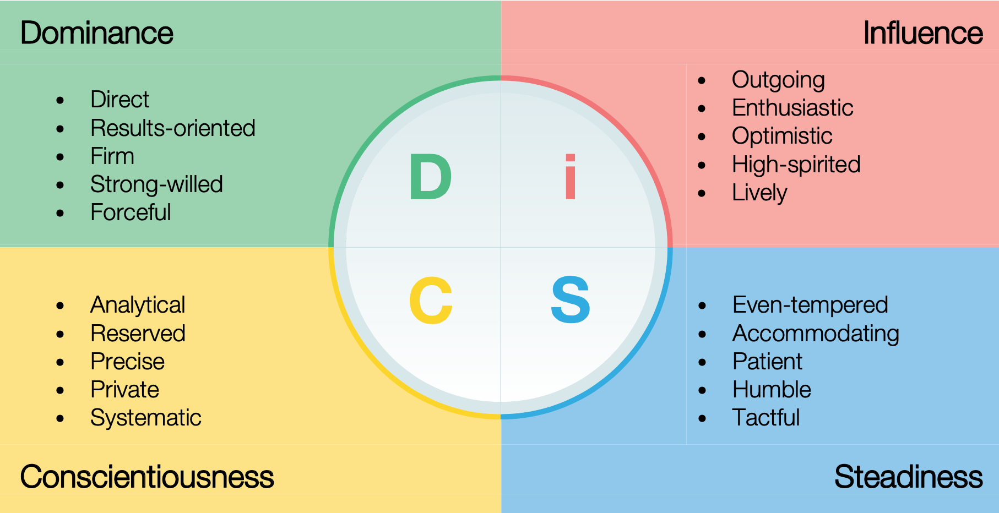

Slide 28
D
i
S
C
Get it done
Get recognised
Get along
Get it right

Slide 29
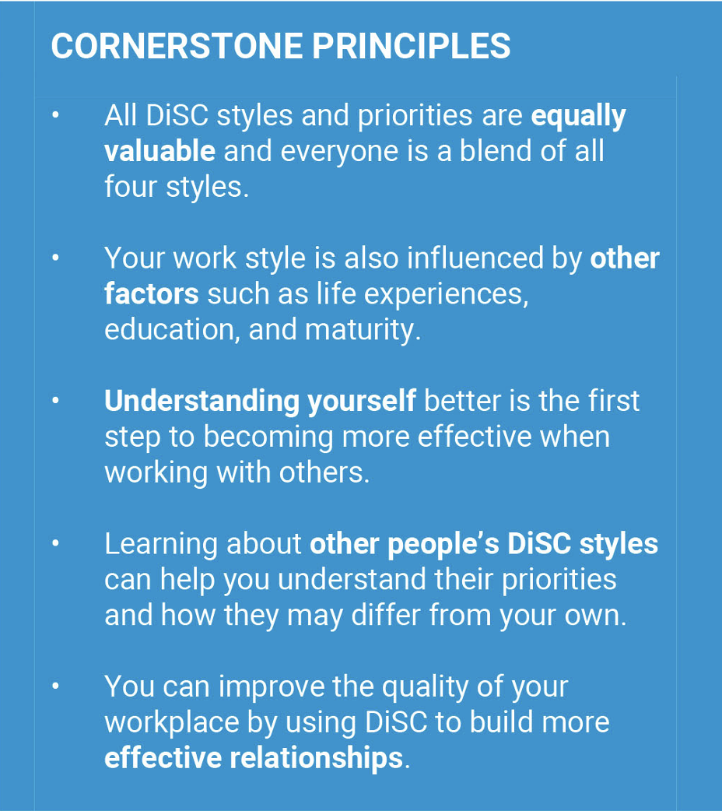
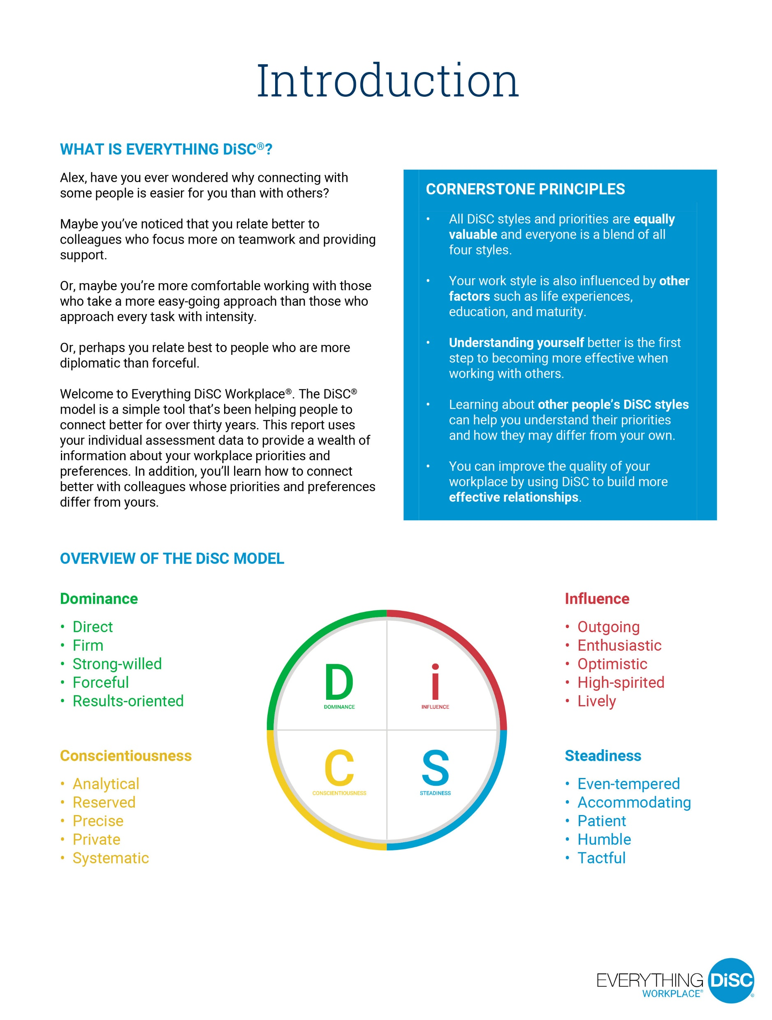
Cornerstone Principles Profile page 2

Slide 30
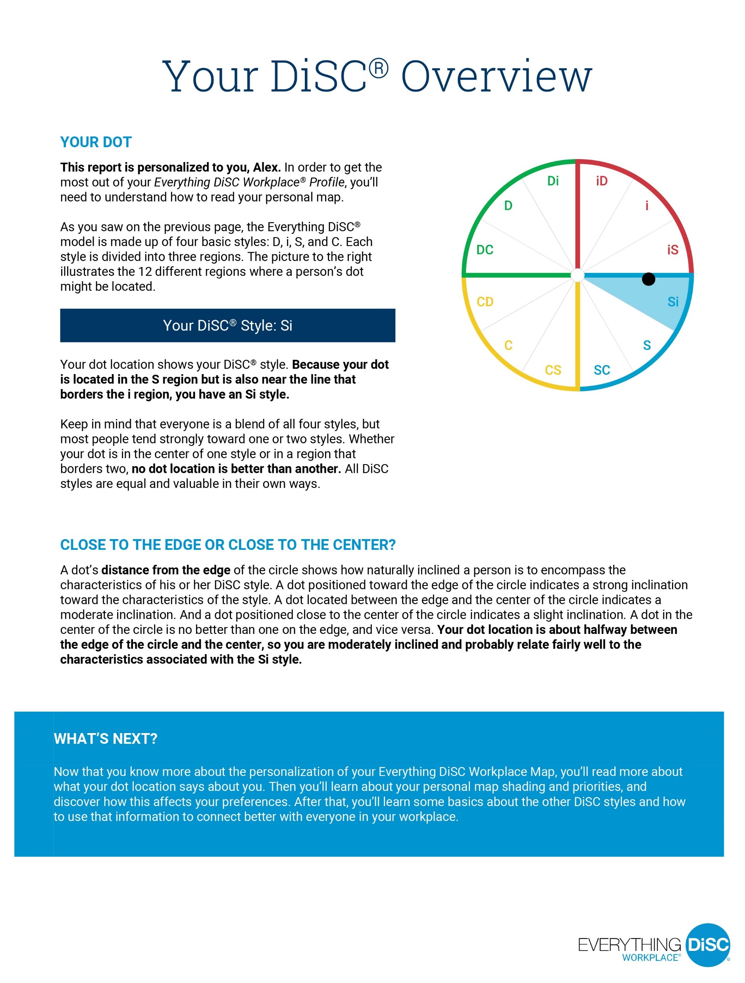
Your DiSC® Style Profile page 3

Slide 31
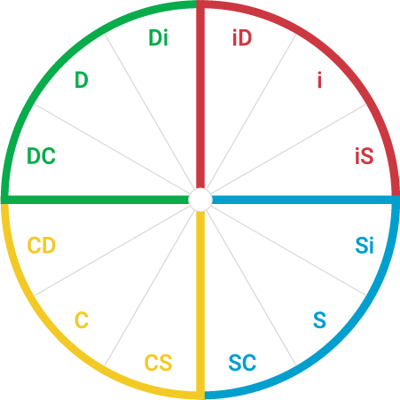
Your DiSC® Style

Slide 32
Inclinations
I
Inclination
Inclination
Slight
Moderate
Strong

Slide 33
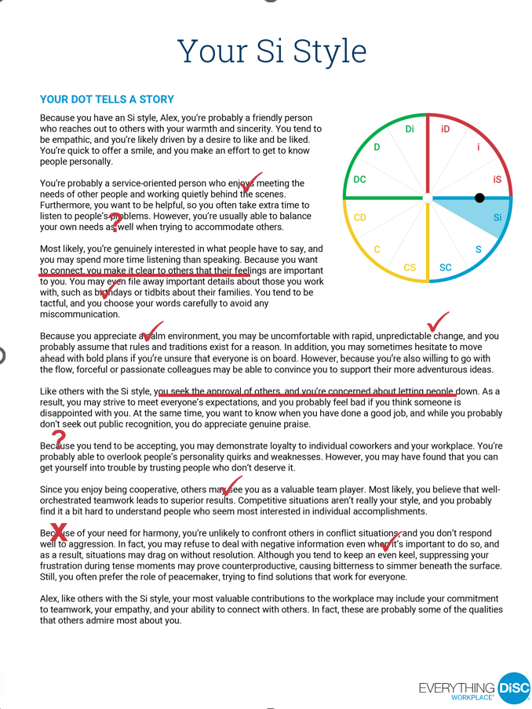
Personalisation – page 5
Read and personalise:
✓= like you
x = not like you
? = not sure
Underline three statements that best describe you
Then, working in pairs, share your findings

Slide 34
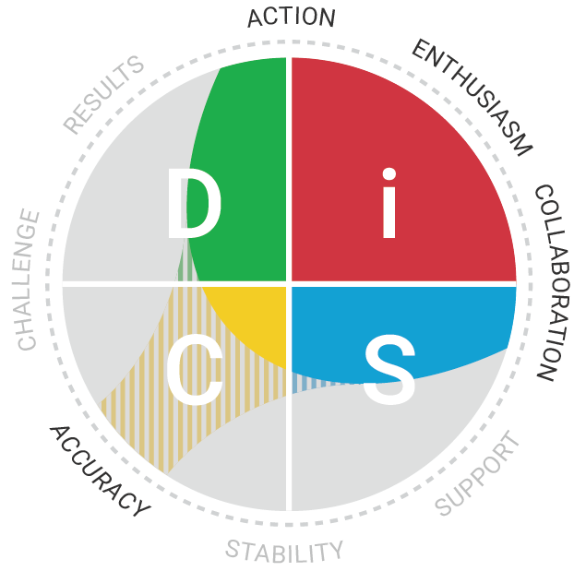
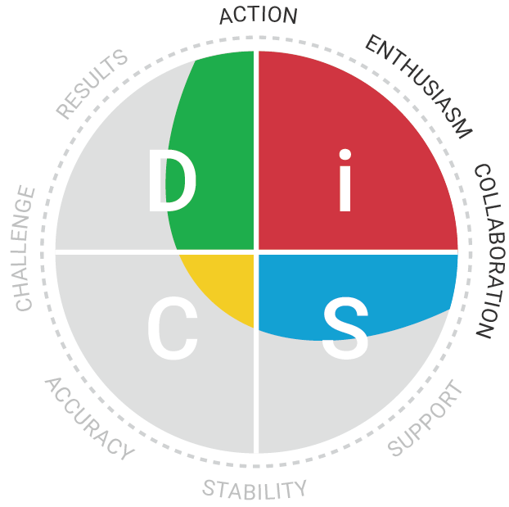
Priorities
Where people focus their energy
You receive the three priorities closest to your dot placement
Priorities represent what tends to be most natural to you
Everyone receives a minimum of 3 and maximum of 5 priorities
i Style
i Style + Accuracy

Slide 36

Create a poster!
GROUP ACTIVITY
OUTLINE:
What strengths this profile will bring to leadership?
What watchouts does this style have ?

Slide 37
Strengths
Thrive Journal
Page 5
PAIRED DISCUSSION

Slide 38
STRENGTHS
Thrive Journal
Page 5
IN PAIRS:
Share your strengths feedback with your partner
Discuss the following questions:
How do you already capitalise on the strengths you are considered to have?
How do they help you achieve your goals?
How do they help you to influence others?
Were there any surprises ? Any omissions?
How can you be more intentional about using these strengths?

Slide 39
YOUR BIG PLAN
Behaviours
Values
Strengths
Objectives

Slide 40
YOUR THRIVING TREE
INDIVIDUAL REFLECTION

Slide 41

Your Thriving Tree
Your Leadership Vision
(to be continued!)
Your Strengths
Your objectives
Your Values

Slide 42
YOUR BIG PLAN
Thrive Journal
Page 11-16
Reflect on the BIG PLAN section
Identify any development actions for your growth – page 13
Start to think about the One Year and Three Month – page 15-16

Slide 43


Reflections Circle
INDIVIDUAL &
GROUP REFLECTION

