Slide 1
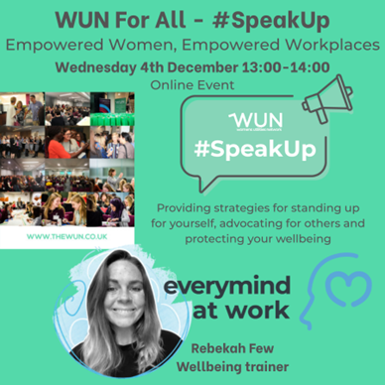

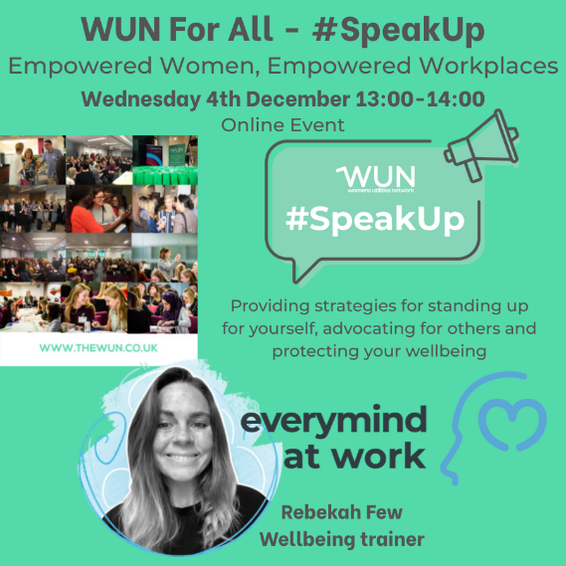
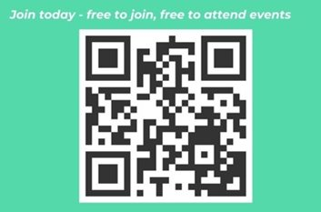
Welcome
#SpeakUp Empowered Women, Empowered Workplaces
We will be starting shortly
Regular Events & Content
10,400+
Members

Slide 2
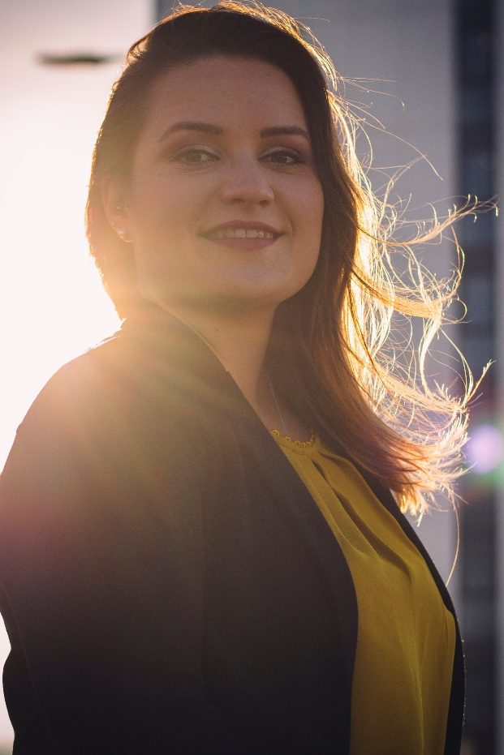

Welcome
#SpeakUp Empowered Women, Empowered Workplaces
Julia Stichling, WUN Advocate & MD R2M
Regular Events & Content
10,400+
Members

Slide 3


About the Womens Utilities Network (WUN)

Slide 4


The utilities sector is lacking in diversity with many women being generally under-represented, particularly in senior roles.
WUN was started in 2018 when a group of likeminded women, working in utilities, united around a common cause. The founders were not only passionate about the industry they worked in, but also passionate about the contribution women were making and could continue to make in the future. We now have over 10,400 members and 80+ partners.
Regular Events & Content
Mentoring Programme & Network
10,400+
Members
80+
Partners

Slide 5























































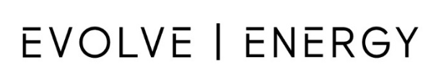
















Slide 6

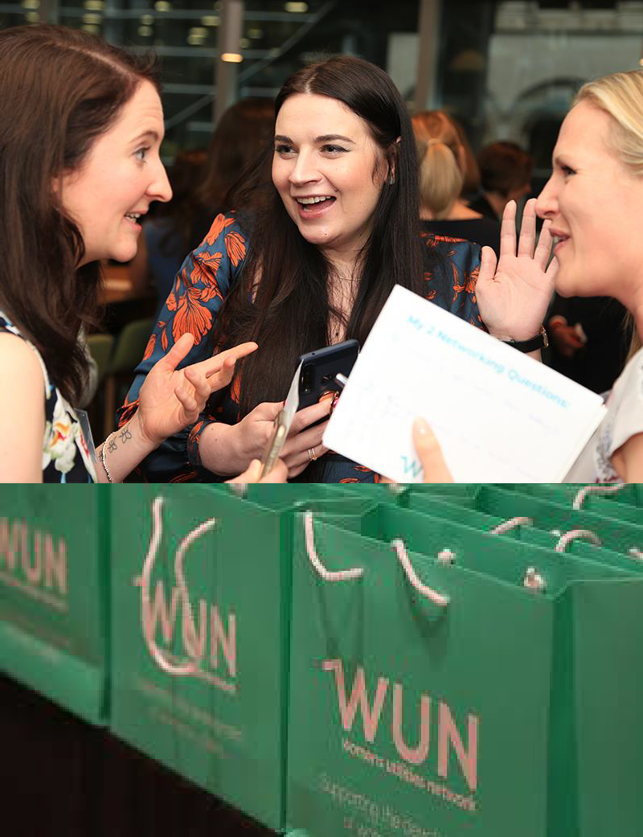
Our Vision
A utilities sector where women join, stay and thrive

Slide 7
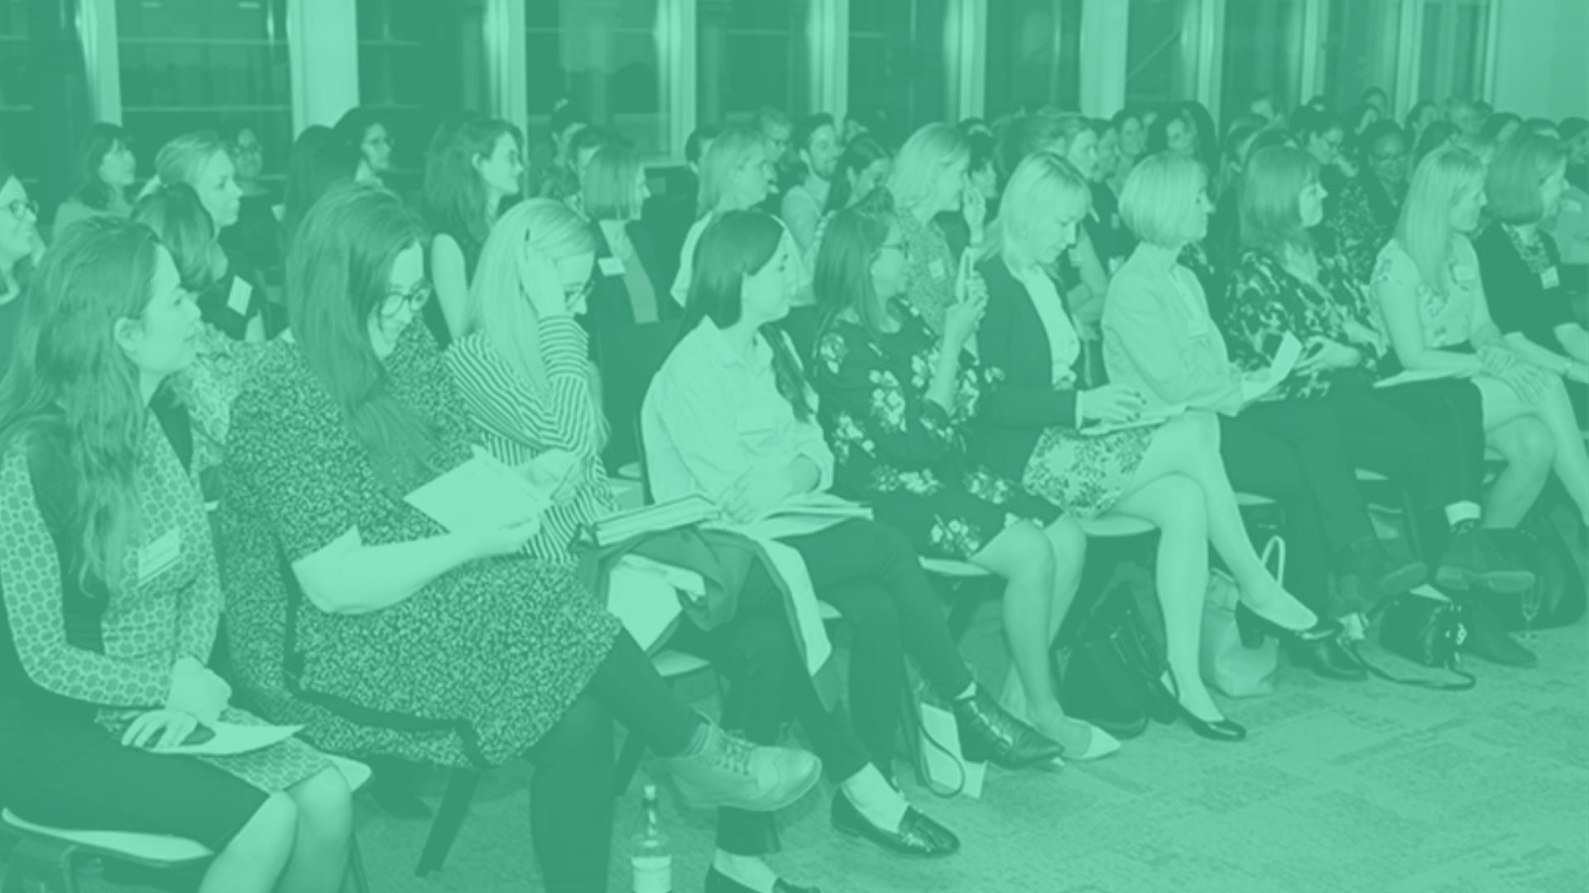
Our Events
A blend of virtual & in-person

Slide 8
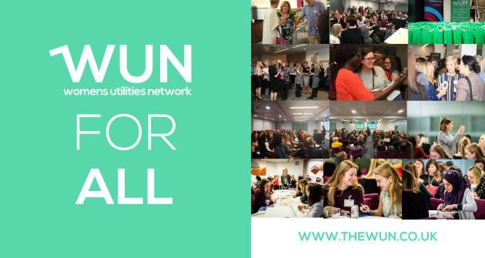
WUN Events – Coming Up
9th December 11:30am – Resilience in Action: Lessons in leadership and overcoming adversity (webinar)
11th December 12.30 – 2pm – #IAmRemarkable Workshop
14th January 2026 11 – 12.30pm - #IAmRemarkable Workshop
21st January 2026 1pm – WUNForWellBeing – The 40’s Woman and Beyond (virtual)
5th February 2026 10.30 – 12.00pm - #IAmRemarkable Workshop
10th February 2026 5-8:30pm, London AI in Energy and Water
Save the Date: Women in Utilities Awards 3rd July 2026
Free Tickets available
https://thewun.co.uk/

Slide 9
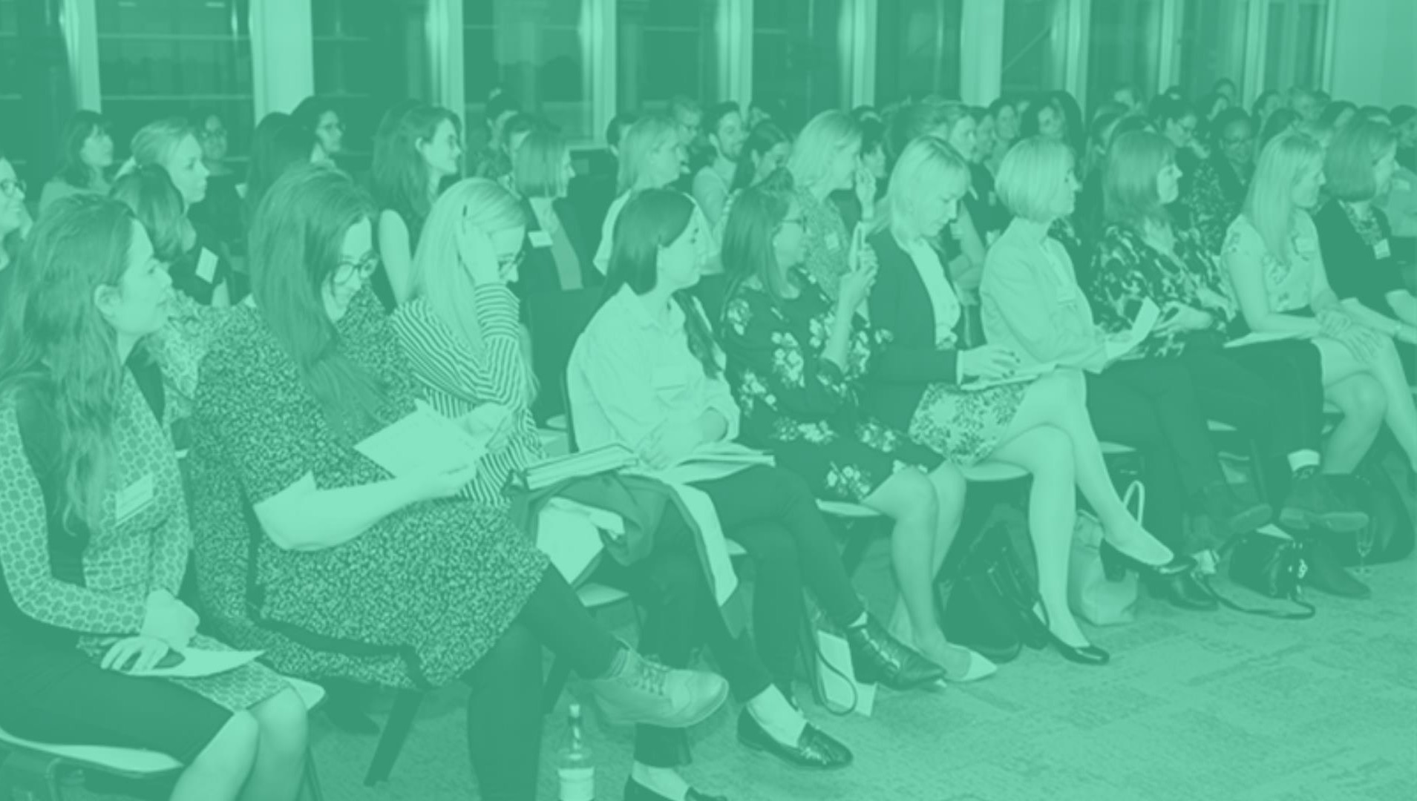
You can also catch up on past events too via the WUN website

Slide 10
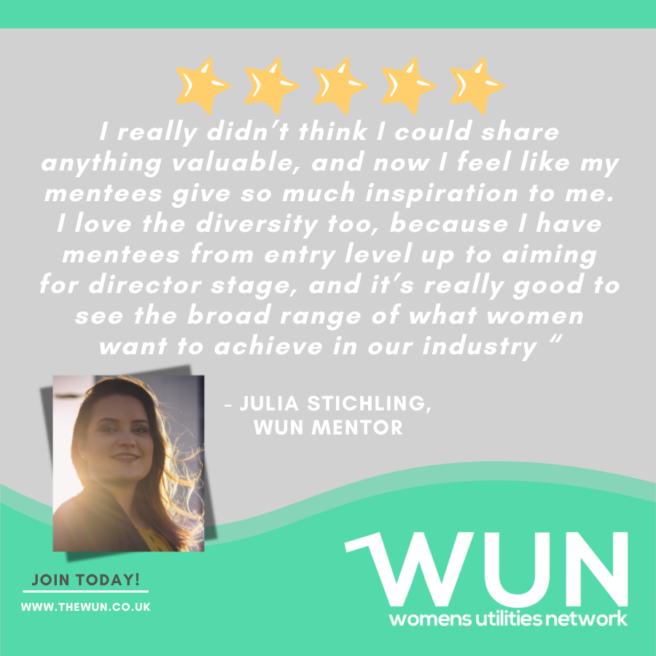
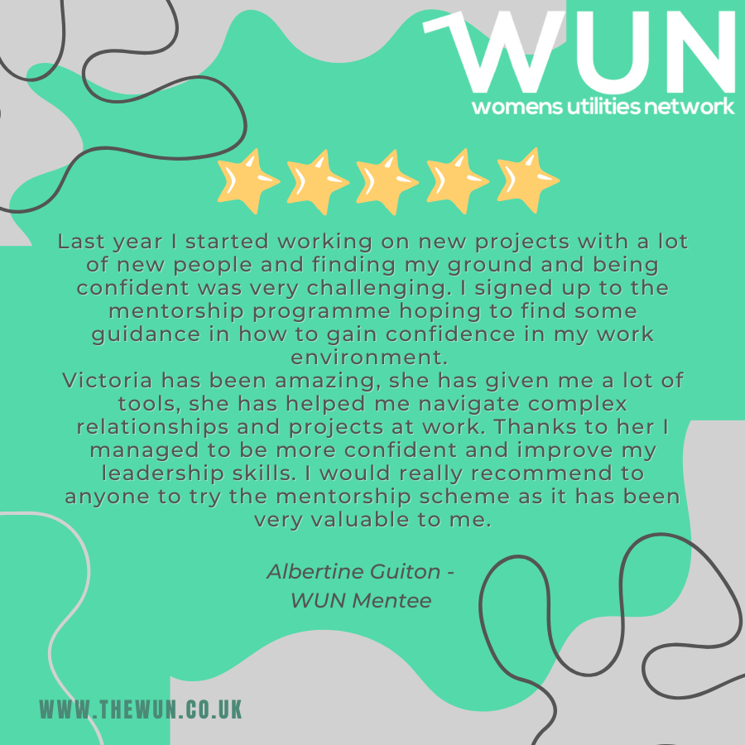
Join the free WUN Mentoring Programme
WUN offers mentoring to women at any stage of their career in the utilities sectors.
We are hugely privileged to have over 180+ fantastic experienced mentors within the WUN mentoring Programme.
With growing numbers of Mentors and Mentees we are delighted with the community and support fostered within the mentoring programme.
If you are interested in becoming a Mentor or Mentee,
please visit our website: https://wun.onpld.com

Slide 11
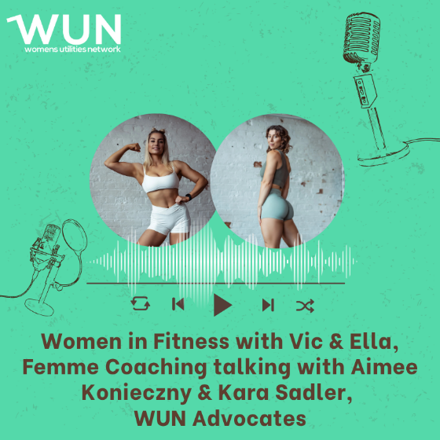
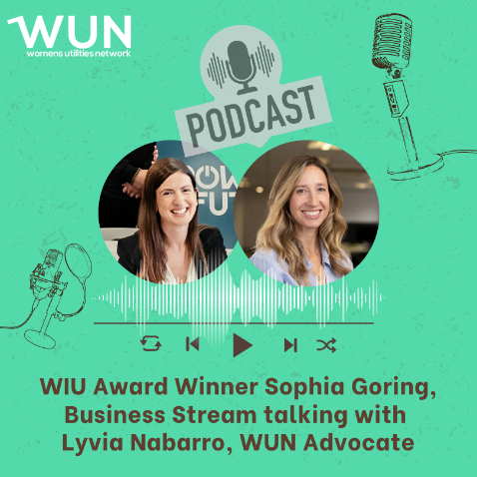
WUN Podcasts
Listen to our latest podcasts
More coming soon !
WUN advocates Aimee Konieczny from Indigo Swan and Kara Sadler from South Staffs and Cambridge Water chat women in fitness. They sit down with Vic and Ella from Femme Coaching – two inspiring fitness professionals dedicated to empowering women through strength and wellbeing.
In this episode, we discuss:
The journeys that led Vic and Ella into the world of fitness
Unique challenges faced by women in the fitness industry, and how to overcome them.
Whether you’re looking for inspiration, practical tips, or just a boost of motivation, this episode is for you!
In this latest Sophia Goring reflects on Business Stream’s success at the Women in Utilities Awards – winning the Best Community Outreach Award. She talks through the initiatives Business Stream has been leading in working with young people and partner organisations in their communities to provide meaningful workplace experiences and how they are inspiring more young women to consider a role in the water industry.
Sophia currently works with a number of charities and social enterprises, with a particular focus on supporting young people.
You can follow our podcast on Apple Podcasts, Spotify, Amazon Music and wherever else you get your podcasts – just search “WUN4ALL”.
Or just click through from the website: https://thewun.co.uk/news-blogs/

Slide 12
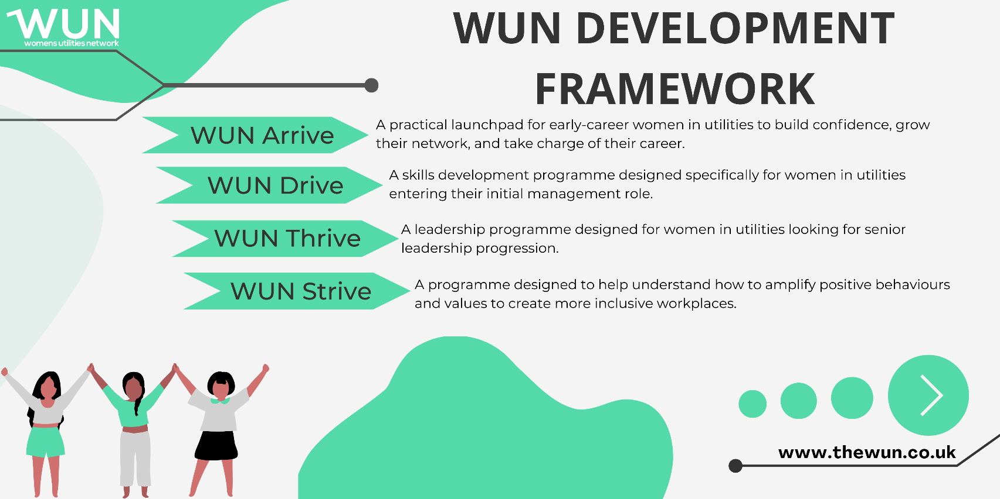
WUN Development Programme
Changing the future of utilities: Introducing our unique WUN development programmes – designed by and for women in utilities
We know that utilities need more women in leadership and, with the fast-changing nature of the sector, this is more important than ever. Changes are being made but the pace isn’t fast enough to make a real difference. We are here to help.
We are proud to have created a bespoke development framework to support women at different points in their utilities careers.
Further information : https://thewun.co.uk/wun-development-programmes/
Our WUN programmes have been created by women in utilities to respond to the challenges and needs reported to us by our members and partner organisations.
Designed to address the unique challenges of utilities, our topics are specifically tailored to support and develop women in the sector.
We are also proud to offer a WUN Bursary Scheme for our WUN Drive and WUN Thrive programmes, helping to ensure development opportunities are accessible to women across the sector.

Slide 13


Don’t forget to join the Network – its free & you also receive our quarterly newsletter!
Podcasts
https://thewun.co.uk/join-wun

Slide 15
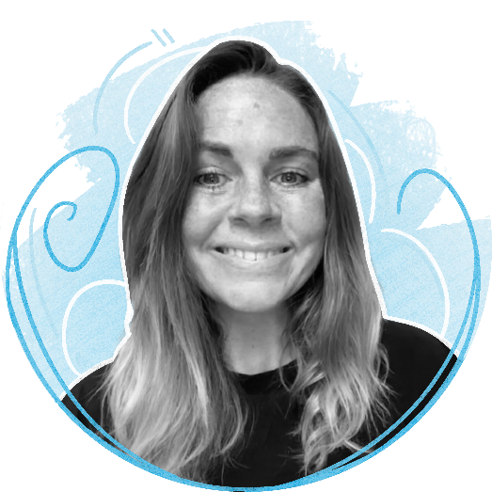


Todays Speaker:
Rebekah Few, Wellbeing Trainer at Everymind at Work
Rebekah Few is a dedicated Wellbeing Trainer at Everymind at Work, driven by a deeply personal journey. Having grown up as a young carer for parents who faced mental illness, she developed a profound passion for supporting others on their own mental health journeys.
Now, she channels this passion into both direct support and education, empowering individuals to take control of their wellbeing. Rebekah firmly believes that through greater knowledge and understanding, we can break the stigma surrounding mental health, allowing people to lead happier, more fulfilling lives.
.

Slide 16

Connect with Us
info@thewun.co.uk
https://thewun.co.uk/
https://www.linkedin.com
/company/womens- utilities-network
@TheWUN1
@WUN4ALL
@Womens Utilities Network

Slide 17


For Further information about WUN visit the website
https://thewun.co.uk

