Slide 1



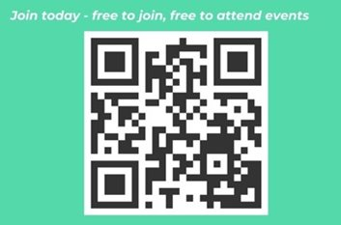
Welcome WUNForWellbeing – The 40s Woman & Beyond
We will be starting shortly
Disclaimer: Anna Black & Gen Hallam cannot be held responsible
for any injury or harm caused as a result of participation in any session
or ideas you follow as a result of listening to this podcast/attending
this workshop. You are taking part at your own risks and need to make sensible
decisions. Check in with your GP if you have any concerns and before making changes.
Regular Events & Content
10,400+
Members

Slide 2
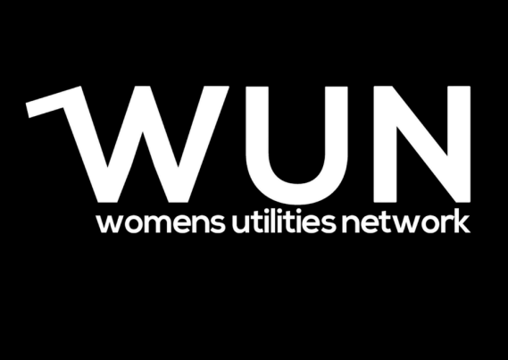


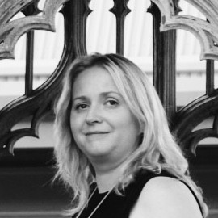


Welcome –
Gill Edwards WUN Advocate & Management Consultant
skewb.

Slide 3


About the Womens Utilities Network (WUN)

Slide 4


The utilities sector is lacking in diversity with many women being generally under-represented, particularly in senior roles.
WUN was started in 2018 when a group of likeminded women, working in utilities, united around a common cause. The founders were not only passionate about the industry they worked in, but also passionate about the contribution women were making and could continue to make in the future. We now have over 10,600 members and 80+ partners.
Regular Events & Content
Mentoring Programme & Network
10,600+
Members
80+
Partners

Slide 5




































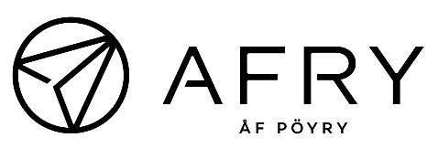


















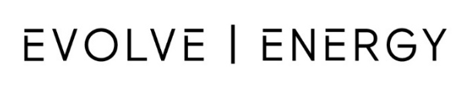















Slide 6

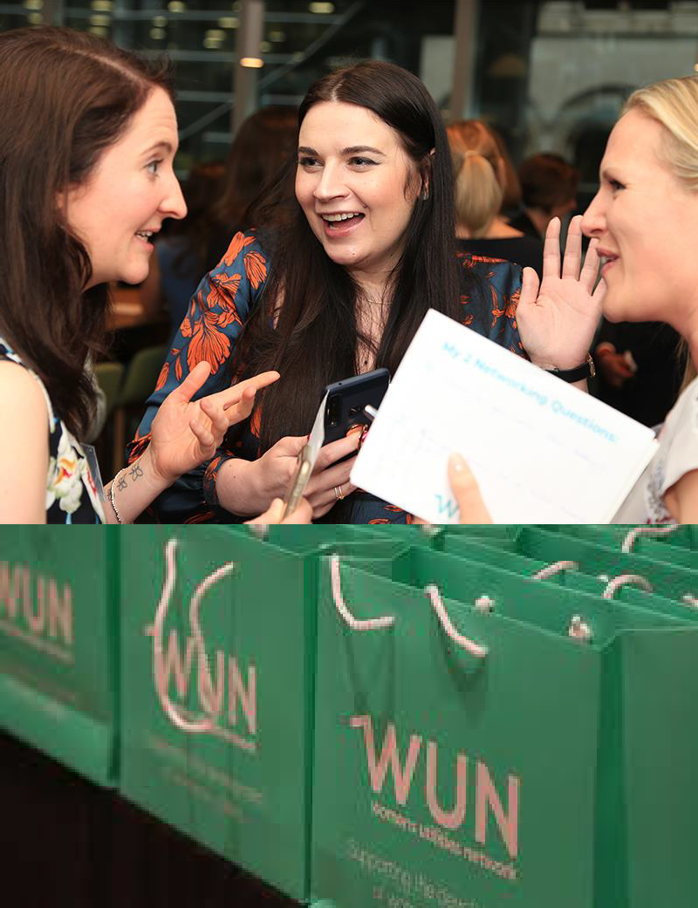
Our Vision
A utilities sector where women join, stay and thrive in workplaces with inclusive leadership and cultures.

Slide 7

WUN Events – Coming Up
21st January 2026 1pm – WUNForWellBeing – The 40’s Woman and Beyond
5th February 2026 10.30 – 12.00pm - #IAmRemarkable Workshop
10th February 2026 5.00 – 8.30pm – AI in Energy & Water
8th March IWD – WUN podcast will be available in advance to WUN partners
Save the Date: Women in Utilities Awards 3rd July 2026 – entries now open until 19th March 2026 – 16 Categories including 3 new #SpeakUp, Technology Champion, Frontline Excellence Award.
Further in person and virtual events will be announced shortly including regional events
Free Tickets available
https://thewun.co.uk/

Slide 8

You can also catch up on past events too via the WUN website

Slide 9

WUN
Mentoring Programme

Slide 10
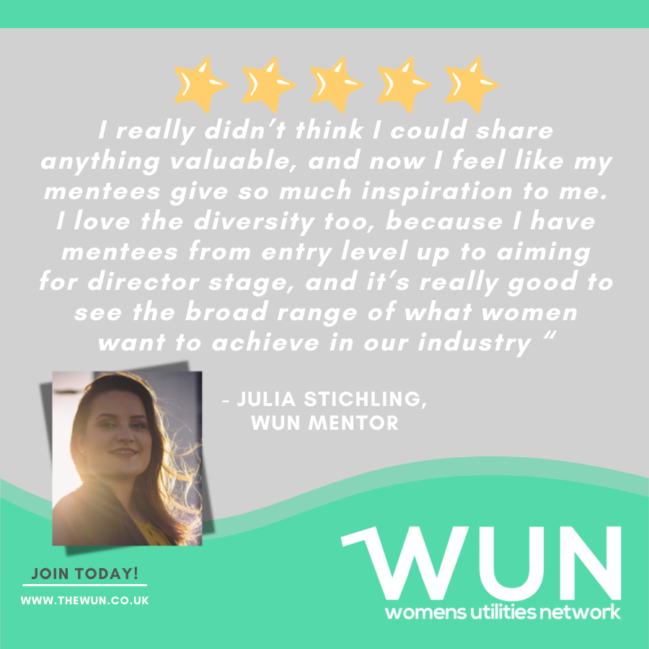
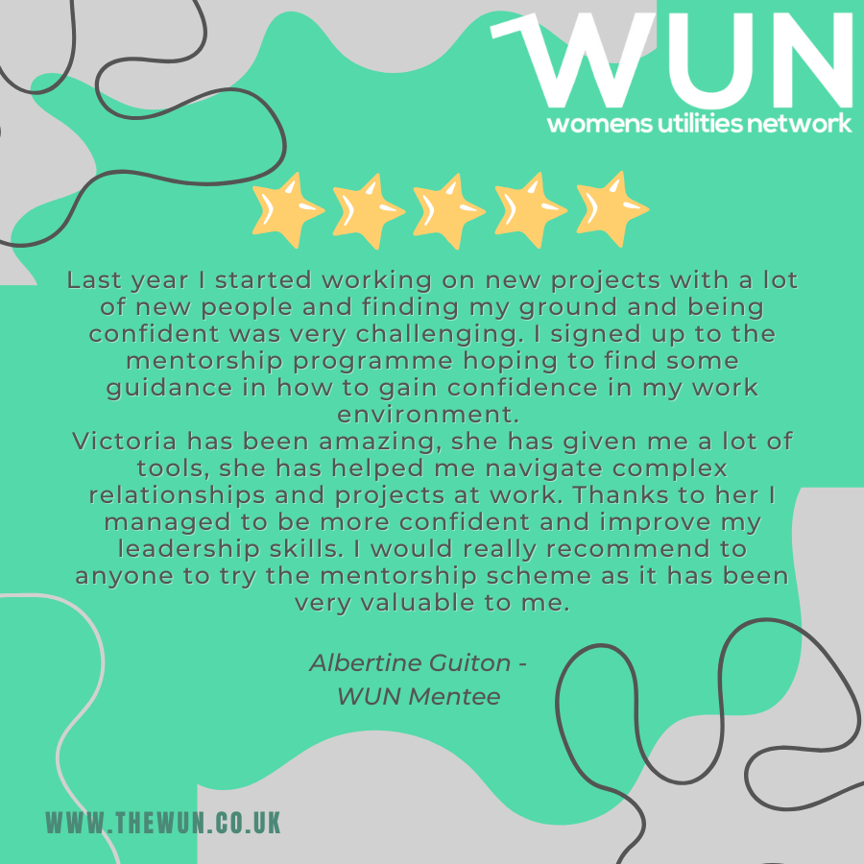
Join the free WUN Mentoring Programme
WUN offers mentoring to women at any stage of their career in the utilities sectors.
We are hugely privileged to have over 180+ fantastic experienced mentors within the WUN mentoring Programme.
With growing numbers of Mentors and Mentees we are delighted with the community and support fostered within the mentoring programme.
If you are interested in becoming a Mentor or Mentee,
please visit our website: https://wun.onpld.com

Slide 11


Podcasts, Video Podcasts & Blogs
Inspiring career stories
Industry topics
Personal development
https://thewun.co.uk

Slide 12
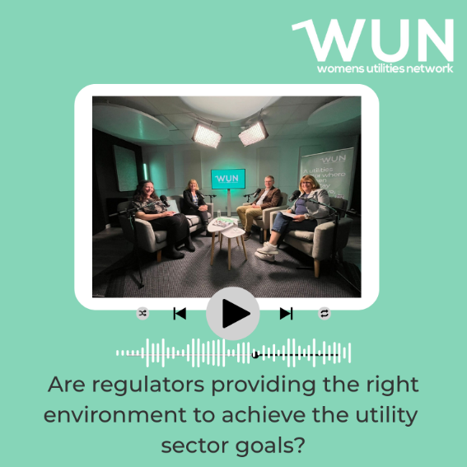

WUN Podcasts
Listen to our latest podcasts
More coming soon !
In this episode, WUN Director Sarah McMath, MOSL brings together Emma Baker, Wessex Water, David Black, former Chief Executive of Ofwat and Zoe Morrissey NESO to explore whether current frameworks are fit for purpose – and what must change. They examine how prescriptive, fragmented rules can block innovation and outcomes, and why outcomes‑based regulation, better codes and smarter use of innovation funds matter.
The panel links this directly to live reforms, including the UK government’s plan to abolish Ofwat and create a new single water regulator by combining functions from Ofwat, the Environment Agency, Natural England and the Drinking Water Inspectorate, in the biggest overhaul of the sector since privatisation.
In this latest WUN podcast WUN Co-Founder & Director Hayley Monks speaks to some other inspiring female leaders & role models, Rebecca Sedler, Managing Director of National Grid Interconnectors & former WUN Director and Monica Collins, Chair of Powerful Women and who holds several Non Exec. roles.
In a far ranging & fascinating discussion they explore the evolving landscape of female leadership and the growing trend of portfolio careers among women. Are we seeing enough women stepping into visible leadership roles? Or are too many opting for flexible, multi-faceted careers that may dilute their influence in traditional leadership spaces?
You can follow our podcast on Apple Podcasts, Spotify, Amazon Music and wherever else you get your podcasts – just search “WUN4ALL”.
Or just click through from the website: https://thewun.co.uk/news-blogs/

Slide 13
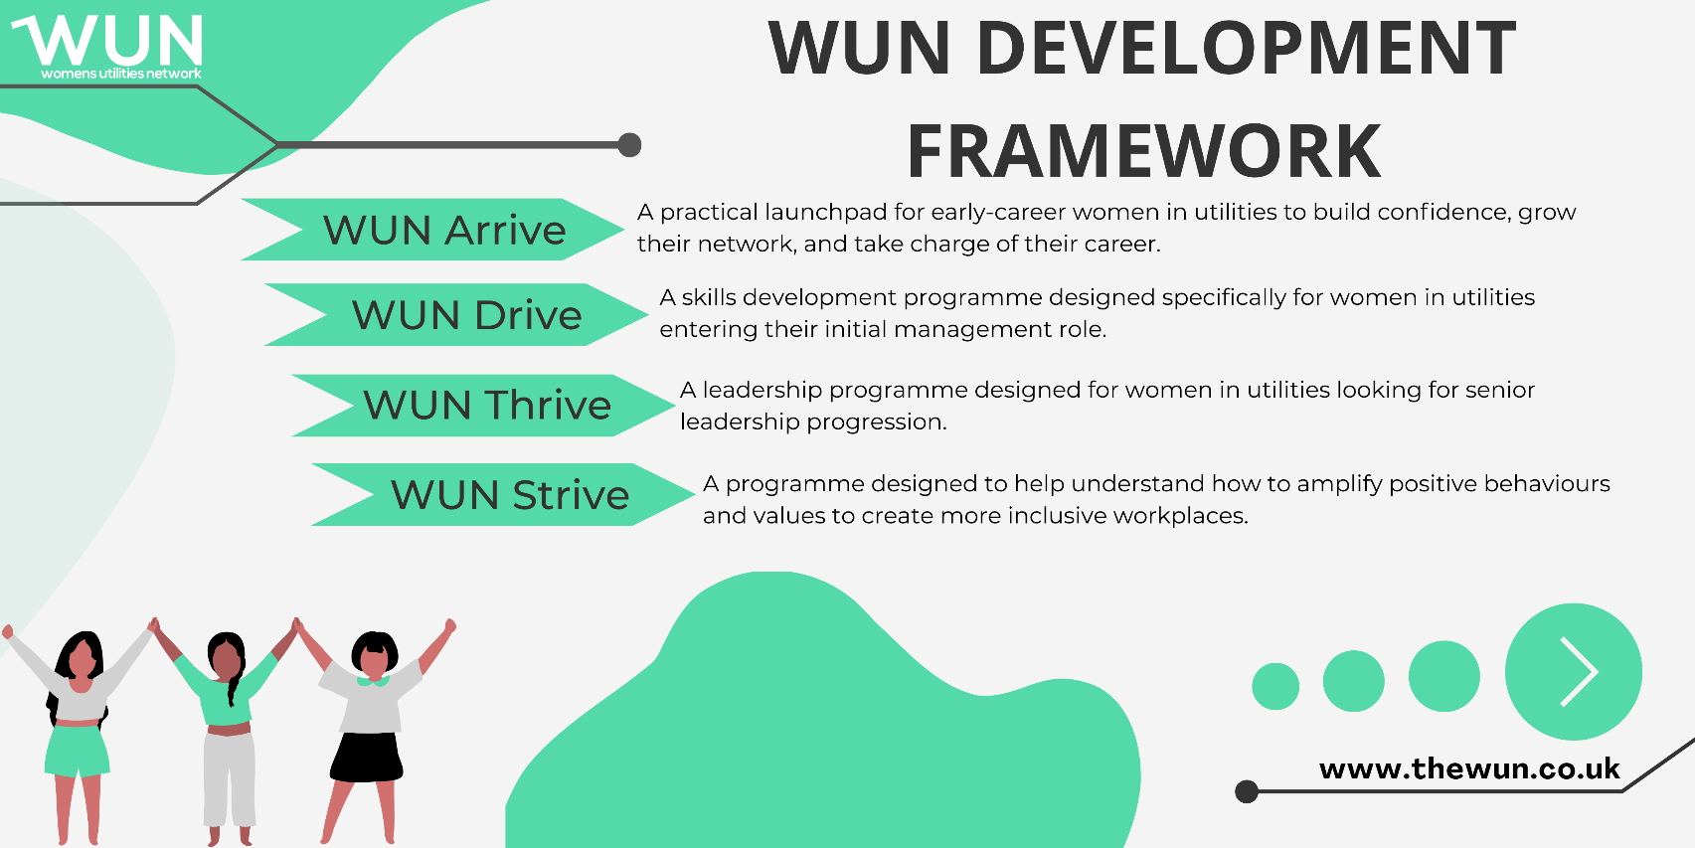
WUN Development Programme
Changing the future of utilities: Introducing our unique WUN development programmes – designed by and for women in utilities
We know that utilities need more women in leadership and, with the fast-changing nature of the sector, this is more important than ever. Changes are being made but the pace isn’t fast enough to make a real difference. We are here to help.
We are proud to have created a bespoke development framework to support women at different points in their utilities careers.
Further information : https://thewun.co.uk/wun-development-programmes/
Our WUN programmes have been created by women in utilities to respond to the challenges and needs reported to us by our members and partner organisations.
Designed to address the unique challenges of utilities, our topics are specifically tailored to support and develop women in the sector.
We are also proud to offer a WUN Bursary Scheme for our WUN Drive and WUN Thrive programmes, helping to ensure development opportunities are accessible to women across the sector.
Bookings for cohorts starting March 2026 now open

Slide 14

WUN 2025 Report : The Power of Culture –
creating change in the utilities workplace.
Download the report to discover:
What women rate most highly when considering a job role
Why some organisational values are seen as little more than 'lip service'
How leaders and individuals can create real change
https://thewun.co.uk/blogs/wun-2025-survey-report-the-power-of-culture/

Slide 15


For Further information about WUN visit the website
https://thewun.co.uk

Slide 17
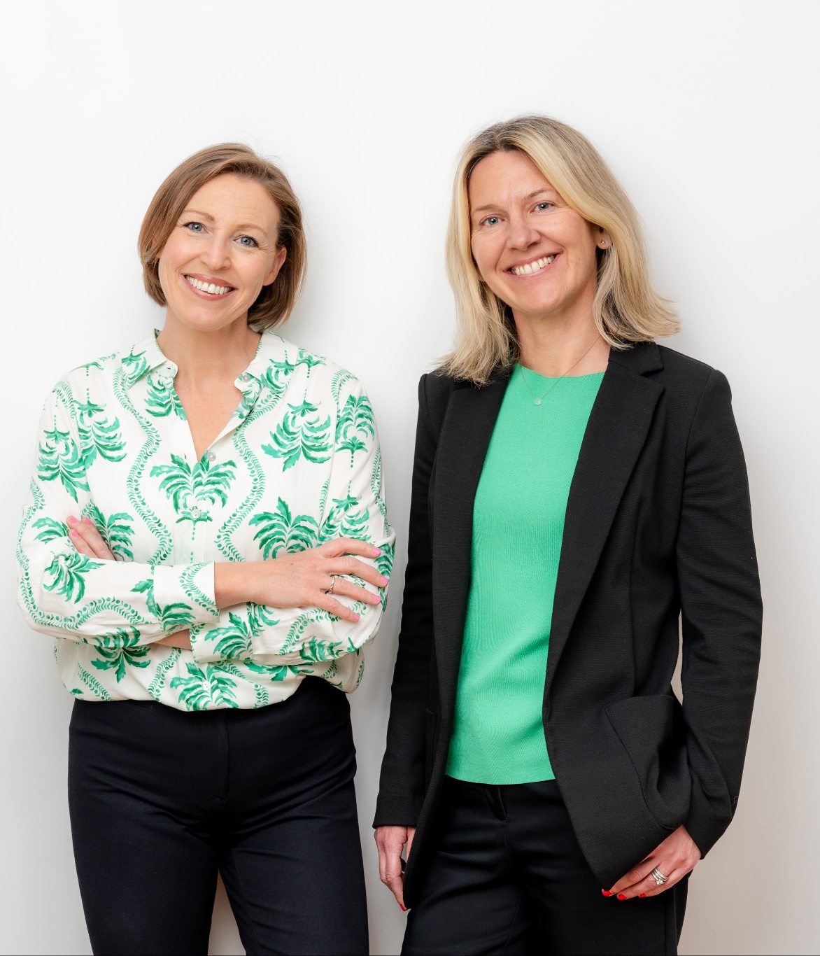


Introduction to Menopause
Empowering Women
Fuelling Success
January 2026

Slide 18
‘Midlife is when the universe gently places her hands upon your shoulders, pulls you close, and whispers in your ear: I'm not screwing around. All of this pretending and performing – these coping mechanisms that you've developed to protect yourself from feeling inadequate and getting hurt – has to go’
Brene Brown, 2018
What worked before will not work now and that’s not your fault

Slide 19
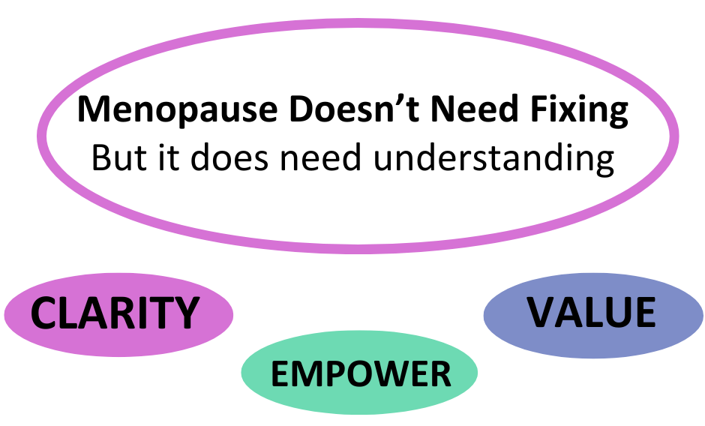

Slide 20
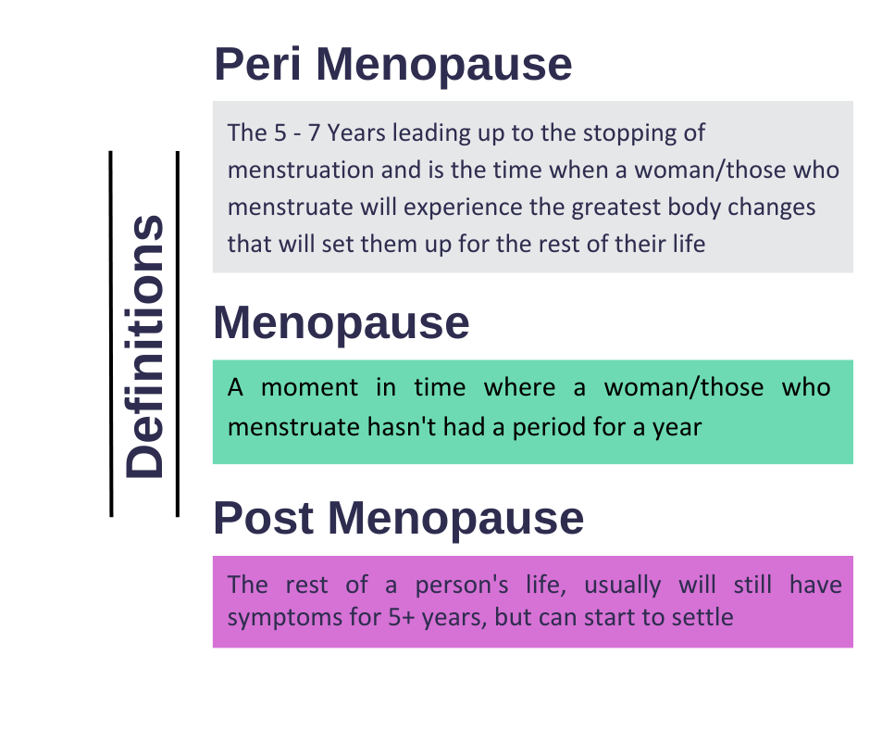

Slide 21
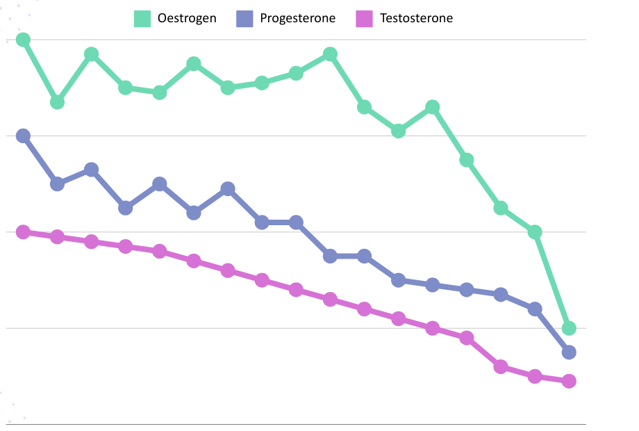
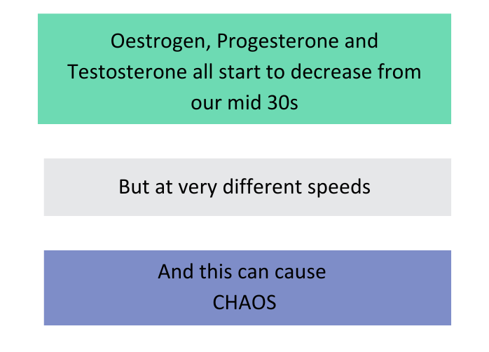
Hormone Timeline
35
45
52
AGE

Slide 22
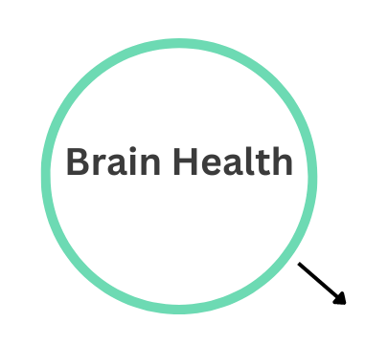
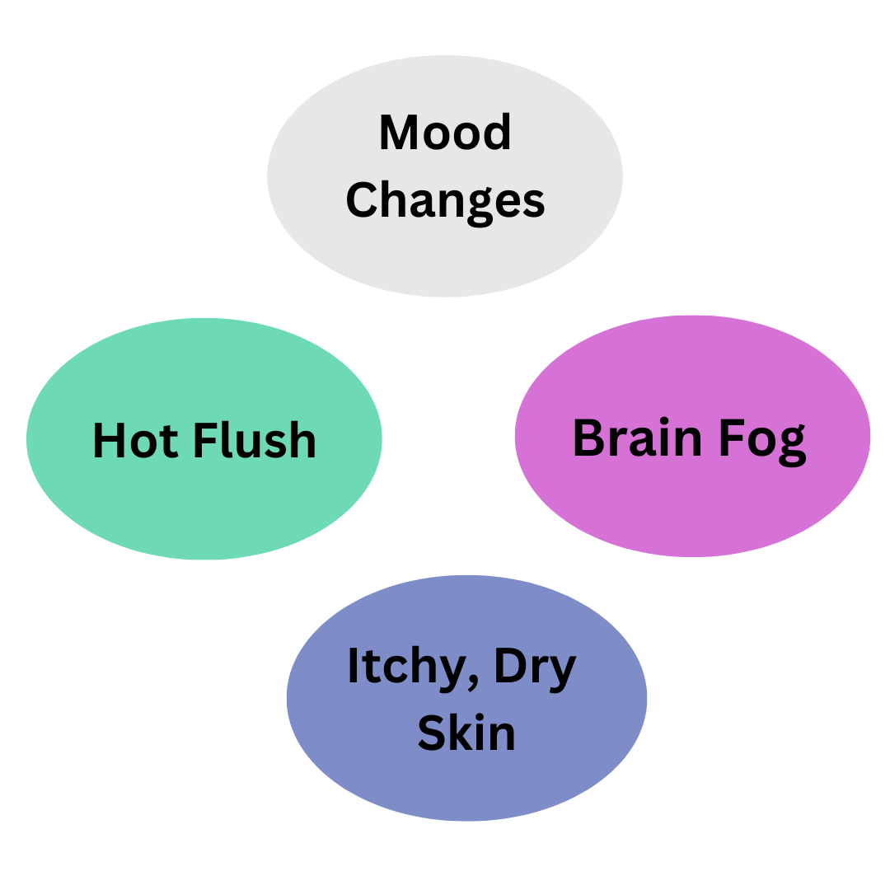
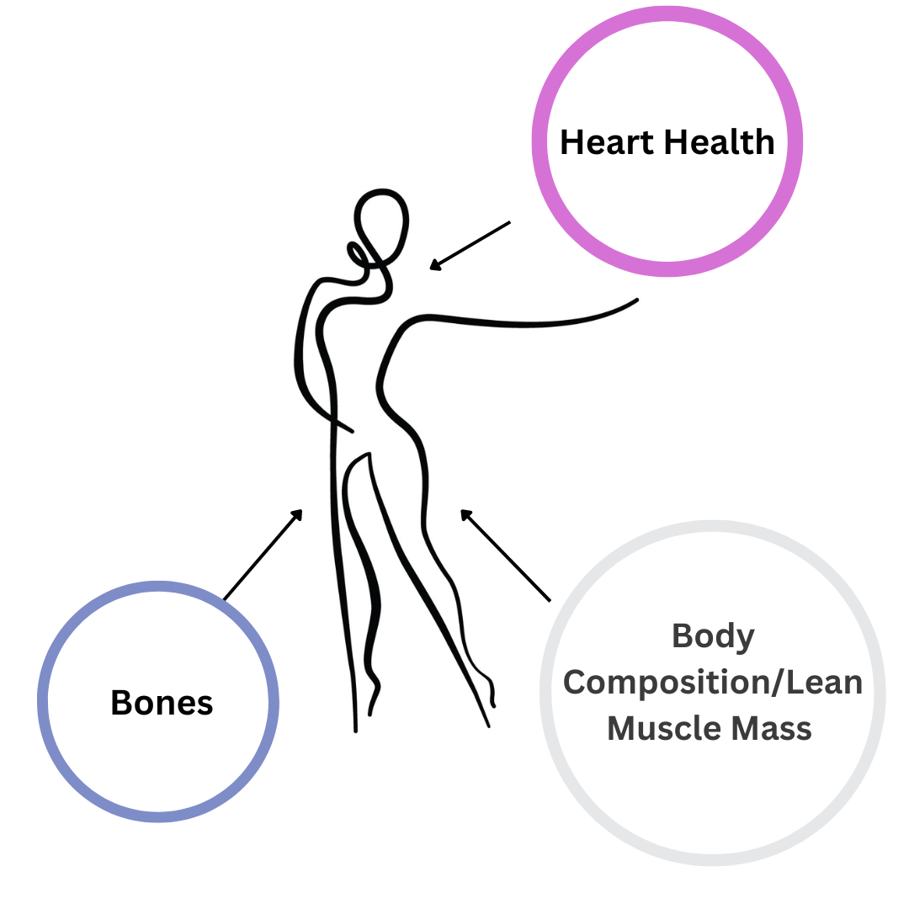
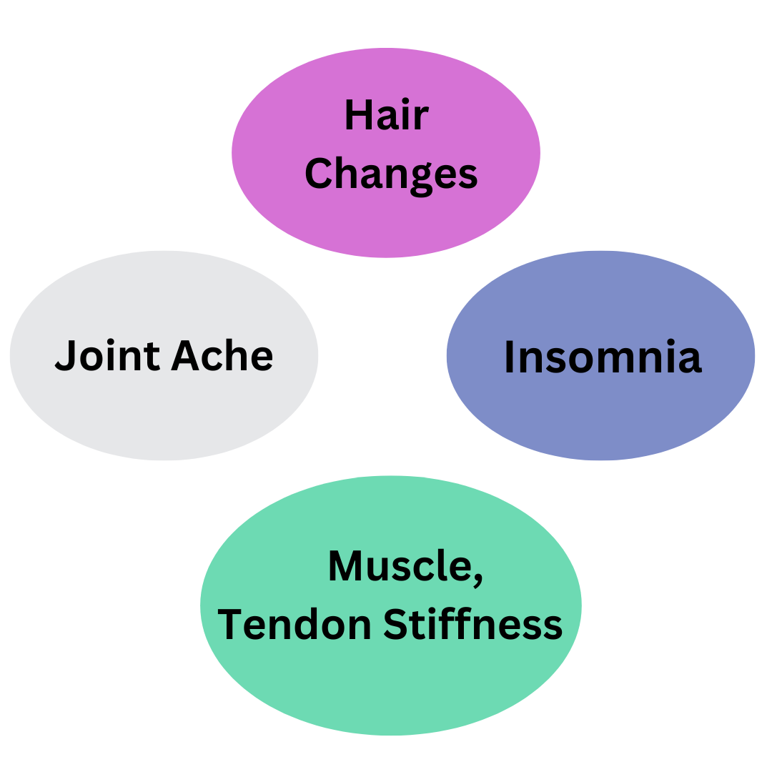
Changes and Symptoms
Balance
Mood Changes - 69%

Slide 23
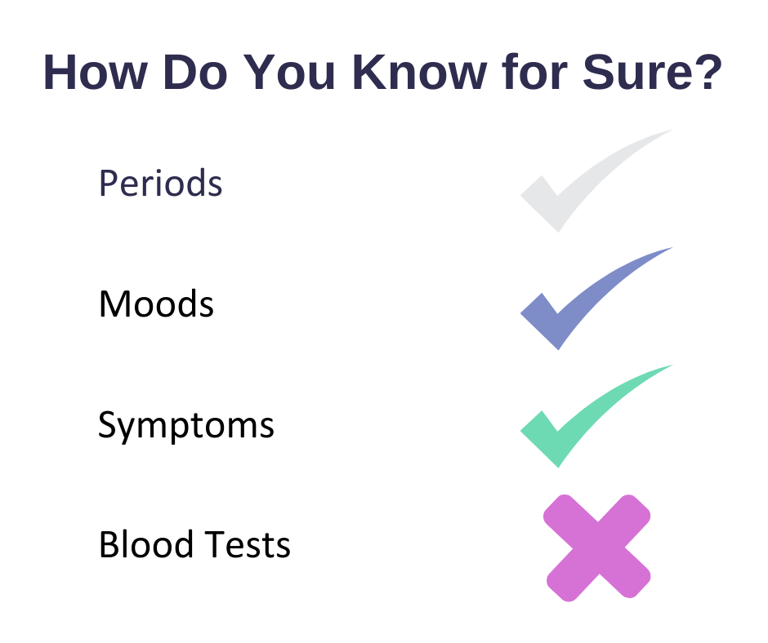

Slide 24
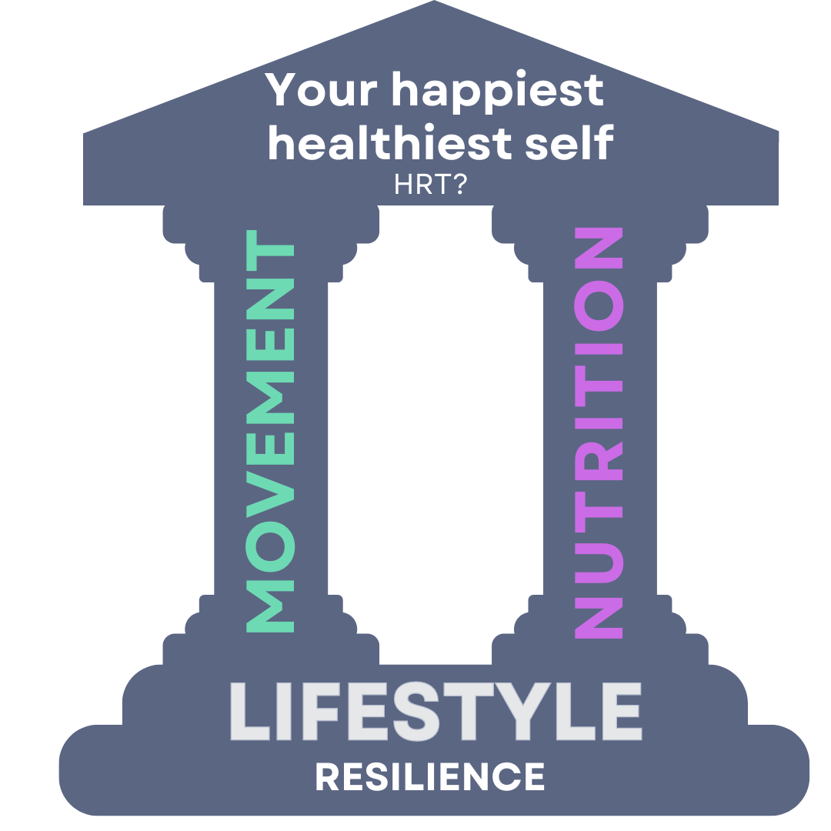

Slide 25
Stress is not just emotional - it’s physiological
Your nervous system doesn’t know the difference between a deadline and a threat - it just responds, which exacerbates everything
LIFESTYLE

Slide 26
Outside
Nervous System Regulation
Breathwork
LIFESTYLE
Connection
Sleep
Recovery
Nutrition

Slide 27
Low Energy
Night Waking
Mood Swings
Brain Fog
NUTRITION
HANGER
‘Meno-belly’
FUELLING
BLOOD SUGAR

Slide 28
Nutrition in your 40s is about building, not restricting
If you’re trying to shrink yourself,
your body will fight back.
When you nourish yourself, your body works with you
NUTRITION

Slide 29
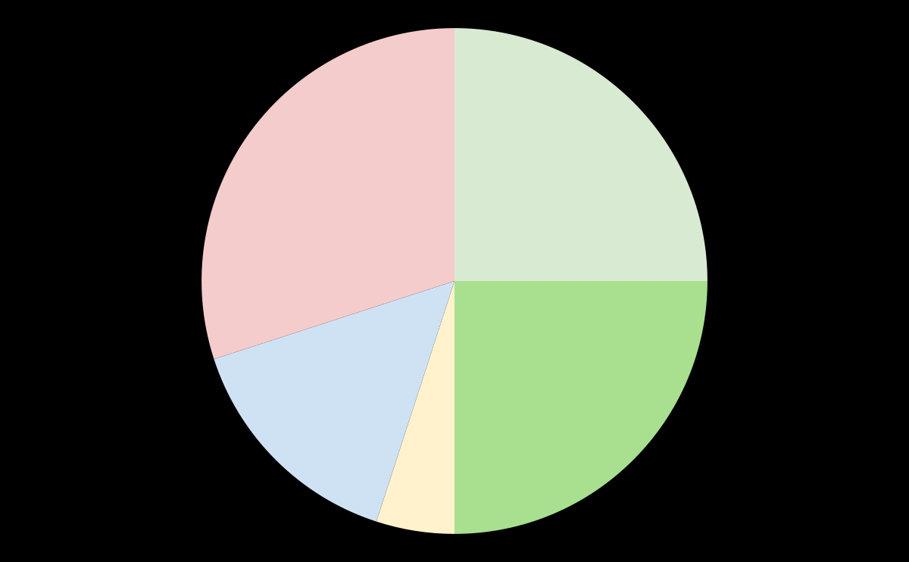
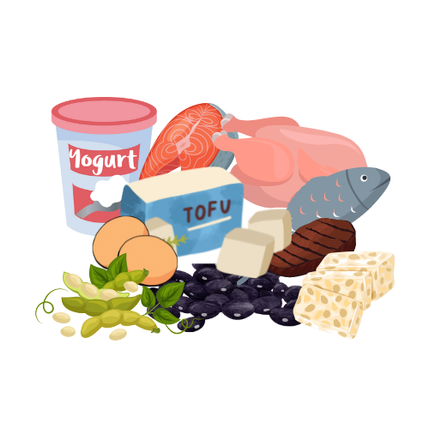




UPDATE YOUR PLATE
Dark Leafy Greens
& Salads
Lean Protein
NUTRITION
Non-starchy Vegetables
Minimally Processed Carbohydrates
Healthy Fats

Slide 30
Gut health is the gateway to hormone balance and energy
You can eat the ‘right’ foods, but if your gut isn’t supported your body can’t use them
NUTRITION

Slide 31

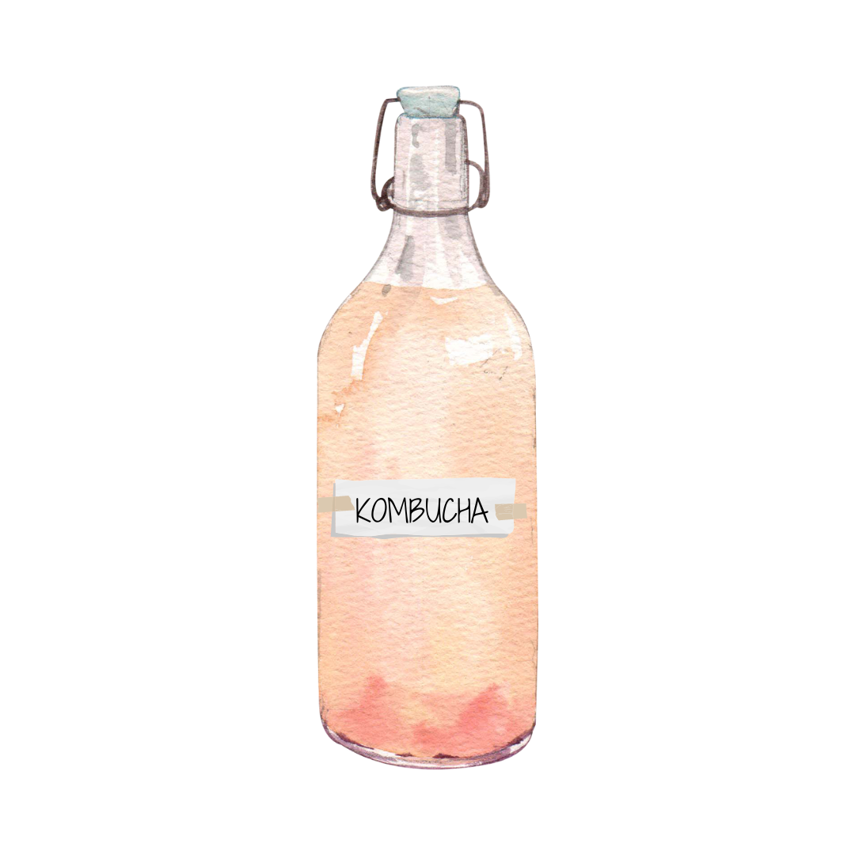
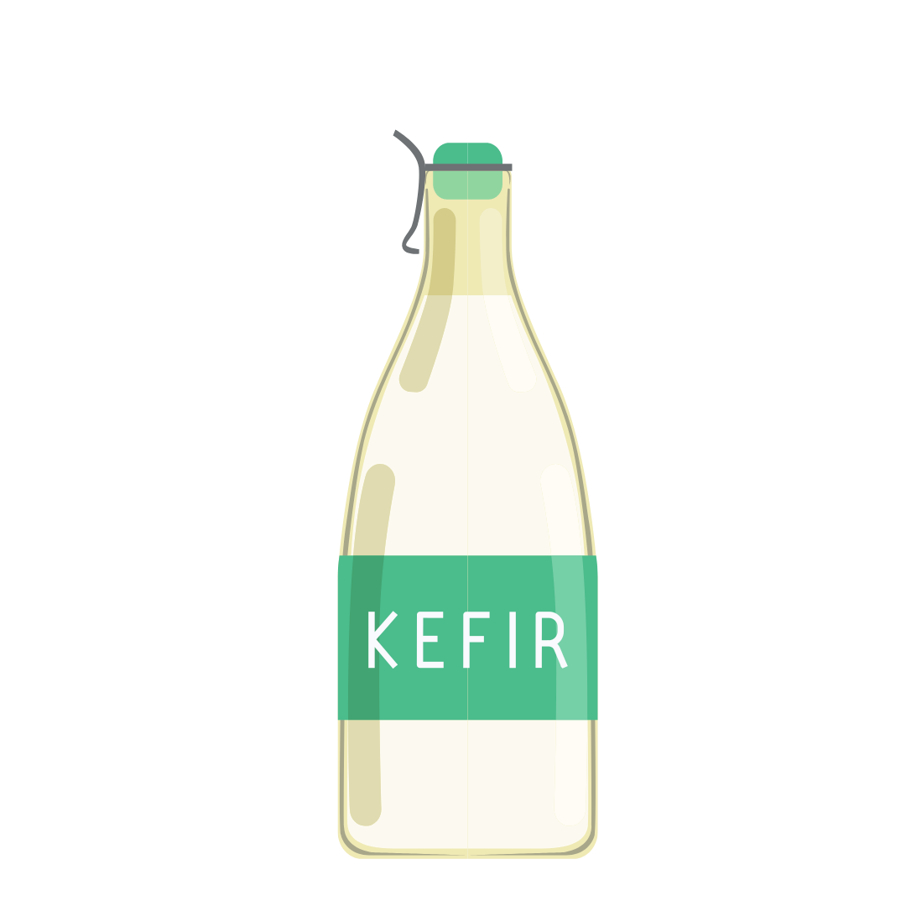
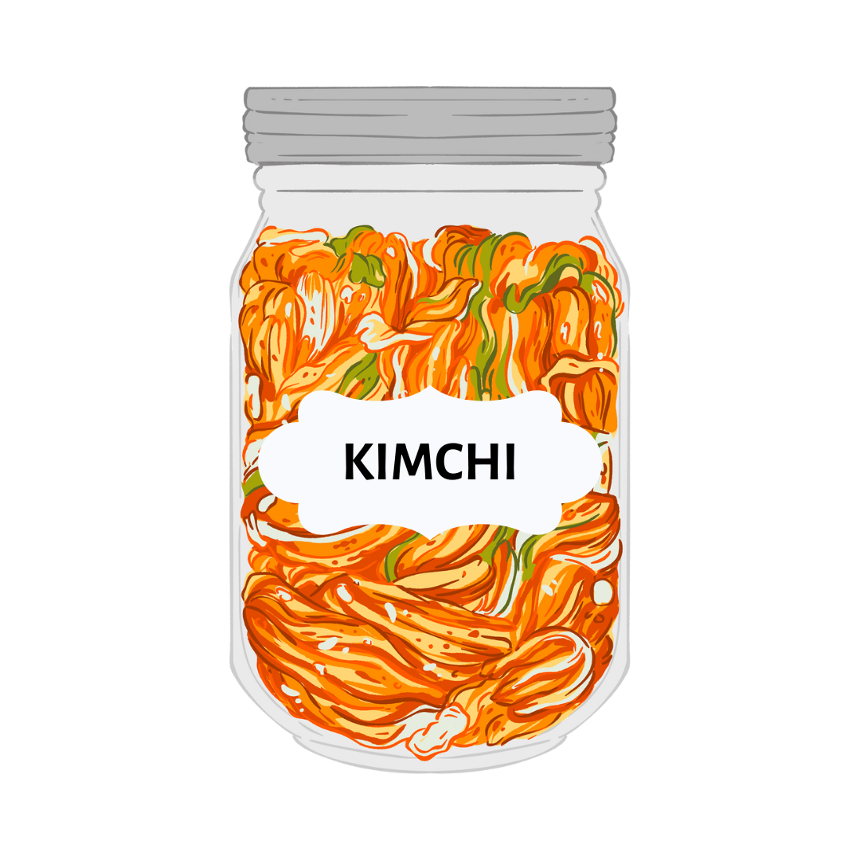

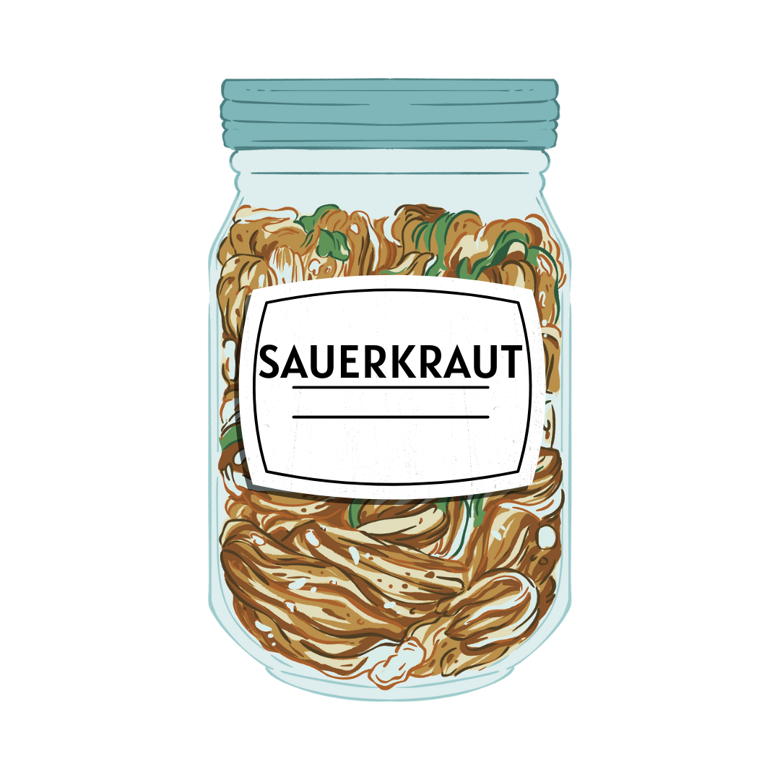


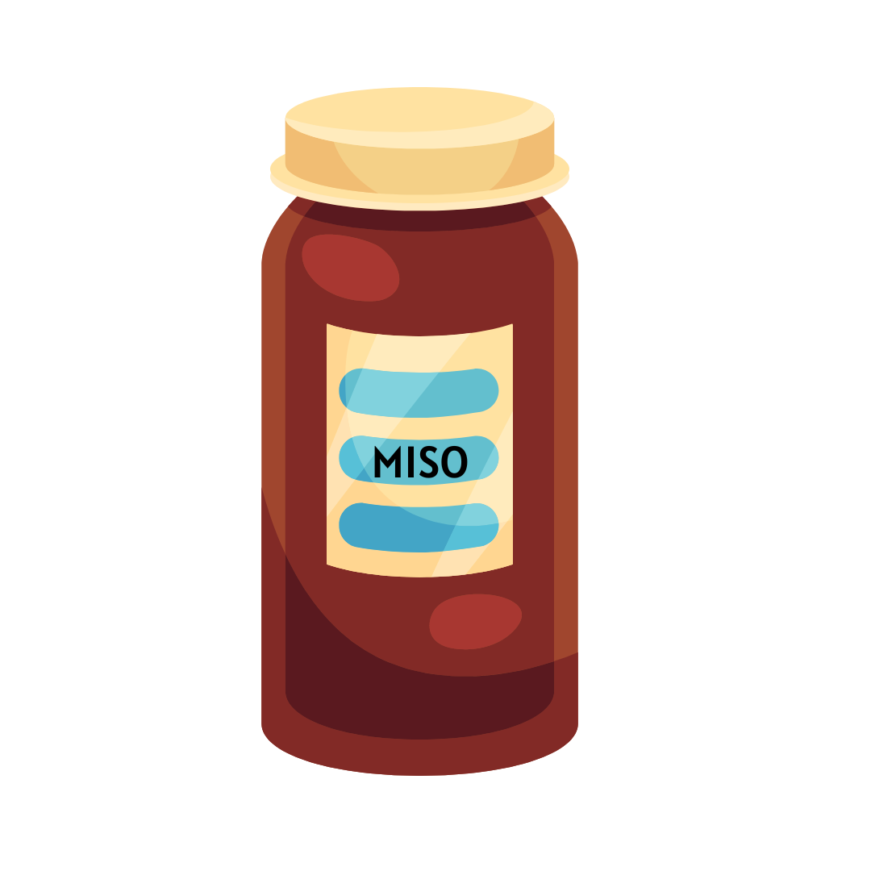
LOOK AFTER YOUR GUT MICROBIOME
MICROBE DIVERSITY DECREASES WITH HORMONES
NUTRITION
ADD VARIETY & MORE PLANT FOODS
LACE LIVE & FERMENTED FOODS THROUGH YOUR DIET

Slide 32
MOBILITY & STRENGTH
MORE EXERCISE IS NOT BETTER,
“BETTER” EXERCISE IS BETTER
SHORT INTERVALS
MOVEMENT
RECOVERY AND FUELLING
WHAT DO YOUR CHANGING HORMONES RESPOND TO?

Slide 33
This isn’t about getting through perimenopause,
It’s about setting yourself up for the rest of your life
PROGRAMMES
NOW IS THE TIME TO MAKE THE DIFFERENCE

Slide 34
REVIVE AND THRIVE
A 12 WEEK GUIDE THAT TEACHES YOU HOW TO TRAIN, BUILD STRENGTH, NOURISH YOUR BODY AND THRIVE
IMPLEMENTATION
CONSISTENCY
CONFIDENCE
SMALL CHANGES THAT FIT INTO YOUR LIFE
YOU DON’T NEED WILLPOWER, YOU NEED A FRAMEWORK & SUPPORT
PROGRAMMES

Slide 35
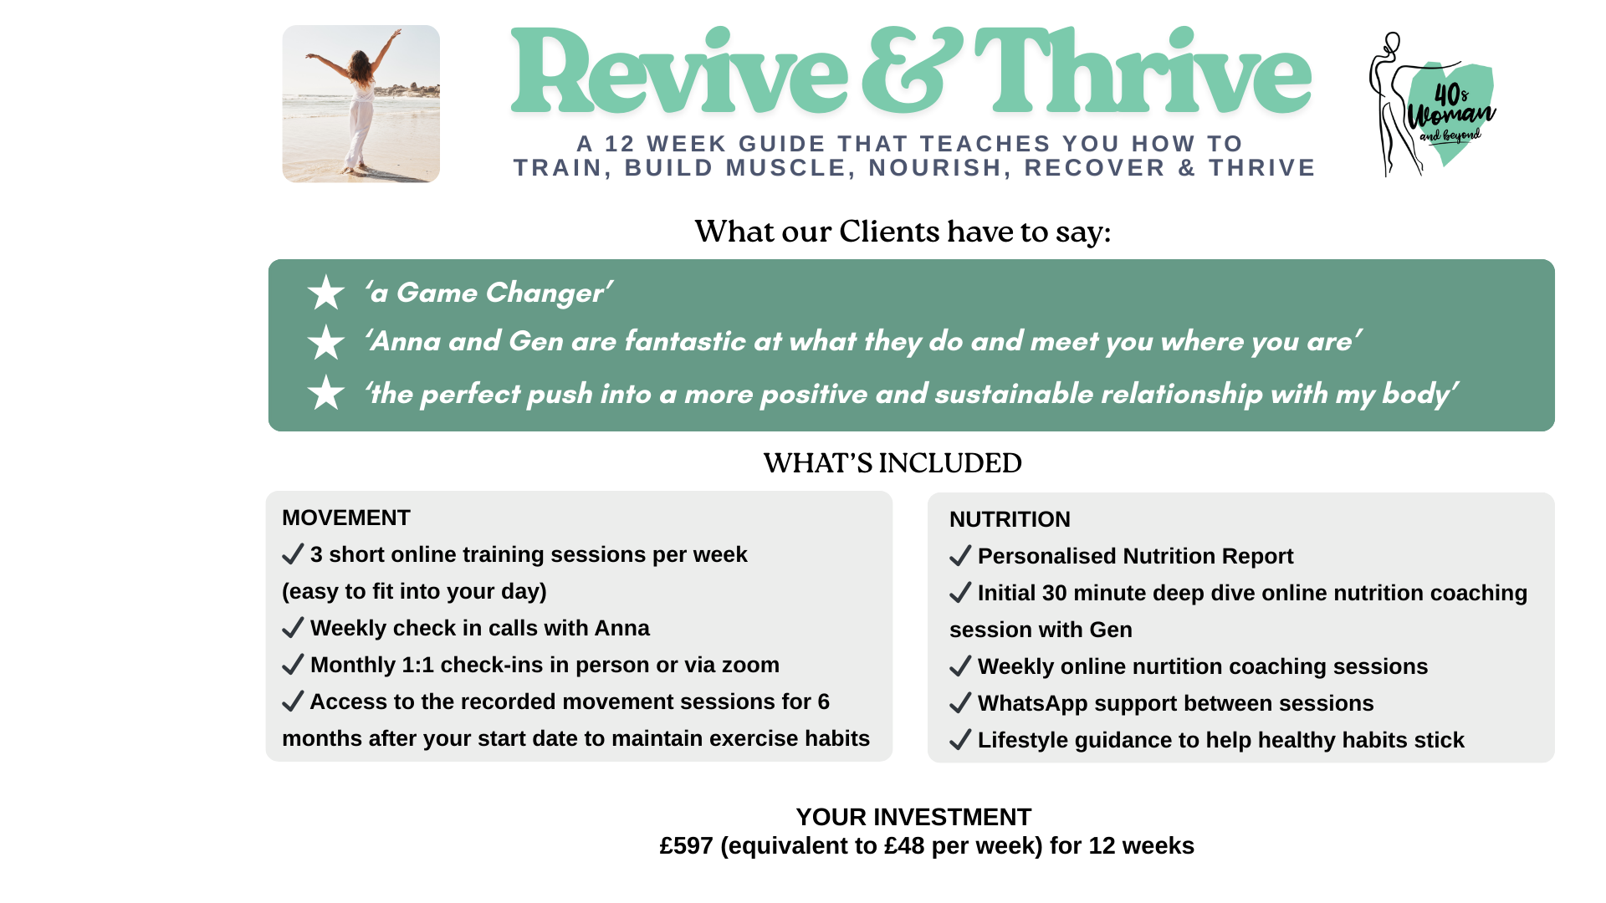
PROGRAMMES

Slide 36


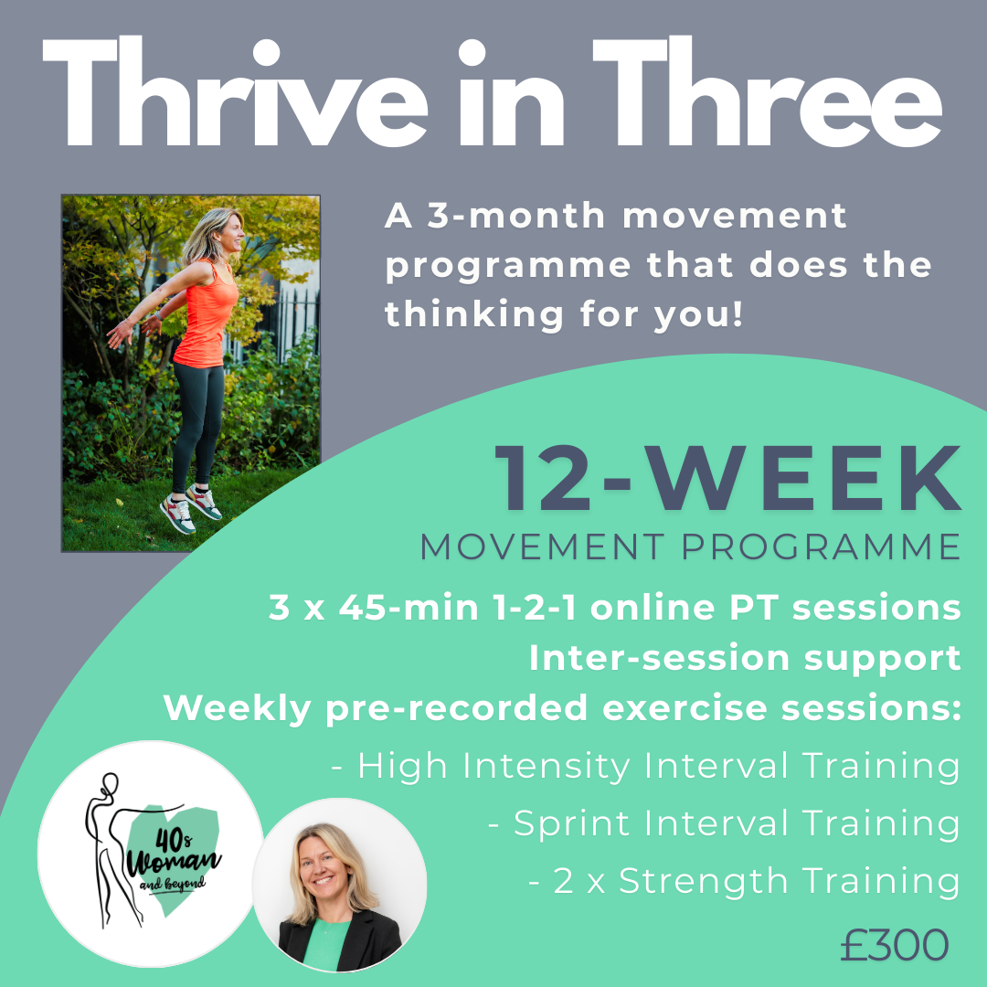


Sign up for 1-2-1 Nutrition Coaching or Thrive in Three and get Kickstarter for FREE*
*FLASH OFFER valid for sign ups by Friday 23rd January 2025 only
40s Woman & Beyond
Anna Black
Genevieve Hallam
@40swoman
@ghnutritioncoaching
email: hello@40swomanandbeyond.co.uk
corporate packages: www.40swomanandbeyond.co.uk

Slide 37
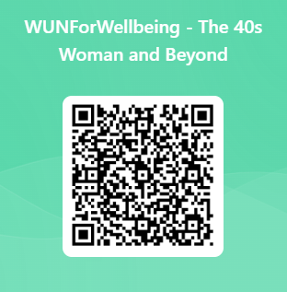
We value really your feedback

Slide 39

Connect with Us
info@thewun.co.uk
https://thewun.co.uk/
https://www.linkedin.com
/company/womens- utilities-network
@TheWUN1
@WUN4ALL
@Womens Utilities Network

