Slide 1










































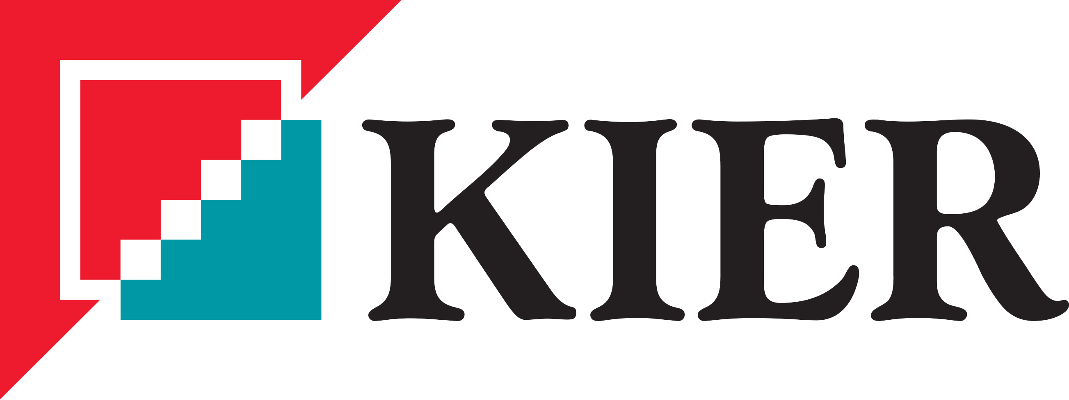












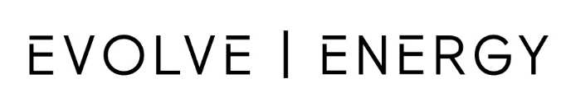
















Slide 2
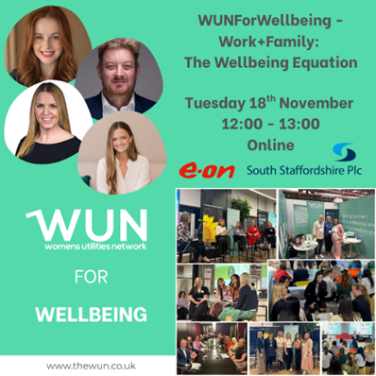


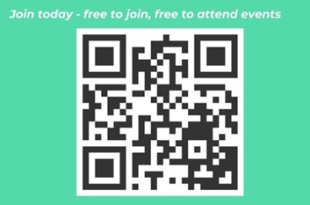
Welcome
WUNForWELLBEING - Work+Family: The Wellbeing Equation -
We will be starting shortly.

Slide 3
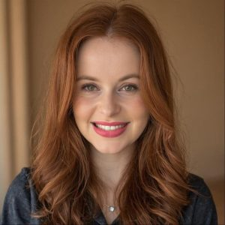
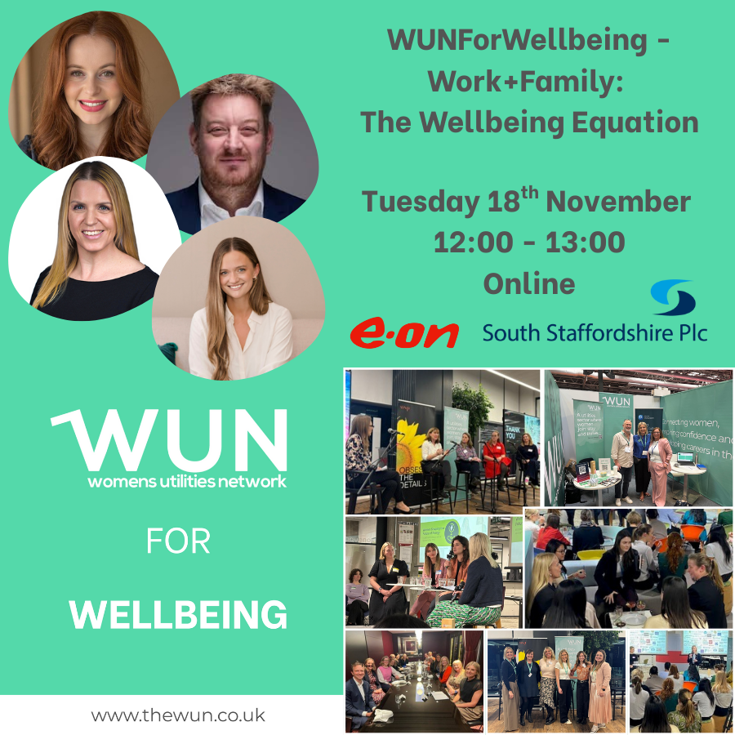

WUN Welcome
Heidi Knapton, WUN Advocate
& Head of Universal Metering,
South Staffs Water
Heidi has recently returned from maternity leave into the role of Head of Universal Metering, responsible for the roll out of water meters to all homes in the South Staffs and Cambridge regions.
A proud advocate of the WUN and keen to support others who are navigating the journey to (and through!) parenthood.

Slide 4

WUN Events – Coming Up
4th December 12pm – WUN #SpeakUp, Empowered Women, Empowered Workplaces
11th December 12.30 – 2pm – #IAmRemarkable Workshop
14th January 2026 11 – 12.30pm - #IAmRemarkable Workshop
21st January 2026 1pm - WUNForWellbeing - The 40s Woman and Beyond
5th February 2026 10.30 – 12.00pm - #IAmRemarkable Workshop
Further dates for 2026 will be announced shortly
Save the Date: Women in Utilities Awards 3rd July 2026
Free Tickets available
https://thewun.co.uk/

Slide 5
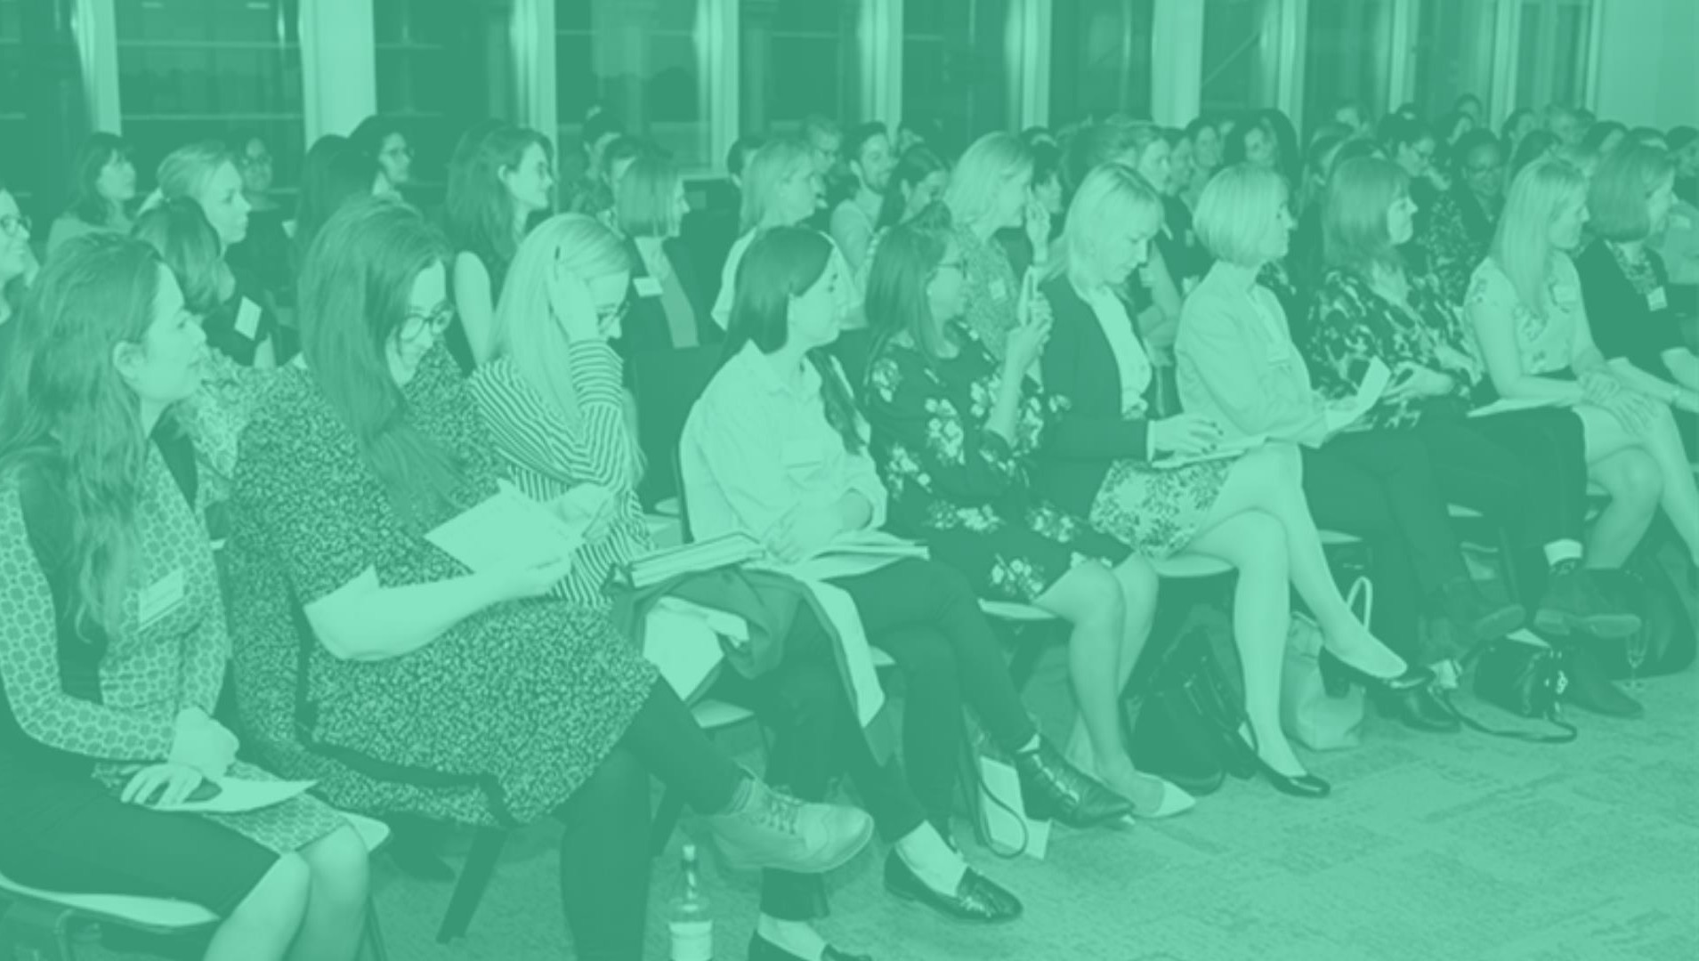

You can also catch up on past events too via the WUN website

Slide 6

WUN
Mentoring Programme

Slide 7
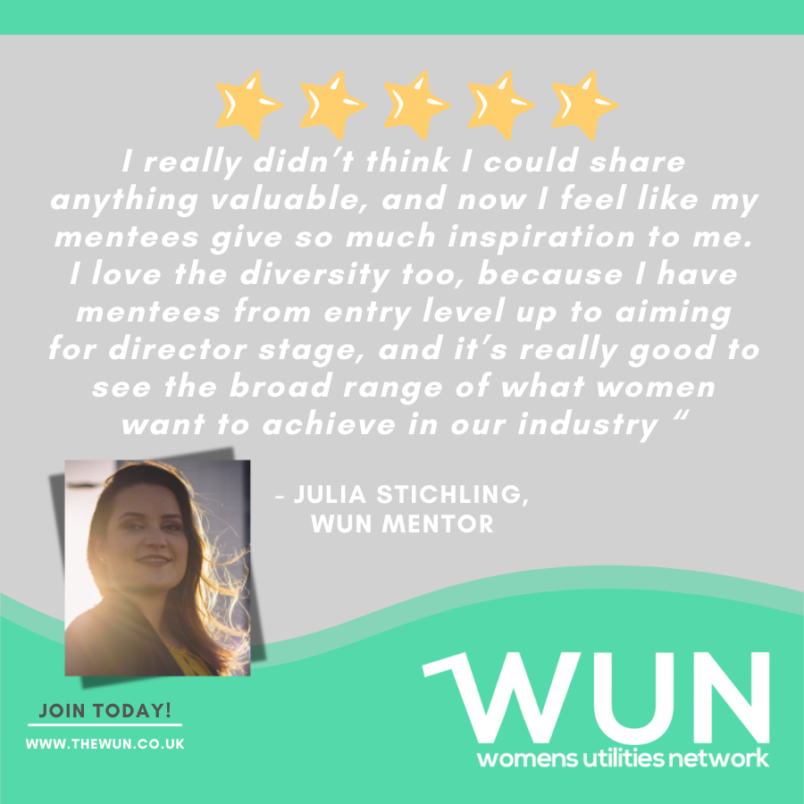
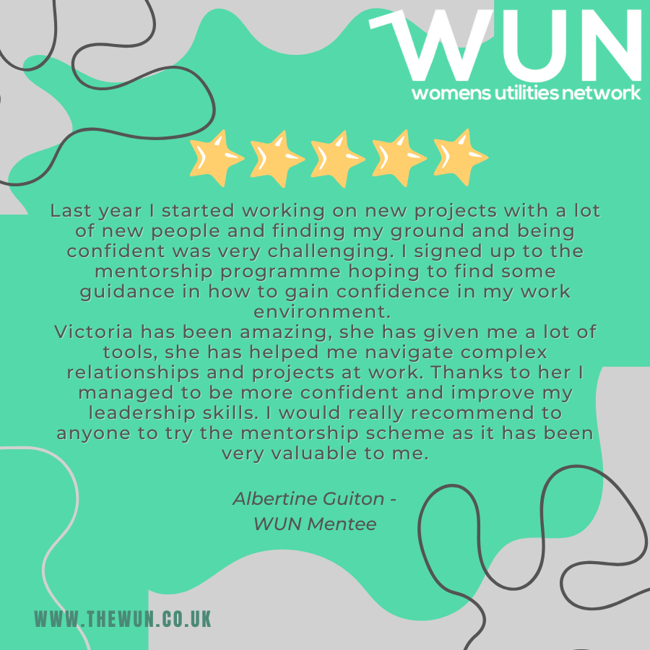
Join the free WUN Mentoring Programme
WUN offers mentoring to women at any stage of their career in the utilities sectors.
We are hugely privileged to have over 180+ fantastic experienced mentors within the WUN mentoring Programme.
With growing numbers of Mentors and Mentees we are delighted with the community and support fostered within the mentoring programme.
If you are interested in becoming a Mentor or Mentee,
please visit our website: https://wun.onpld.com

Slide 8


Podcasts, Video
Podcasts & Blogs
Inspiring career stories
Industry topics
Personal development.
https://thewun.co.uk

Slide 9
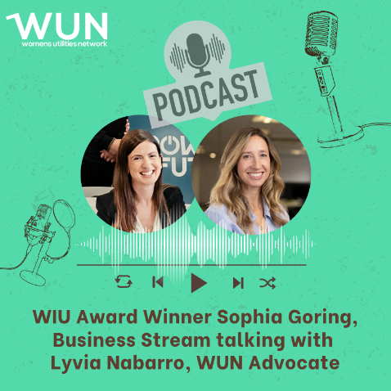
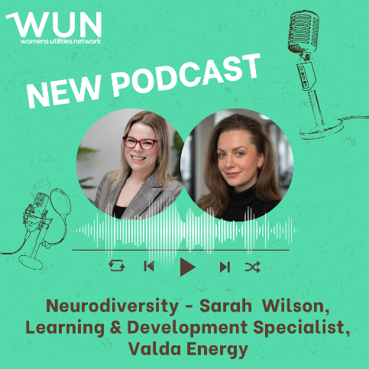
WUN Podcasts
Listen to our latest podcasts
More coming soon !
In this latest Sophia Goring reflects on Business Stream’s success at the Women in Utilities Awards – winning the Best Community Outreach Award. She talks through the initiatives Business Stream has been leading in working with young people and partner organisations in their communities to provide meaningful workplace experiences and how they are inspiring more young women to consider a role in the water industry.
Sophia currently works with a number of charities and social enterprises, with a particular focus on supporting young people.
In this episode , we are joined by Sarah Wilson from Valda Energy to reflect on her journey being diagnosed with ADHD. From her journey at school and throughout her career, we discuss what it was like to navigate work and daily life without a clear understanding of neurodiversity, exploring the personal challenges and emotions that came with that experience.
We discuss where individuals, managers, and teams can turn for reliable resources and support, and highlight the benefits that emerge when workplaces genuinely embrace neurodiverse talent.
You can follow our podcast on Apple Podcasts, Spotify, Amazon Music and wherever else you get your podcasts – just search “WUN4ALL”.
Or just click through from the website: https://thewun.co.uk/news-blogs/

Slide 10
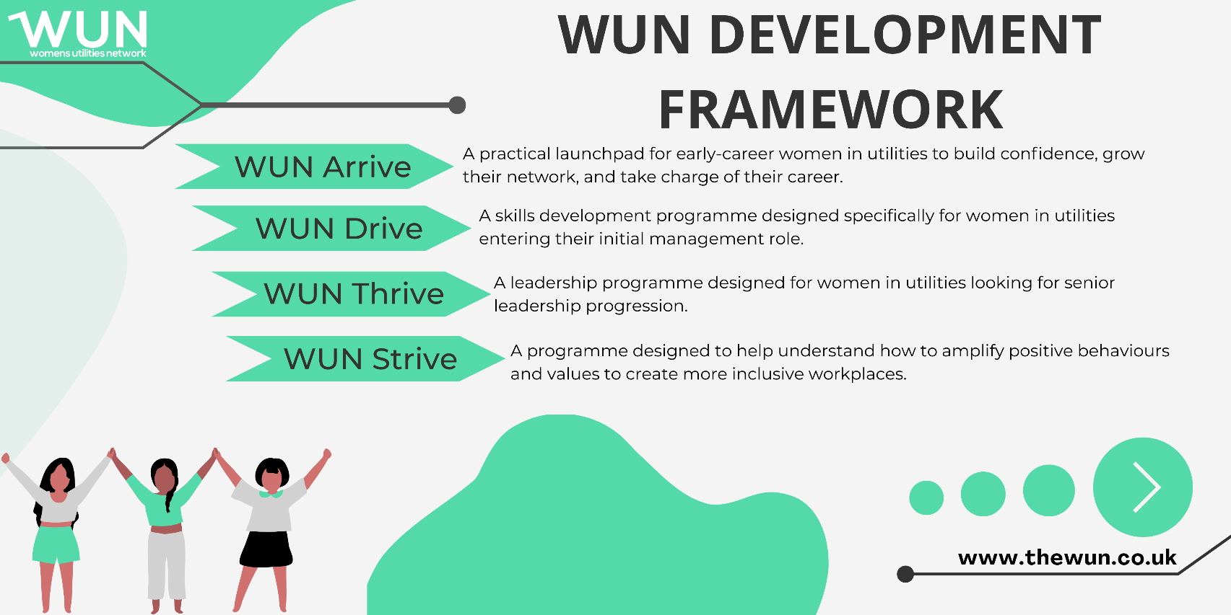
WUN Development Programme
Changing the future of utilities: Introducing our unique WUN development programmes – designed by and for women in utilities
We know that utilities need more women in leadership and, with the fast-changing nature of the sector, this is more important than ever. Changes are being made but the pace isn’t fast enough to make a real difference. We are here to help.
We are proud to have created a bespoke development framework to support women at different points in their utilities careers.
Further information : https://thewun.co.uk/wun-development-programmes/
Our WUN programmes have been created by women in utilities to respond to the challenges and needs reported to us by our members and partner organisations.
Designed to address the unique challenges of utilities, our topics are specifically tailored to support and develop women in the sector.
We are also proud to offer a WUN Bursary Scheme for our WUN Drive and WUN Thrive programmes, helping to ensure development opportunities are accessible to women across the sector.

Slide 11
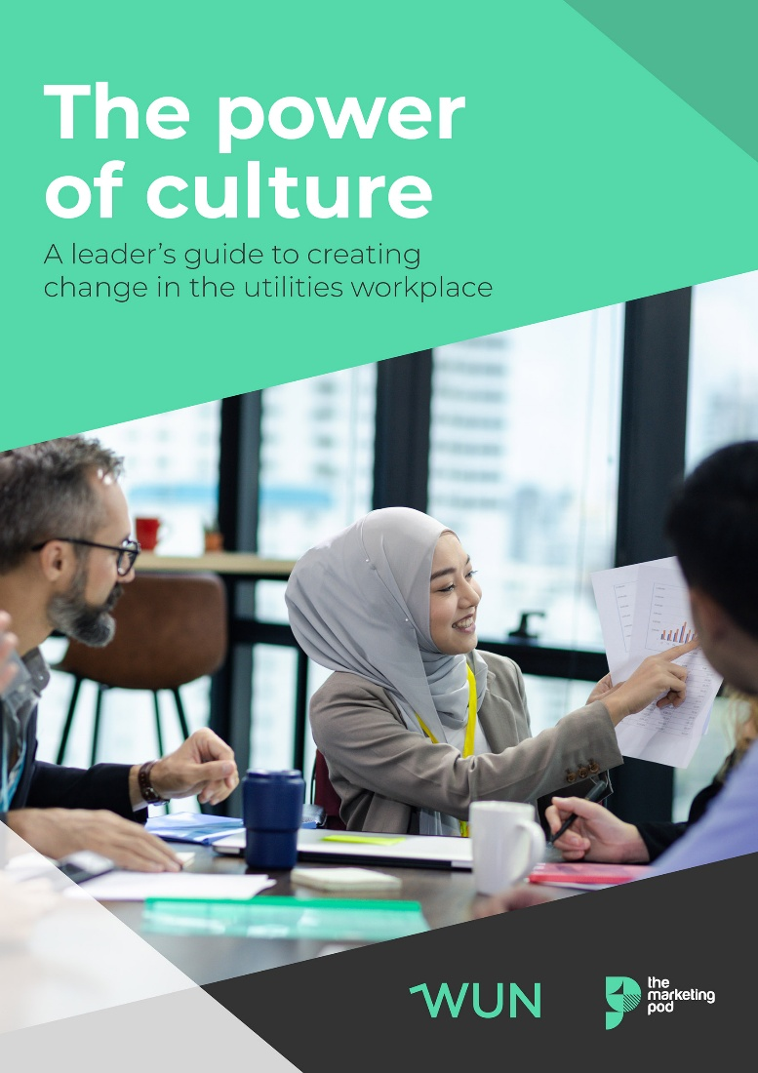
WUN 2025 Report :
The Power of Culture –
creating change in the utilities workplace.
Download the report to discover:
What women rate most highly when considering a job role
Why some organisational values are seen as little more than 'lip service'
How leaders and individuals can create real change
https://thewun.co.uk/blogs/wun-2025-survey-report-the-power-of-culture/

Slide 12
Todays Panel
Letty Gordon-Furse, CEO of The Spring Back Guide
Charlotte Lack – Head of Safe and Well at E.ON
Andrew Lobley - Managing Director at Hydrosave

Slide 13
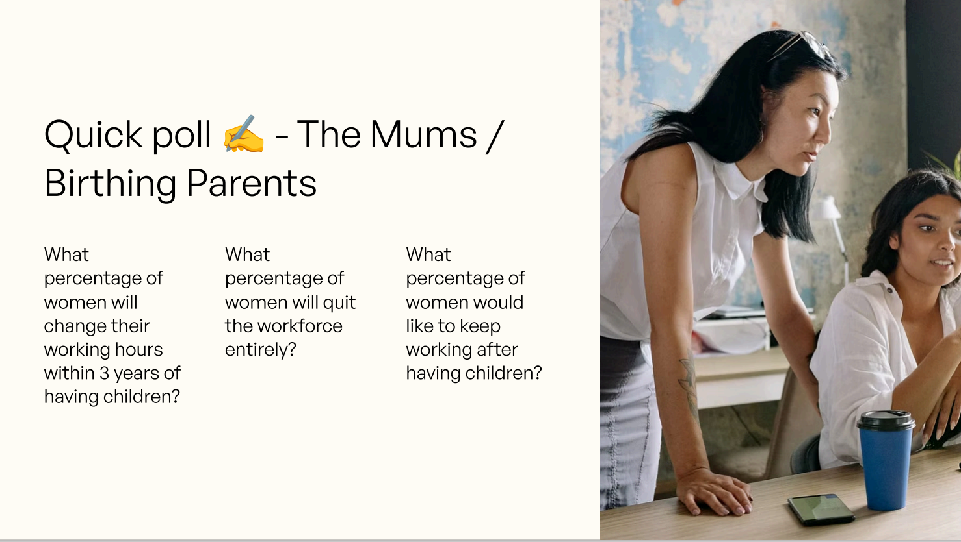

Slide 14
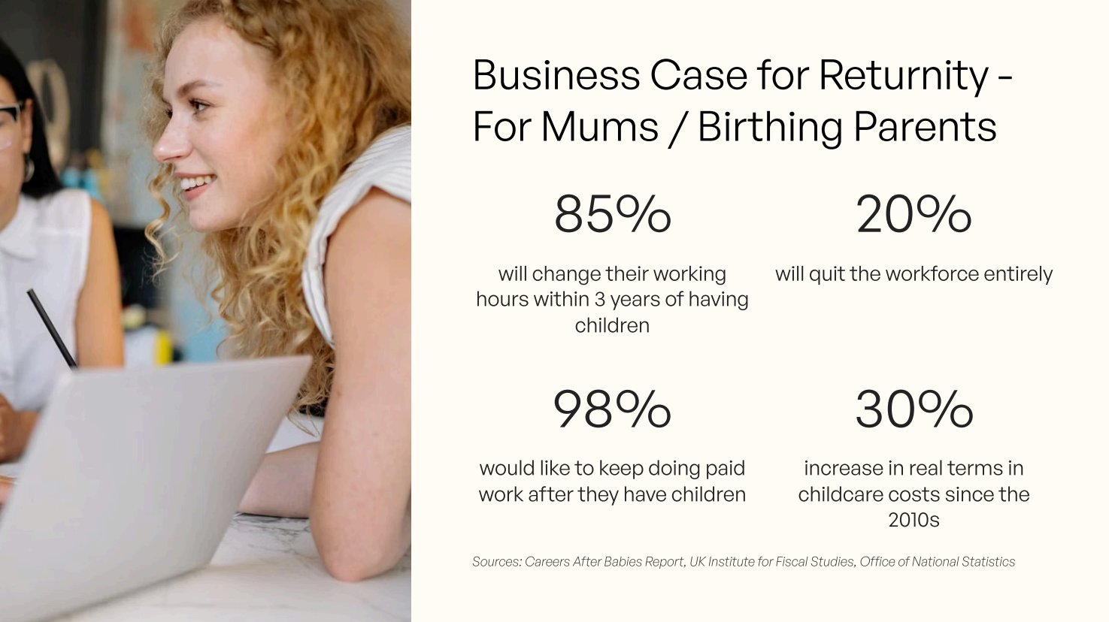

Slide 15
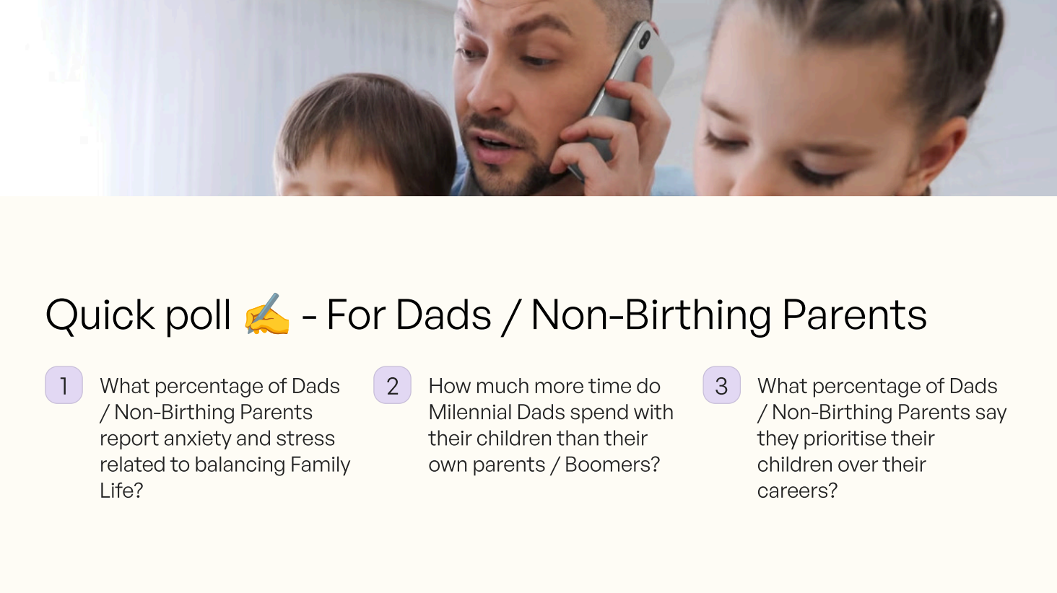

Slide 16
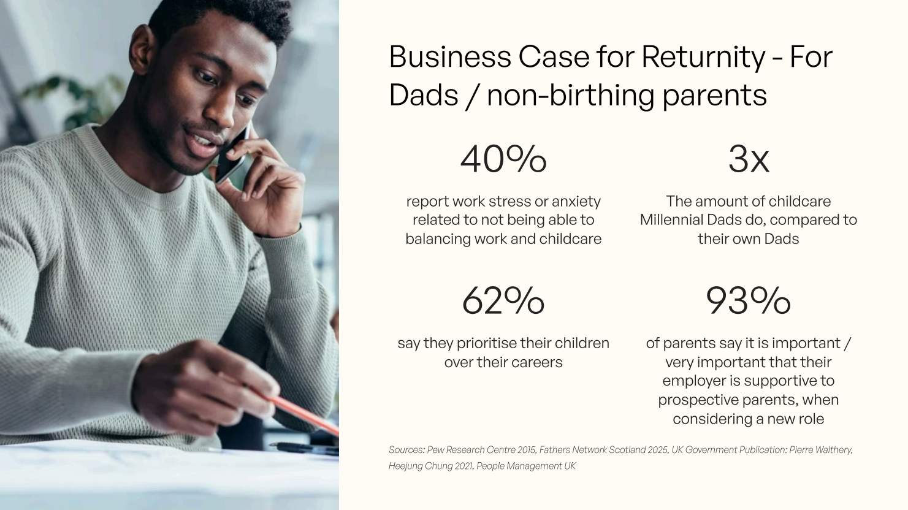

Slide 17
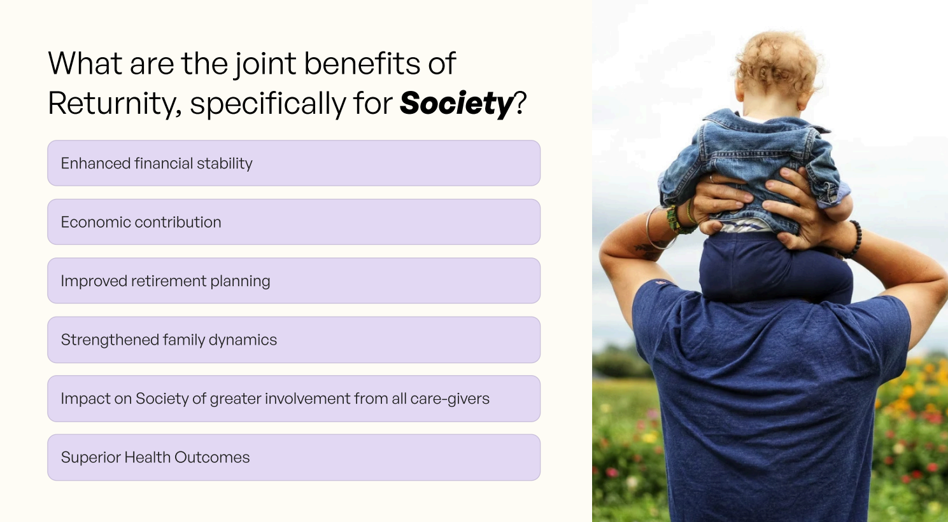

Slide 18
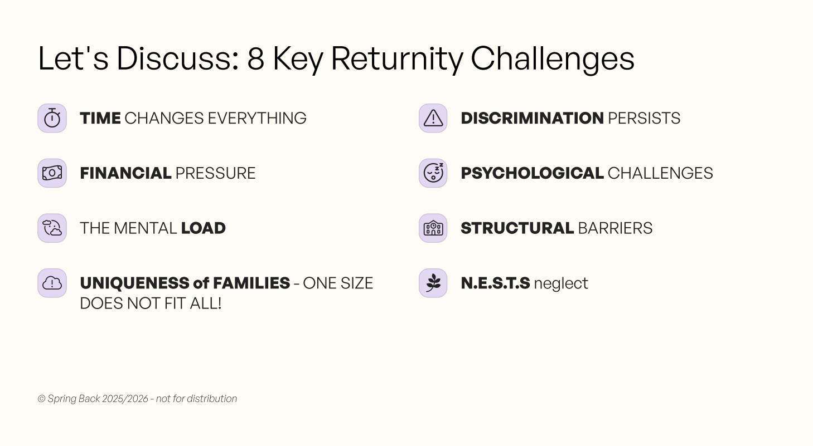

Slide 19
Tip for ‘Returnity’…
Swap ‘I’ve got to’ to ‘I get to’…

Slide 20
Tip for ‘Returnity’…
TAKE UP SPACE

Slide 21
Tip for ‘Returnity’…
You can ‘have it all’ – but don’t feel the pressure to !!!
“Don’t be afraid of moving sideways, backwards or stopping entirely. As sometimes these are the very moves that will propel you forward and land you exactly where you need to be”
– Elaine Higgings, Chief People Officer, Robiquity

Slide 22
WUN: Celebrating parents and carers
Andrew Lobley
…a Dad, a bang average grassroots football coach and Managing Director of Hydrosave and AES

Slide 23

This Dad’s thoughts…
Notes:
Be proud of our out of work responsibities, and talk about them.
Especially if you are in a leadership role and are taking advantage of some professional flexibility to take a loved one to an appointment or attend parents evening.
Caring responsibilities don’t always fit within a 9-5 day, sometimes we need to compromise
Be honest

Slide 24

This Dad’s thoughts…
Notes:
Its always good to challenge norms and ‘the way we’ve always done it’. For my sins I am an engineer, there was nothing wrong with steam engines, but we don’t use them anymore as electric motors are safer, more reliable and more efficient. Its always ok to ask why, about everything, and certainly about how we can make our business the best it can be for working parents and carers

Slide 25
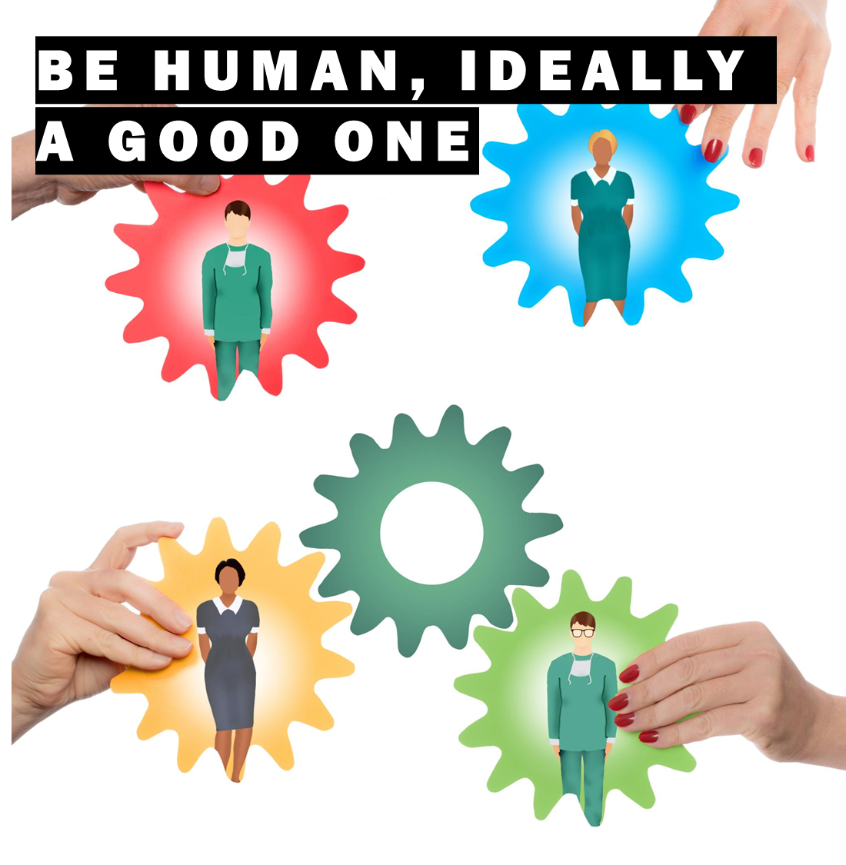
This Dad’s thoughts…
Notes:
Again, a fairly simply life statement, but empathy is huge, especially with things as close to peoples hearts as their loved ones.
How would you want someone to respond if you were asking them for some flexibility because something disastrous has happened at home? Most of the time we can

Slide 26

This Dad’s thoughts…
Notes:
Work comes home with you…. I’ve never managed not to, so talk about it. You may be surprised that they are interested.

Slide 27
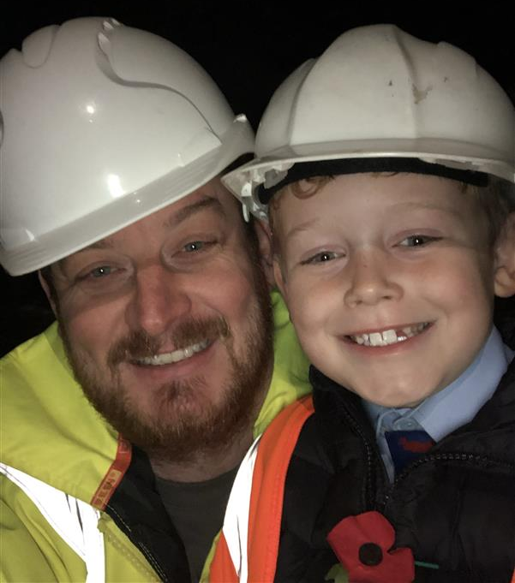
Our new working parents and carers network
Launching shortly
Assembled an inspirational bunch of parents and carers from across the whole South Staffordshire PLC Group with a staggering amount of experience, energy and drive
We have a draft purpose:
  The Parents & Carers Network is here to make our workplace better for everyone navigating the changing journey of care. We build community, raise awareness, and shape policies - so colleagues across all roles and locations, feel supported, empowered, and able to thrive at every stage, both at work and at home.
Much like being a new parent, we aren’t really sure what we are doing, but we know its really important, and we don’t want to mess it up!
More than happy to copy the brilliance of others – please do reach out with what has gone well for your groups, or things you would do differently for those of you who are further down this journey than we are
Thank you ☺
Notes:
Unapologetic plug, and I did gain image permission from my son!

Slide 28

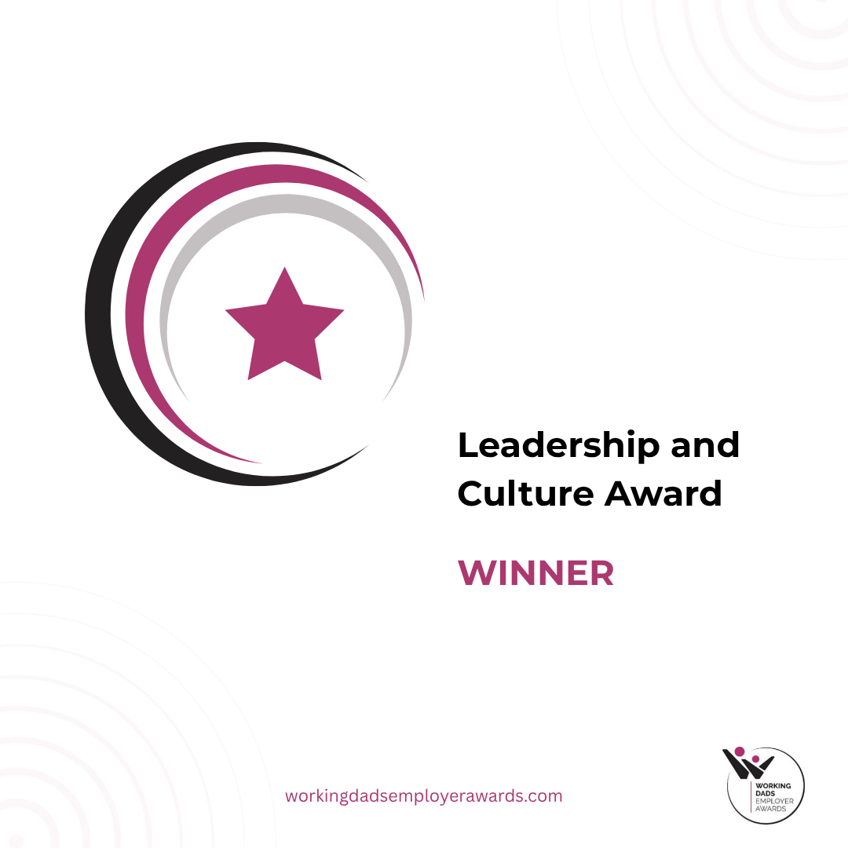
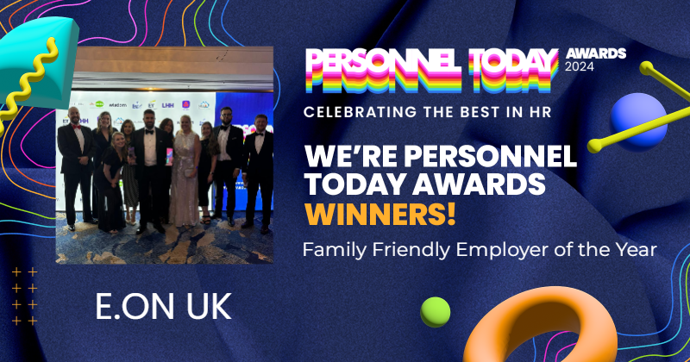
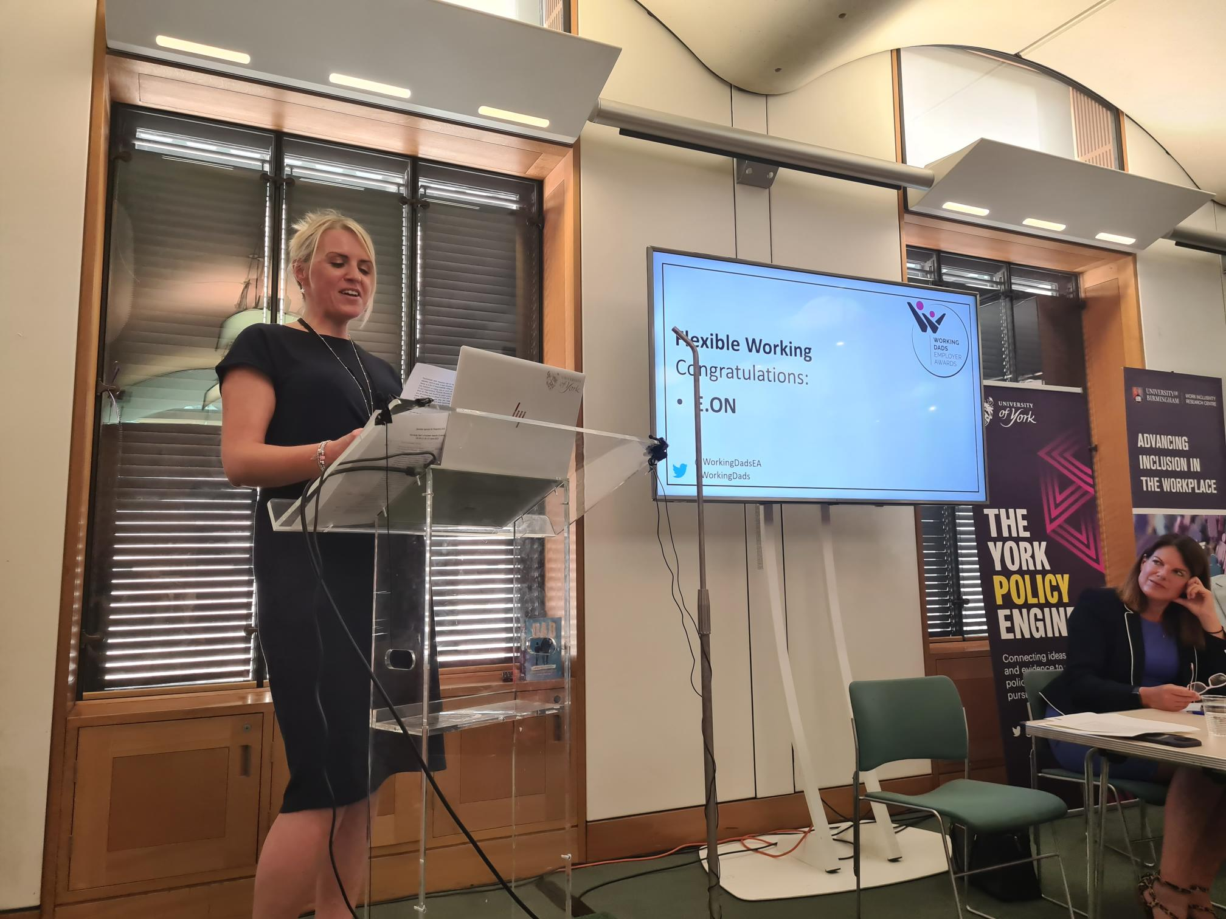
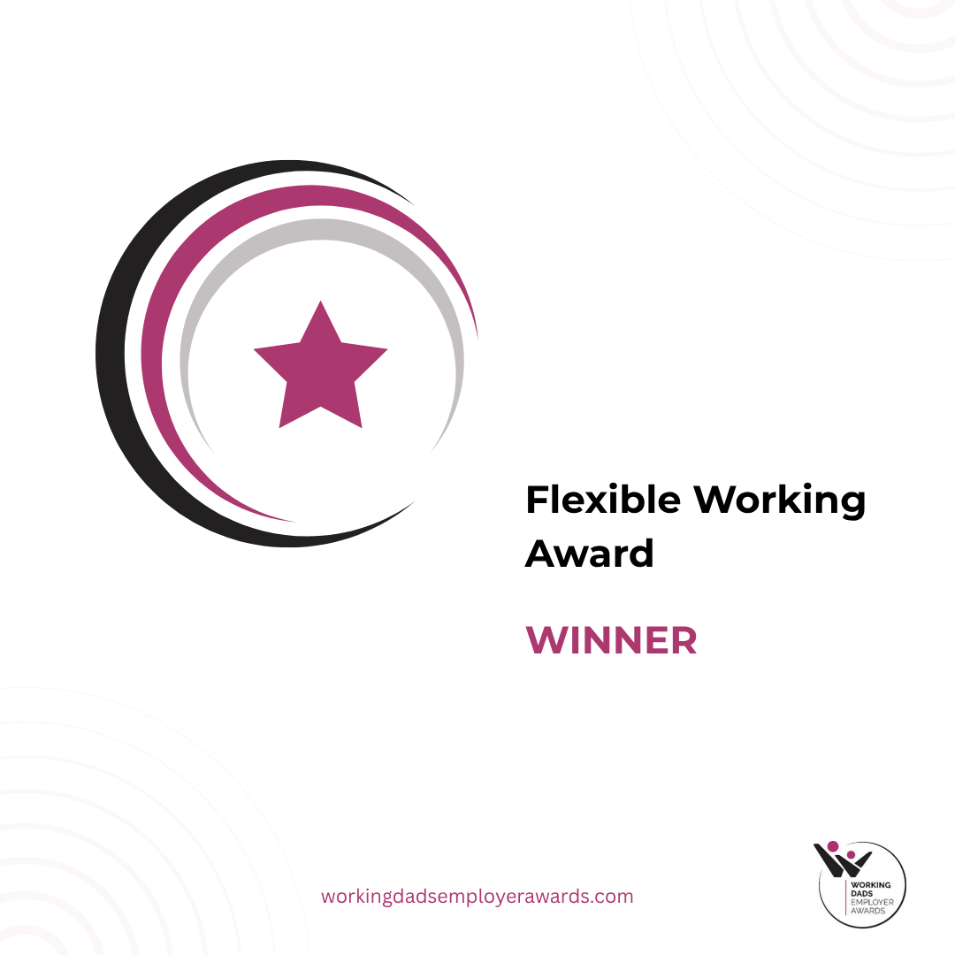
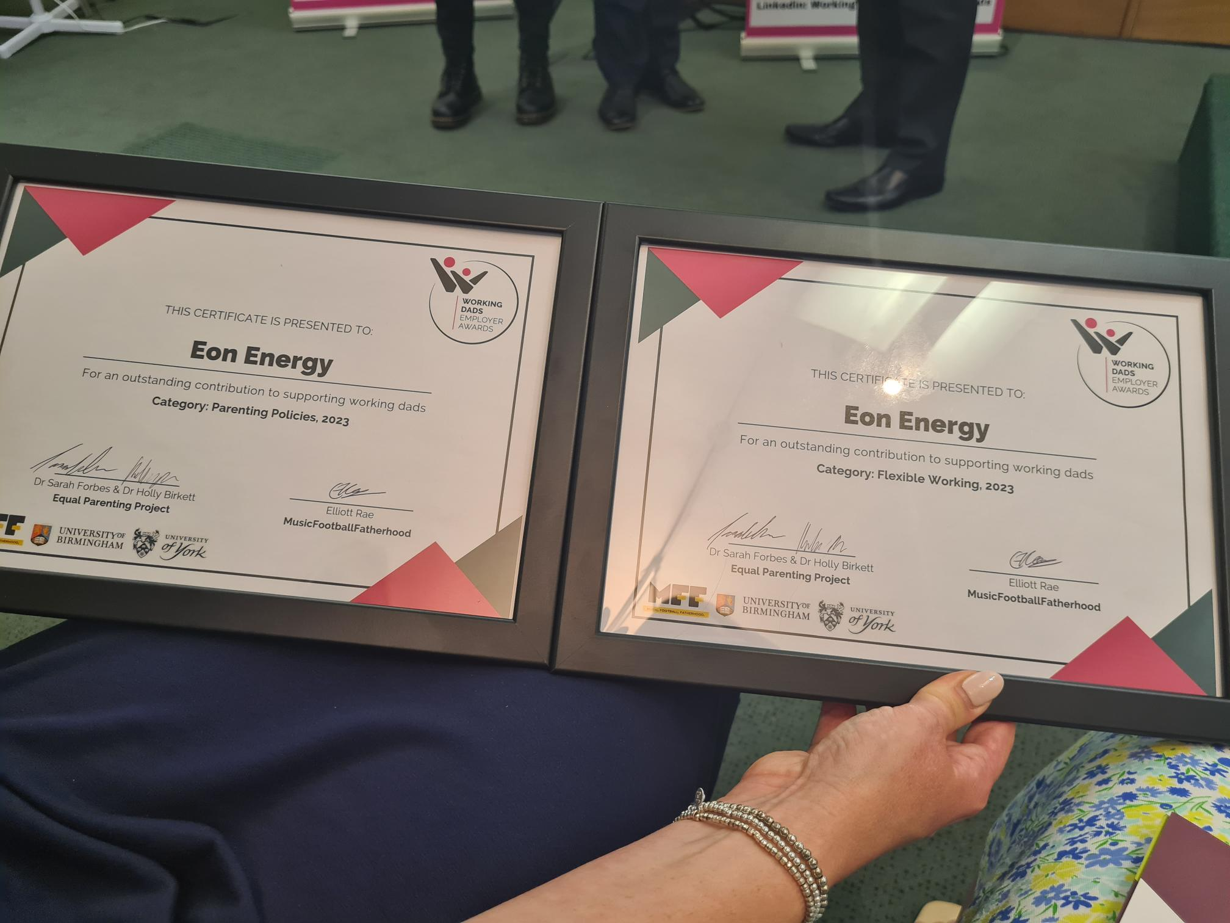
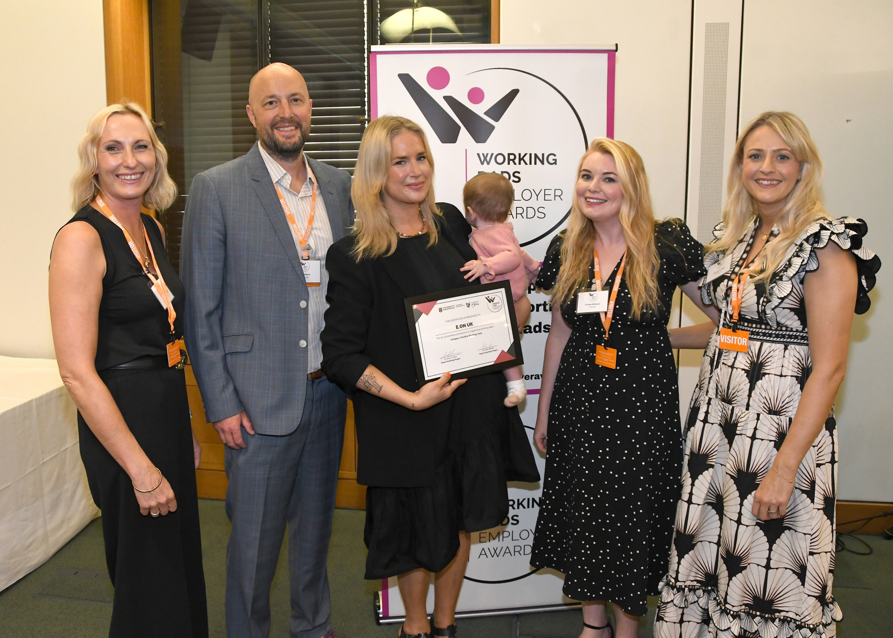
Recent Highlights
Notes:
Awards and Events
TLC Lions 2023 and 2024 – Human Company of the Year
Personnel Today – Family Friendly Employer of the Year and Hybrid Working Award.
Working Dads Employer Awards 2023 and 2025 – case study launch and panel event.
Inclusive Employers Top 50 (2024)
Working Families Top 30 (2025)
Sunday Times Best Places to Work 2025 employer
Working Dads Employer Awards
We’ve done a lot of work with and really got behind the work the team have done there.
We recognise by amplifying the support to Dads, we’re levelling the playing field on both sides.
Working Dad’s Survey
448 responses.
55% of Dad’s work flexibly and 80% of those for childcare reasons.
Some great comments about being able to do school runs and spend more time with their families.

Slide 29
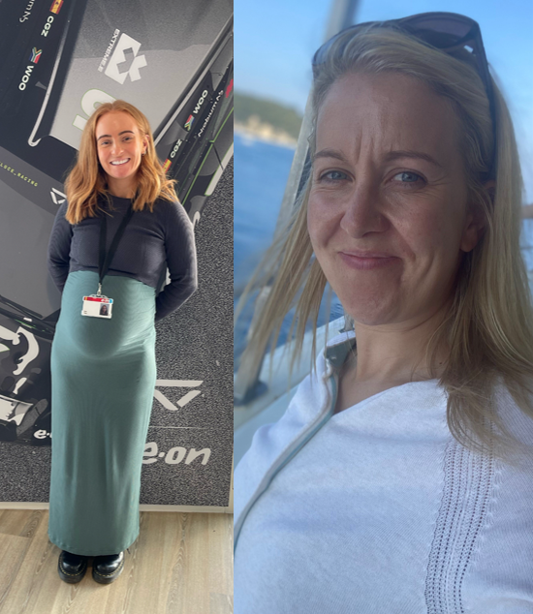
What support do we offer?
We foster a culture that values work-life balance, diversity, and inclusion.
Working Families and Fertility Networks.
Provide a platform for sharing experiences, resources, and best practices among employees with families.
Facilitate listening cafes, blogs, storytelling and award wins.
Enhanced leave - Equal Parent, Neonatal, Fertility, Flexible Working, Special Leave
Coaching that works
In 2024, we rolled out career coaching for parents.
External coaching: Spring Back’s Letty scored a perfect 10/10 for satisfaction and recommendations across the board.
Internal coaching community: tailored, actionable support for all colleagues.
Number of Wellbeing Services & Award Winning Benefits benefits
Notes:
We tackle some of the most demanding parts of family life and open-up spaces for colleagues to understand each other and share experiences. Our aim is to ensure that our working families, no matter what journey you’re on, have a supportive and flexible work/life balance.
We foster a culture that values work-life balance, diversity, and inclusion.
We provide a platform for sharing experiences, resources, and best practices among employees with families.
Facilitate listening cafes, blogs, storytelling and award wins.
We influence policies and practice on all things parenting and caring.
We are open to anyone with families, regardless of gender, role, or seniority.
We are close allies of our other D&I networks

Slide 30

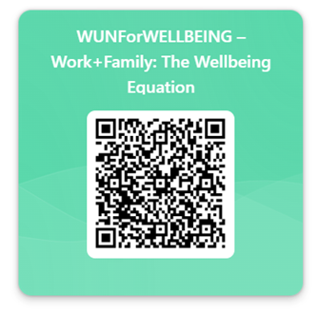
Thank you to all our contributors & for all the WUN partners for their ongoing support of the network.
We really value your opinions so please do take a few moments to complete a quick feedback form
https://thewun.co.uk/

Slide 31


Don’t forget to join the Network – its free & you also receive our quarterly newsletter!
Podcasts
https://thewun.co.uk/join-wun

Slide 32

Connect with Us
info@thewun.co.uk
https://thewun.co.uk/
https://www.linkedin.com
/company/womens- utilities-network
@TheWUN1
@WUN4ALL
@Womens Utilities Network

Slide 33


For Further information about WUN visit the website
https://thewun.co.uk

Slide 34
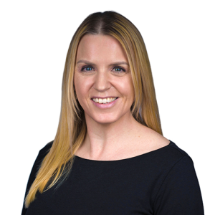
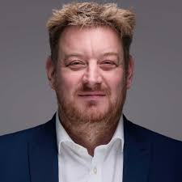
Charlotte Lack – Head of Safe and Well at E.ON
Experienced HR leader passionate about creating safer, healthier workplaces where people thrive. At E.ON, Charlotte leads the Safety and Wellbeing, Employee Relations, Occupational Health and HR Policy—driving transformational change and inclusive leadership. She believes in playing to people’s strengths, breaking down hierarchy, and making time for everyone. Her mission is simple: help others reach their full potential.
Andrew Lobley - Managing Director at Hydrosave
Andrew Lobley is the Managing Director of Hydrosave, leading South Staffordshire Plc’s
new Asset Health division, which also includes Group company Advanced Engineering Solutions (AES). Having been with South Staffordshire Plc for 10 years, Andrew previously held roles as Interim MD for Group company OnSite, a drainage, waterways, pipelines and rail sector specialist, and, before this, Operations Director at regulated water companies Cambridge Water & South Staffs Water. He holds a PhD in Civil Engineering focused on asset risk management.

Slide 35
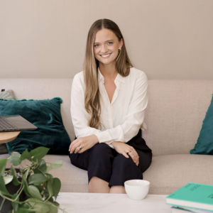
Letty Gordon-Furse, CEO of The Spring Back Guide
Letty, offers a unique blend of corporate acumen and global perspective to the challenges businesses face when it comes to parental leave and retaining great talent.
With a background in People and Organisational Change at EY and a track record of leading large-scale transformation projects for national and international charities, Letty brings a depth of knowledge and insight to her role as the CEO of a coaching product, specifically targeted at companies interested in the retention of new parents and closing of the Gender Pay Gap. Spring Back's client list includes E.On, The Gym Group, Pan Macmillan, Tonies, Major Players, Smiths Interconnect, LEK Consulting, as well as other large corporates.
Spring Back's approach is to combine technology with personalised coaching to support organisations in keeping this brilliant segment of the workforce, using 5 years worth of Parental Leaver Data. Letty also hosts a successful podcast, Returnity - 5.0 star rated across all platforms and listened to in 23 countries.

