Slide 1
Career Transformational Map
Contents:
The Map framework
Your Map – Build your map here
Example Map for reference

Slide 2
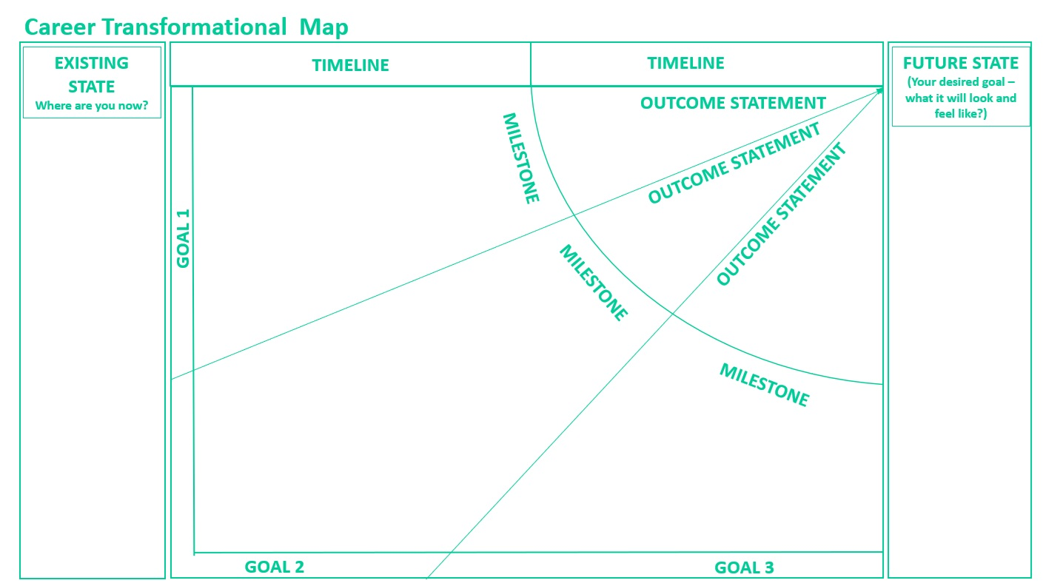
Career Transformational Map – Framework

Slide 3

Career Transformational Map – Your Map
TIMELINE
TIMELINE
OUTCOME STATEMENT
OUTCOME STATEMENT
MILESTONE
OUTCOME STATEMENT
GOAL 1
MILESTONE
MILESTONE
GOAL 2
GOAL 3

Slide 4
Career Transformational Map - Example
EXISTING STATE
Where are you now?
Now – June 2026
June 2026 – June 2027
FUTURE STATE
(Your desired goal – what it will look and feel like?)
Build the team capability to underpin performance.
Shape the team – let go, delegate and move to strategic / functional headspace.
Customer experience project work to get out of silo.
Drive new team metrics and set the pace.
Communicate more and test
out with key stakeholders.
Cut through the politics.
Lead without authority
External benchmarking, networking and bring new ideas.
Applying for role/s
New team in against pressure of deliverables already committed to. Need to build capability and alignment / trust.
Taking criticism personally and need to manage and seek feedback more regularly.
Workload high and multiple stakeholders to engage.
Confidence can get in the way of challenge and innovation with certain senior stakeholders.
Balancing family life is tricky.
Identify new opportunities to lead work across the business / senior team.
Get clear and reset agenda
Team working together and increased capability to delegate and build from. Clear expectations and clarity on common goals.
Feeling comfortable and confident in senior role.
Wider stakeholder engagement.
Time to think strategically and plan ahead built into BAU.
Leading from a strong position of health, wellbeing and energy – balance and true to my values / brand.
Feeling fit, healthy and balancing family life
Assessment process and preparation. Stakeholder mgt.
Leads from the front
Identified next role and path
Integrating work / life better – less stress and long hours.
Routines & results
Explore getting a mentor.
Consider flexible working request?
Identify potential moves/roles internally.
Research external market and any entry/qualification requirements.
Review working routines – boundaries on time at work and top time wasters.
Explore career options with my coach.
Career
Wellbeing

