Slide 2
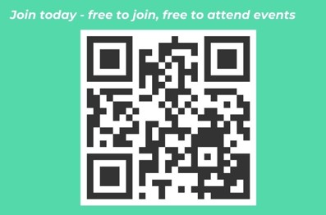
Welcome
we will be starting shortly The role allies play supporting others in the workplace – How we can practically help others to #SpeakUp.

Slide 3
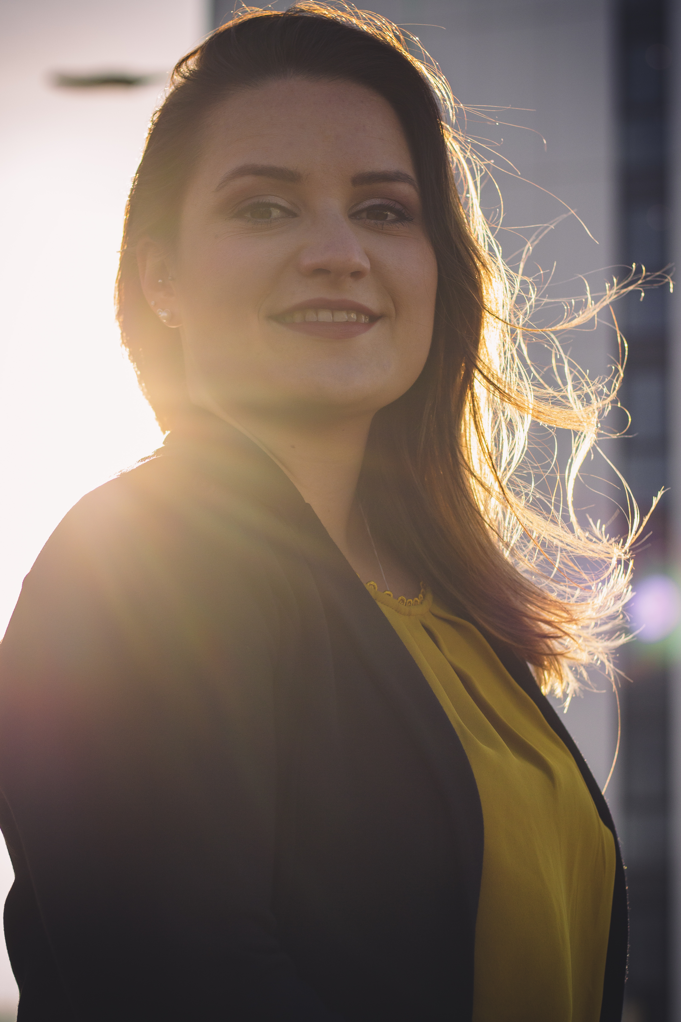
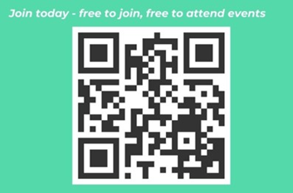
Julia Stichling
WUN Advocate
& MD R2M Ltd.

Slide 4
WUN
The utilities sector is lacking in diversity with many women being generally under-represented, particularly in senior roles.
WUN was started in 2018 when a group of likeminded women, working in utilities, united around a common cause. The founders were not only passionate about the industry they worked in, but also passionate about the contribution women were making and could continue to make in the future. We now have over 9300 members & 70 plus, partners & supporters.
9300+
Followers &
Members
Regular Events & Content
Mentoring Programme & Network
70 +
Partners & Supporters

Slide 6
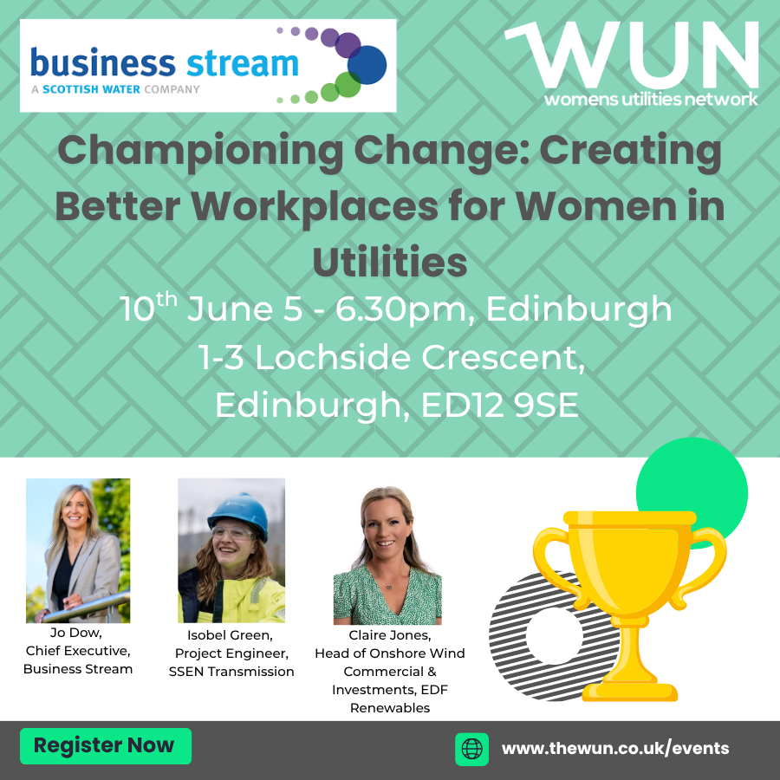
Dates for your diary
WUN Events
Wednesday 4th June, 3:30pm Championing Change Creating Better Workplaces for Women in Utilities, Newport.
Tuesday 10th June, 5pm Championing Change, Creating Better Workplaces for Women in Utilities Edinburgh
Monday 7th July 12pm– WUNForAll Better with Money – Empowering Women Financially – Tickets available shortly. (Virtual Event )
Free tickets available - visit our Events page!
WUN on the Road – Find us at:
Wednesday 11th and Thursday 12th June - Future of Utilities Summit London
Tuesday 1st July - Energy Live Consultancy Conference, London
Wednesday 9th July – NWG Innovation Festival, Newcastle.
Tuesday 15th July –The Energy UK EDI Conference, London
https://thewun.co.uk/

Slide 7
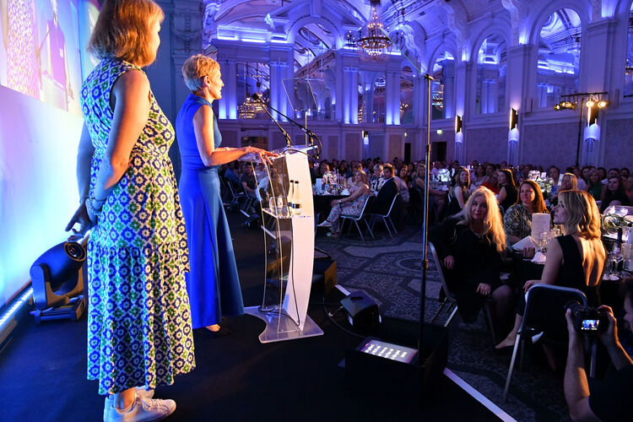
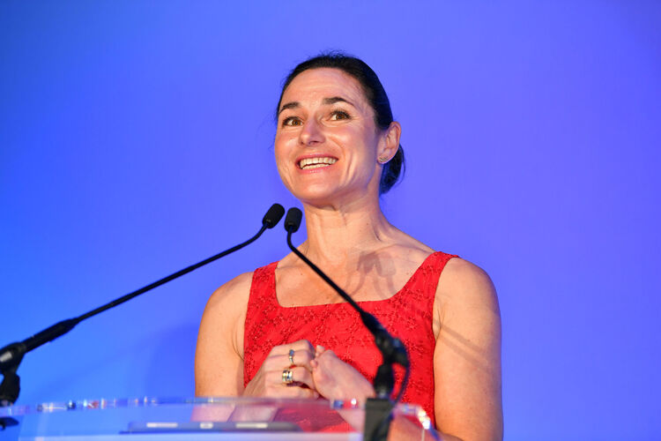
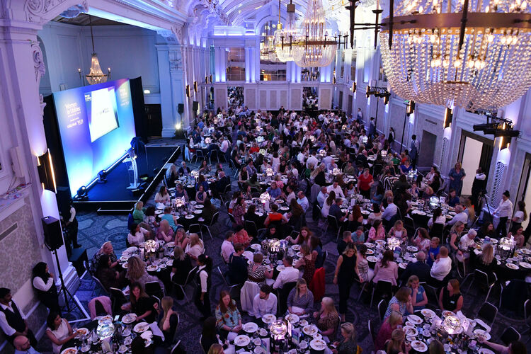
27th June 2025 - Lunchtime
Women in Utilities Awards 2025 – Ceremony tickets now available.
More categories. More recognition. Women leading the way This is your chance to shine, or to champion someone whose impact deserves the spotlight. Here’s where you, your team, or your initiatives could be recognised: 🔥 Women’s Network of the Year (company) 🤝 Allyship Award 🌍 EDI Initiative of the Year 🏡 Community Outreach Award 🎓 Mentor of the Year 🦺 Hi Vis Award
🔧 Onsite Excellence
📈Business Champion 🔹 Apprentice of the Year 🎓 Graduate of the Year ✨ Rising Star ⭐ Returning Star 🏢 Best Employer for Women (< 500 employees) 🏢 Best Employer for Women (>500 employees
Visit our Events page!
https://thewun.co.uk/

Slide 8
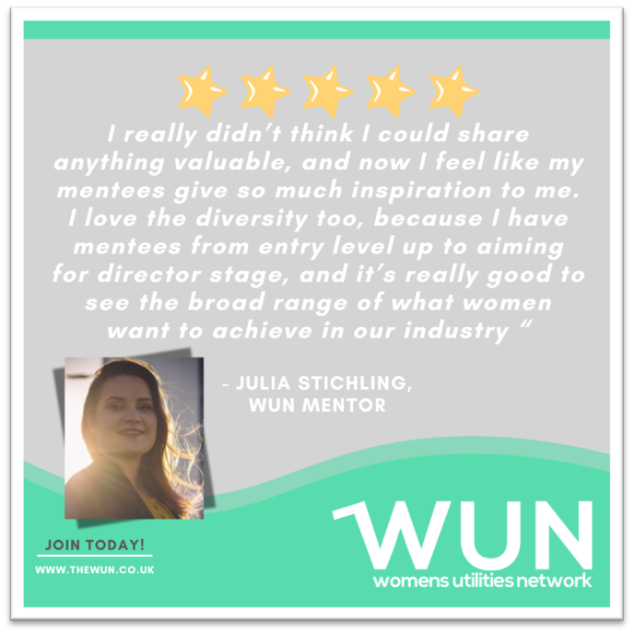
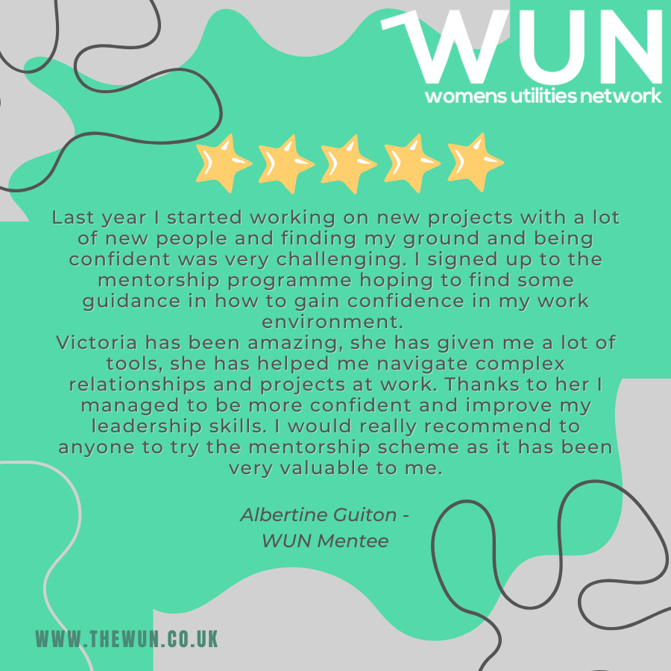
Join the free WUN Mentoring Programme
WUN offers mentoring to women at any stage of their career in the utilities sectors.
We are hugely privileged to have over 130+ fantastic experienced mentors within the WUN mentoring Programme.
With growing numbers of Mentors and Mentees we are delighted with the community and support fostered within the mentoring programme.
If you are interested in becoming a Mentor or Mentee,
please visit our website: https://wun.onpld.com

Slide 9
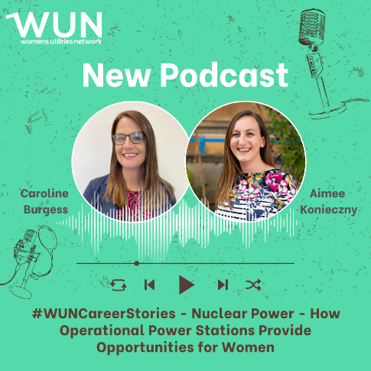
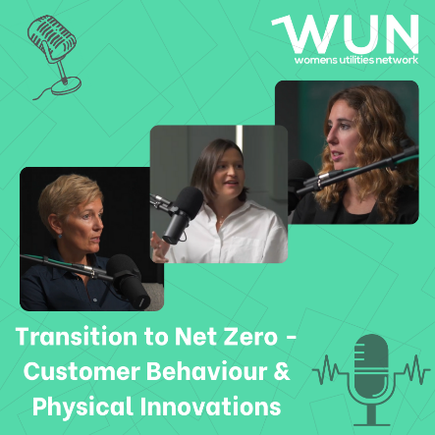
WUN Podcasts
Listen to our latest podcasts More coming soon !
In this latest WUN podcast Aimee Konieczny, WUN Advocate and Commercial Director at Indigo Swan, talks to Caroline Burgess, Enablement Manager – Single Integrated Delivery Organisation at EDF Energy’s Sizewell B Nuclear Power Station, about Caroline’s varied career across renewables, oil and gas, and most recently nuclear, and the skills she has learned and can now put into practice on a nationally important infrastructure site.
How do we overcome the barriers to achieving net zero? - In this video podcast we explore the transition to net zero and explore customer behavior and physical innovations.
WUN Advocate Kerris Mackley chats with WUN partners:
Hayley Monks, WUN Co-Founder & Director and Managing Director ECHO.
Rebecca Teasdale - Director, Baringa.
Natasha Ackroyd - Head of Proposition (Electrification of Heat),EON.
You can follow our podcast on Apple Podcasts, Spotify, Amazon Music and wherever else you get your podcasts – just search “WUN4ALL”.
Or just click through from the website: https://thewun.co.uk/news-blogs/

Slide 10
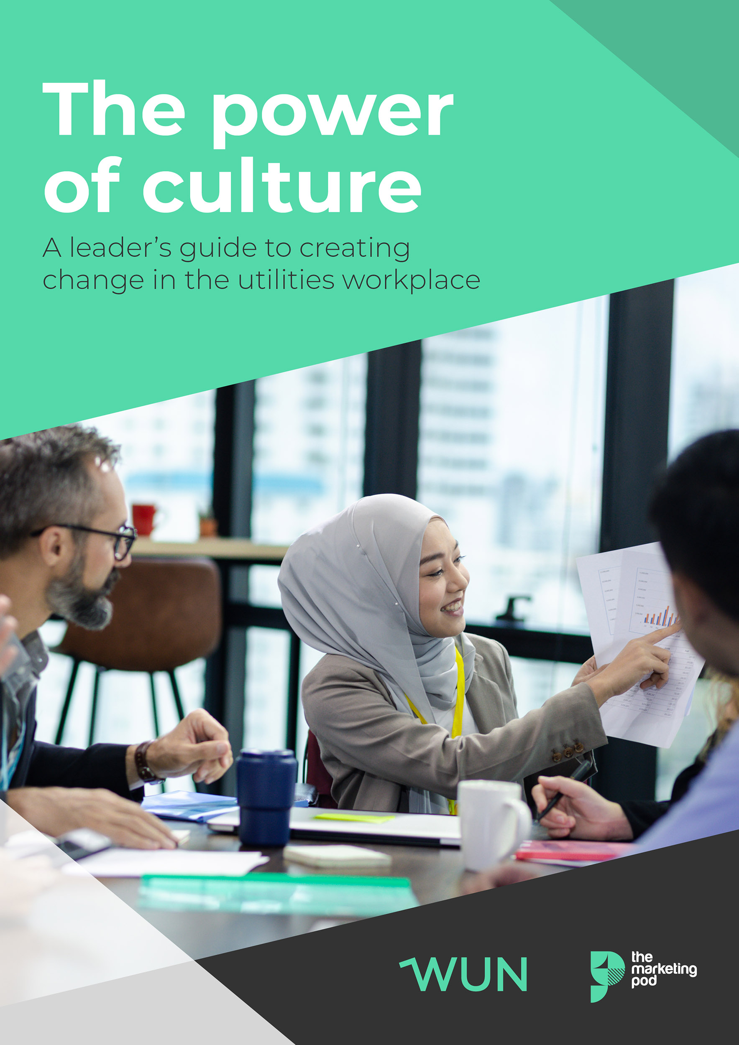
WUN 2025 Report - The Power of Culture –
creating change in the utilities workplace.
Get your free copy today to discover:
✋ What women rate most highly when considering a job role
🫤 Why some organisational values are seen as little more than 'lip service'
⚖️ How leaders and individuals can create real change
Download the report now:
https://thewun.co.uk/blogs/wun-2025-survey-report-the-power-of-culture/

Slide 11
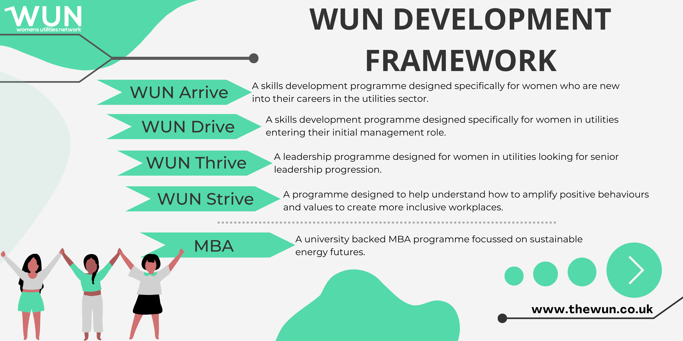
The Womens Utilities Network – Development Framework
A suite of targeted and bespoke development journeys designed to empower women working in utilities
WUN programmes have been designed by women in the sector, specifically for women in the sector
A safe space to really discuss challenges honestly and create solutions together
Building a supportive network of peers across the sector
Sector relevant with insight and examples that are rooted in the reality for women in utilities
Third cohort WUN Drive– bookings open for Sept 25. A skills development programme for women seeking or in initial management roles. Available to sign up on the WUN website now.
WUN Thrive. A development programme for women already in or seeking senior leadership roles. Sign up for Cohort 2 -Q4 2025 & Q1 2026.

Slide 12
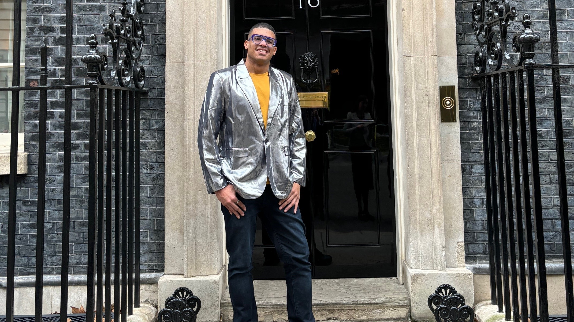
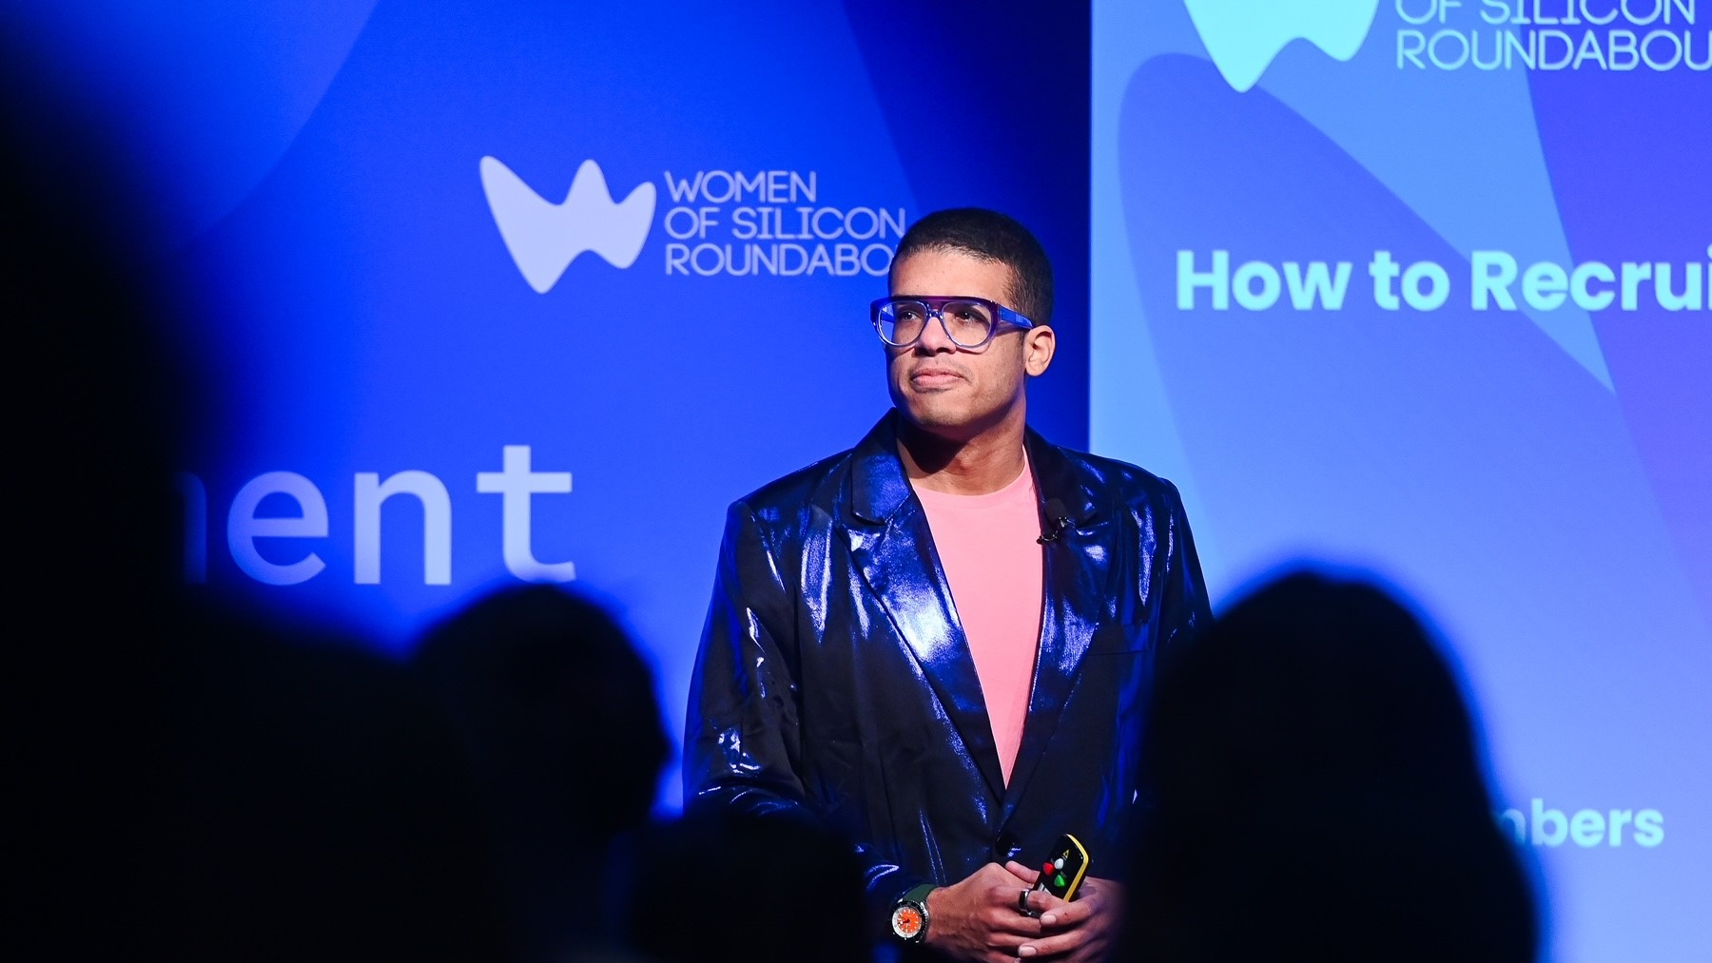
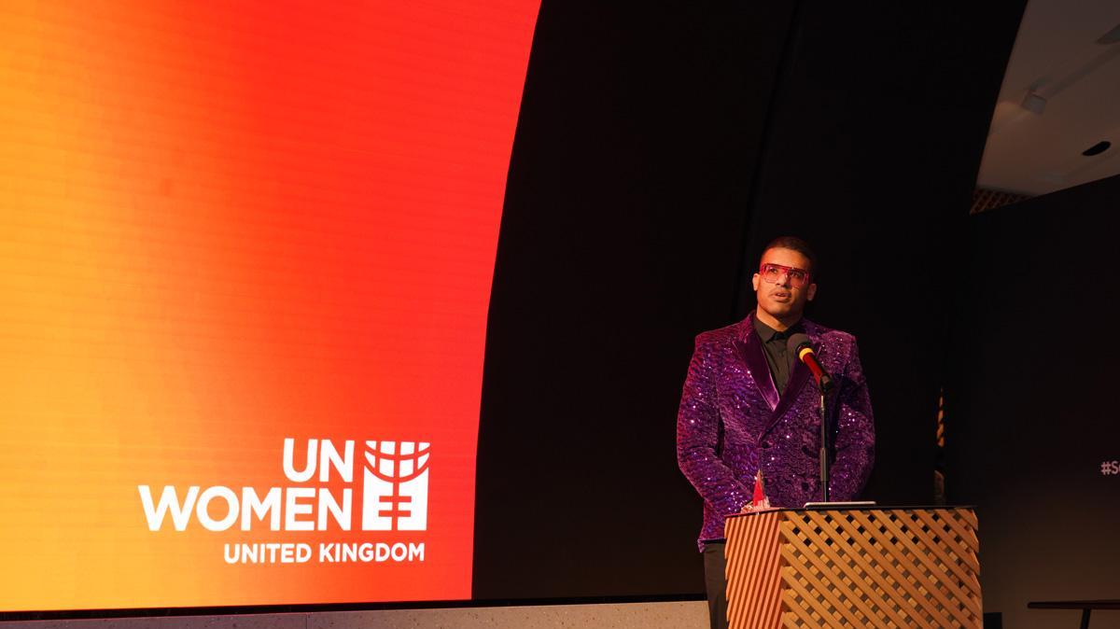
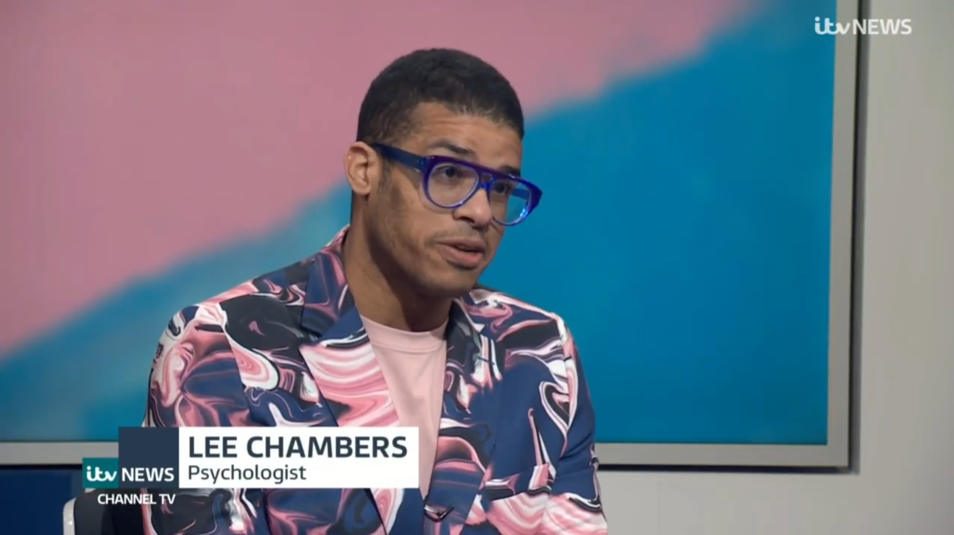

Slide 13
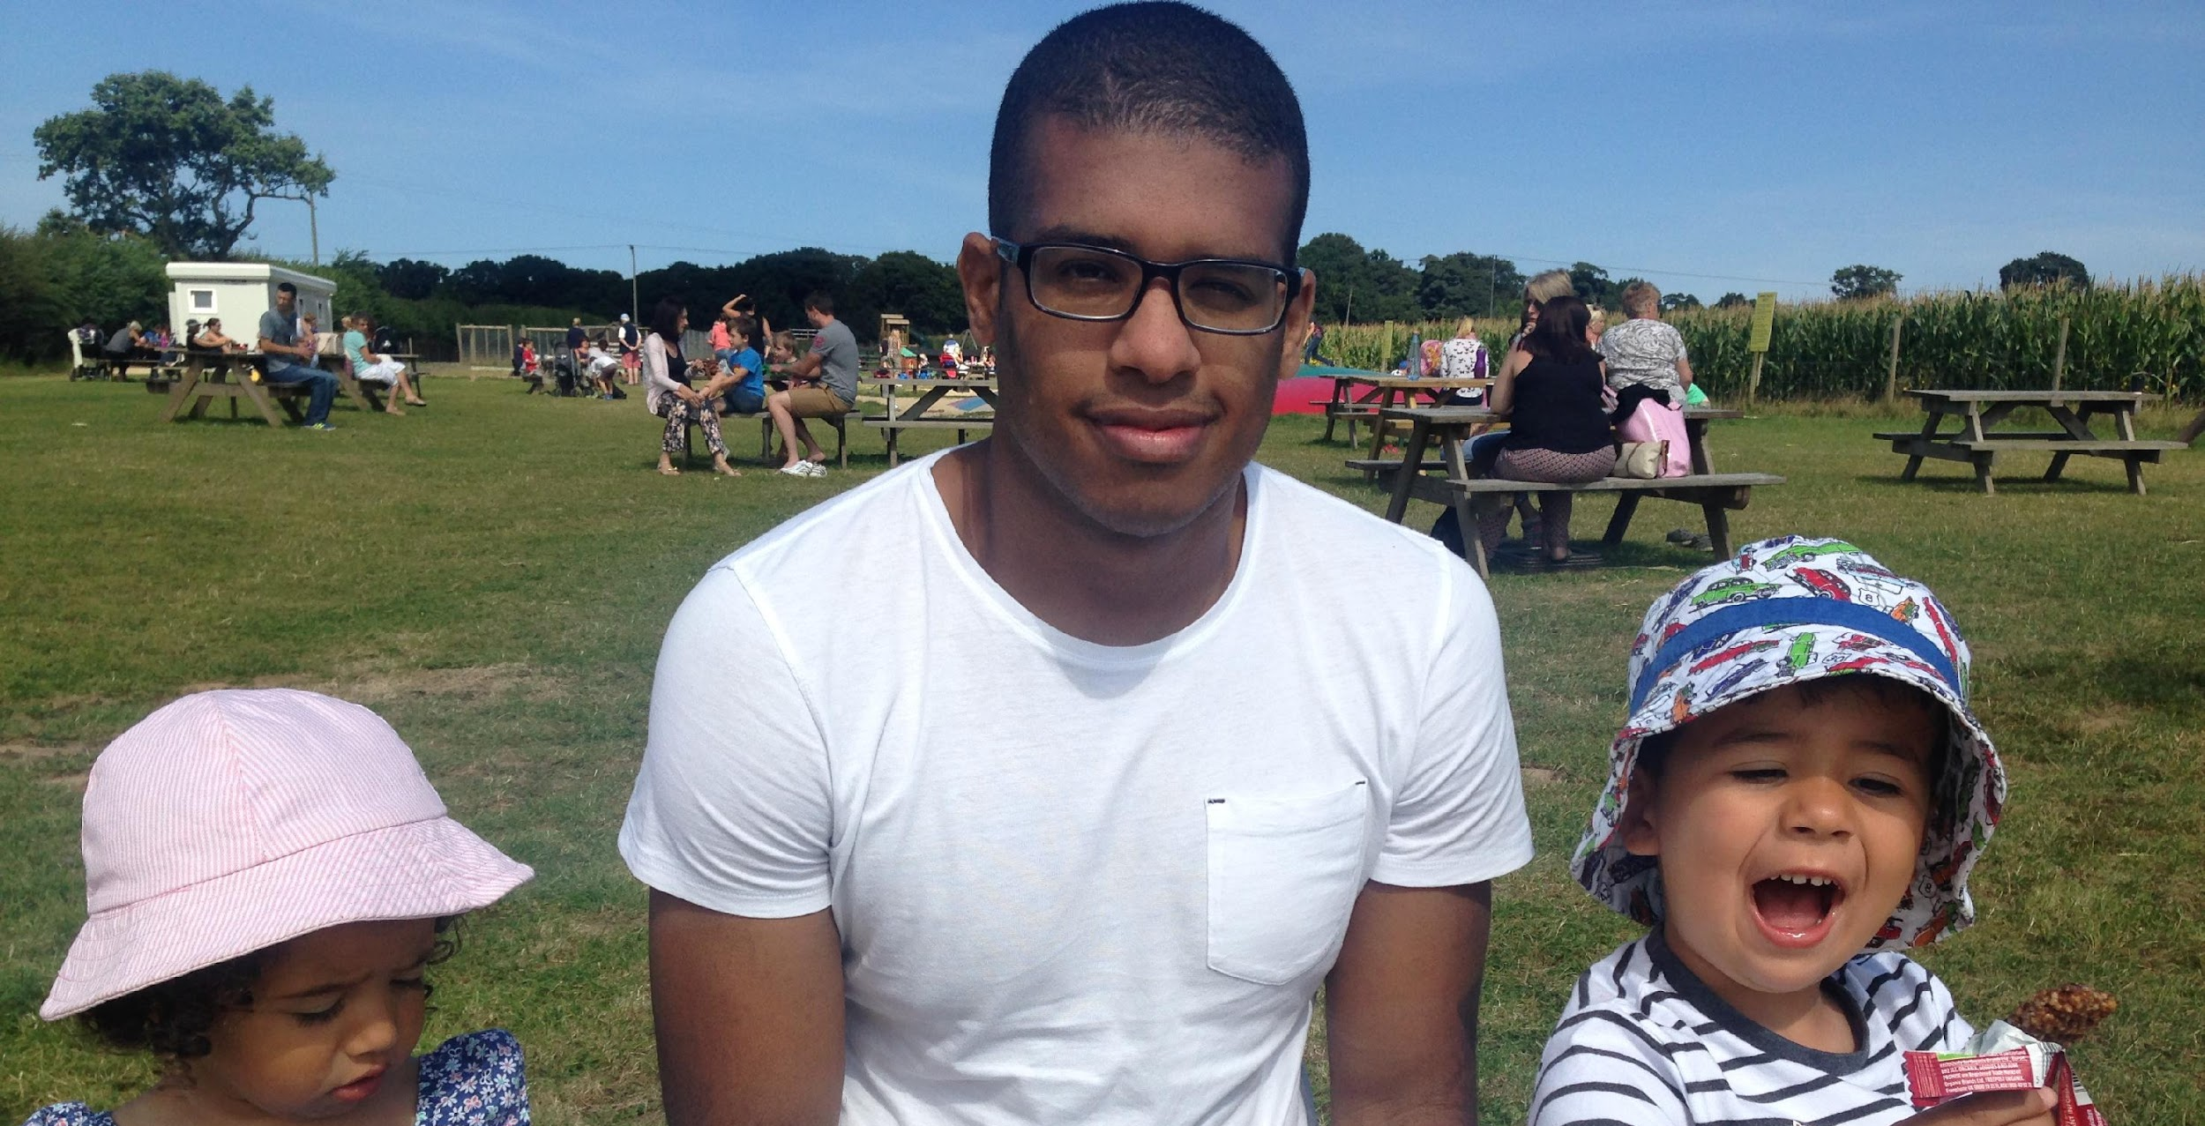

Slide 15
Notes:
One Culture

Slide 19
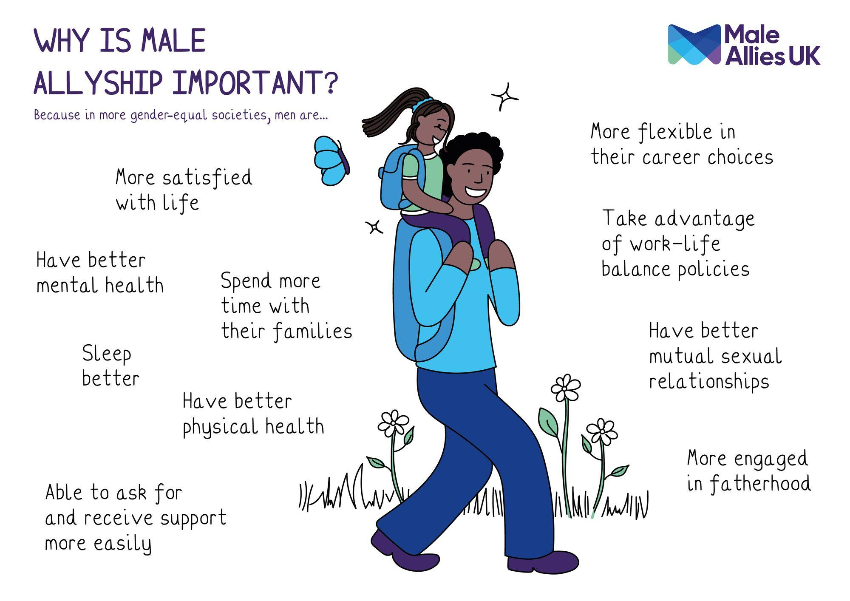

Slide 20
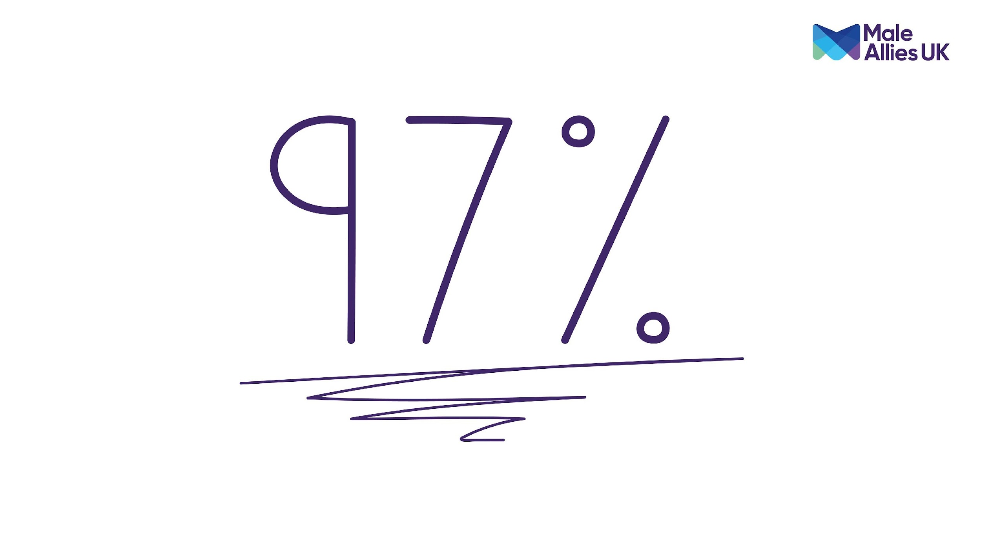

Slide 21
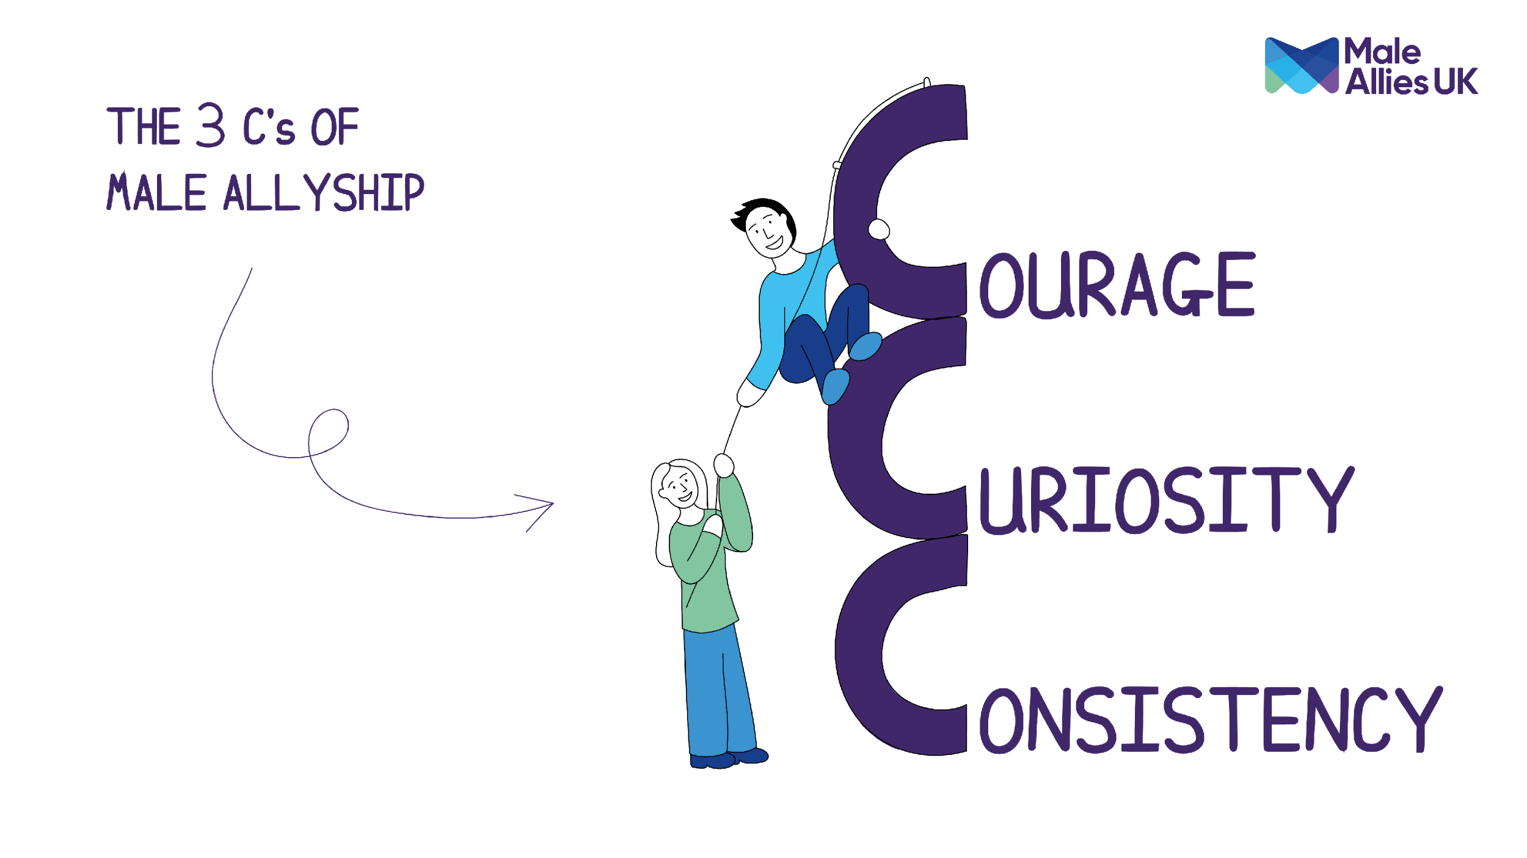

Slide 22
Chair:
Julia Stichling, WUN Advocate and MD, R2M Ltd
Keynote & Panel:
Joshua Ketley, Junior Leakage Consultant, WRc Group and Institute of Water Rising Star 2025
Lee Chambers, Founder and CEO, Male Allies UK
Halyma Begum, Equity Diversity Inclusion and Wellbeing Specialist, Calisen
Keri Handford, HR Director, Centre of Expertise at Cadent Gas Limited

Slide 23
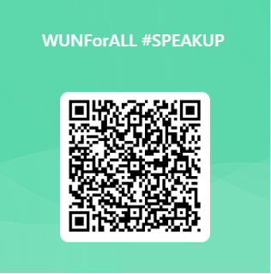
We do value your feedback as they help shape future events

Slide 24
Thank you to our panellist & all WUN’s partners for their ongoing support.

Slide 26
Don’t forget to join the Network
to receive the next WUN newsletter
https://thewun.co.uk/join-wun/

Slide 27
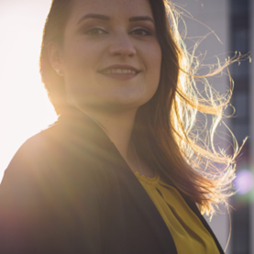
Julia Stichling, WUN Advocate and MD R2M Ltd
Julia is the Managing Director at R2M Ltd., a supplier to all of the UK’s water utilities and their contractors. R2M is part of the Hawle Austria Group, a manufacturer of valves and fittings.
Julia has been in the water industry for almost a decade, having started at the parent company
of R2M, Hawle Austria Group. Her international background has brought her from
Germany to Japan, then Austria and now the UK, which is where she spends most of her time currently.
Julia joined WUN in 2023 to help support and network with other women in the utility industry,
as well as gaining a better understanding of other aspects of the utility industry.

Slide 28
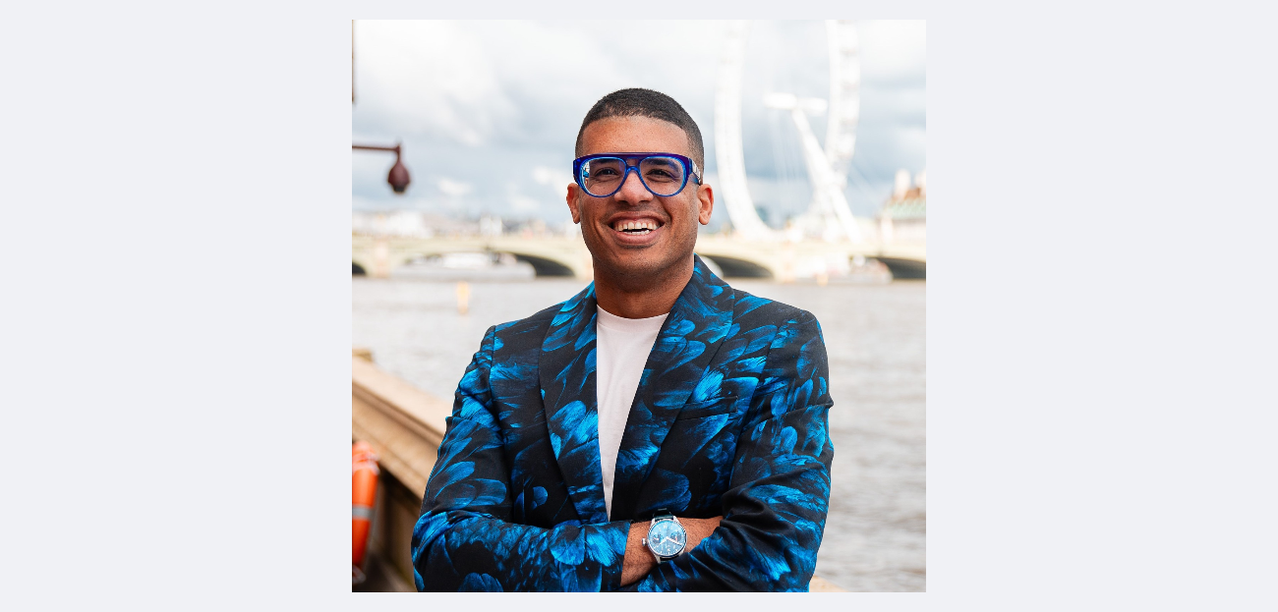
Lee Chambers, Founder and CEO of Male Allies UK.
After a diverse career, from corporate finance to building and exiting tech company, he is now focused on supporting organisations to engage men in inclusion and promote effective allyship. He has been featured on the Startups 100 Index, has received a Great British Entrepreneur Award, and sits on the board of CMI Women, Regenerage UK and the Manchester Metropolitan University Business School. In 2024, he received the Freedom of the City of London for services to equality in business.
He is a Kavli Fellow of the National Academy of Sciences in the USA, the first Black British scientist to be awarded in its 33-year history, received for his work on health inequalities. He is the 2023 UN Women Changemaker of the Year, and is an ambassador for the UK Governments Lilac Review for Disabled Entrepreneurship.
He speaks globally on allyship and intersectionality, having taken the stage at One Young World, ChangeNOW and the Bloomberg Global Equality Summit, and is the author of the bestselling book, Momentum: 13 Ways To Unlock Your Potential

Slide 29
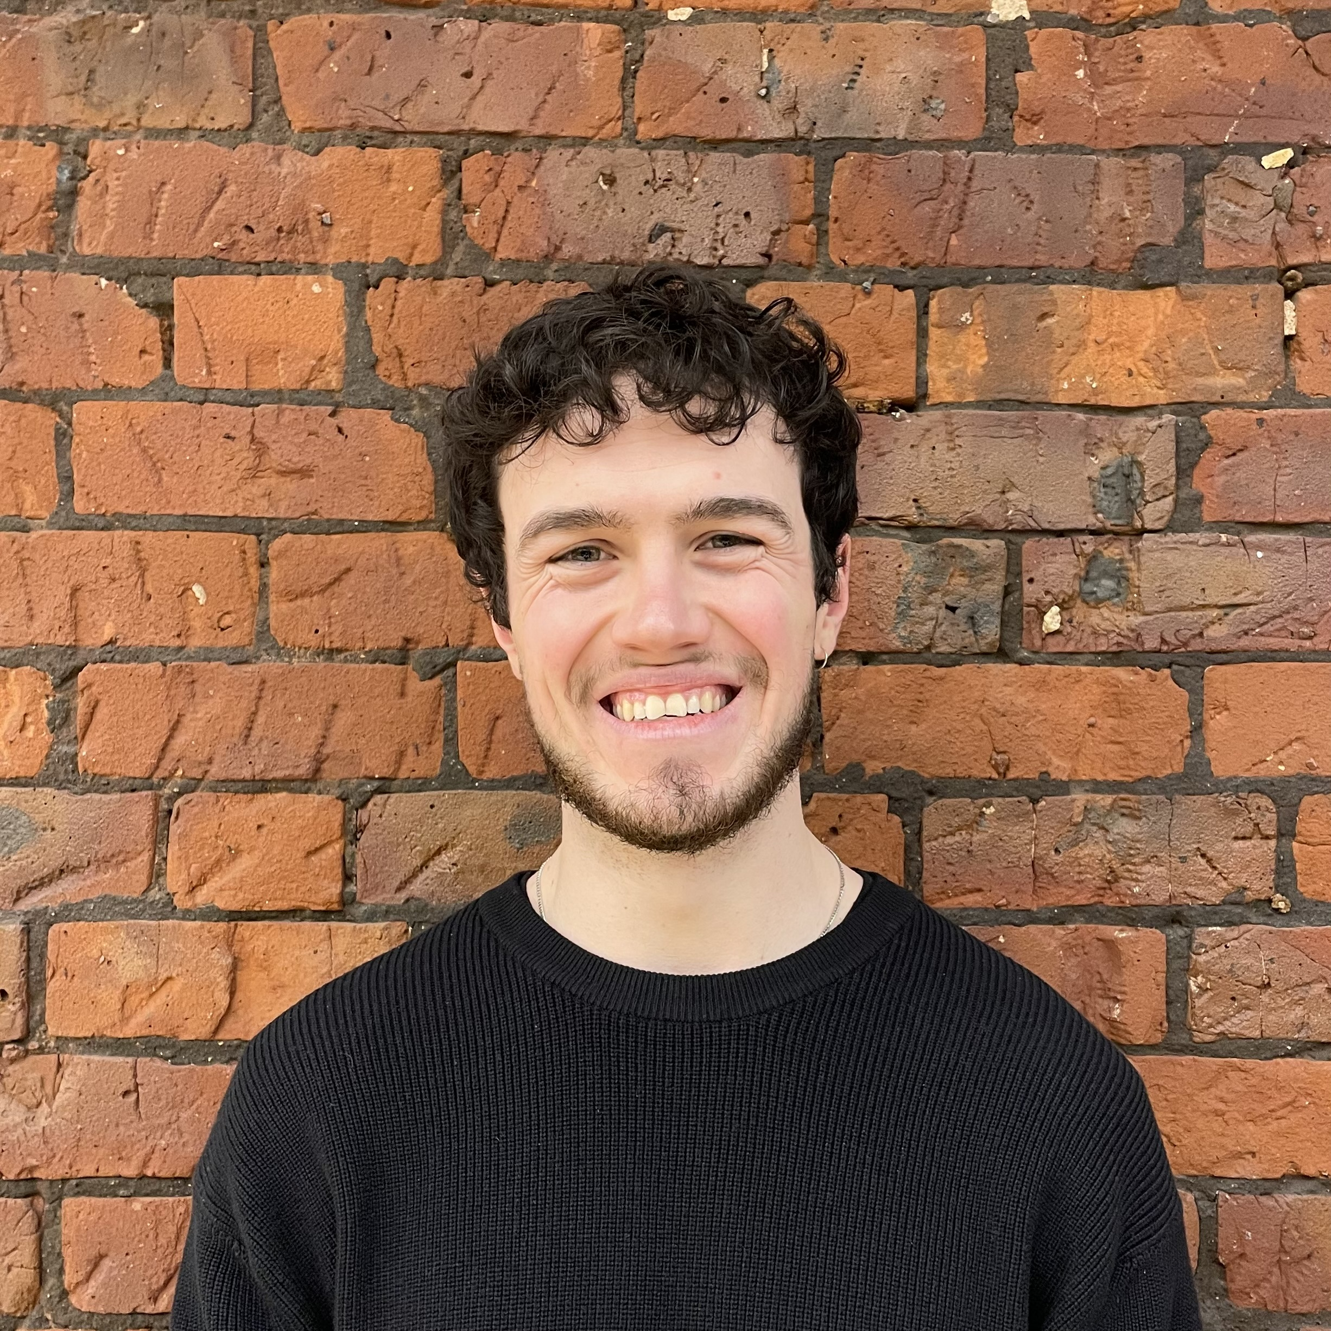
Joshua Ketley, Junior Leakage Consultant, WRc Group and Institute of Water Rising Star 2025
Joshua has been in the Water industry for 2.5 years at WRc, initially as a hydraulic modeller, and now as a leakage consultant working on leakage calculation and strategy. Being involved in WRc’s Early Careers Group committee and Employee Voice team.
Joshua believes strongly in the positive impact that communication and collaboration can have in the workplace. Joshua is also a part of the Institute of Water, this year having the privilege of being selected for their Rising Stars programme.

Slide 30
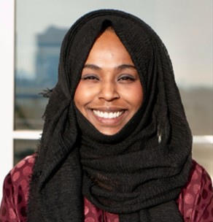
Halyma Begum, Equity Diversity Inclusion and Wellbeing Specialist, Calisen.
Halyma Begum is an experienced equity, diversity, and inclusion (EDI) specialist, currently working at Calisen as EDI & Wellbeing Specialist. She is Vice Chair and Anti-Racism Lead at Refugee Action and was a Digital Delegate for UN Women CSW69.
Halyma has held senior roles including Global D&I Manager at DIAL Global and Inclusion Advisory Manager at Business in the Community, working with leaders across sectors to drive culture change. She previously led leadership and inclusion work at Co-op Group, co-founding its Ethnic Minority Colleague Network.
A former Chair of the Greater Manchester Women’s and Girls’ Equality Panel, Halyma is committed to dismantling systemic racism and advocating for gender and racial equity in all spaces.

Slide 31
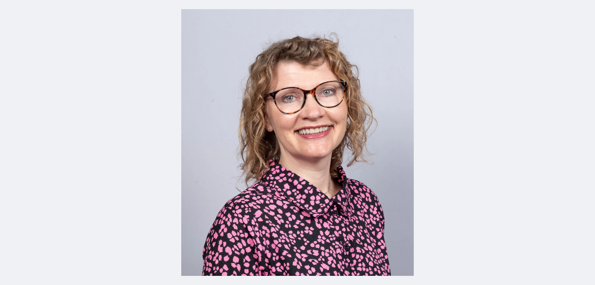
Keri Handford, HR Director, Centre of Expertise at Cadent Gas Limited
Keri is an experienced HR professional currently working as the HR Director, Centre of Expertise, at Cadent, the UK's largest gas distribution network, bringing gas to 11 million homes and businesses. With over 20 years in HR roles, Keri has been instrumental in driving key HR initiatives and fostering a positive work environment.
Keri is committed to equity, diversity, and inclusion; striving to make Cadent a place where all colleagues feel like they belong, through the experiences and opportunities they have.

