Slide 2
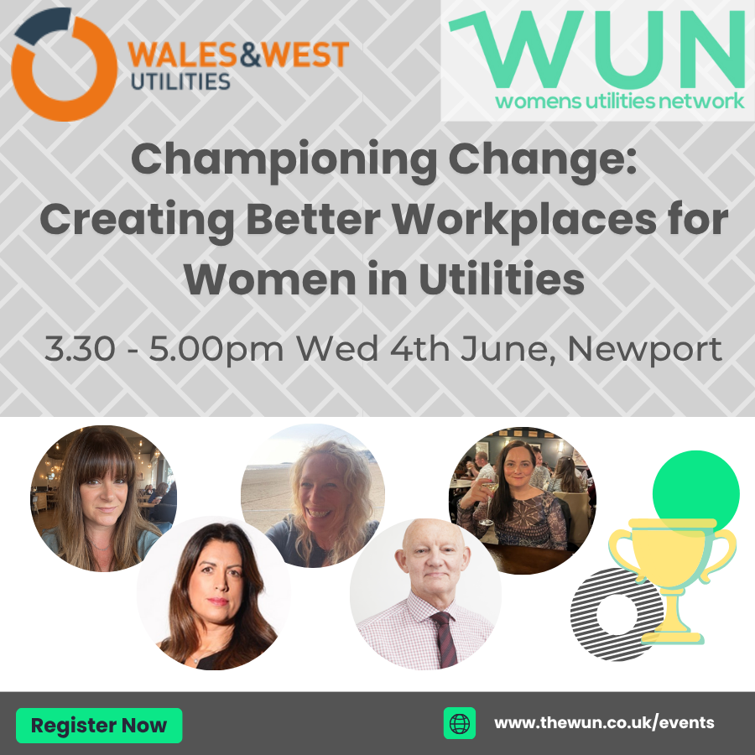
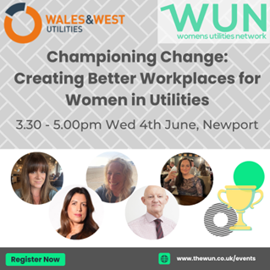
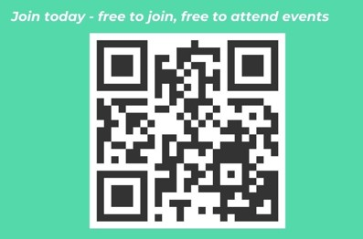
Welcome
Championing Change:
Creating Better Workplaces for Women in Utilities

Slide 3
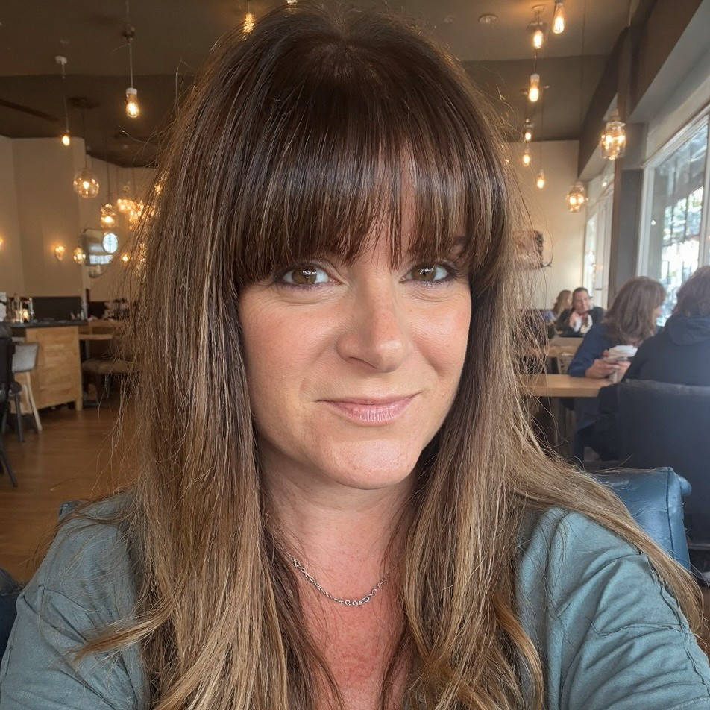
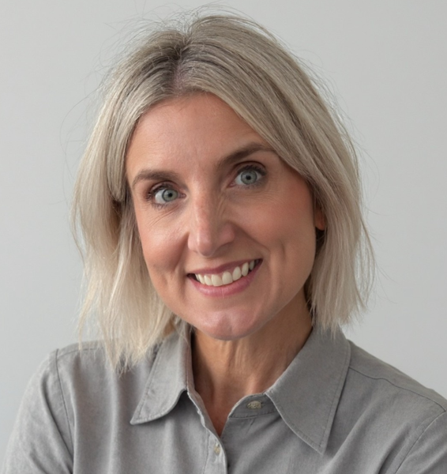
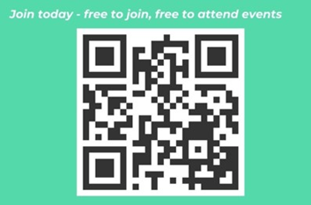
Sarah Hopkins WUN Director & Director of Pathways People Solutions
Karen Anderson WUN Programme Development Manager

Slide 4
WUN
The utilities sector is lacking in diversity with many women being generally under-represented, particularly in senior roles.
WUN was started in 2018 when a group of likeminded women, working in utilities, united around a common cause. The founders were not only passionate about the industry they worked in, but also passionate about the contribution women were making and could continue to make in the future. We now have over 9,300 members and 70+ partners & supporters.
9300+
Followers &
Members
Regular Events & Content
Mentoring Programme & Network
70 +
Partners & Supporters

Slide 6
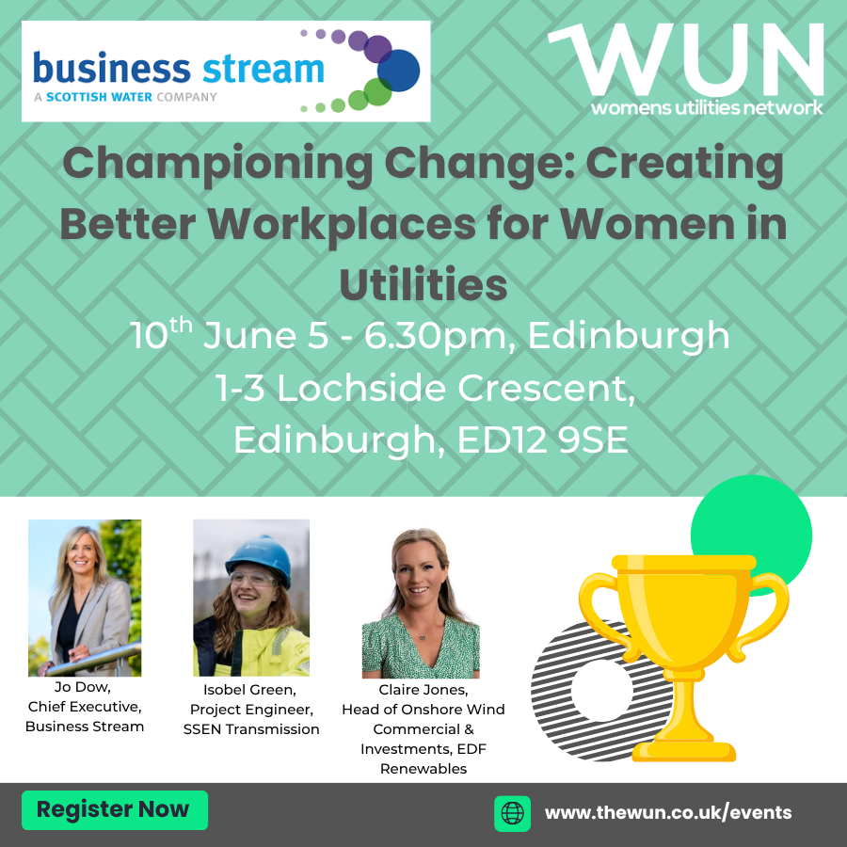
Dates for your diary
WUN Events
Tuesday 10th June - Championing Change, Creating Better Workplaces for Women in Utilities (Edinburgh)
Monday 7th July – WUNForWellbing: Better with Money – Empowering Women Financially Tickets available shortly (Virtual Event)
Free tickets available - visit our Events page!
WUN on the Road – Find us at:
Wednesday 11th & Thursday 12th June - Future of Utilities Summit (London)
Tuesday 1st July - Energy Live Consultancy Conference (London)
Wednesday 9th July – NWG Innovation Festival (Newcastle)
Tuesday 15th July –The Energy UK EDI Conference (London)
https://thewun.co.uk/

Slide 7
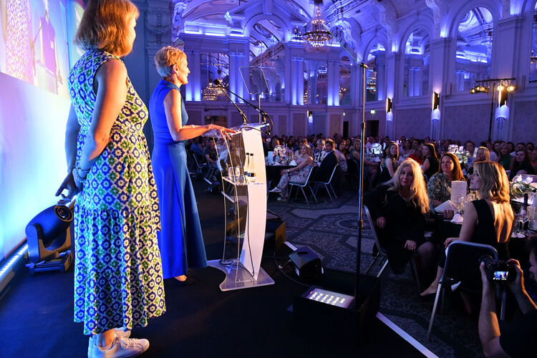
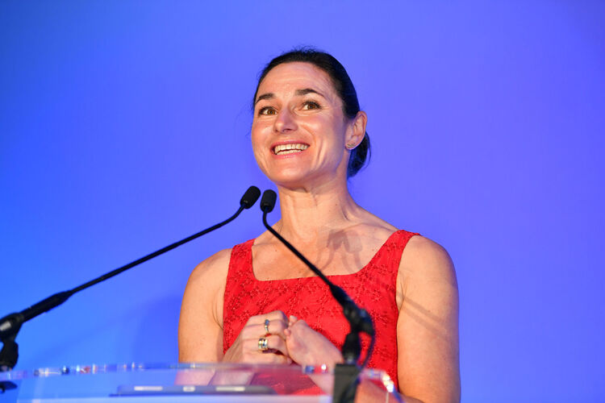
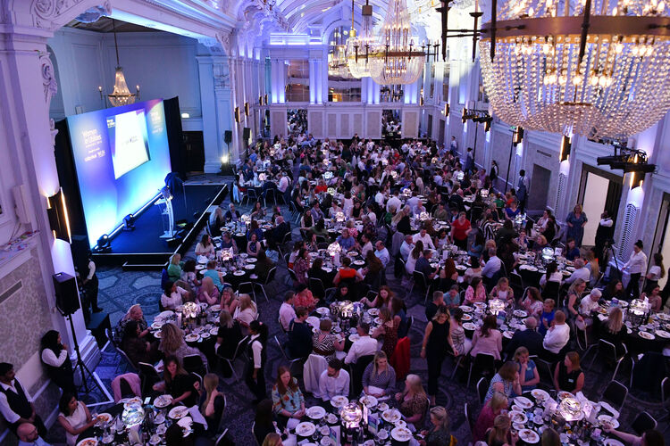
Friday 27th June 2025 – 12pm
Women in Utilities Awards 2025 – Last few ceremony tickets now available
Congratulations to our hosts who are shortlisted for two awards this year! 🌍 EDI Initiative of the Year 🦺 Hi Vis Award
And a number of the organisations represented today are also shortlisted!
Good luck and thank you for your support!!
Visit our Events page for more info
https://thewun.co.uk/

Slide 8
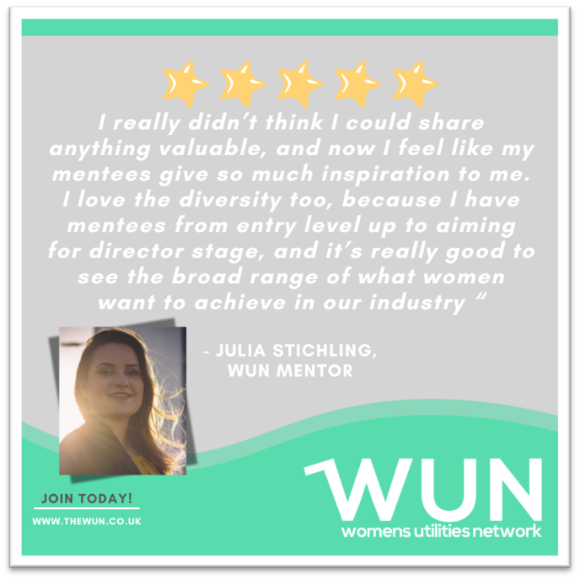
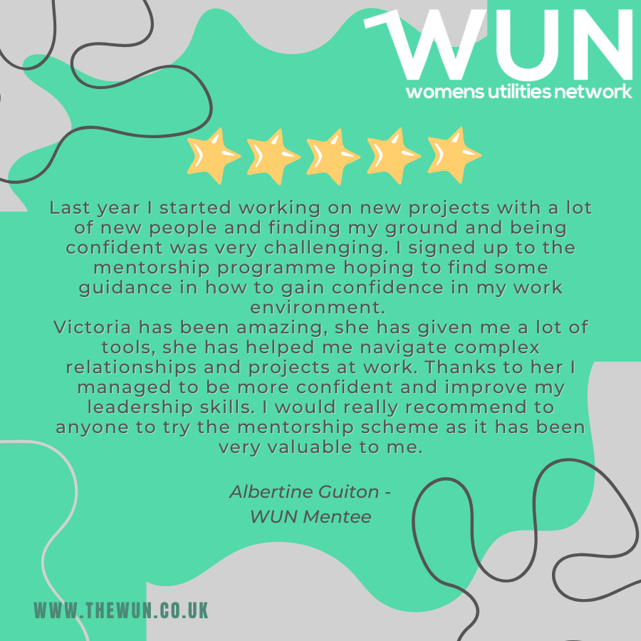
Join the free WUN Mentoring Programme
WUN offers mentoring to women at any stage of their career in the utilities sectors.
We are hugely privileged to have over 130+ fantastic experienced mentors within the WUN mentoring Programme.
With growing numbers of Mentors and Mentees we are delighted with the community and support fostered within the mentoring programme.
If you are interested in becoming a Mentor or Mentee,
please visit our website: https://wun.onpld.com

Slide 9
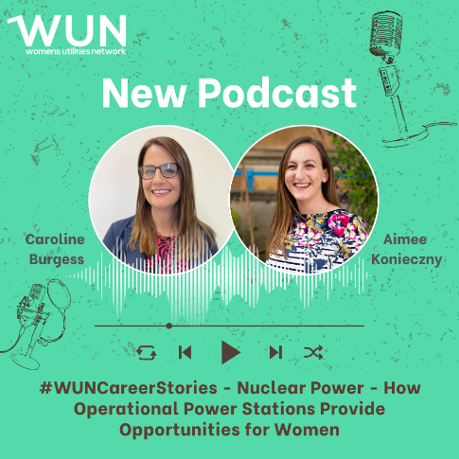
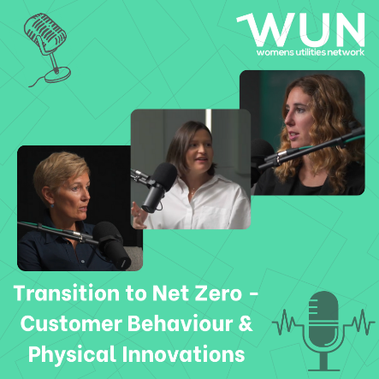
WUN Podcasts
Listen to our latest podcasts More coming soon !
In this latest WUN podcast Aimee Konieczny, WUN Advocate and Commercial Director at Indigo Swan, talks to Caroline Burgess, Enablement Manager – Single Integrated Delivery Organisation at EDF Energy’s Sizewell B Nuclear Power Station, about Caroline’s varied career across renewables, oil and gas, and most recently nuclear, and the skills she has learned and can now put into practice on a nationally important infrastructure site.
How do we overcome the barriers to achieving net zero? - In this video podcast we explore the transition to net zero and explore customer behavior and physical innovations.
WUN Advocate Kerris Mackley chats with WUN partners:
Hayley Monks, WUN Co-Founder & Director and Managing Director ECHO.
Rebecca Teasdale - Director, Baringa.
Natasha Ackroyd - Head of Proposition (Electrification of Heat),EON.
You can follow our podcast on Apple Podcasts, Spotify, Amazon Music and wherever else you get your podcasts – just search “WUN4ALL”.
Or just click through from the website: https://thewun.co.uk/news-blogs/

Slide 10
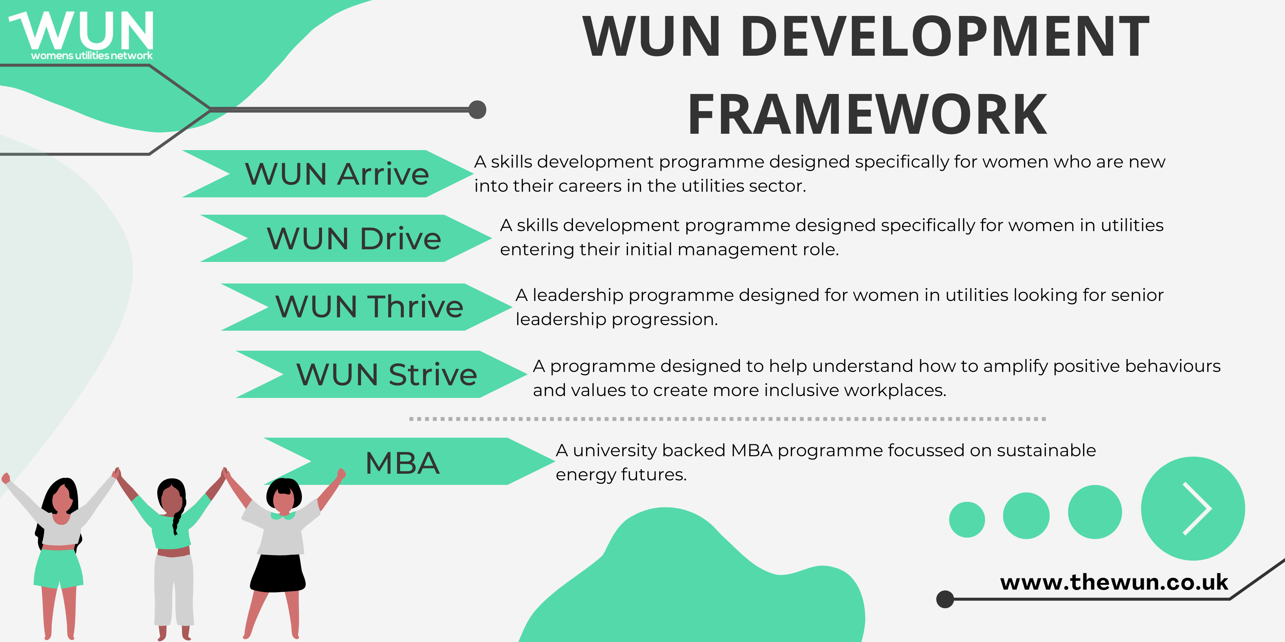
The Womens Utilities Network – Development Framework
A suite of targeted and bespoke development journeys designed to empower women working in utilities
Designed by women in the sector, specifically for women in the sector
A safe space to really discuss challenges honestly and create solutions together
Building a supportive network of peers across the sector
Sector relevant with insight and examples that are rooted in the reality for women in utilities
Third cohort WUN Drive– bookings open for Sept 25.
A skills development programme for women seeking or in initial management roles.
Sign up on the WUN website now!
WUN Thrive - A development programme for women already in or seeking senior leadership roles. Register interest for Cohort 2 now..

Slide 11
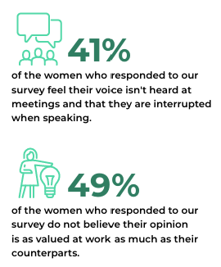
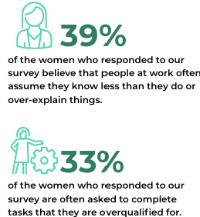
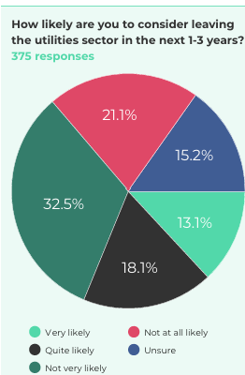
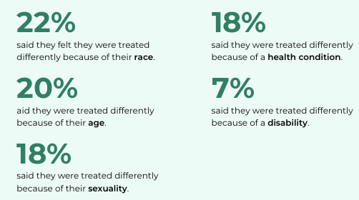

Slide 12
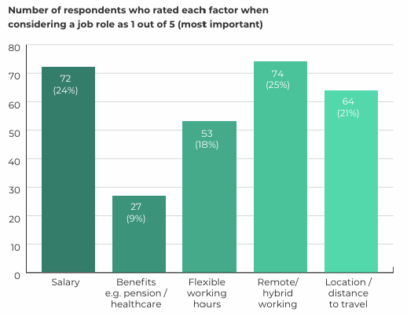
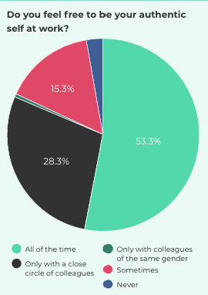
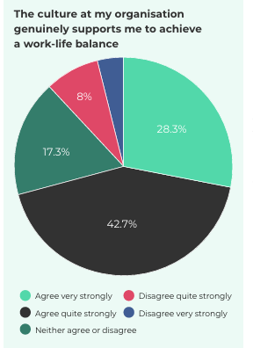
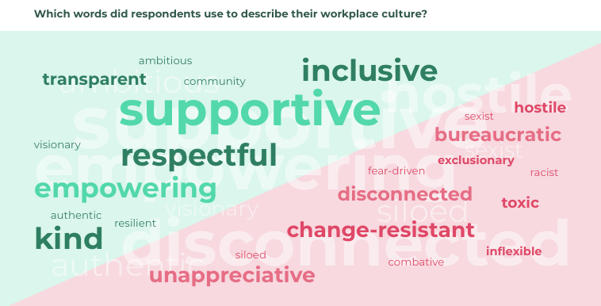
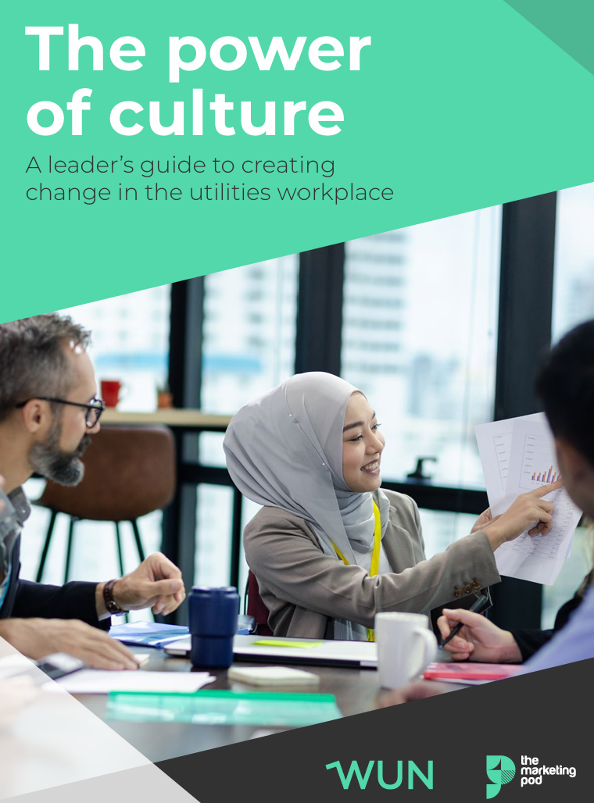

Slide 13
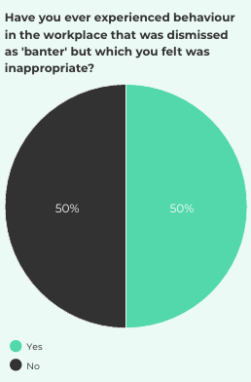
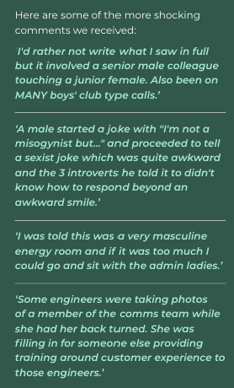
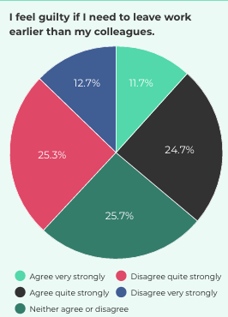
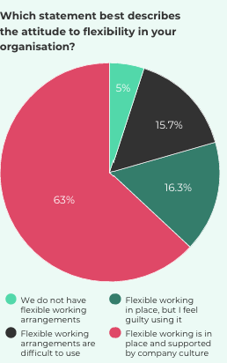

Slide 14
Panellists:
Graham Edwards, Chief Executive Officer at Wales & West Utilities
Jo Robinson, Director of Client Services at Equity Energies
Katie Spackman, Deputy Director of CBI Wales
Stephane Puddy, Talent Partner & Inclusivity Lead at Dwr Cymru Welsh Water

Slide 15
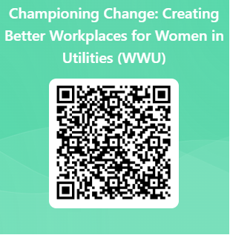
We do value your feedback as they help shape future events

Slide 16
Thank you to our panellists, Wales & West Utilities - our generous hosts - and all WUN’s partners for their ongoing support

Slide 18
Don’t forget to join the Network
to receive the next WUN newsletter
https://thewun.co.uk/join-wun/

Slide 19
Sarah Hopkins, WUN Director, Pathways People Solutions.
Sarah is an experienced senior HR professional with 25 years’ experience, operating at Executive level at Wales & West Utilities for 13 years. She has subsequently set up her own consulting company, Pathways People Solutions, supporting clients to evolve their people and culture strategy, create leadership and management programmes, and deliver senior level coaching.
Sarah has a passion for culture transformation and has launched The Culture Kit to help organisations to create and nurture workplace cultures by blending proven expertise in Human Resources, colleague engagement and brand development.
She has been on the board of WUN since 2023 and has helped to create the bespoke WUN Drive and Thrive development programmes for female line manages and senior leaders.
Sarah has a degree in Business Management, a Masters in HRM and is a Chartered Fellow of the Chartered Institute of Personnel & Development. She is a qualified coach and is a Trustee Director of National Energy Action and Cardiff Rugby Community Foundation.

Slide 20
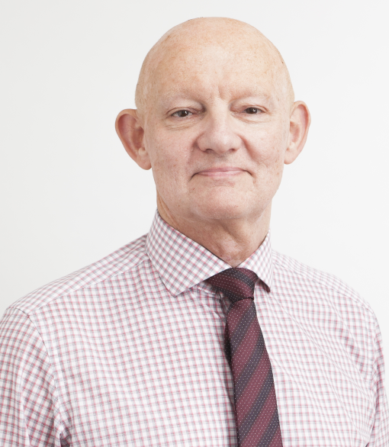
Graham Edwards OBE, Chief Executive, Wales & West Utilities
Graham has been Chief Executive since start-up in 2005, following the acquisition of the Wales & southwest of England gas networks from National Grid. Graham has also run electricity and water businesses in the utility sector prior to setting up WWU in 2005. Before moving into utilities he worked in the manufacturing sector with a number of international companies – most notably in automotive and consumer goods. During his varied career he has held senior posts in a variety of disciplines - including Engineering, Production and Human Resources - prior to his roles as a business leader.
Graham has held a number of non-executive positions, notably with Welsh Water, University of South Wales and Royal College of Music & Drama. He is also a previous Chair of the CBI in Wales.
He has an MBA from Cardiff University, and in 2022 was awarded an OBE for services to business
and the community in Wales.

Slide 21
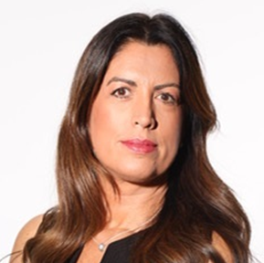
Jo Robinson – Director of Client Services, Equity Energies
Jo excels at empowering high-performing teams to deliver business impact for clients and has extensive experience in client services and energy accounting, with more than sixteen years in the energy industry.
Jo is passionate about client relationships, service delivery and the combination of her finance background, client-centric experience and industry knowledge ensures customers can capitalise on the environmental, commercial, and operational advantages of advancing Net Zero progress. Jo is not only committed to client excellence and optimizing client relationships, but also to fostering a workplace where women in utilities are empowered to thrive. Jo actively drives initiatives that promote diversity, equity, and inclusion, ensuring that the energy sector evolves to embrace diverse leadership and perspectives. Jo is currently a Co-Chair of EmpowHER, a women’s colleague resource group across the Flogas and DCC Group of companies.
Prior to joining Equity Energies, Jo held several positions within industry leading organisations including Inspired PLC, Energy and Carbon Management Limited, Inprova Energy, Wales & West Utilities and Tesco PLC.
As Deputy Director at CBI Wales, Katie drives member engagement and plays a key role in the team's vital work with the Welsh and UK governments. She spearheads the CBI Networks in Wales, including the Women's Leadership, Net Zero, People & Skills, and AI & Innovation groups.
With a Postgraduate Certificate in Strategy, Change & Leadership from the University of Bristol, Katie brings extensive experience from membership organizations, the private sector, and her own business. A dedicated Diversity Ambassador at CBI and a trustee for three decades, she is a passionate advocate for equity, diversity, and inclusion.

Slide 22
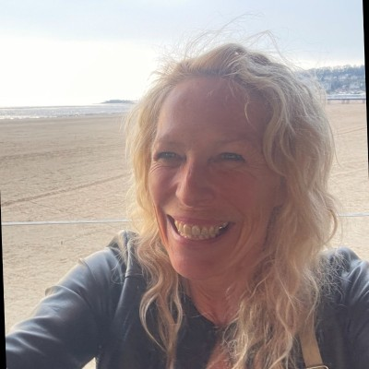
Katie Spackman, Deputy Director of CBI Wales
As Deputy Director at CBI Wales, Katie drives member engagement and plays a key role in the team's vital work with the Welsh and UK governments. She spearheads the CBI Networks in Wales, including the Women's Leadership, Net Zero, People & Skills, and AI & Innovation groups.
With a Postgraduate Certificate in Strategy, Change & Leadership from the University of Bristol, Katie brings extensive experience from membership organizations, the private sector, and her own business. A dedicated Diversity Ambassador at CBI and a trustee for three decades, she is a passionate advocate for equity, diversity, and inclusion.

Slide 23
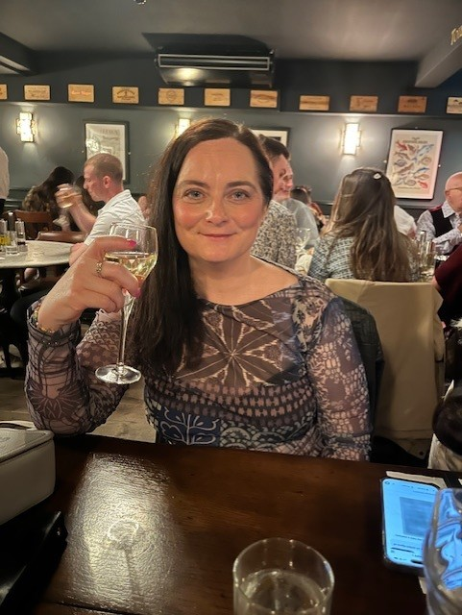
Stephne Puddy, Talent Partner& Inclusivity Lead, Welsh Water
Stephne Puddy is Chartered MCIPD and a dynamic force at Dŵr Cymru Welsh Water, where she has been making waves for 14 years. With over 4,000 employees, she takes on the exciting challenge of leading the leadership programme, driving the equality, diversity, and inclusivity strategy, and overseeing, early careers, career development and onboarding for new colleagues.
Stephne is not just a HR professional; she's a HR Ninja, passionate about helping others succeed in their careers. Her dedication and enthusiasm make her an invaluable asset to Welsh Water with a passion and commitment to fostering a positive and inclusive workplace.

