Slide 1































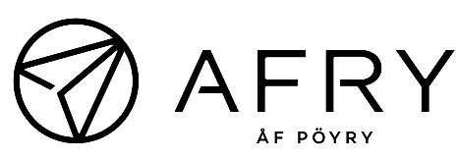


















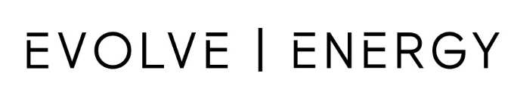














Slide 2
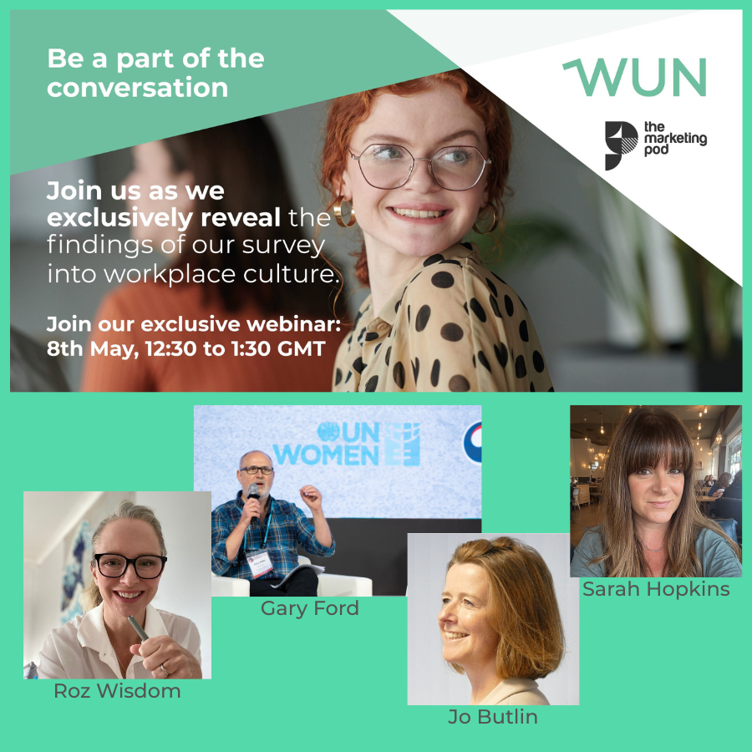


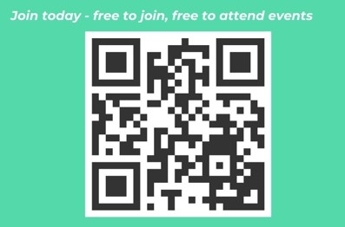
Welcome
we will be starting shortly
The Power of Culture –
creating change in the utilities workplace.

Slide 3
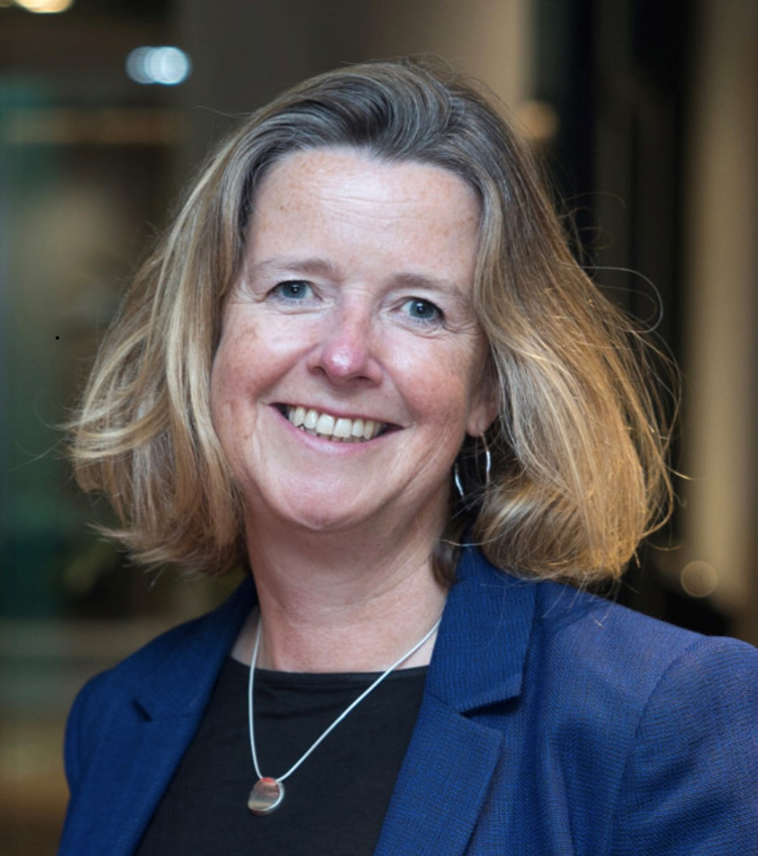
Jo Butlin
WUN Co –Founder & Director.

Slide 5


WUN
The utilities sector is lacking in diversity with many women being generally under-represented, particularly in senior roles.
WUN was started in 2018 when a group of likeminded women, working in utilities, united around a common cause. The founders were not only passionate about the industry they worked in, but also passionate about the contribution women were making and could continue to make in the future. We now have over 9950 members & 70 plus, partners & supporters.
9900+
Followers &
Members
Regular Events & Content
Mentoring Programme & Network
70 +
Partners & Supporters

Slide 6

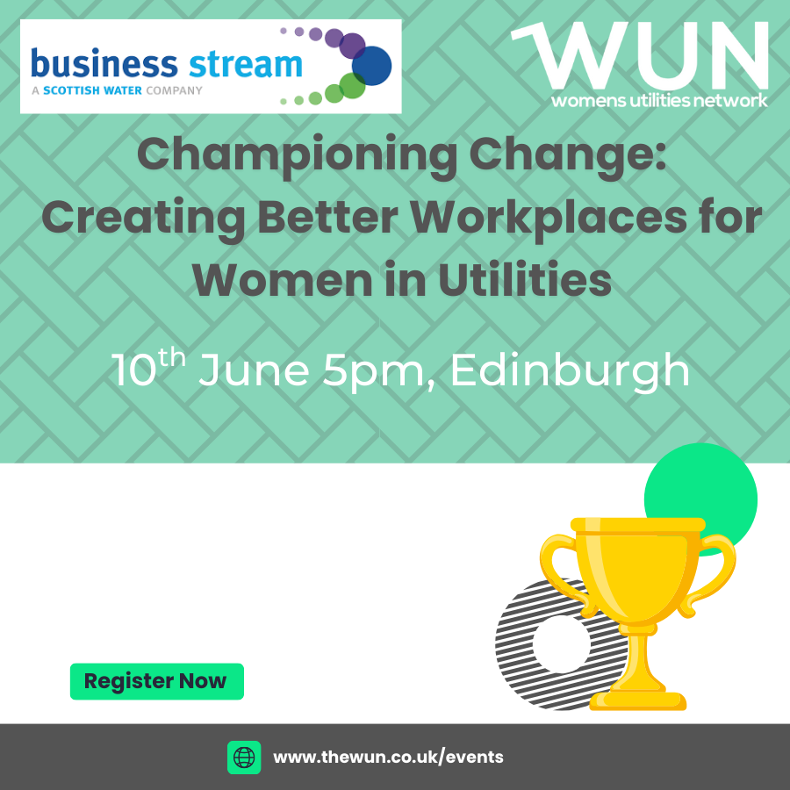
Dates for your diary
WUN Events
Tuesday 3rd June 12:30pm WUN For ALL - The role allies play supporting others in the workplace – How we can practically help others to #SpeakUp.- Virtual event.
Wednesday 4th June Championing Change Creating Better Workplaces for Women in Utilities, Newport time TBC
Tuesday 10th June Championing Change, Creating Better Workplaces for Women in Utilities Edinburgh
Free tickets available - visit our Events page!
WUN on the Road – Find us at:
20th & 21st May-Utility Week Live ,NEC, Birmingham, including #IAR in person workshop.
Wednesday 11th and Thursday 12th June - Future of Utilities Summit London
Tuesday 1st July - Energy Live Consultancy Conference, London
Tuesday 15th July –The Energy UK EDI Conference, London
https://thewun.co.uk/

Slide 7
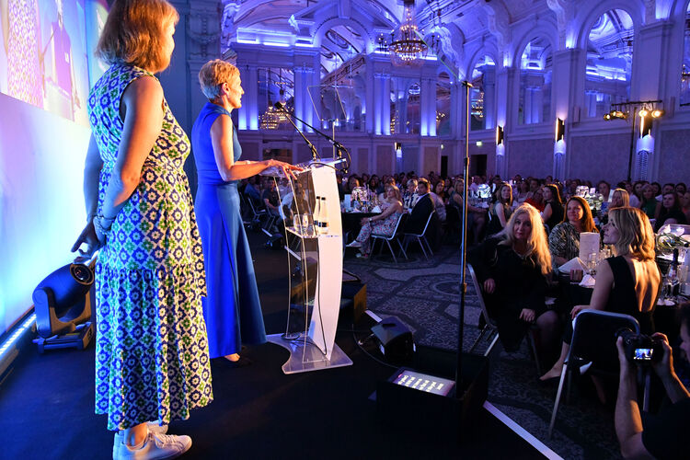
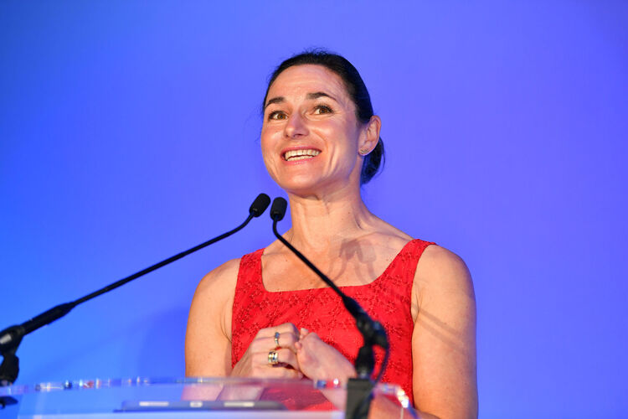
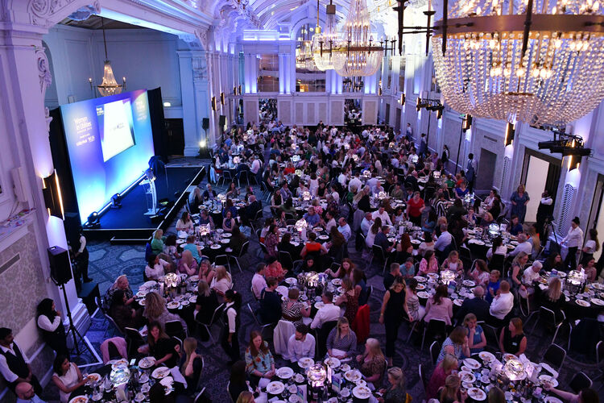

27th June 2025 - Lunchtime
Women in Utilities Awards 2025 – Ceremony tickets now available.
More categories. More recognition. Women leading the way
This is your chance to shine, or to champion someone whose impact deserves the spotlight.
Here’s where you, your team, or your initiatives could be recognised:
🔥 Women’s Network of the Year (company)
🤝 Allyship Award
🌍 EDI Initiative of the Year
🏡 Community Outreach Award
🎓 Mentor of the Year
🦺 Hi Vis Award
🔧 Onsite Excellence
📈Business Champion
🔹 Apprentice of the Year
🎓 Graduate of the Year
✨ Rising Star
⭐ Returning Star
🏢 Best Employer for Women (< 500 employees)
🏢 Best Employer for Women (>500 employees
Visit our Events page!
https://thewun.co.uk/

Slide 8
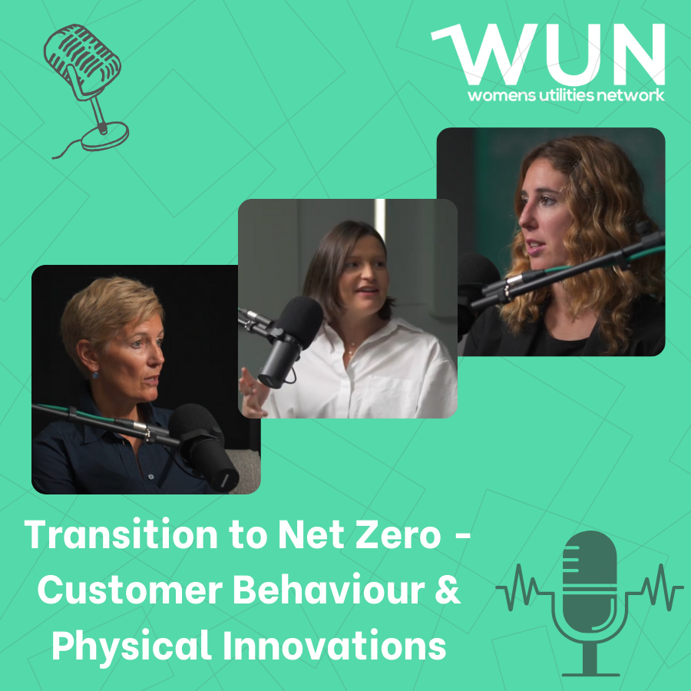
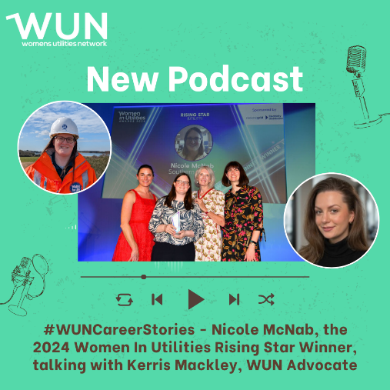


WUN Podcasts
Listen to our latest podcasts More coming soon !
How do we overcome the barriers to achieving net zero? - In this video podcast we explore the transition to net zero and explore customer behaviour and physical innovations.
WUN Advocate Kerris Mackley chats with WUN partners:
Hayley Monks, WUN Co-Founder & Director and Managing Director ECHO.
Rebecca Teasdale - Director, Baringa.
Natasha Ackroyd - Head of Proposition (Electrification of Heat),EON.
WUN Advocate Kerris Mackley chats with Nicole McNab, the 2024 Women in Utilities Rising Start Winner, discussing the importance of owning your own career – stop waiting for other people to do it for you.
Also discussed in this episode is the need to be authentic, that it is ok to have ups and downs, and that the key to successful recruiting is finding people that care!
You can follow our podcast on Apple Podcasts, Spotify, Amazon Music and wherever else you get your podcasts – just search “WUN4ALL”.
Or just click through from the website: https://thewun.co.uk/news-blogs/

Slide 9
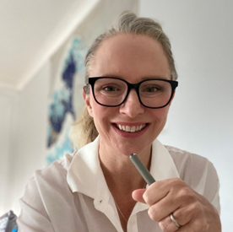
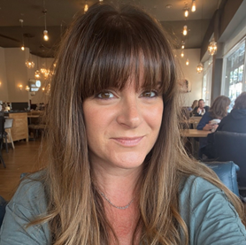
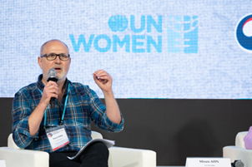
Chair: Jo Butlin, WUN Co Founder & Director
Panellists:
Gary Ford, Co-Founder Men for Inclusion.
Roz Wisdom, Head of Client Services, The Marketing Pod.
Sarah Hopkins, WUN Director, Pathways People Solutions.

Slide 10
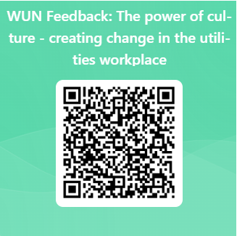
We do value your feedback as they help shape future events

Slide 11
Thank you to our panellist , the Marketing Pod , & all WUN’s partners for their ongoing support.

Slide 13

Don’t forget to join the Network
to receive the next WUN newsletter
https://thewun.co.uk/join-wun/

Slide 14
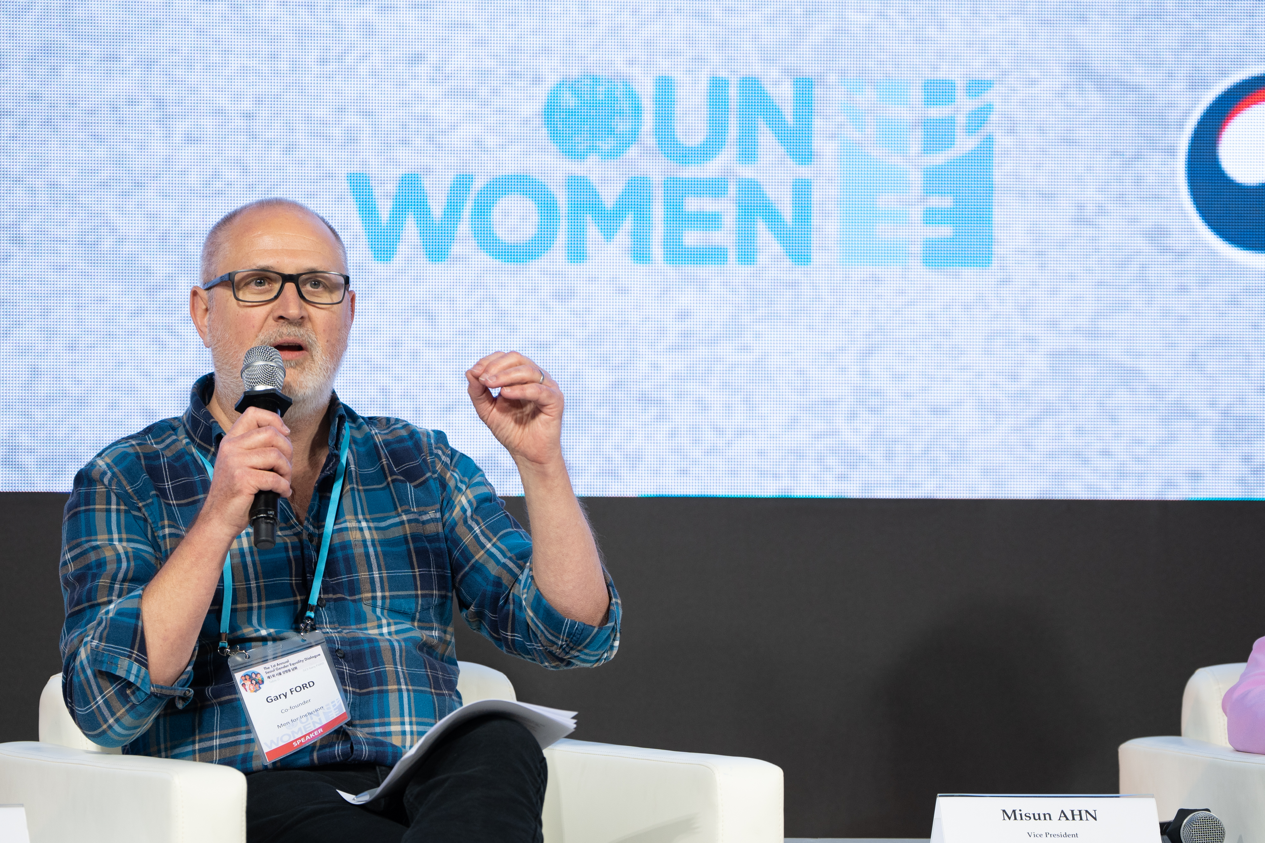
Gary Ford, Co-Founder Men for Inclusion.
Gary Ford is a transformational IT and Diversity & Inclusion leader. As a former Managing Director within Global Technology at JPMorgan, he co-founded their male allies programme for women in technology.His Amazon best-selling book “The Accidental Sexist: A handbook for men on workplace diversity and inclusion” tells the story of how to change the culture in a traditional male-centric sector and how we can all build inclusive work practices.
Alongside Mark Freed, he is the co-founder of Men for Inclusion, an organisation that works with companies across multiple sectors to help them engage men in diversity and inclusion efforts and create an all-gender narrative to deliver an inclusive culture that leads to real improvements in business performanceHe has presented at multiple diversity conferences, as well as appearing on BBC Radio 4’s Woman’s Hour to talk about allyship. He recently presented at the UN Women’s conference on Gender Equality in Seoul.
Gary lives with his wife, Julie in Fulham in London. They have 2 children, Isabella who is a Public Relations Associate for Strand Partners, and Lily, who is the UK correspondent of the Hollywood Reporter.

Slide 15

Roz Wisdom, Head of Client Services,
  The Marketing Pod.
With over 20 years' experience working in both supplier-side and agency roles, Roz Wisdom brings a unique perspective on the utilities sector's challenges and opportunities.
Currently Head of the Client Services Team at The Marketing Pod, a female-led agency, Roz leads a team dedicated to delivering exceptional client experiences. Her team works with major industry players, including some of the "Big Six" suppliers, as well as new market entrants and utility infrastructure companies.
Roz is committed to innovation, adaptability, and customer-centric solutions, helping clients navigate evolving regulations, technology, and customer expectations. She is passionate about fostering talent
and driving inclusivity, aiming to create a more diverse and dynamic utilities industry.

Slide 16

Sarah Hopkins, WUN Director, Pathways People Solutions.
Sarah is an experienced senior HR professional with 25 years’ experience, operating at Executive level at Wales & West Utilities for 13 years. She has subsequently set up her own consulting company, Pathways People Solutions, supporting clients to evolve their people and culture strategy, create leadership and management programmes, and deliver senior level coaching.
Sarah has a passion for culture transformation and has launched The Culture Kit to help organisations to create and nurture workplace cultures by blending proven expertise in Human Resources, colleague engagement and brand development.
She has been on the board of WUN since 2023 and has helped to create the bespoke WUN Drive and Thrive development programmes for female line manages and senior leaders.
Sarah has a degree in Business Management, a Masters in HRM and is a Chartered Fellow of the Chartered Institute of Personnel & Development. She is a qualified coach and is a Trustee Director of National Energy Action and Cardiff Rugby Community Foundation.

Slide 17
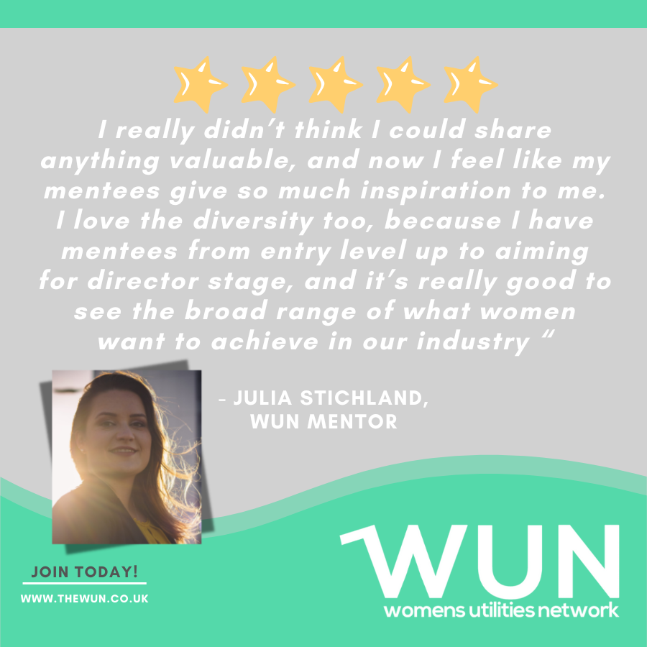
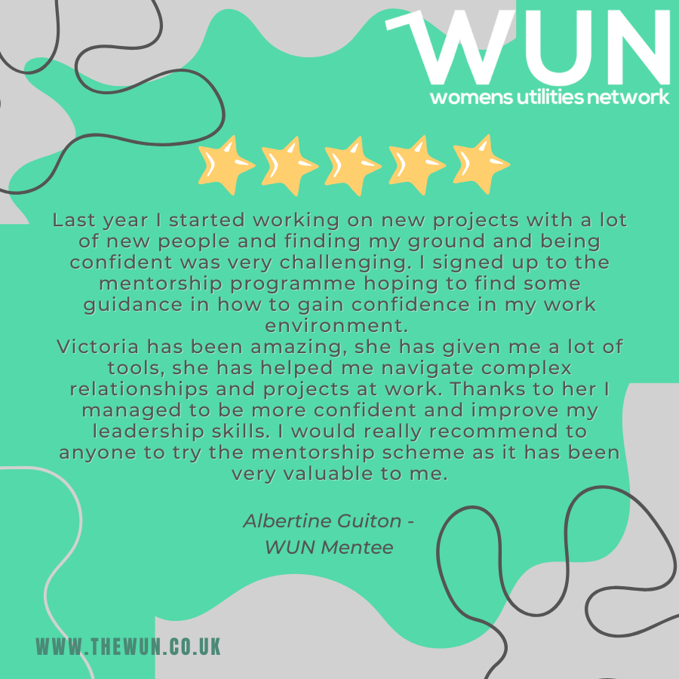
Join the free WUN Mentoring Programme
WUN offers mentoring to women at any stage of their career in the utilities sectors.
We are hugely privileged to have over 130+ fantastic experienced mentors within the WUN mentoring Programme.
With growing numbers of Mentors and Mentees we are delighted with the community and support fostered within the mentoring programme.
If you are interested in becoming a Mentor or Mentee,
please visit our website: https://wun.onpld.com

Slide 18
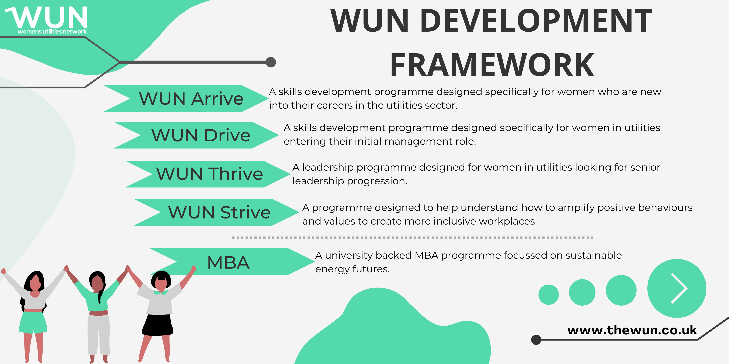
The Womens Utilities Network – Development Framework
A suite of targeted and bespoke development journeys designed to empower women working in utilities
WUN programmes have been designed by women in the sector, specifically for women in the sector
A safe space to really discuss challenges honestly and create solutions together
Building a supportive network of peers across the sector
Sector relevant with insight and examples that are rooted in the reality for women in utilities
Third cohort WUN Drive– bookings open for Sept 25. A skills development programme for women seeking or in initial management roles. Available to sign up on the WUN website now.
WUN Thrive. A development programme for women already in or seeking senior leadership roles. Sign up for Cohort 2 -Q4 2025 & Q1 2026.

