Slide 1
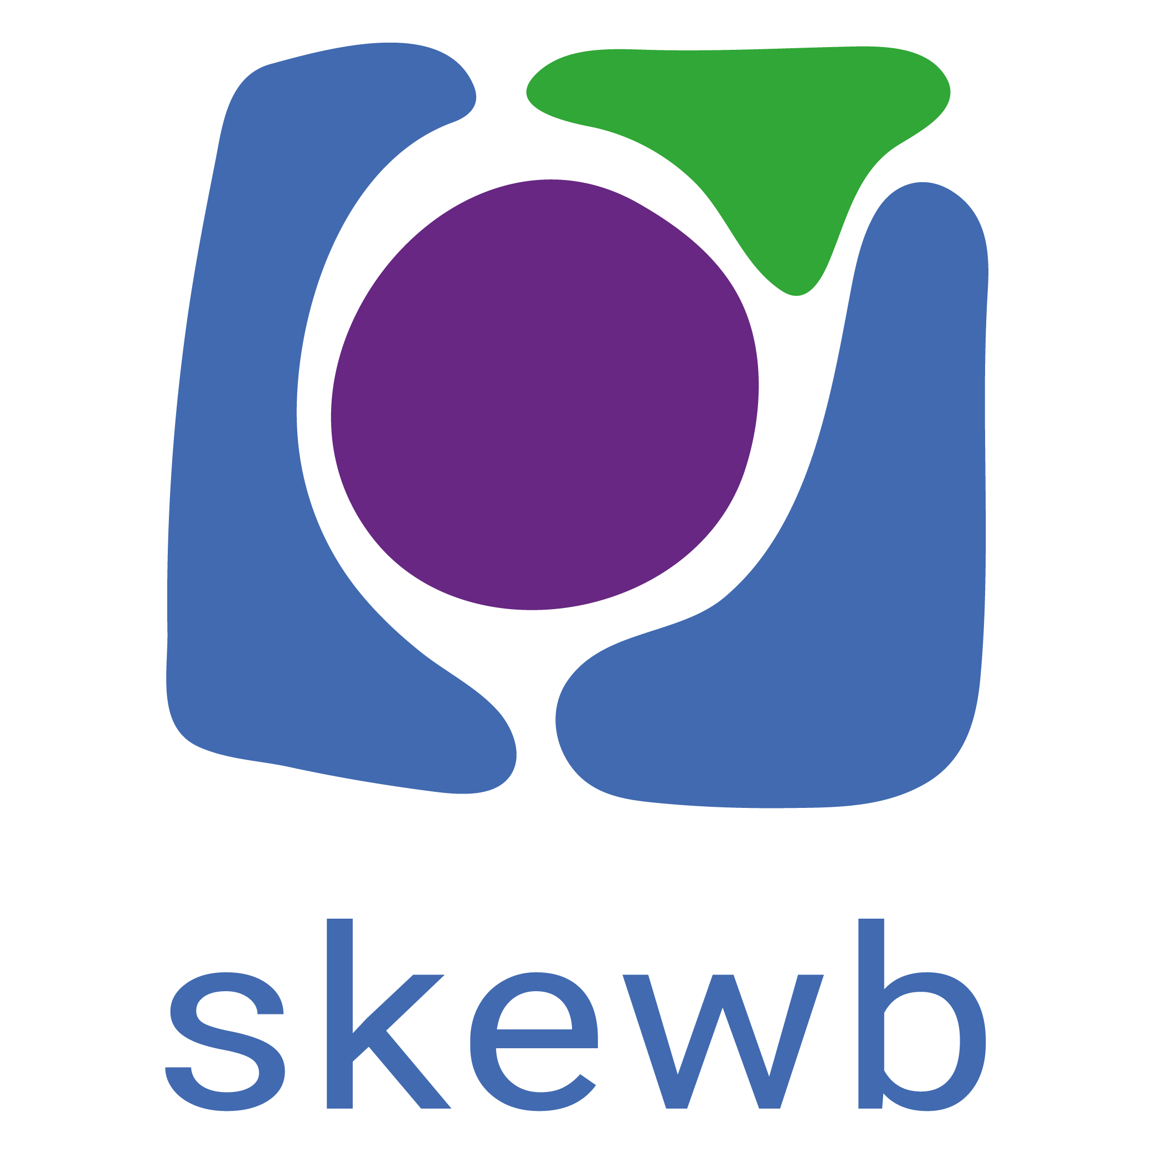

Slide 2
Welcome
we will be starting shortly
Women Shaping the Future of Energy

Slide 3
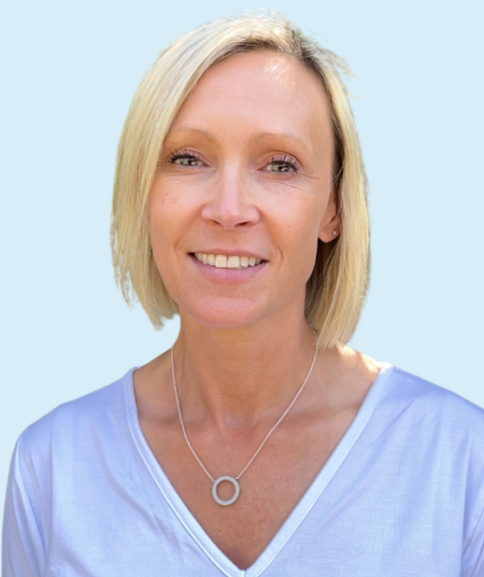
Louise Wapshare
WUN Director & CEO SmartestEnergy Business

Slide 4
WUN
The utilities sector is lacking in diversity with many women being generally under-represented, particularly in senior roles.
WUN was started in 2018 when a group of likeminded women, working in utilities, united around a common cause. The founders were not only passionate about the industry they worked in, but also passionate about the contribution women were making and could continue to make in the future. We now have over 8500 members & 70 plus, partners & supporters.
8500+
Followers &
Members
Regular Events & Content
Mentoring Programme & Network
70 +
Partners & Supporters

Slide 6
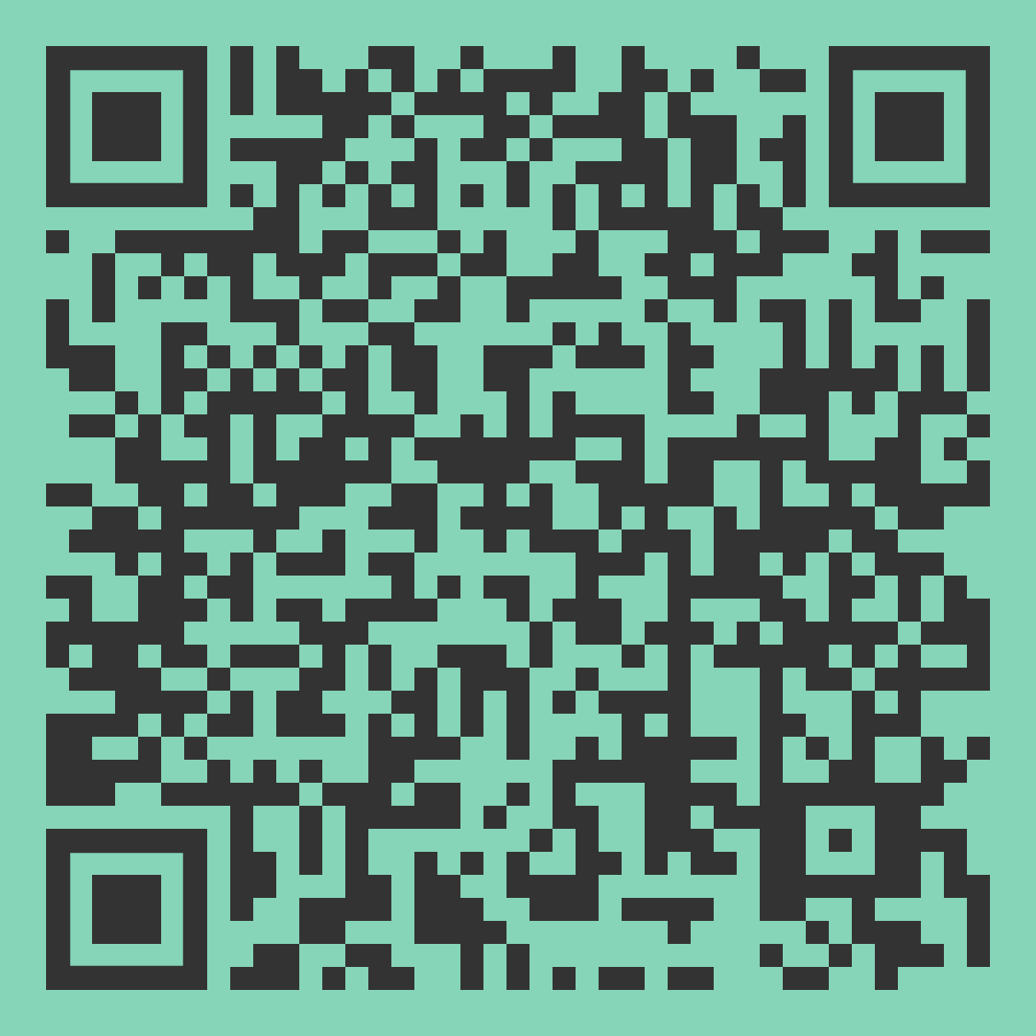
WUN Annual Survey
The Power of Culture in Shaping the Utilities Workplace
Please do take the time to complete & share with your wider network & colleagues – we want to capture your thoughts & opinions
https://thewun.co.uk

Slide 7
Dates for your diary
WUN Events
#IAmRemarkable workshops: Virtual Event – April & May full – September, October & November available.
Tuesday 18th March 17:30 – WUN /Strathclyde University MBA webinar
Further events for 2025 will be announced periodically
Free tickets available - visit our Events page!
WUN on the Road – Find us at:
Wednesday 26th March - MEUC Buying and Using Utilities London
Tuesday 20th and Wednesday 21st May - Utility Week Live ,NEC, Birmingham.
Wednesday 11th and Thursday 12th June - Future of Utilities Summit London
Wednesday 2nd July - Energy Live Consultancy Conference London
https://thewun.co.uk/

Slide 8
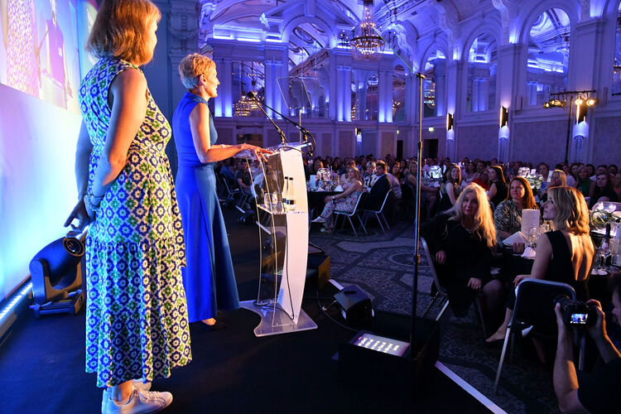
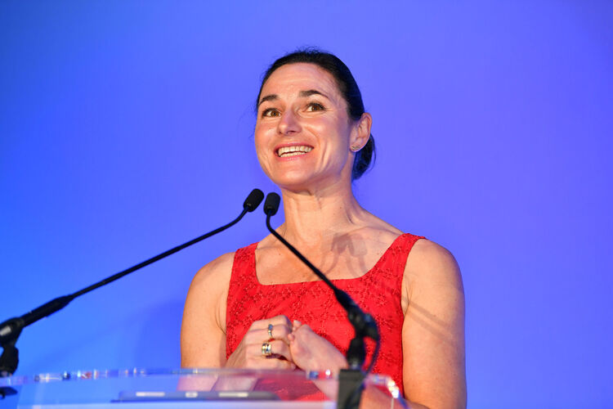
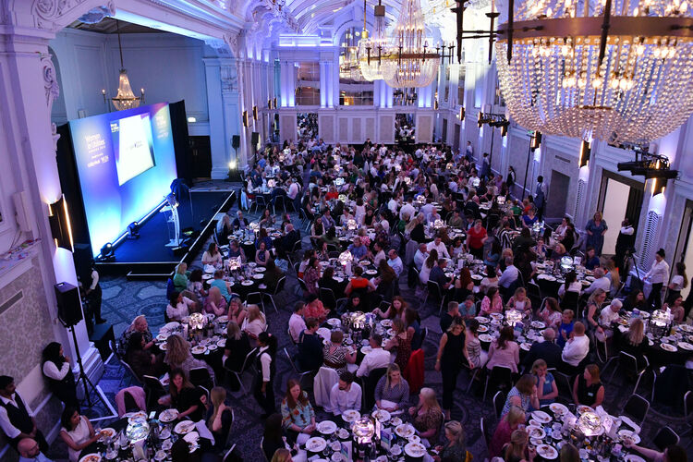
27th June 2025 - Lunchtime
Women in Utilities Awards 2025 – Nominations open until 14th March 25
More categories. More recognition. Women leading the way This is your chance to shine, or to champion someone whose impact deserves the spotlight. Here’s where you, your team, or your initiatives could be recognised: 🔥 Women’s Network of the Year (company) 🤝 Allyship Award 🌍 EDI Initiative of the Year 🏡 Community Outreach Award 🎓 Mentor of the Year 🦺 Hi Vis Award
🔧 Onsite Excellence
📈Business Champion 🔹 Apprentice of the Year 🎓 Graduate of the Year ✨ Rising Star ⭐ Returning Star 🏢 Best Employer for Women (< 500 employees) 🏢 Best Employer for Women (>500 employees
Visit our Events page!
https://thewun.co.uk/

Slide 9
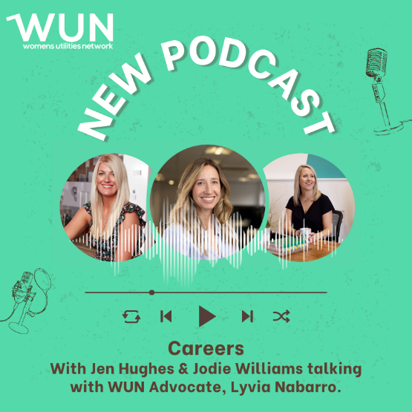
WUN Podcasts
Listen to our latest podcasts More coming soon !
Accelerate Action for Gender Equality in Utilities - International Women’s Day, WUN is launching a special video podcast exploring how we can accelerate action and foster inclusive environments, to achieve gender equality in the utilities sector.
At the current rate of progress, full gender parity won’t be reached until 2158—five generations from now. We can’t afford to wait.
WUN Co Founders Jo Butlin & Hayley Monks are joined by WUN advocates Kerris Mackley & Gill Edwards
#WUNCareerStories - WUN Advocate, Lyvia Nabarro, is joined by seasoned marketing professionals Jen Hughes and Jodie Williams.
Jen and Jodie set up their multi-award-winning marketing agency, The Marketing Pod, 11 years ago. In this podcast we explore what it’s like to take the leap and start your own business, the lessons they learnt from the utilities sector and the difference they wanted to make for their teams and the positive changes they want to see in the industry.
You can follow our podcast on Apple Podcasts, Spotify, Amazon Music and wherever else you get your podcasts – just search “WUN4ALL”.
Or just click through from the website: https://thewun.co.uk/news-blogs/

Slide 10
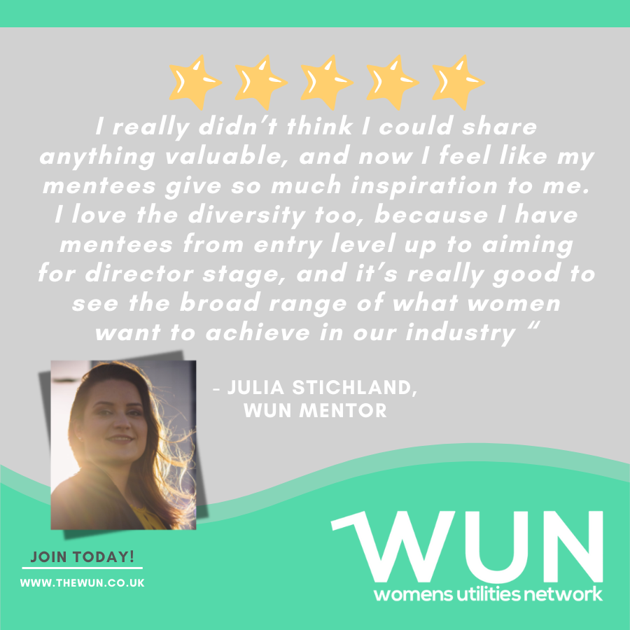
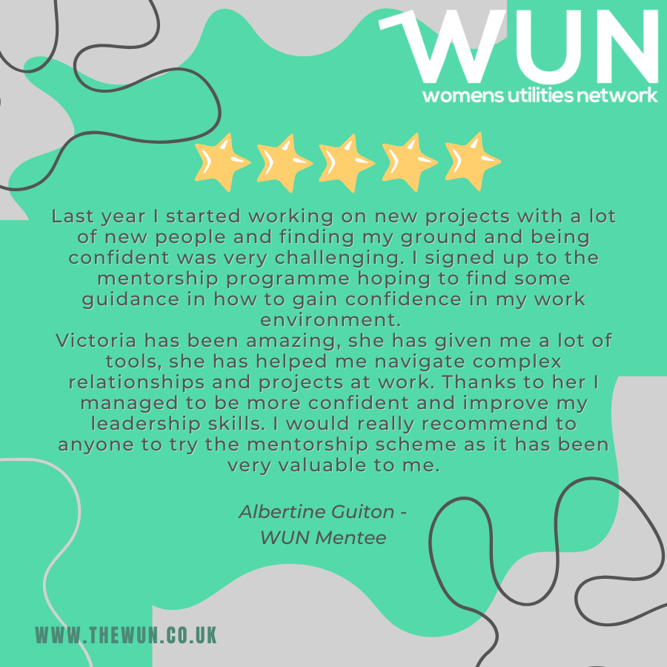
Join the free WUN Mentoring Programme
WUN offers mentoring to women at any stage of their career in the utilities sectors.
We are hugely privileged to have over 130+ fantastic experienced mentors within the WUN mentoring Programme.
With growing numbers of Mentors and Mentees we are delighted with the community and support fostered within the mentoring programme.
If you are interested in becoming a Mentor or Mentee,
please visit our website: https://wun.onpld.com

Slide 11
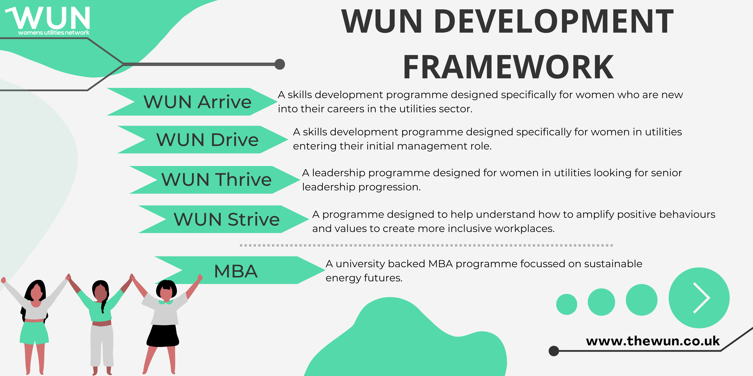
The Womens Utilities Network – Development Framework
A suite of targeted and bespoke development journeys designed to empower women working in utilities
WUN programmes have been designed by women in the sector, specifically for women in the sector
A safe space to really discuss challenges honestly and create solutions together
Building a supportive network of peers across the sector
Sector relevant with insight and examples that are rooted in the reality for women in utilities
Second WUN Drive cohort starting in March 25 now full – bookings open for Sept 25.
A skills development programme for women seeking or in initial management roles. Available to sign up on the WUN website now.
WUN Thrive few final places remaining –starting March 25. A development programme for women already in or seeing senior leadership roles.

Slide 12
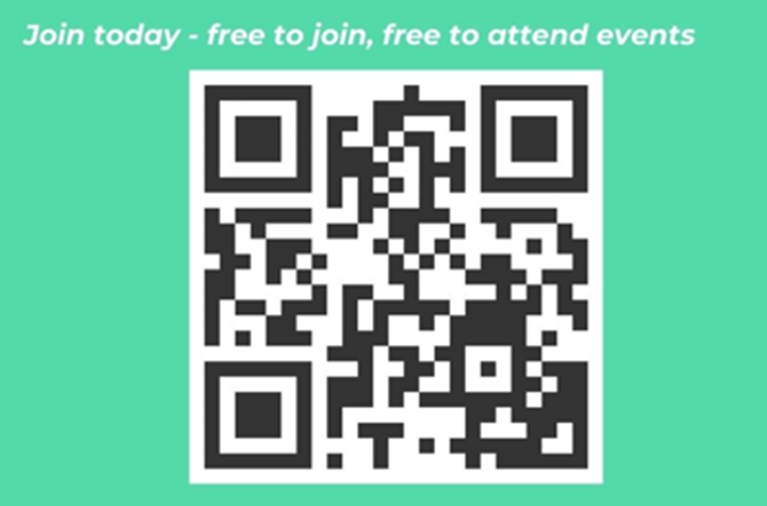
Don’t forget to join the Network
to receive the next WUN newsletter
https://thewun.co.uk/join-wun/

Slide 13
Chair: Louise Wapshare, WUN Director and CEO of Smartest Energy Business
Panellists:
Selina Paxton, Market Specialist, EDF
Della Newton, Originator, Engie
Kat Mucha, Trading Analyst, SmartestEnergy
Sabrina Sabella, Senior Spot Trader, SmartestEnergy

Slide 14
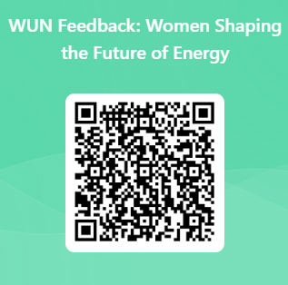
We do value your feedback as they help shape future events

Slide 15
Thank you to our generous hosts, SmartestEnergy, & all WUN’s partners for their ongoing support

Slide 17
About SmartestEnergy
SmartestEnergy is a people-powered energy company on a mission to empower a greener generation.
We work with C&I customers, small to medium businesses, generators, brokers and trading counterparties across our four global businesses to drive the net zero transition in the UK, US and Australia.
In the UK…
Award-winning Commercial & Industrial Division, supplying 33,000+ MPANs with a 10.8TWh annual volume.
Business Division supplying SME businesses with electricity and gas to 64,000+ MPxNs.
Generation aggregator providing over 300 independent generators with a competitive route to market, with 6.8TWh flow per annum.
Notes:
SmartestEnergy is a people-powered energy company built on strong relationships and two decades of trading expertise.
We’re the UK’s leading purchaser of independently generated renewable electricity and a licensed energy supplier. This gives us valuable experience in providing commercial agreements across many different sectors.

Slide 18
Women Shaping the Future of Energy
In celebration of International Women’s Day 2025

Slide 19
WUN Annual Survey
The Power of Culture in Shaping the Utilities Workplace
Please do take the time to complete & share with your wider network & colleagues – we want to capture your thoughts & opinions
https://thewun.co.uk

