Slide 1
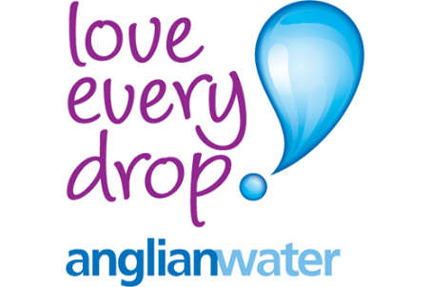
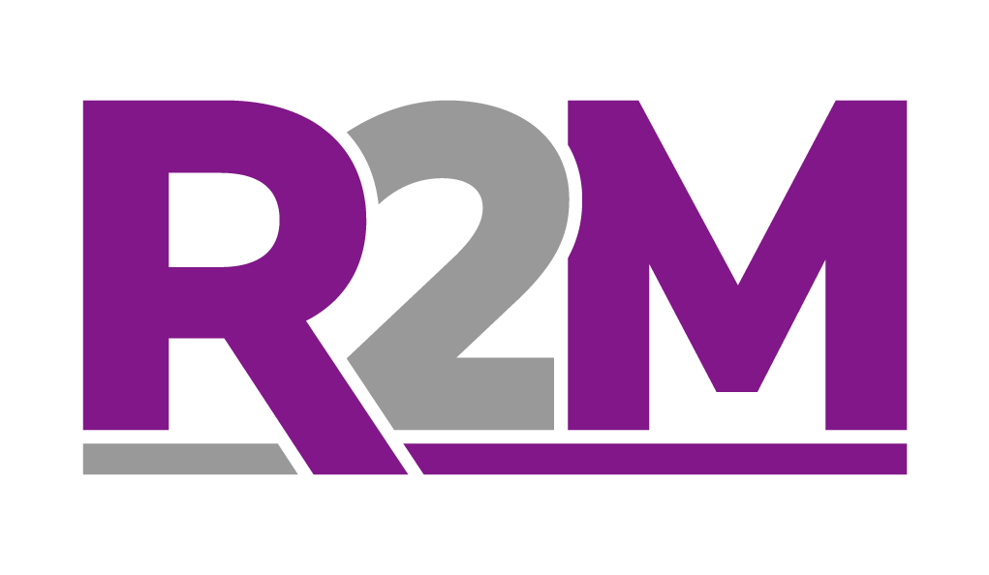
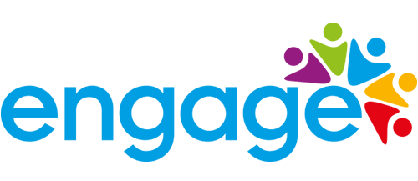
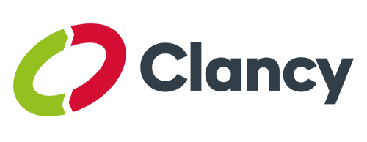
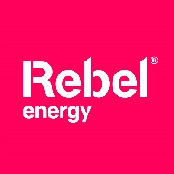
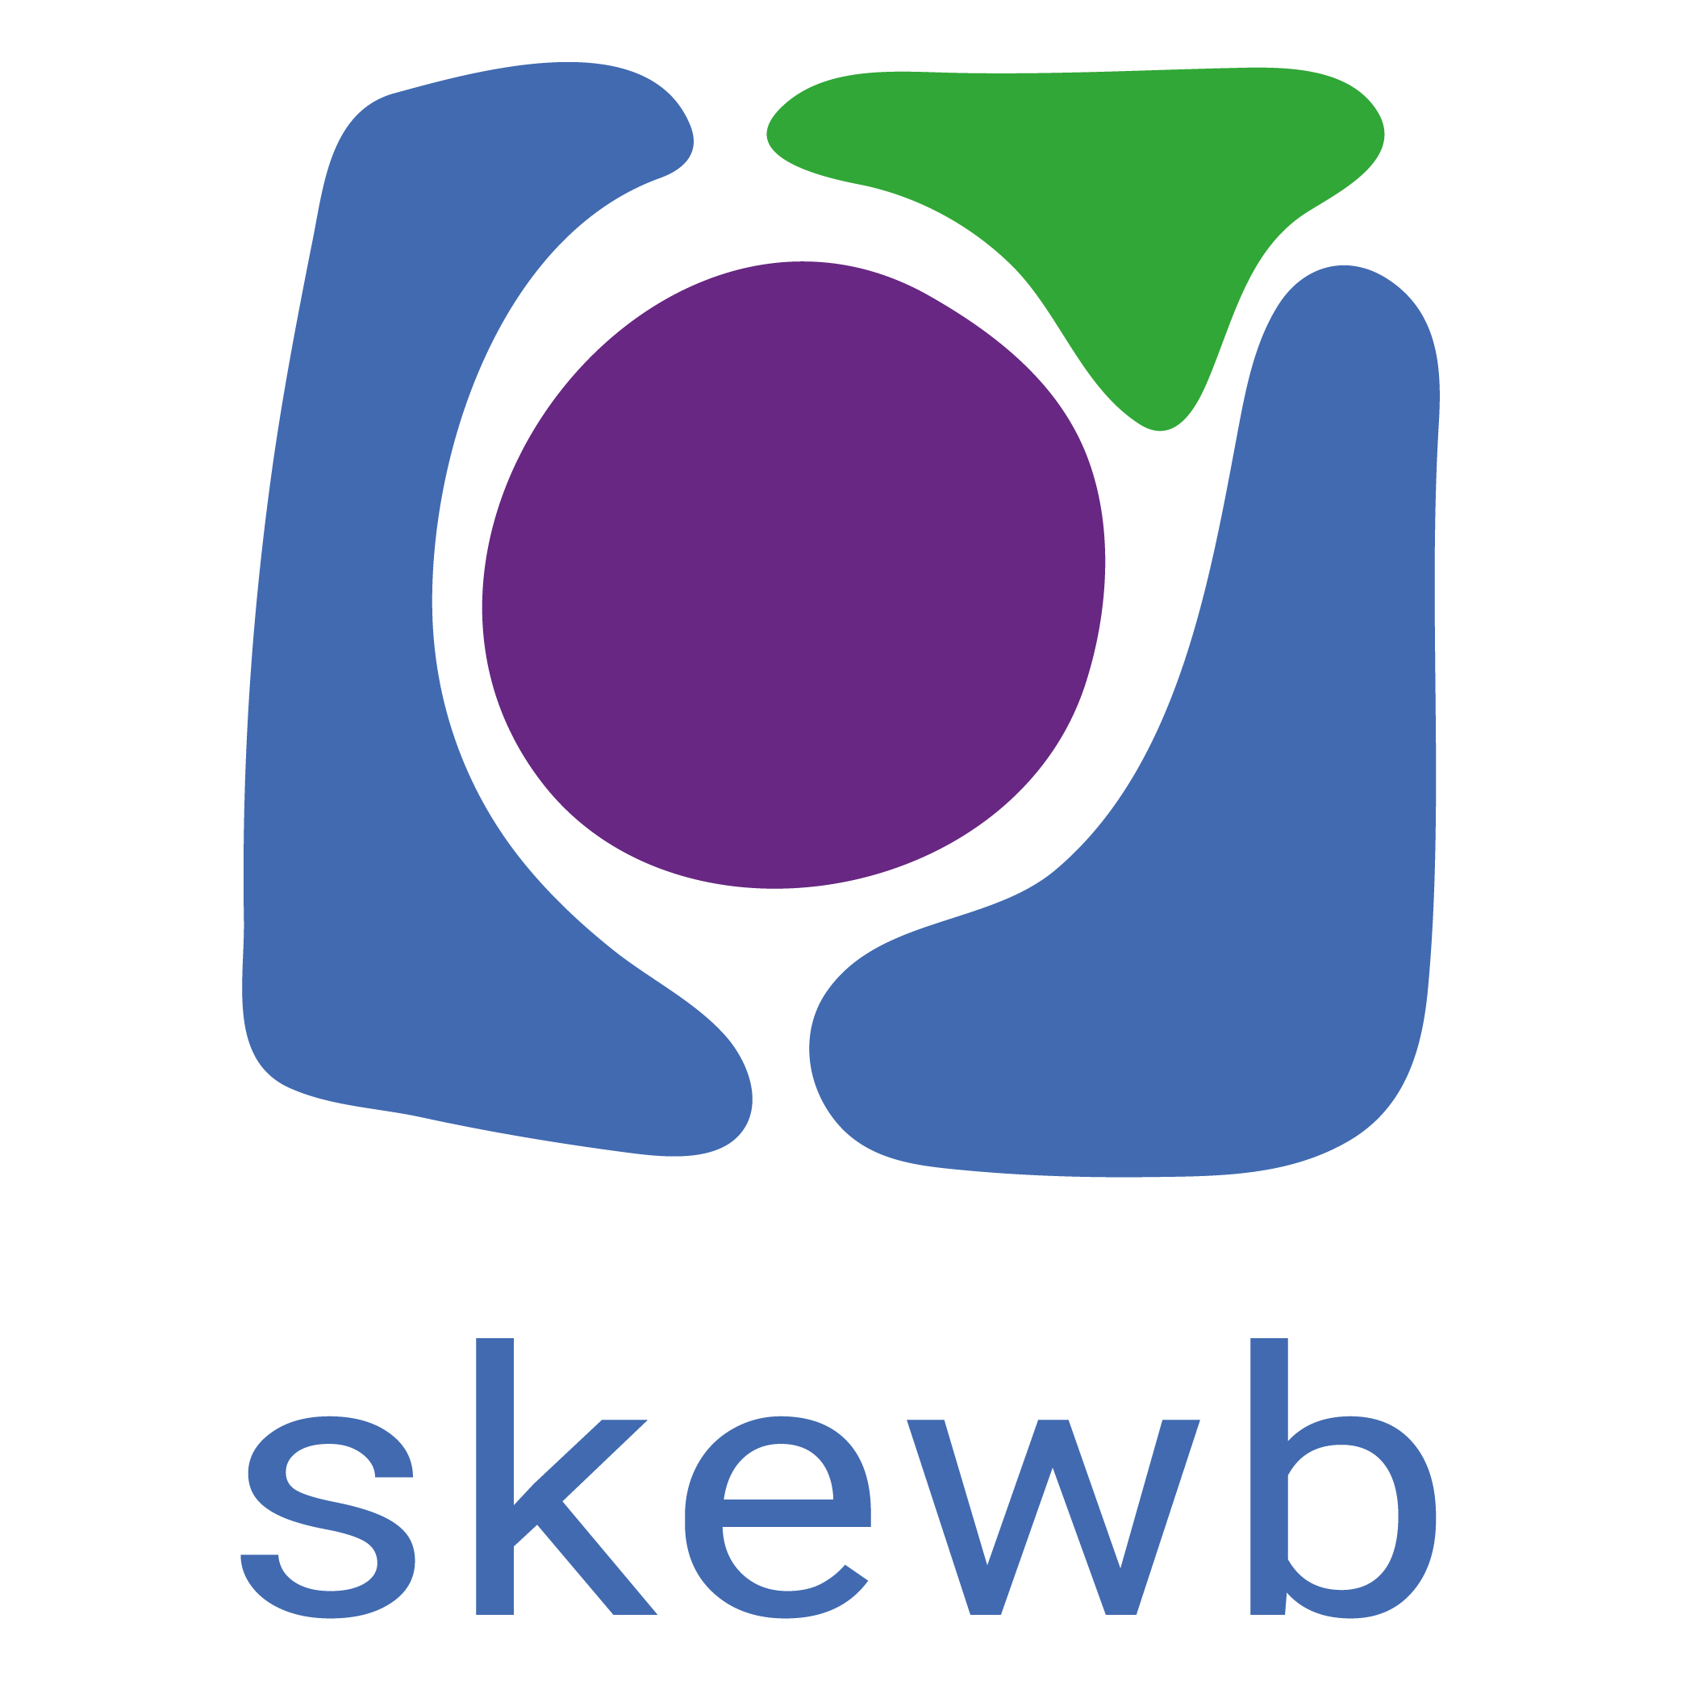
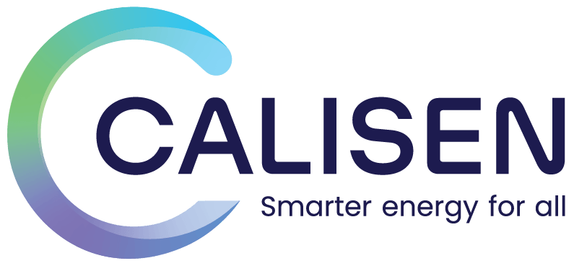
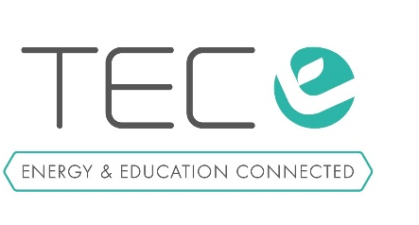
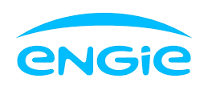

Slide 2
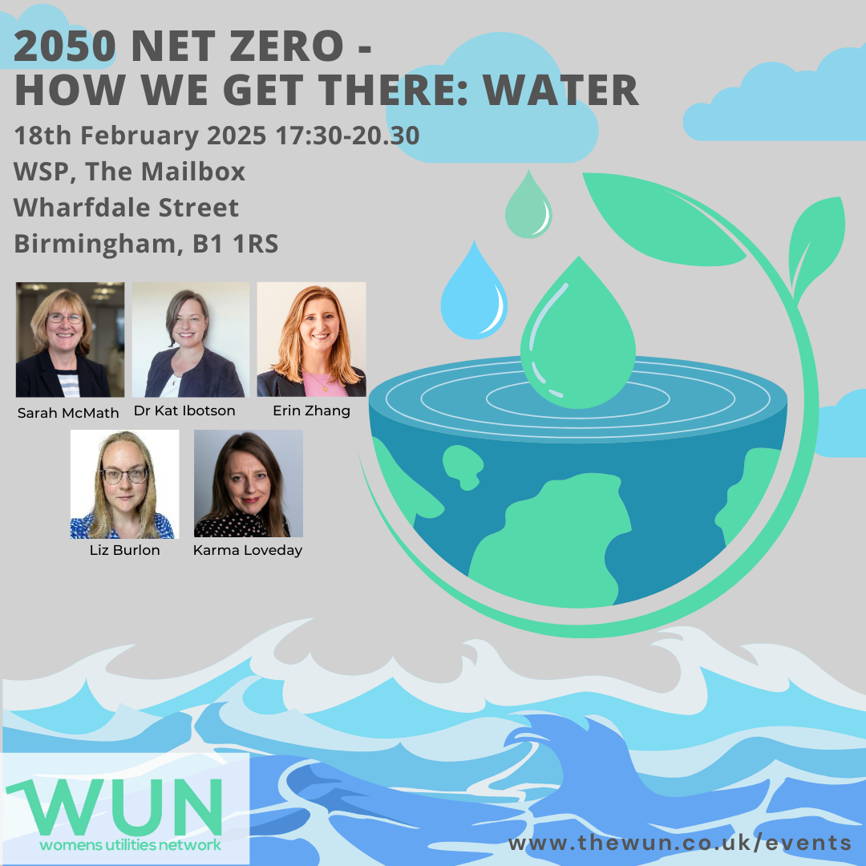
Welcome
we will be starting shortly
2050 Net Zero – How we get there: Water

Slide 3
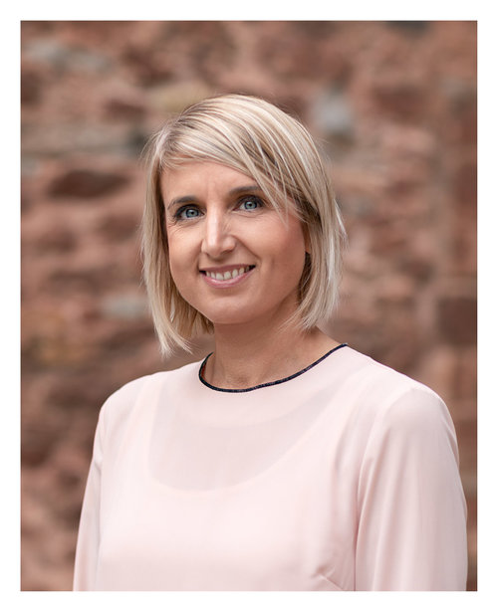
Karen Anderson
WUN Development Manager

Slide 4
WUN
The utilities sector is lacking in diversity with many women being generally under-represented, particularly in senior roles.
WUN was started in 2018 when a group of likeminded women, working in utilities, united around a common cause. The founders were not only passionate about the industry they worked in, but also passionate about the contribution women were making and could continue to make in the future. We now have over 8250 members & 70 plus, partners & supporters.
8250+
Followers &
Members
Regular Events & Content
Mentoring Programme & Network
70 +
Partners & Supporters

Slide 6
Dates for your diary
WUN Events
6th March 2025 6:00 – 9:00pm – Women Shaping the Future of Energy - London
14th March 2025 11.30 – 1.00pm - #IAmRemarkable workshop – Virtual Event
10th April 2025 12.30 – 2.00pm - #IAmRemarkable workshop – Virtual Event
6th May 2025 11.00 – 12.30pm - #IAmRemarkable workshop – Virtual Event
9th September 2025 12:00-1:30pm - #IAmRemarkable workshop – Virtual Event
9th October 2025 12.30 – 2.00pm - #IAmRemarkable workshop – Virtual Event
Further events for 2025 will be announced periodically.
Free tickets available - visit our Events page!
27th June 2025 - Lunchtime
Women in Utilities Awards 2025 – Nominations now open
https://thewun.co.uk/

Slide 7
WUN Annual Survey
The Power of Culture in Shaping the Utilities Workplace
Please do take the time to complete & share with your wider network & colleagues – we want to capture your thoughts & opinions
https://thewun.co.uk

Slide 8
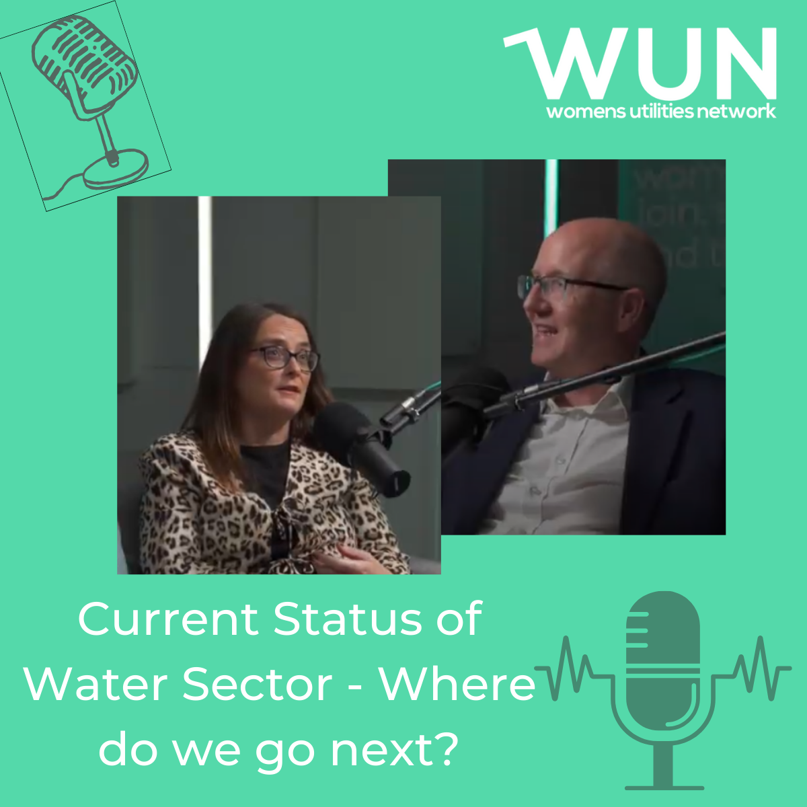
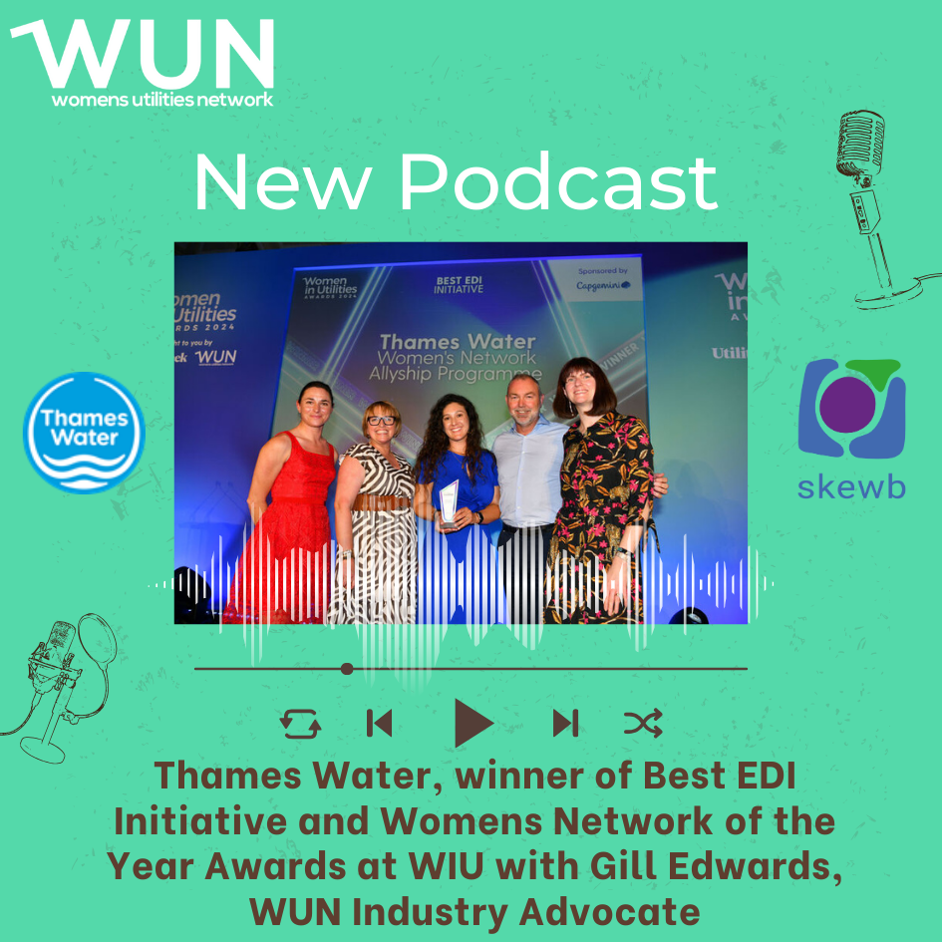
WUN Podcasts
Listen to our latest podcasts More coming soon !
💧 Where next for the water industry? 💧
With growing challenges around sustainability, resilience, and achieving net zero, the future of the water industry has never been more important.
In our latest WUN video podcast, we dive into these issues with industry leaders Sarah McMath , WUN Board Director and CEO at MOSL, Stephne Puddy, Talent Partner and Inclusivity Lead at Welsh Water and Robin Price, Director of Quality and Environment at Anglian Water.
Watch as they share their insights on what’s next for the sector and what we need to do to drive progress.
Join WUN Water Industry Advocate Gill Edwards as she discusses the amazing achievement of Thames Water, winning two awards at the Women in Utilities Awards 2024 – Women’s Network of the Year and Best EDI Initiative .
In this episode, Gill chats with Dina Gillespie, Catchment Manager, and Emma Philogene, Engineering Manager at Thames Water, diving into their award-winning initiatives and the impact they are making in the industry.
You can follow our podcast on Apple Podcasts, Spotify, Amazon Music and wherever else you get your podcasts – just search “WUN4ALL”.
Or just click through from the website: https://thewun.co.uk/news-blogs/

Slide 9
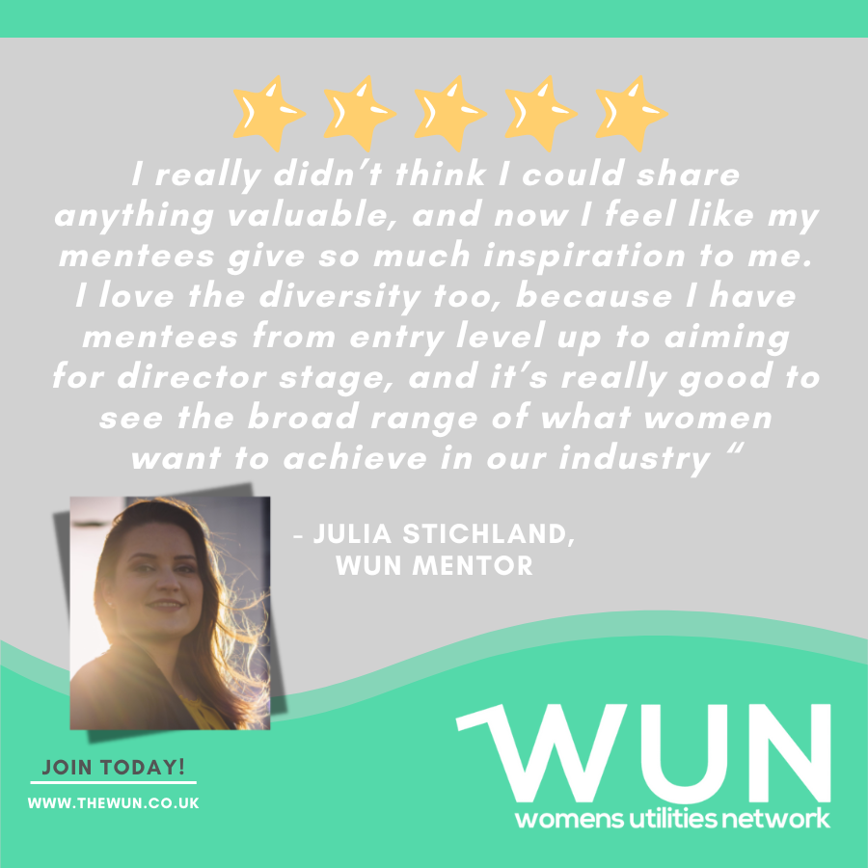
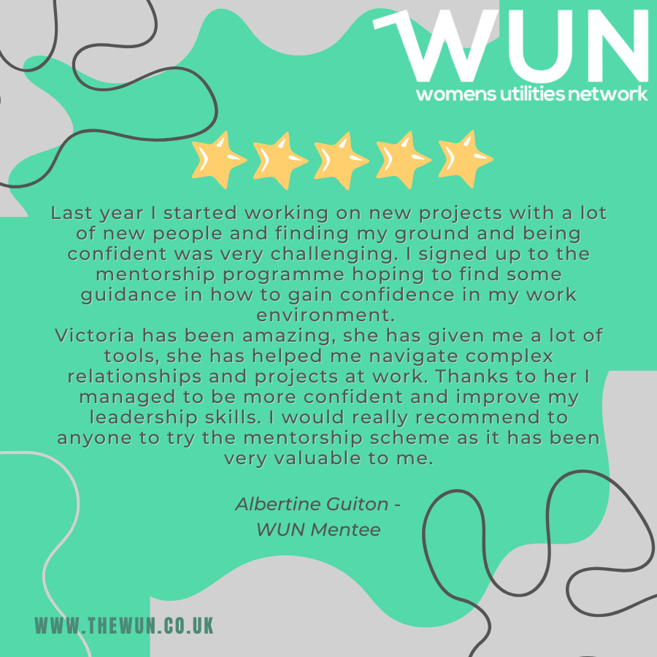
Join the free WUN Mentoring Programme
WUN offers mentoring to women at any stage of their career in the utilities sectors.
We are hugely privileged to have over 130+ fantastic experienced mentors within the WUN mentoring Programme.
With growing numbers of Mentors and Mentees we are delighted with the community and support fostered within the mentoring programme.
If you are interested in becoming a Mentor or Mentee,
please visit our website: https://wun.onpld.com

Slide 10
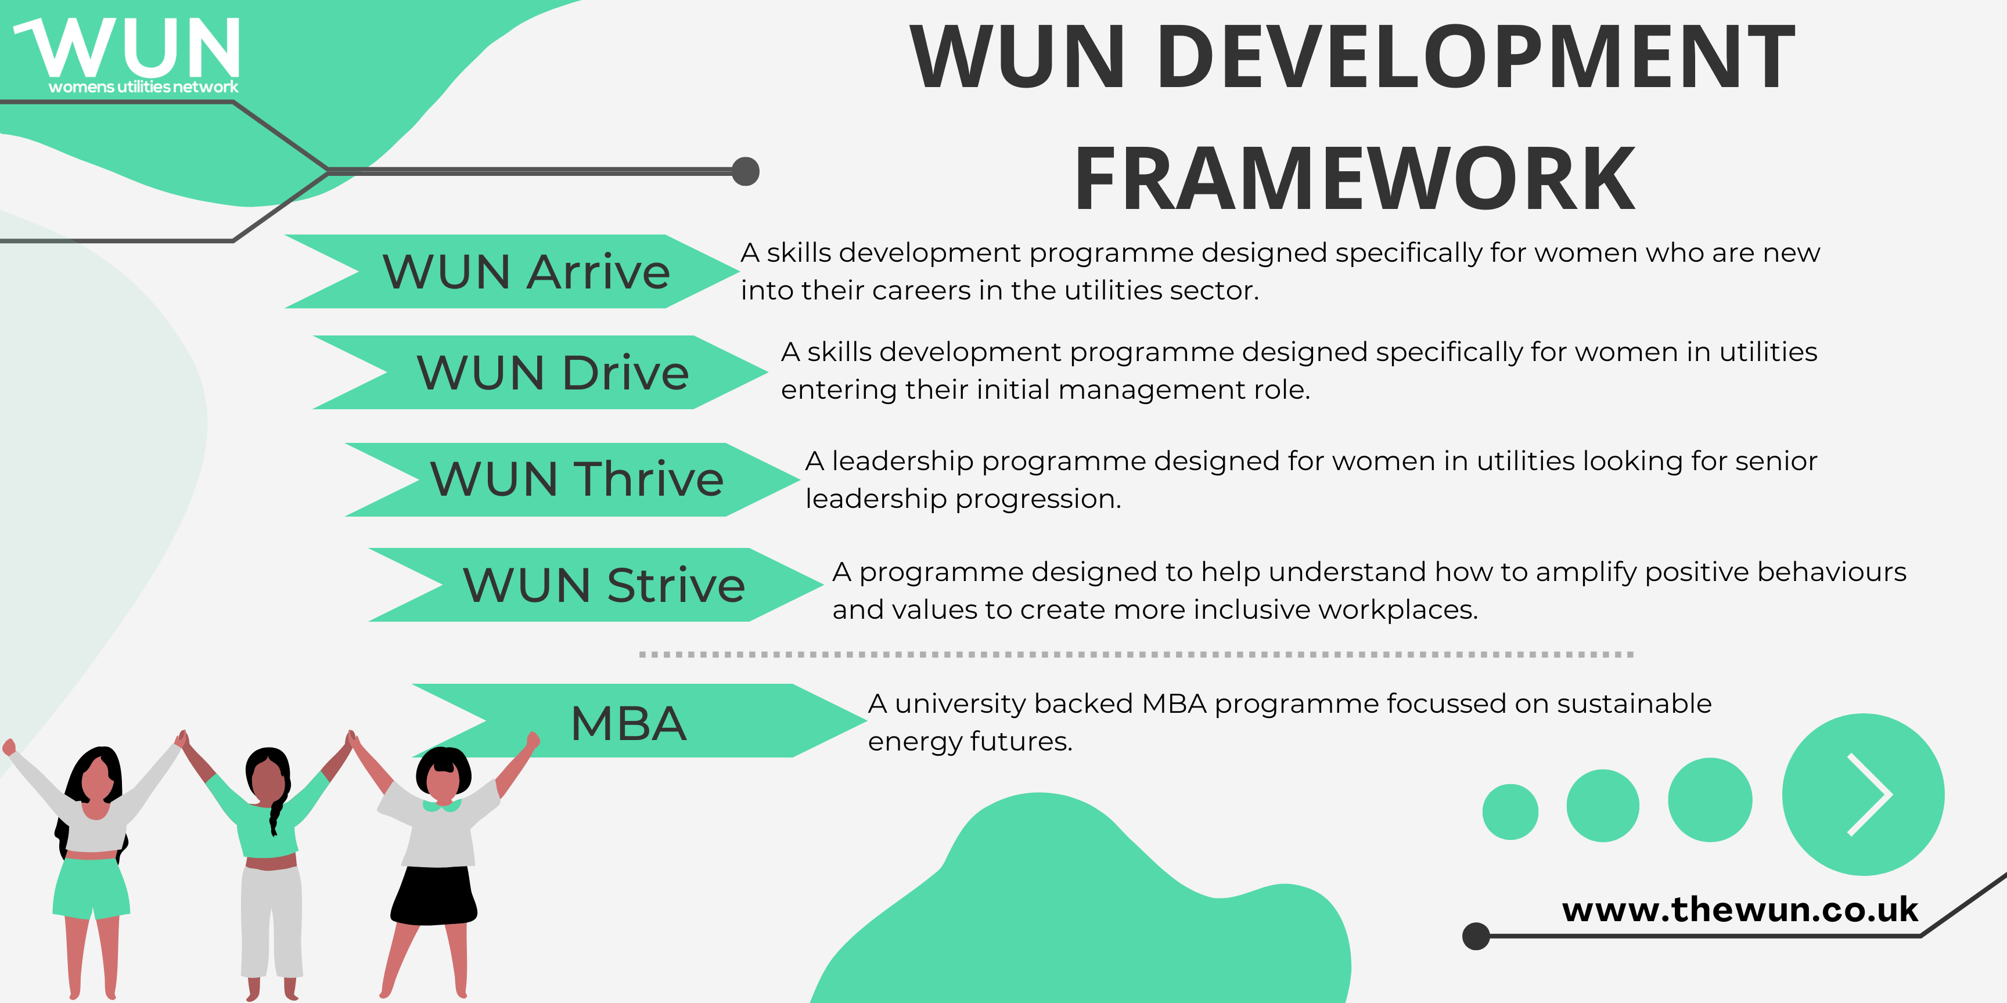
The Womens Utilities Network – Development Framework
A suite of targeted and bespoke development journeys designed to empower women working in utilities
WUN programmes have been designed by women in the sector, specifically for women in the sector
A safe space to really discuss challenges honestly and create solutions together
Building a supportive network of peers across the sector
Sector relevant with insight and examples that are rooted in the reality for women in utilities
Second WUN Drive cohort starting in March 25 now full – bookings open for Sept 25.
A skills development programme for women seeking or in initial management roles. Available to sign up on the WUN website now.
WUN Thrive few final places remaining –starting March 25. A development programme for women already in or seeing senior leadership roles.

Slide 11
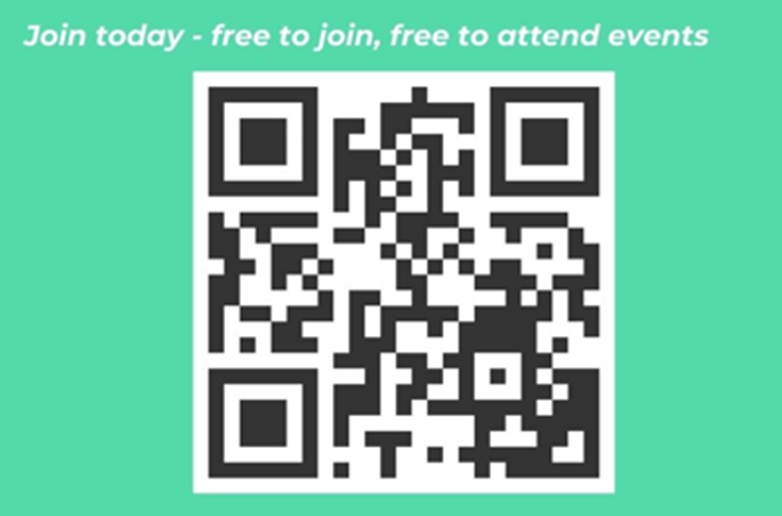
Don’t forget to join the Network
to receive the next WUN newsletter
https://thewun.co.uk/join-wun/

Slide 13
How can water industry achieve net zero? Dr Katherine Ibbotson
Net zero transition
Presented to WUN| February 2025

Slide 14
Net Zero Strategies and Roadmaps
Water UK published a net zero routemap developed by the water companies in 2020 (Net Zero 2030 Routemap | Water UK
In PR24, Ofwat introduced a common performance commitment which requires companies to achieve a % reduction in operational GHGs in AMP8 (2025-30).
Bespoke performance commitments relating to capital carbon
Environment Agency e:Mission and Net Zero Roadmap 2030
Notes:
Water UK published a net zero routemap developed by the water companies in 2020 (Net Zero 2030 Routemap | Water UK), this followed a pledge by water companies in England in 2019 to reach net zero on operational emissions by 2030 as part of a ‘Public Interest Commitment’.
In PR24, Ofwat introduced a common performance commitment which requires companies to achieve a % reduction in operational GHGs in AMP8 (2025-30).
Three companies also have bespoke performance commitments relating to capital carbon – Severn Trent Water (Microsoft Word - SVE Capital carbon _ FD bespoke PC definition.docx) and embodied GHG emissions – South West Water (Microsoft Word - SWB Embodied Greenhouse Gas Emissions.docx) and United Utilities (Microsoft Word - UUW Embodied greenhouse gas emissions _ FD bespoke PC definition.docx).
Original Content: Water Industry Net Zero: Impacts on National Water Availability

Slide 15
Water Industry Net Zero
Carbon Reduction Focus
Direct Emissions Reduction
Renewable Energy Integration
Nature-Based Solutions
Efficiency Improvements
Alternative Sources
System Integration
Digital Improvements
Regulatory Framework
Investment Support
Stakeholder Engagement
Water Management
Altered Rainfall Patterns
Climate change causes significant changes in rainfall patterns, leading to unpredictable water supply and distribution.
Reduced Snowpack
A reduction in snowpack due to warming temperatures affects freshwater supplies, especially in regions reliant on snowmelt.
Increased Evaporation Rates
Rising temperatures result in increased evaporation rates, contributing to water scarcity and reducing available freshwater resources.
Notes:
Direct Emissions Reduction
Process Optimization
Treatment efficiency improvements
Reduced chemical usage
Energy optimization
Infrastructure Updates
Renewable Energy Integration
On-site Generation
Energy Storage
Nature-Based Solutions
Catchment Management
Carbon Sequestration
Efficiency Improvements
Water Conservation
Demand reduction
Leakage control
Recycling/reuse
Energy Optimization
Alternative Sources
Water Reuse
Desalination
System Integration
Circular Economy
Cross-sector Planning
Regulatory Framework
Integrated Planning
Cross-sector coordination
Long-term forecasting
Risk assessment
Standards Development
Investment Support
Infrastructure Funding
Research & Development
Stakeholder Engagement
Public Awareness
Industry Collaboration

Slide 16
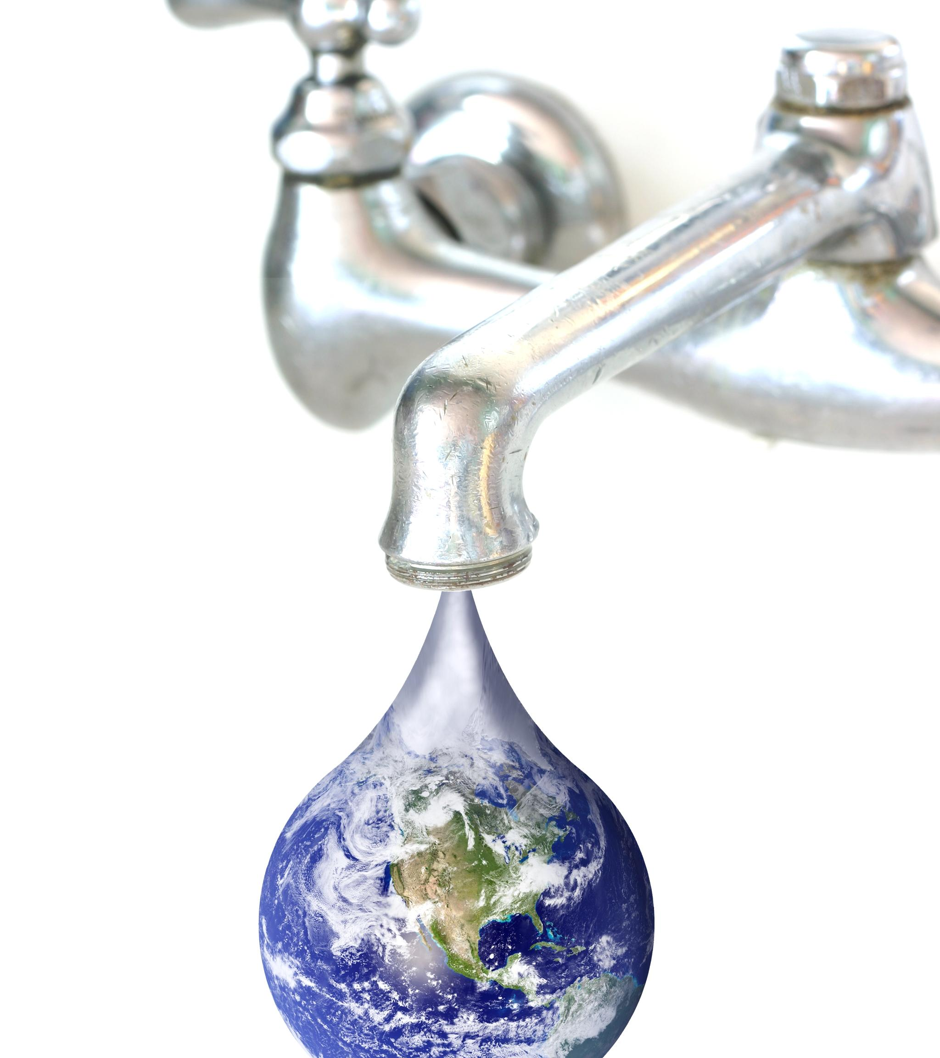
Net Zero Transition

Slide 17
Challenges in Balancing Water (and Energy) Needs
Competing Demands
The need for water in agriculture, industry, and energy production often conflicts, creating challenges in resource management.
Resource Depletion
If not managed properly, the competing demands for water can lead to significant resource depletion and environmental issues.
Conflict Resolution
Effective management strategies are essential to resolve conflicts and balance the needs of water and energy sectors sustainably.
Collaborative Efforts
Achieving water sustainability requires collaboration among governments, organizations, and communities to ensure equitable resource distribution.
Technological Investments
Investing in innovative technologies is crucial for improving water management and enhancing availability in a sustainable manner.
Strong Policy Frameworks
Implementing strong policies is essential to support sustainable water practices and achieve net-zero targets effectively.
Notes:
Direct Emissions Reduction
Process Optimization
Treatment efficiency improvements
Reduced chemical usage
Energy optimization
Infrastructure Updates
Renewable Energy Integration
On-site Generation
Energy Storage
Nature-Based Solutions
Catchment Management
Carbon Sequestration
Efficiency Improvements
Water Conservation
Demand reduction
Leakage control
Recycling/reuse
Energy Optimization
Alternative Sources
Water Reuse
Desalination
System Integration
Circular Economy
Cross-sector Planning
Regulatory Framework
Integrated Planning
Cross-sector coordination
Long-term forecasting
Risk assessment
Standards Development
Investment Support
Infrastructure Funding
Research & Development
Stakeholder Engagement
Public Awareness
Industry Collaboration

Slide 18
Energy Sector Water Requirements
Hydrogen Production
Green hydrogen water consumption
Electrolysis water quality needs
Cooling system requirements
Nuclear Power
Cooling water demands
Safety system requirements
Discharge temperature impacts
Hydroelectric Power Expansion
Reservoir storage requirements
River flow modifications
Seasonal availability impacts

Slide 19
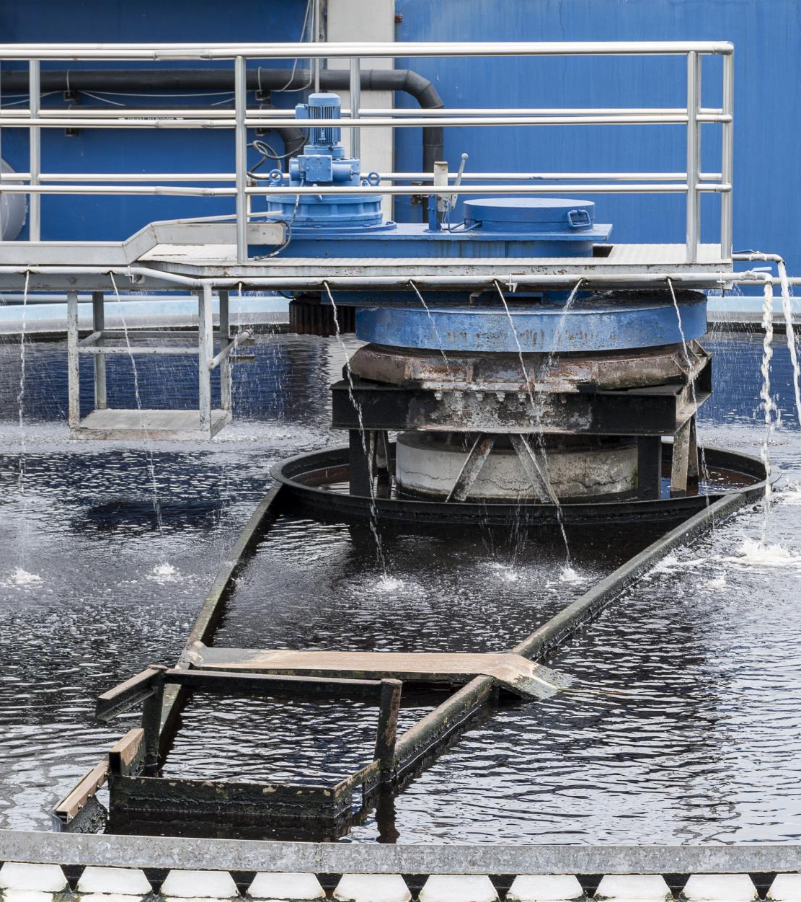
Industrial Decarbonization
Carbon Capture and Storage (CCS)
Process water requirements
Cooling system needs
Water quality impacts
Industrial Process Changes
Clean technology water demands
Water recycling requirements
Quality specifications

Slide 20
Agricultural Adaptation
Biofuel Production
Crop irrigation demands
Land use changes
Watershed impacts
Sustainable Farming
Irrigation efficiency
Soil carbon sequestration effects
Water retention changes
Notes:
This slide covers agricultural adaptation strategies, focusing on biofuel production and sustainable farming. Key points include crop irrigation demands, land use changes, watershed impacts, irrigation efficiency, soil carbon sequestration, and water retention changes.

Slide 21
Integrated Water Management
Coordinated Development
IWM encourages the coordinated development of water, land, and related resources for optimal use and sustainability.
Balancing Needs
The IWM approach helps balance social and environmental needs, ensuring that all stakeholders benefit from water resources.
Sustainable Practices
IWM supports sustainable energy practices through effective management of water resources, promoting long-term environmental health.
Importance of Water Availability
Water availability is essential for achieving net zero emissions and sustainable development. This requires careful management of water resources
Energy and Water Interconnectedness
The relationship between energy production and water use is crucial for sustainability. Understanding this connection is key to effective strategies
Strategies for Sustainability
Implementing strategies that promote both energy efficiency and environmental protection is essential for sustainable development.

Slide 22
How can water industry achieve net zero?
System
Network
Asset
Notes:
Asset Management
Capital programme investment
Operational and Maintenance
Growth
Increase Population
Residential and business development
Carbon Management
PAS 2080:2023

Slide 23
Thank you
wsp.com

Slide 24
Chair: Karma Loveday, The Water Report
Panellists:
Sarah McMath, MOSL
Dr Katherine Ibbotson, WSP
Liz Burlon, Accenture
Erin Zhang, Isle Utilities
Exhibiting – WaterAid & Institute of Water

Slide 25
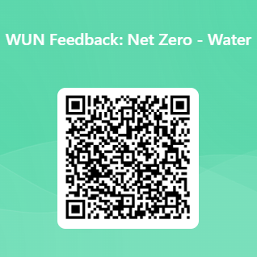
We do value your feedback as they help shape future events

Slide 26
Thank you to our generous hosts, WSP, & all WUN’s partners for their ongoing support

Slide 27
2050 Net Zero How we get there: Water

Slide 28
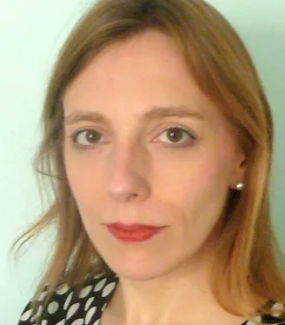
Chaired by Karma Loveday, Founder & Editor at the Water Report.
Karma Loveday is founder and editor of The UK Water Report,
an independent publication covering UK water sector policy, regulation,
strategy and competition. Karma has 25 years of experience as a
journalist covering regulated industries. Karma also works as water advisor to the Major Energy Users Council, a membership body for industrial and commercial water and energy customers.

Slide 29
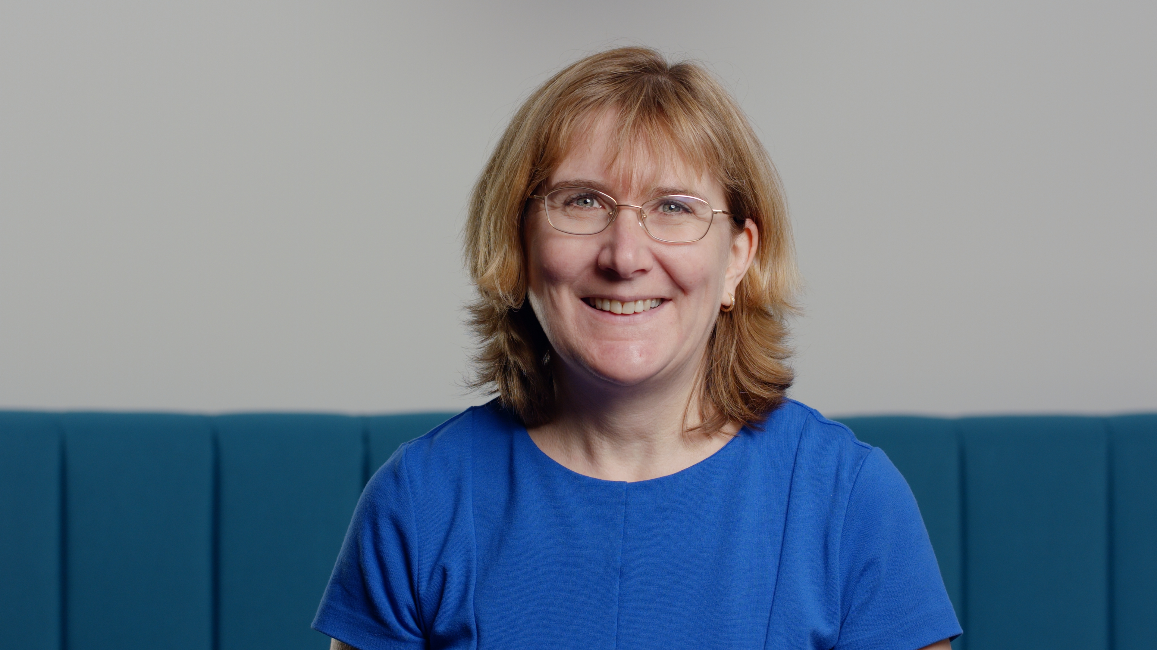
Sarah McMath, WUN Director & CEO of MOSL.
Sarah became Chief Executive of MOSL, the market operator for the non-household
water retail market in June 2019. Her focus is on driving collaboration to ensure that the
water market delivers on its commitments to customers and uses its position of
independence to advance simple and effective water markets for the benefit of business customers and the environment. MOSL is an inclusive workplace, with a focus on ensuring that all members of the team can be their authentic selves at work.
With a doctorate in Environmental Engineering, Sarah worked for Thames Water for 24 years in a wide variety of roles, leading teams of up to 3,000 people in both technical and operational areas. After eight years leading Asset Management functions, Sarah led the development of the company’s Business Plan. Sarah was then Head of Strategy, developing the corporate strategy for the board of Thames Water. Sarah was also responsible for the programme management of the preparations for the opening of the non-household market in April 2017. Sarah joined the executive team at Thames Water in April 2017, as Managing Director of Water, with executive accountability for the treatment and delivery of clean, safe drinking water to over nine million customers in London and the Thames Valley. Sarah is also a non-executive director at Stonbury Limited and Advisor to MadeTech.
Sarah joined the WUN board in 2022 & is married, with two children at University. Outside of work Sarah enjoys cooking, reading and walking.

Slide 30
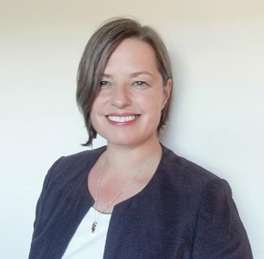
Dr Katherine Ibbotson, Director, Transformation Advisory,
Sustainable Change, WSP.
With over 20 years’ experience in water sector and wider industry, as a Director in WSP,
Kat is bringing together WSPs services as a trusted advisor, focusing on Sustainability, Net Zero, Organisation and People change. Kat’s leadership and experience is in taking a holistic approach to complex systems, bridging the gap between policy, and embedding practical action. Taking forward sustainable change services within infrastructure, facilitating and enabling the connections across sectors and technical disciplines.
Having worked within the water Public Sector for over 17 years, Kat has supported clients across several sectors, delivering a variety of services from: Infrastructure Resilience and Net Zero transformation, through to people and process change at an asset, network, and system level. Ensuring a whole life approach, governance, continuous improvement, and review are driving an evidence-based approach to influence and shape future policy. Kat’s experience is supported by a broad skill set in programme, project management and commercial services.

Slide 31
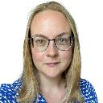
Liz Burlon, Senior Manager, Accenture
Liz is a leader in the Accenture water utilities practice
across our clients globally
She has 15+ years of experience in cross-industry
sustainability and transformation, including working with the World Economic Forum on accelerating Net Zero.
She has 4 publications on water management, virtual water management and the water-energy-food-nexus. She holds a Master of Science in Water: Science and Governance from Kings College London.

Slide 32
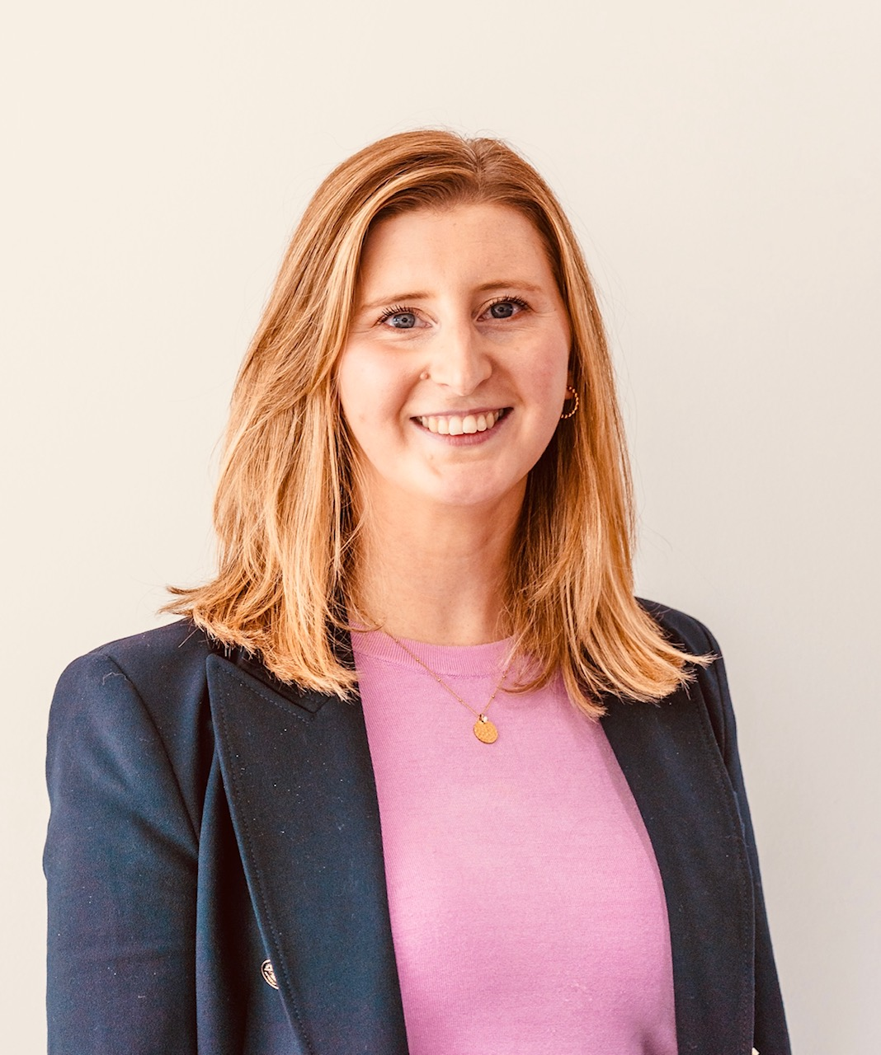
Erin Zhang, Head Of Commercial, Isle.
Since studying Sustainable Development, Erin has
developed a passion for the subject and gained a breadth of knowledge and experience from working in a variety of roles within the water industry as well as management consulting at Ernst & Young.
She has hands-on experience supporting numerous businesses to deliver major transformation programmes, embrace innovation and introduce sustainable strategies. Erin is the Head of Commercial UK at Isle and supports companies looking to develop strategies which will enable them to tackle the current and future challenges they face related to climate change by embracing innovation and innovative solutions.

