Slide 1
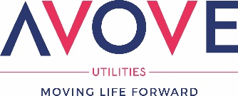
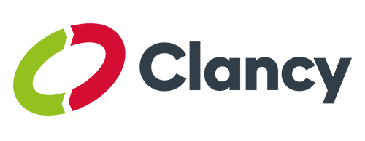

Slide 2
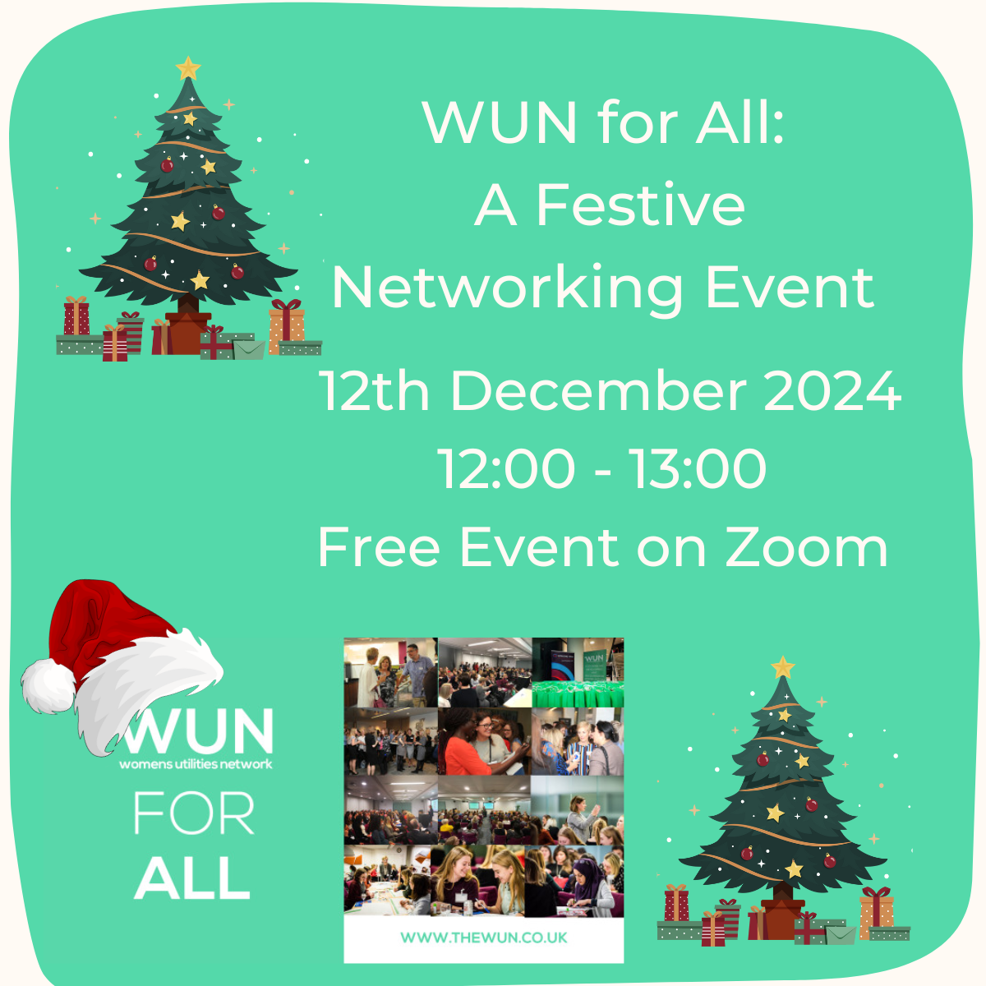
Welcome
This WUN For ALL Festive networking event will be starting shortly

Slide 3
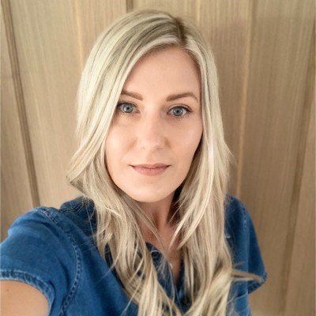
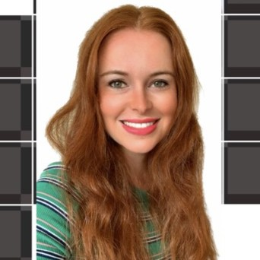
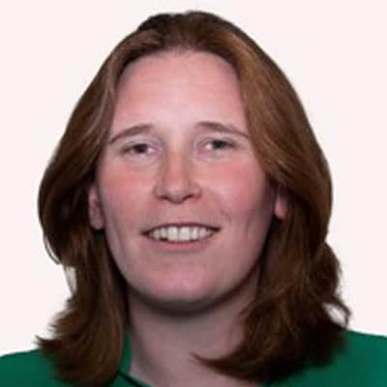
This interactive workshop will be led by WUN advocates:
Julia Stichling, Holly Beeston & Heidi Knapton
Supported by Jenny Barlow, Gentrack

Slide 4
WUN
The utilities sector is lacking in diversity with many women being generally under-represented, particularly in senior roles.
WUN was started in 2018 when a group of likeminded women, working in utilities, united around a common cause. The founders were not only passionate about the industry they worked in, but also passionate about the contribution women were making and could continue to make in the future. We now have over 7900 members & 60 plus partners.
Regular Events & Content
Mentoring Programme & Network
7900+
Members
60 +
Partners

Slide 6
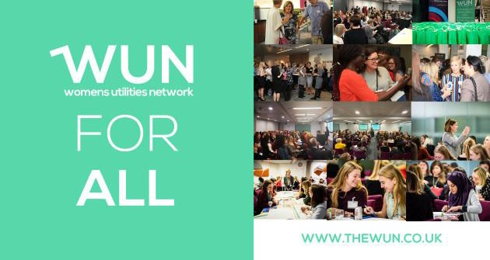
Dates for your diary
WUN Events
10th January 2025 12.00 – 1.30pm - #IAmRemarkable workshop – (Fully booked)
13th February 2025 12.30 – 2.00pm - #IAmRemarkable workshop – Virtual Event
18th Feb 2025 5:30 -8:30 pm 2050 Net Zero How we get there: Water – Birmingham
14th March 2025 11.30 – 1.00pm - #IAmRemarkable workshop – Virtual Event
6th May 2025 11.00 – 12.30pm - #IAmRemarkable workshop – Virtual Event
27th June 2025 Lunchtime – Women in Utilities Awards 2025-
Call for entries January 2025
Further events for 2025 will be announced shortly.
Free tickets available - visit our Events page!
https://thewun.co.uk/

Slide 7
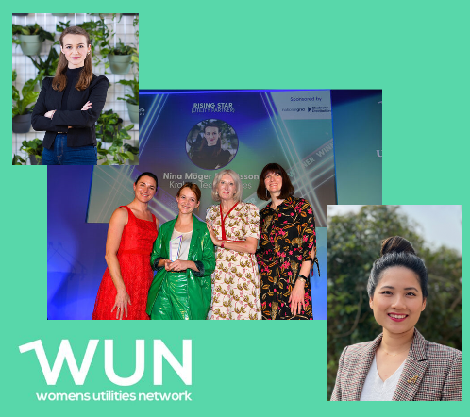
WUN Podcasts
Listen to our latest podcasts More coming soon !
#WUN Making Site More Accessible – Inclusivity in the Utility Industry with Meg Ginsberg, South West Water and Julia Stichling, WUN Advocate
Meg Ginsberg is an assistant project manager at South West Water who has forged an inspiring career in the wastewater industry after facing significant personal and professional challenges. Born in Guildford and now based in Devon, Meg became a mother during the pandemic and navigated multiple surgeries that left her a wheelchair user by the age of 18. Originally pursuing a career in nursing, she shifted to project management, completing an apprenticeship and soon to start a degree apprenticeship at Exeter.
Join Lillian Philip, WUN Advocate in this latest WUN Podcast as she chats to Nina Moger, Transformation Director at Kraken Technologies and the 2024 Rising Star Award winner at the Women in Utilities Awards.
Nina shares insights from her inspiring career journey, her passion for climate action, building expertise in energy, and fostering trust and innovation in utilities. Discover her leadership philosophies, strategies for driving cultural transformation, and how she champions women in the industry.
You can follow our podcast on Apple Podcasts, Spotify, Amazon Music and wherever else you get your podcasts – just search “WUN4ALL”.
Or just click through from the website: https://thewun.co.uk/news-blogs/

Slide 8
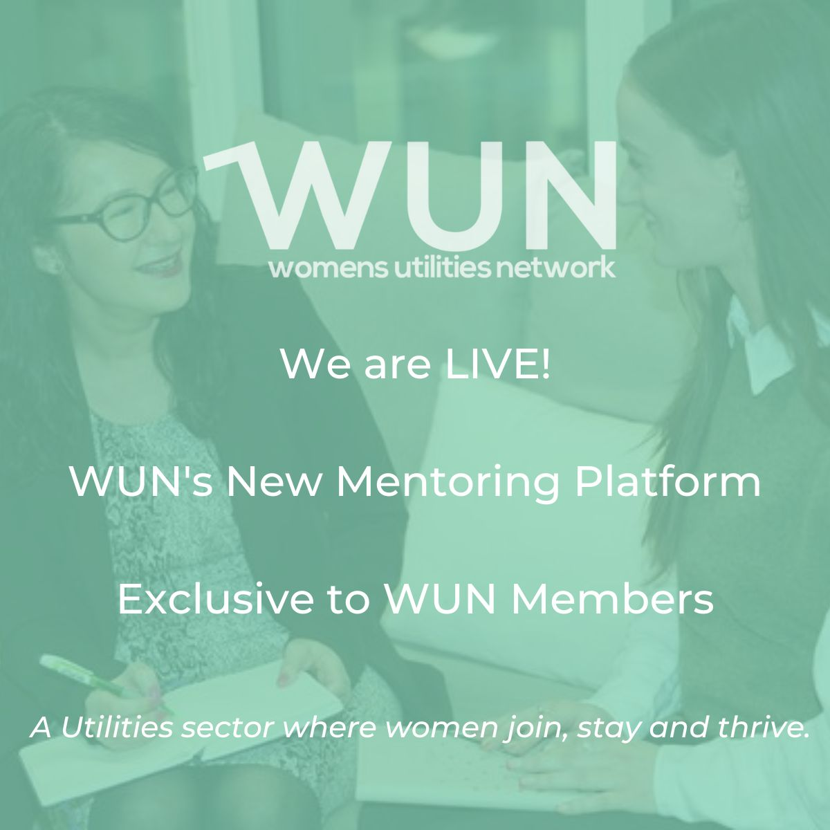
Join the free WUN Mentoring Programme
New WUN Mentoring now available –
WUN offers mentoring to women at any stage of their career in the utilities sector.
We are hugely privileged to have over 130 fantastic experienced mentors within the WUN mentoring programme.
With growing numbers of Mentors and Mentees we are delighted with the community and support fostered within the mentoring programme.
If you are interested in becoming a Mentor or Mentee, please visit our website: https://wun.onpld.com

Slide 9
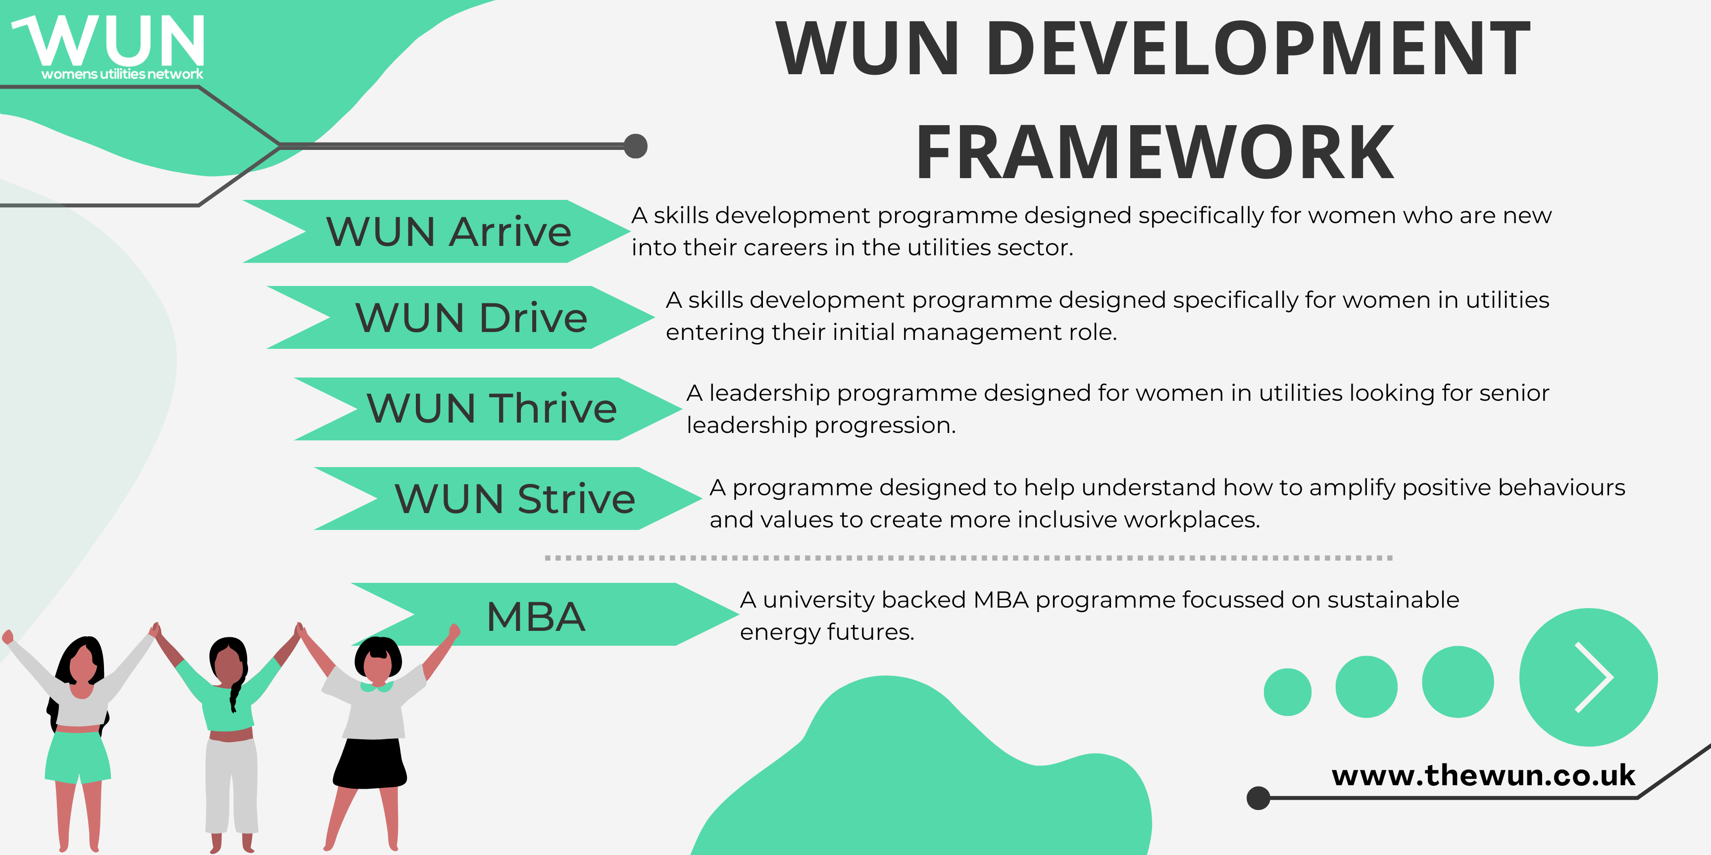
The Womens Utilities Network – Development Framework:
A suite of targeted and bespoke development journeys designed to empower women working in utilities
WUN programmes have been designed by women in the sector, specifically for women in the sector
A safe space to really discuss challenges honestly and create solutions together
Building a supportive network of peers across the sector
Sector relevant with insight and examples that are rooted in the reality for women in utilities
Second Drive cohort starting in March 25.
A skills development programme for women seeking or in initial management roles. Available to sign up on the WUN website now.
Thrive available now for registration –start March 25. A development programme for women already in or seeing senior leadership roles.

Slide 10
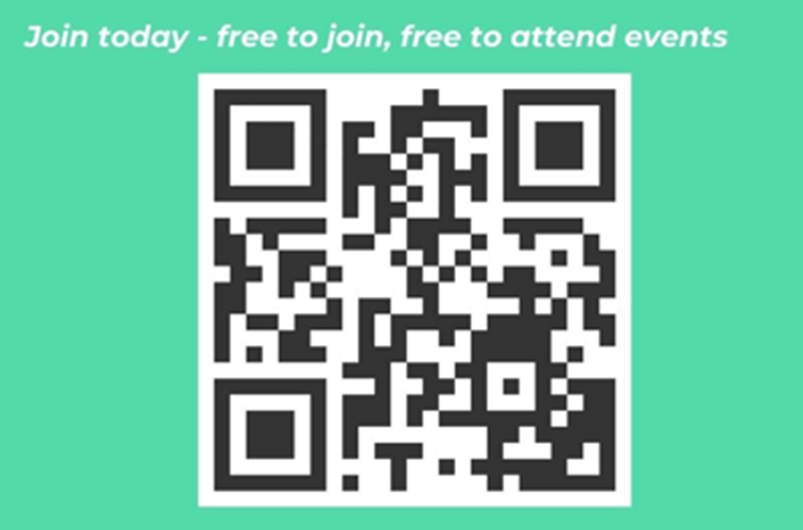
Don’t forget to join the Network
to receive the WUN newsletter.
https://thewun.co.uk/join-wun/

Slide 11
Networking – What is it?
Definition: Networking is the process of building and nurturing professional relationships to exchange information, resources, and opportunities.
Key Elements:
Relationship-building: Establishing trust and mutual support
Exchange: Sharing insights, experiences, and connections
Long-term benefit: Fostering career growth and collaboration
Relevance in Utilities Sector:
A traditionally male-dominated field benefits from strong networks for women to amplify their voices, foster inclusion, and open doors to leadership
https://thewun.co.uk/join-wun/

Slide 12
The Importance of Networking
Professional Growth:
Gain access to mentorship opportunities
Stay informed on industry trends and technological advancements
Career Advancement:
Discover job opportunities, promotions, and collaborations
Build a personal brand and reputation within the industry
Community Building:
Create supportive circles to navigate challenges specific to women in utilities.
Advocate for gender equity and drive cultural change in the workplace
https://thewun.co.uk/join-wun/

Slide 13
Challenges and Opportunities for Women Networking in Utilities
Limited representation: Women often face smaller peer networks in male-dominated fields.
Stereotypes: Overcoming biases that may undervalue women's contributions.
Time constraints: Balancing work and personal responsibilities.
Opportunities:
Women-specific organisations and events: e.g., WUN – Womens Utilities Network, Powerful Women – Energy, Women on Water – British Water
Online platforms: LinkedIn and industry-specific forums for remote connections.
Mentorship programs: Gaining insights from experienced professionals.
https://thewun.co.uk/join-wun/

Slide 14
Attending your first Networking Event
Remember that we all attended our first networking event at some point in time so we understand the nerves
Attend a session with a colleague for moral support
Remember to Smile!
Introduce yourself to others that seem to be alone or small groups of people – a great place to start is where the coffee / drinks are being served
Be honest that it’s your first time – it’s an icebreaker
Introduce yourself to the facilitator of the event – they will want you to connect with new people
https://thewun.co.uk/join-wun/

Slide 15
How to Network Effectively as a Woman in Utilities
Leverage Industry Events:
Attend conferences, seminars, and workshops tailored to the utilities sector
Participate actively by asking questions and joining discussions
Join Professional Associations:
Engage with groups like WUN or Utilities-focused associations
Volunteer or take leadership roles to increase visibility
Utilise Online Platforms:
Build a strong LinkedIn profile
Share insights, comment on industry trends, and connect with thought leaders
Develop a Personal Pitch:
Articulate your goals, expertise, and aspirations confidently
Use this to introduce yourself and create impactful first impressions
https://thewun.co.uk/join-wun/

Slide 16
Building Inclusive and Impactful Networks
New peer relationships
Cross industry collaboration
Be Intentional:
Seek diverse perspectives and collaborators who challenge and inspire growth.
Support Others:
Mentor other women entering the field to strengthen the collective network.
Advocate for Change:
Use your network to champion diversity, equity, and inclusion initiatives.
Measure Success:
Regularly assess the value your network brings to your career and personal development.
Networking is not just about connections; it’s about creating meaningful, lasting relationships that empower both you and others in the utilities sector.
https://thewun.co.uk/join-wun/

Slide 17
WUN Festive Quiz!
Match the quote to the person who said it….
7750+
Members

Slide 18
“Democracy is the best revenge”…
Benazir Bhutto
Indira Gandhi
Michelle Obama
7750+
Members

Slide 19
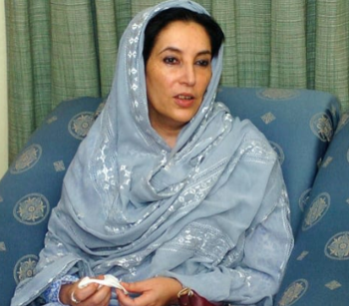
Answer – A) Benazir Bhutto
Benazir Bhutto was a Pakistani politician who served as Prime Minister of Pakistan from 1988 to 1990 and again from 1993 to 1996. She was the first woman to head a democratic government in a Muslim majority nation.
7750+
Members

Slide 20
“No one can make you feel inferior without your consent”…
Mairead Maguire
Eleanor Roosevelt
Katharine Hepburn
7750+
Members

Slide 21
Answer – B) Eleanor Roosevelt
Anna Eleanor Roosevelt was an American political figure, diplomat and activist. She served as the First Lady of the United States from March 4, 1933 to April 12, 1945 during her husband President Franklin D. Roosevelt's four terms in office, making her the longest serving First Lady of the United States.
7750+
Members

Slide 22
“When the whole world is silent, even one voice becomes powerful”…
Helena Morrissey
Harper Lee
Malala Yousafzai
7750+
Members

Slide 23
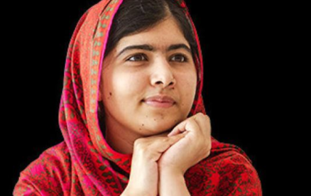
Answer – C) Malala Yousafzai
Malala Yousafzai is a Pakistani activist for female education and the youngest Nobel Prize laureate.
7750+
Members

Slide 24
“It took me quite a long time to develop a voice, and now that I have it, I am not going to be silent”…
Madeleine Albright
Hillary Clinton
Angela Merkel
7750+
Members

Slide 25
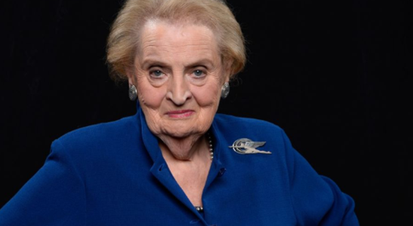
Answer – A) Madeleine Albright
Madeleine Jana Korbel Albright is an American politician and diplomat. She is the first female United States Secretary of State in U.S. history, having served from 1997 to 2001 under President Bill Clinton
7750+
Members

Slide 26
“The Women in Utilities Awards (2024) was more than just an event; it was a celebration of progress and a call to continue striving for greater equality. As a man in the sector, I left feeling inspired”…
David Black
Darren Jeffery
Mike Keil
7750+
Members

Slide 27
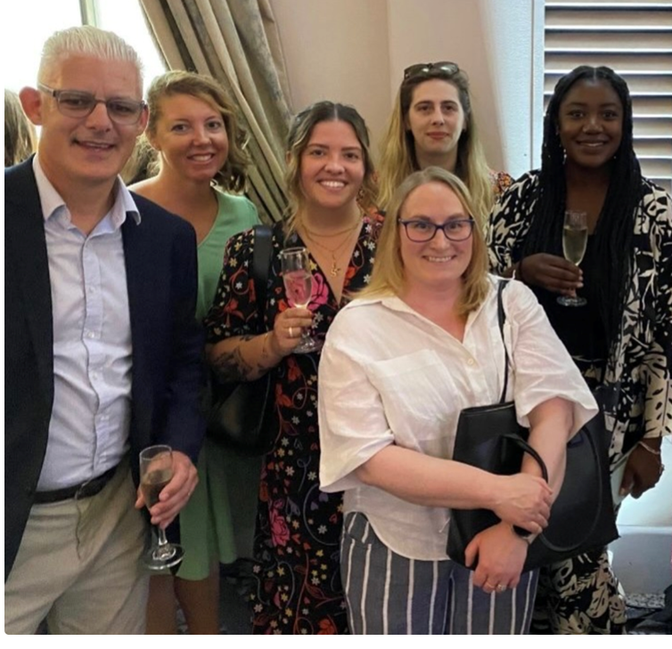
Answer – B) Darren Jeffery
Darren Jeffery is the Head of Operations- Customers, SmartestEnergy Business, and a huge advocate of WUN. He recently attended the WUN Awards and followed up with an insight blog to capture a male perspective of the event.
Blog - A Male Perspective: Reflecting on the Women in Utilities Awards 2024 - Womens Utilities Network
7750+
Members

Slide 28
“At WUN we continue to learn a lot about women in the workplace throughout their careers and love to come and talk to Boards about the reality – for those brave enough to invite us in”…
Hayley Monks
Sarah Hopkins
Jo Butlin
7750+
Members

Slide 29
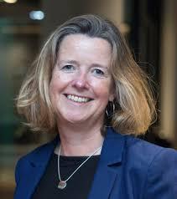
Answer – C) Jo Butlin
Jo Butlin is a WUN Founder and CEO of EnergyBridge (UK). Jo has built a portfolio of Non Executive and advisory roles across the market, and plays a significant role in supporting WUN and all of its members.
Meet the board: Jo Butlin - Womens Utilities Network
7750+
Members

Slide 30
“We are facing a loss of knowledge in the water industry and a high demand for new talent, and more and more women are becoming attracted to the water industry now, which I feel will help immensely in facing the upcoming challenges”…
Holly Beeston
Lucy Ritchie
Julia Stichling
7750+
Members

Slide 31
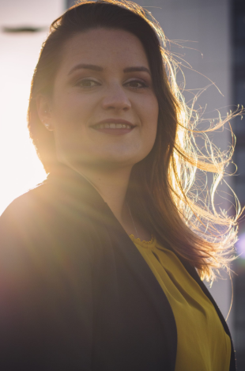
Answer – C) Julia Stichling
Julia Stichling is the Managing Director at R2M Ltd., a supplier to all of the UK’s water utilities and their contractors. As well as being responsible for the Operations of the business, Julia has a wealth of experience in marketing, and is also a significant contributor to the WUN. Meet the advocates: Julia Stichling - Womens Utilities Network
7750+
Members

Slide 32
It’s all to play for!!!
At this exact moment, how many members does the WUN have?
7750+
Members

Slide 33
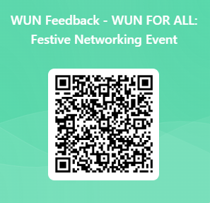
Thank you to our WUN advocates Julia, Holly & Heidi and to Jenny Barlow from Gentrack for leading this event .
We do really appreciate the feedback to help shape future WUN events.

