Slide 1
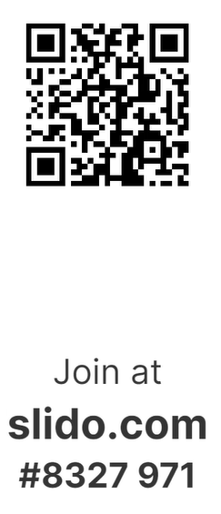
Welcome to
Wun4All
#Speak Up Skills Session
The session will be starting shortly
06th November 2024
Notes:
Welcome to today’s WUN 4 All session – the #SpeakUp Skills Session.
Speaking up after experiencing or seeing other people experience inappropriate behaviour can be tough. We understand that some of our attendees might see this as a topic where they’ve had traumatic experiences. Hence, we want to create a safe space for all attendees today, and we ask everyone to treat any topics being brought up by any participants today as confidential please. The session today will be recorded as are all our Wun 4 all session. However, given the topic we’re discussing, we will stop the recording once it comes to the Question and Answer session towards the end. Also, we will share some further resources on speaking up after this session. This is planned in form of blogs but also potentially further skills session like today. Further resources will include parts of the presentation in there to make the content accessible for everyone and also signposts where to go to in case you need someone. We want to encourage people to share what they feel comfortable sharing, but obviously if we do think that there are potential issues around somebody's safety or well being, we might need to take the appropriate action. Before we start the session, I would like to thank EON and M Group Services for their support today on this session and the #Speak Up campaign. The colleagues from EON will be sharing some input on their speak up campaign and how this has evolved within the organisation. M Group Services will support us with some practical input around the new worker protection act. A huge thank you to Becky, Jess, Di, Kirin and Colin for their support!
During this session, we will be using SLIDO on three occasions, so please have your phones ready for when we will ask for some input of yourselves.

Slide 2
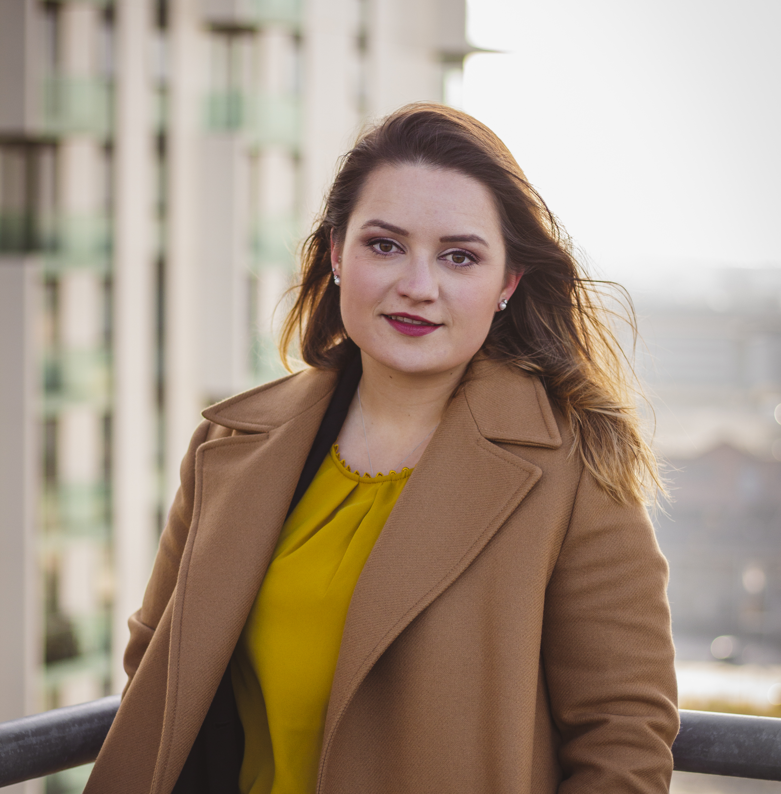
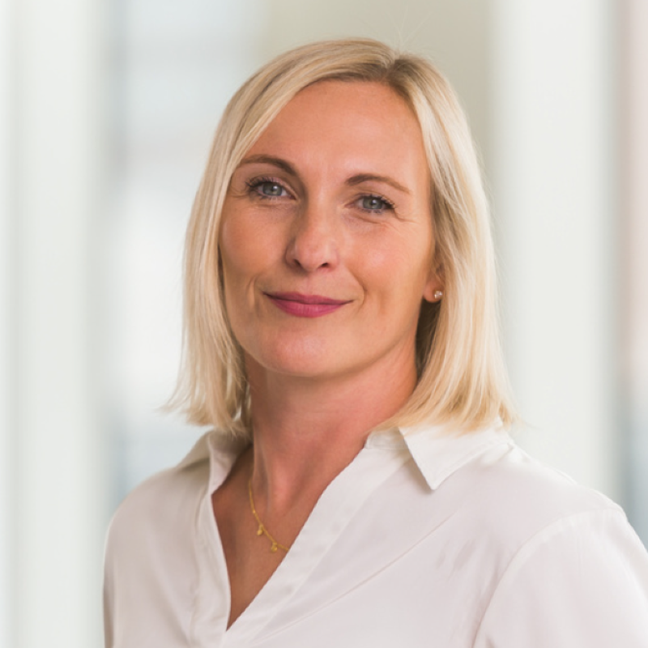
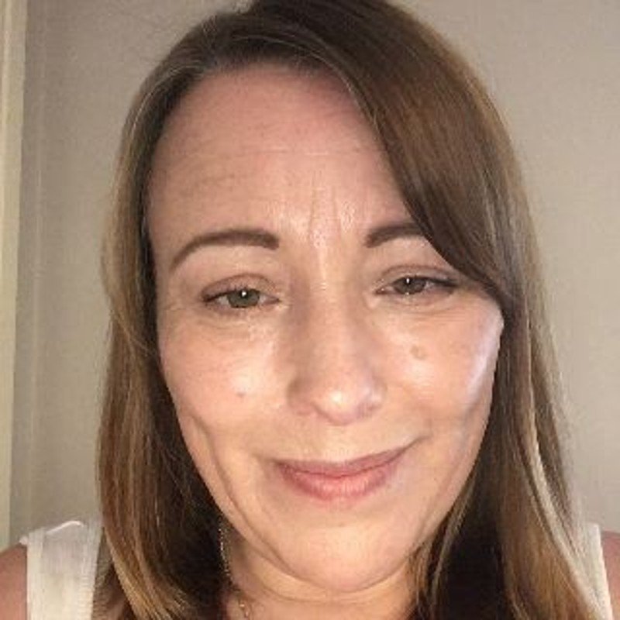
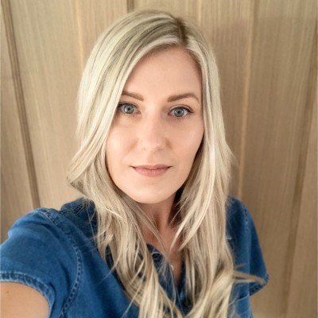
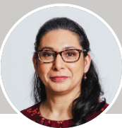
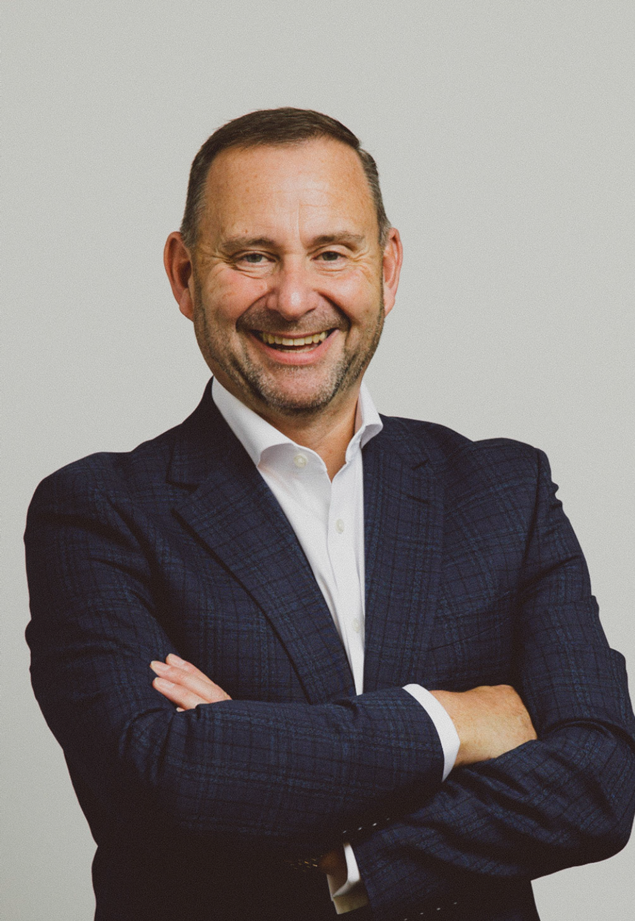
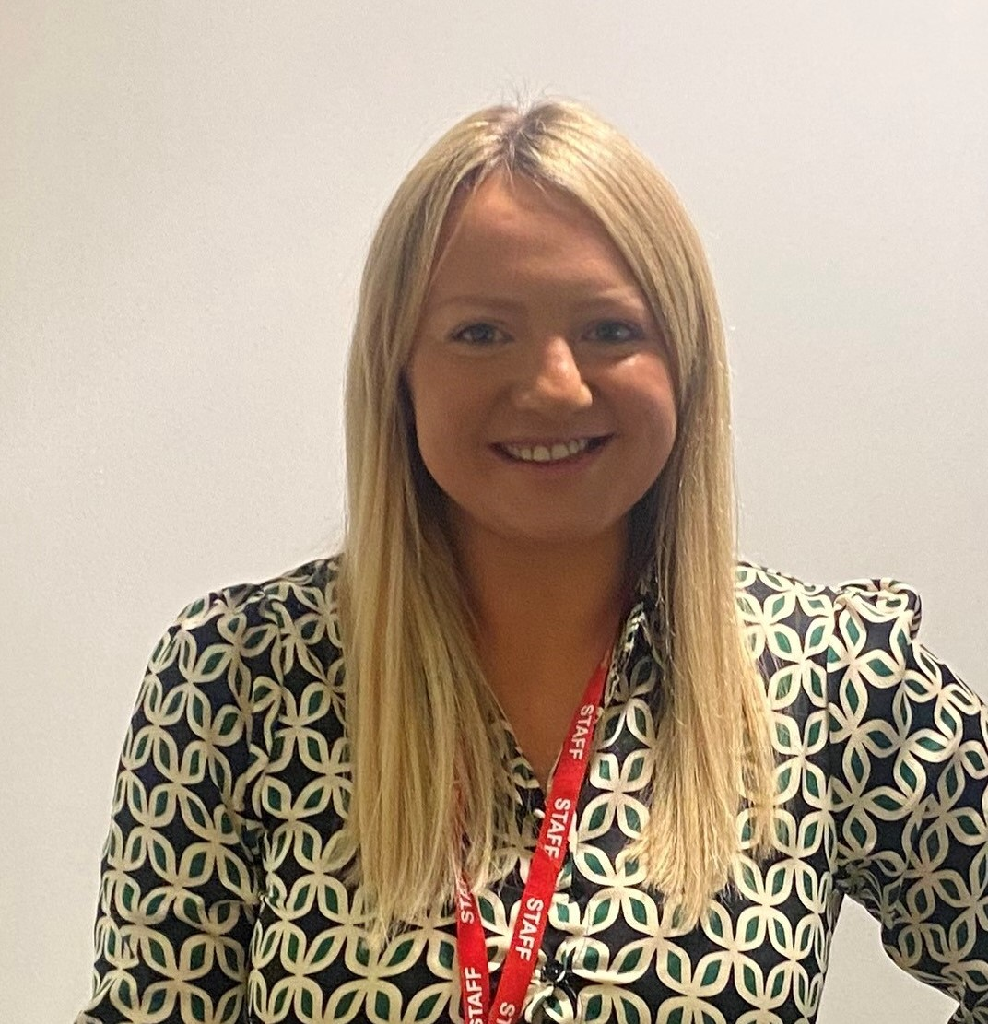
Rebecca Percy
Diversity & Inclusion Lead @ EON
Julia Stichling
WUN Advocate
Managing Director @ R2M Ltd
Diane Spooner
ER Consultant @ EON
Holly Beeston
WUN Advocate
Executive Search Practice Lead - Utilities @ Douglas Jackson
Kirin Kalsi
General Counsel, Compliance Officer and Data Protection Officer @ EON
Colin Jellicoe
Chief People Officer @ MGroup Services
Jessica Raine
Data Protection & Compliance Manager @ EON

Slide 3
WUN
The utilities sector is lacking in diversity with many women being generally under-represented, particularly in senior roles.
WUN was started in 2018 when a group of likeminded women, working in utilities, united around a common cause. The founders were not only passionate about the industry they worked in, but also passionate about the contribution women were making and could continue to make in the future. We now have over 7600 members & 60 plus partners.
Regular Events & Content
Mentoring Programme & Network
7600+
Members
60 +
Partners

Slide 5
Dates for your diary
WUN Events
14th November 2024 12.00 – 1.30pm - #IAmRemarkable workshop – Virtual Event
26th November 2024 6.00 – 9.00pm – 2050 Net Zero – How we get there: Energy
12th December 2024 12:00- 1:00 pm – WUNForAll A festive networking event.
10th January 2025 12.00 – 1.30pm - #IAmRemarkable workshop – Virtual Event
13th February 2025 12.30 – 2.00pm - #IAmRemarkable workshop – Virtual Event
14th March 2025 11.30 – 1.00pm - #IAmRemarkable workshop – Virtual Event
6th May 2025 11.00 – 12.30pm - #IAmRemarkable workshop – Virtual Event
27th June 2025 Lunchtime – Women in Utilities Awards 2025
Free tickets available - visit our Events page!
https://thewun.co.uk/

Slide 6
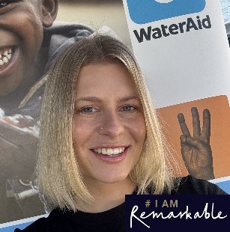
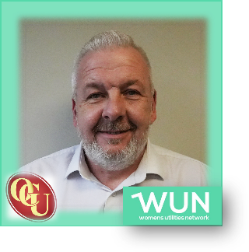
WUN Podcasts
Listen to our latest podcasts More coming soon !
Allyship with Andy Lax, Group Talent Acquisition Manager for OCU Group talking with Julia Stichling, WUN Advocate
Andy is the Group Talent Acquisition Manager for OCU Group. He has worked in the Recruitment Industry for the last 20 years, predominantly across engineering and construction, including the last 3 years in the Utilities sector. Over the years he has seen a significant change in these industries with more opportunities being afforded to women in what has historically been a male dominated arena, which can only be seen as a positive step forward.
His advocacy for women in this industry is based purely on ability to fulfil the opportunities within the sector. Providing equal opportunity opens a whole new talent pool for the industry which he believes is a positive step forward.
Charlie Page at WaterAid reflects on her #IAmRemarkable experience with WUN Advocate, Kara Sadler
In this episode WUN Advocate Kara Sadler talks with Charlie Page, Engagement Manager within WaterAid’s Water Industry Partnership team, to discuss her experiences with the WUN #IAmRemarkable workshop.
You can follow our podcast on Apple Podcasts, Spotify, Amazon Music and wherever else you get your podcasts – just search “WUN4ALL”.
Or just click through from the website: https://thewun.co.uk/news-blogs/

Slide 7
Join the free WUN Mentoring Programme
New WUN Mentoring now available –
WUN offers mentoring to women at any stage of their career in the utilities sector.
We are hugely privileged to have over 100 fantastic experienced mentors within the WUN mentoring programme.
With growing numbers of Mentors and Mentees we are delighted with the community and support fostered within the mentoring programme.
If you are interested in becoming a Mentor or Mentee, please visit our website: https://wun.onpld.com

Slide 8
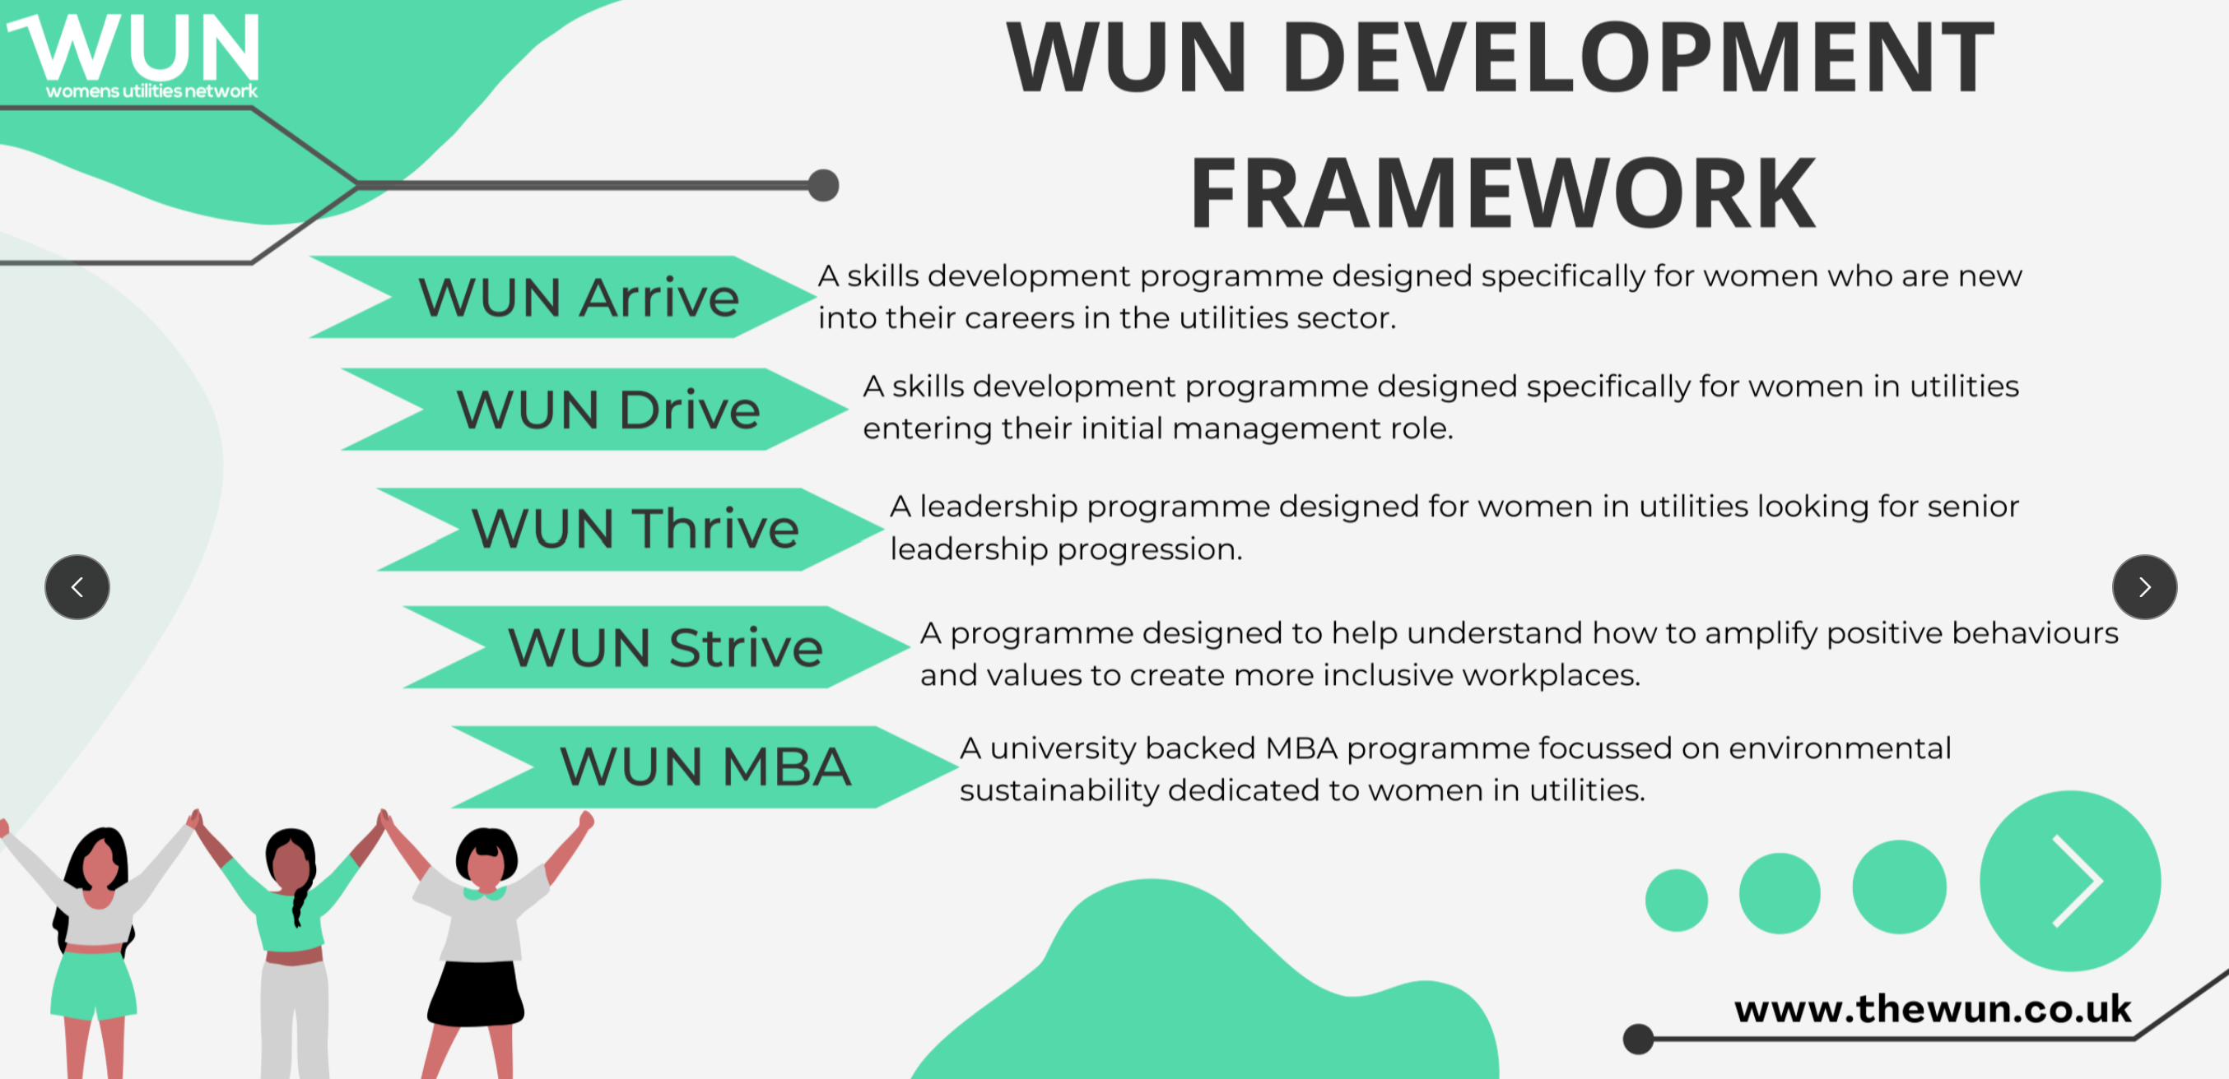
The Womens Utilities Network – Development Framework:
A suite of targeted and bespoke development journeys designed to empower women working in utilities
Designed by women in utilities, for women in utilities and delivered by women!
A safe space to really discuss challenges honestly and create solutions together
Building a supportive network of peers across the sector
Sector relevant with insight and examples that are rooted in the reality for women in utilities
First Drive cohort starting on 4th December. A skills development programme for women seeking or in initial management roles. Available to sign up on the WUN website now.
Thrive available for registration in November. A development programme for women already in or seeing senior leadership roles.

Slide 9
Don’t forget to join the Network
to receive the next WUN newsletter
https://thewun.co.uk/join-wun/

Slide 10
Unconscious Bias Survey
Some responses we received:
50% said they felt they were treated differently because of their gender.
22% said they felt they were treated differently because of their race.
20% said they were treated differently because of their age.
41% said they felt their voice isn’t heard at meetings and that they were interrupted when speaking.
49% said they felt their opinion isn’t as valued at work as much as their counterparts.
31% said they were likely to leave the utilities sector in the next 1-3 years.
https://thewun.co.uk/blogs/unconscious-bias-in-the-utilities-sector-2024-report/

Slide 11
#Speak Up Campaign
After an awards night last year where we were subject to, and saw others experiencing inappropriate behaviour, the WUN team decided we need to address incidents that most women have experienced in their life – the #Speak Up campaign was born.
Today‘s session, hosted in partnership with EON and supported by MGroup Services, aims to give participants the skills and confidence to speak up when experiencing or witnessing inappropriate behaviour. We will be working with Slido through the session.
What are we discussing?
The context and examples of harassment
Techniques that can be used to #SpeakUp
Fostering participants’ confidence – when, why and how to speak up
https://thewun.co.uk/
Notes:
Speaking up when you hear something sexist can help to derail sexism. When you voice your opinion, you can help people challenge their own assumptions and biases about sex and gender. Your actions can help teach others how to effectively confront sexism. Standing up against sexism also shows victims of sexism that you will support them.

Slide 12
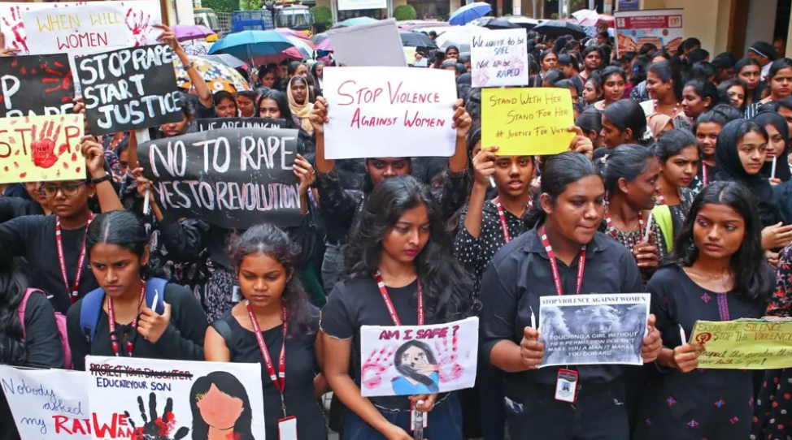
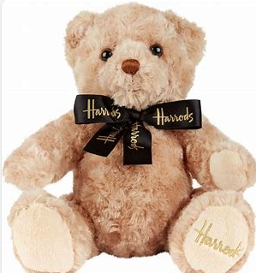
Notes:
Over the last couple of years there has been increasingly strong focus and media interest in sexual harassment cases global basis.
What we are covering might be upsetting for some that have experienced such incidents, and we will also signpost to official organisations at the end to reach out for support

Slide 13
Please download and install the Slido app on all computers you use
How confident are you to speak up in a work-related setting when you see / experience something that isn’t right?
ⓘ Start presenting to display the poll results on this slide.

Slide 14
Practical Input
Colin Jellicoe – Chief People Officer, MGroup Services
The legal implications & how to put them into practice
https://thewun.co.uk/
Notes:
Speaking up when you hear something sexist can help to derail sexism. When you voice your opinion, you can help people challenge their own assumptions and biases about sex and gender. Your actions can help teach others how to effectively confront sexism. Standing up against sexism also shows victims of sexism that you will support them.

Slide 15
What is harassment?
Harassment is unwanted conduct related to protected characteristics, which are sex, gender reassignment (i.e. transgender status), race (which includes colour, nationality and ethnic or national origins), disability, sexual orientation, religion or belief and age, that:
has the purpose of violating a person's dignity or creating an intimidating, hostile, degrading, humiliating or offensive environment for that person
is reasonably considered by that person to have the effect of violating their dignity or of creating an intimidating, hostile, degrading, humiliating or offensive environment for them, even if this effect was not intended by the person responsible for the conduct.
Under this new legislation, employers not only have to ensure sexual harassment is managed appropriately, but they have a duty to undertake anticipatory action. Therefore, they must put in place proactive steps, to prevent harassment, especially of a sexual nature, occurring in the first place.
https://thewun.co.uk/
Notes:
What is classed as sexual harassment:
unwelcomed and unreciprocated behaviour of a sexual nature
can include different levels of severity from physical to non-physical often explained as banter or a joke
can be in the form of leering, sexual comments on appearance, sexual gestures, emails, phone messages or the sharing of visual images
From October 2024 the Worker Protection (Amendment of Equality Act 2010) Bill strengthens existing protection for workers against sexual harassment. The law places a duty on employers to take all ‘reasonable steps’ to prevent sexual harassment by colleagues, third parties, such as clients and customers, service users and members of the public.
When is it classed sexual harassment:
the person receiving the sexual behaviour decides if it’s unwanted – not the person doing the behaviour
It doesn’t matter if other people think the unwanted sexual behaviour is okay, or if it’s common in the place it’s happened in
It can be a one-off incident or repeated
Just because certain sexual behaviour was welcomed or not objected to in the past doesn’t mean that it can’t become unwanted, or that other sexual behaviour is wanted
Unwanted sexual behaviour doesn’t need to be intentionally directed at the victim or survivor – it can be something they witness or overhear
If a victim or survivor of sexual harassment is treated badly or less favourably because of their reaction to that harassment, the Equality Act 2010 says that this is also harassment
What some people might consider as joking, 'banter' or part of their workplace culture is still sexual harassment if:
the behaviour is of a sexual nature
it's unwanted
it violates someone's dignity or creates an intimidating, hostile, degrading, humiliating or offensive environment for them
There are particular situations where sexual harassment may be more likely to happen: when there is an imbalance of power, events and Christmas parties where there is alcohol involved and lone workers

Slide 16
Please download and install the Slido app on all computers you use
Have you ever experienced or observed discrimination in the workplace?
ⓘ Start presenting to display the poll results on this slide.

Slide 17
Your Experience
You are not alone:
2 in 3 young women have experienced sexual harassment, bullying or verbal abuse at work
Half of LGBT+ workers have been bullied or harassed at work
43% of women have experienced problematic behaviour at work, compared to 37% of men
Women are three times more likely to be the target of sexist jokes
Research from the Fawcett Society in 2020 found that at least 40% of women experienced workplace harassment, and nearly half of them had experienced online harassment
https://thewun.co.uk/

Slide 18
Why does it matter?
“It’s just banter.”
“Learn to take a joke.”
“Don’t be so sensitive.”
https://thewun.co.uk/
Notes:
Bullying is already a hard to define term, especially since it is not considered unlawful in the workplace unless it is discriminatory or constitutes harassment. However, beyond those fine lines between bullying, discrimination and harassment, is the fine line between bullying and banter, which is often not thought to be the same as bullying but can lead to bullying behaviour, discrimination and harassment.
What is banter?
Banter is described as the playful and friendly exchange of teasing remarks. This is often between friends who know each other well and are comfortable with one another to say things that could potentially be deemed offensive by others, especially if the joke is at somebody else’s expense.
Dealing with banter at work
There have been several high-profile cases of “banter” being taken too far by some colleagues in workplaces, particularly over WhatsApp groups where “jokes” were accused of being used to bully and discriminate people both in and out of the group.
Researchers discovered that when a sexist remark is delivered as a joke, the humour decreased perceptions that the speaker was sexist, and ultimately decreased the probability that the listener would confront the perpetrator. Alarmingly, hostile sexists were less likely to be confronted when their message was delivered with humour.
Sexist, humorous messages actually increase tolerance for sexual harassment in the workplace. Raunchy jokes / lewd humour that demean or target women and other minority groups are dangerous for our culture. Recipients who stay silent are tacitly endorsing it, meaning they are part of the problem, too.

Slide 19
How to confidently #Speak Up
There is no one-size-fits-all strategy, but we suggest:
Recognise the behaviour that happened to you / to other people Respond to behaviour / comments. This could be done in two ways: In the moment when the incident happened At a later stage, when you‘ve gathered your thoughts and confidence When and how you speak up highly depends on the audience and situation You can still speak up, even if the incident happened a few hours / days / weeks / months ago You can speak up for yourself or on behalf of others It might feel uncomfortable at first, that‘s normal, but it will get easier
https://thewun.co.uk/
Notes:
Speaking Up can be difficult, you might feel uncomfortable or like ‘you’re rocking the boat’
It can be hard to find the right words, and it’s normal to feel this way.
You might not know what to say in the moment, this is normal.
There is no right way!
Really hard & difficult to speak up in the moment sometimes
If you don‘t speak up in the moment, you can still do something about it!
Don‘t feel bad if you can‘t speak up in the moment
First time – might feel uncomfortable but gets easier the more you do it

Slide 20
Techniques to #Speak Up
Speaking up in the moment:
Call attention to it: I don’t understand. Why is that funny?
Ask for clarification or more information: “Could you say more about what you mean by that?” “How have you come to think that?”
Restate or paraphrase: “I think I heard you saying____________. Is that correct?
Challenge:
“Actually, in my experience__________________.”
“I think that’s a stereotype. I’ve learned that_________________.”
“Another way to look at it is _________________.”
https://thewun.co.uk/
Notes:
Kill ‘em with kindness – often works better than aggression or emotional responses

Slide 21
Techniques to #Speak Up
Promote empathy
Ask how they would feel if someone said something like that about their group, or their friend/partner/child/parent:
“I know you don’t like the stereotypes about ______ (their group.”
“ How do you think he feels when he hears those things about his group?”
“How would you feel if someone said that about/did that to your sister or girlfriend?”
Remind them of the rules or policies:
“That behaviour is against our code of conduct and could really get you in trouble.”
Tell them they’re too smart or too good to say things like that:
“Come on. You’re too smart to say something so ignorant/offensive.”
https://thewun.co.uk/
Notes:
Kill ‘em with kindness – often works better than aggression or emotional responses

Slide 22
Formal #Speak Up
If you feel you can’t speak up in person or when the incident happened, there are still ways to speak up:
Whistleblowing Policy
Worker Protection Act – requirement for risk assessments on potential sexual harassment
Historical incident reporting
Company Employee Assistance Programmes
Mental Health First Aider
External support from specialised organisations
https://thewun.co.uk/
Notes:
Whistleblowing Policy within your organization
Changes in the Equality Act 2010 require every UK business to have risk assessments against risks of workers experiencing sexual harassment
3 months period to report incidents has been increased to 6 months – any historical incidents to be reported culturally
If your company has an Employee Assistance Programme (EAP) in place, try and use the resources provided
Speak to the Mental Health First Aider in your organisation, if you have one
If you want external support, please refer to organisations such as:
Citizens Advice
ACAS
MIND
Suzy Lamplugh Trust
Or to other material such as:
The sound of things not being said | Margaret Heffernan (youtube.com)

Slide 23
EON’s Best Practice
Kirin Kalsi
General Counsel, Compliance Officer and
Data Protection Officer @ EON
https://thewun.co.uk/

Slide 24
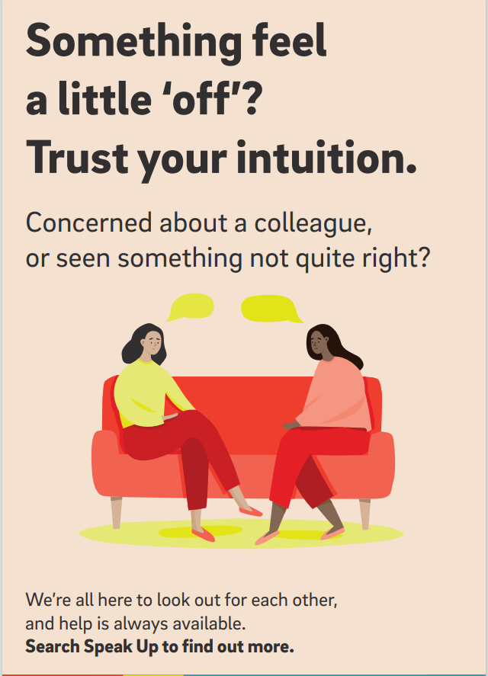
Best Practice Example –
EON’s #Speak Up
Focus on how you feel within a situation, and trust your intuition Encourage colleagues to look out for one another Support with updates to policies, and practical guides Leadership engagement Compliance cafes Webinar with Margaret Heffernan, author of Wilful Blindness Share information with inclusion network leads for them to support their members and communities
What worked for EON:
CEO interview on Speak Up Culture Guest speaker webinar Roadshows across various UK sites Attendance at leadership events Office TV screens, posters HR policy and guidance updates CPO interview on ‘Speak Up‘ Culture Whistleblowing stories
https://thewun.co.uk/
Notes:
It can be the case that you don’t realise something wasn’t right until afterwards. Reflecting and returning to the situation doesn’t diminish its importance. One option involves talking to the other person. This can help resolve issues quickly and can help improve the relationship.
At the meeting:
• Clearly describe the behaviour to the other person
• Say that it is unwanted and describe what you consider to be more acceptable behaviour
• Seek agreement on what to do next
• Be prepared for the other person to be upset and be sensitive to their reaction – they may not have realised there is a problem
Appropriate when:
• The working relationship is ok at least some of the time
• The problems are recent
• Both parties are confident
Not appropriate when:
• There have been threats or threatening behaviour

Slide 25
Please download and install the Slido app on all computers you use
reflecting back to our first slido... how confident are you now to speak up when you see / experience something that isn’t right?
ⓘ Start presenting to display the poll results on this slide.

Slide 26
What Else to Expect from #SpeakUp
Event Policy Behaviours and Pledge Potential further skills sessions Blogs around the topic of speaking up + resources Podcasts with senior leaders discussing best practices
https://thewun.co.uk/

Slide 27
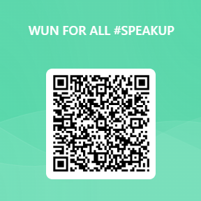
Q&A and Feedback
https://thewun.co.uk/
Notes:
This part will not be recorded and please treat anything brought up confidentially.
We will share material from the session in a blog after
Holly will kindly look into the chat to help guide any upcoming questions, and we encourage you to ask anything. If you want to remain anonymous, please can you send a message to Holly only, and she will mention the question without a name attached to it.
If you feel like there is something you’d like to discuss in more detail and maybe a smaller circle, Di and I will stay on for another 15-20 mins after this session for anyone that feels like they want to talk. Although we will do our best to support of course, we will ask to take certain topics offline into a separate conversation if we feel they require a certain confidentiality or would go too deep for the whole group of attendees. You can also of course get in touch with either myself or Di after this session. We will obviously keep any topics confidential, however if we feel there is potential safeguarding concerns, we will raise it with yourself and set further steps necessary.
Addressing topics to specific people:
Dy – How / get you through when you’re in the process
Kirin – practical experience / Leadership piece, best practice
Colin – legal implications around equality act
Jess –
Becky –
If you feel like there is something you want to raise / discuss, please feel free to reach out to Dy / Julia
If you feel like you have something to share, please do. In case we think there is something where we might need to take appropriate action, we will discuss this with you separately

Slide 28
Thank you!
https://thewun.co.uk/

