Slide 1
























































Slide 2




Welcome
Career Mapping
The session will be starting shortly
18th September 2024
https://thewun.co.uk/

Slide 3
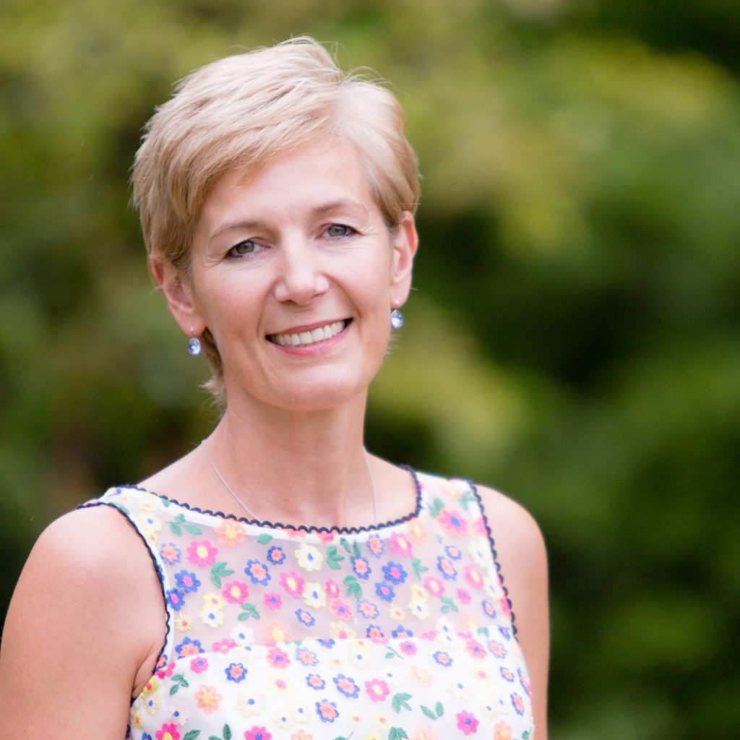

Hayley Monks WUN Co-Founder & Director,
SVP WNS

Slide 4


Dates for your diary
WUN Events
18th October #IAmRemarkable workshop – Fully booked
14th November #IAmRemarkable workshop – Just a few places remaining.
26th November Net Zero 6pm– How we get there: Energy – CMS, London.
Panelists: Cathy McClay National Grid DSO, Alexandra Meagher Octopus Energy Group,
Nichola Plower, Baringa & Sarah Elias, AFRY Management Consulting.
The WUN advocates & directors are out & about over the coming months at:
Reuters, MEUC & TEC events too – so please do come & say hello!
27th June 2025 Women In Utilities Awards in association with Utility Week, London.
Free tickets available visit our Events page!
https://thewun.co.uk/

Slide 5

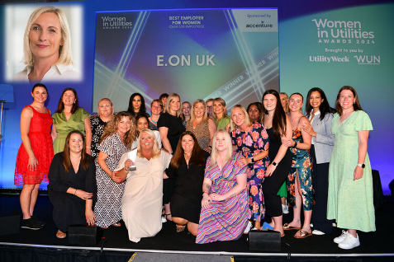
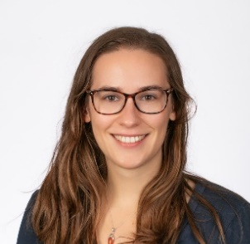


WUN Podcasts
Listen to our latest podcasts More coming soon !
Behind the Scenes with E.ON Winner at Women in Utilities Awards for Best Employer – Becky Percy, Diversity & Inclusion Lead talking with WUN Advocate, Holly Beeston.
Becky has worked in the industry for over 20 years, with experience in internal communication, engagement, digital, agency management, diverse talent development, and culture change. Over the last three years, as D&I lead, created and delivered an insight-based strategy to improve engagement and experiences that put colleague voice and lived experiences at its heart.
Energy Markets with Lillian Philip talking to Kip Quiney, Senior Manager at EDF Energy
In this episode WUN advocate Lillian Philip talks to Kip Quiney, Senior Manager at EDF Energy, discussing the UK commodity markets and how movements here change the prices on our energy bills.
You can follow our podcast on Apple Podcasts, Spotify, Amazon Music and wherever else you get your podcasts – just search “WUN4ALL”.
Or just click through from the website: https://thewun.co.uk/news-blogs/

Slide 6


Join the free WUN Mentoring Programme
New WUN Mentoring now available –
WUN offers mentoring to women at any stage of their career in the utilities sector.
We are hugely privileged to have over 100 fantastic experienced mentors within the WUN mentoring programme.
With growing numbers of Mentors and Mentees we are delighted with the community and support fostered within the mentoring programme.
If you are interested in becoming a Mentor or Mentee, please visit our website: https://wun.onpld.com

Slide 7

Don’t forget to join the Network
to receive the next WUN newsletter
https://thewun.co.uk/join-wun/

Slide 8
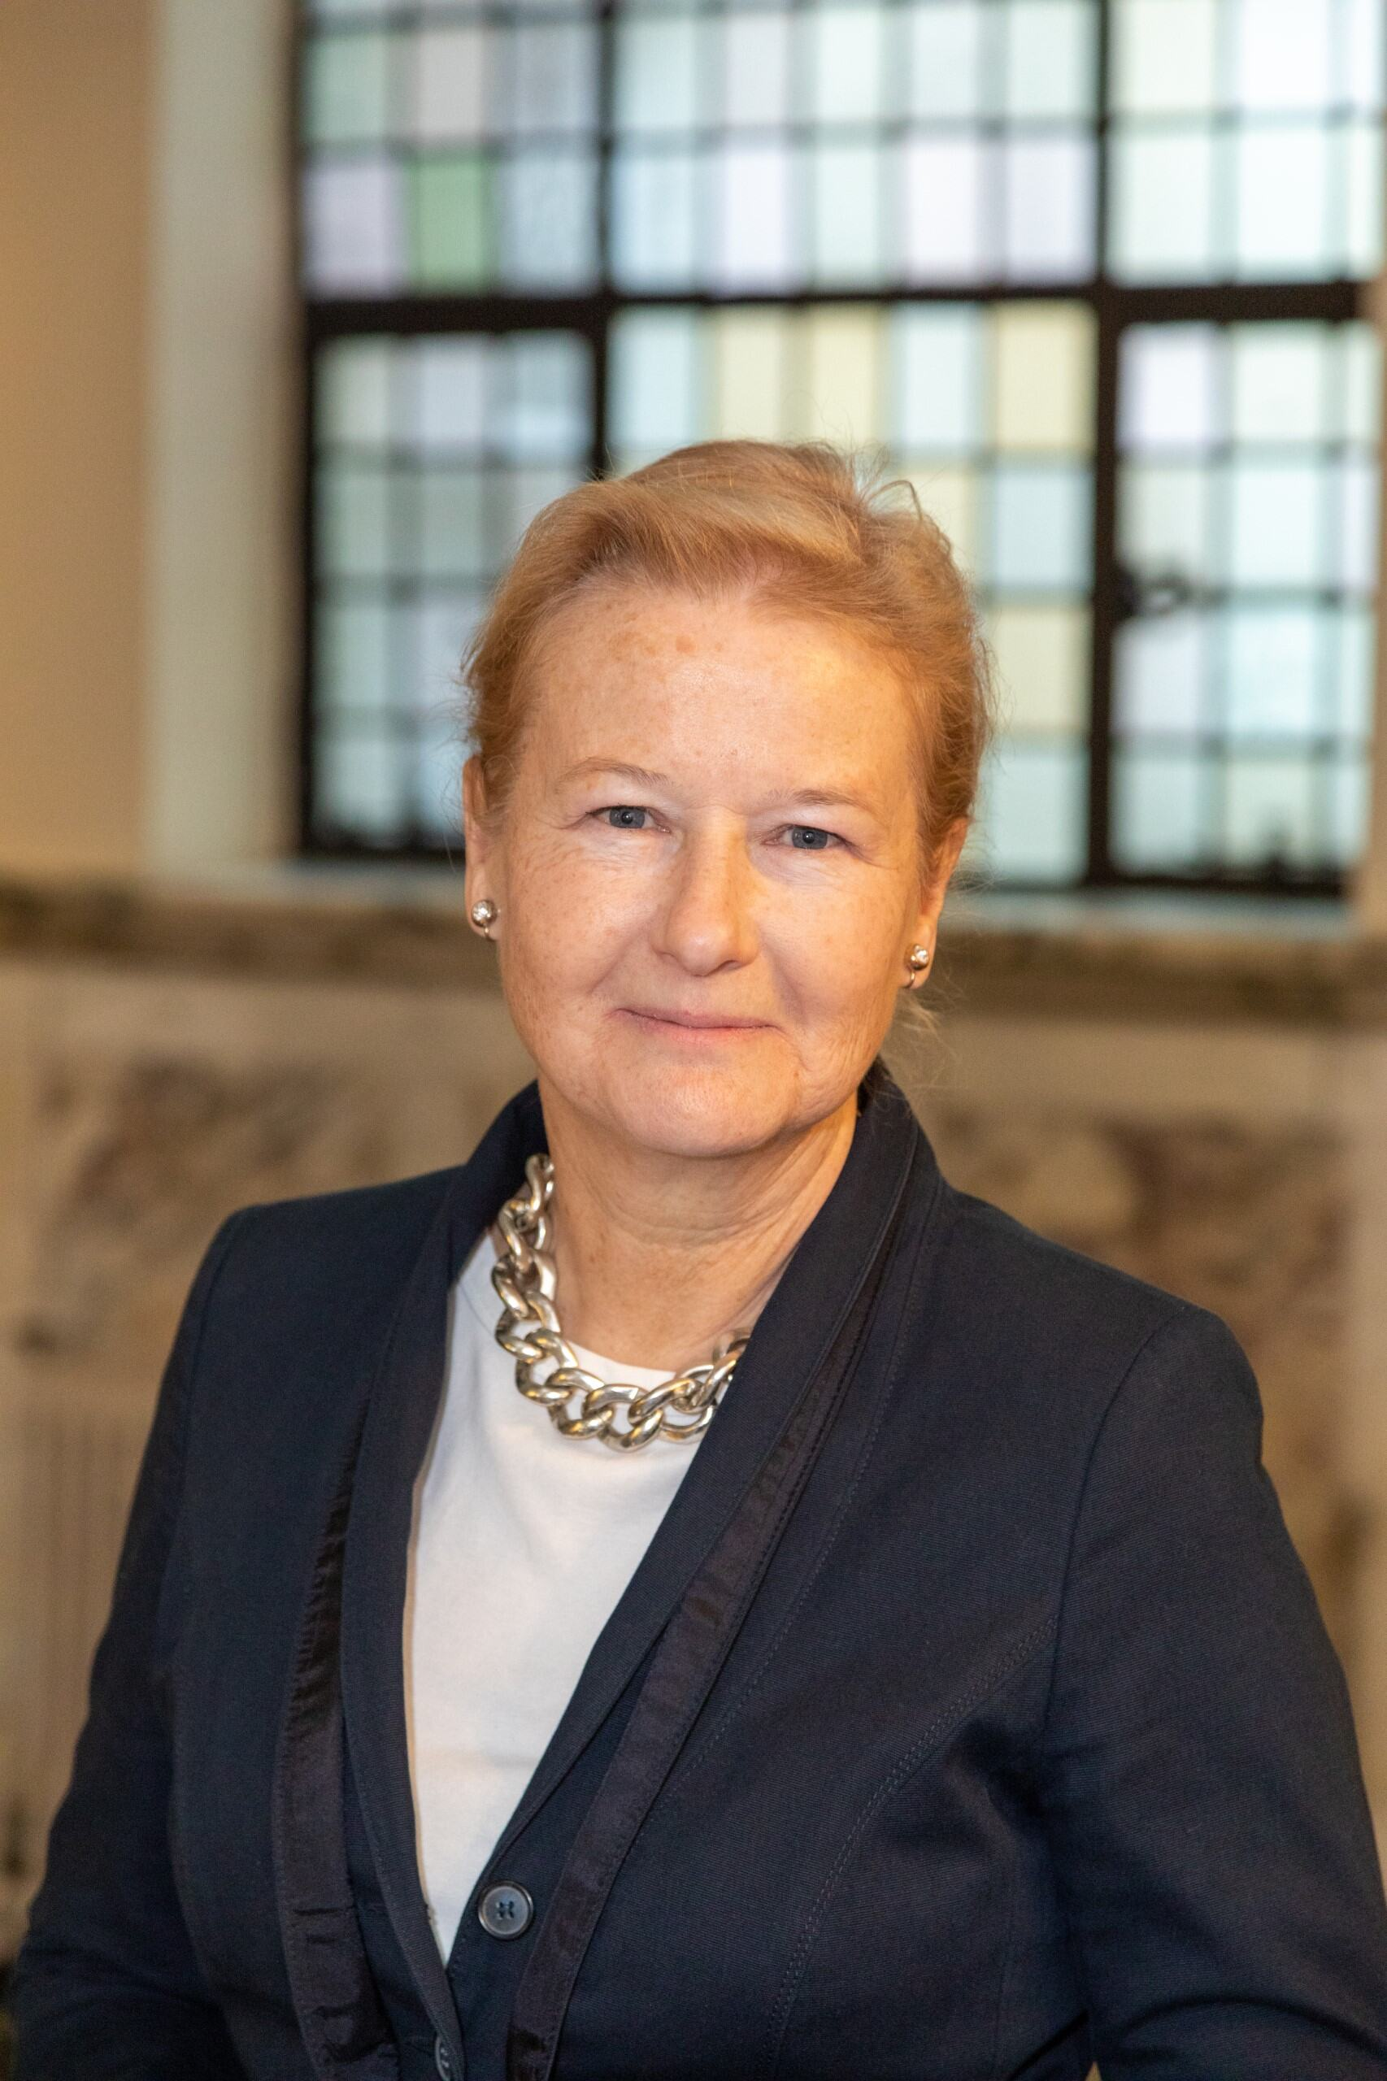
Today’s Speaker Kathryn Bishop, CBE.
Kathryn Bishop combines teaching at Oxford’s Saïd Business School, with the practical
experience of leadership roles in the private, public and voluntary sectors.
She served as the first Chair of the Welsh Revenue Authority, Britain’s newest tax authority, and was awarded a CBE in June 2021 for services to diversity and public administration. She is the Chairman of the Dean Close Foundation and a non-executive on the board of DAC Beachcroft, an international law firm.
She has spent the last decade working to help individuals – both men and women - build successful working lives, and has poured everything she has learnt into her first book, Make Your Own Map: Career Success Strategy for Women. The book focuses on women’s working lives but contains useful insights for everyone. Her second book – on the importance of conversations round the boardroom table – was published in October 2023 and is called “Board Talk: 18 crucial conversations that count inside and outside the boardroom.”
https://thewun.co.uk/

Slide 9
Mapping Your Career
WUN – Womens Utilities network
Notes:
Transitions
Some ideas from research
Two models that many people find helpful in dealing with – or planning for – transitions

Slide 10


Your Journey so far…

Slide 11

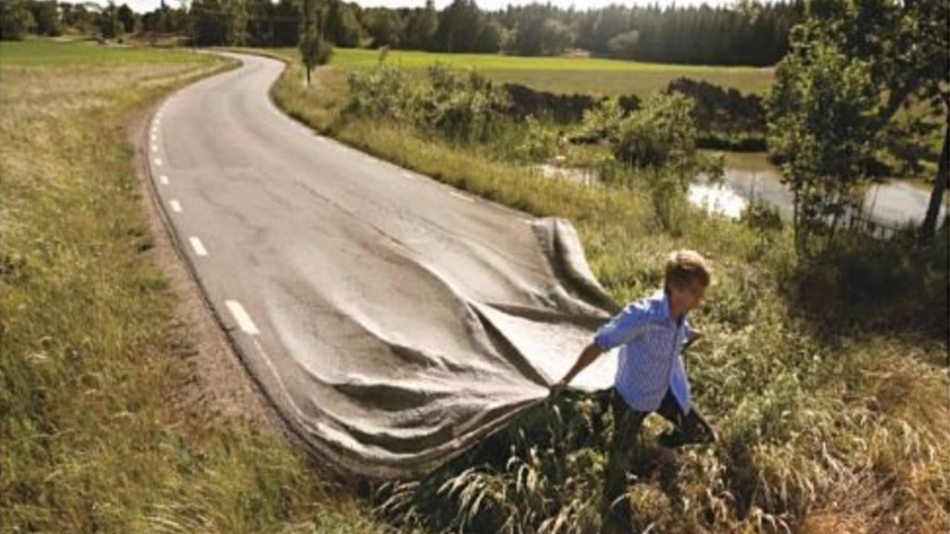

Slide 12

“Would you tell me, please, which way I ought to go from here?”
“That depends a
good deal on where you want to get to.”
This Photo by Unknown Author is licensed under CC BY-NC

Slide 13
Three themes emerged from research with female CEOs about their careers:
self-acceptance
self-development
self-management
Claiming the Corner Office: Female CEO Careers and Implications for Leadership Development
Dr Andromachi Athanasopoulou, Dr Amanda Moss-Cowan,
Dr Michael Smets,
Professor Tim Morris
Human Resource Management, 2018

Slide 14

Photo by Salomon Byuma Pexels

Slide 15
self-acceptance:
“…processes by which female CEOs came to recognize and accept their own leadership potential, and cope with their own and others’ expectations about their priorities on work and family. Overcoming confidence barriers emerged as key, alongside learning to cope with career and family challenges as they were taking on greater responsibilities…”
Claiming the Corner Office: Female CEO Careers and Implications for Leadership Development

Slide 16

Photo by Min An from Pexels

Slide 17
self-development:
“…Supporting the long game not only offers women the time and space to accept their potential as leaders, but also develop the requisite skills. Without access to formal development programs - due to lack of self-promotion or sponsorship - much of this development remains incumbent upon women. Hence, we discuss their self-development – in preparation for and on the job…”
Claiming the Corner Office: Female CEO Careers and Implications for Leadership Development

Slide 18

Photo by Peter Fazekas from Pexels
Photo by Peter Fazekas from Pexels

Slide 19
self-management:
“… With “more and more pressure on CEOs to be more truthful and more genuine”, a recurring self-management theme was how they seek to be authentic and focused on their purpose. …For women, their multiple life and work roles and identities mean they may be drawn to behave in ways that contradict each other and finding a balance can be challenging …”
Claiming the Corner Office: Female CEO Careers and Implications for Leadership Development

Slide 20

The proposition
Using the same approaches which organisations use for planning and development…. on your own working life

Slide 21

Using the lessons from corporate strategy on ourselves:
Navigating through uncertain and changing conditions and markets
Organizing to implement strategy – for your own career – and life in general
Focused around purpose

Slide 22
Three stages of organizational strategy
Where are you now? The “as-is” state
Where do you want to get to? The “to-be” state
How will you get there? The journey of change

Slide 23
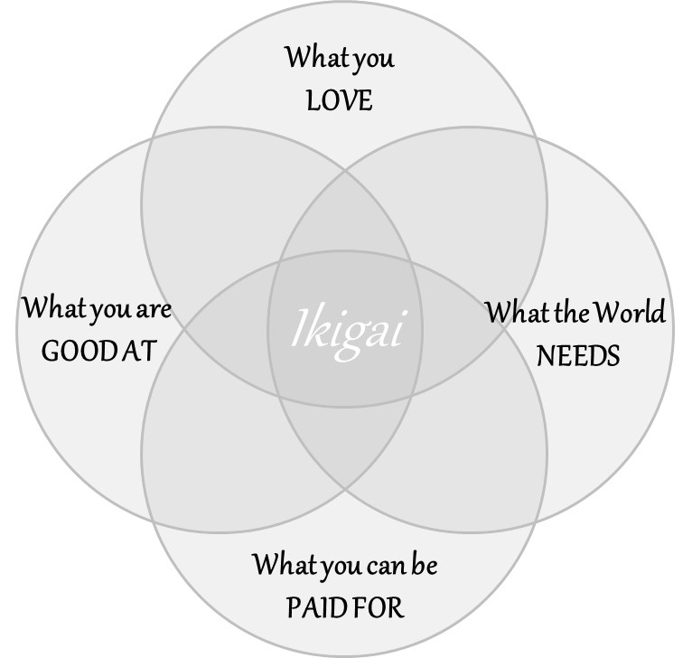

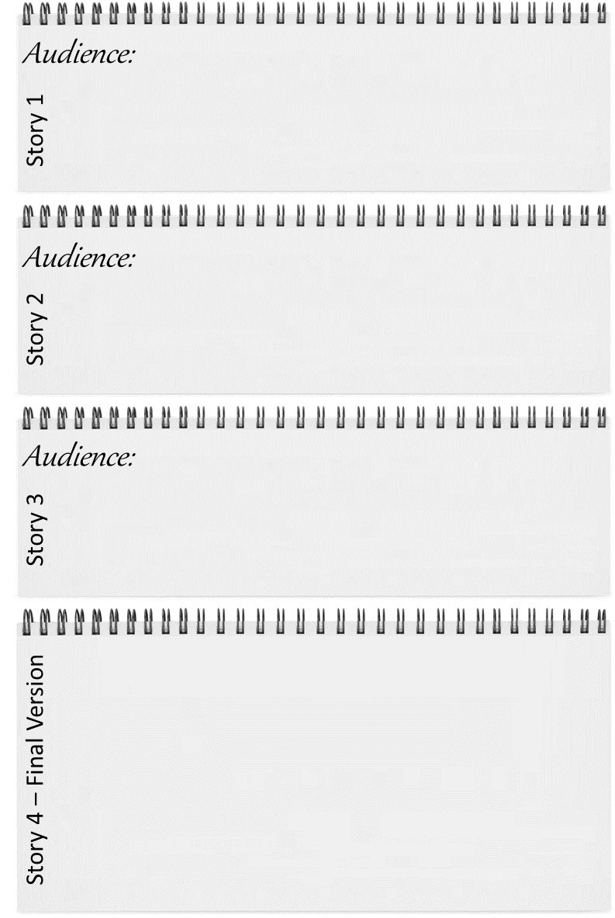
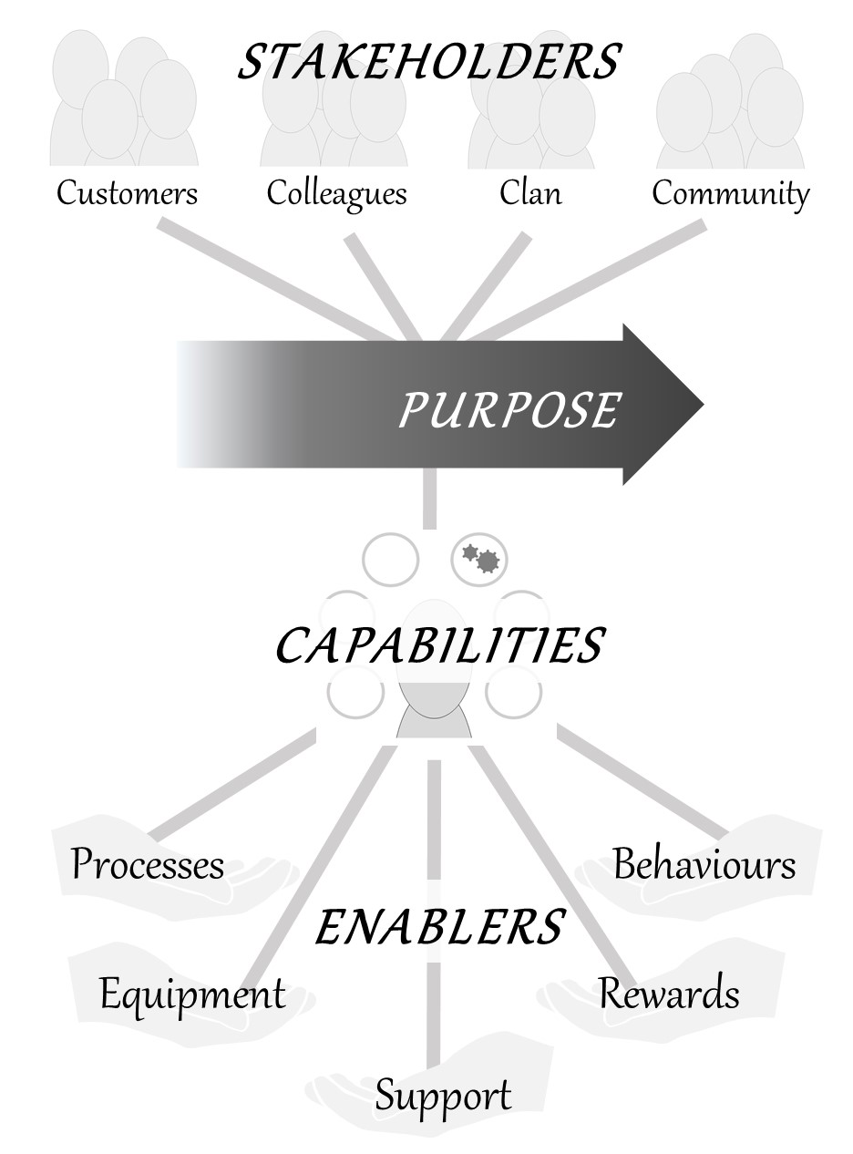
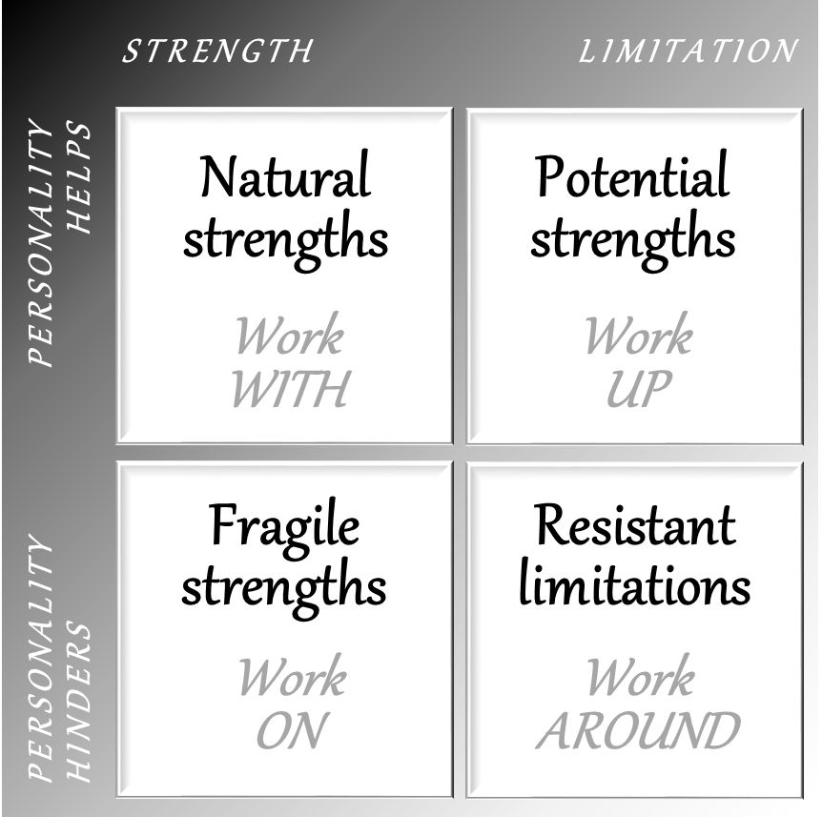
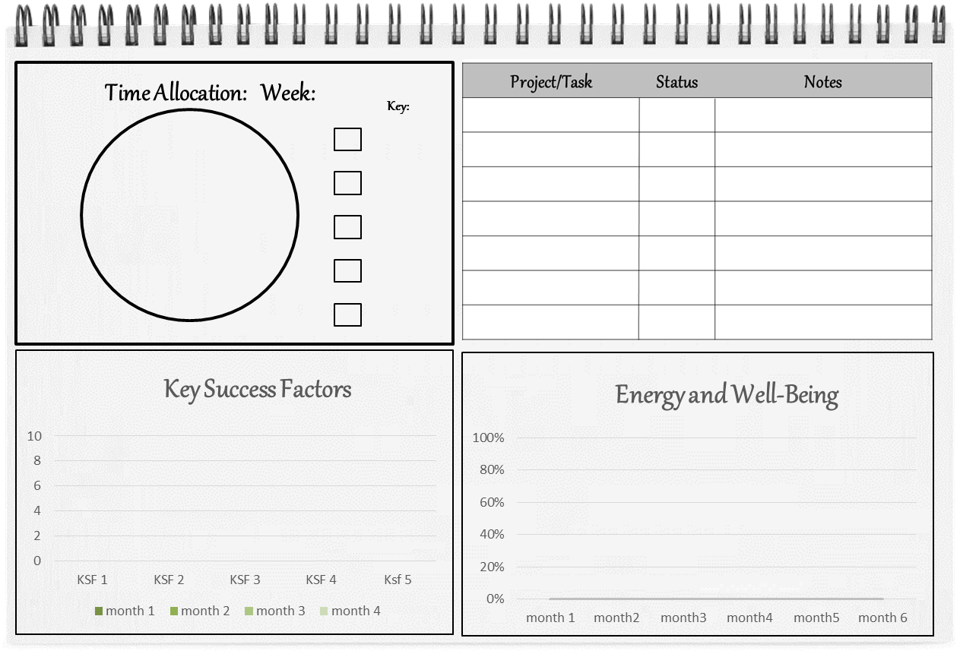
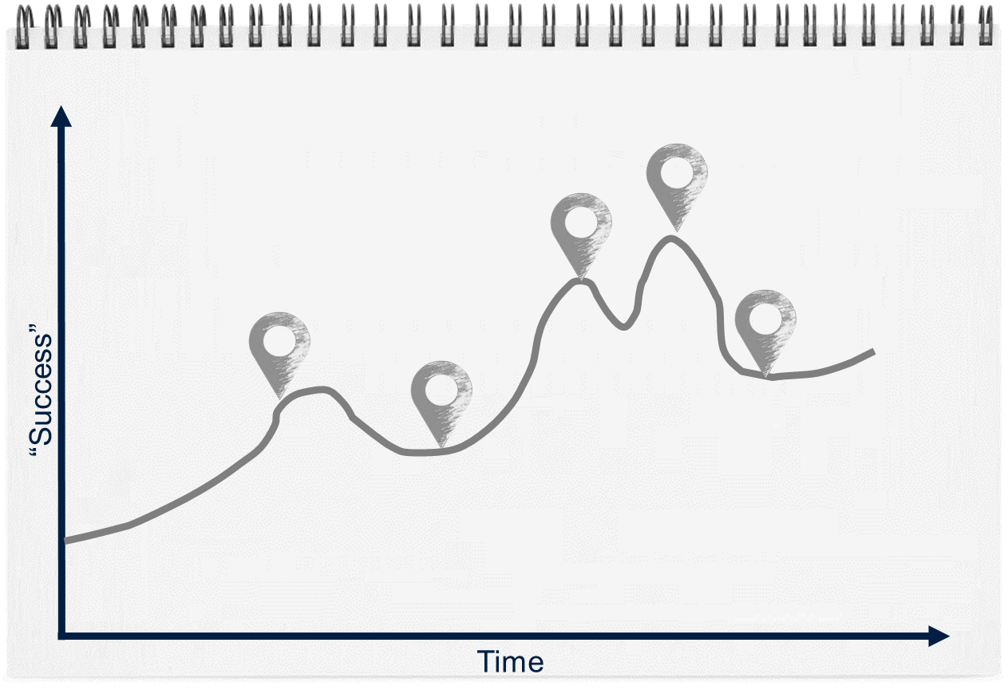
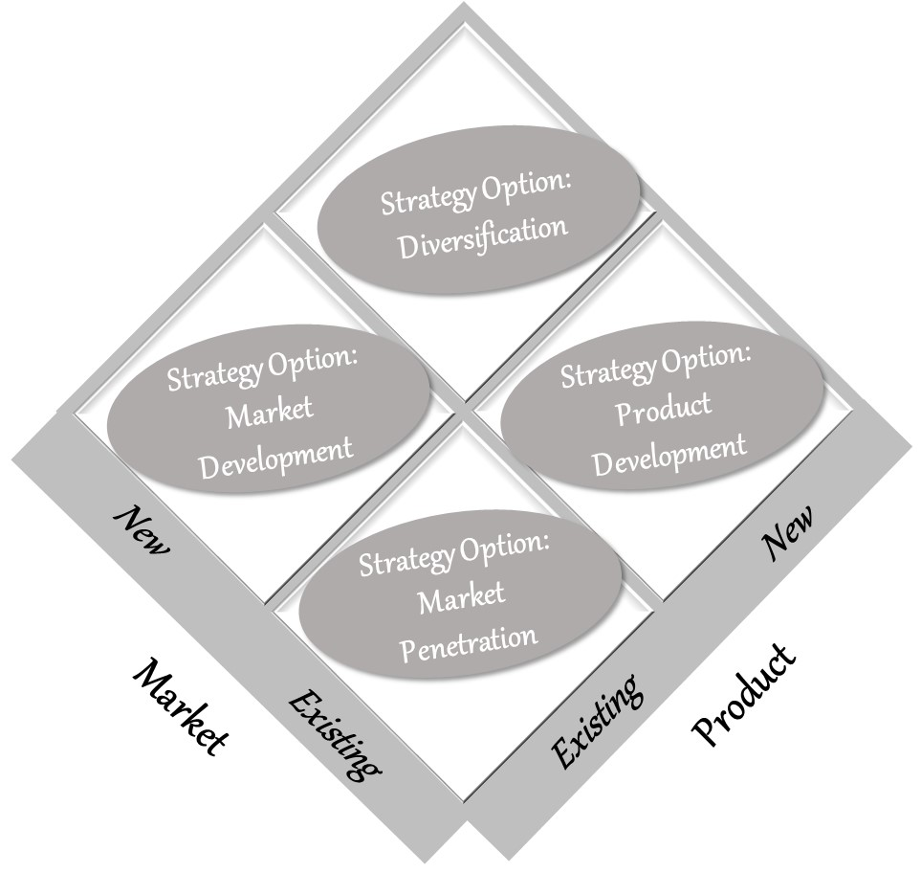
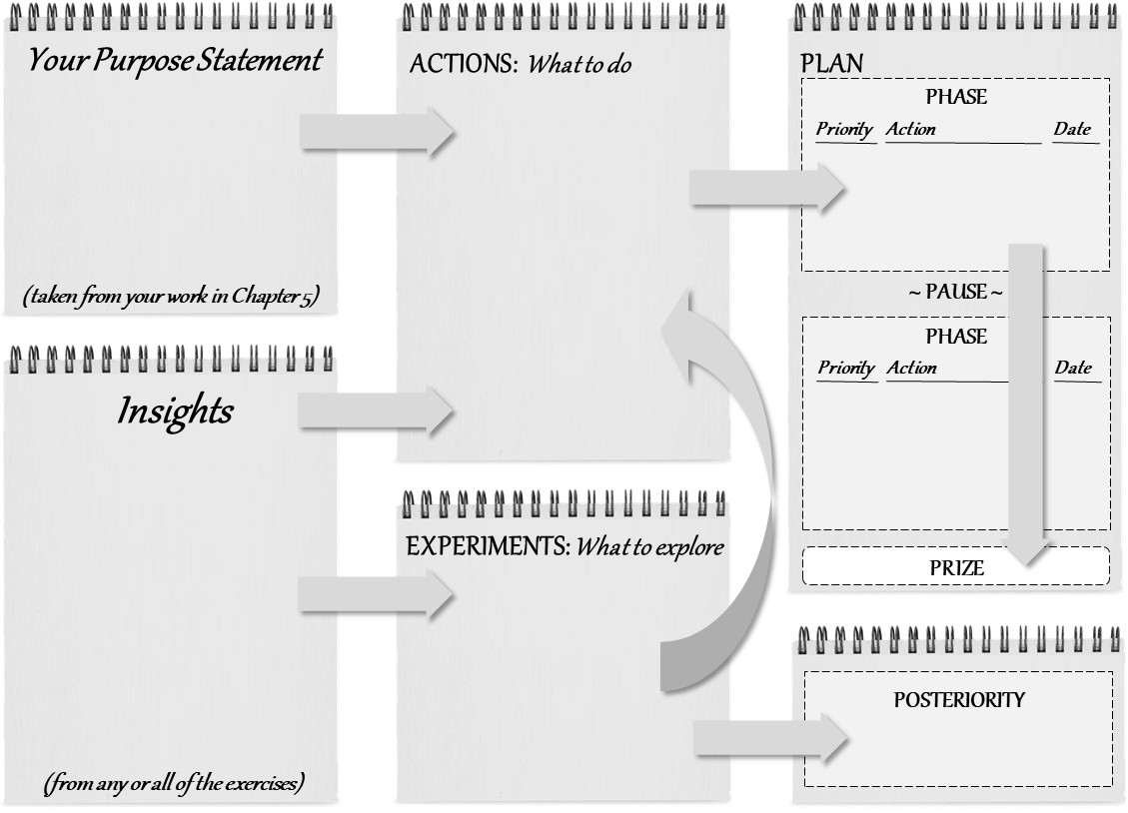
Making Your Own Map
Where do you want to be?
How to get there?
Where are you now?

Slide 24
Making Your Own Map
What you’ve done and
learned so far – what
you have to work with

Slide 25
Making Your Own Map
Where are you spending time and energy right now – what’s working and what is not?

Slide 26
Making Your Own Map
Reflecting on the whole of your life -

Slide 27
Making Your Own Map
Uncovering your current sense of purpose

Slide 28
Making Your Own Map
Organizing your life around your purpose

Slide 29
Making Your Own Map
Deciding what to develop – 4 strategies

Slide 30
Making Your Own Map
How to plan a transition – 3 strategies

Slide 31
Making Your Own Map
Turning insights into action

Slide 32
Before we do an exercise…. a moment for questions and discussion

Slide 33
Making Your Own Map
What you’ve done and
learned so far – what
you have to work with

Slide 34
Your Journey Map
????
“Success”
Time

Slide 35
Your Journey Map – a new perspective
“Success”
Time

Slide 36
How did I get out of the times when I wasn’t successful – what did I do?
What was going on in my work life when I was “successful”?
Have I learnt skills and had experiences which aren’t on my CV?

Slide 37
Making Your Own Map

Slide 38



Thank you to Kathryn,
our generous hosts SEFE Marketing and Trading & supporters Microsoft plus all of WUN partners for their support to make this event possible.
https://thewun.co.uk/

Slide 40

WUN’s NEW Career Development Framework
Introduction to WUN Drive -
Our Skills Development Programme for Women
https://thewun.co.uk/

Slide 41

What is WUN Drive ?
A skills development programme for women in management roles
Designed and delivered by women in utilities, for women in utilities
Six virtual three-hour modules, delivered from December 2024 to May 2025
£1,250 (excl VAT) per participant
Why choose us ?
More than just a training course—a comprehensive development journey designed to empower women working in utilities
A safe space to really discuss challenges honestly
Gain a supportive network of peers to create long lasting relationships across the sector
Sector relevant with insight and examples that are rooted in the reality for women in the sector
https://thewun.co.uk/

Slide 42

Programme Overview
Module 1: Management Foundations
Setting personal objectives, managing the challenges of life as a woman at work, psychological safety and creating an environment where your team feel safe to express ideas, try new things and voice concerns.
Module 2: Impactful Conversations
Communication and coaching techniques to support growth and development. and techniques for self-reflection and personal development for managers and their teams.
Module 3: Speaking Up & Leaning In
Strategies to build and maintain confidence in different situations, including presenting yourself assertively, handling difficult conversations, and making decisions with conviction. Imposter syndrome, techniques to overcome it, and developing a strong sense of self-worth and confidence.
Module 4: Performance Management
Setting expectations, constructive and actionable feedback and conducting performance reviews. Engagement and involvement techniques, and personal reflection.
Module 5: Navigating Careers
Setting career goals, identify opportunities for growth, creating actionable plans to achieve your aspirations and managing the life challenges that women face alongside a career.
Module 6: Commercial Savviness
Bite sized skills to support the climb up the career ladder - influencing, stakeholder engagement, decision making and financial awareness, through the lens of the changing utilities landscape.
https://thewun.co.uk/

Slide 43
What next?
First cohort starts on 4th December 2024
Registration for our first cohort is live NOW !
Sign up or share our website link with your manager or L&D Team !
WUN Thrive – our bespoke Leadership Programme will be launched in October for women already in or seeking senior management roles.
https://thewun.co.uk/

Slide 44
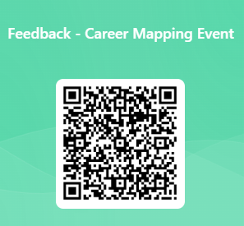
https://thewun.co.uk/

Slide 45


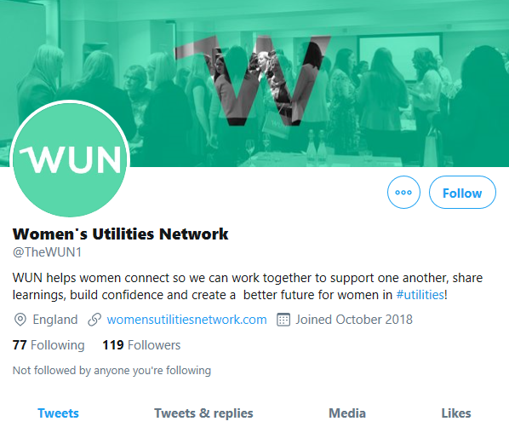
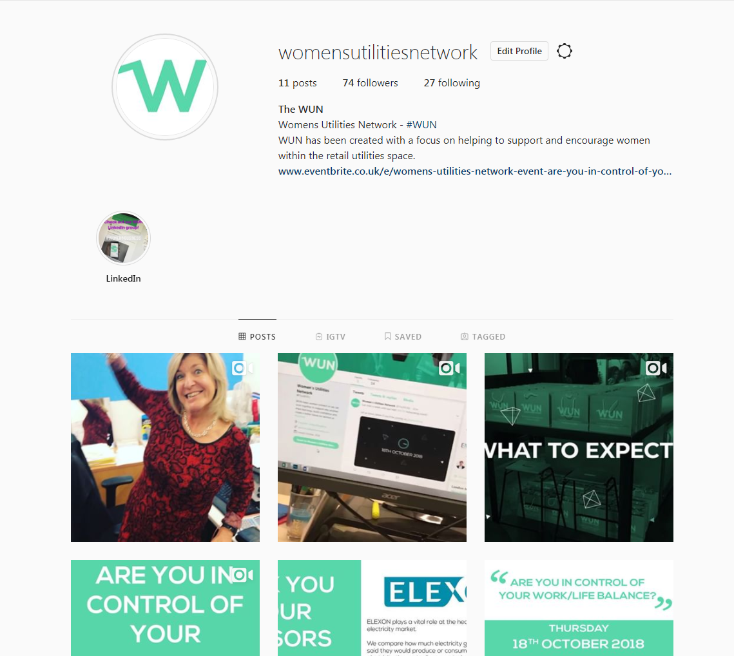
#WUN Don’t forget to follow us for the latest news and updates
https://thewun.co.uk

