Slide 2
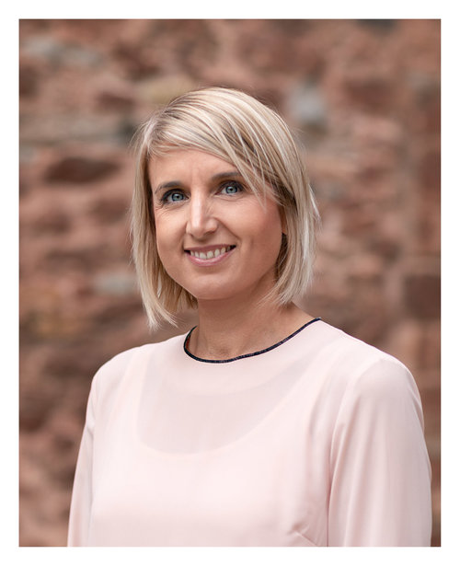
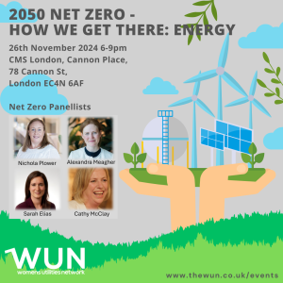
CMS Logo
WUN welcome from
Karen Anderson,
WUN Programme Development Manager
Welcome
2050 Net Zero – How we get there: Energy
https://thewun.co.uk/

Slide 3
WUN
The utilities sector is lacking in diversity with many women being generally under-represented, particularly in senior roles.
WUN was started in 2018 when a group of likeminded women, working in utilities, united around a common cause. The founders were not only passionate about the industry they worked in, but also passionate about the contribution women were making and could continue to make in the future. We now have over 7750 members & 60 plus partners.
Regular Events & Content
Mentoring Programme & Network
7750+
Members
60 +
Partners

Slide 5
Dates for your diary
WUN Events
14th November 2024 12.00 – 1.30pm - #IAmRemarkable workshop – Virtual Event
26th November 2024 6.00 – 9.00pm – 2050 Net Zero – How we get there: Energy
12th December 2024 12:00- 1:00 pm – WUNForAll A festive networking event.
10th January 2025 12.00 – 1.30pm - #IAmRemarkable workshop – Virtual Event
13th February 2025 12.30 – 2.00pm - #IAmRemarkable workshop – Virtual Event
18th Feb 2025 5:30 -8:30 pm 2050 Net Zero How we get there: Water – Birmingham
14th March 2025 11.30 – 1.00pm - #IAmRemarkable workshop – Virtual Event
6th May 2025 11.00 – 12.30pm - #IAmRemarkable workshop – Virtual Event
27th June 2025 Lunchtime – Women in Utilities Awards 2025
Free tickets available - visit our Events page!
https://thewun.co.uk/

Slide 6
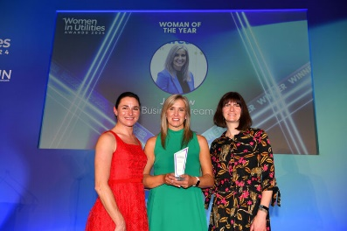
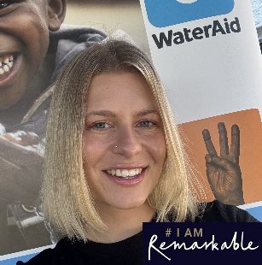
WUN Podcasts
Listen to our latest podcasts - More coming soon !
Hayley Monks, WUN Board Member talks openly with Jo Dow from Business Stream on her recent win at the Women in Utilities Awards 2024.
Jo talks about her pride that Business Stream won three awards & “ how unexpected it was, hugely proud & very humbled by it “her career -time as CEO, as she has led the successful delivery of the company’s ambitious growth strategy.
Jo talks about creating an inclusive environment & is passionate about driving positive change for the environment and society as a whole. This belief led her to introduce the business’ purpose-led vision.
Charlie Page at WaterAid reflects on her #IAmRemarkable experience with WUN Advocate, Kara Sadler
In this episode WUN Advocate Kara Sadler talks with Charlie Page, Engagement Manager within WaterAid’s Water Industry Partnership team, to discuss her experiences with the WUN #IAmRemarkable workshop.
You can follow our podcast on Apple Podcasts, Spotify, Amazon Music and wherever else you get your podcasts – just search “WUN4ALL”.
Or just click through from the website: https://thewun.co.uk/news-blogs/

Slide 7
Join the free WUN Mentoring Programme
New WUN Mentoring now available –
WUN offers mentoring to women at any stage of their career in the utilities sector.
We are hugely privileged to have over 120 fantastic experienced mentors within the WUN mentoring programme.
With growing numbers of Mentors and Mentees we are delighted with the community and support fostered within the mentoring programme.
If you are interested in becoming a Mentor or Mentee, please visit our website: https://wun.onpld.com

Slide 8
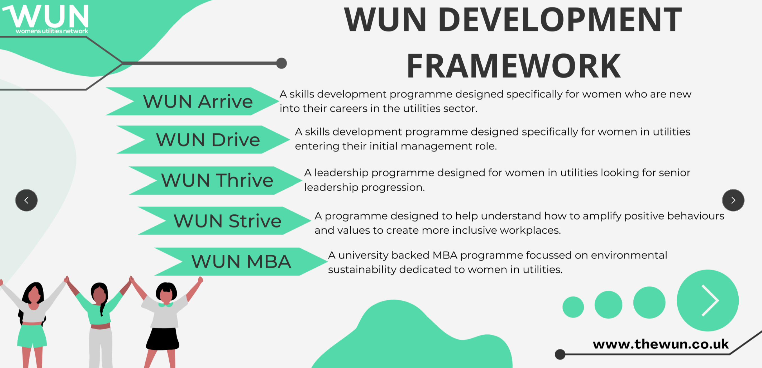
The Womens Utilities Network – Development Framework:
A suite of targeted and bespoke development journeys designed to empower women working in utilities
Created by women in utilities, for women in utilities A safe space to really discuss challenges honestly and create solutions together
Building a supportive network of peers across the sector
Sector relevant with insight and examples that are rooted in the reality for women in utilities
Second Drive cohort starting in March 25.
A skills development programme for women seeking or in initial management roles. Available to sign up on the WUN website now
Thrive available now for registration – start March 25. A development programme for women already in or seeking senior leadership roles

Slide 9
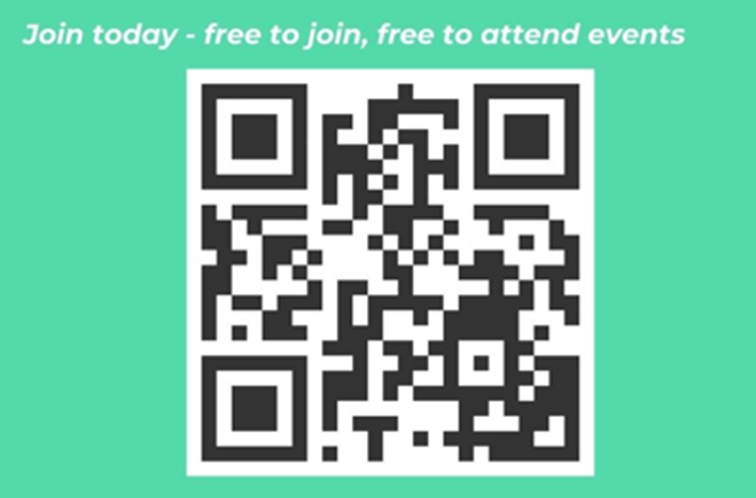
Don’t forget to join the Network
to receive the December WUN newsletter
https://thewun.co.uk/join-wun/

Slide 10
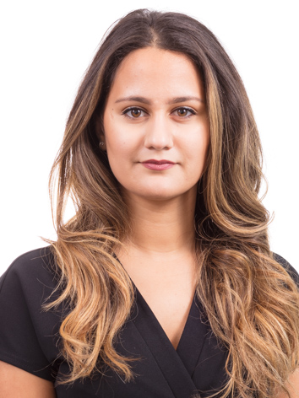
CMS Logo
Welcome and introduction from Sabrina Polito, Associate, Energy & Climate Change Team, CMS
Welcome
2050 Net Zero – How we get there: Energy
Sabrina advises developers, investors, utilities and energy users on power projects, transactions and related regulatory and commercial matters both in the UK and internationally.
Sabrina is passionate about the transition to a low-carbon, smart and flexible energy system, and has a particular interest in digitalisation of the energy sector, the retail market and flexibility.
https://thewun.co.uk/

Slide 11
2050 Net Zero: How we get there
Sabrina Polito (CMS, Energy & Climate Change)

Slide 12
The Energy Trilemma
Decarbonising energy production
ENVIRONMENTAL
SUSTAINABILITY
SECURE AND RELIABLE
SECURE AND RELIABLE
Ensuring the security and reliability of energy supplies
AFFORDABLE AND AVAILABLE
Minimising the cost of energy to consumers

Slide 14
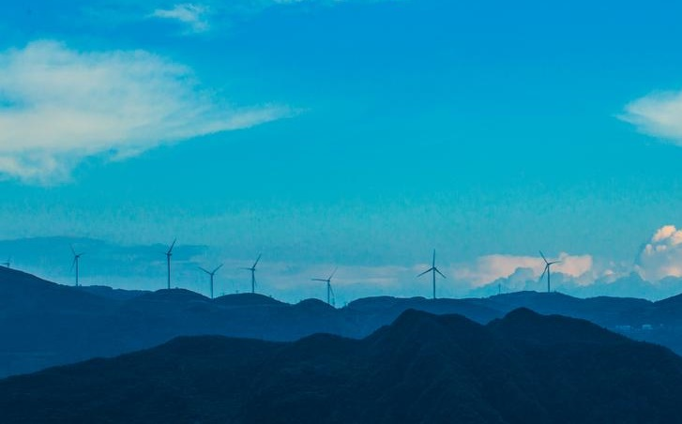
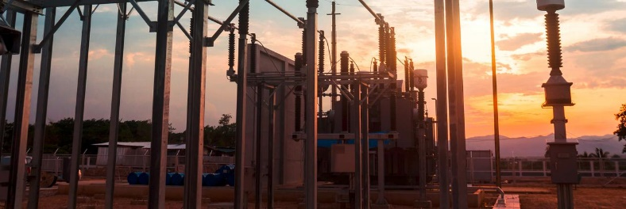
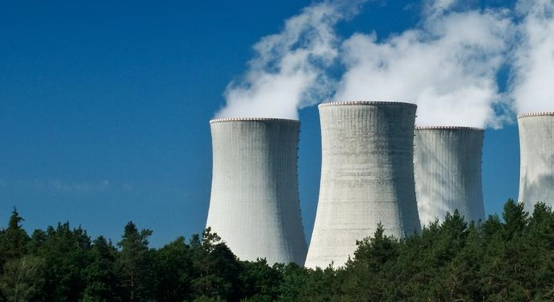
Energy security and reliability

Slide 15
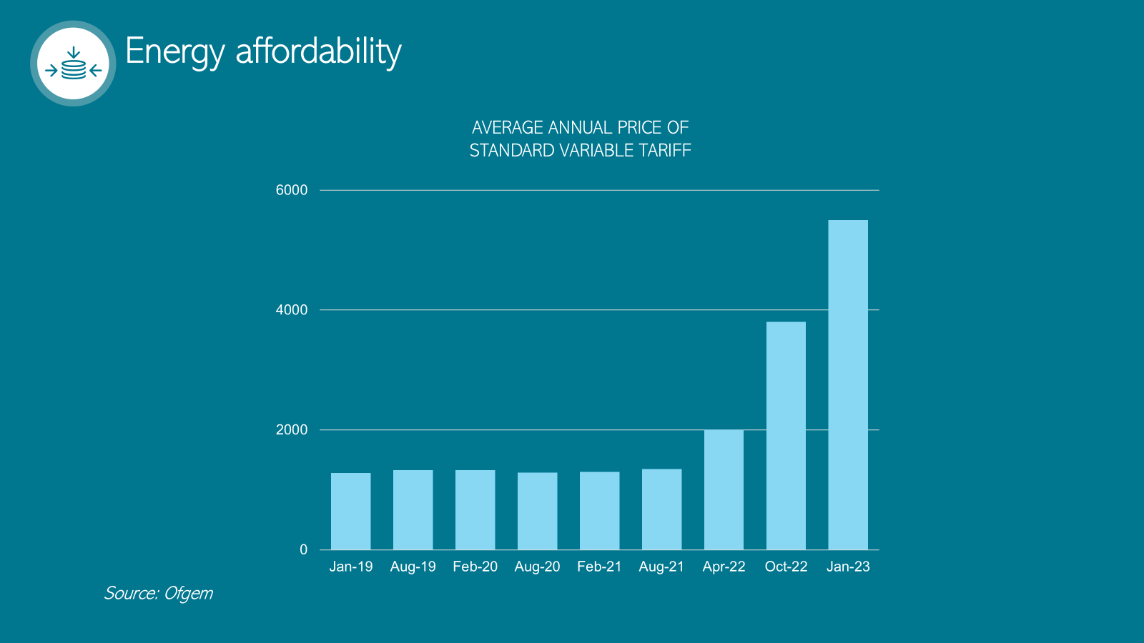

Slide 16
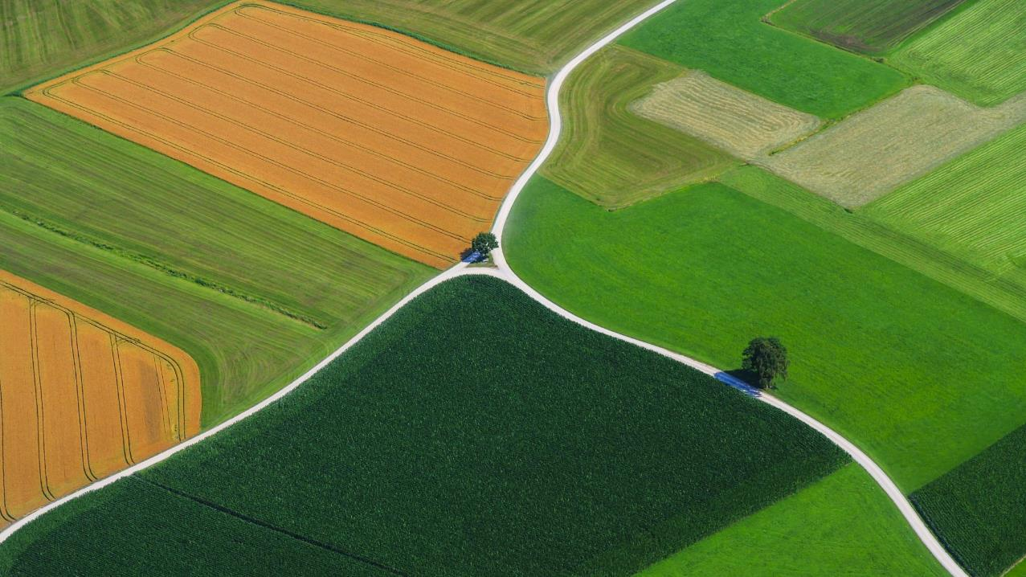
The road ahead
New roles and responsibilities – who will do what to get us to net zero?
How will we get the energy mix we need built?
How do we deliver the right market signals for investment?
How do we bring consumers on board?

Slide 18
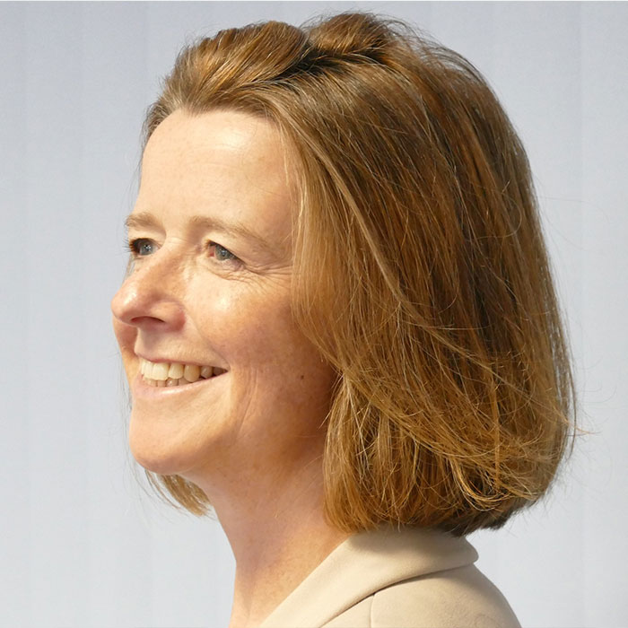
CMS Logo
Chaired by Jo Butlin,
WUN Co- Founder & Director
Welcome
2050 Net Zero – How we get there: Energy
https://thewun.co.uk/

Slide 19
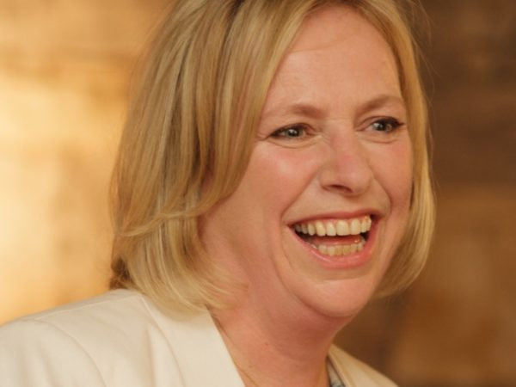
Todays panel:
Cathy McClay - Managing Director, National Grid DSO
Cathy has 25 years’ experience in the electricity industry. In the first part of her career, she worked for a number of energy companies in the UK, France and the Netherlands, specialising in modelling and analysis for trading, risk management, strategy and investment. Cathy then joined National Grid System Operator as Head of Commercial where she was responsible for opening up the ancillary service markets to new sources of flexibility, such as demand side response and batteries.
Most recently, Cathy has been Director of Flexibility at ENOWA, the energy company of NEOM. NEOM is focused on developing sustainable living in the desert in the North West of Saudi Arabia, powered by a fully-renewable energy system. Cathy was responsible for
ensuring that everything was in place to be able to balance and control the
fully-renewable energy system, including the design
and implementation of the flexibility market. In addition, Cathy led the teams
developing the physical flexible assets needed to balance the system, including a
2.1GW, 23 GWh pumped storage station in the desert.
Cathy is an electrical engineer and a Fellow of the Royal Academy of Engineering.

Slide 20
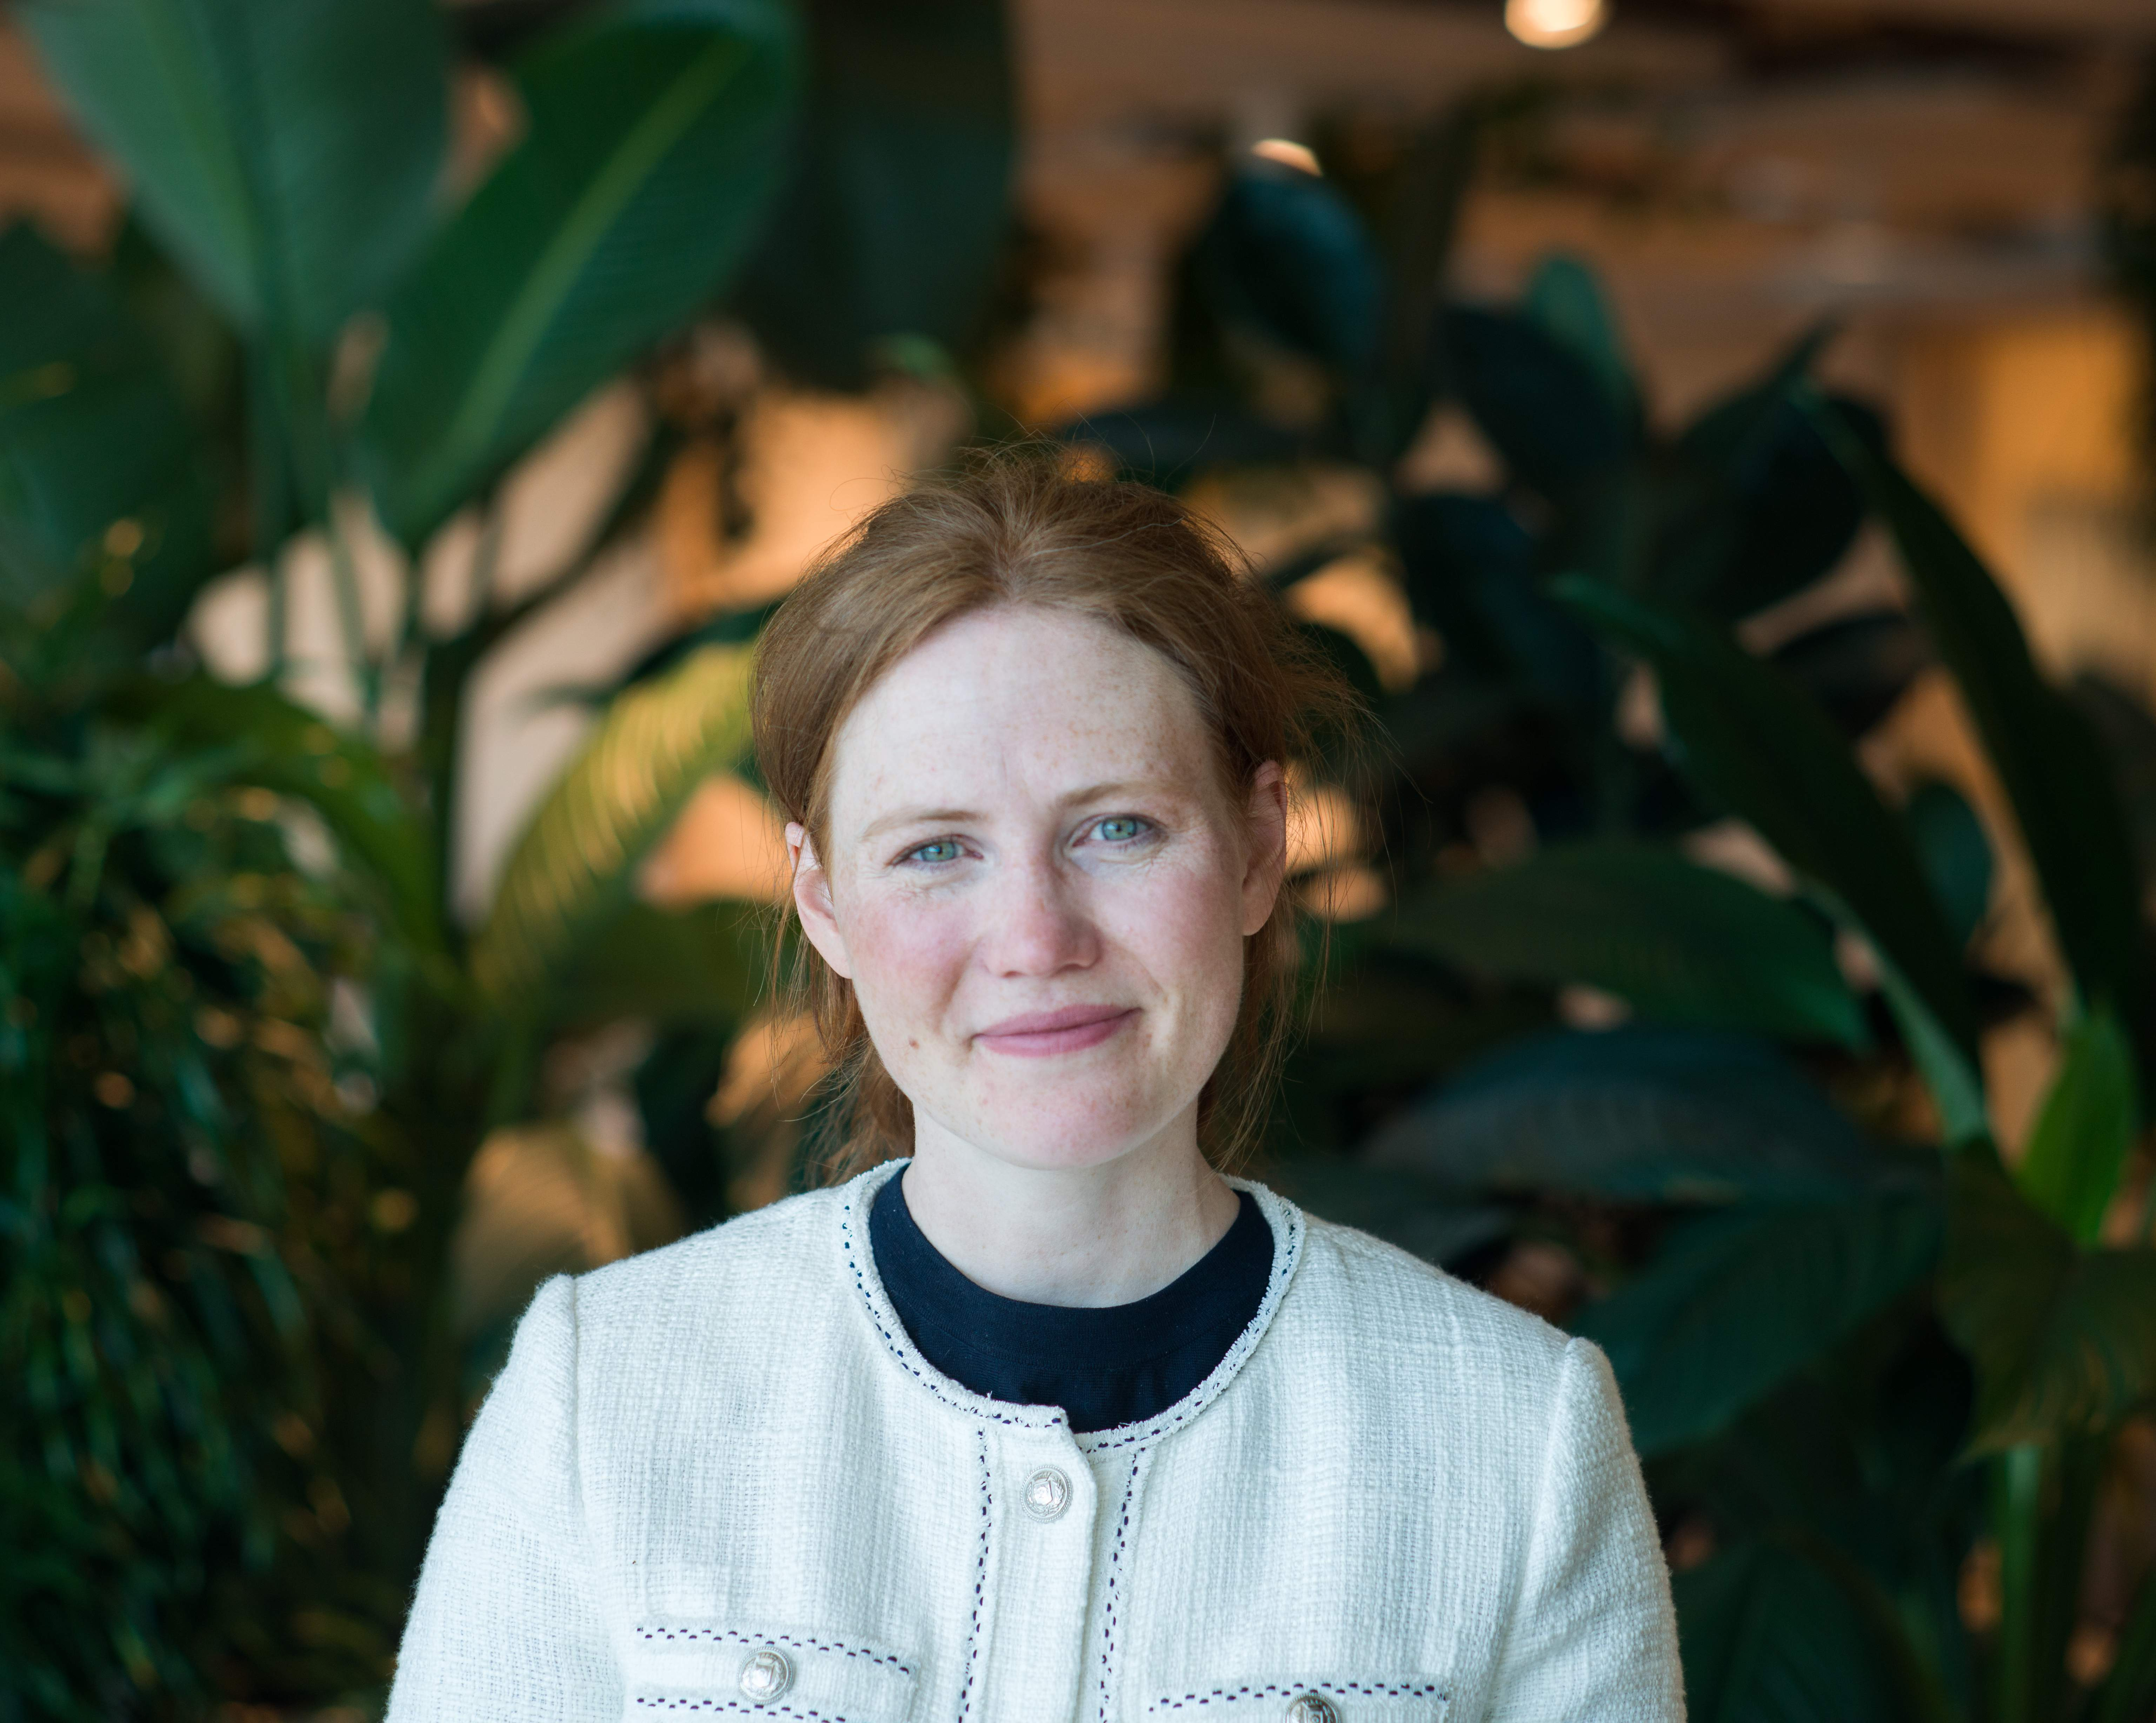
Alexandra Meagher - Group Head of Regulation, Octopus Energy Group
Octopus Energy Group is an energy transition group which is also the UK’s biggest electricity supplier. Alexandra has more than a decade’s experience in regulatory policy and strategy at the Cabinet Office, Bulb and Freshfields

Slide 21
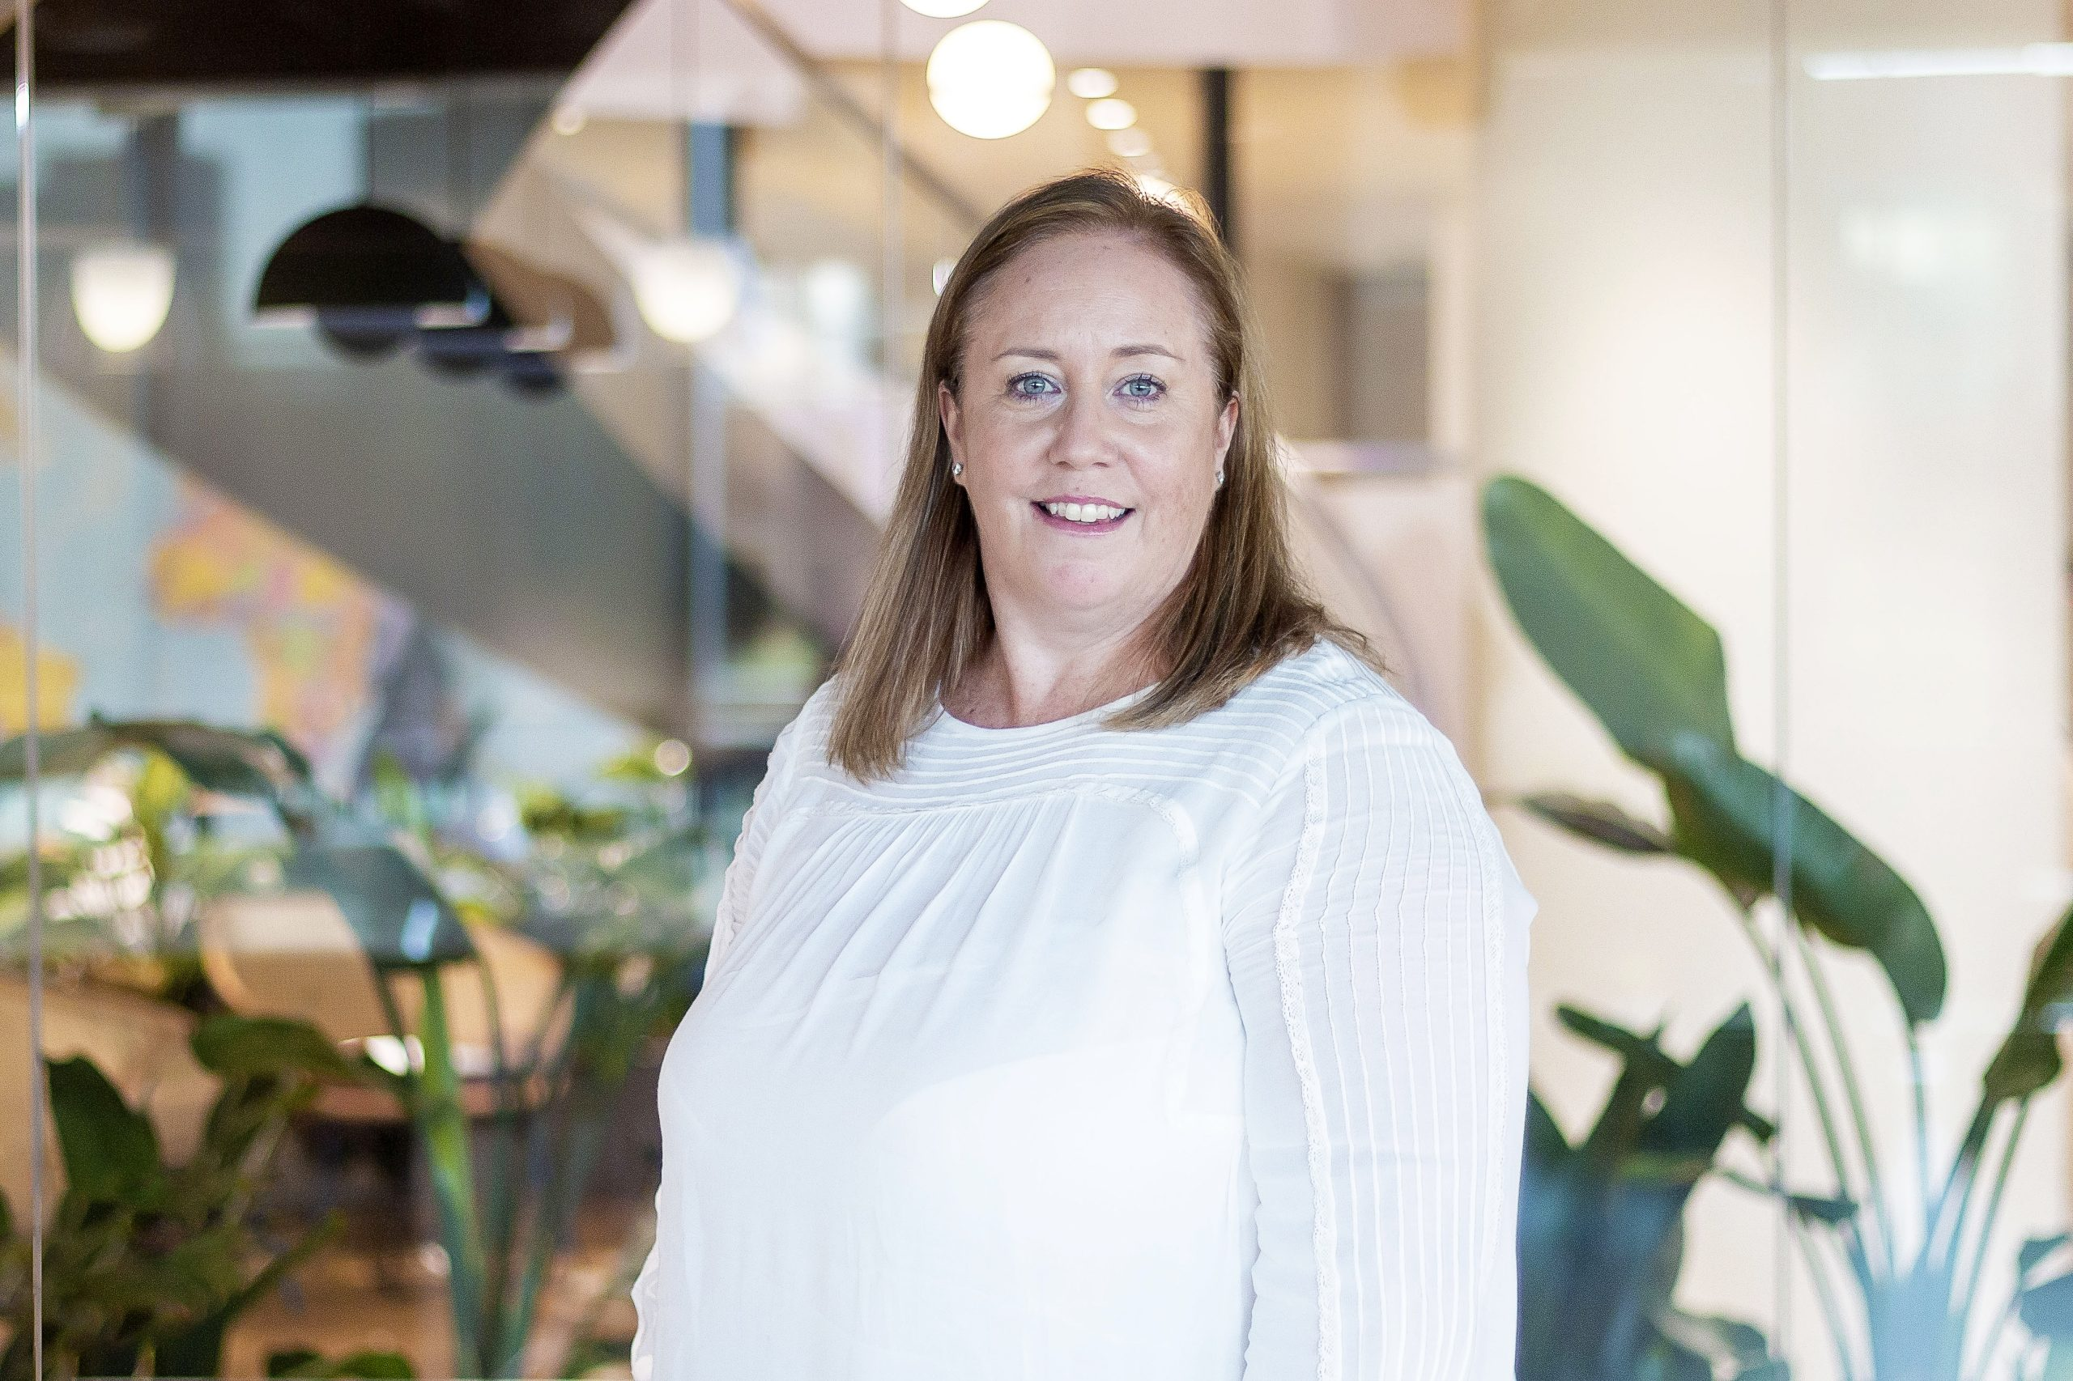
Nichola Plower - Partner, Baringa
Nichola is proud to be the longest-serving woman at Baringa. Joining as an entry level advisor in 2004, Nichola now leads our Power & Low Carbon Market Access team having grown her career in step with Baringa’s own growth. She cut her teeth in energy trading, working with global trading houses to install trading platforms. Over the course of her career, she’s forged strong relationships with the world’s largest energy companies, including EDF, Shell and BP.
Nichola was Baringa's first advisor to work on trading projects in Singapore and Houston and works across the entire energy value chain from production to consumption. With such dramatic Energy system change underway, Nichola guides clients on how to transition efficiently and cost-effectively while keeping pace with market pressure for value.
Nichola loves coaching and mentoring, always looking to bring out
the best in others. She encourages colleagues to grow and gives
them the space and the means to do so, in ways that feel right for them.

Slide 22
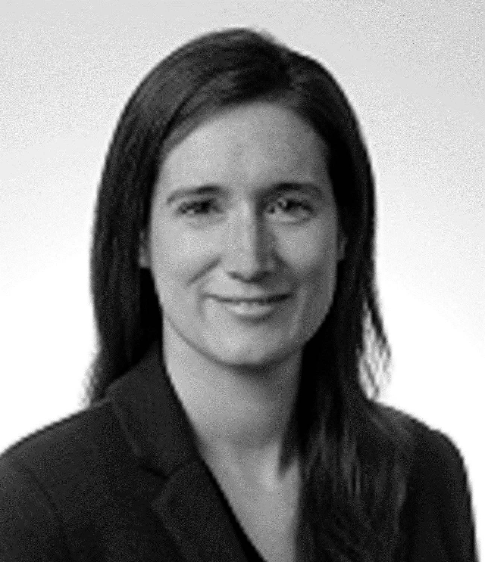
Sarah Elias - Principal Consultant,
AFRY Management Consulting
With over a decade’s experience in the energy industry, Sarah is a Principal at AFRY Management Consulting, focusing on the GB electricity market.
Her work includes overseeing AFRY’s quarterly projections of GB electricity prices as well as bespoke market analysis and transaction support for utilities, oil and gas majors, developers and investors.

Slide 23
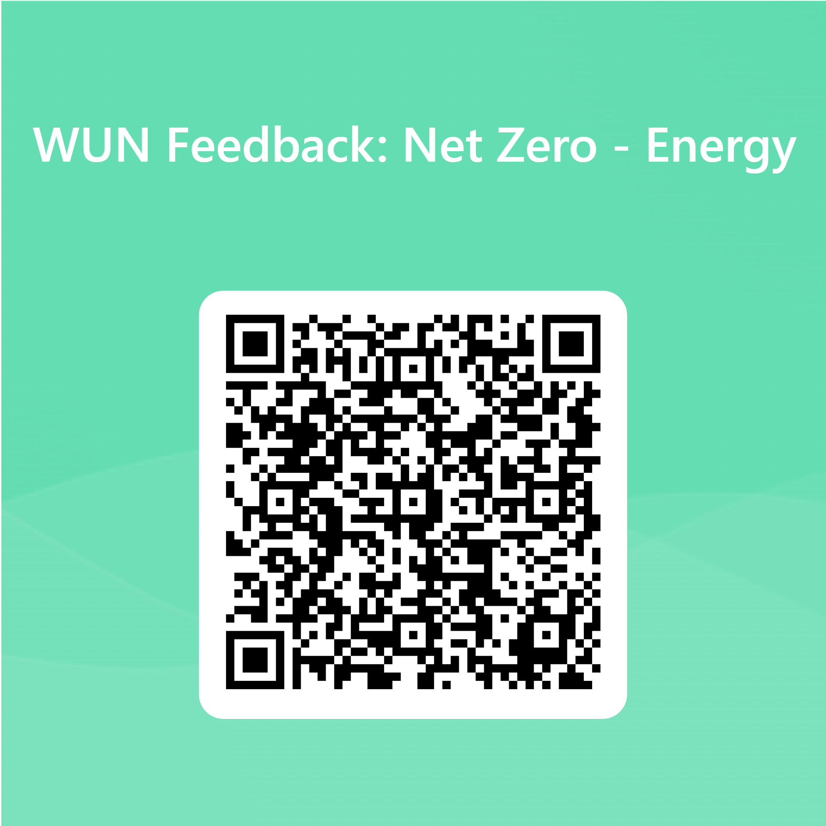
Q&A and Feedback
https://thewun.co.uk/

Slide 24
Thank you
to our hosts CMS,
all tonight’s panel & to all WUN partners for making the event possible
https://thewun.co.uk/

Slide 25
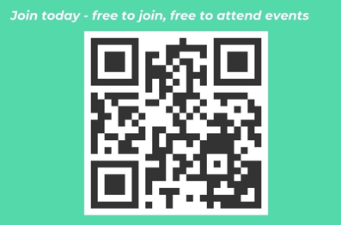
https://thewun.co.uk/join-wun/

