Slide 1
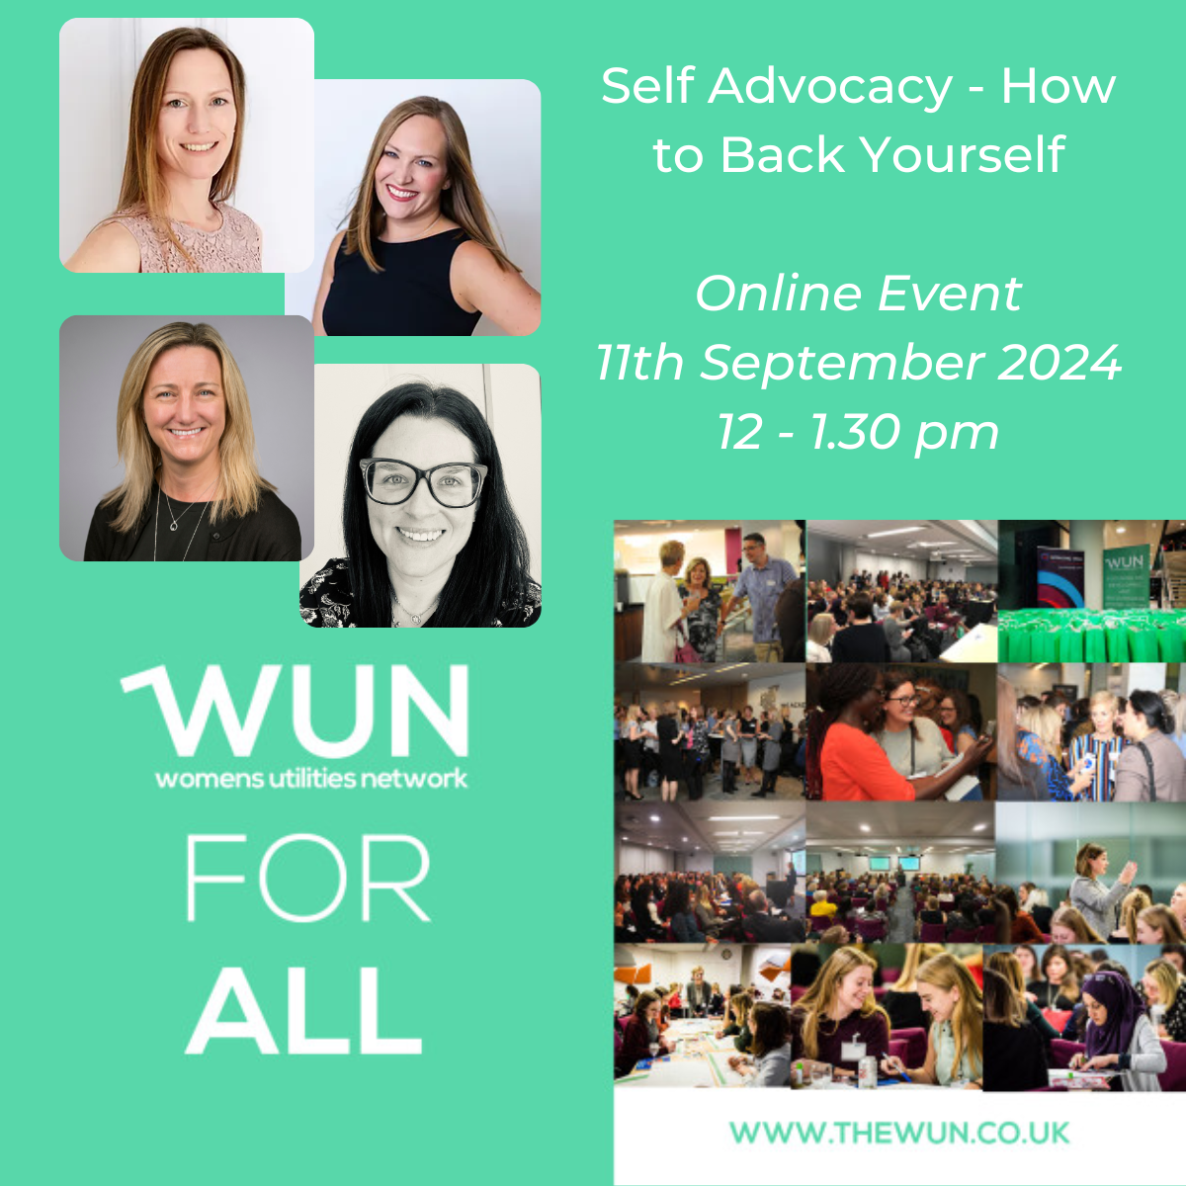
Welcome
Self Advocacy – How to back yourself
The session will be starting shortly
11th September 2024
https://thewun.co.uk/

Slide 3
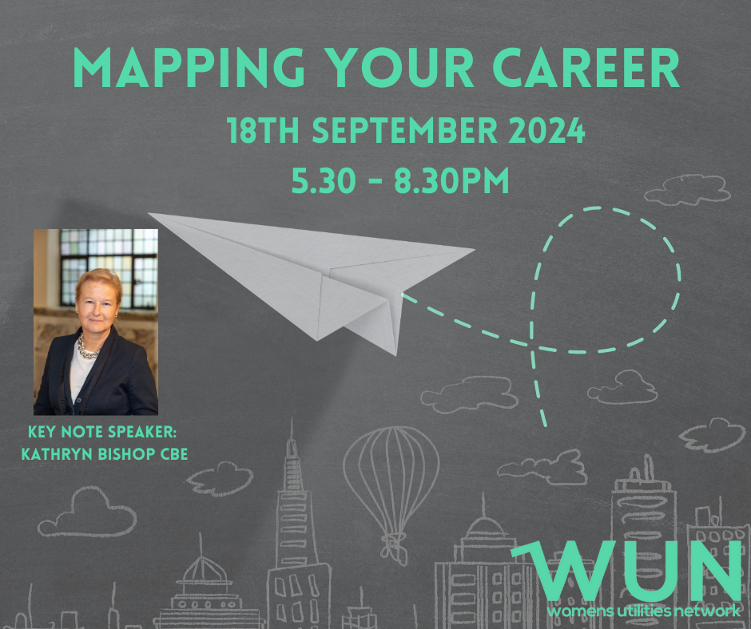
Dates for your diary
WUN Events 2024
18th September Career Mapping 5:30pm note new venue SEFE Energy London offices
18th October #IAmRemarkable workshop – Fully booked
14th November #IAmRemarkable workshop
26th November Net Zero 6pm– How we get there: Energy – CMS, London.
27th June 2025 Women In Utilities Awards in association with Utility Week, London.
Further dates for the autumn will be announced shortly.
Free tickets available visit our Events page!
https://thewun.co.uk/

Slide 4
Join the free WUN Mentoring Programme
New WUN Mentoring now available –
WUN offers mentoring to women at any stage of their career in the utilities sector.
We are hugely privileged to have over 100 fantastic experienced mentors within the WUN mentoring programme.
With growing numbers of Mentors and Mentees we are delighted with the community and support fostered within the mentoring programme.
If you are interested in becoming a Mentor or Mentee, please visit our website: https://wun.onpld.com

Slide 5
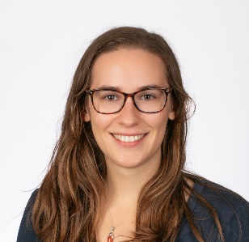
WUN Podcasts
Listen to our latest podcasts More coming soon !
Energy Markets with Lillian Philip talking to Kip Quiney, Senior Manager at EDF Energy
In this episode WUN advocate Lillian Philip talks to Kip Quiney, Senior Manager at EDF Energy, discussing the UK commodity markets and how movements here change the prices on our energy bills.
#WUN Career Stories – Female Health in the Workplace with Lauren Tyler, former Head of Innovation at Southern Water
Julia Stichling, WUN Advocate talks with Lauren Tyler – known as Loz – who is the former Head of Innovation at Southern Water and a passionate advocate for innovation as an essential business capability. A problem-solver at heart, Loz is known for her creative curiosity, strategic thinking, and humble leadership.
You can follow our podcast on Apple Podcasts, Spotify, Amazon Music and wherever else you get your podcasts – just search “WUN4ALL”.
Or just click through from the website: https://thewun.co.uk/news-blogs/

Slide 6
Don’t forget to join the Network
to receive the next WUN newsletter
https://thewun.co.uk/join-wun/

Slide 8
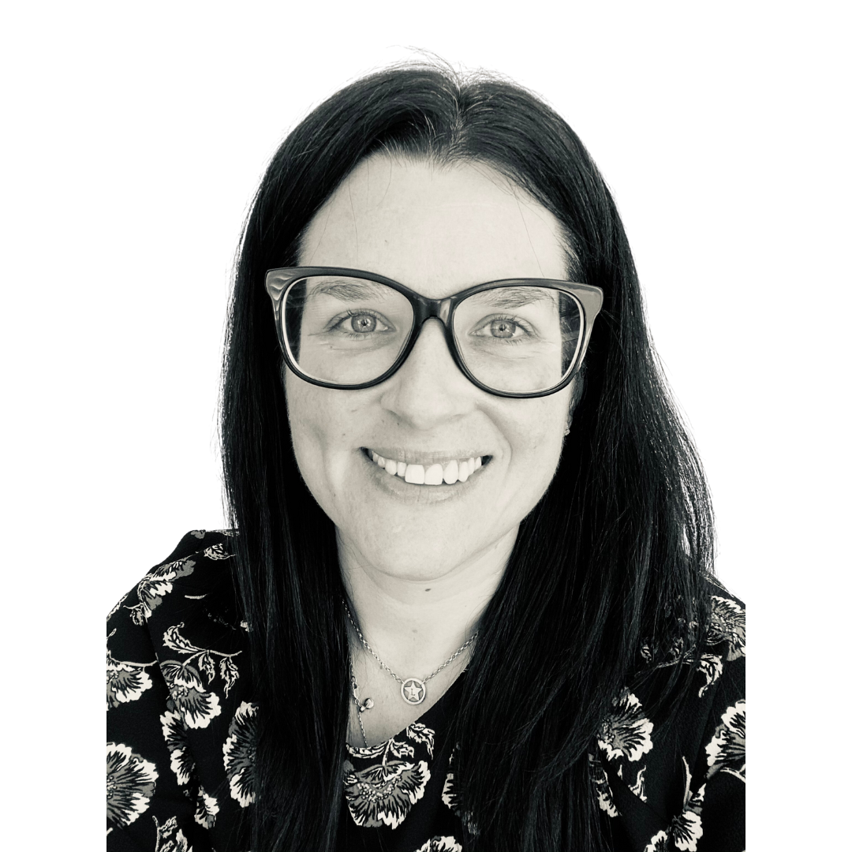
Today’s Speakers - Lisa Robyn Wood
The Middle Manager Coach, GRIP Coaching Limited.
I grew my career within the energy sector, enjoying several management positions across a range of departments including customer services, process improvement, contract management, and finance, before being promoted to a senior middle management role within metering operations. This promotion triggered imposter syndrome which motivated me to employ a personal coach.
I help individuals and organisations to make effective and healthy management a reality for themselves, their people, and their business, by providing 1-2-1 coaching and training for their middle managers and teams.
I have been privileged to work with multiple managers and leaders across a range of organisations, including Viridor, Floodre, Suntory, HSBC, Camelot, Burberry, and Swarovski, as well as small businesses and entrepreneurs.
I’m qualified in Corporate & Executive Coaching, Personal Performance Coaching, NLP, and DISC; all through The Coaching Academy and with each diploma accredited by the ICF.
I currently split my time between the Kent coast and Cape Town in South Africa
with my husband Dom and our Springer Spaniel Alfie.
https://thewun.co.uk/

Slide 9
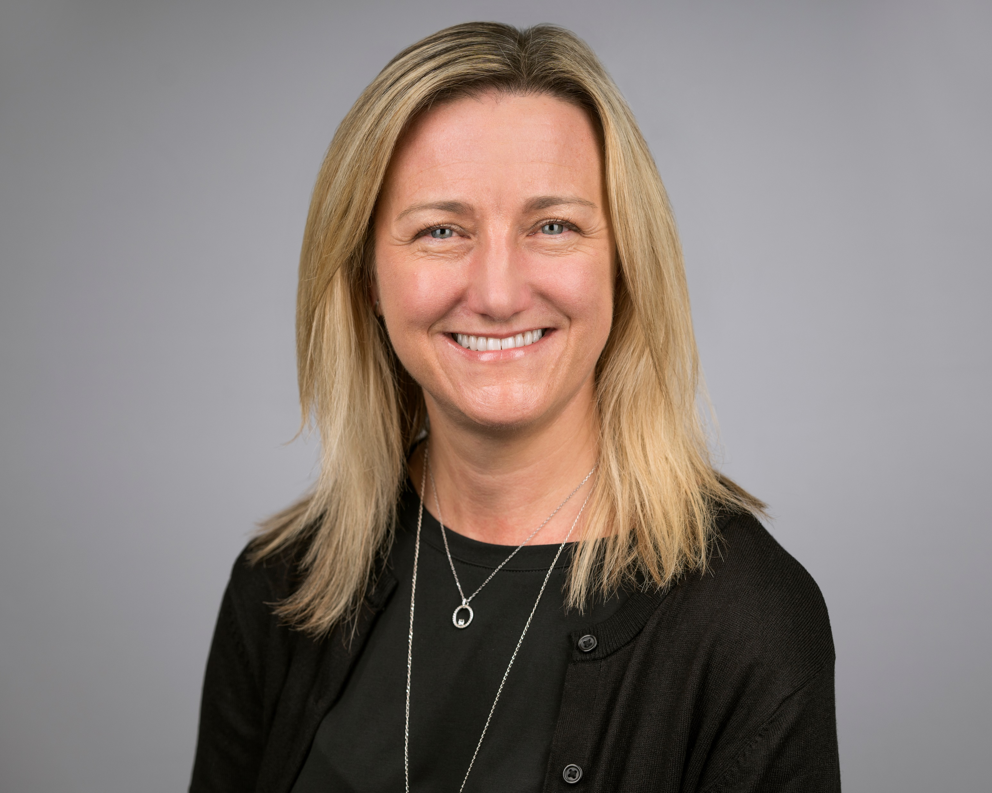
Juliet Summers
Director & Lead Coach, owner of Inner Talent Ltd
Juliet brings her corporate career in the retail and utility industries and insight
in HR, talent management and leadership to enable individuals and organisations to succeed through professional coaching and leadership development facilitation.
She has led talent departments, strategy and teams alongside coaching, mentoring and supporting the development, progression and career transition of many individuals. She is highly skilled in coaching across the talent pipeline, especially supporting women through their career transitions.
An ICF ACC credentialled coach who specialises in transformational coaching across career leadership, confidence and life. Clients have described Juliet as, ‘Insightful, supportive, inspirational, empathetic and positive.’ When she’s not coaching or facilitating workshops, you’ll find her raising two boys and running which is one of her other passions!
https://thewun.co.uk/

Slide 10
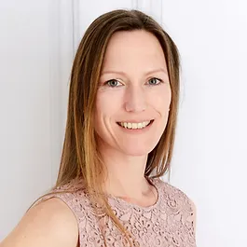
Karen Boyd
Partner Coach, Inner Talent.
Karen is an accredited career and mental fitness coach on a mission to make work happiness the norm, not the exception. She has an extensive corporate background and is experienced in coaching leaders from a range of companies and sectors including many of the UK FTSE 100.
Karen helps clients boost confidence and overcome their challenges so they can thrive at work, whether this means making a tweak or a significant change. Through coaching and training, she empowers leaders and teams to unlock their potential and create careers with more impact, meaning and joy.
She holds Executive Coach accreditation by the Association for Coaching (AC), an Advanced Coaching Diploma and is certified in Positive Psychology.
​Aside from coaching, Karen’s favourite ways to spend time are great food with friends, travelling the world with her husband and kids, and cold-water sea swims.
https://thewun.co.uk/

Slide 11
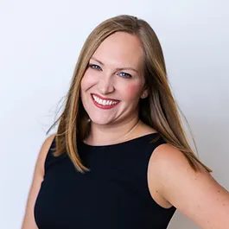
Kate Hughes
Partner Coach, Inner Talent.
Kate is a coach, mentor and facilitator who thrives in helping people make the transition from individual contributor to inspirational leader. Following her own skills gap challenge during her move to her first leadership position and finding huge success with her own coach and mentor, Kate continued as a leader of high-performing communication teams for a further 15 years before joining a leading management consultancy specialising in people performance and development.
Kate qualified as a coach with Animas Centre for Coaching and holds practitioner status with the EMCC.
Her style is described by clients as engaging, compassionate, safe and provocative. When not working Kate can be found facing the (sometimes) fun challenges of raising her 12-year-old daughter, while attempting to train two unruly Labradors.
https://thewun.co.uk/

Slide 12
WUN Self Advocacy – How to Back Yourself
Notes:
Open with question: What does backing yourself mean to you? Ask individuals to add to the chat and pick a few out

Slide 13
Today
Notes:
5

Slide 14
Poll: How well are you currently backing yourself?
I am in some situations
I’m bossing it
I’m not really sure where to start
I’m making excuses - not right moment, who am I...
Notes:
5

Slide 15
Our internal world
How we hold ourselves back
Proof it’s possible
Is it true?
Watch your mouth!
What do you believe?
Notes:
Proof it’s possible - Karen
Accuracy check - Lisa
Minimising language - Joolz
Limiting beliefs + breakout to get started - Kate

Slide 16
Notes:
PIP - Karen

Slide 17
Is it true?

Slide 18
Minimising Bingo!
‘I’m only part-time’
‘I just thought…’
‘I’m just checking in on progress’
‘It’s only me..’
'I may be wrong but…'
‘Am I being stupid but..’
'I'm not totally sure..'
'It might just be me..'
'sorry' - 'I'm sorry, we have this room booked', 'sorry, I thought you'd been copied in'
'um', well, maybe…
'possibly we could..’
‘...I don’t know?’

Slide 19
I can
I always land on my feet
I always work something out
There’s no failure, only feedback and learning
No matter what happens, I can handle it
I really want
I’m not going to learn any less so go for it
I believe everything happens for a reason
If what I’m doing isn’t working, I’ll try something else
I love to try new things
If it’s worth doing, it’s worth doing well (not to perfection!)
I am good enough
I like a challenge
I celebrate success
I am responsible for me
What
do
you
believe?
Notes:
This slide is animated so we can introduce limiting beliefs before clicking to bring up the examples of empowering beliefs.

Slide 20
I can’t or I can’t because…
I’m no good at presenting / sales /sport…
If you work part-time, you can’t be a leader
I don’t have the time / money…
I’m not good enough
I don’t need help
I need to change….before I can…
I’ll be judged
I’ll fail
It’s too late…
It has to be perfect
They’re better than me / they’d be better than me
No one ever listens to me
I shouldn’t…
I don’t have all the qualifications for that role
What
do
you
believe?

Slide 21
Exercise: Reframing limiting beliefs
Individual reflection
Write down a limiting belief starting with "I can't...", “I don’t…” or "I'm not..."
2. Reframe the belief
Identify the positive opposite belief
Gather evidence to support the new belief

Slide 22
External Forces
How our environment holds us back
Workplace can be a tough and challenging place
Multiple factors that can be obstacles – limited budgets, conflicting/misaligned priorities, relationships, policies, processes, systems; worse, sexism, racism
Important to check our perceptions and understanding to identify true obstacles, and more effective solutions
Techniques & Tools:
Network, cheerleaders
& Allies
Toxic workplace
Wants & Needs
Celebrate Wins
Notes:
Cheerleaders & Allies – identify and nurture key relationships to support you and aid your learning and growth, mapping
Wants & Needs – clear in what you want to achieve and our priorities; use to define and establish boundaries
Celebrate wins – recognise your achievements; build a record; use it to advocate for yourself - Karen Exercise – build a evidence wall
11

Slide 23
Notes:
Cheerleaders & Allies – identify and nurture key relationships to support you and aid your learning and growth, mapping

Slide 24
Wants & Needs

Slide 25
Celebrate Wins
Notes:
Celebrate wins (K) – recognise your achievements; build a record; use it to advocate for yourself

Slide 26
Notes:
Belief Wall breakout intro (Karen):
Breakout 9 mins – small groups of 3-4 – build your own evidence/belief wall. Bring back to main room – invite reflections from a couple of people (5 mins)
This Belief Wall exercise helps you shift perspective - away from what we can't do or what went wrong to what went well.

Slide 27
Exercise: Belief and confidence wall
Write down tangible successes that make you proud.
(E.g. Wins, results, promotions)
What intangible successes make you proud?
(E.g. Strong relationships, overcoming hardships)
What attributes allowed you to have the successes?
(E.g. Competitive nature, impactful communication skills)
Think carefully about the values which underpin all of this.
(E.g. Loyalty, family values, fairness, hard work)
Notes:
Karen:
Breakout 9 mins – small groups of 3-4 – build your own evidence/belief wall. Bring back to main room – invite reflections (5 mins)

Slide 29
What’s your next smallest step to backing yourself from today?

Slide 31
Notes:
5

Slide 32
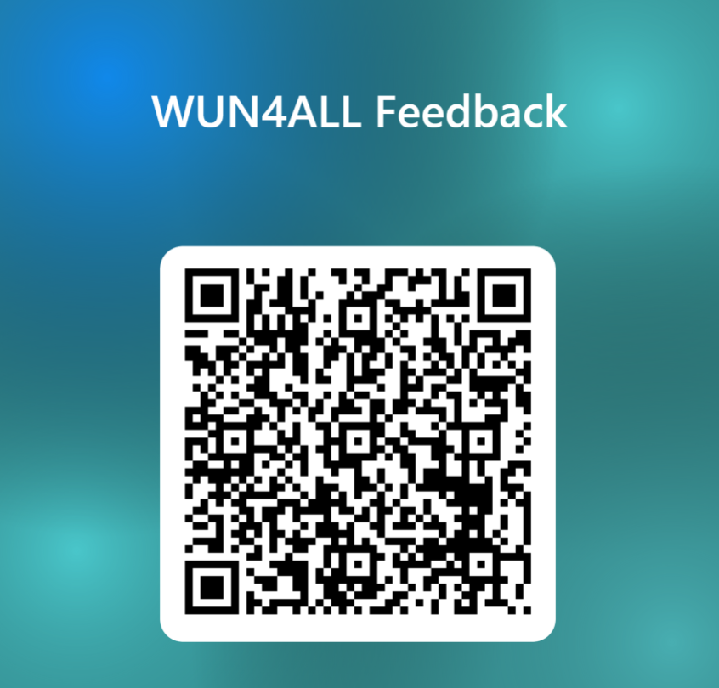
https://thewun.co.uk/

Slide 33
Thank you to all of our amazing
speakers, you for your participation & WUN partners for their support to make this event possible.
https://thewun.co.uk/

Slide 35
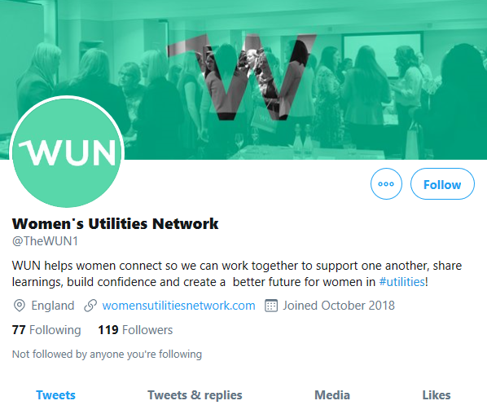
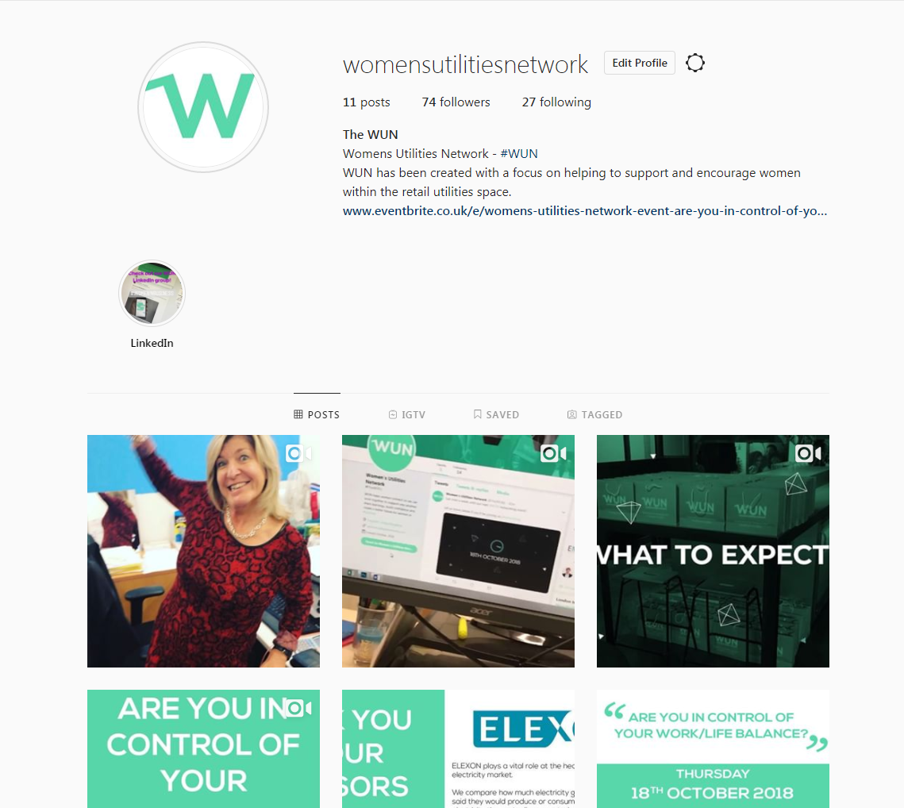
#WUN Don’t forget to follow us for the latest news and updates
https://thewun.co.uk

