Slide 1
Welcome
11th April 2024
Unconscious bias in the utilities sector: what is the reality?
The critical need for women to be seen & heard
https://thewun.co.uk/

Slide 2
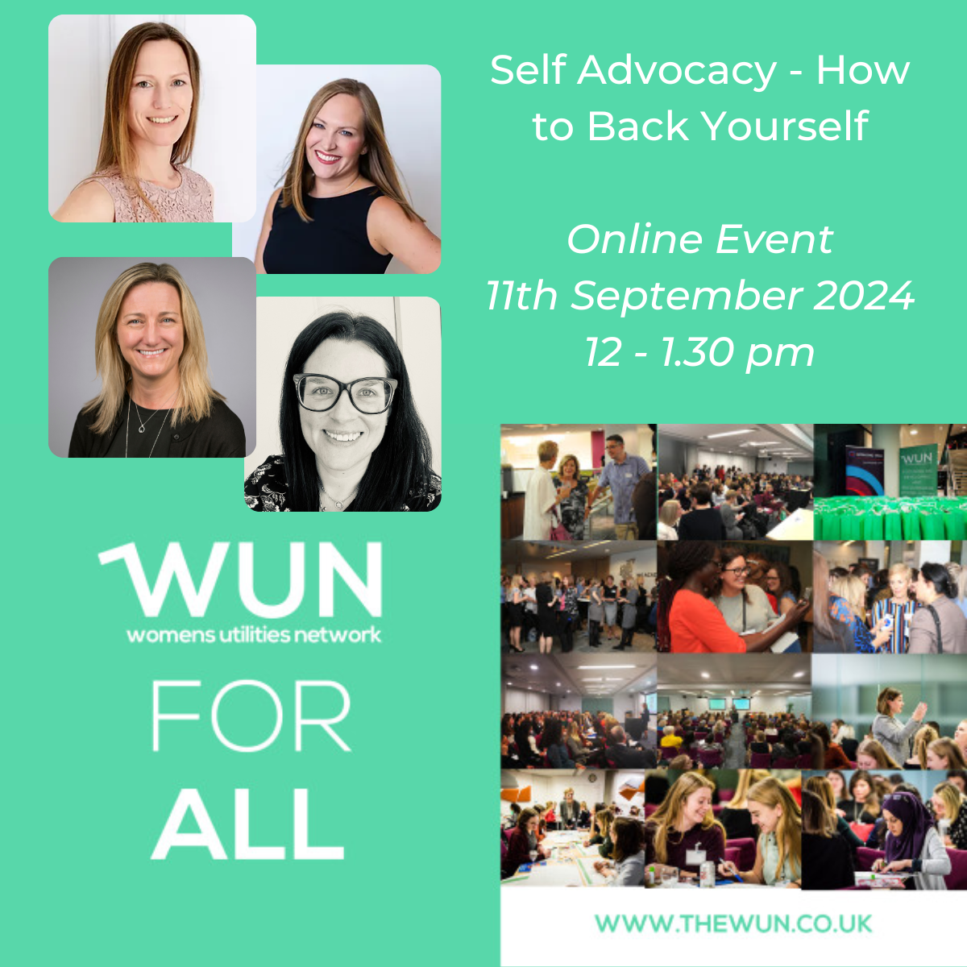
Dates for your diary
WUN Events 2024
9th May 2024 – WUN For All – Psychological Safety – Virtual event
10th May, 10th July, 5th September: #IamRemarkable Virtual Workshop
21st & 22nd May Utility Week Live NEC – ‘Will intentional allies & advocates change the landscape for women in utilities?’ & come & say hello at our stand.
19th & 20th June will also be exhibiting at Future of Utilities & hosting a mentoring brunch
27th June 2024 - Women in Utilities Awards 2024 in association with Utility Week
11th September WUN For ALL Self Advocacy – How to Back Yourself.
Free tickets available visit our Events page! Further events coming soon including:
https://thewun.co.uk/

Slide 3
Join the free WUN Mentoring Programme
WUN offers mentoring to women at any stage of their career in the utilities sector.
We are hugely privileged to have over 100 fantastic experienced mentors within the WUN mentoring programme.
With growing numbers of Mentors and Mentees we are delighted with the community and support fostered within the mentoring programme.
If you are interested in becoming a Mentor or Mentee, please visit our website: https://wun.onpld.com

Slide 4
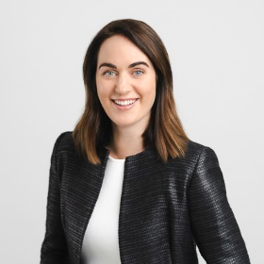
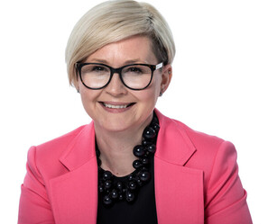
WUN Podcasts
Listen to our latest podcasts More coming soon !
#WUNCareerStories – Backing Yourself with Emily Timmins, Director of Water Recycling at Anglian Water
Listen to our latest podcast when WUN advocate, Victoria Lemmon chats to Anglian Water’s Director of Water Recycling, Emily Timmins, about her 30 years in the water sector where she’s been busy creating her patchwork quilt of leadership.
Discussing how saying “yes” will open doors and how backing yourself gives you opportunities to new experiences.
WUN Industry Advocate and EDF Originator, Karen Hosking talks to Nicole Alley, Vice President and Segment Head of Renewables at Capgemini.
We discuss the ever-changing face of Net Zero and, in particular, the challenges and Opportunities that brings the UK Grid. Can Augmented, Artificial Intelligence and Virtual Reality bring new perceptive in the ever changing face of Net Zero.
Renewables, Capture Capture and digital twins just some of the content covering in this episode.
We also hear about Nicole ’s interesting career journey to date , her current role at Capgemini and what the future may look like for UK’s Net Zero ambitions
You can follow our podcast on Apple Podcasts, Spotify, Amazon Music and wherever else you get your podcasts – just search “WUN4ALL”.
Or just click through from the website: https://thewun.co.uk/news-blogs/

Slide 5
Don’t forget to join the Network
to receive the next WUN newsletter
https://thewun.co.uk/join-wun/

Slide 7
Today’s Event
Today’s Chair – Hayley Monks WUN Co- Founder & WNS
Panel:
Adam Clarke, MD, EC.
Francesca Stepney , Account Director, The Marketing Pod.
Jo Butlin, WUN Co- Founder & Director & EnergyBridge
Sharon Sage, Senior Manager of Public Sector, EDF & WUN Director.
Lucy Ritchie, Business Development, Correla & WUN Advocate.
https://thewun.co.uk/

Slide 8
Survey Summary
https://thewun.co.uk/

Slide 9
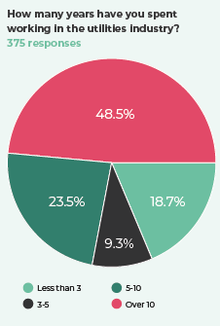
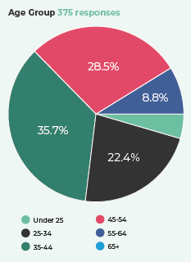
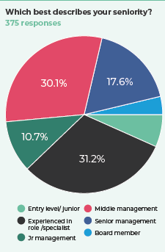
375 responses with good representation across the sector
Time in the sector
Age
Seniority

Slide 10
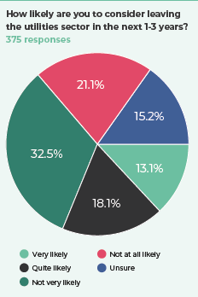
Almost a third (31%) of respondents said that they were very or quite likely to leave the sector in the next 1-3 years

Slide 11
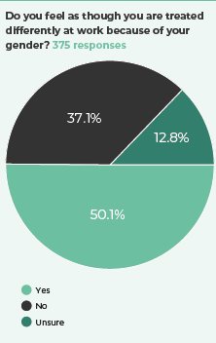
Half of respondents feel that they are treated differently due to their gender

Slide 12
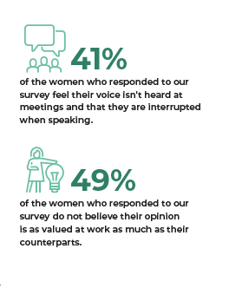
A recurring theme: Women do not feel they are listened to...so hesitate to give opinions
Almost half (46%) of the women who responded to our survey told us that they often hesitate to give their opinions or share ideas at work even though they know they are valuable

Slide 13
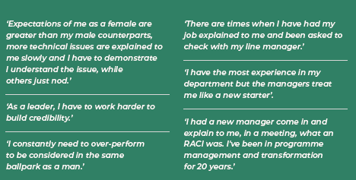
It appears that bias is creating higher hurdles for women in the workplace than men

Slide 14
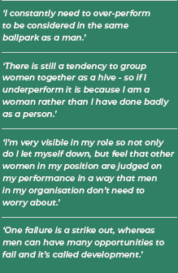
Tall poppy syndrome is a real issue....

Slide 15
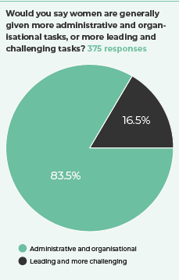
Whatever level...women are disproportionately spending their time on admin and organisational tasks.

Slide 16
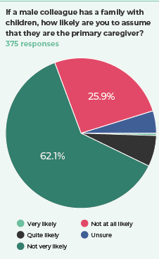
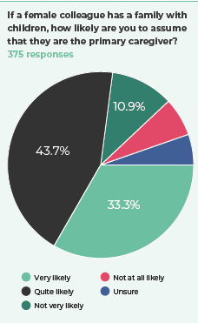
Unconscious bias is everywhere... we all make assumptions based on life experience

Slide 17
Call to action…the big 5
Change recruitment process
01
Encourage mindful decision making
02
Make training mandated, practical and targeted
03
Promote advocacy to actively support women
04
Hold others accountable
05

Slide 18
With huge thanks to The Marketing Pod

Slide 20
Q&A
https://thewun.co.uk/

Slide 21
Thank you to all our speakers and WUN partners who made this event possible & particular thanks to
The Marketing pod.
https://thewun.co.uk/

Slide 22
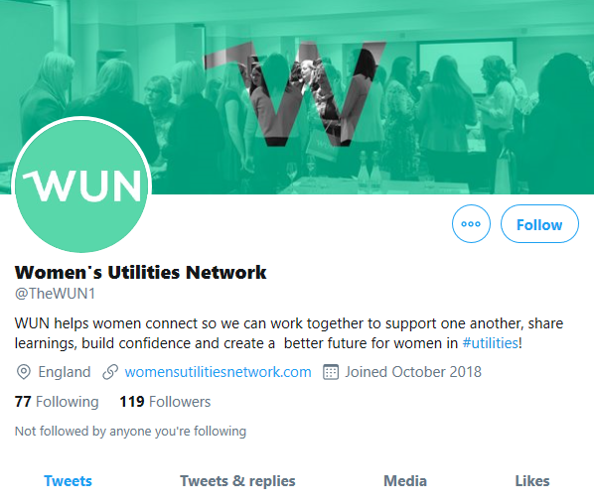
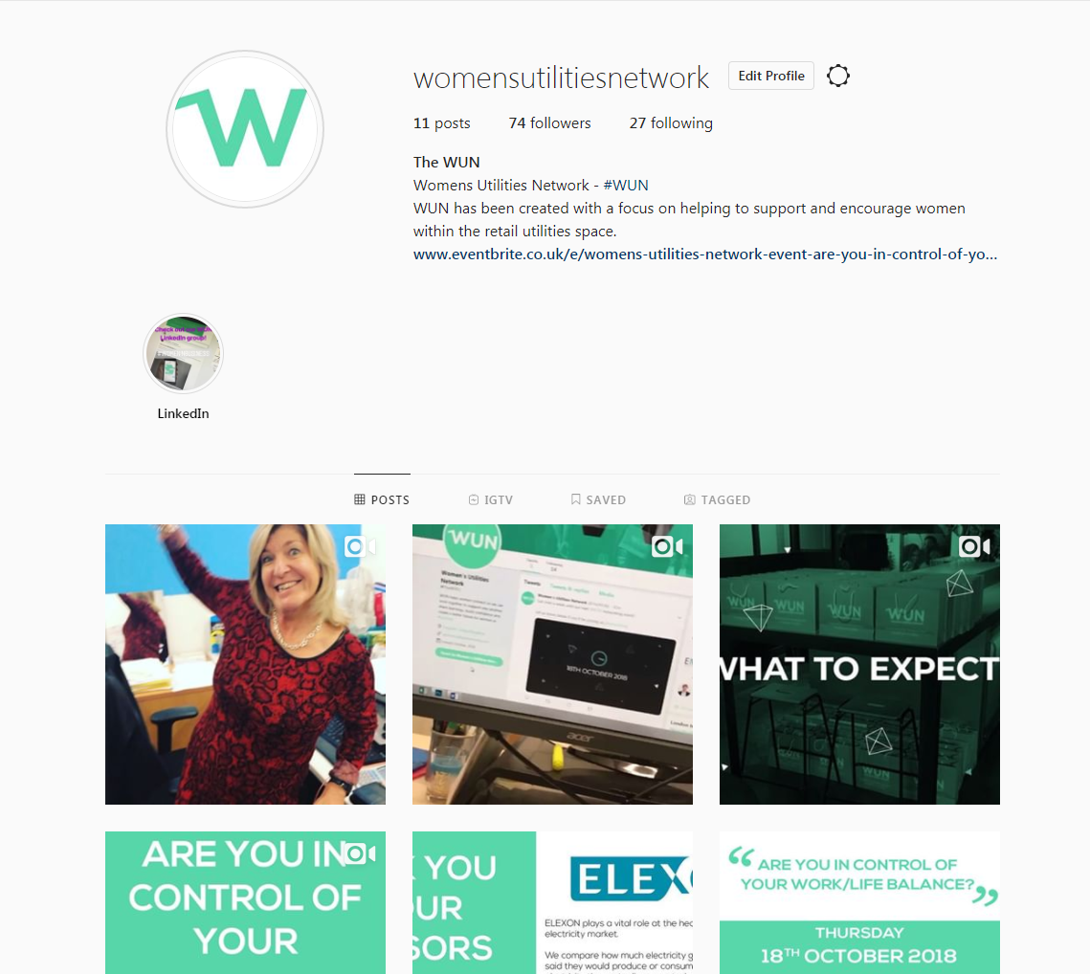
#WUN Don’t forget to follow us for the latest news and updates
https://thewun.co.uk

Slide 23
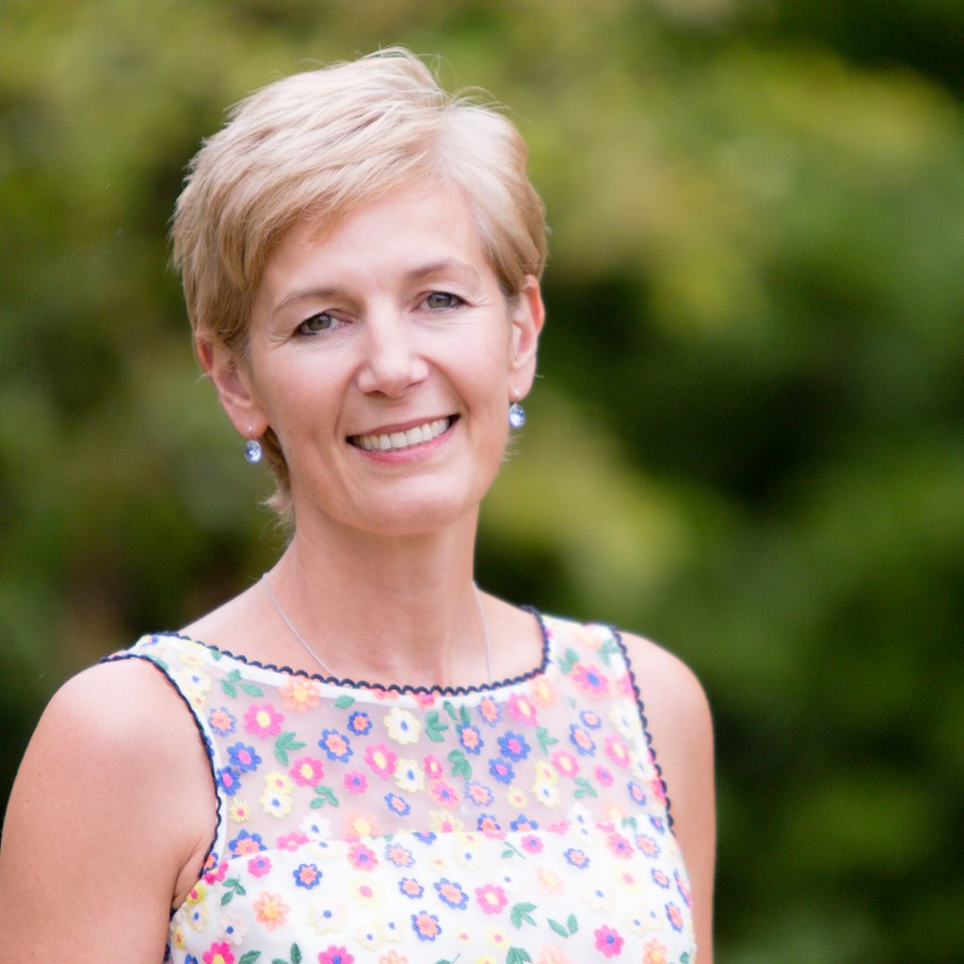
Today’s Chair
Hayley Monks WUN Co- Founder & Director & WNS
Hayley is an experienced utilities business leader, with over 20 years spent in roles in
operations, credit management, and customer service leadership.
She is also Co-founder of the successful Womens Utilities Network. Having previously set up
and ran a successful training and consulting business, she has recently joined WNS Global as SVP Utilities.
https://thewun.co.uk/

Slide 24
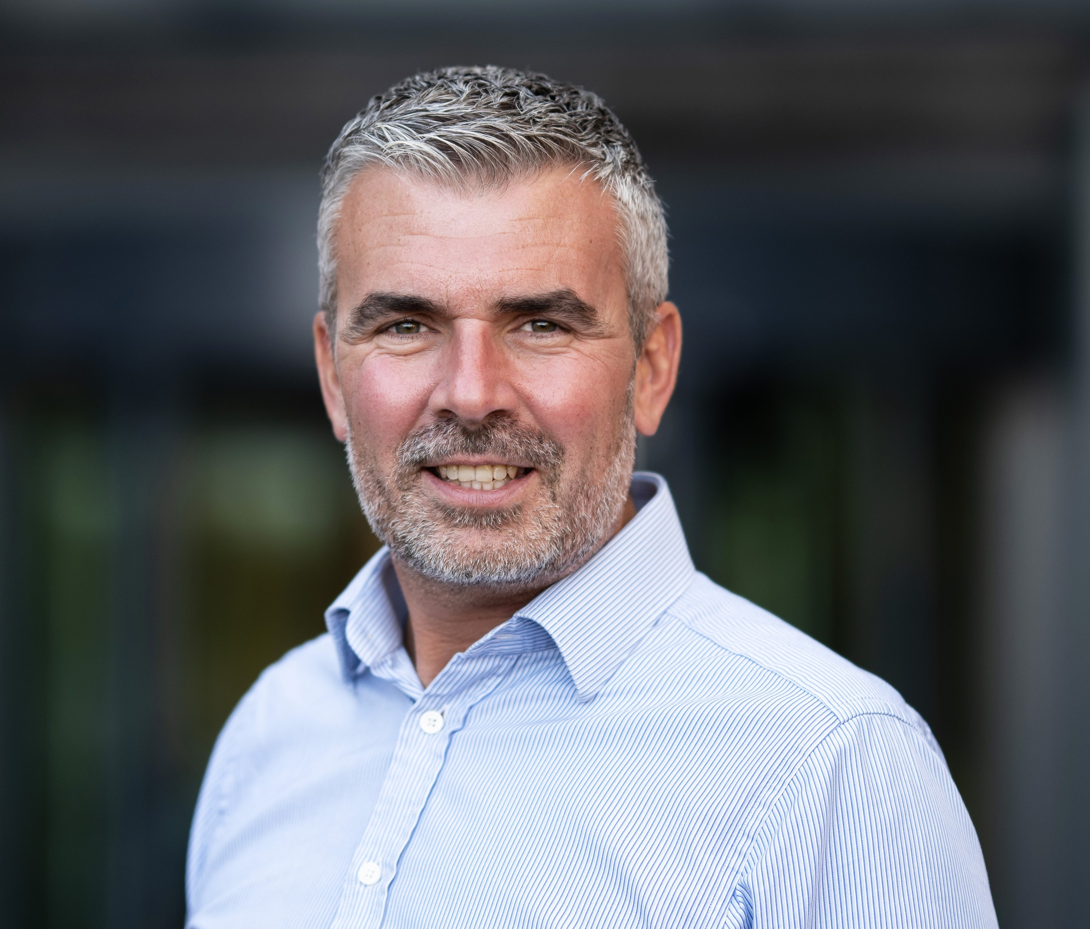
Todays Panel :
Adam Clarke, MD TEC.
Adam joined The Energy Consortium (TEC) as MD in 2022. TEC provides industry leading energy risk management and carbon reduction products and services to the Higher Education, Further Education and Museum Groups sector.
Starting his career in commodity trading and asset optimisation, Adam has over 20-years of UK Trading experience. Adam made the switch from Wholesale trading to Energy Retail in 2012, developing energy trading and decarbonisation products for the Industrial & Commercial sector. Whilst at EDF, Adam established the largest renewable offtake portfolio in the UK – including a number of notable Corporate PPAs.
https://thewun.co.uk/

Slide 25
Todays Panel :
Francesca Stepney - Account Director,
The Marketing Pod
Francesca is currently a marketing Account Director for a B2B agency
specialising in the energy and utilities industries. Having previously also worked in marketing roles covering the automotive and technology sectors, Francesca has spent most of her career in traditionally male-dominated spaces. Her current employer, The Marketing Pod, was founded by two women and is ranked in the UK’s Best Workplaces for Women list. This background, therefore, has given her extensive insight into the role of women and the challenges and solutions of unconscious bias in the workplace.
Outside of work, Francesca is a film buff who has two dogs and enjoys countryside walks with them and her fiancé.
https://thewun.co.uk/

Slide 26
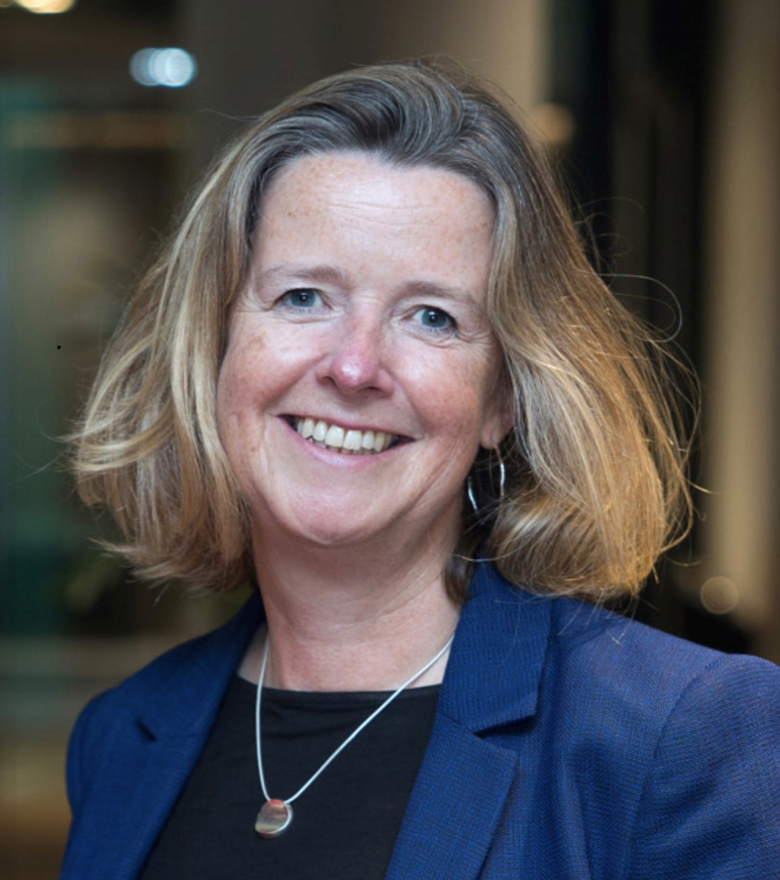
Today’s Panel
Jo Butlin- WUN Co- Founder & Director & CEO EnergyBridge
Having qualified as an accountant, Jo spent the majority of her career in leadership roles working across the energy sector before setting up her own consulting company, EnergyBridge (UK) Limited in 2017, to help businesses and investors navigate the energy market.
Jo has built a portfolio of Non Executive and advisory roles across the market. She is Chair of the OFGEM’s ESO Performance Panel, Chair of the Board of Thrive Renewables plc, Chair of the board of The Energy Consortium and a NED of Kensa Group Limited in addition to Board advisory roles to several clients. She works with organisations and individuals with a passion and ambition for facilitating the transition to a net zero world.
Jo is mother to two adult daughters. She spends her time outside work rowing, playing the piano, cello and organ and exploring the world with her husband in a very cool VW campervan.
https://thewun.co.uk/

Slide 27
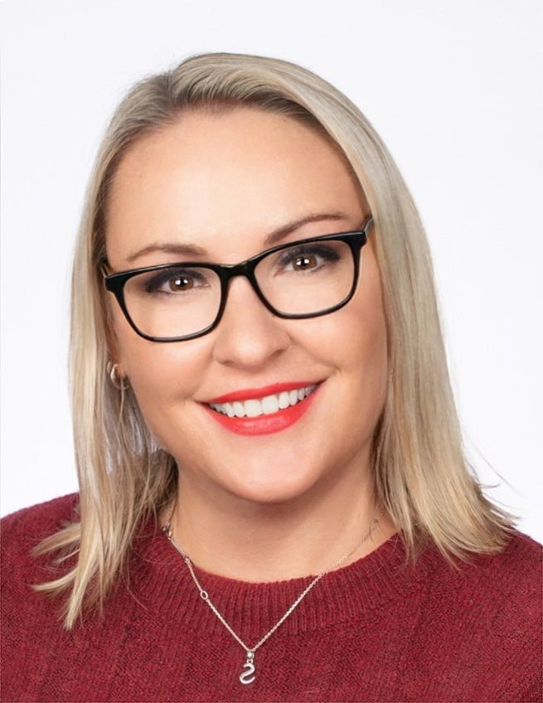
Todays Panel:
Sharon Sage Senior Manager,
Public Sector, EDF & WUN Director.
I began working as a part-time customer service advisor at EDF in 2006. I worked here
for 4/5 years before moving on to a sales operation role. After that I progressed to an Account Manager and then on to a Senior Account Manager. After years of delivering exceptional results, last year, I was promoted to the Senior Manager of the Public Sector. I manage the team who looks after Europe’s largest electricity contract. We are responsible for the sales and service of 19TWh of Public Sector energy volume. I have been resolute in my mission to make the customer’s journey as easy as possible. We do this by educating our customers on the market conditions, energy efficiency, and supporting the public sector’s sustainability initiatives. The work we do aligns with the government’s target to achieve Net Zero by 2050.
I joined WUN as an advocate four years ago & joined the board in 2023. Earlier this year I won the Businesswoman of the Year award.
https://thewun.co.uk/

Slide 28
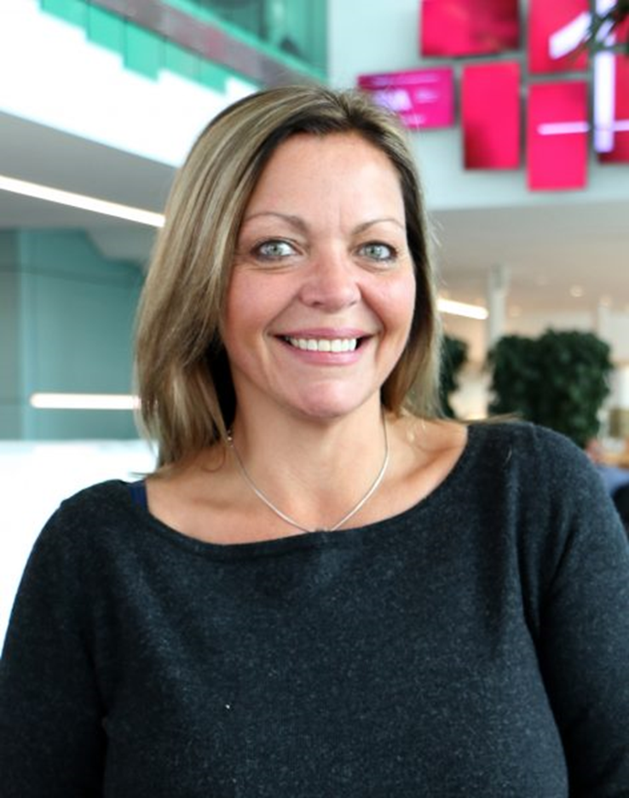
Todays Panel :
Lucy Ritchie Business Development, Correla
& WUN Advocate
Lucy is an award-winning senior leader in the energy industry, speciLalising in Stakeholder engagement, Client Partner Development & is accomplished in creating successful Business Development Strategies. Working for Correla she has an impressive portfolio of clients across the entire energy industry helping them to navigate the complexities of the energy market. Partnering with them to create cost efficiencies that guide the way forward to a net-zero future through fully adaptable SaaS platforms, comprehensive managed services and unrivalled energy industry knowledge.
Lucy is a mentor & Advocate for WUN a community of women who can connect, support develop and encourage each other. She sits on IGEM ( Institution of Gas Engineers and Managers) Council & Chaired their Midlands Section in 2020 throughout the Covid 19 Pandemic, successfully running a 1 year programme of webinars for the industry being awarded the Best Section Chair Medal in 2021. She avidly supports & connects her clients to ensure that the workforce is “future proofed” and in recognition of this Lucy was awarded a “Special Recognition Award” in 2019 for her contribution to the energy industry and support of females in the sector at ASCP Safety & Compliance Awards 2019.
https://thewun.co.uk/

Slide 30
4th SME Associate Onboard
6400+ supporters
11 Events
in 2023 & 19 planned for 2024
55+ Partner Organisations
WUN Achievements
13 Advocates
1595 Event Registrations in past year
194 Mentees & 100+ Mentors
45+ Podcasts available on website
https://thewun.co.uk/

