Slide 1
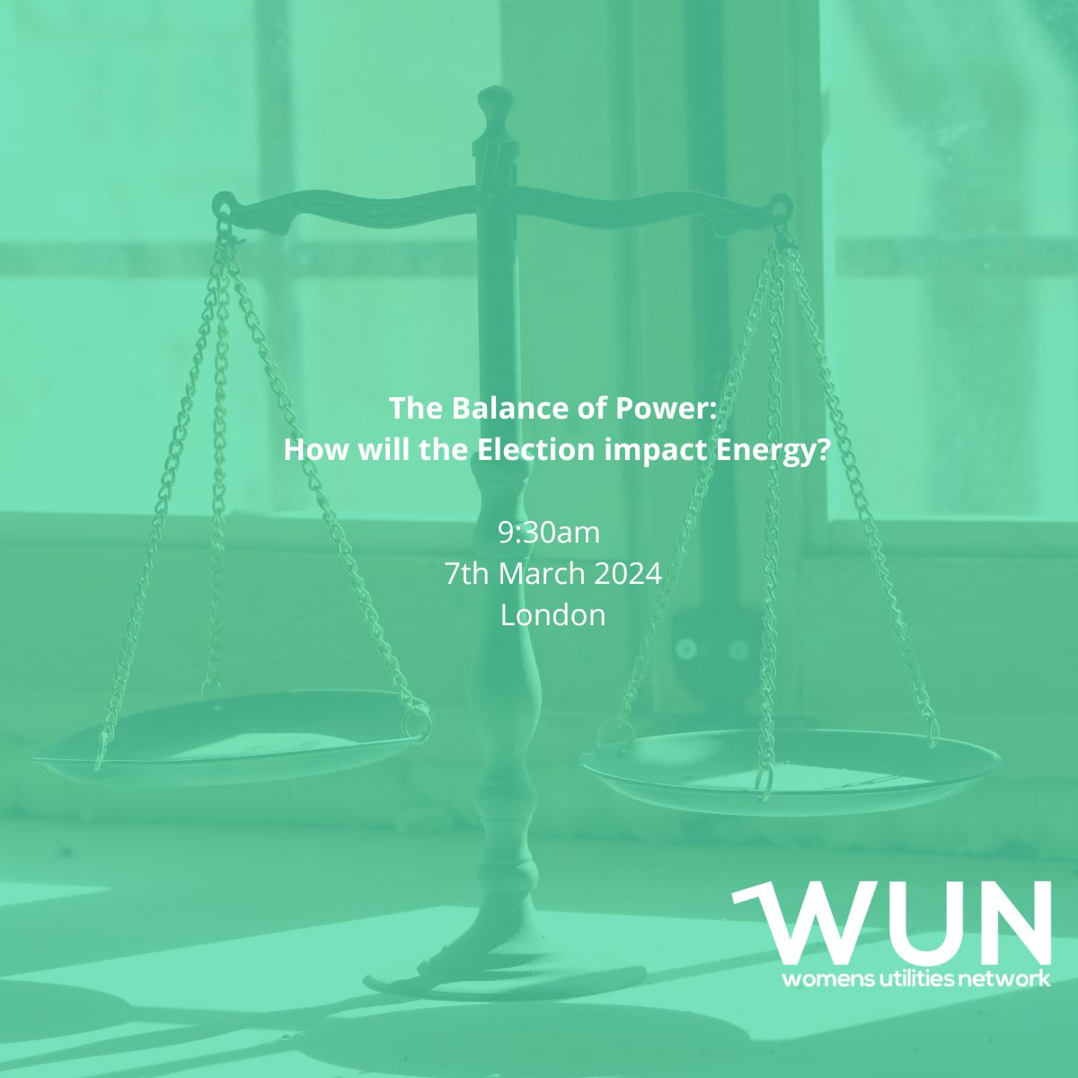
Welcome
7th March 2024
The Balance of Power- how will the election impact energy
Kindly hosted by
Elexon
https://thewun.co.uk/

Slide 2
Health and safety
In case of an emergency
An alarm will sound to alert you
The alarm is tested for fifteen seconds every Wednesday at 9:20am
Evacuating 350 Euston Road
If you discover a fire, operate one of the fire alarms next to the four emergency exits
Please do not tackle a fire yourself. If you hear the alarm, please leave the building immediately
Evacuate by the nearest signposted fire exit and walk to assembly point
Please remain with a member of Elexon staff and await further instruction from a fire warden
For visitors unable to use stairs, a fire warden will guide you to a refuge point and let the fire brigade know where you are
When evacuating please remember
Do not use the lifts
Do not re-enter the building until the all clear has been given by the fire warden or ground floor security
Our team on reception is here to help you, if you have any questions, please do ask them.

Slide 3
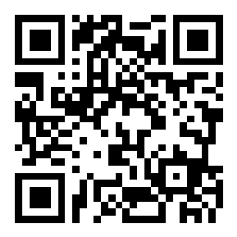
SLIDO
You can join at Slido.com with the code #2513147

Slide 4
4th SME Associate Onboard
6100+ supporters
11 Events
in 2023 & 17 planned for 2024
55+ Partner Organisations
WUN 2024
13 Advocates
1556 Event Registrations in past year
40+ Podcasts available on website
170 Mentees & 90 Mentors
https://thewun.co.uk/

Slide 6
Dates for your diary
WUN Events 2024
8th March 2024 – #IAmRemarkable virtual workshop on IWD2024 – Fully booked further dates to be announced shortly.
11th April 2024 Unconscious Bias: What is Reality? 6pm, London .
9th May 2024 – WUN For All – Psychological Safety
Free tickets available now – visit our Events page!
Further events coming soon including:
27th June 2024 - Women in Utilities Awards 2024 in association with
Utility Week
https://thewun.co.uk/

Slide 7
Join the free WUN Mentoring Programme
New WUN Mentoring now available –
WUN offers mentoring to women at any stage of their career in the utilities sector.
We are hugely privileged to have over 75 fantastic experienced mentors within the WUN mentoring programme.
With growing numbers of Mentors and Mentees we are delighted with the community and support fostered within the mentoring programme.
If you are interested in becoming a Mentor or Mentee, please visit our website: https://wun.onpld.com

Slide 8
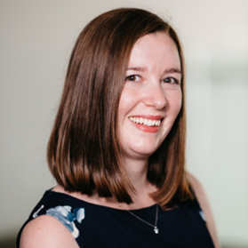
WUN Podcasts
Listen to our latest podcasts More coming soon !
WUNCareer Stories – Kirsty Ayres, Optimisation Portfolio Manager at Anglian Water with Julia Stichling
In this latest podcast WUN advocate Julia Stichling talks to Kirsty Ayres, Optimisation Portfolio Manager at Anglian Water about her 13 years experience in the water industry, specialising in clean water network improvement projects and how she finds leading a team of engineers to design and implement holistic solutions as well as being a working mum.
Defining Leadership at Every Level – WUN Advocate, Lucy Ritchie , Correla talks to Amanda Hinde, Market Design Manager & Lyvia Nabarro, Head of Engagement & Communications at MOSL.
Do you need to be a CEO to be a leader? Our interviewees, both at different points in their career journeys, discuss how they try to embody leadership, how leaders have shaped their views and how we need to move away from unhelpful comparisons in terms of career progression.
You can follow our podcast on Apple Podcasts, Spotify, Amazon Music and wherever else you get your podcasts – just search “WUN4ALL”.
Or just click through from the website: https://thewun.co.uk/news-blogs/

Slide 9
Don’t forget to join the Network
to receive the next WUN newsletter
https://thewun.co.uk/join-wun/

Slide 10
Today’s Event: The Balance of Power- how will the election impact energy
Panel:
Kat Gay, EMR Change Manager, Elexon.
Rachel Hayes, Associate director, Regen.
Kate Mulvany – Principle Consultant, Cornwall Insight
https://thewun.co.uk/

Slide 11
SLIDO Questions....
You can also join at Slido.com with the code #2513147

Slide 12
Over 80% of people are concerned about climate change according to Government research
Source: DESNZ Public Attitudes Tracker: Net Zero and Climate Change Summer 2023, UK

Slide 13
Most expect living expenses to increase as a result of the transition to Net Zero
Source: DESNZ Public Attitudes Tracker: Net Zero and Climate Change Summer 2023, UK

Slide 14
<20% of people are confident that the UK will achieve Net Zero by 2050
Source: DESNZ Public Attitudes Tracker: Net Zero and Climate Change Summer 2023, UK

Slide 16
Q&A
https://thewun.co.uk/

Slide 17
Given what you have heard from our experts, only in relation to the transition to Net Zero, do you believe that a change of government would be:
ⓘ Start presenting to display the poll results on this slide.

Slide 18
Thank you to all our speakers & WUN partners who made this event possible & particular thanks to our kind hosts Elexon
https://thewun.co.uk/

Slide 20
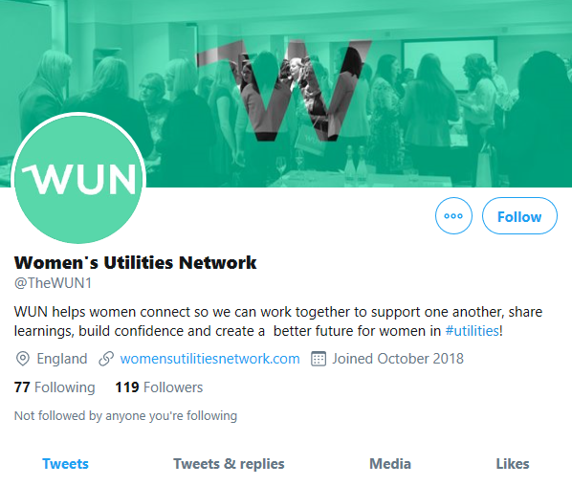
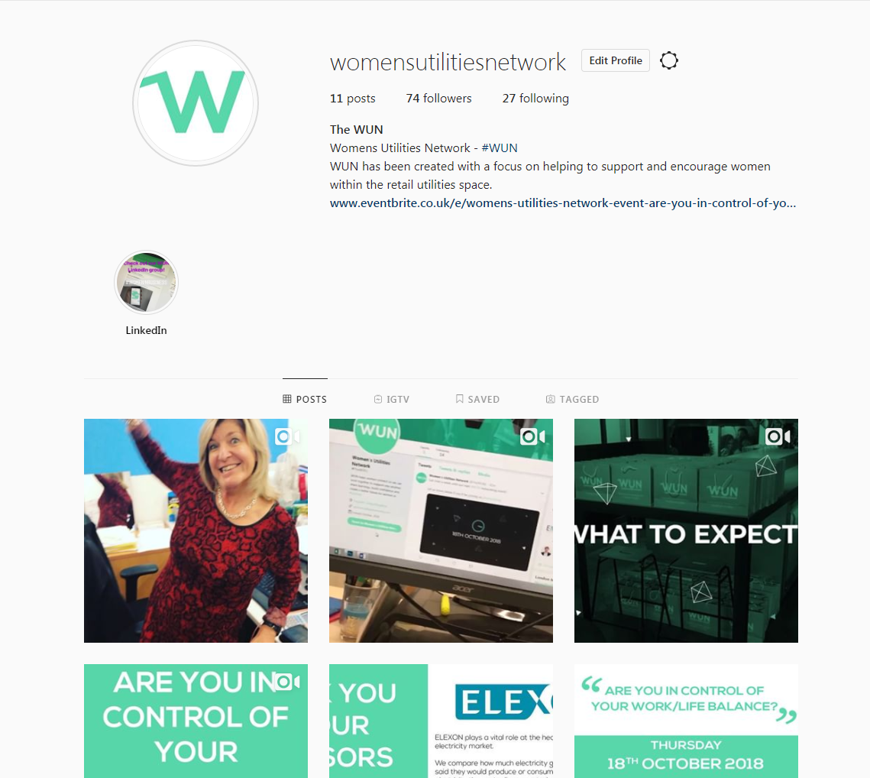
#WUN Don’t forget to follow us for the latest news and updates
https://thewun.co.uk

Slide 21
WUN: Balance of Power
Hosted by Elexon
7 March 2024

Slide 22
Please fill in the survey
ⓘ Start presenting to display the poll results on this slide.

Slide 23
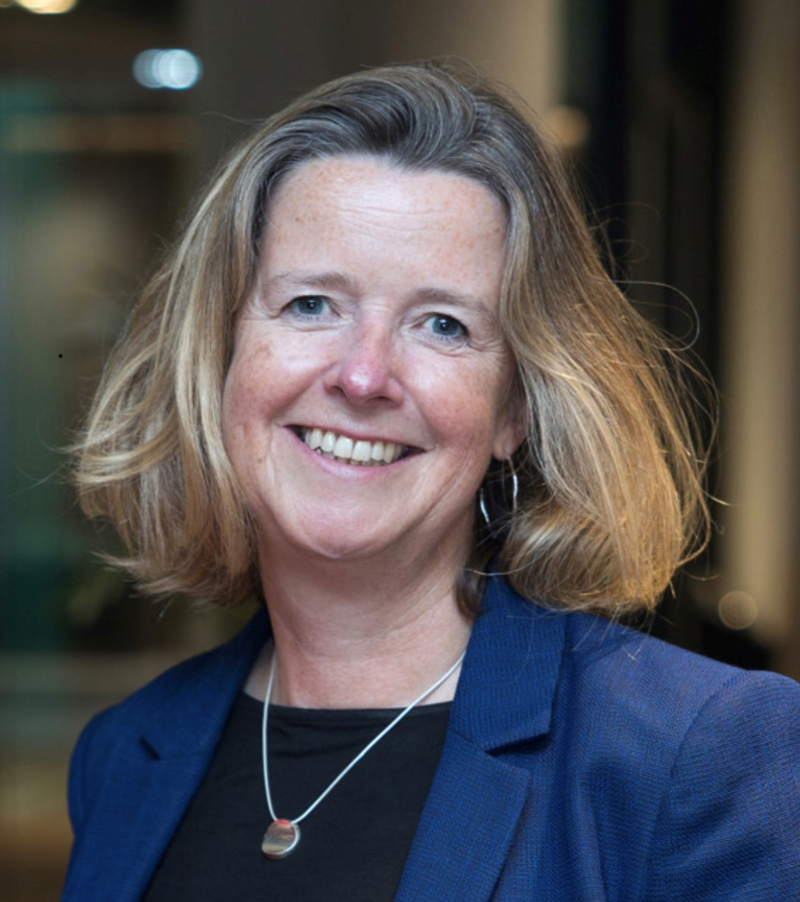
Today’s Chair
Jo Butlin- WUN Co- Founder & Director & CEO EnergyBridge
Having spent the majority of her career in leadership roles working across the energy sector, Jo has now built a portfolio of Non Executive and advisory roles across the market.
She is Chair of the OFGEM’s ESO Performance Panel, Chair of the Board of Thrive Renewables plc, Chair of the board of The Energy Consortium and a NED of Kensa Group Limited in addition to Board advisory roles to several clients.
She works with organisations and individuals with a passion and ambition for facilitating the transition to a net zero world.
https://thewun.co.uk/

Slide 24
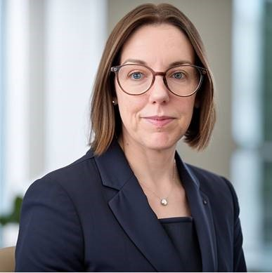
Todays Panel :
Kat Gay, EMR Change Manager,
Elexon.
An experienced Electricity Industry professional, focused on system change and governance. With nearly 20 years’ experience in the energy industry from a metering operative to my current role as Change Manager for EMR Settlement EMR Settlement (a subsidiary of Elexon)
I lead a team gathering and translating changes in Energy Regulation, Rules and operational improvements into a working settlement system for Capacity Providers, Generators and Energy Suppliers.
https://thewun.co.uk/

Slide 25
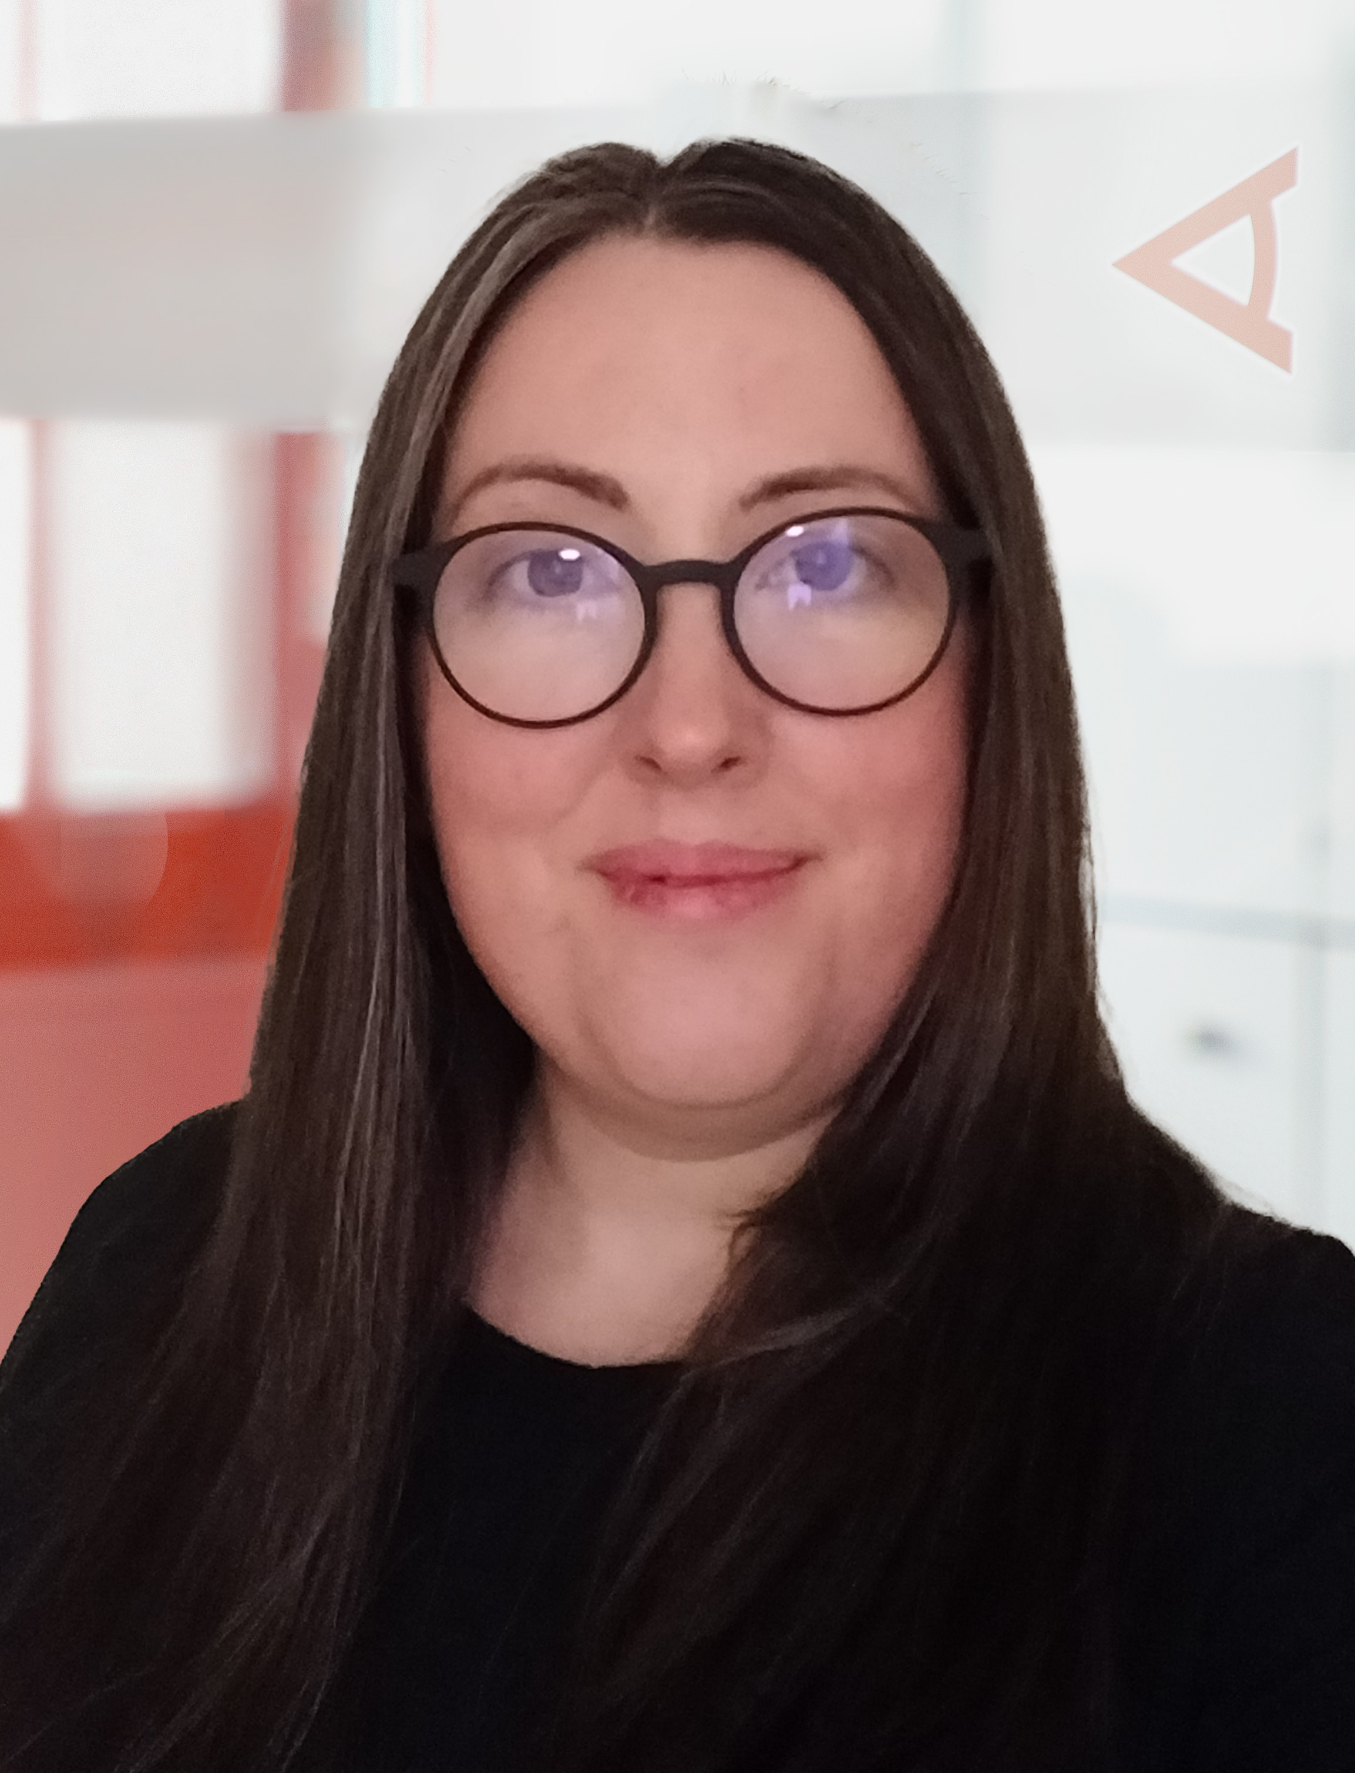
Todays Panel :
Kate Mulvany –Principle Consultant,
Cornwall Insight
Kate is a Principal Consultant specialising in strategy at Cornwall Insight, an independent energy consultancy firm.
Using nearly two decades of experience in policy, regulation and market design, Kate advises on investment, reform and Net Zero delivery.
https://thewun.co.uk/

Slide 26
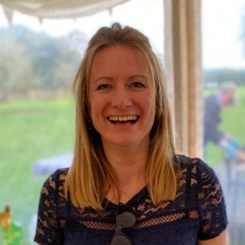
Todays Panel :
Rachel Hayes, Associate director,
Regen
Rachel is a key member of our leadership team and leads Regen’s strategic partnerships
and impact, raising our profile as a key national voice in decarbonising our energy system. Rachel spent 2021 on secondment in the strategy team in the Cabinet Office working on COP26.
Rachel leads our networks, as well as the organisation’s policy, events and communications. Harnessing insight from our members and key stakeholders, including Regen members focussed across the whole system and the Electricity Storage Network. Providing key forums that address the latest issues for the sector, helping us to be a strong, informed and independent force for change. Rachel is a director of the Electricity Storage Network and is also the driving force behind some of the leading clean energy events.
As a working mum, Rachel is a passionate advocate of diversity and she founded a thriving national Women in Renewables network, ReWiRE, to ensure the sector is at the forefront of harnessing talent and received a British Empire Medal in 2017 for her services to the energy sector, in particular, her work supporting the development of women in the sector.
https://thewun.co.uk/

