Slide 1
Welcome
WUN For ALL Utilities as a Service
–What needs to change to make this happen.
https://thewun.co.uk/

Slide 2
1st SME Associate Onboard
5400+ Members
50+ Partner Organisations
10 Events this Year
WUN Achievements
14 Advocates
1300 Event Registrations
35 Podcasts available on website
121 Mentees & 75 Mentors
https://thewun.co.uk/

Slide 3
WUN EVENTS – Coming up
22nd Nov 6pm Leading the Way – Women leading, Innovating & Role Modeling
- Kindly hosted by Salesforce, London.
Charlotte Kirby, Head at Manufacturing, Salesforce.
Katy Taylor, Chief Customer Officer, Southern Water.
Frances Caldwell, Chief People Officer, Gentrack.
Jo Butlin, WUN Co-Founder & Director. EnergyBridge
Free Tickets available
https://thewun.co.uk/

Slide 4
WUN EVENTS – Coming up
17th Jan’ 24 1pm WUN For ALL - Gender Pay Gap – What is it, how is it calculated, why should I care and what needs to happen to close the gap?
Panel:
﻿Claudia McIntosh Global Diversity Inclusion Officer, Smartest Energy.
﻿Sharna Mason Knight, ﻿WUN Advocate & Equity, Diversity and
Inclusion Manager, Cadent Gas Limited.
Further panelist to be announced shortly
Free Tickets available
https://thewun.co.uk/

Slide 5
Join the free WUN Mentoring Programme
New WUN Mentoring now available –
WUN offers mentoring to women at any stage of their career in the utilities sector.
We are hugely privileged to have over 75 fantastic experienced mentors within the WUN mentoring programme.
With growing numbers of Mentors and Mentees we are delighted with the community and support fostered within the mentoring programme.
If you are interested in becoming a Mentor or Mentee, please visit our website: https://wun.onpld.com

Slide 6
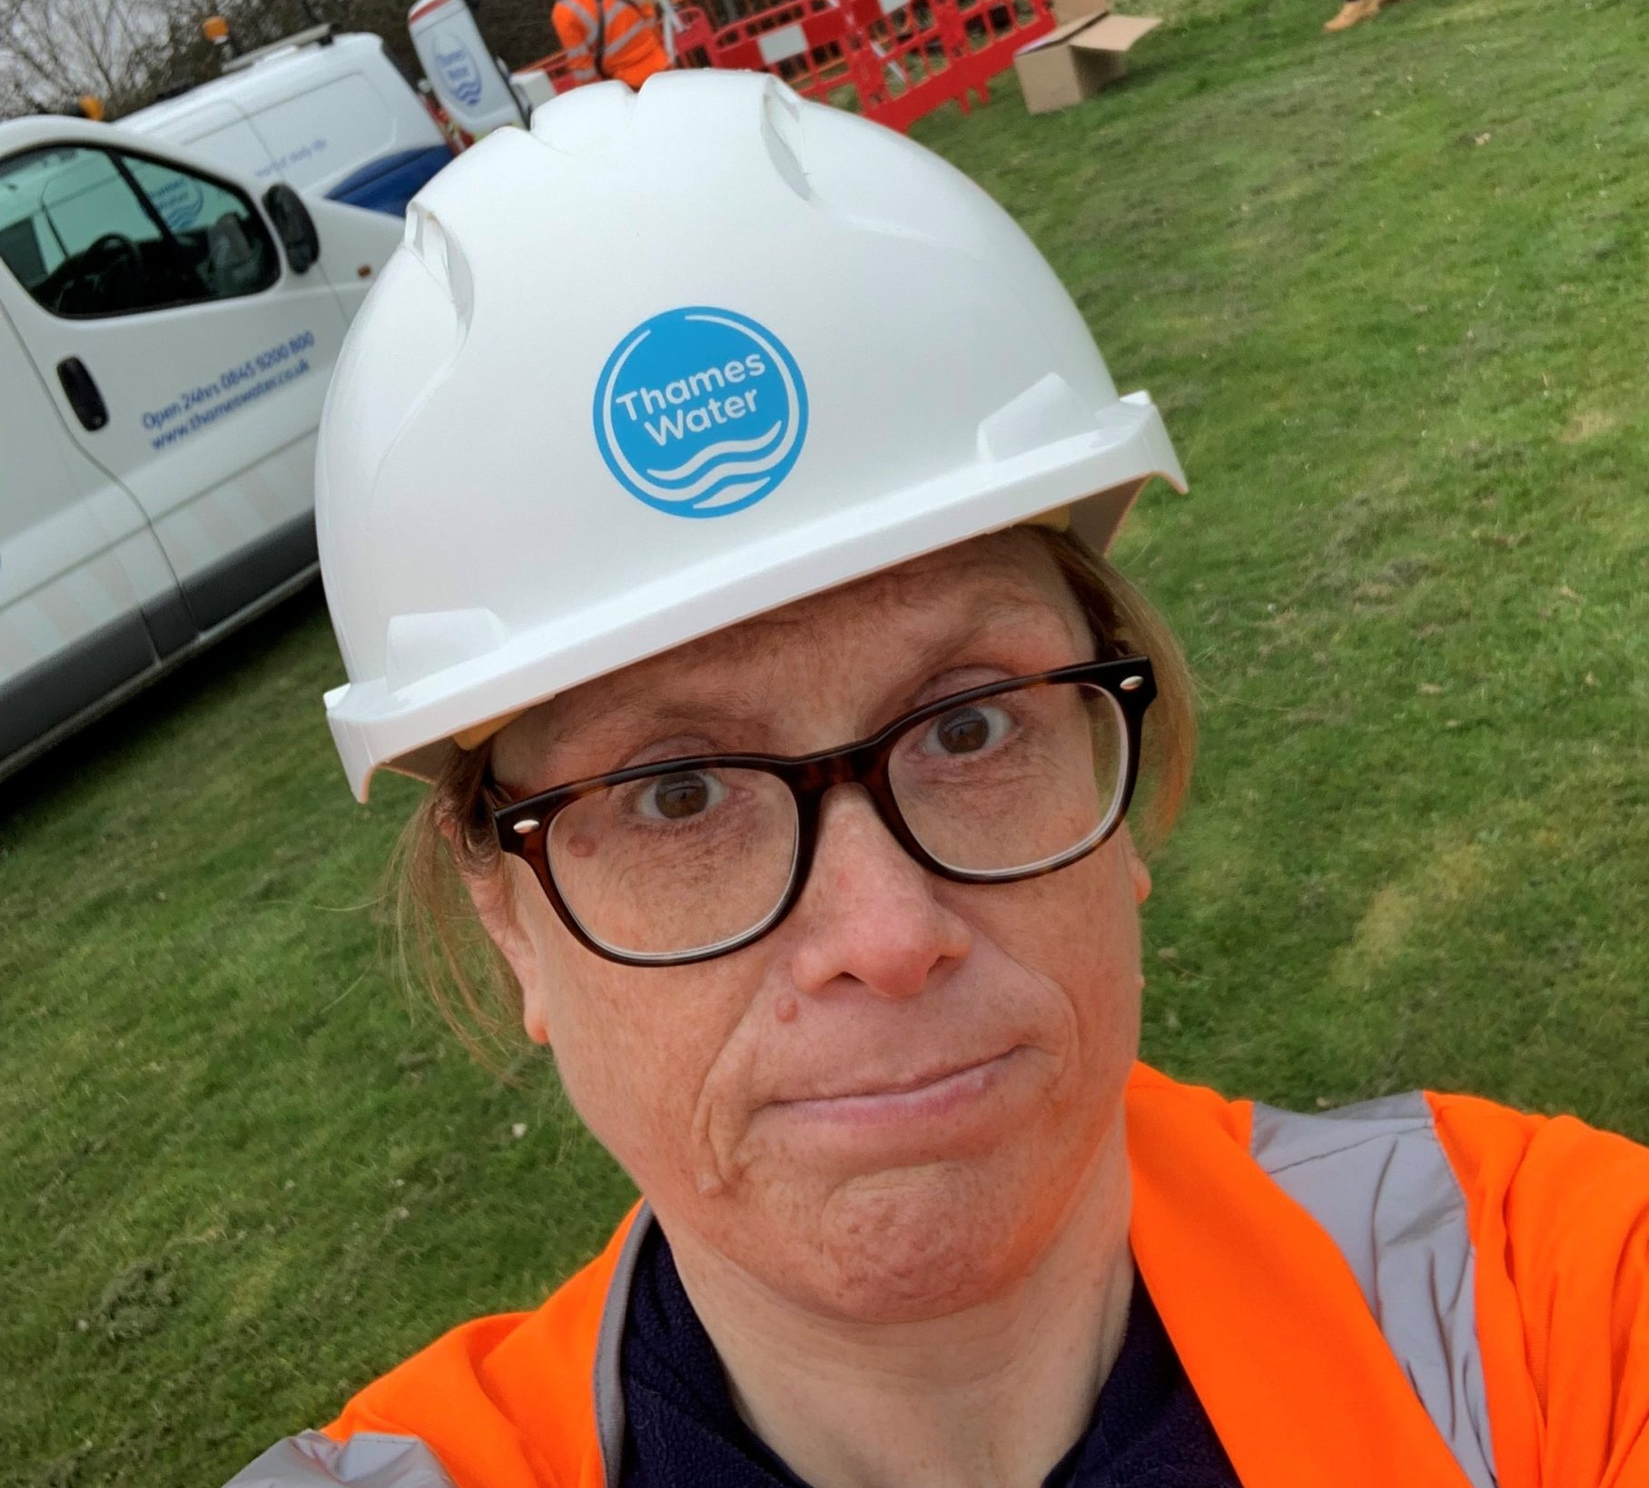
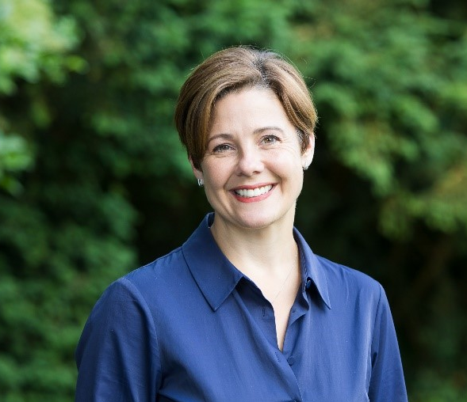
WUN Podcasts
Listen to our latest podcasts
More coming soon !
I
WUN Career Story with Katy Taylor, Chief Customer Officer at Southern Water
Bold Decision Making with Anna Boyles, Head of Mogden Catchment at Thames Water
This is a fascinating listen, as Katy shares her career story with WUN advocate Holly Beeston and discusses a variety of other topics including the importance of mentoring, challenges in a male dominated sector & the work life balance of being a working mother.
Katy joined Southern Water in 2021 as Chief Customer Officer, having previously spent nine years as Chief Strategy and Customer Officer at Go-Ahead, the FTSE 250 international passenger transport business.
In this WUN Podcast episode Holly Beeston talks to Anna Boyles, Head of Mogden Catchment at Thames Water.
Anna is a water industry professional with over 25 years’ wastewater experience. She has worked within operational, regulatory, project management and asset management environments with an extensive focus on operational leadership and environmental protection.
You can follow our podcast on Apple Podcasts, Spotify, Amazon Music and wherever else you get your podcasts – just search “WUN4ALL”.
Or just click through from the website: https://thewun.co.uk/news-blogs/

Slide 7
Don’t forget to join the Network
to receive the next WUN newsletter
https://thewun.co.uk/join-wun/

Slide 8
Today’s Event
Chair –Jo Butlin, Co- Founder & Director
Today's Panel
Ritika Wattan – Head of Strategy at SSE Energy Customer Solution
Pete Nisbet – Managing Director at Edenseven
Emma Keedwell – Head of Innovation at Vodafone Business UK
Richard Bartlett – VP Sales & marketing at Smartest Energy Business
https://thewun.co.uk/

Slide 9
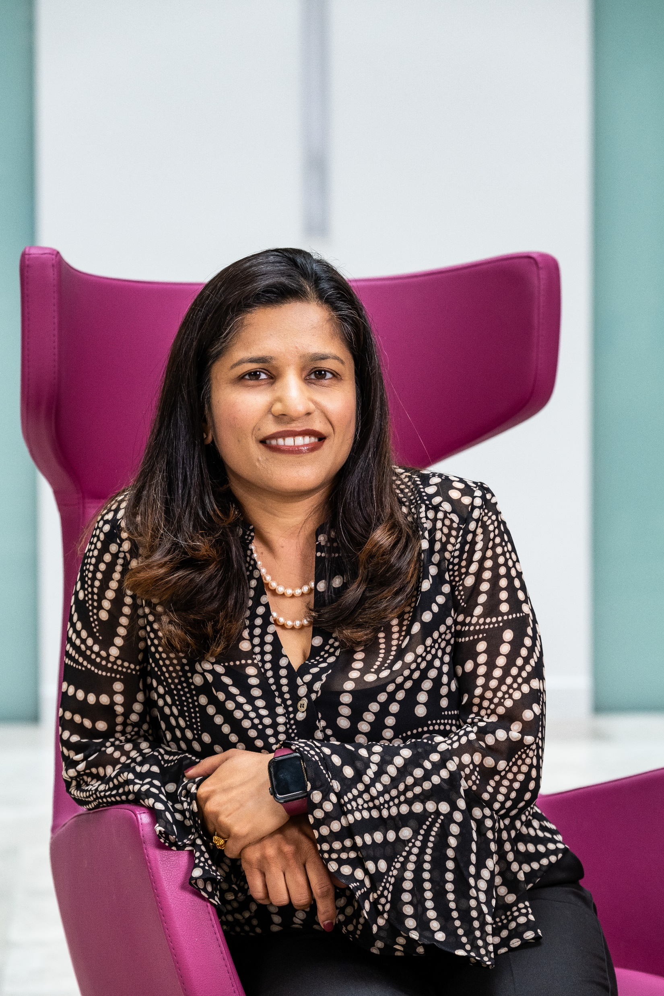
Today’s Speakers
Ritika Wattan – Head of Strategy at SSE Energy Customer Solution
Ritika is a strategy and business transformation leader with 21+ years
experience across Europe and Asia in Consultancy and Energy industry . She has held various roles in Strategy, Strategic planning and change delivery leading multiple high impact initiatives aimed at strategy definition, alignment between strategy , business outcomes and customer experience and embedding a culture of customer centricity
In her current role she is Head of Strategy and Strategic Planning at SSE’s Energy Customer Solutions business which is the shopfront for SSE and aims to help customers on their journey to net zero by providing low carbon solutions and electrification. Prior to joining SSE , Ritika spent almost a decade in Centrica in a variety of roles within British Gas , the largest Energy retailer in the UK and Centrica’s Energy Management and Trading Business Unit. Ritika’s experience in the energy sector is preceded by a significant experience in consultancy with Tata Consultancy Services and CGI (formerly Logica).
https://thewun.co.uk/

Slide 10
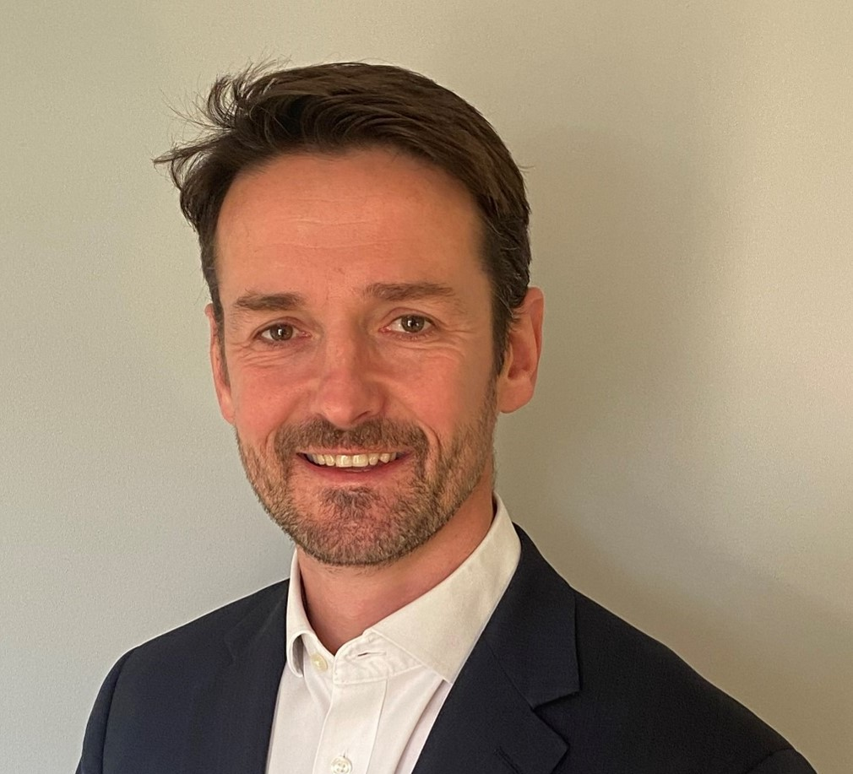
Today’s Speakers
Pete Nisbet – Managing Director at Edenseven
Pete is the Managing Partner at edenseven ltd. Pete started his career working for SSE within the operations team and since then has built a deep understanding of the Energy and Carbon sector having held senior roles in operations, commodity trading and portfolio management across a number of businesses. Prior to joining edenseven, Pete was Managing Director for Mitie Energy.
https://thewun.co.uk/

Slide 11
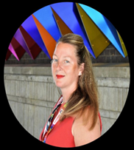
Today’s Speakers
Emma Keedwell - Head of Innovation, IOT, Cloud and Security at
Vodafone Business UK.
Emma has 23 years delivering Cocreation, Innovation, Sales, & New Business development activities across the Global Telecommunications Industry. Beginning her early career at Racal Recorders she was responsible for developing leading edge video/audio insights solutions to market. Furthermore, delivering complex Contact Centre projects at BT Global Services and international transformation projects for Jersey Telecom.
However, for the past 9-year Emma has been championing the Innovation flag at Vodafone Business. It all began with setting up the Bluefish consulting activities in Iberia, then leading the Global Innovation programme and steering incubation
teams to deliver key platforms.
https://thewun.co.uk/

Slide 12
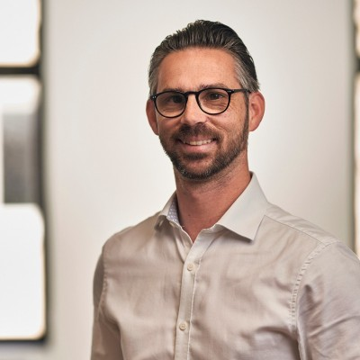
Today’s Speakers
Richard Bartlett - Vice President Sales & Marketing SmartestEnergy
As the Vice President Sales Marketing at SmartestEnergy Business, I lead the growth of the SME electricity and gas supply business in the UK. I have over 20 years of experience in sales and marketing, spanning the energy and telecommunications sectors.
I joined SmartestEnergy in 2019, following its acquisition of Dual Energy, where I was part of the shareholder management team and the Sales & Marketing Director. I executed a high growth strategy that established Dual Energy as the leading UK independent energy supplier to the SME sector, offering a genuine alternative to the Big 6. I developed innovative product
and pricing strategies, built diverse sales channels, and fostered long-term
partnerships with customers and stakeholders
https://thewun.co.uk/

Slide 13
Upgrading Britain's Smart Meter System
Smart substations
Energy Solutions – part of vertically integrated group SSE plc
NaaS
Network as a Service
Shopfront for SSE’s low carbon solutions
A sustainability consultancy and emissions software provider
Empowering a greener generation
2027
UK’s operations to be NetZero
Helping customers on journey to Net Zero – providing green energy & helping customers optimise energy use
Helping switched-on customers to control costs and get smart to net zero
100%
European network powered by 100% renewable electricity
Whole systems thinking approach including EaaS
Strong Data is key to any ‘as a service’ offer Without it, there will be confusion
People-powered built on strong, diverse talent & relationships
Notes:
optimise and manage their low carbon energy use.

Slide 14
Q&A
https://thewun.co.uk/

Slide 16
Thank you again to our speakers & to our partners for their ongoing support in making this event possible.
https://thewun.co.uk/

Slide 17
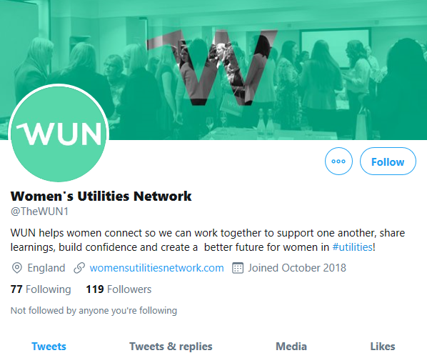
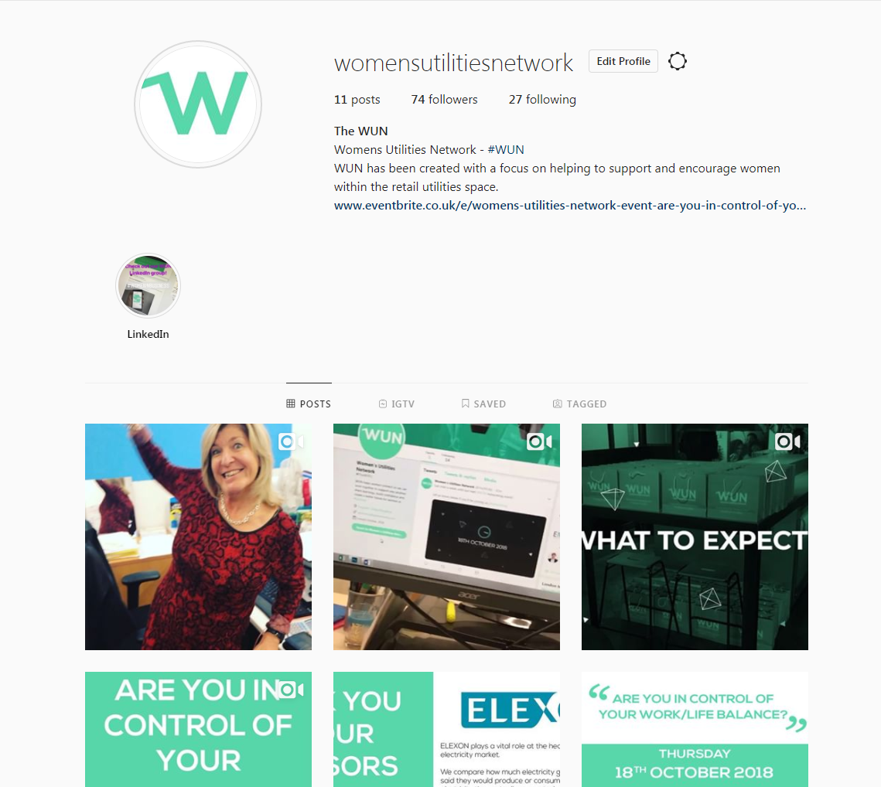
#WUN Don’t forget to follow us for the latest news and updates
https://thewun.co.uk

