Slide 1
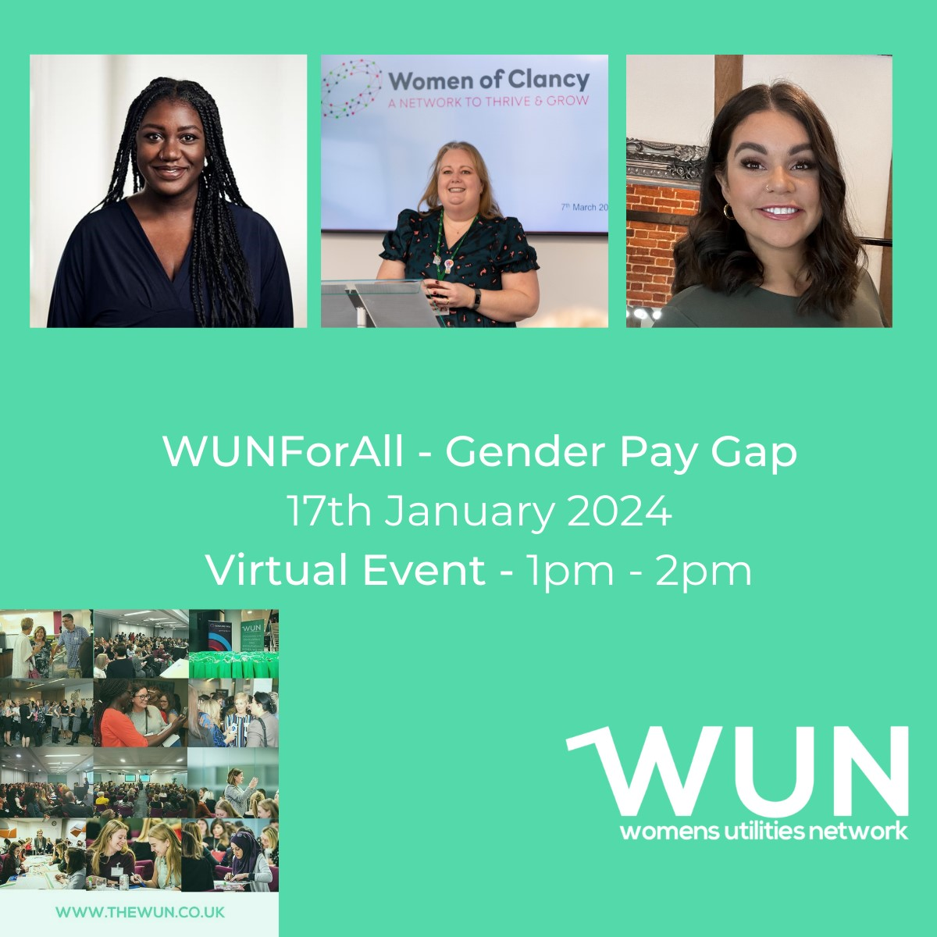
Welcome
Todays WUN For ALL will be starting shortly
https://thewun.co.uk/

Slide 2
4th SME Associate Onboard
5800+ Members
50+ Partner Organisations
11 Events in 2023
WUN Achievements
13 Advocates
1300 Event Registrations
40+ Podcasts available on website
145 Mentees & 76 Mentors
https://thewun.co.uk/

Slide 3
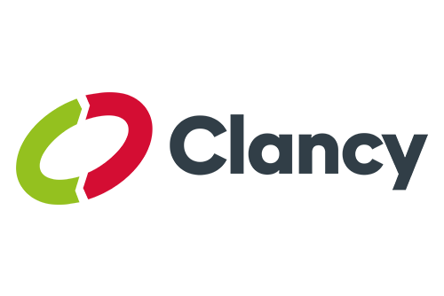

Slide 4
Dates for your diary
WUN Events 2024
22nd Feb 2024 Levelling up in decision making – inclusion in action, Leeds.
7th March 2024 The Balance of Power- how will the election impact energy, London
8th March 2024 – #IAmRemarkable virtual workshop on IWD2024
Free tickets available now – visit our Events page!
Further events:
27th June Women in Utilities Awards 2024 in association with
Utility Week
https://thewun.co.uk/

Slide 5
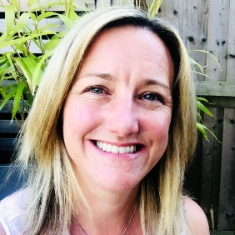
WUN Podcasts
Listen to our latest podcasts More coming soon !
Balancing the Motherload - What Is it & Some Tips to Stay in Control - Juliet Summers, Inner Talent speaking to Kerris Mackley, WUN Advocate
In this episode, Juliet Summers from Inner Talent and Kerris Mackley, one of our WUN Advocates, take us through all things the 'Motherload'. Firstly understanding what the motherload is and what impact it has on us, as well as how to know when it's too much, how to manage it and what the future looks like for the working world. To understand more about the motherload and all the associated complexities around being a mum in the workplace, take a listen!
Turning Challenges into Opportunities in Japan with Yuko Tanaka, Sales Operations Manager at GridBeyond speaking with Victoria Lemon, WUN Advocate
Join us as Victoria talks to Yuko Tanaka about her experience of being a bilingual woman in a male dominated industry in Japan.
You can follow our podcast on Apple Podcasts, Spotify, Amazon Music and wherever else you get your podcasts – just search “WUN4ALL”.
Or just click through from the website: https://thewun.co.uk/news-blogs/

Slide 6
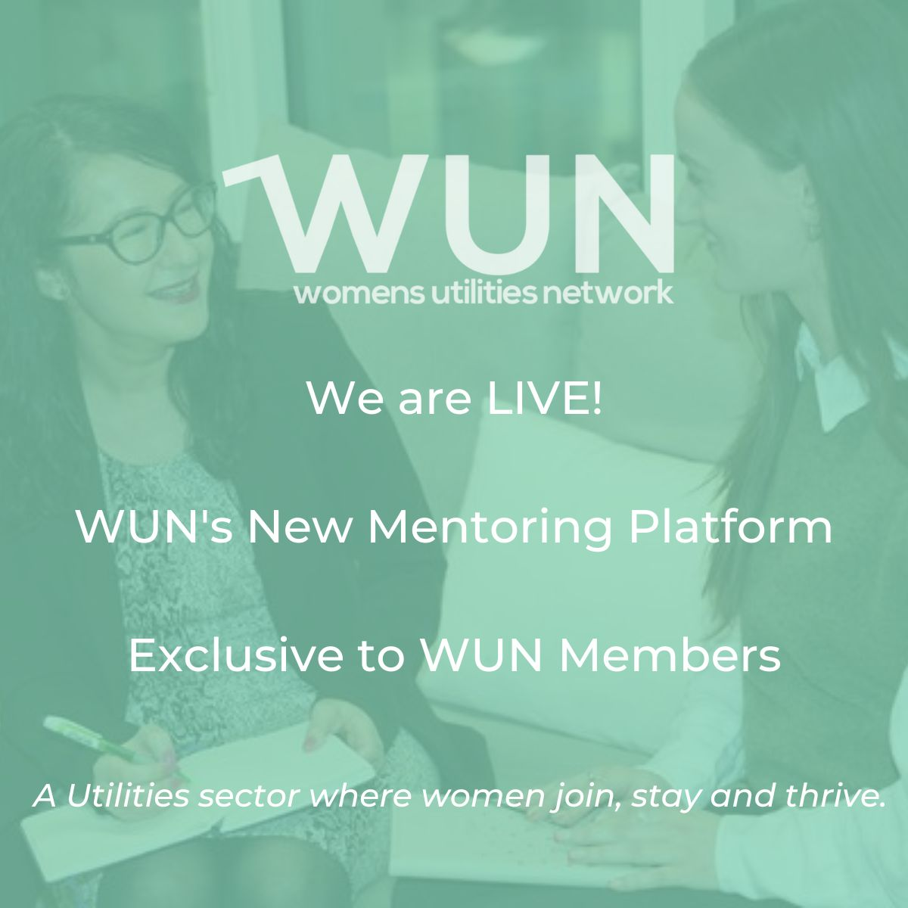
International Mentoring Day
Join the free WUN Mentoring Programme
New WUN Mentoring now available –
WUN offers mentoring to women at any stage of their career in the utilities sector.
We are hugely privileged to have over 75 fantastic experienced mentors within the WUN mentoring programme.
With growing numbers of Mentors and Mentees we are delighted with the community and support fostered within the mentoring programme.
If you are interested in becoming a Mentor or Mentee, please visit our website: https://wun.onpld.com

Slide 7
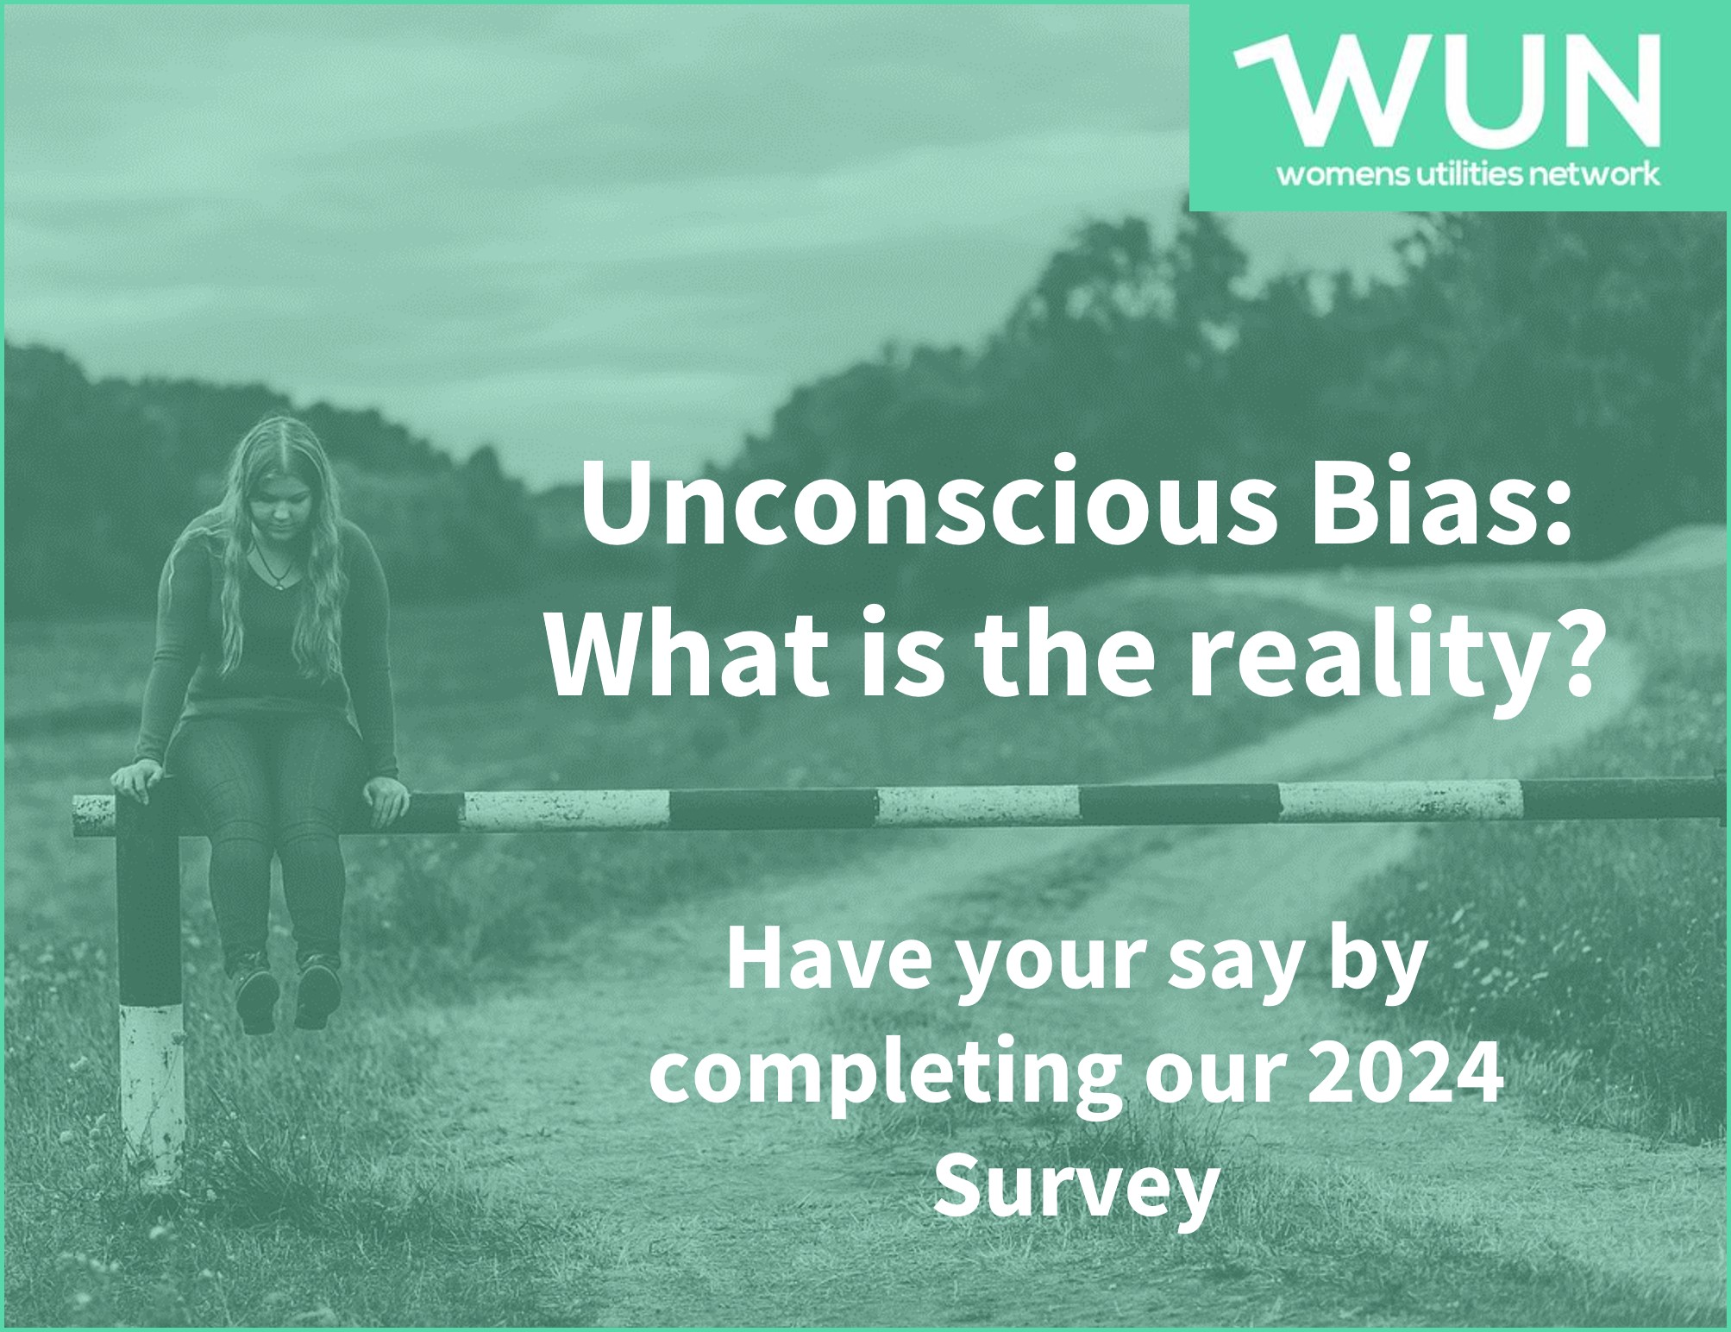
WUN Survey 2024 - Unconscious Bias: What is the reality?
WUN, in a collaboration with The Marketing Pod have launched its 2024 opinion survey focused on unconscious bias.
We want to get under the skin of unconscious bias in the workplace and how it is affecting women’s careers.We are looking to build a picture of the reality in Utilities today and particularly bringing to light real life examples where bias is positively or negatively impacting career development.
Our research will be published & shared across the sector bringing enhanced data & insight to employers and stakeholders with the aim of providing tangible
improvements to the development of womens’ careers.
Please complete & encourage colleagues to do the same.
https://thewun.co.uk/

Slide 8
Don’t forget to join the Network
to receive the next WUN newsletter
https://thewun.co.uk/join-wun/

Slide 9
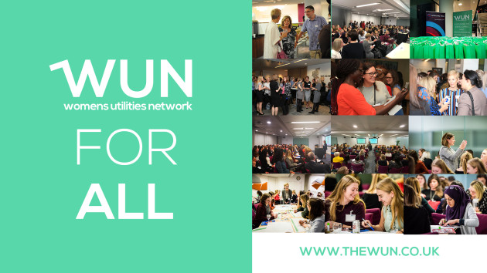
Today’s Event
Chair –.Hayley Monks, WUN Co-Founder & Director, WNS Global.
Today's Panel
Claudia McIntosh Global Diversity Inclusion Officer, Smartest Energy.
Sharna Mason Knight, WUN Advocate & Equity, Diversity & Inclusion Manager, Cadent Gas Limited.
Amanda Rance, Senior People Business Partner & Diversity & Inclusion Lead, The Clancy Group Ltd,
https://thewun.co.uk/

Slide 10
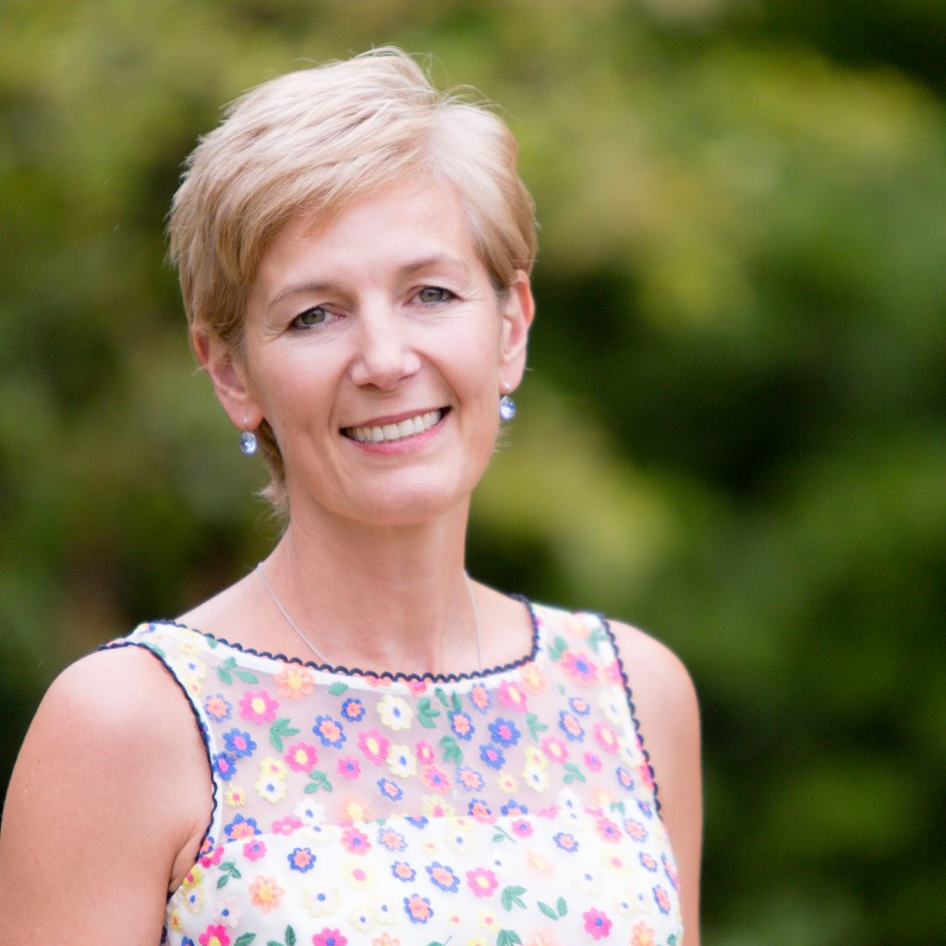
Today’s Chair
Hayley Monks WUN Co-Founder & Director
WNS Global.
Hayley is an experienced business leader, with over 20 years spent in roles in operations, credit management, and customer service leadership. She is one of the founder Members of Women in Utilities Network, and in 2015 launched Think, Inspire Create, a unique consultancy focused on supporting businesses to grow, evolve and drive change through working with them to develop their people
Hayley’s experience gives her a unique perspective on what makes businesses successful, and her engaging and inspiring style means she is an influential speaker and acts as a personal coach to many senior leaders. In March 2023 Hayley joined WNS Global as SVP Utilities.
https://thewun.co.uk/

Slide 11
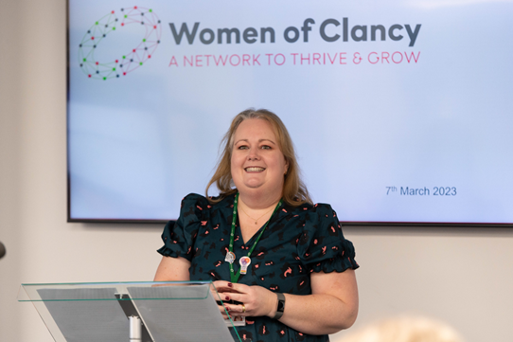
Todays Panel :
Amanda Rance –
Senior People Business Partner
and Diversity & Inclusion Lead for
The Clancy Group Ltd,
Amanda has over twenty years HR experience most of which has been in the construction, infrastructure and utilities sector. She is passionate about coaching and mentoring people to succeed in whatever they choose to do.
https://thewun.co.uk/

Slide 12
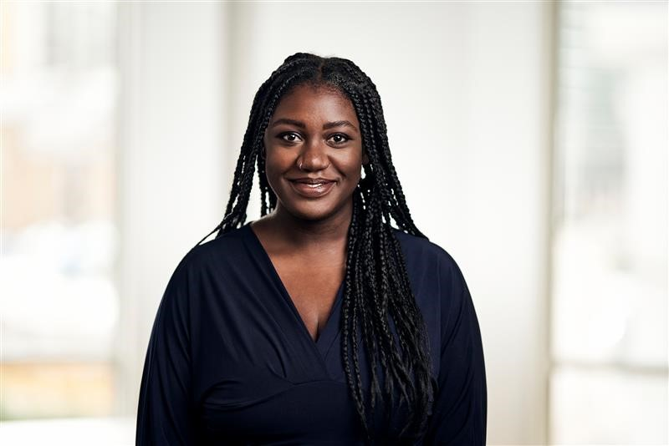
Claudia McIntosh –
Global Diversity Inclusion Officer,
Smartest Energy.
My experience in the DE&I space spans over the last decade and covers both the public and most recently, the private sector. I’ve dedicated my career my to exploring, unpicking, and improving the ways in which employers create the kind of environment that helps their people to thrive, reach self-actualisation, and do their best work.
I’m a first-time working mum to a two-year-old, and a step mum to two brilliant pre- teen daughters. Through my own lived experience and position as an active ally to many causes, I’ve always been drawn to supporting marginalised groups by amplifying their voices and truly understanding the societal barriers that they face. Knowing that there are 3 growing humans in my care who will at some point experience the workplace themselves, it grows ever more important for me to ensure that the future of the workplace is one where they feel recognised for their achievements, safe, and able to speak up.
https://thewun.co.uk/

Slide 13
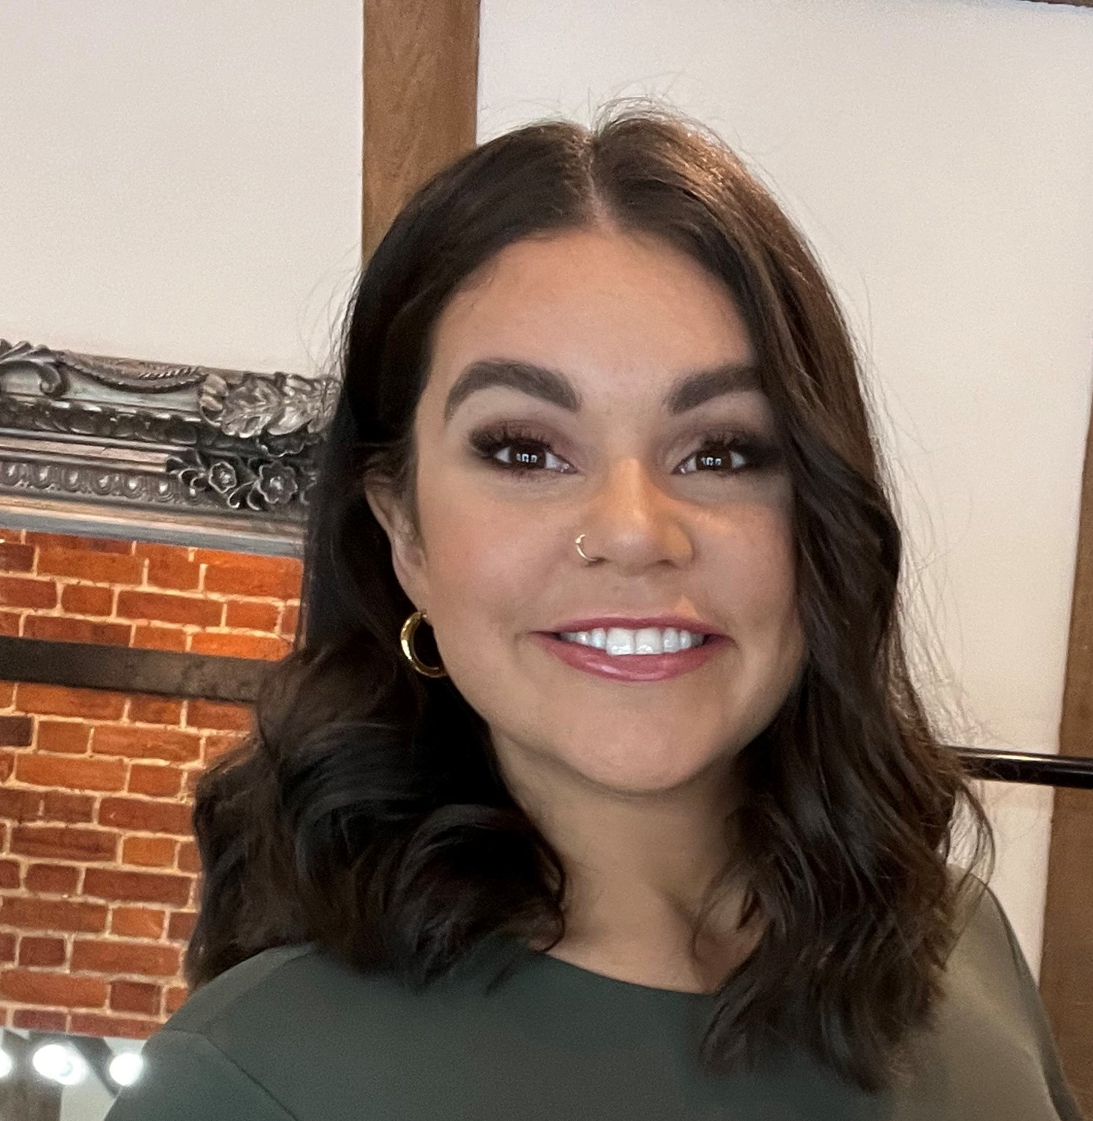
Sharna Mason Knight, WUN Advocate & Equity, Diversity & Inclusion Manager, Cadent Gas Limited.
I have a background in HR, Learning & Development, and worked in Energy
Operations within Cadent. I am passionate about everyone having opportunities, whether that’s in work, society or their personal lives, to have confidence, succeed and be the most authentic version of themselves.
I joined WUN as an Advocate back in 2020, and I took a role managing the Mentoring programme and starting up the Podcast. Everything that WUN stands for really resonates with me. I am grateful that I can give back to a sector that I have enjoyed and succeeded in for the last 10 years.
I enjoy helping women to believe in themselves through building confidence, empowering them, and helping them thrive. I am excited to re-join WUN after having my daughter and continue to contribute to a network that inspires the current, and future generations of women.
https://thewun.co.uk/

Slide 14
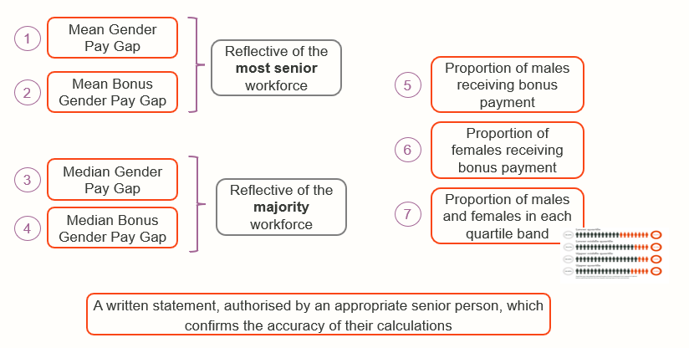
What is the gender pay gap?
Difference between gender pay gap and equal pay
The gender pay gap shows the difference between the average (mean or median) earnings and bonus paid of men and women. This is expressed as a percentage of men’s earnings e.g. women earn 15% less than men.
There are 7 data sets that are calculated;
Equal pay deals with the pay differences between men and women who carry out the same jobs, similar jobs or work of equal value. It is unlawful to pay people unequally because they are a man or a woman.
The gender pay gap shows the differences in the average pay between men and women. The individual calculations may help to identify what those issues are.

Slide 15
Speakers
&
Q&A
https://thewun.co.uk/

Slide 17
Thank you to all our speakers & WUN partners who made this event possible
https://thewun.co.uk/

Slide 18
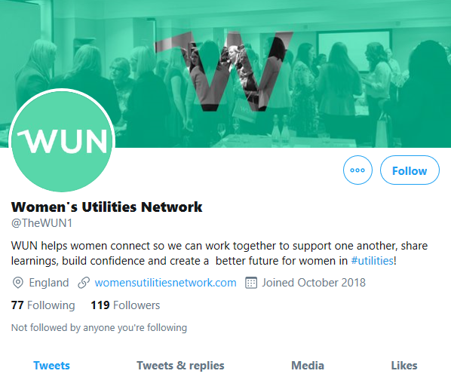
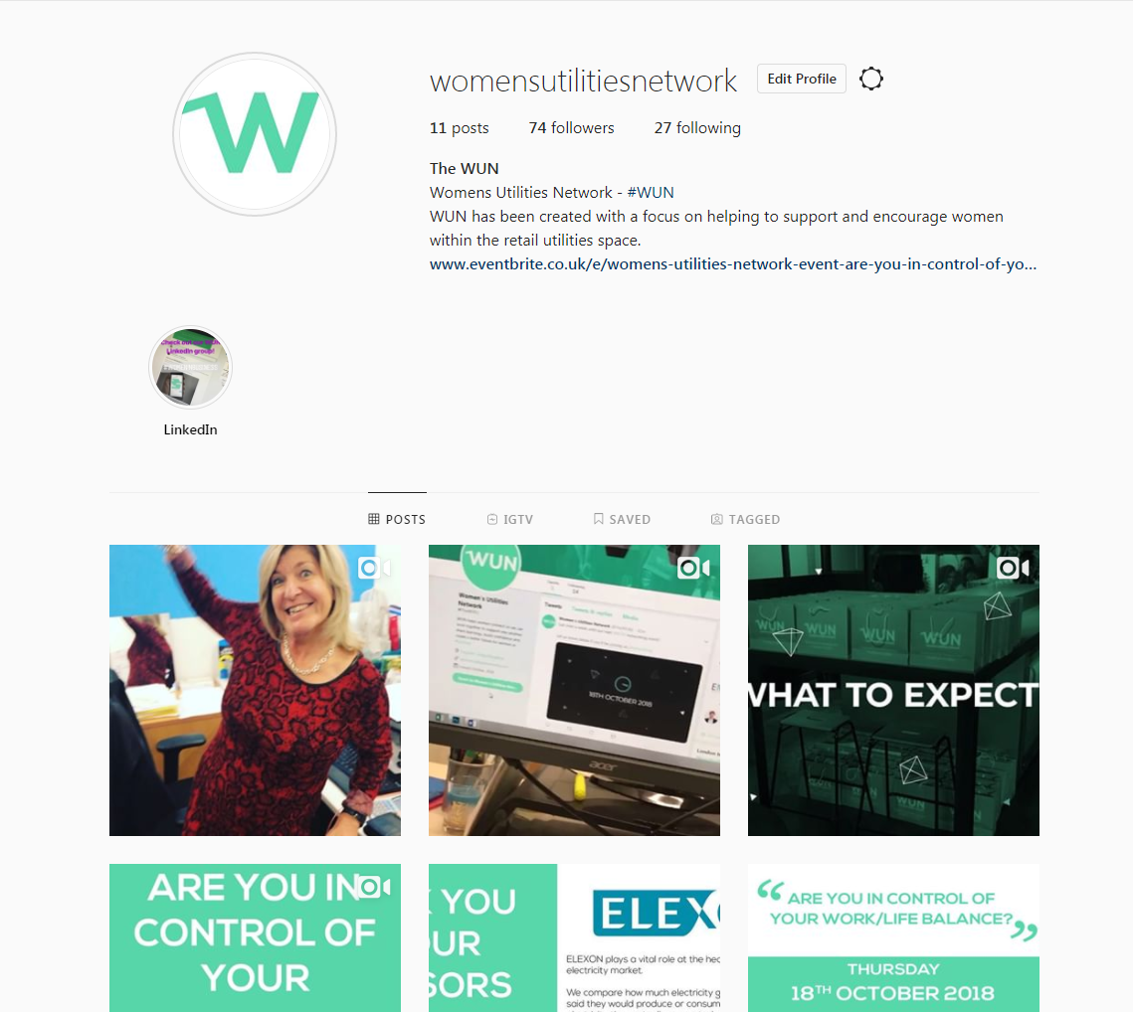
#WUN Don’t forget to follow us for the latest news and updates
https://thewun.co.uk

