Slide 1
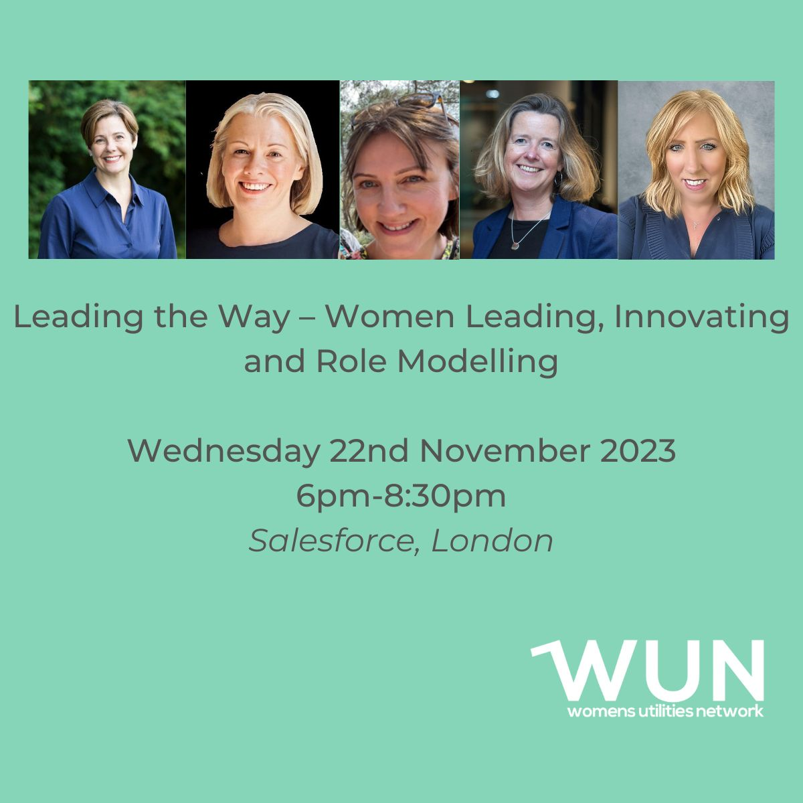
Welcome
Women leading, Innovating & Role Modelling
Kindly hosted by Salesforce in partnership with
Anglian Water
https://thewun.co.uk/

Slide 3
4th SME Associate Onboard
5500+ Members
50+ Partner Organisations
11 Events this Year
WUN Achievements
13 Advocates
1300 Event Registrations
37 Podcasts available on website
145 Mentees & 76 Mentors
https://thewun.co.uk/

Slide 4
WUN EVENTS – Coming up
17th Jan’ 24 1pm WUN For ALL - Gender Pay Gap – What is it, how is it calculated, why should I care and what needs to happen to close the gap?
Panel:
﻿Claudia McIntosh Global Diversity Inclusion Officer, Smartest Energy.
﻿Sharna Mason Knight, ﻿WUN Advocate & Equity, Diversity and
Inclusion Manager, Cadent Gas Limited.
Further events for 2024 to be announced shortly.
Free Tickets available
https://thewun.co.uk/

Slide 5
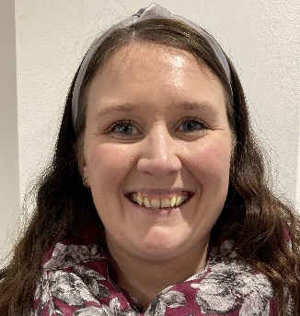
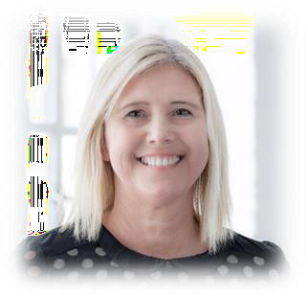
WUN Podcasts
Listen to our latest podcasts More coming soon !
What it Takes To Do It All – Boundaries, Teams and Sponsors – Robyn Jenkins, Executive Advisor, National Grid
Join us as we delve into the world of work-life balance, boundary-setting, and sponsorship with Robyn Jenkins, Executive Advisor at National Grid ESO, and advocate for women in leadership. Robyn talks passionately about how she sets expectations so she can deliver at her best and the initiatives she’s helped put in place recently at her company to support employees bring their whole selves and grow.
Re-Inventing Leadership with Karen Moran, Director of Disruptive HR
Listen to the latest WUN podcast Re-thinking Leadership – taking a fresh perspective on how we can all behave as leaders.
WUN advocate Victoria Lemmon chats with Karen Moran, Director of Disruptive HR to discuss her experience as a HR professional and why she feels some leadership styles need a change. Karen provides an updated view on leadership approaches at all levels, sharing hints and tips we can all take on board.
You can follow our podcast on Apple Podcasts, Spotify, Amazon Music and wherever else you get your podcasts – just search “WUN4ALL”.
Or just click through from the website: https://thewun.co.uk/news-blogs/

Slide 6
Join the free WUN Mentoring Programme
New WUN Mentoring now available –
WUN offers mentoring to women at any stage of their career in the utilities sector.
We are hugely privileged to have over 75 fantastic experienced mentors within the WUN mentoring programme.
With growing numbers of Mentors and Mentees we are delighted with the community and support fostered within the mentoring programme.
If you are interested in becoming a Mentor or Mentee, please visit our website: https://wun.onpld.com

Slide 7
Don’t forget to join the Network
to receive the next WUN newsletter
https://thewun.co.uk/join-wun/

Slide 8
Today’s Event
Chair –.Jo Butlin, WUN Co-Founder & Director. EnergyBridge
Today's Panel
Charlotte Kirby, Head at Manufacturing, Salesforce.
Carly Leonard, Head of Environmental Strategy, Anglian Water
Katy Taylor, Chief Customer Officer, Southern Water.
Frances Caldwell, Chief People Officer, Gentrack.
https://thewun.co.uk/

Slide 9
Speakers
&
Q&A
https://thewun.co.uk/

Slide 11
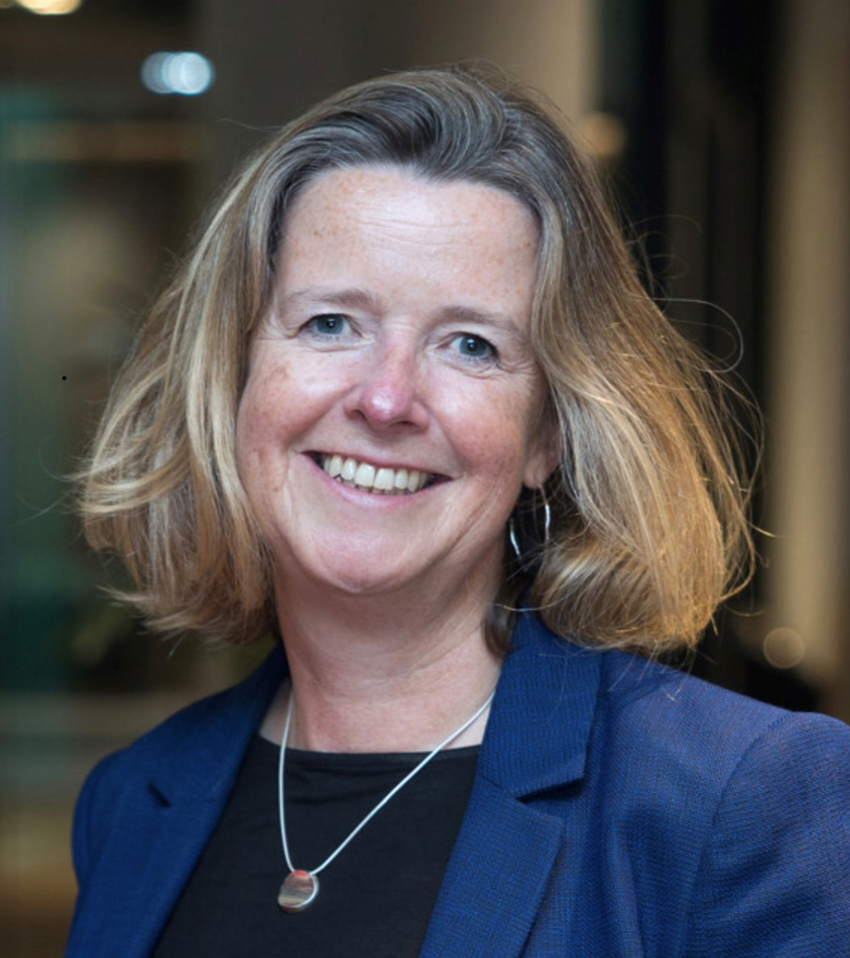
Today’s Chair
Jo Butlin, WUN Co-Founder & Director EnergyBridge.
Having qualified as an accountant, Jo spent the majority of her career in leadership roles working across the energy sector before setting up her own consulting company, EnergyBridge (UK) Limited in 2017, to help businesses and investors navigate the energy market.
Jo has built a portfolio of Non Executive and advisory roles across the market. She
is Chair of the OFGEM’s ESO Performance Panel, Chair of the Board of
Thrive Renewables plc, Chair of the board of The Energy Consortium and a
NED of Kensa Group Limited in addition to Board advisory roles to several
clients. She works with organisations and individuals with a passion and ambition
for facilitating the transition to a net zero world.
https://thewun.co.uk/

Slide 12
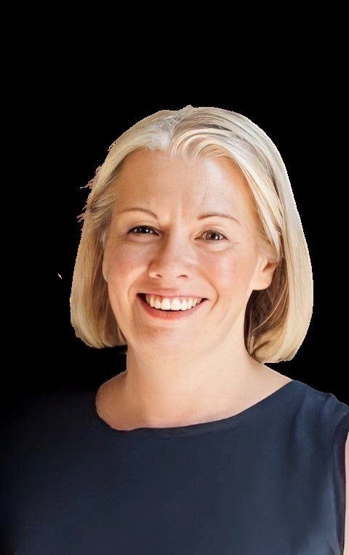
Today’s Speakers
Charlotte Kirby.
Area Vice President of Manufacturing, Salesforce.
Charlotte is Area Vice President of Manufacturing at Salesforce, responsible for leading the company's growth in the Manufacturing, Automotive and Aero/ Defence sectors. Since joining the business in 2013, Ms Kirby has been a passionate advocate of technology innovation and its role in driving sustainable business transformation and customer success. She is a
champion of Responsible Business and the role of business as a platform for change.
Prior to Salesforce, Ms Kirby worked in senior management roles in the
telecommunications industry, holding senior management positions within
Verizon and WorldCom and focusing on business transformation and customer
success. Ms Kirby holds a BA (Hons) in Business from Anglia Ruskin and
a MSc in Corporate Governance from London South Bank.
https://thewun.co.uk/

Slide 13
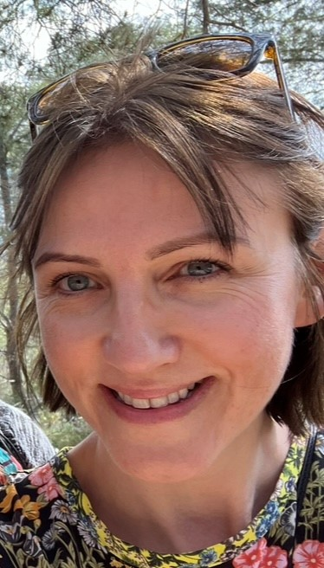
Today’s Speakers
Carly Leonard, Head of Environmental Strategy, Anglian Water
Carly is the Head of Environmental Strategy for Anglian Water. She oversees environmental strategy and policy as alongside delivery of key environmental activities within the team with wider links across the business. This includes the preparation and management of our WINEP (Water Industry Natural Environment Programme) and delivery of catchment management and biodiversity. A large area of focus for Carly and her team is working in collaboration with others to achieve greater environmental outcomes.
Prior to her role at Anglian Water, Carly was Chief Executive of an environmental charity for eight years. She has also worked in regional and local government as well as setting up a social enterprise focussed on climate change and sustainability.
https://thewun.co.uk/

Slide 14
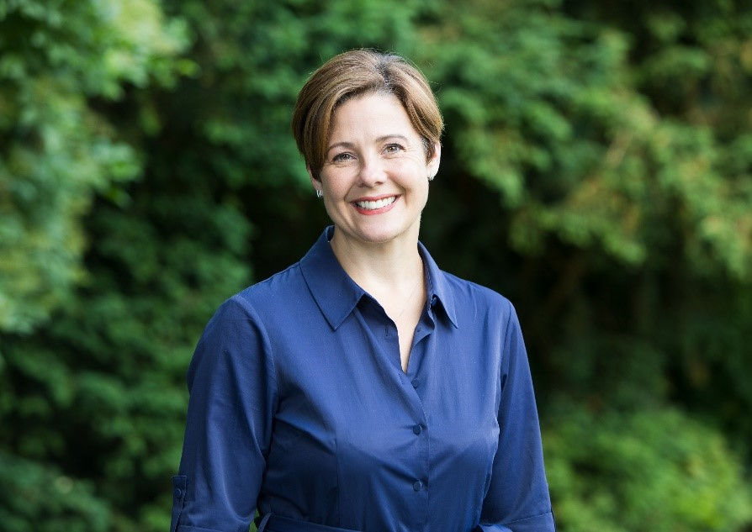
Today’s Speakers
Katy Taylor, Chief Customer Officer, Southern Water.
Katy joined Southern Water in 2021 as Chief Customer Officer, having previously spent nine years as Chief Strategy and Customer Officer at Go-Ahead, the FTSE 250 international passenger transport business. Her responsibilities have included customer services, marketing, commercial development, digital transformation, corporate affairs, innovation, strategy, sustainability and culture change.
Before Go-Ahead, Katy held director-level roles in financial and professional services, and hospitality including Kroll, Vneshtorgbank and IG Group. Katy is a
Non-Executive Director at England's largest housing and care provider
Anchor, a member of the Board of Governors at Kingston University and
an advisory Board Member at micro-giving charity Pennies. She is also
a founding member of the Business in the Community Place initiative.
https://thewun.co.uk/

Slide 15
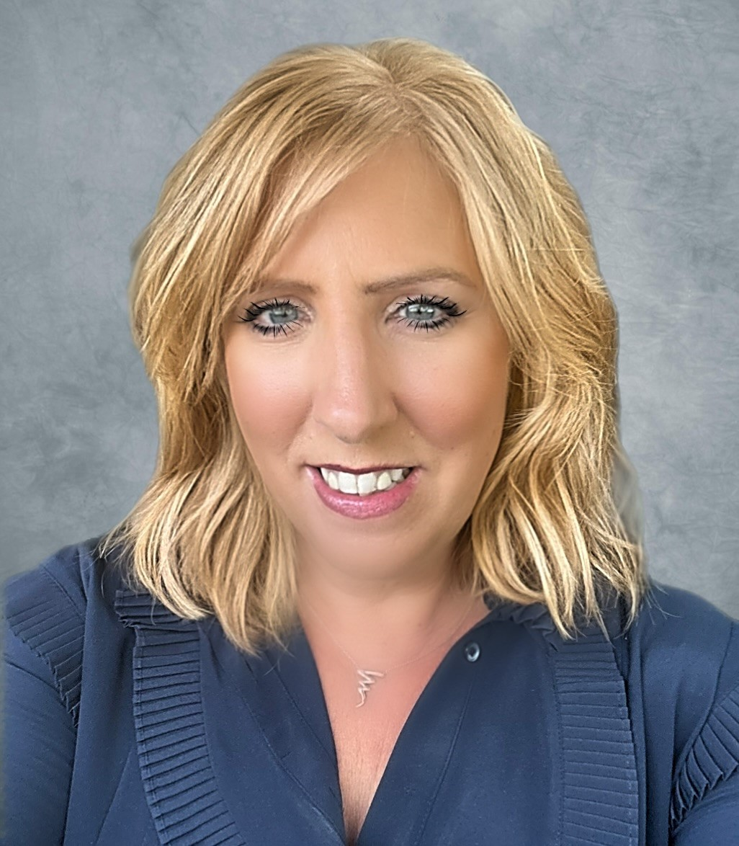
Today’s Speakers
Frances Caldwell, Chief People Office, Gentrack.
Currently the Chief People Officer for Gentrack, Fran is a commercial HR leader, with over 20 years of experience in leading and transforming Global people functions and the businesses they partner. Prior to Gentrack, Fran has led HR functions within global multinationals including Barclaycard, Intertek and KPMG.
A large part of Fran’s early career was in leading specialist functions of Reward and
Employee Engagement, Executive coaching and strategic transformation and
change. Fran is passionate about working with innovative, and commercial
technology led companies with a strong sense of purpose – inspiring the teams to
deliver meaningful change for people and the planet.
https://thewun.co.uk/

Slide 16
Thank you again to our generous hosts - Salesforce, our speakers & to all our partners for their ongoing support in making this event possible.
See you in 2024 !
https://thewun.co.uk/

Slide 17
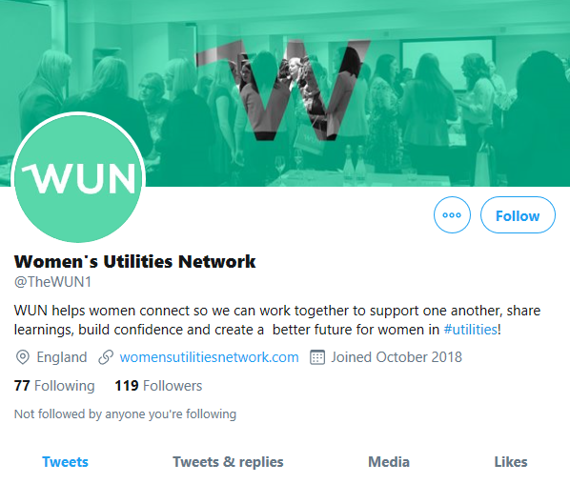
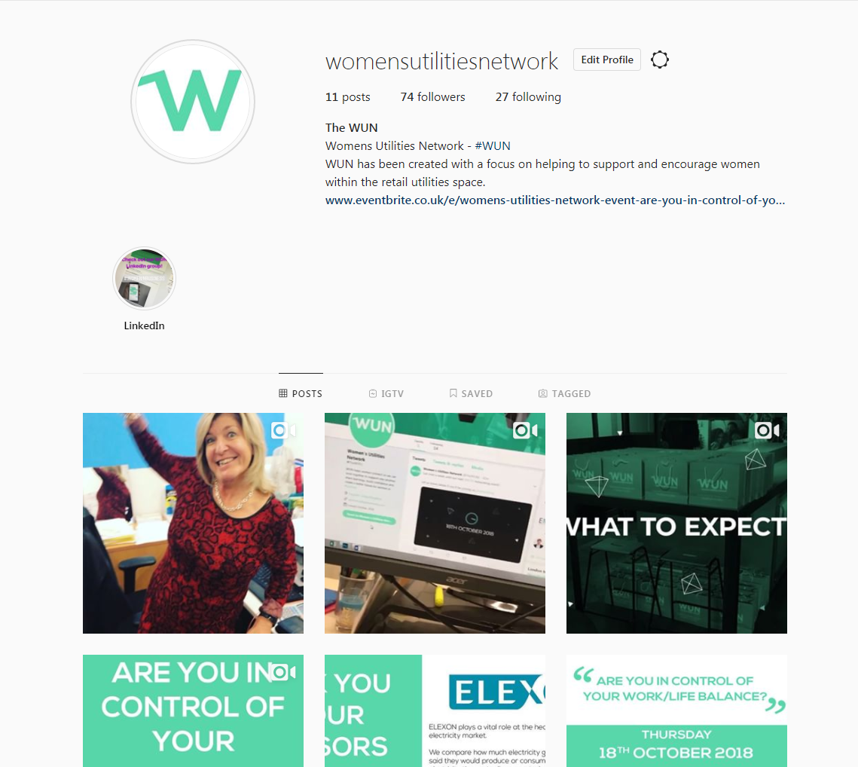
#WUN Don’t forget to follow us for the latest news and updates
https://thewun.co.uk

