Slide 1
Welcome to
The Affluent & The Effluent – How does the Water Industry respond to rebuild customer trust?
We are delighted to be co-hosting this event with the Institute of Water
https://thewun.co.uk/

Slide 2
Today’s Event
Chair – Hayley Monks, WUN CoFounder & Director
Todays Panellists:
Sarah McMath, WUN Board Member & CEO of MOSL
Chris Pollard, Director of Customer Service, Thames Water
Karma Loveday, Editor of the Water Report
Dr Heather Smith, Senior Lecturer in Water Governance Cranfield University
https://thewun.co.uk/

Slide 3
2023 WUN Events- book now
20th September -WUN Careers Event - Building your career in Utilities 5:30-9pm.
WUN are hosting our first ever careers event - a fantastic opportunity to speak to women working at our partner organisations to discover the breadth of careers open across the Utilities sector.
Join us at Microsoft's London offices, with keynote speakers discussing key hints and tips on how to get ahead and build the career you want, and exhibitors from across the sector showcasing a range of different career opportunities.
More details to follow shortly, but this one is likely to be a
sell-out - so sign up early!
https://thewun.co.uk/wun-events/

Slide 4
Join the free WUN Mentoring Programme
New WUN Mentoring now available –
WUN offers mentoring to women at any stage of their career in the utilities sector.
We are hugely privileged to have over 60 fantastic experienced mentors within the WUN mentoring programme.
With growing numbers of Mentors and Mentees we are delighted with the community and support fostered within the mentoring programme.
If you are interested in becoming a Mentor or Mentee, please visit our website: https://wun.onpld.com

Slide 5
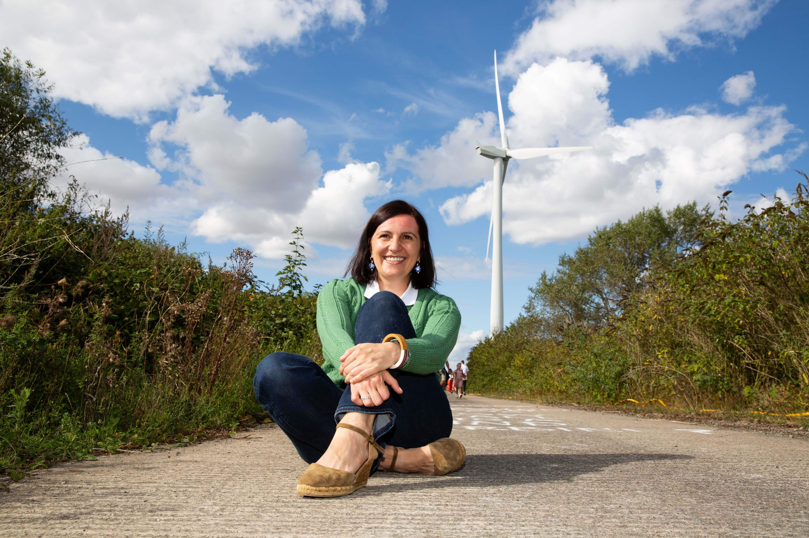
WUN Podcasts
Listen to our latest podcasts
More coming soon !
Fertility Friendly Accreditation with Liz Brand at Caden Gas
WUN Advocate Lillian Philip speaks with Liz Brand, Risk and Assurance manager and Fertility lead at Cadent Gas. In this episode Liz shares Cadent’s journey becoming the first utility company to be awarded the “Fertility Friendly Employer” accreditation by Fertility Matters at Work.
Looking into the future of Renewable Energy Monika Paplaczyk Thrive Renewables
WUN Advocate, Karen Hosking, talks to Monika Paplaczyk , Investment Director at Thrive Renewables. We look into future development an ongoing decarbonation of the UK Energy Grid, also addressing the changing landscape of Renewable Generation development as the UK heads towards Net Zero targets.
.
You can follow our podcast on Apple Podcasts, Spotify, Amazon Music and wherever else you get your podcasts – just search “WUN4ALL”.
Or just click through from the website: https://thewun.co.uk/news-blogs/

Slide 6
Don’t forget to join the Network
to receive the next WUN newsletter
https://thewun.co.uk/join-wun/

Slide 7
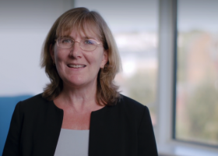
Today’s Panellist - Sarah McMath, WUN Board Member & CEO of MOSL
Sarah joined MOSL as CEO in June 2019. She has a strong track record for driving improvement and has become well-respected as a force for innovation and collaboration to ensure the open market delivers on its commitments to customers and tackles some of the biggest challenges facing the water industry.
Sarah started her career at Thames Water in the innovation team, working as a research scientist, where she completed her doctorate in Environmental Engineering. In 2011, Sarah moved to the Strategy and Regulation team, leading the preparation and submission of Thames Water’s business plans for PR14 and held the responsibility of Programme
Director for Competition 2017 ahead of the opening of the water retail market on 1 April. Sarah was previously Managing Director of Water at Thames, before becoming Managing Director of Strategic Planning and Investment in April 2018.
Sarah is also a trustee of the Don McMath Foundation, a charity which provides free schooling to children in the Gambia, and sits on the Board of the National Oceanography Centre and the Women’s Utilities Network. She is also Chair of the Water Efficiency Strategy Steering Group and a member of the National Drought Group and is an advocate for water efficiency and building resilience in the water sector.
.
https://thewun.co.uk/

Slide 8
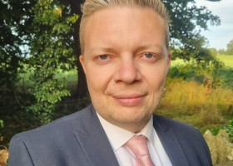
Today’s Panellist – Chris Pollard, Director of Customer Services, Thames Water
Chris is the Director of Customer Services at Thames Water and has over 20 years’ experience leading large and complex organisations in utilities, telecoms and government – in both engineering and contact centre roles. Chris joined Thames Water as Transformation Director in 2018 and has been in his current role as CS Director since 2021. He has led a number of operational improvements in customer service over the last two years including a 58% reduction in complaints, a 31% reduction in operating expenditure and a 43% reduction in telephone contacts.
Prior to Thames Water, Chris worked for BT Group and Openreach for 14 years – initially as a first line manager in BT Consumer, then progressing quickly into second and third line leadership roles. This was then followed by General Manager and Director positions in BT’s Technology team. BT Group Services, BT Wholesale and Openreach. Chris has a BSc. Geology from the University of Liverpool, which came immediately after a two year spell working as an Executive Officer at the Department for Work and Pensions. In addition to his Thames Water responsibilities, Chris holds a Non-Executive position on the Board of two pension schemes as a Company Nominated Trustee Director.
Chris was born and bred in Lancashire and lives with his wife and three children in Somerset.
.
https://thewun.co.uk/

Slide 9
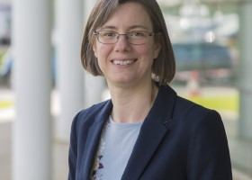
Today’s Panellist – Dr Heather Smith, Senior Lecturer in Water Governance
Heather started her career working as a researcher for a Canadian NGO, delivering projects and recommendations for improved water management policies at provincial and national levels. She then moved to the UK to complete her MSc and PhD, before joining Cranfield University in 2011. Heather’s research explores the societal dimensions of the water and wastewater services sector.
Her research interests include customer engagement in sector governance, the role of legitimacy and trust, as well as public perceptions and behavior towards new technologies and approaches, such as water recycling and smart metering. Through her track record of research projects, she has worked with water utilities and other stakeholders in the UK, Europe, North America and Australia. She has a particular interest in the boundary between social science and engineering.
She is a Fellow of the Royal Geographical Society and the Higher Education Academy..
https://thewun.co.uk/

Slide 10
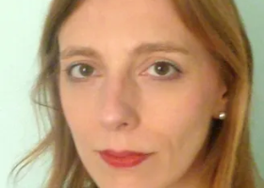
Today’s Panellist – Karma Loveday, Editor of the Water Report
Karma Loveday is a specialist water sector journalist respected throughout the industry for her authoritative analysis and reporting.
She is chair of the Major Energy Users’ Council water competition group.
https://thewun.co.uk/

Slide 11
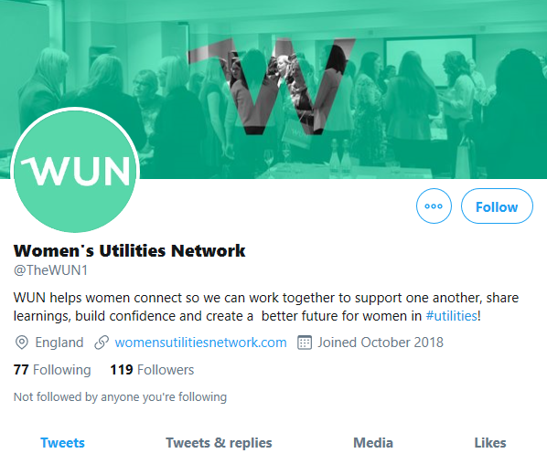
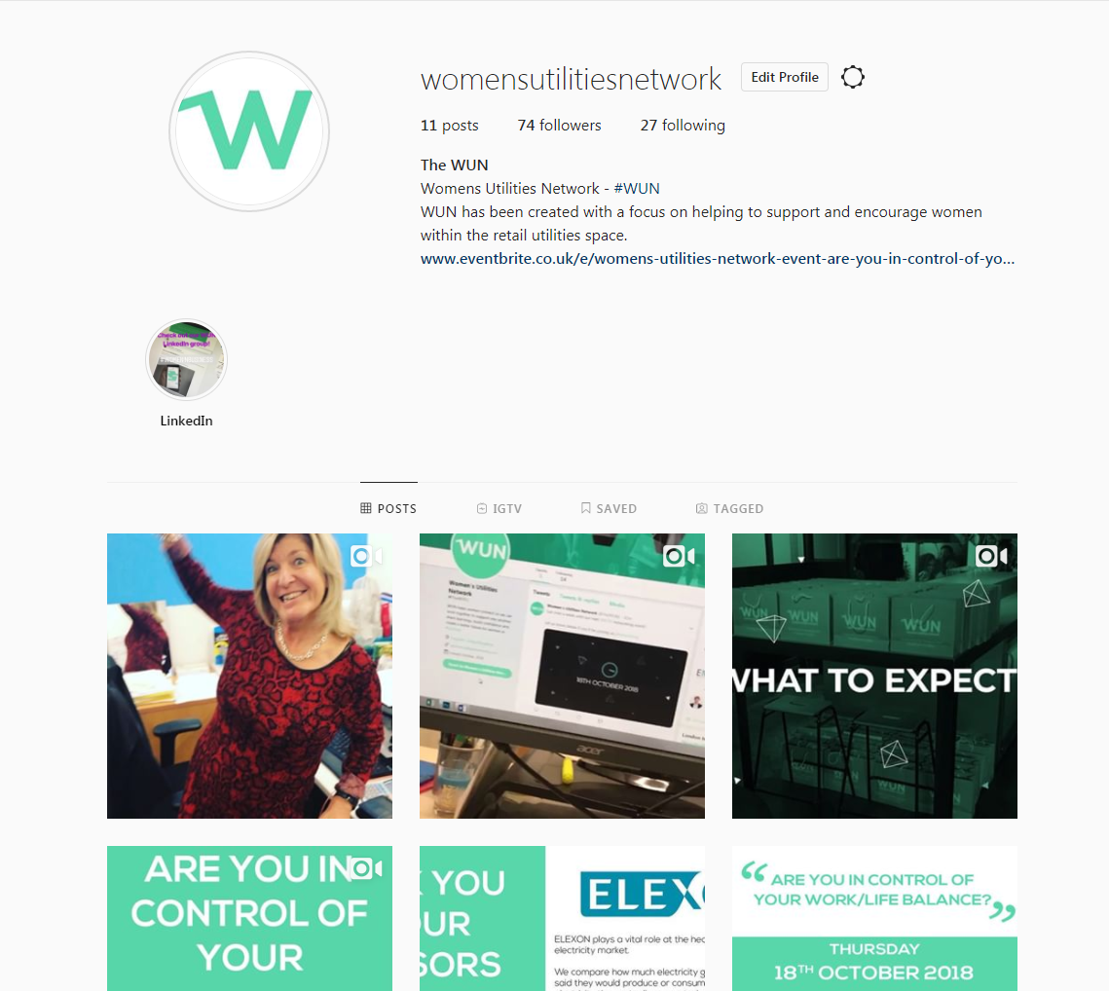
#WUN Don’t forget to follow us for the latest news and updates
https://thewun.co.uk

Slide 12
Thank you to our hosts, speakers & partners for their ongoing support in making this event possible.
https://thewun.co.uk/

