Slide 1
Welcome to
20th September -WUN Careers Event - Building your Career in Utilities
https://thewun.co.uk/

Slide 2
Thank you to all the WUN partners exhibiting & attending today and of course for their ongoing support.
https://thewun.co.uk/

Slide 3
1st SME Associate Onboard
5000+ Members
50+ Partner Organisations
10 Events this Year
WUN Achievements
14 Advocates
1300 Event Registrations
30+ Podcasts available on website
121 Mentees & 71 Mentors
https://thewun.co.uk/

Slide 4
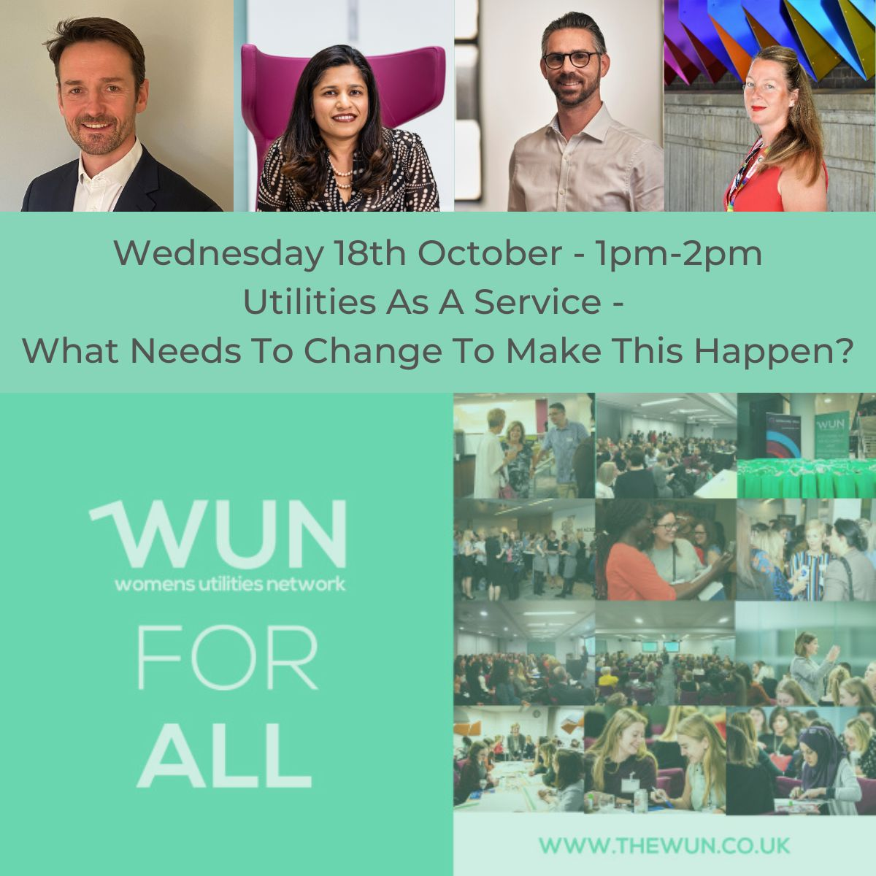
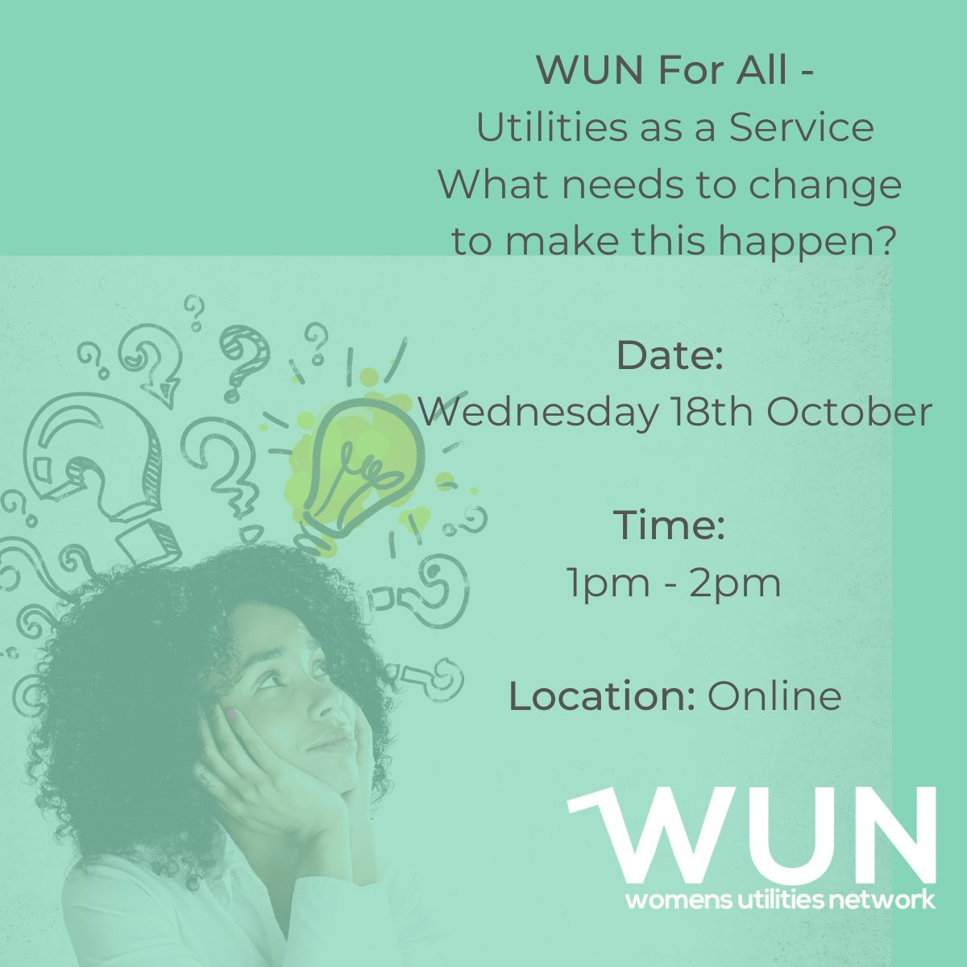
WUN EVENTS – Coming up
18th Oct 1pm WUN For ALL Utilities as a Service
– What needs to change to make this happen (virtual event)
Speakers: Ritika Wattan –SSE Energy; Richard Bartlett –Smartest Energy Business,
Pete Nisbet, Edenseven; Emma Keedwell, Vodafone Business UK
22nd Nov 6pm Leading the Way – Women leading, Innovating & Role Modeling - Kindly hosted by Salesforce, London.
17th Jan’ 24 1pm WUN For ALL - Gender Pay Gap – What is it, how is it calculated, why should I care and what needs to happen to close the gap?
Free Tickets available online
https://thewun.co.uk/

Slide 5
Join the free WUN Mentoring Programme
New WUN Mentoring now available –
WUN offers mentoring to women at any stage of their career in the utilities sector.
We are hugely privileged to have over 60 fantastic experienced mentors within the WUN mentoring programme.
With growing numbers of Mentors and Mentees we are delighted with the community and support fostered within the mentoring programme.
If you are interested in becoming a Mentor or Mentee, please visit our website: https://wun.onpld.com

Slide 6
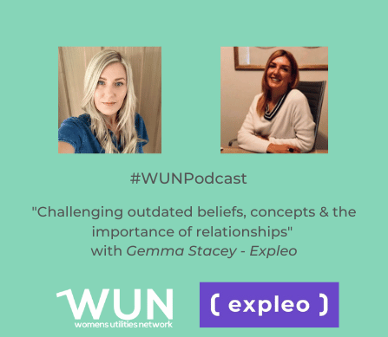
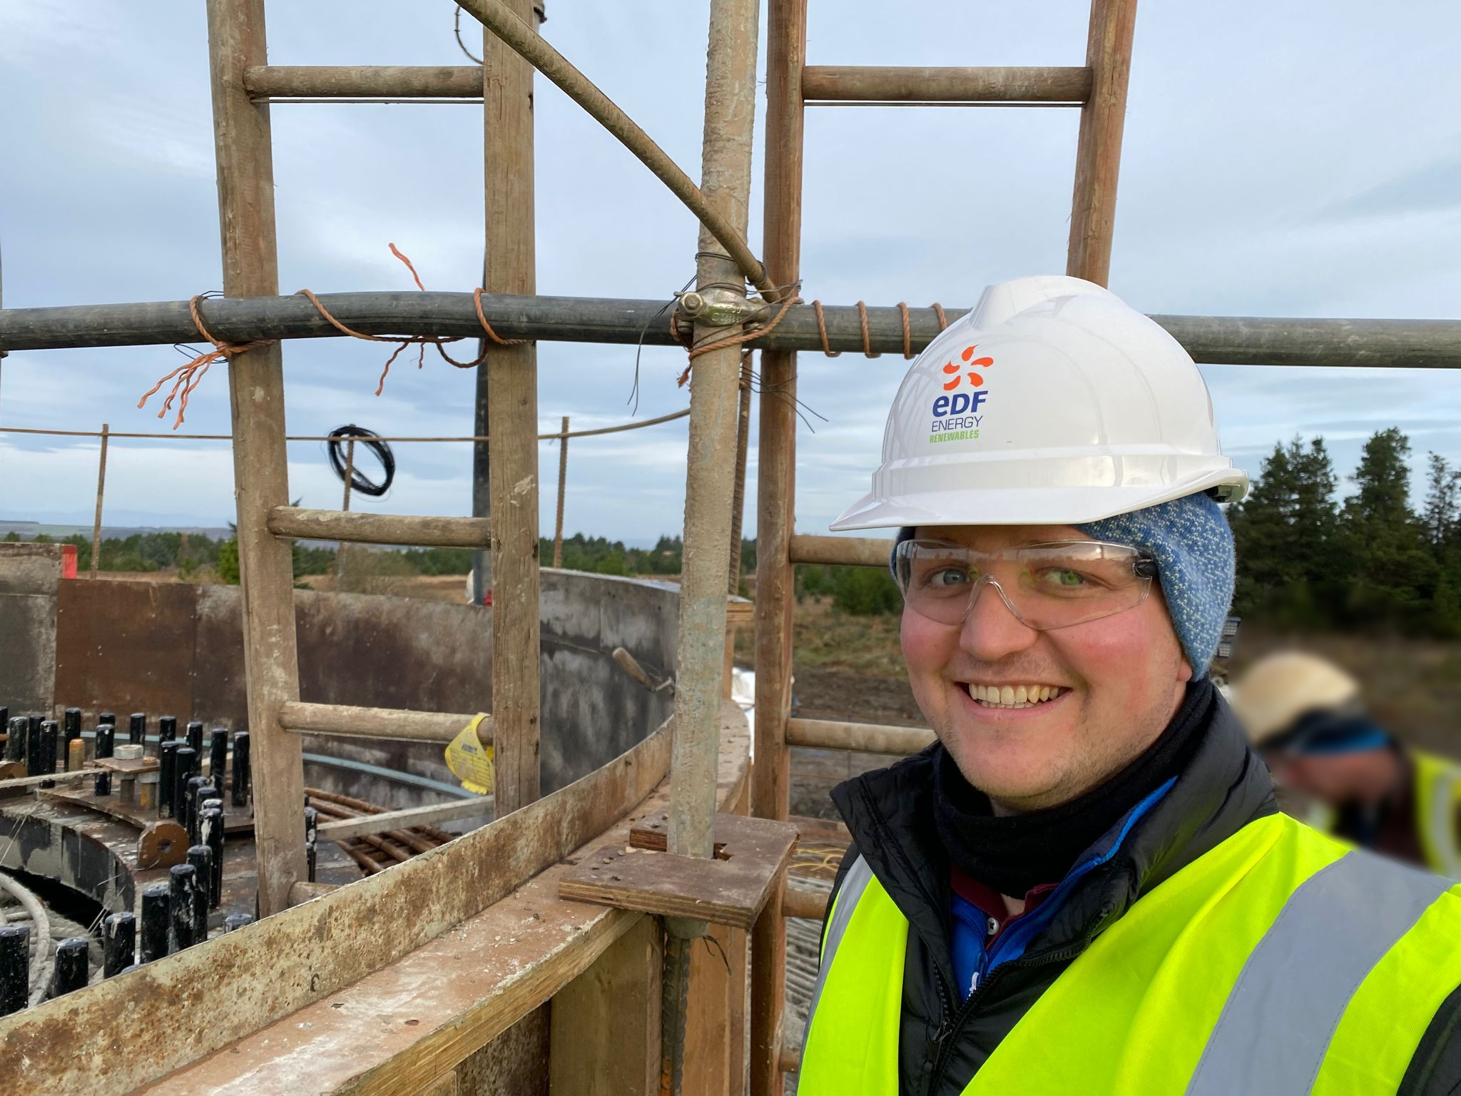
WUN Podcasts
Listen to our latest podcasts
More coming soon !
Challenging Outdated Beliefs and Concepts and the Importance of Relationships – With Gemma Stacey – Expleo
WUN Advocate Holly Beeston is joined by Gemma Stacey, Head of Sector at Expleo to discuss Gemma's thoughts on 'Challenging Outdated Beliefs and Concepts, and the importance of relationships’. Gemma talks about the importance of connection for relationships that're built to last, as well as how we see and frame success in our careers as women.
Developing New Wind Generation Across Scotland with Karen Hosking.
In this podcast episode WUN Industry Advocate, Karen Hosking (EDF) , talks to Logan Black , Principal Business Development Manager at EDF Renewables UK.
We discuss the changing UK Renewable Energy Landscape and in particular the challenges that Renewable developers face in Scotland.
Some of these challenges are unique to areas of Scotland and Logan walks us through the key milestones of getting a project commissioned and generating power to UK Grid.
You can follow our podcast on Apple Podcasts, Spotify, Amazon Music and wherever else you get your podcasts – just search “WUN4ALL”.
Or just click through from the website: https://thewun.co.uk/news-blogs/

Slide 7
Don’t forget to join the Network
to receive the next WUN newsletter
https://thewun.co.uk/join-wun/

Slide 8
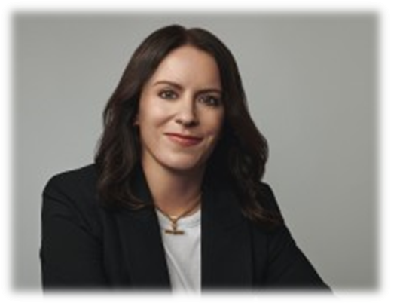
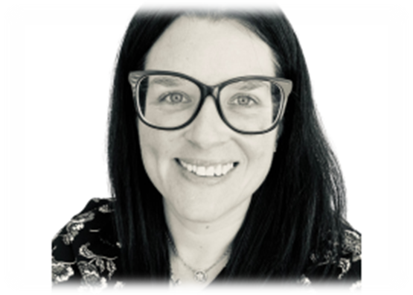
Today’s Event
Chair – Jo Butlin, Energy Bridge & WUN Co- Founder & Director
Todays Speakers:
Kath Rosier Clarke of BLCKBOX
Lisa Robyn Wood of GRIP Coaching Limited.
https://thewun.co.uk/

Slide 9
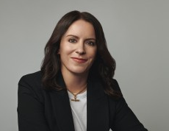
Today’s Speaker – Kath Clarke, CEO at BlckBx
Kath is the founder of BlckBx, a personal assistant platform with the mission of leveling the playing field for women in the workplace.
Prior to BlckBx which she launched 3 years ago, Kath was founder and MD of Rosier Consulting which she ran for 10 years where she led marketing and service optimisation projects at global telecoms and technology brands.
She headed up marketing at global US technology provider NeuStar for 4 years and left the corporate world to set up on her own as it was impossible juggling family and a career when there was no flexible working, no support for working parents and people worked like they didn’t have caring responsibilities outside of work.
The seed for BlckBx started there when her generation started having children and she saw her female friends dropping out of the workforce without any other option and decided this needed to change. On a mission to break the system and re-build it so that working parents, care-givers and particularly women can thrive in a workplace which has been designed for men as the breadwinner and women as the care-giver.
BlckBx wants to be part of the fabric of every business in the world to support everyone so they can thrive, attain their career goals and never feel held back just because they decide to have a family.
.
https://thewun.co.uk/

Slide 11
40%

Slide 12
Brick Walls

Slide 13
54,000 mothers pushed out of work

Slide 14
Women do not fit the cookie cutter mold of the workplace

Slide 15
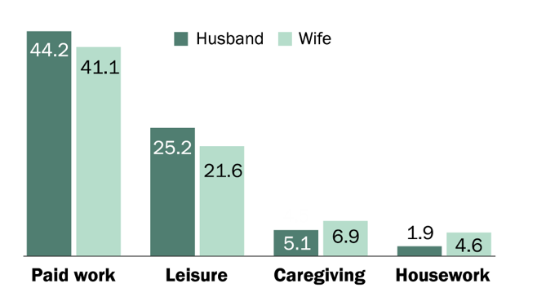

Slide 16
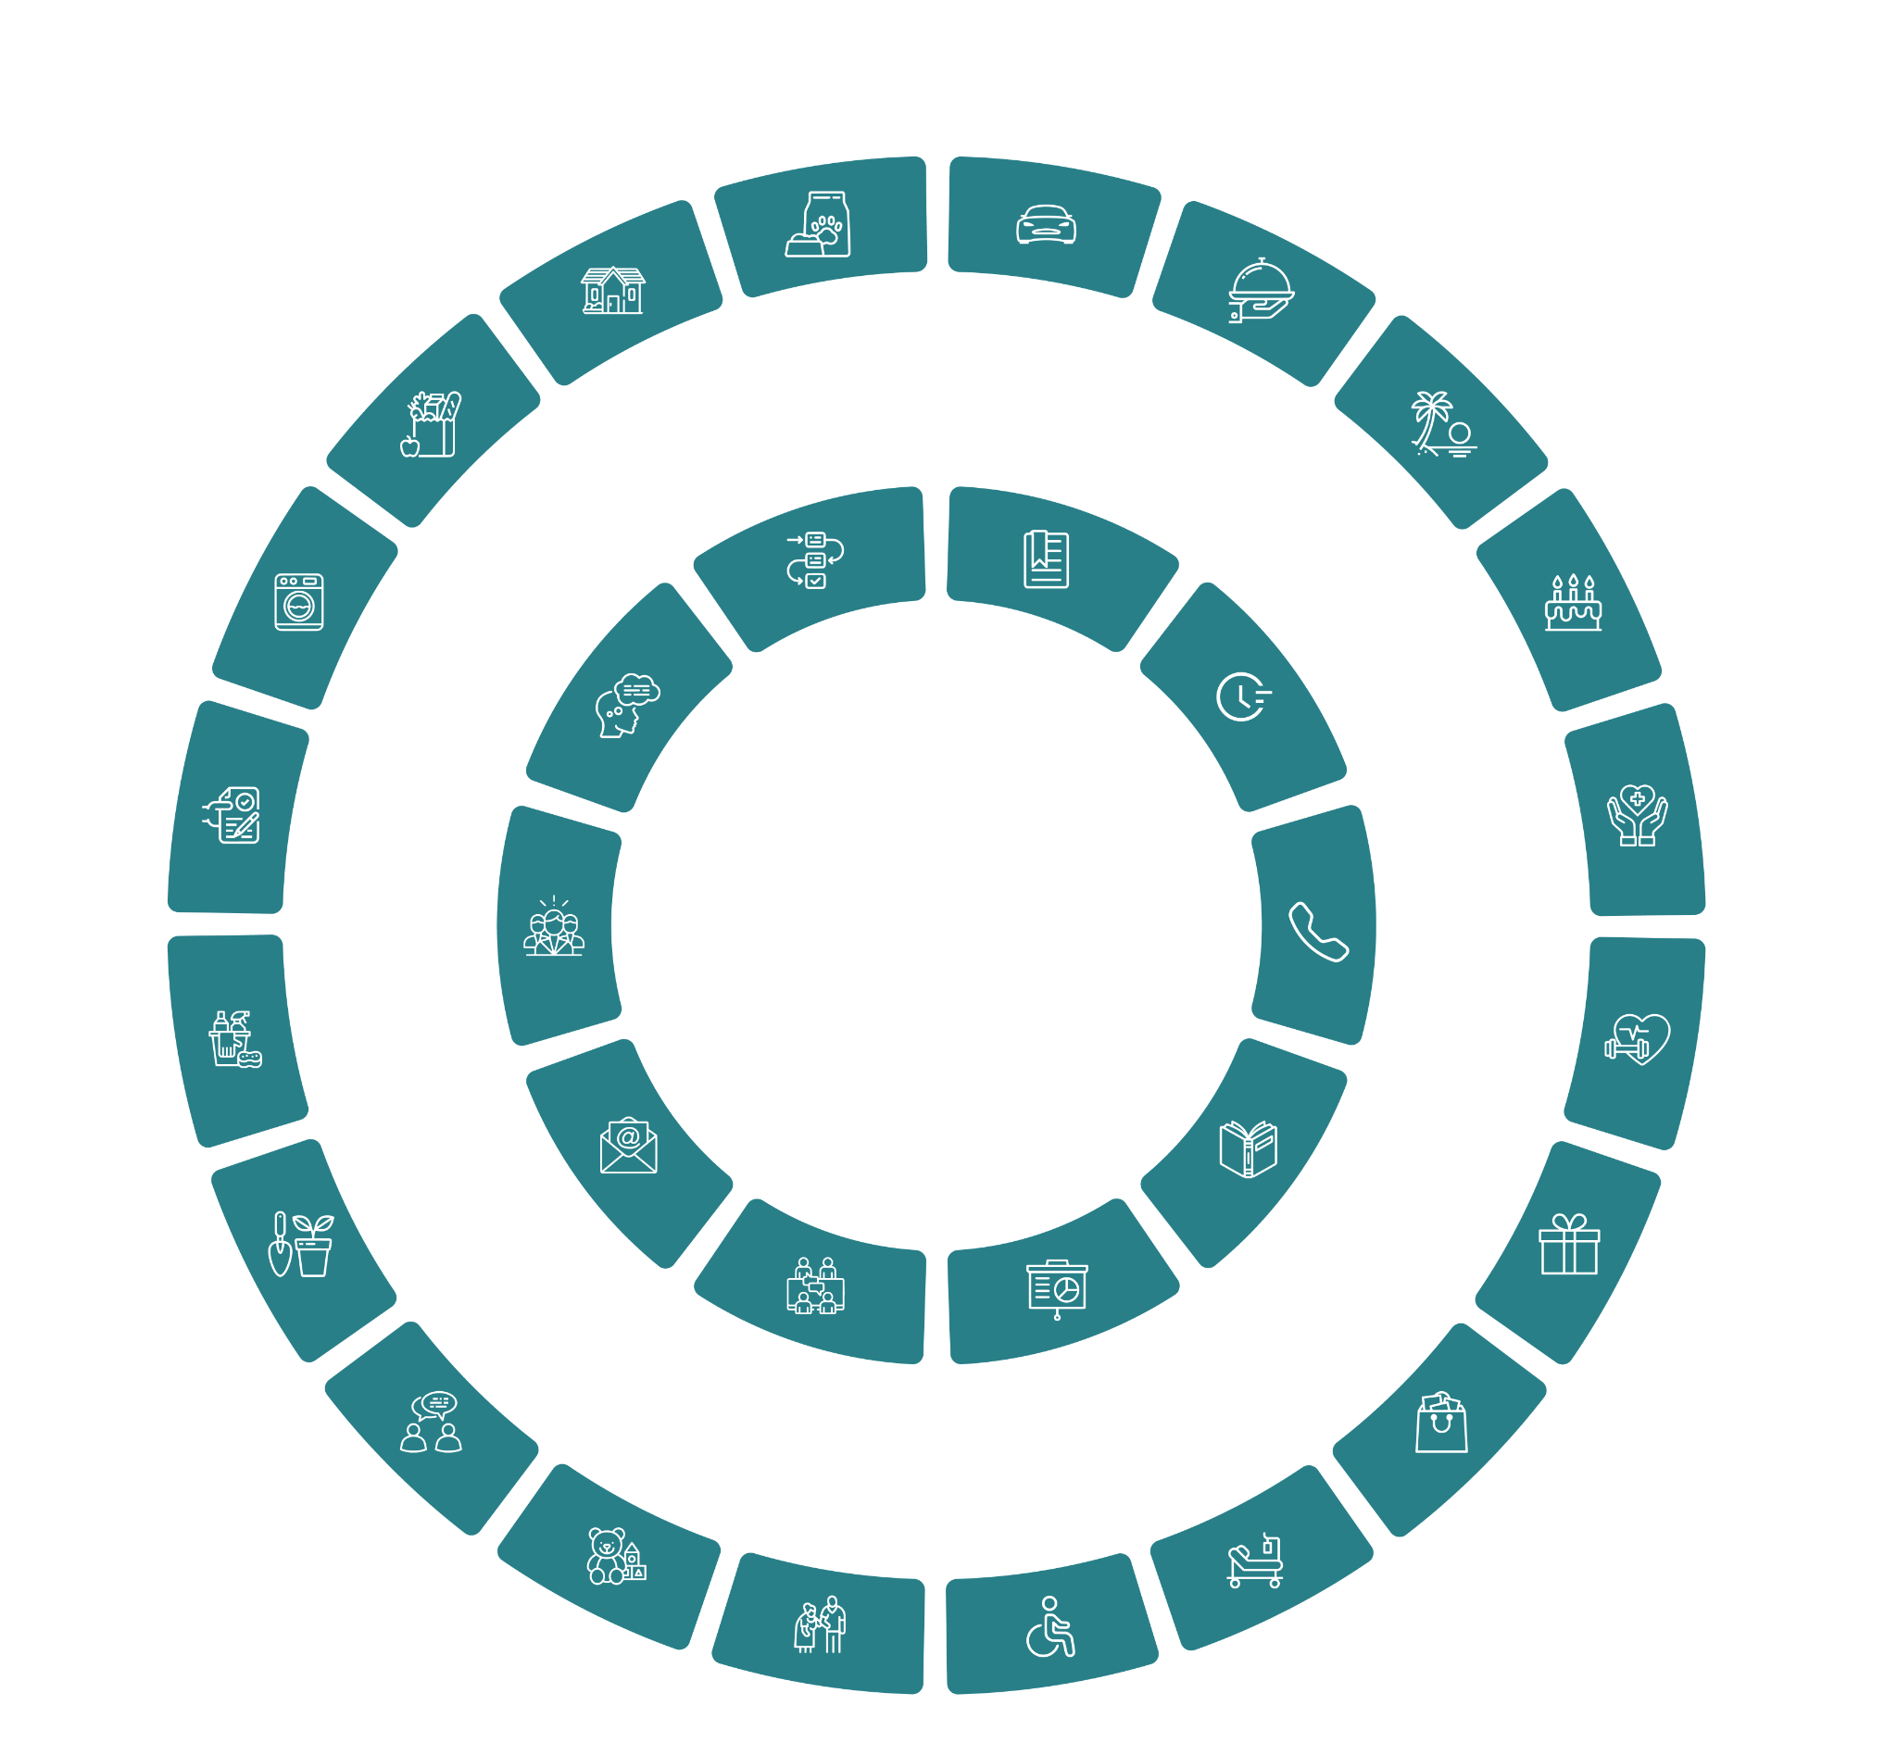
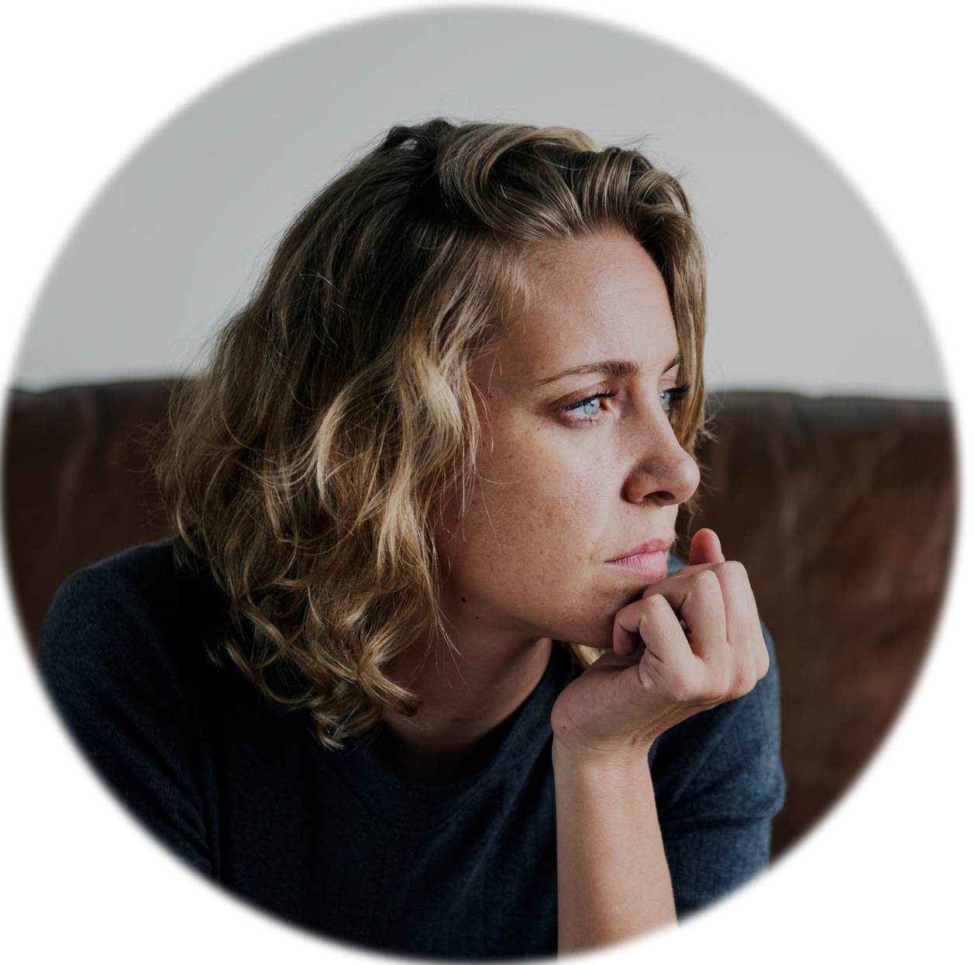
Family Tasks
Working Day

Slide 17
“I’m the administrator in the house. Everything falls to me. I constantly feel like I’m rushed and running out of time. From the moment I wake up to the moment I fall asleep I’m running on cortisol, constantly thinking about the next thing I have to do.”
Executive assistant, mum of 1
Notes:
Constant
Can’t be valued
All together - that’s when you see how much it hurts
The family admin / manager
Running on cortisol
Constantly thinking
Barrage of things to organise
Constant thinking
Endless
Not keeping up - failing

Slide 18
Food 40% more

Slide 19
Clothes 42% more

Slide 20
Birthdays 50% more

Slide 21
Medical appts 46% more

Slide 22
School messages 43% more

Slide 23
Why should work care?

Slide 24
Stress

Slide 25
52% regularly have to catch up with work at the weekends

Slide 26
Productivity

Slide 27
51% struggle to be mentally present at work

Slide 28
DEI

Slide 29
53% feel pressured to have one main breadwinner and one caregiver

Slide 30
This is not a woman’s issue to fix

Slide 31
Childcare

Slide 32
Flexible Working

Slide 34
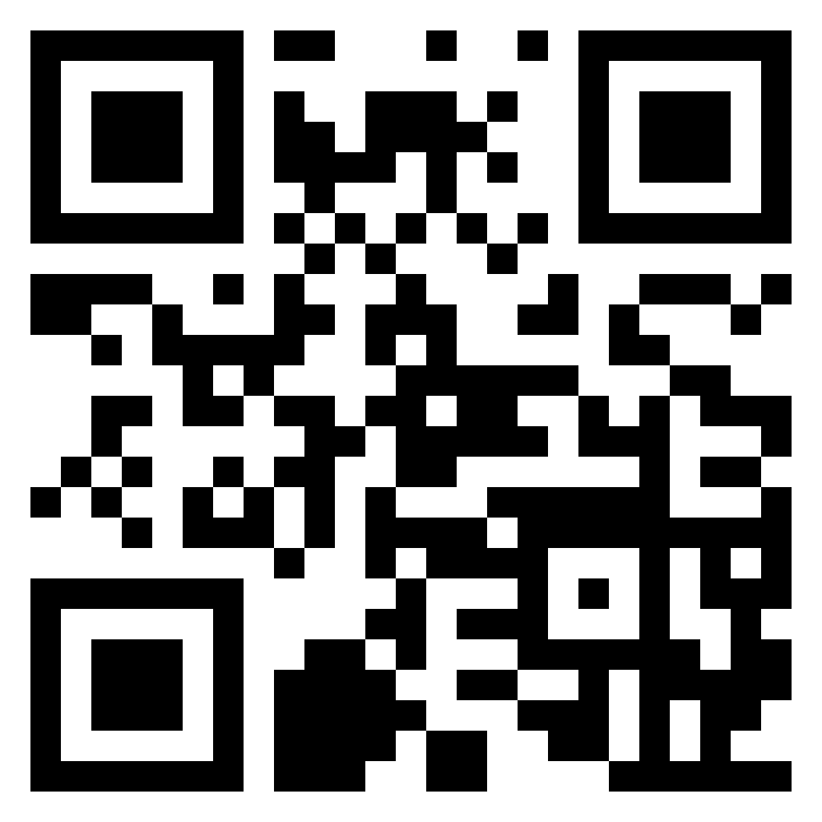

Slide 35
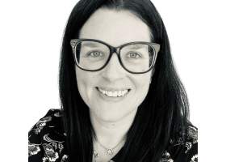
Today’s Speaker – Lisa Robyn Wood, Grip Coaching
The Middle Manager Coach
I grew my career within the energy sector, enjoying several
management positions across a range of departments including
customer services, process improvement, contract management, and
finance, before being promoted to a senior middle management role within metering operations. This promotion triggered imposter syndrome which motivated me to employ a personal coach. Coaching reconnected me with my confidence, self-belief, and value, and this strengthened relationship with myself enabled me to progress my career into areas I would not have felt capable of attempting prior to my experience.
It is this power that I’m on a mission to share with as many managers and leaders as I can in my own coaching practice as The Middle Manager Coach.
I don’t think being a manager should be shit and so I work with middle managers, who work in the most pressured and conflicted layer in any business, to embrace their roles with energy and enjoyment, to get a grip of their personal development and growth, and connect with their confidence and capabilities, to ensure that they thrive and don’t get caught in the crap trap.
I help individuals and organisations to make effective and healthy management a reality for themselves, their people, and their business, by providing 1-2-1 coaching and training for their middle managers and teams.
I have been privileged to work with multiple managers and leaders across a range of organisations, including Suntory, HSBC, Camelot, Burberry, and Swarovski, as well as small businesses and entrepreneurs.
I’m qualified in Corporate & Executive Coaching, Personal Performance Coaching, NLP, and DISC; all through The Coaching Academy and with each diploma accredited by the ICF.
I split my time between The Cotswolds in the UK and Cape Town in South Africa with my husband Dom and our Springer Spaniel Alfie.
.
https://thewun.co.uk/

Slide 36
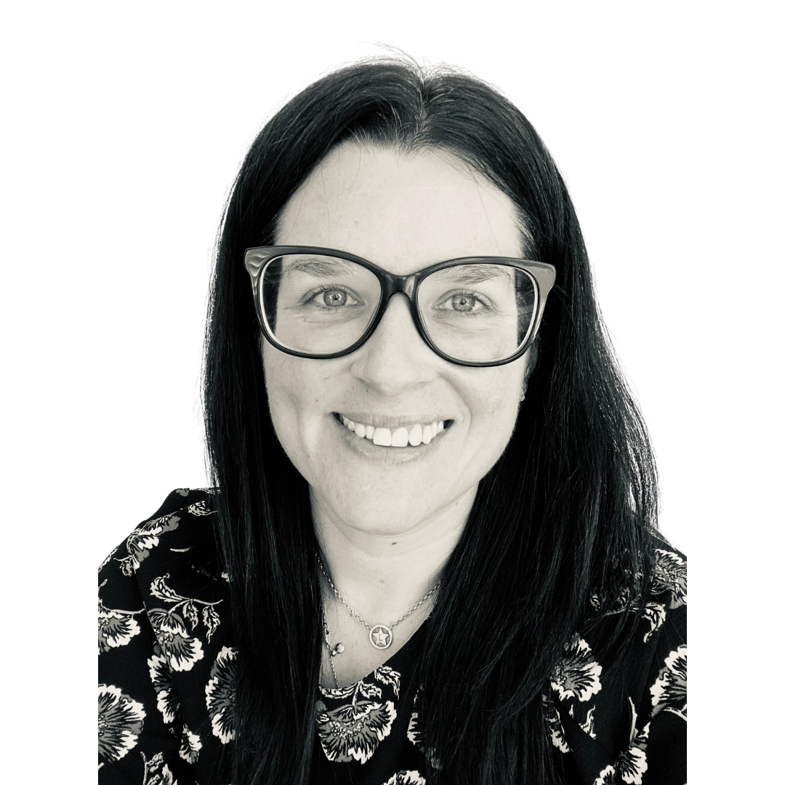
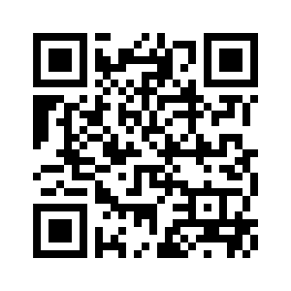
Connect with Me
Lisa Robyn Wood
The Middle Manager Coach
GRIP Coaching Limited
www.gripcoaching.co.uk
Scan me!

Slide 37
Q&A
https://thewun.co.uk/

Slide 39
Thank you again to our hosts, speakers & partners for their ongoing support in making this event possible.
https://thewun.co.uk/

Slide 40
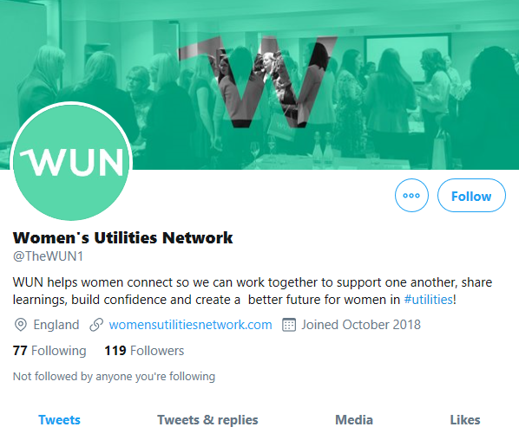
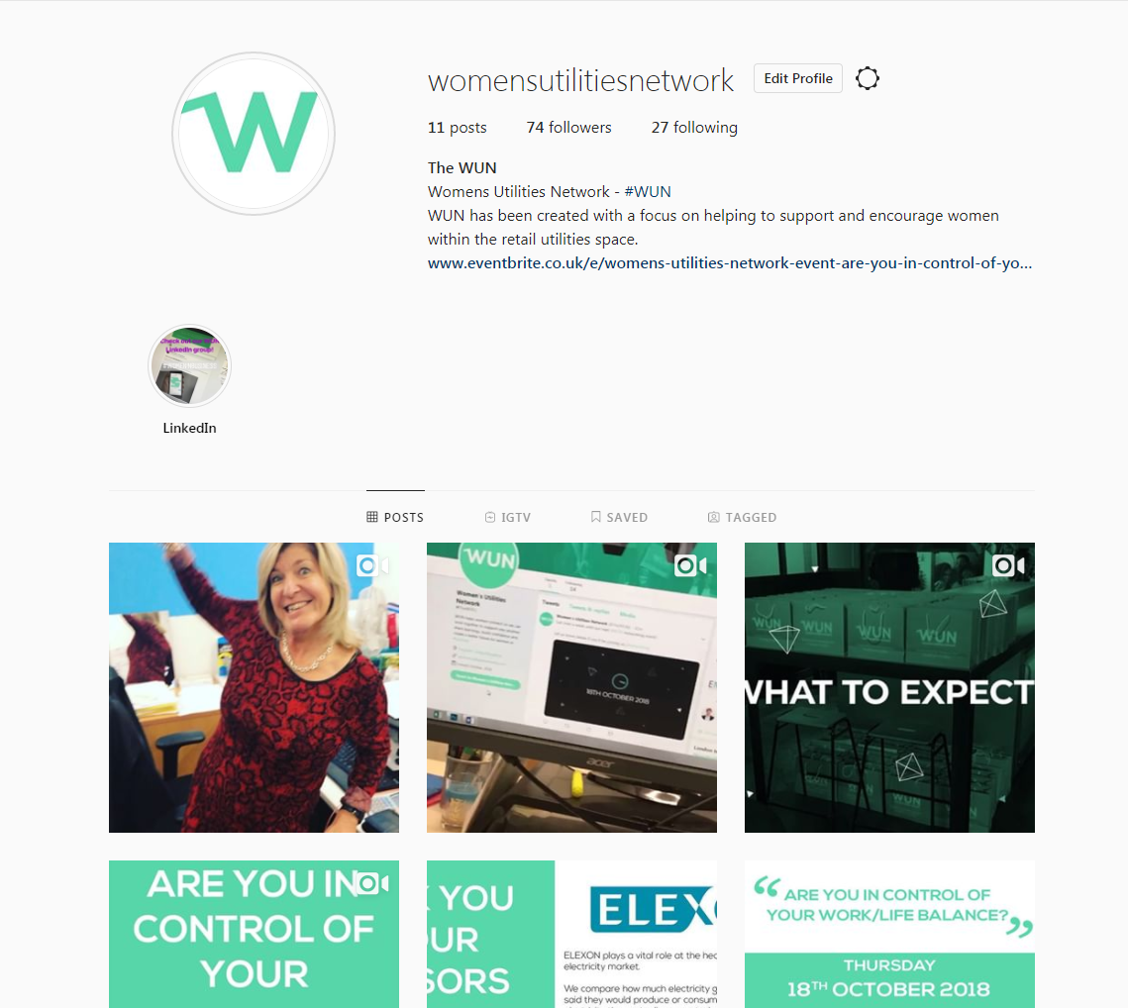
#WUN Don’t forget to follow us for the latest news and updates
https://thewun.co.uk

