Slide 1
Welcome to WUN – We will be starting shortly.
https://thewun.co.uk/

Slide 2
Todays Agenda
Welcome –Hayley Monks WUN Founder & Director
& Victoria Lemmon- WUN Advocate.
Todays Speaker – Danielle Macleod, Founder Remarkable Women
Q&A & Wrap up and close –Victoria Lemmon
https://thewun.co.uk/

Slide 3
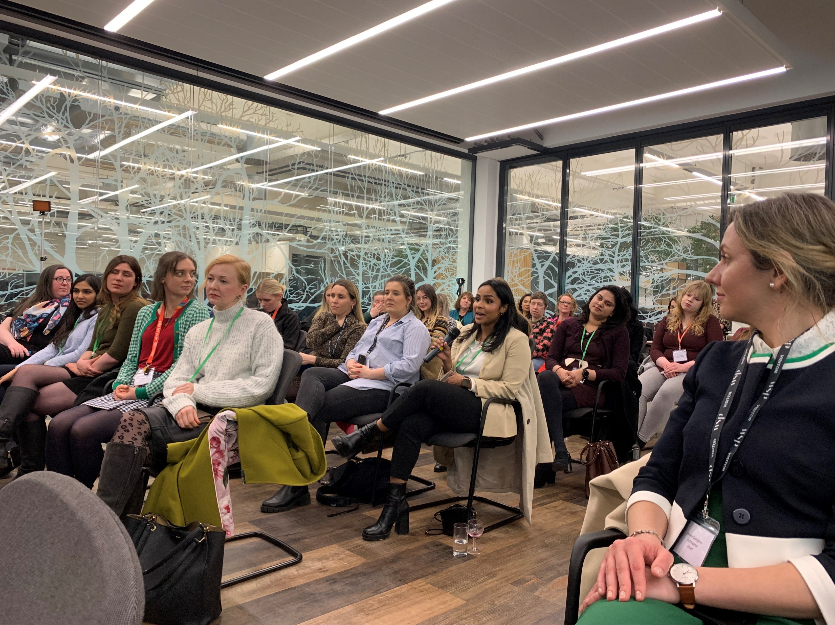
2023 WUN Events- book now
13th July 2023 6-8:30 pm, Reading
The affluent & the effluent: How does the water industry respond
to rebuild customer trust?
Following on from the House of Lords report on the issues around storm overflows and water pollution, the Water industry needs to come together to re-build customer trust - as they look to build a water infrastructure for the future.
Panelists: Sarah McMath, WUN Board member & CEO MOSL &
Karma Loveday, Editor of the Water Report –further panelists to be confirmed.
https://thewun.co.uk/

Slide 4
2023 WUN Events- book now
20th September -WUN Careers Event - Building your career in Utilities 5:30-9pm.
WUN are hosting our first ever careers event - a fantastic opportunity to speak to women working at our partner organisations to discover the breadth of careers open across the Utilities sector.
Join us at Microsoft's London offices, with keynote speakers discussing key hints and tips on how to get ahead and build the career you want, and exhibitors from across the sector showcasing a range of different career opportunities.
More details to follow shortly, but this one is likely to be a
sell-out - so sign up early!
https://thewun.co.uk/

Slide 5
Join the free WUN Mentoring Programme
New WUN Mentoring now available –
WUN offers mentoring to women at any stage of their career in the utilities sector.
We are hugely privileged to have over 50 fantastic experienced mentors within the WUN mentoring programme.
With growing numbers of Mentors and Mentees we are delighted with the community and support fostered within the mentoring programme.
If you are interested in becoming a mentor or a mentee please visit our website: https://thewun.co.uk/mentoring/

Slide 6
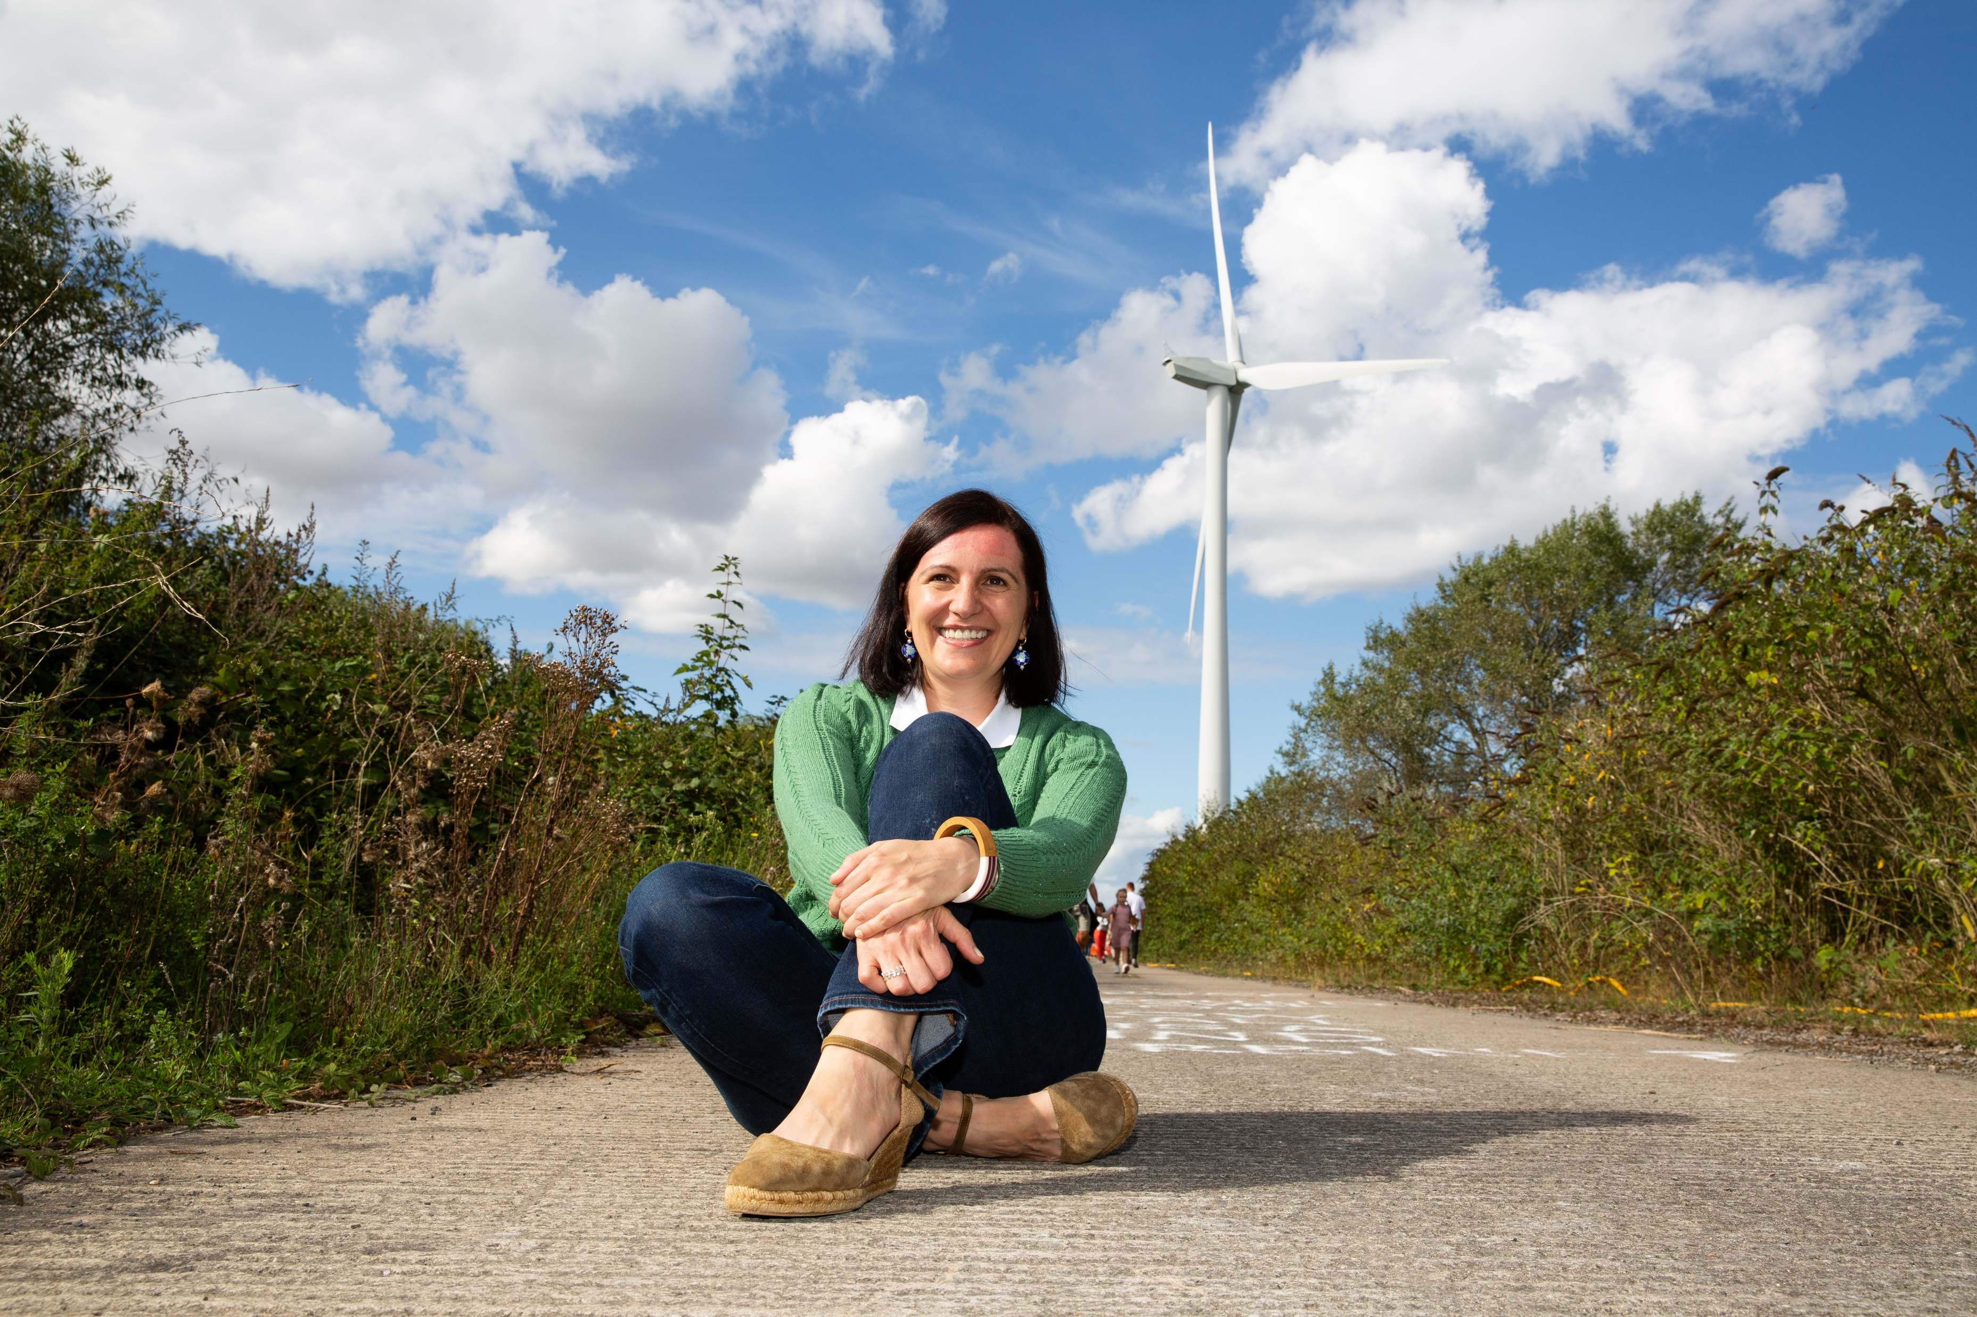
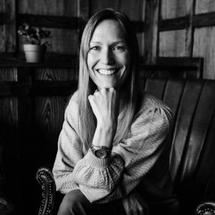
WUN Podcasts
Listen to our latest podcasts
More coming soon !
Looking into the future of Renewable Energy Monika Paplaczyk Thrive Renewables
WUN Advocate, Karen Hosking, talks to Monika Paplaczyk , Investment Director at Thrive Renewables. We look into future development an ongoing decarbonation of the UK Energy Grid, also addressing the changing landscape of Renewable Generation development as the UK heads towards Net Zero targets.
WUN Founder Hayley Monks speaks to Karen who explains what burnout is, what the symptoms look like and what practical tips and strategies you can adopt you help you manage burnout.
Karen, a career & confidence coach specialising in helping people build fulfilling careers and mental fitness.
How you can identify and manage burnout with Karen Boyd, Miabo Consulting
.
You can follow our podcast on Apple Podcasts, Spotify, Amazon Music and wherever else you get your podcasts – just search “WUN4ALL”.
Or just click through from the website: https://thewun.co.uk/news-blogs/

Slide 7
Don’t forget to join the Network
to receive the next WUN newsletter
https://thewun.co.uk/join-wun/

Slide 8
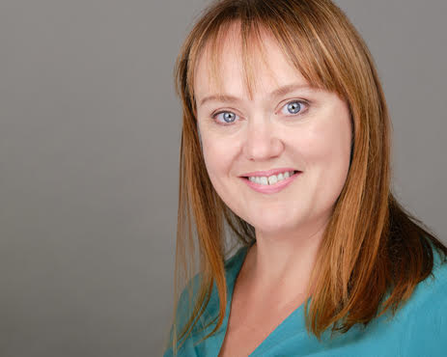
Todays Speaker – Danielle Macleod, Founder Remarkable Women
Danielle Macleod is a coach, teacher, leader, keynote speaker and published author.
She is the former Customer Service Director of Sky, where she led 10,000 people to record breaking results and an exponential improvement in Customer Service over a 4 year period. Prior to that, her corporate background spans Director level positions in Technical and Strategic Change and Human Resources.
Since founding Remarkable Women, Danielle has coached Exec (COO and CPO), SVP, VP, Director and Head of level individuals and leadership teams (men and women) at many well known organisations.
She has an MBA from the Open University and in 2020 also obtained an AltMBA with Seth Godin, winning her cohort prize.
.
https://thewun.co.uk/

Slide 9
Todays Speaker – Danielle Macleod, Founder Remarkable Women
Danielle is a sought after public speaker and has delivered keynote speeches in many blue-chip organisations and at leading customer experience and leadership conferences. In 2020, she delivered masterclasses for over 20 blue chip organisations.
Danielle knows big corporate and behavioural change. She is a transformational and unconventional coach who specialises in heart centred, compelling and inspiring leadership that removes limitations and creates big commercial results with ease and grace.
Danielle has published two books. “Remarkably Easy – how to get out of your way and unleash your brilliance” (2018) and most recently, “Remarkable Leadership” (July 2022)
.
https://thewun.co.uk/

Slide 10
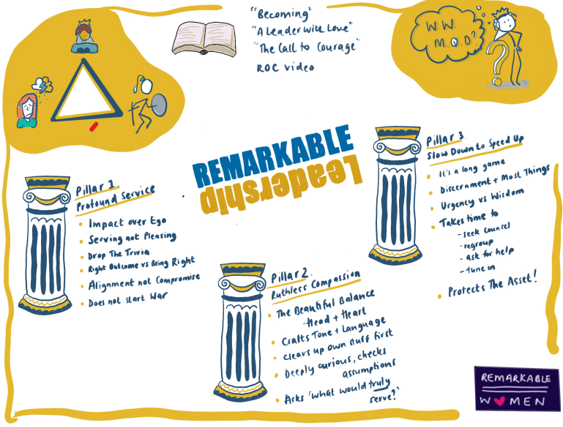
.
https://thewun.co.uk/

Slide 11
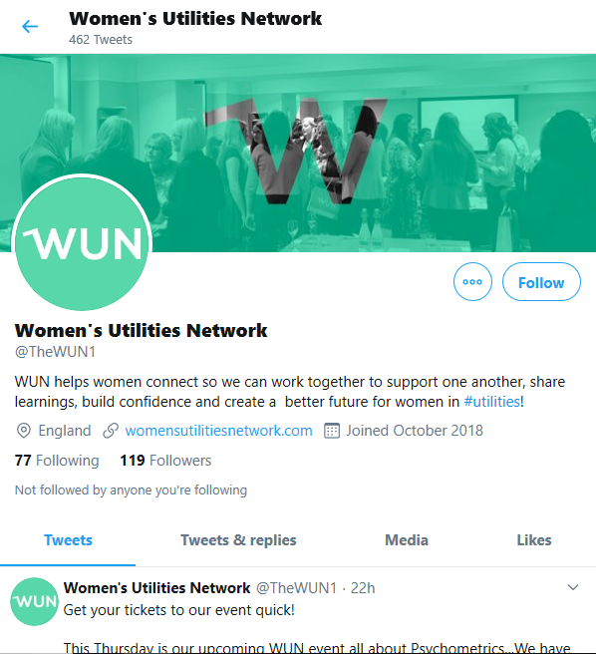
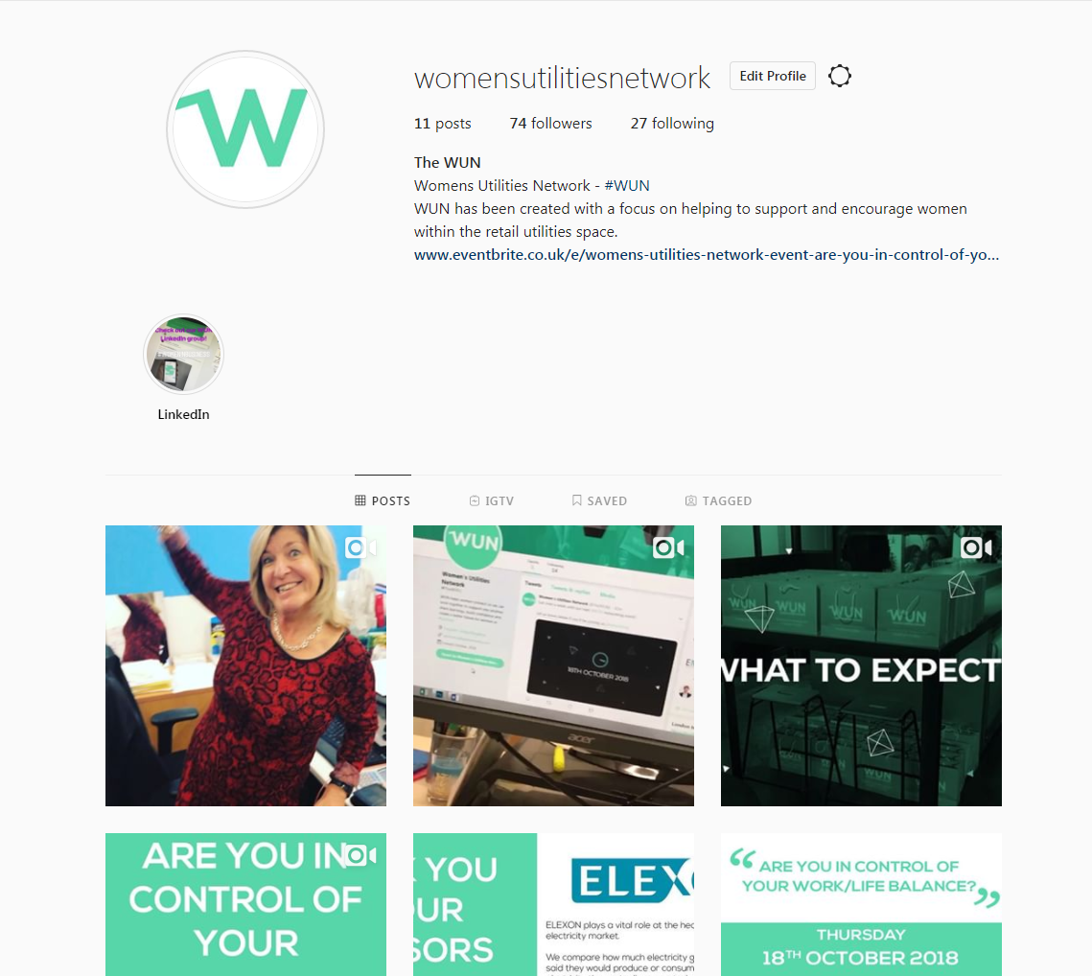
#WUN Don’t forget to follow us for the latest news and updates
https://thewun.co.uk/

Slide 12
Thank you to all our speakers & partners for their ongoing support to make this event possible.
https://thewun.co.uk/

