Slide 1
Welcome to WUN – We will be starting shortly.
https://thewun.co.uk/

Slide 2
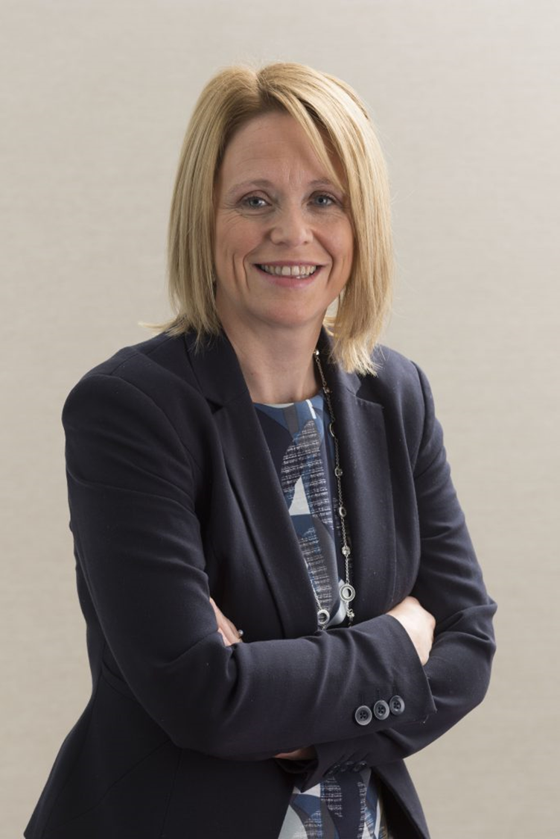
Welcome - Louise Parry WUN Director & Director of
People & Organisational Development at Energy & Utility Skills
Louise is responsible for people, organisational resilience, health & safety and business continuity and part of the Executive Team at Energy & Utility Skills.
Passionate about making a difference, as part of her role Louise leads on Diversity & Inclusion. Working across the industry, she has played a key role in establishing the Energy & Utilities Inclusion Commitment and sector wide inclusion measurement framework.
A Chartered Fellow of the CIPD, Louise is a senior people leader & executive coach with over 20 years of experience working within people, diversity and related roles. Louise is currently also a member of the Royal Academy of Engineering’s Industry Leadership Group. Louise joined the WUN board in April 2022.
Louise is married with three daughters and spends her free time juggling their social lives and is a member of a local gym and running club.
.
https://thewun.co.uk/

Slide 3
2023 WUN Events- book now
Wednesday 15th March WUN For ALL ( Virtual) 1-2 pm –
Importance of data and changing behaviour
with Matthew Roderick @N3rgy.
Further events to be announced shortly &
Be sure to join us at UWL in May.
https://thewun.co.uk/

Slide 4
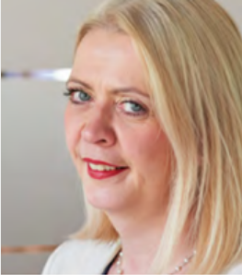
WUN Podcasts
Listen to our latest podcasts
WUN Founder Hayley Monks speaks to Karen who explains what burnout is, what the symptoms look like and what practical tips and strategies you can adopt you help you manage burnout.
Karen, a career & confidence coach specialidses in helping people build fulfilling careers and mental fitness.
#Career Stories with Angela Love
How you can identify and manage burnout with Karen Boyd, Miabo Consulting
We speak to Angela Love to hear more about her deep and varied career across the energy sector.
Angela has over 25 years of experience in the EU/UK energy market covering public affairs, finance, governance, regulation and communications. Listen in to hear more about Angela’s fascinating journey and the lessons she has learnt along the way.
.
You can follow our podcast on Apple Podcasts, Spotify, Amazon Music and wherever else you get your podcasts – just search “WUN4ALL”.
Or just click through from the website: https://thewun.co.uk/news-blogs/

Slide 5
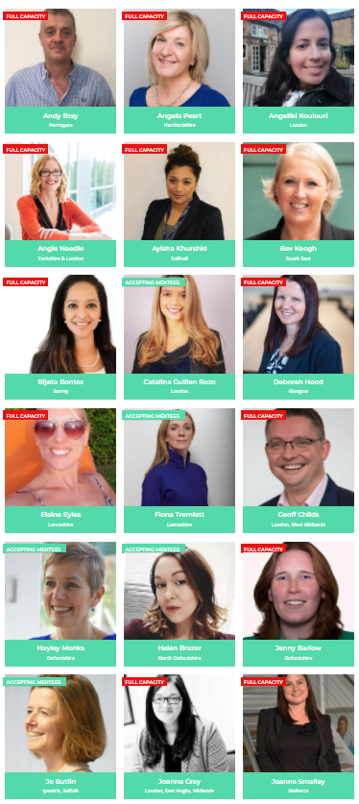
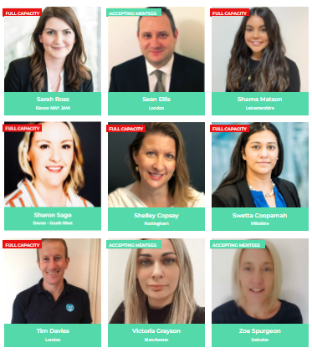
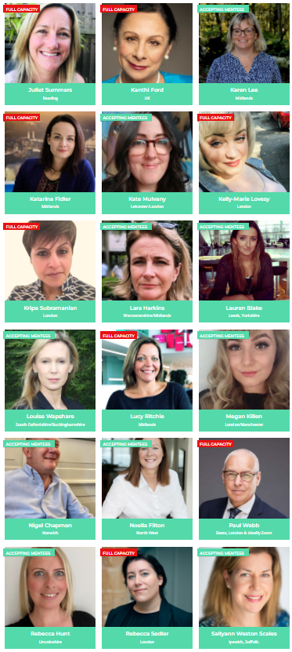
Join the free WUN Mentoring Programme
Our Mentors
WUN offers mentoring to women at any stage of their career in the utilities sector.
We are hugely privileged to have some fantastic experienced mentors within the WUN mentoring programme.
With growing numbers of Mentors and Mentees we are delighted with the community and support fostered within the mentoring programme.
If you are interested in becoming a mentor or a mentee please visit our website: https://thewun.co.uk/mentoring/

Slide 6
Todays Agenda
Welcome - Louise Parry - WUN Director & Director of
People & Organisational Development at Energy & Utility Skills
Keynote speaker - Angie Needle Cadent Gas Director of Strategy,
Vice President of Hydrogen UK
Panel - Rhian Jones, Associate WSP & Chia Nwajagu, Senior Regulatory Analyst at Ørsted.
Wrap up and close –Louise Parry.
https://thewun.co.uk/

Slide 7
Todays Keynote Speaker: Dr Angie Needle
Dr Angie Needle is Cadent’s Director of Strategy, the Vice President
of Hydrogen UK and a key figure in the nascent hydrogen industry.
In her current role for Cadent Angie is responsible for driving the
UK’s largest gas distribution network towards a net zero future,
spearheading all things hydrogen and positioning Cadent as a
leading voice in the sector.
Prior to joining Cadent in 2019, Angie held a number of senior roles at Centrica and Anglian Water, developing energy and customer services propositions and supporting both organisations on their moves towards cleaner energy, reduced carbon emissions and more sustainable business models.
Alongside her work for Cadent and Hydrogen UK, Angie is a leading proponent for diversity in the utilities sector, being a co-founder of the Women’s Utilities Network.
.
https://thewun.co.uk/

Slide 8
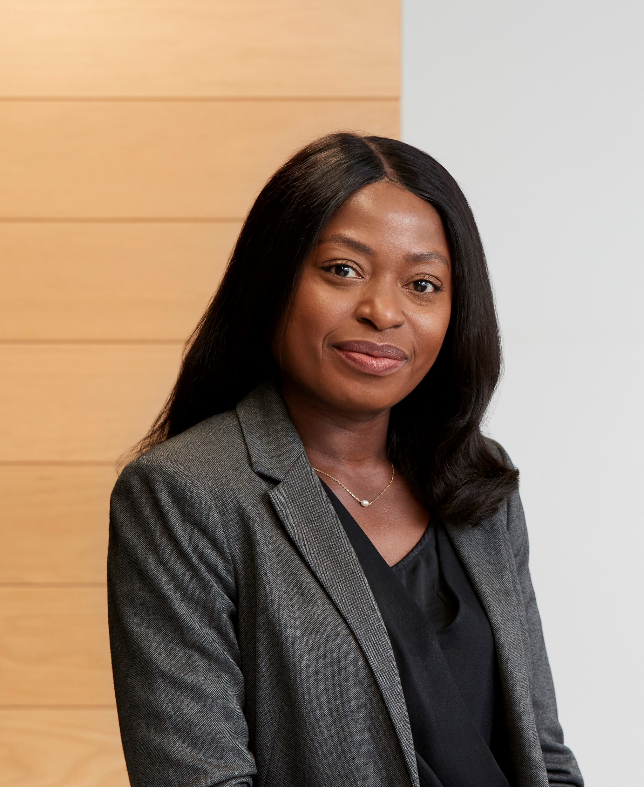
Todays Panel – Rhian Jones & Chia Nwajagu
Rhian is a Chartered Fellow with both IMechE and IGEM and 30 years’ experience in the Gas industry.
She started her career as a clerical trainee with British Gas Wales with the intention of becoming an accountant, but soon realised that she wanted to specialise in a more technical role so trained as an engineer. She has also held a series of Metering, Grid and Transmission roles with Transco.
Rhian is currently an Associate with the Gas and Hydrogen team at WSP, delivering projects within the natural gas, hydrogen and carbon capture utilisation and storage sector, as well as being a STEM mentor.
Interesting fact: A lot of people aren’t aware that town’s gas was originally made up of around 50% hydrogen, so transporting it around the UK isn’t new!
Chia is a Senior Regulatory Analyst at Ørsted. Chia has worked for almost a decade in the energy
industry, and covers a wide range of technical regulatory topics including power market reform,
networking charging and the development of the regulatory framework for hydrogen.
She is an active member of working groups across Renewable UK, Hydrogen UK, Energy UK, where
she offers her knowledge and expertise in these areas.
.
https://thewun.co.uk/

Slide 9
Hydrogen
Dr Angela Needle
February 2023

Slide 10
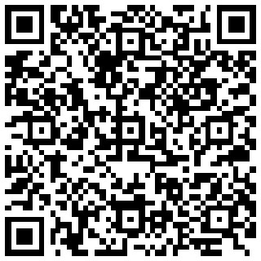
Dr Angela Needle
Strategy Director, Cadent

Slide 11
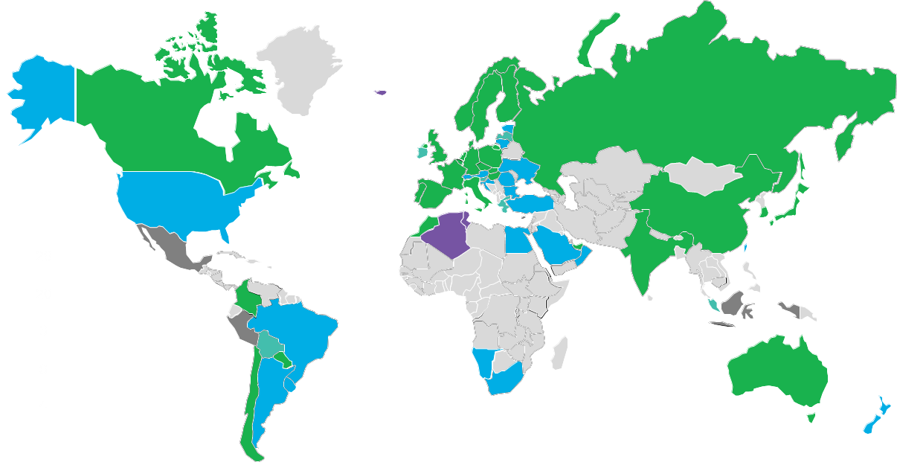
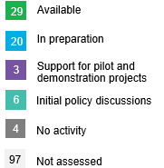
The world is starting a hydrogen revolution estimated to be worth $2.5tn by 2050
EU (+ UK) >€60bn of state funding earmarked to develop hydrogen by 2030
Canada aspires to become a world-leading producer, user, and exporter of clean hydrogen
Russia published its strategy in Oct 2020
Japan 2030 Energy Roadmap, which has H2 / ammonia meeting 25% of energy mix
$8bn allocated to hydrogen industry as part of Infra bill
No national plans yet although North Africa has vast green hydrogen potential & REPowerEU plan is likely to benefit H2 exports to Europe
China hydrogen roadmap calls for 100GW of electrolysers by 2030. Recent 5yr plan is less ambitious
India’s H2 ambition focuses on electrolysis (~40GW by 2030)
Middle East countries are developing national plans aimed at exporting hydrogen / ammonia
Australia aims to become one of the top three exporting countries for hydrogen markets in Asia by 2030.
Chile has the most ambitious national hydrogen plan in Latin America
Source: UK Market Fundamentals, World Energy Council, BNEF
Notes:
We are in a global race!
29 countries representing ~60% of global GDP already have a national hydrogen strategy in place or are on the verge of publishing one
Announced Global hydrogen supply projects amount to 100GW+ of nameplate capacity and ~$120bn of total cumulative investment

Slide 12
Professor Ed Hawkins (University of Reading): #ShowYourStripes
Notes:
Catalysed by the need to reduce carbon emissions.
These are the climate stripes:
Left handside is 1860, the right hand side is now.
Each stripe or bar represents the global temperature averaged over a year.
Thank you to professor Ed Hawkins (University of Reading)… and this is what they look like in a chart…

Slide 13
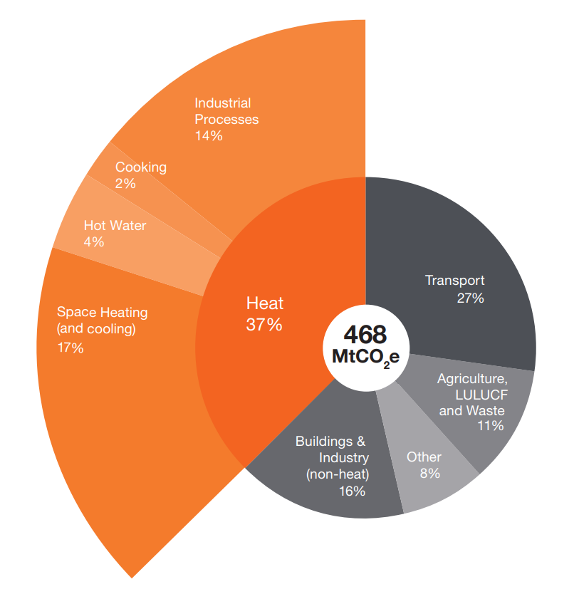
UK’s emissions are 468 MtCO2e with c. 37% heat
BEIS
Notes:
UK’s emissions are 468 MtCO₂e
Yes.. Only 1 % of Global emissions, ranked 17th in the world. But by capita significant emissions, developed countries aspiring to have the level of wealth that we have.. And we need to show how you can do it without fossil fuels.
37% is heating homes in the UK.. And that heat is driven mostly by the gas in our network.

Slide 14
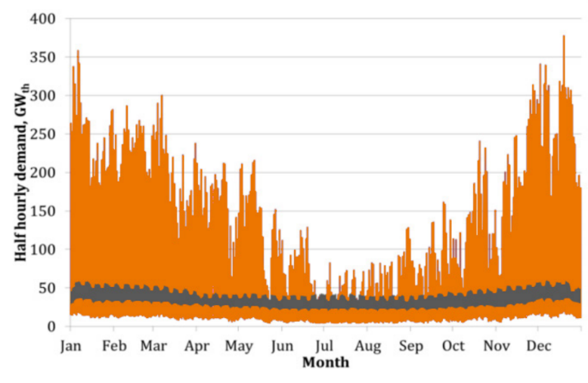
Hydrogen can help solve many of the problems in achieving net zero
Hard to abate sectors
Demand variation and storage
Pressure on electricity networks
Smart sector coupling
Choice/optionality
Seasonal electricity and gas demand
Total UK energy demand
TWh | Inputs | Use | Loses
Electricity | 700 | 300 | 400
Gas | 970 | 900 | 70
Petroleum | 850 | 850 | 0
Total | 2,520 | 2,050 | 470
Source: Electricity & Gas Flow charts. Digest of UK Energy Statistics, 2019.
Notes:
Narrative
What hydrogen could do that other decarbonisation options can’t

Slide 15
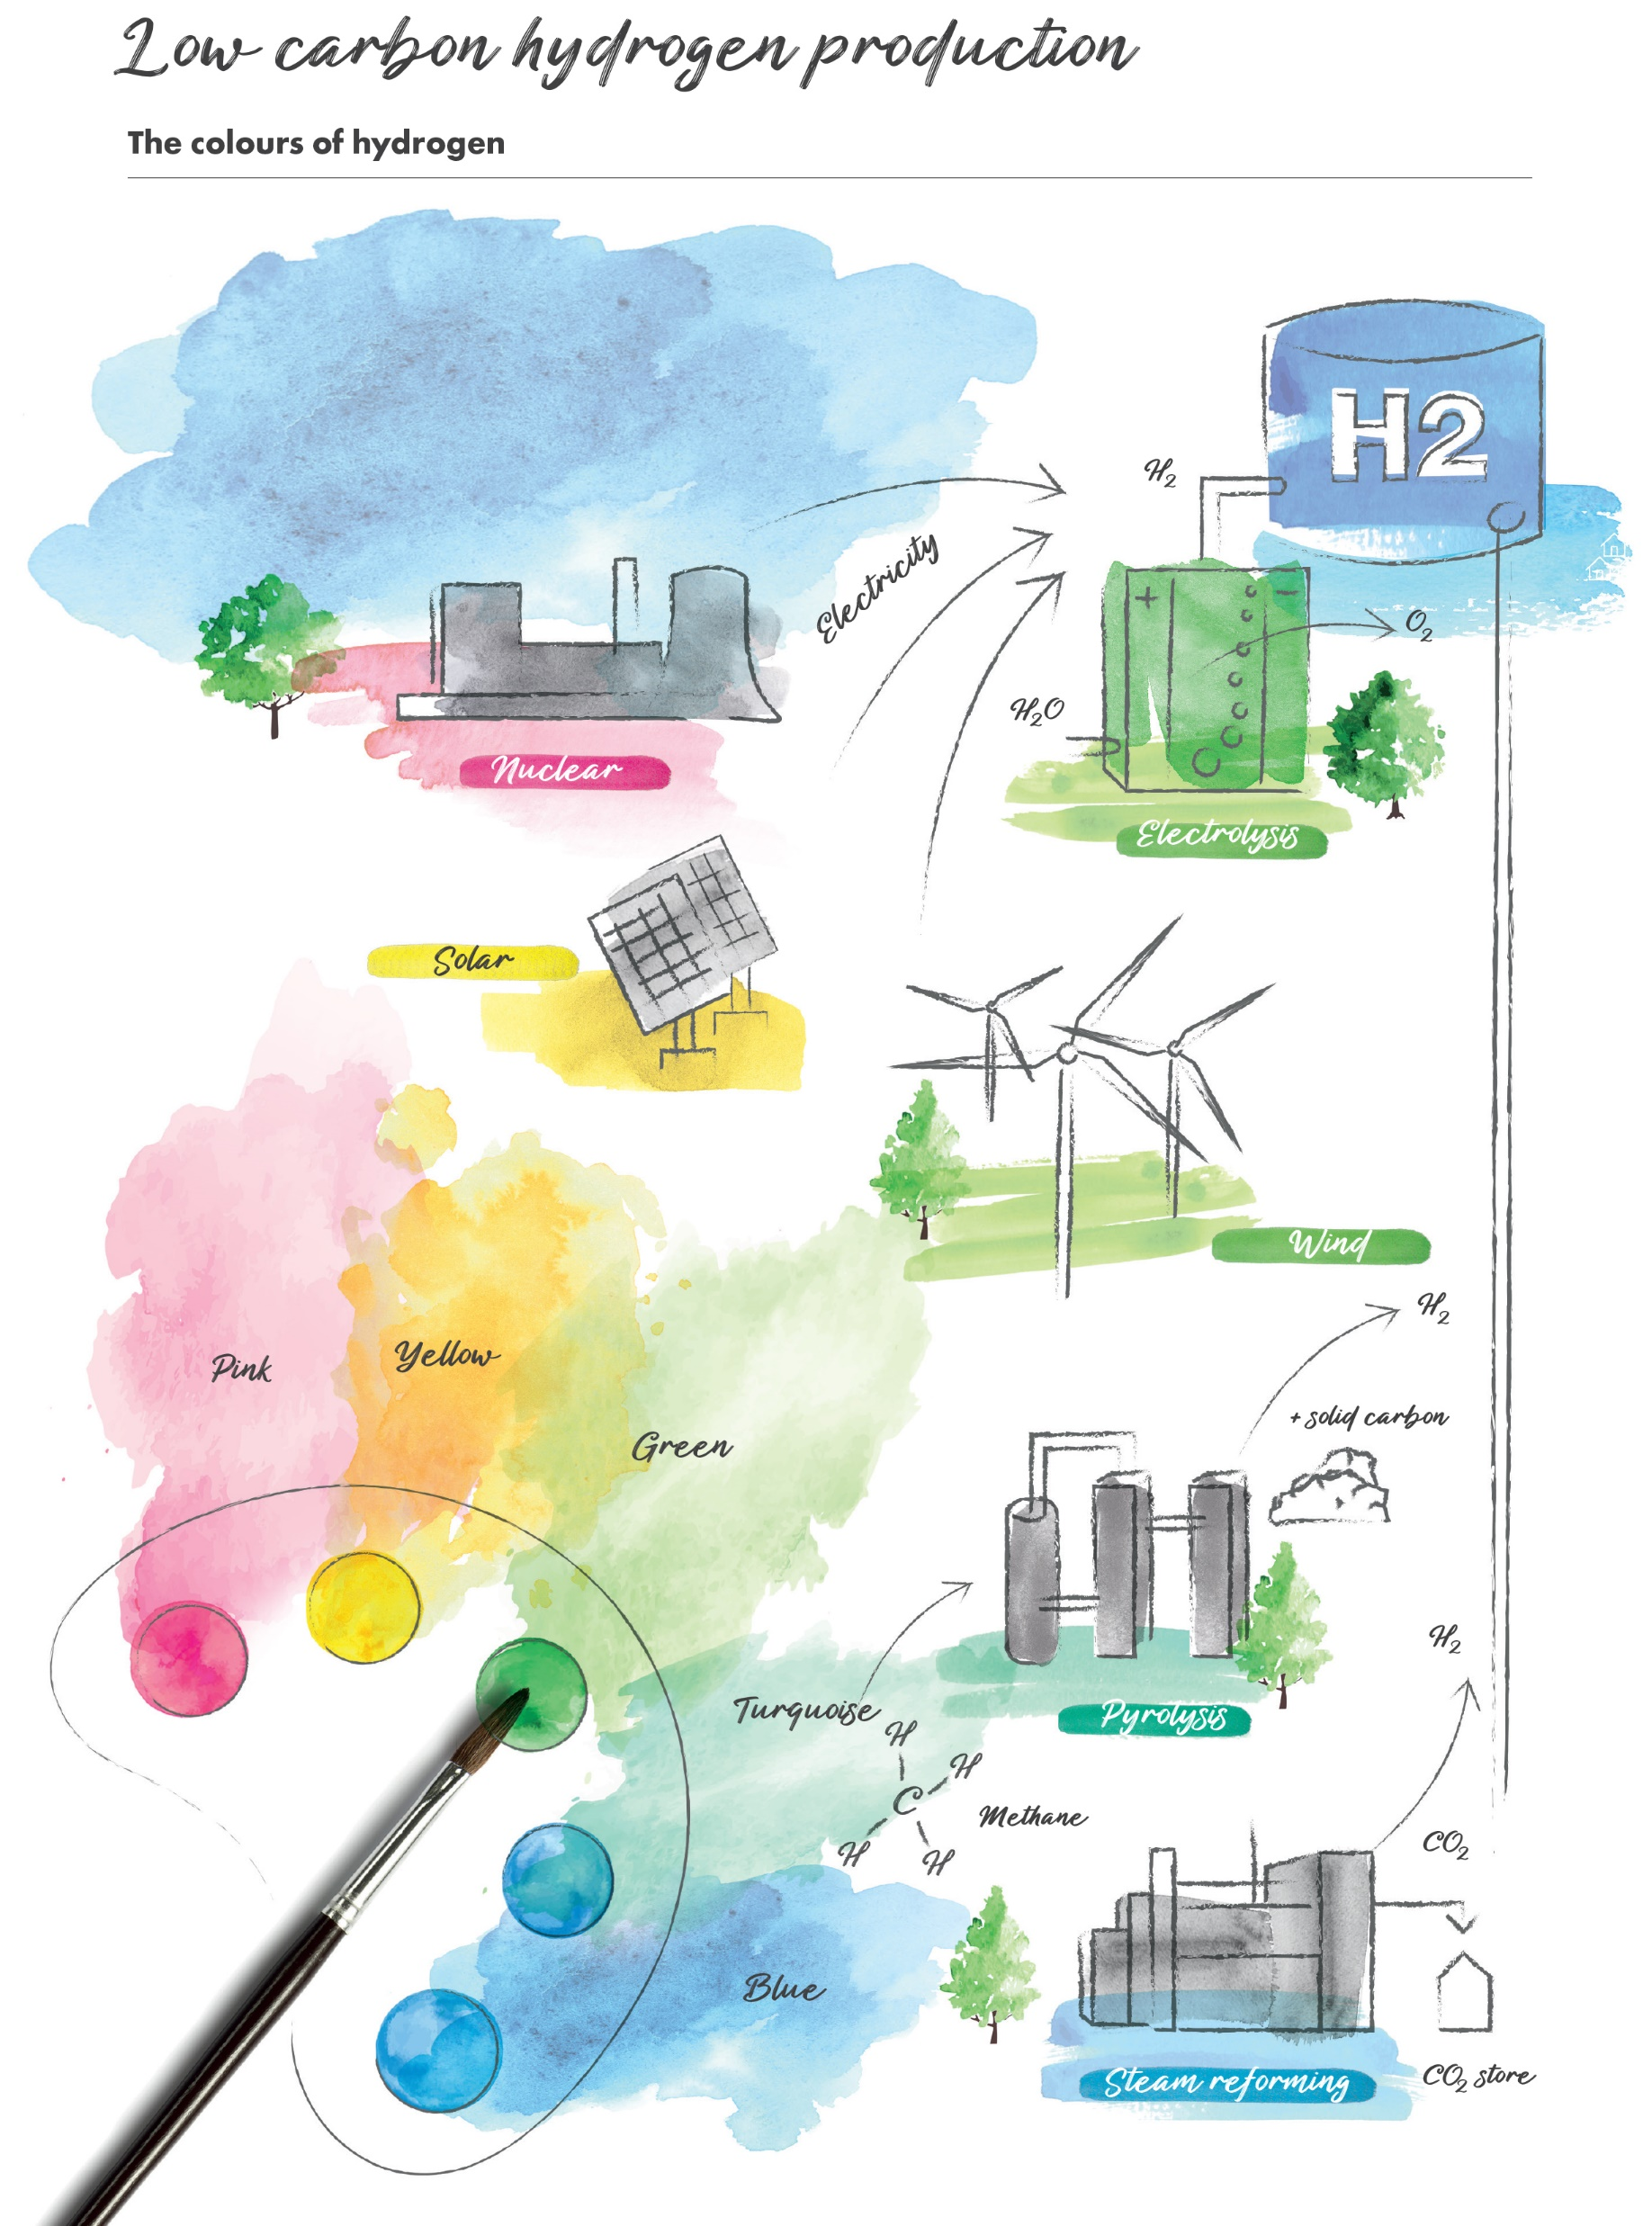
Hydrogen production
Blue – Methane reformation, H₂ and CO₂
Turquoise – Pyrolysis, H₂ and solid carbon
Green – Electrolysis, H₂ and O₂
Yellow – solar driven electrolysis, H₂ and O₂
Pink – Nuclear driven electrolysis, H₂ and O₂

Slide 16
How much hydrogen is needed?

Slide 17
Notes:
The UK Government has responded:
UK Hydrogen Strategy 2021: 10 GW Hydrogen Production (blue and green by 2030)
Heat and buildings Strategy: How the hydrogen neighbourhood, village and town came about
Hydrogen heating timeline
Neighbourhood 2023
Village 2025
Heat Policy decision 2026
Hydrogen town by 2030

Slide 18
Five regional programmes exploring the first hydrogen infrastructure - starting with industrial demand
Cumbria
Carlisle
Newcastle- upon-Tyne
TEESIDE
Middlesbrough
ECH₂
East Coast Hydrogen
BARROW
Hynet NW
Blackpool
Leeds
Hull
Bradford
Manchester
Grimsby
Liverpool
Sheffield
Warrington
Lincoln
Stoke-on-Trent
Nottingham
Derby
RATCLIFFE-ON-SOAR
BACTON
Wolverhampton
Norwich
Birmingham
Leicester
LOWESTOFT
Worcester
Coventry
Cambridge
Ipswich
SIZEWELL
Gloucester
Luton
IDC Funded Hydrogen Production Projects
Oxford
Future Hydrogen Production Clusters
Southend-on-Sea
Bristol
London
THAMES ESTUARY & ISLE OF GRAIN
Current Clusters
SOUTHAMPTON
Portsmouth
Notes:
Whilst demonstrateing hydrogen for heating.. The need for hydrogen to feed our industrial clusters is now:
And we have
The rest of the region:
5 main schemes that will be developed in offer to ensure that we have hydrogen production in relatively close proximity to all of our major demand centres.
Need to encourage hydrogen production in the Southern half of the Cadent Patch because although the North could probably provide all of the hydrogen that England and Wales needs, clusters developed locally to Birmingham and London will provide hydrogen earlier than waiting for the North, and make it more likely that hydrogen is part of the energy mix there.
HyNet (expands into N. Wales in collaboration with WWU and maximising the opportunities brought by green hydrogen from offshore wind in North Wales)
Cumbria where a new hydrogen production cluster is forming, which has come out of the decarbonisation pathway and a subsequent feasibility study and collaboration with NG, NGN and Spirit Energy.
West Midlands early discussions with WWU and National Grid about developing a future scheme that covers Wales and the West Midlands.
We've talked already about East Coast Hydrogen in the North
In the South East, a huge outstanding question is: how much hydrogen will be needed by London, where will it be produced and how will it get there.

Slide 19
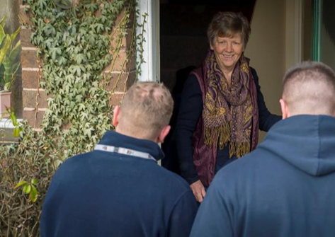
We building the safety and technical evidence
Blending gas up to 20%
Minimum disruption to customers
No appliance changes
Keele – Winlaton – Commercial
HSE evaluation underway
Government decision in 2023
Notes:
We have proved that we can blend hydrogen into the gas network up to 20%

Slide 20
Notes:
And our 100% hydrogen programme is working through al the technical and safety aspects of putting 100% hydrogen into our current network
Project builds on work already completed by gas networks under the H21 programme which has explored
Compatibility of network and components to hydrogen blends and 100% hydrogen
Gas networks now 72% plastic, 95% plastic by 2032 mains replacement programme

Slide 21
Notes:
As much work is focusing on how we can safely use hydrogen I the home
And the in-home safety evidence Hy4Heat already delivered which has enabled hydrogen appliances and meters to be developed As well as busting some myths
Such as:
100% hydrogen gas can be odorised in the same way as natural gas so it smells the same
Flames on hobs etc can be designed to burn with an orange flame
Hydrogen boilers are as efficient as natural gas boilers 97% (in comparison to the 90% that you have in your models)
NOX emissions are half that of natural gas boilers
Internal plumbing and gas pipes can remain the same
Any leaks with natural gas will also leak with hydrogen (but no more)
A few extra safety features have been identified. This includes additional excess flow valve, ventilation check

Slide 22
Thank you

Slide 23
Q & A
.
https://thewun.co.uk/

Slide 24
Don’t forget to join the Network
https://thewun.co.uk/join-wun/

Slide 25
Thank you to all our Partners for their ongoing support & particular thanks to WSP for kindly hosting tonight's event
https://thewun.co.uk/

Slide 26
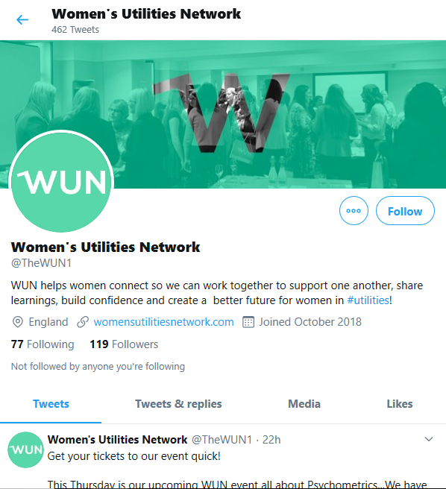
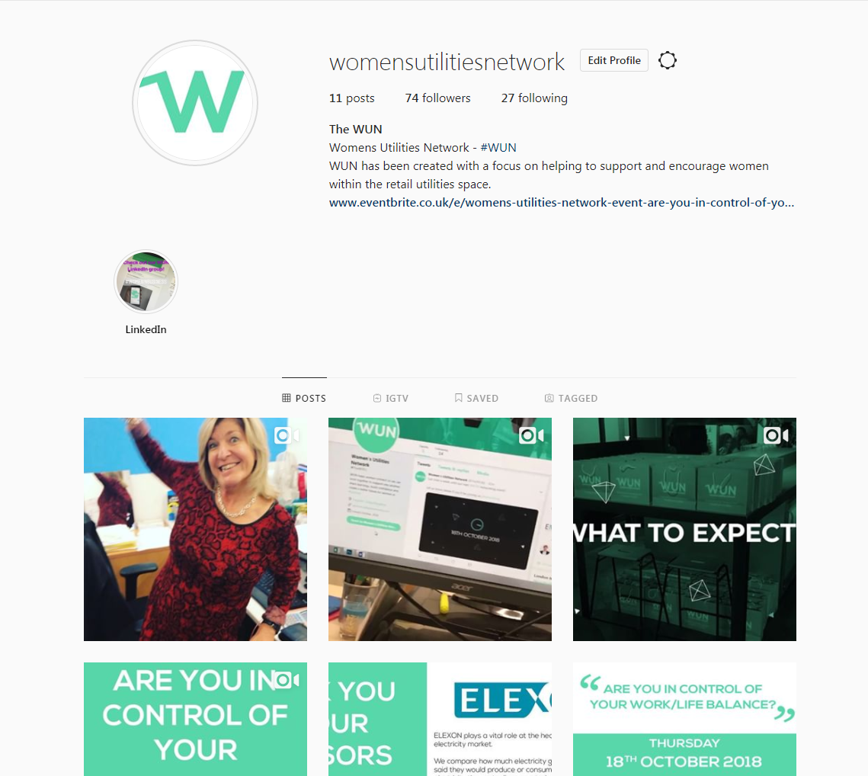
#WUN Don’t forget to follow us for the latest news and updates
https://thewun.co.uk/

