Slide 1
Welcome to WUN – We will be starting shortly.
https://thewun.co.uk/

Slide 2
Todays Agenda
Welcome – Louise Parry , WUN Director & Director of People & Organisational Development Energy & Utility Skills.
Keynote speaker -Danielle Lara, Client Executive in the Utilities space, Microsoft.
Panel Discussion & Q&A - Chaired by Hayley Monks WUN Founder & MD of Utilities Sector of Gobeyond Partners.
Wrap up and close – Louise Parry.
https://thewun.co.uk/

Slide 3
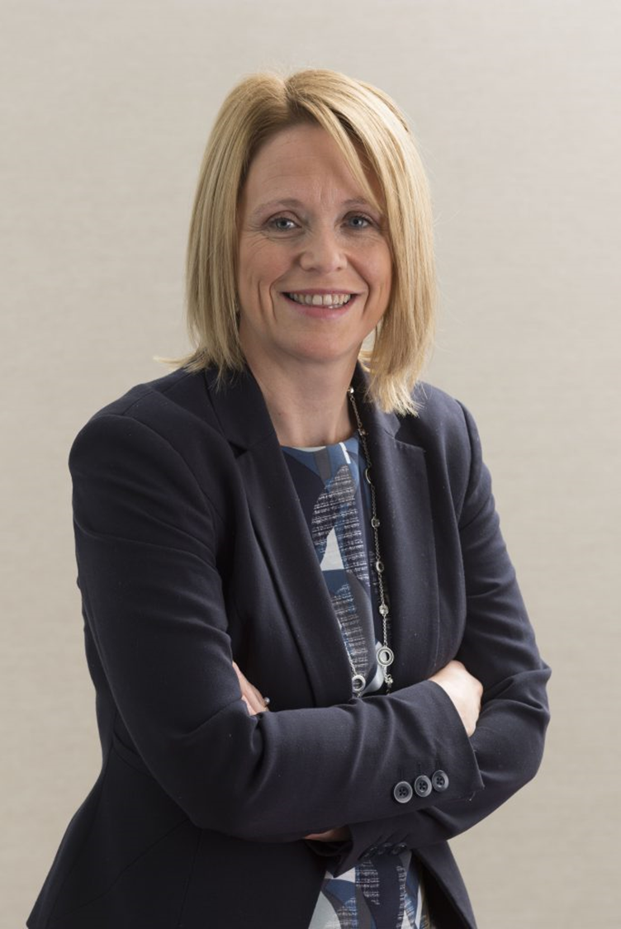
Louise Parry WUN Director & Director of People & Organisational Development at Energy & Utility Skills
Louise is responsible for people, organisational resilience, health & safety and business continuity and part of the Executive Team at Energy & Utility Skills.
Passionate about making a difference, as part of her role Louise leads on Diversity & Inclusion. Working across the industry, she has played a key role in establishing the Energy & Utilities Inclusion Commitment and sector wide inclusion measurement framework.
A Chartered Fellow of the CIPD, Louise is a senior people leader & executive coach with over 20 years of experience working within people, diversity and related roles. Louise is currently also a member of the Royal Academy of Engineering’s Industry Leadership Group. Louise joined the WUN board in April 2022.
Louise is married with three daughters and spends her free time juggling their social lives and is a member of a local gym and running club.
.
https://thewun.co.uk/

Slide 4
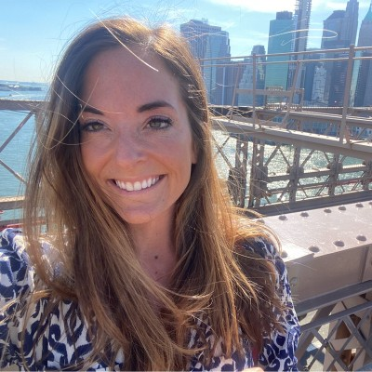
Todays Speaker
Danielle Lara – Senior Account Executive for Energy & Utilities at Microsoft
Over 20 years' experience working across Energy, Utilities and Technology, helping enable organisations to use digital technologies to achieve industry focussed outcomes. It’s such a pivotal time for the industry to transform, with a real opportunity to deliver a positive impact at scale for our customers and the communities we work in.
The Renewable energy transition, sustainability and decarbonisation are at the heart of many my customer conversations. I’m passionate and fortunate that my role at Microsoft allows
.
https://thewun.co.uk/

Slide 5
Innovation with Purpose – Womens Utilities Network
Danielle Lara – Microsoft

Slide 6
“She’s the DNA of the organisation”

Slide 7
Microsoft’s vision is to be the leading platform provider of technology solutions to environmental challenges​
Products & Services
Preferred platform and products for environmental solutions
Carbon
Water
Operations
Align with science and international goals
Customers & Partners
Trusted partner for customers’ sustainability journeys
Employees
Policy
Advocate for policies to achieve corporate and societal goals
Waste
Ecosystems
Notes:
We’re invested in being the leading cloud platform provider of technology solutions to environmental challenges, and we’re delivering on that vision in several ways.
We’ve long been focused on delivering our on operational commitments, which are aligned with the best available science. Our operations team is working across the entire company and with suppliers to minimize the environmental impact of our organization and value chain. But that will only affect our 0.03 percent of global emissions.
We are building commercial technologies, products, and services that can help our customers and partners with their commitments, too.
We have a policy team that is working with governments all around the world to advocate for climate-friendly policies.
And we’re embedding sustainability into the culture of our organization. There are 190 thousand employees at Microsoft, many that have a tremendous passion for environmental sustainability. We have an Employee Engagement Lead focused on unlocking the potential and energy of Microsoft employees with a variety of programs centered around sustainability, and we’ll share more shortly about the work we’re doing to center sustainability as a priority throughout the organization, from top to bottom and across.
<CLICK>

Slide 8
$1 billion over 4 years
Climate Innovation Fund
Speeding development of sustainability technologies and solutions through targeted investments and grant-funding
Notes:
Through our 1-billion-dollar Climate Innovation Fund, we’re investing in promising technologies, research, and development.
As of FY22, we’ve allocated 524 million dollars through this fund to accelerate deployment of existing climate technologies and invest in innovative solutions that have the potential to create meaningful, measurable climate impact by 2030.
Our global portfolio of investments is driving changes in energy, industrial, and natural systems. Our investments are focused primarily on four criteria: climate impact, underfunded markets, climate equity, and shared alignment to Microsoft.
A list of the organizations we’re investing in is available on our corporate social responsibility website.
<CLICK>
For more information:
Climate Innovation Fund, Microsoft CSR, https://www.microsoft.com/en-us/corporate-responsibility/sustainability/climate-innovation-fund?activetab=pivot1%3aprimaryr6
Sources:
“Microsoft 2020 Environmental Sustainability Report,” Microsoft, 28 January 2021, https://aka.ms/msftsustainabilityreport2020
“Microsoft 2021 Environmental Sustainability Report,” Microsoft, 9 March 2022, https://aka.ms/msftsustainabilityreport2021
https://blogs.microsoft.com/blog/2020/01/16/microsoft-will-be-carbon-negative-by-2030/
Climate Innovation Fund, Microsoft CSR, https://www.microsoft.com/en-us/corporate-responsibility/sustainability/climate-innovation-fund?activetab=pivot1%3aprimaryr6

Slide 9
Embedding Innovation within Utilities
Culture
Partnership
Sustainability

Slide 10
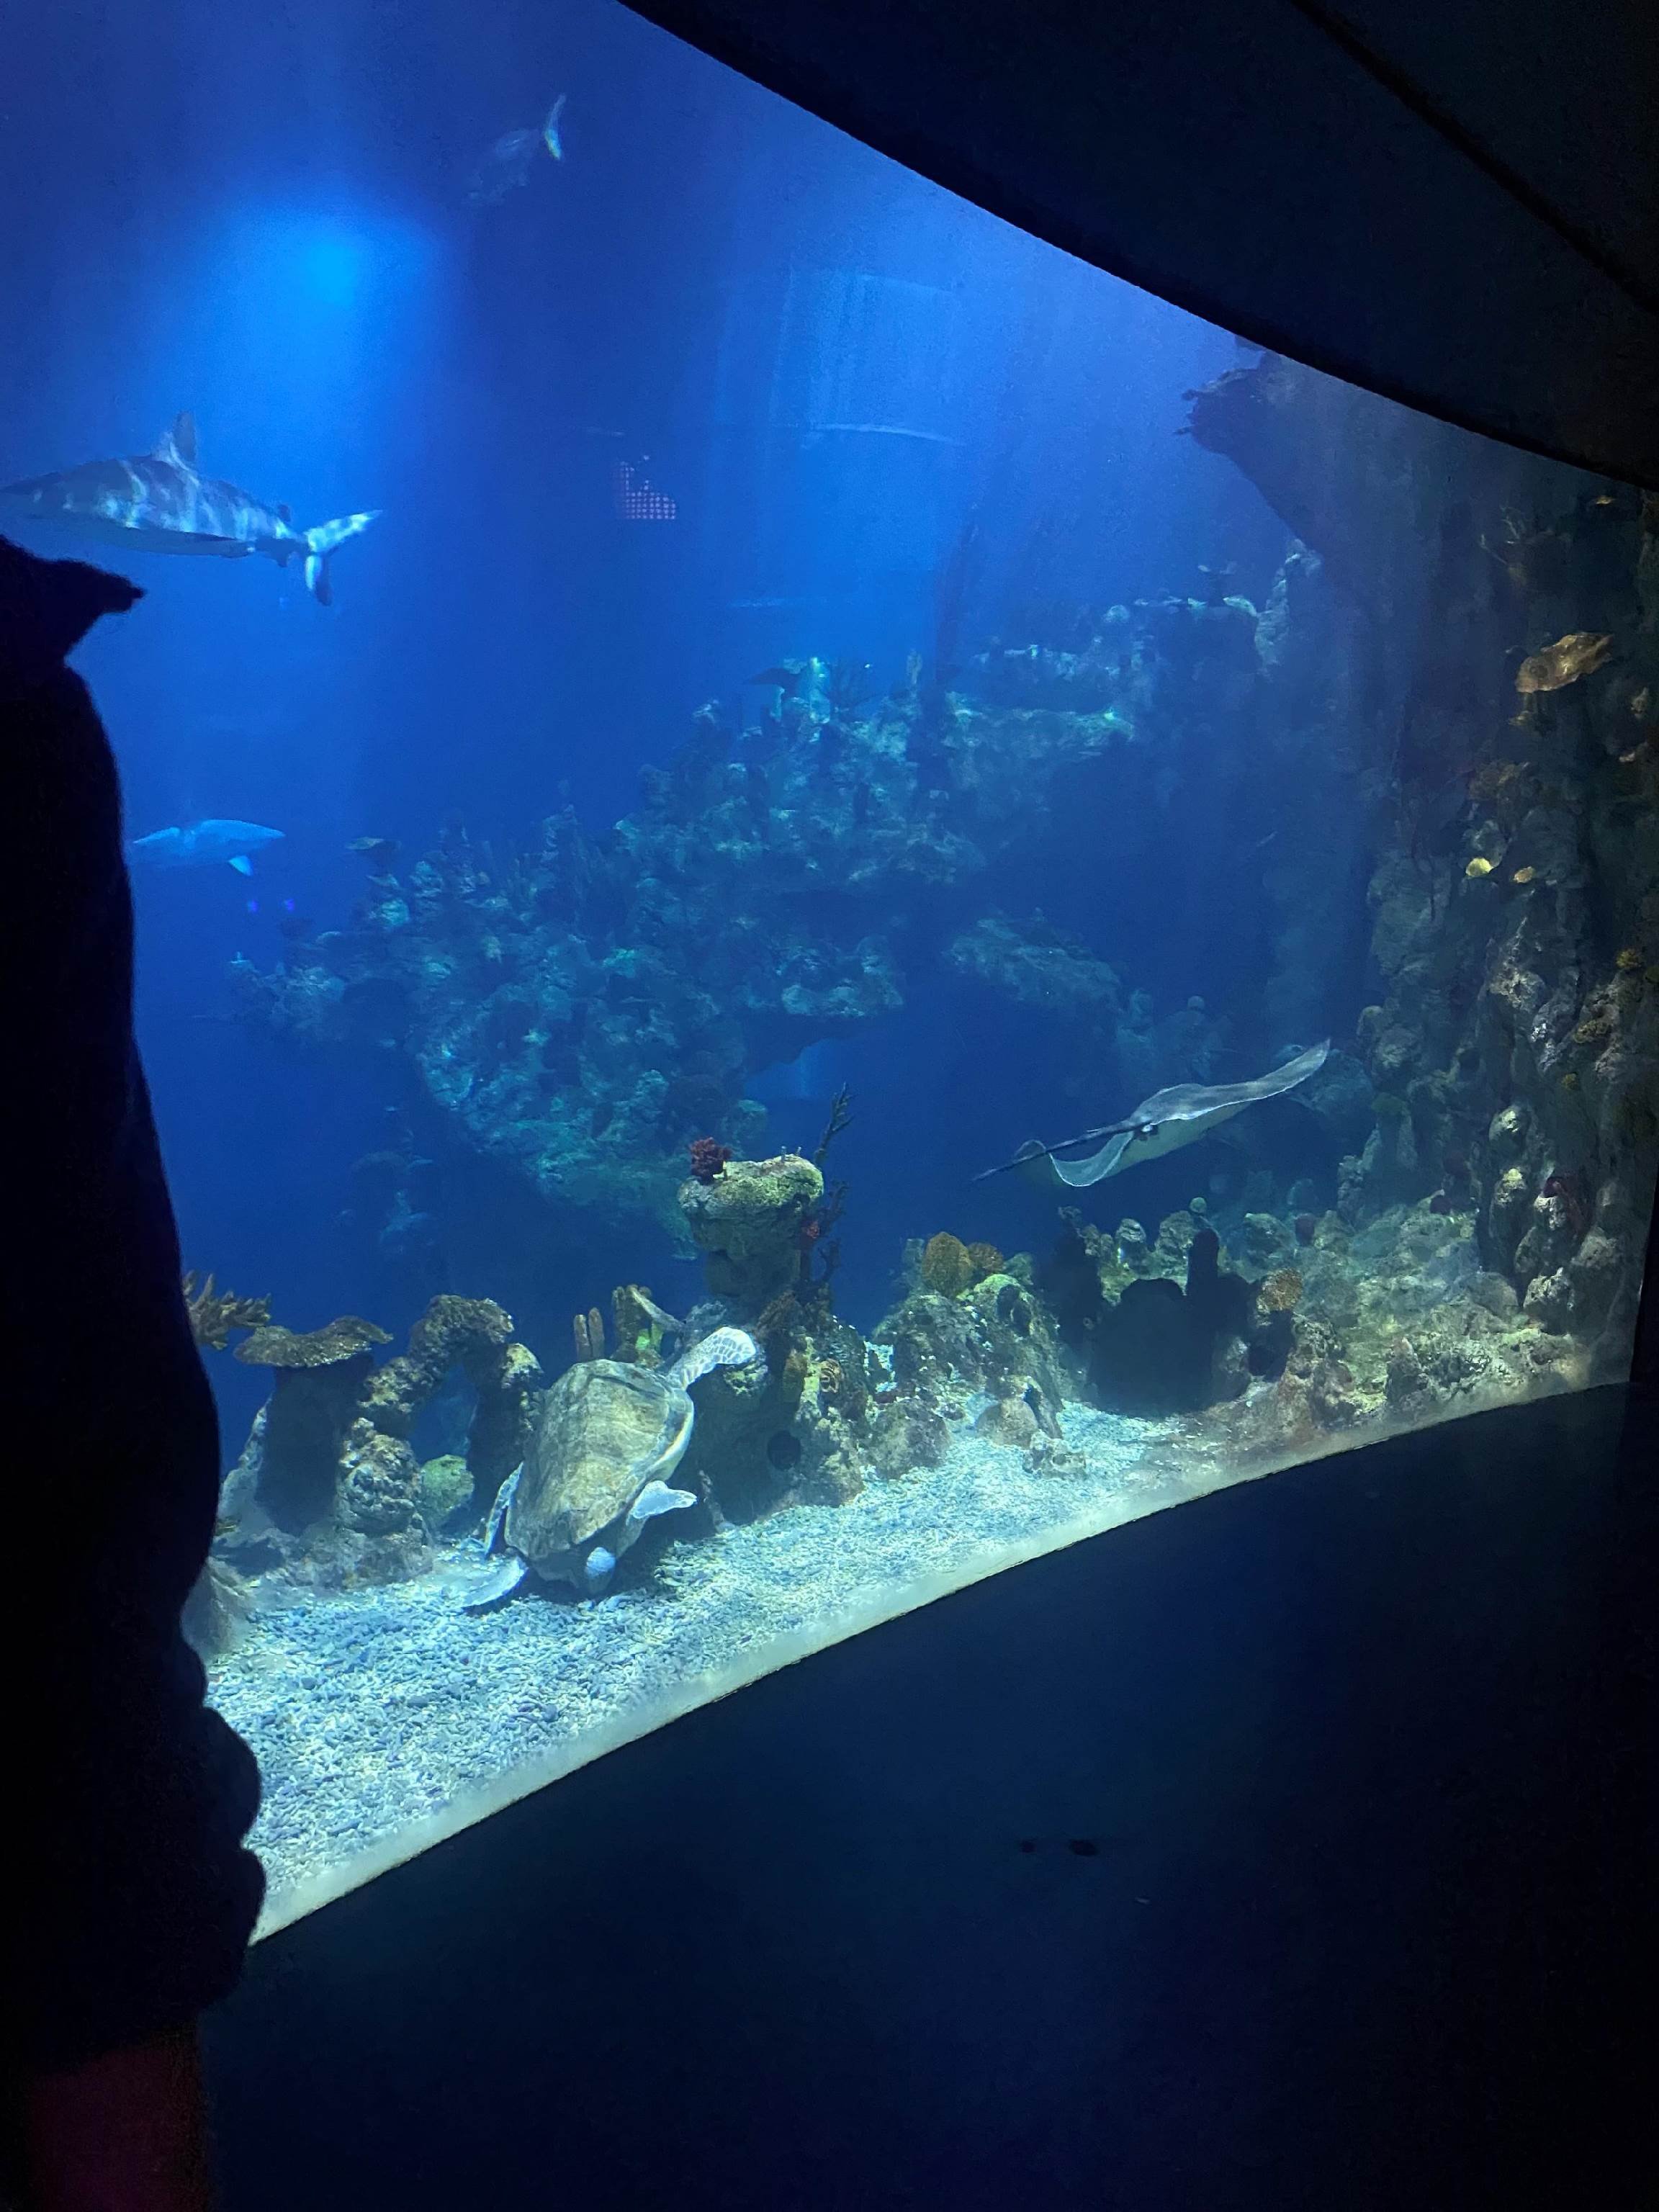
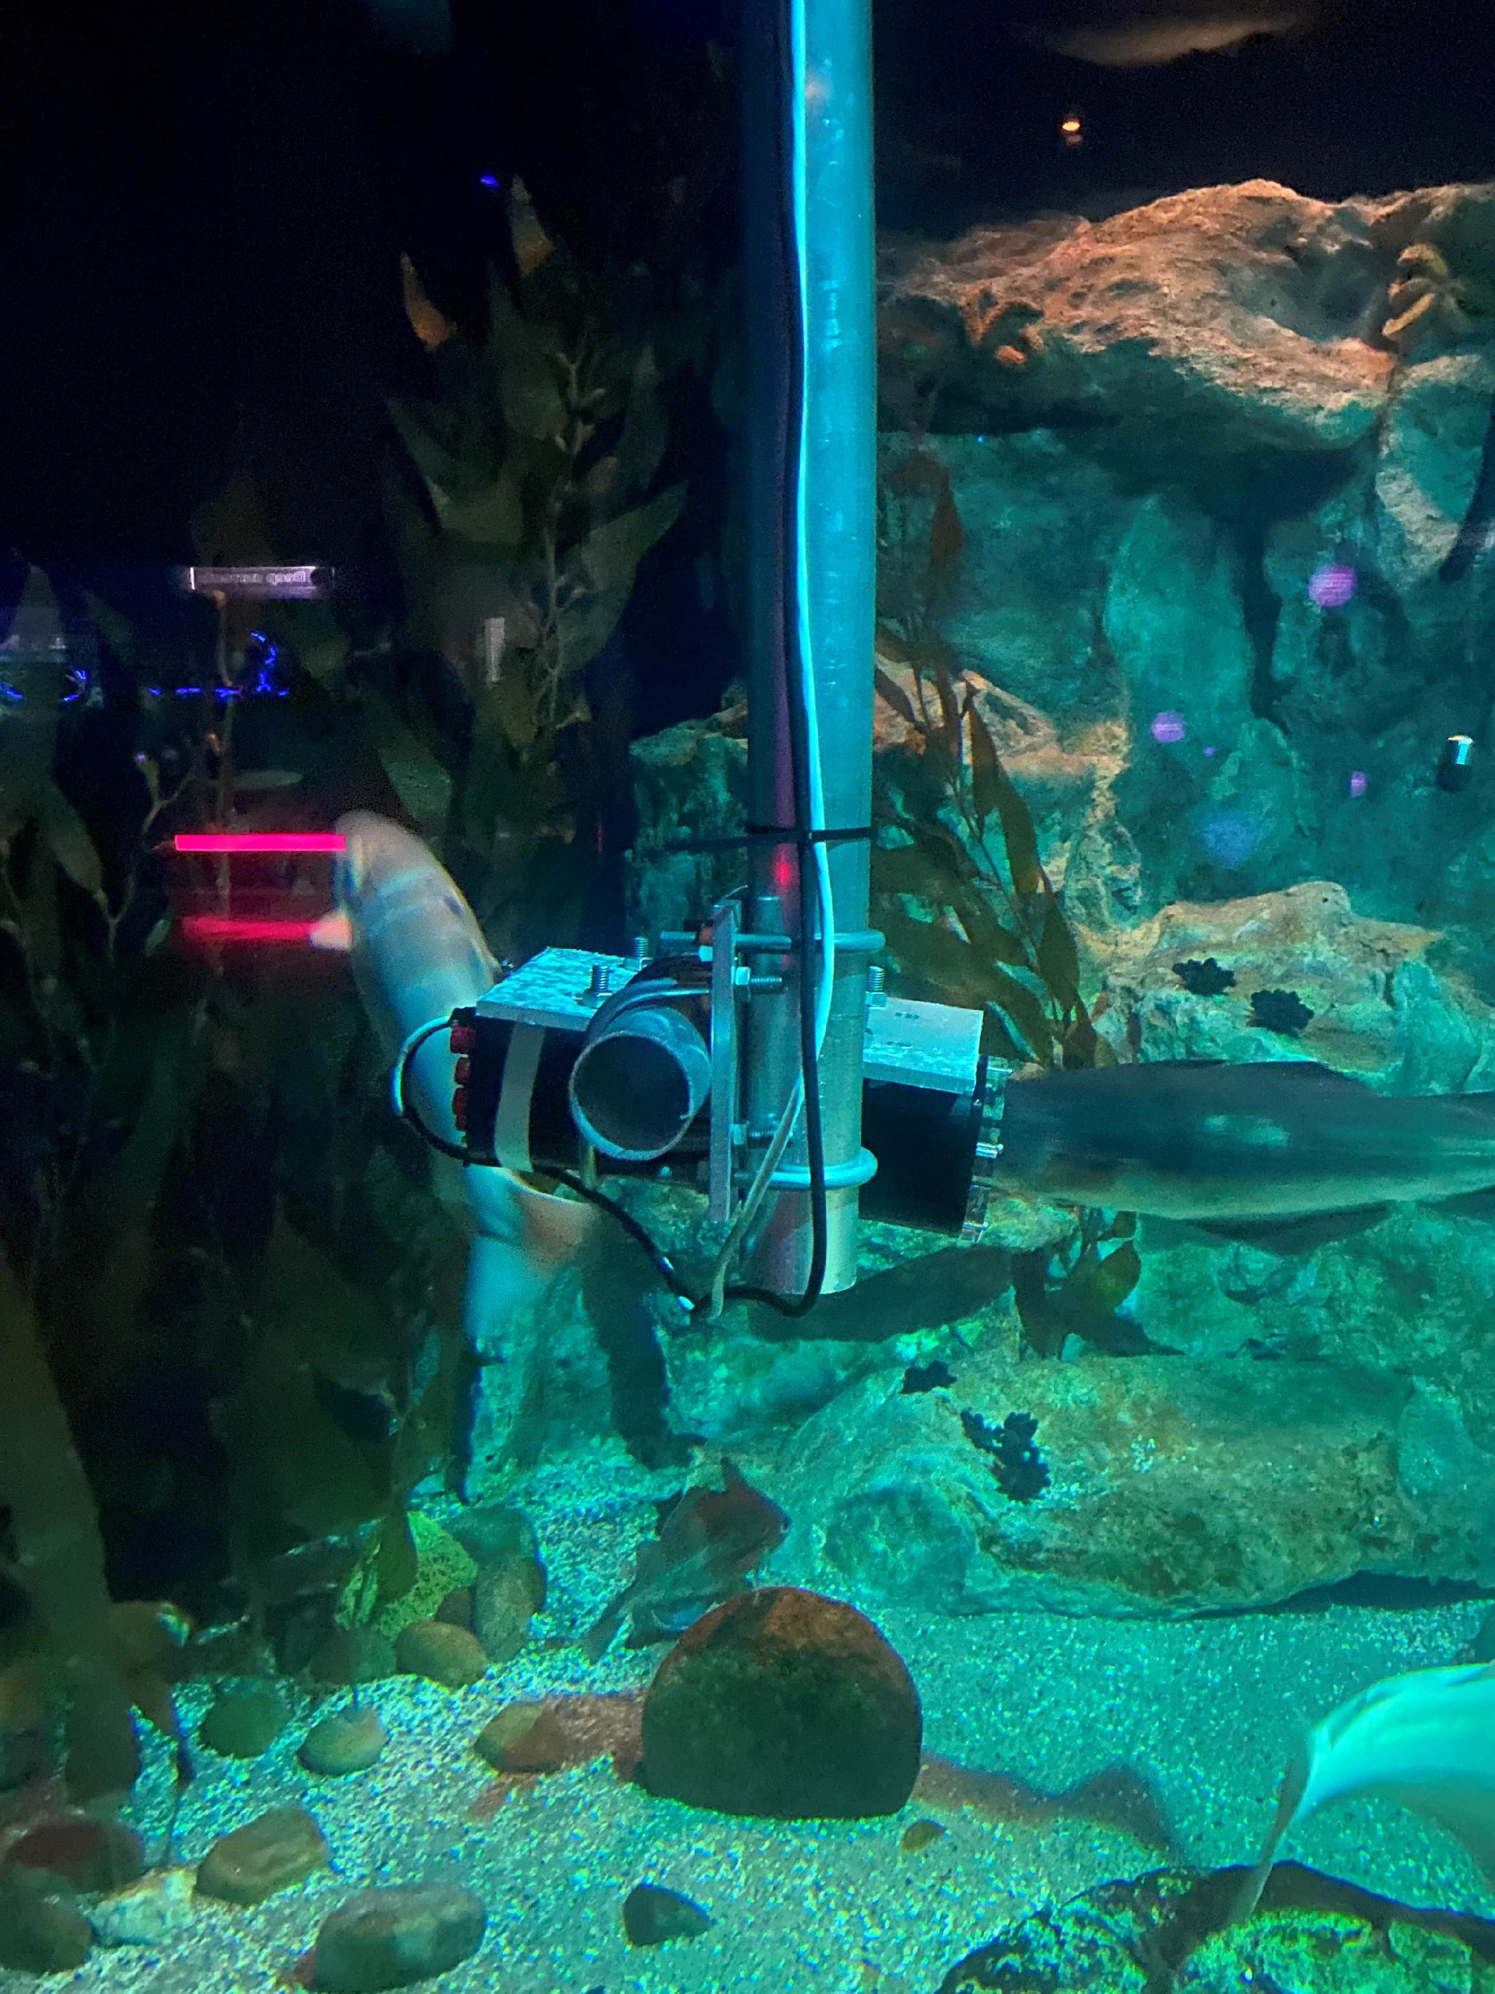
Pushing the boundaries

Slide 12
What’s different – why now?

Slide 13
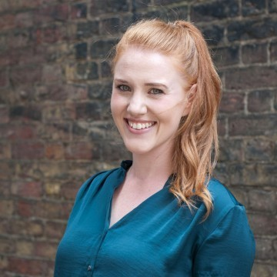
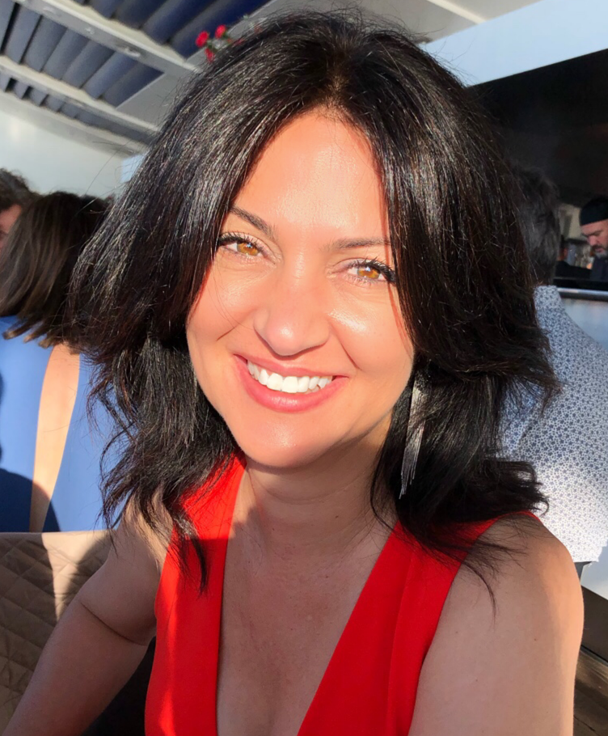
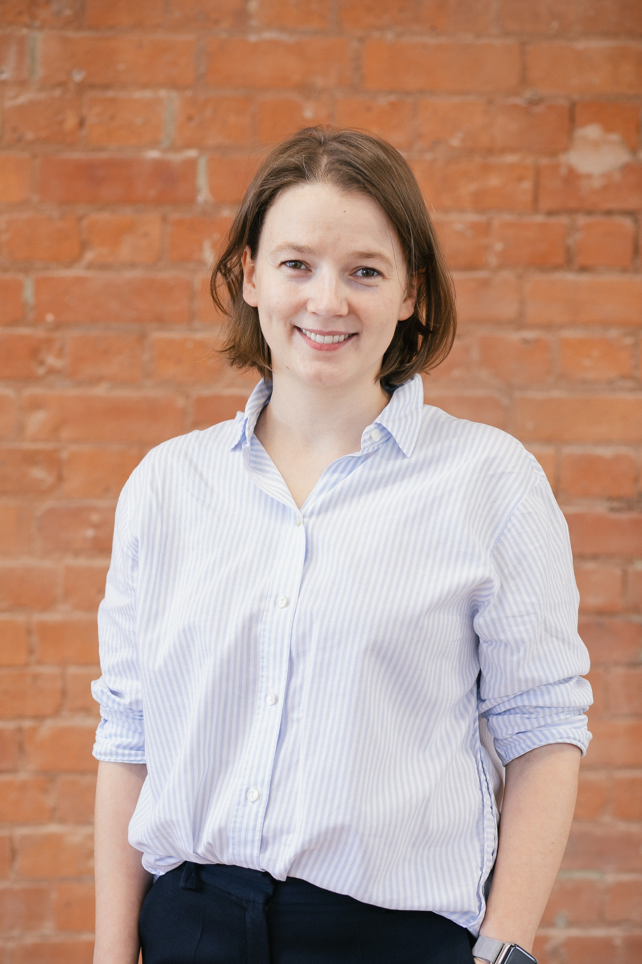
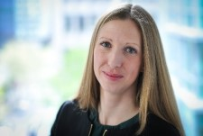
Todays Panel
https://thewun.co.uk/

Slide 14
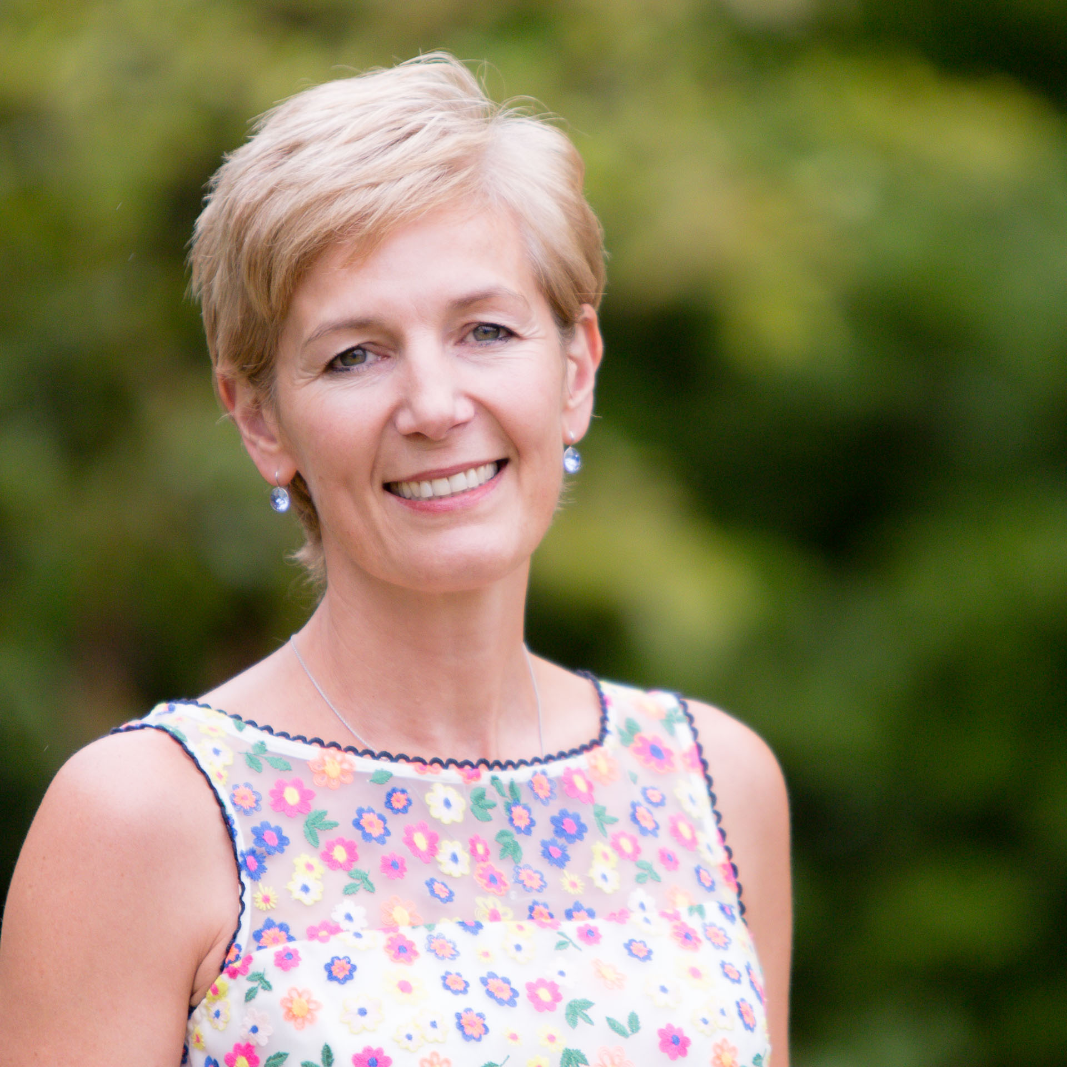
Todays Chair : Hayley Monks,
WUN Founder &
MD of Utilities Sector of Gobeyond Partners
Hayley is an experienced business leader, with over 20 years spent in roles in operations, credit management, and customer service leadership.
She is one of the founder Members of the successful Women in Utilities Network, and in 2015 launched Think, Inspire Create, a unique consultancy focused on supporting businesses to grow, evolve and drive change through working with them to develop their people. Think Inspire Create, known to colleague and customers as TICL (pronounced Tickle) work with clients across many sectors. Hayley’s experience gives her a unique perspective on what makes businesses successful, and her engaging and inspiring style means she is an influential speaker and acts as a personal coach to many senior leaders.
In November 21 Hayley joined Gobeyond Partners as Managing Director of the Utilities Sector.
.
https://thewun.co.uk/

Slide 15
Panel
Tina Diamond Director of Data & AI, Microsoft Uk Solutions
Azure Director - Manu, Energy & Resources, Automotive, Mobility & Transport, Pharma Azure
Tina Diamond is passionate about all things data and AI, helping enterprise customers with their data strategy and cloud transformations. Focused on enabling technology for business value, she brings a pragmatic approach to thinking big, starting small, planning for industrialisation, to scale fast in the cloud. Her experience and expertise is grounded in 20+ years spanning from start ups to global SI / consulting, cloud and big data. Currently leading the Manufacturing, Energy, Resources, Automotive, Mobility, Transport & Pharma Sector of Data/AI and Core Specialists Team for Microsoft Azure. Outside of work, she is one of the co-founders of Women in Dynamic Leadership, mentoring young ladies and men, and considers herself a life long learner, to bring her cumulative best to whatever she chooses to do.
.
https://thewun.co.uk/

Slide 16
Panel
Yulia Lamonov, Product Lead at FYLD AI
Throughout my career, I worked in several sectors: consumer goods, social care, and now utilities. However, the common denominator across the roles was the need to understand how people make their choices and what drives their behaviours in certain areas. And from that understanding, I looked for solutions to help people make safer/ healthier/ more time-efficient choices while supporting our business growth.
I've always had that innate curiosity about what motivates human behaviour at scale, which led me to have many first degrees in sociology. My second degree in business administration helps me ensure that there's a viable business case behind what I build with the team.
At FYLD, I'm leading a cross-functional team that builds and iterates on an operational digital town for fieldworkers and managers, helping them make safer and more productive decisions on a day-to-day basis. I'm also heading a team of product analysts that supports FYLDers with data and insights for decision-making.
.
https://thewun.co.uk/

Slide 17
Panel
Shaunna Berendsen - Head of Innovation Engagement at Anglian Water,
& Client Programme Director at UKWIR.
Shauna's key areas of focus at Anglian are:
• Developing and delivering innovation engagement strategy
• Driving and influencing internal innovation culture to meet business challenges,
• Sustaining current and future supplier engagement including developing platforms which enable true supply chain collaboration,
• Continuing the development of the Anglian Water Shop Window and WIN to continue the reputation of being one of the Leading Utilities of the Worl
Prior to working at Anglian Shaunna has also worked at UKWIR as Client Programme Director and Isle Utilities as Business & Innovation Marketing Manager.
.
https://thewun.co.uk/

Slide 18
Panel
Andrea Gysin, Director Energy & Industry WSP
Andrea’s career spans over 20 years in the water industry, working across consultancy, start-ups and utility companies. In 2005 she launched a ‘dragons’ den’ style innovation programme to accelerate technology commercialisation in the water sector. Her start-up experience includes companies that focused on delivering renewable and circular economy solutions, thereby contributing directly to decarbonisation.
Immediately prior to joining WSP, Andrea was Head of Innovation Partnerships for Thames Water where she was accountable for development and delivery of the innovation portfolio, aligning it to key business challenges including leakage, pollutions, asset condition and climate change. Andrea is accountable for developing and implementing WSP’s net zero strategy for water, energy and industry sectors in the UK and has recently taken responsibility for the development of the water strategic advisory tea
.
https://thewun.co.uk/

Slide 19
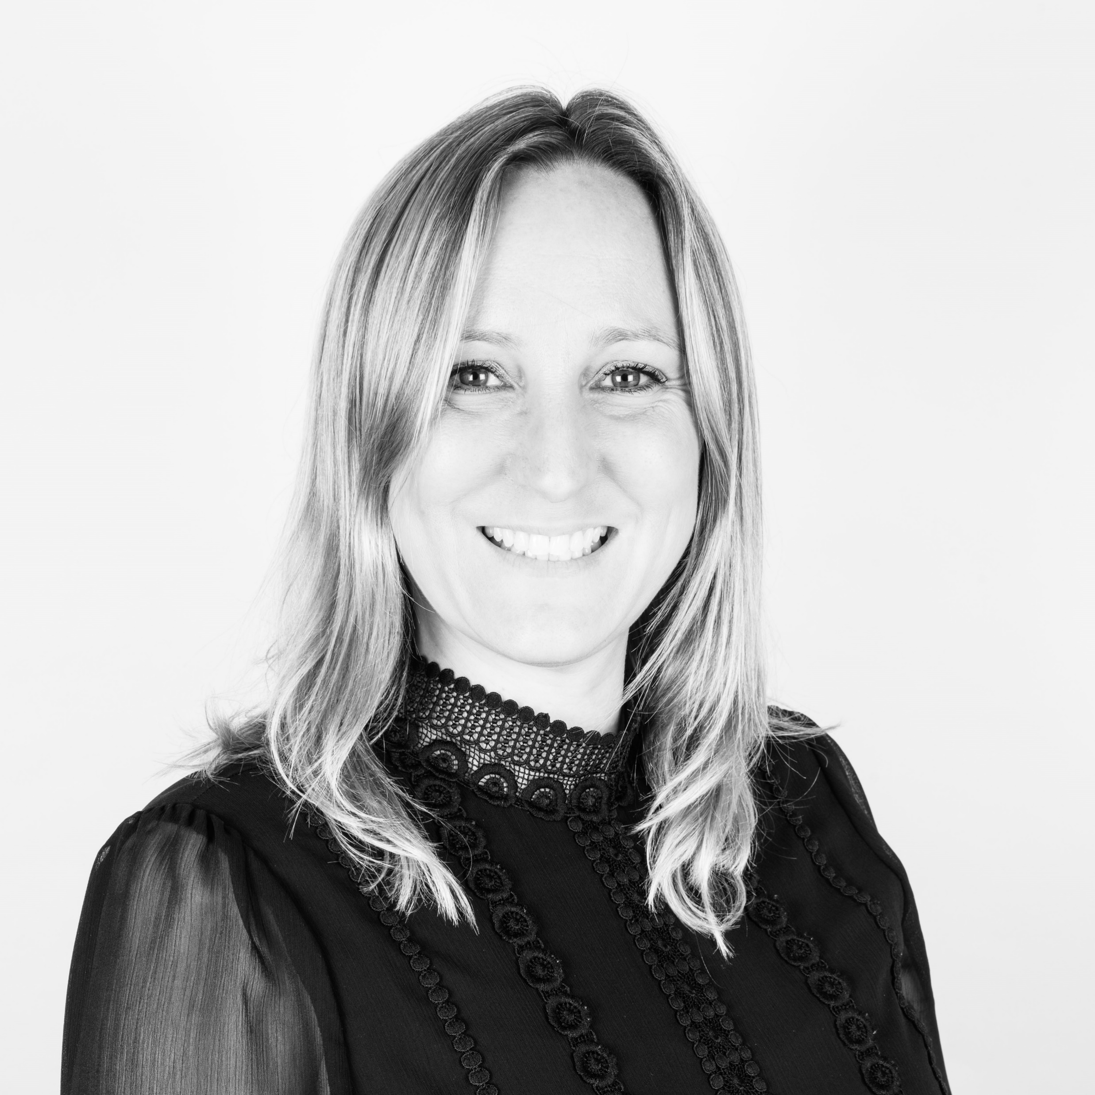
Panel
Carly Perry, Managing Director, Spring
In May 2022, Carly commenced her role as the first Managing Director of the UK water innovation centre of excellence, Spring. She brings 15 years of experience into her role having led water teams as a management consultant in Sia Partners and PA Consulting. Her experience spans across regulation, strategy and innovation with an extensive and broad background, working with water companies to deliver Price Review programmes, transform performance and work through the barriers of technology and innovation adoption. She has worked with Spring, in her consulting role, since July 2021 and has been the driving force behind the minimum viable product launched in December 2021.
Carly is highly experienced in cross sector collaborations, working with supply chain and academia to explore future business models for UKWIR and she has also led the UK water sector to design an Open Data Strategy. She brings a huge amount of passion for collaborative working and solving the sectors big challenges.
.
https://thewun.co.uk/

Slide 20
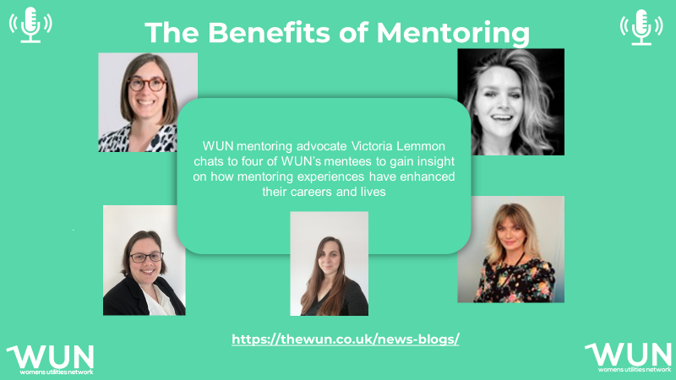
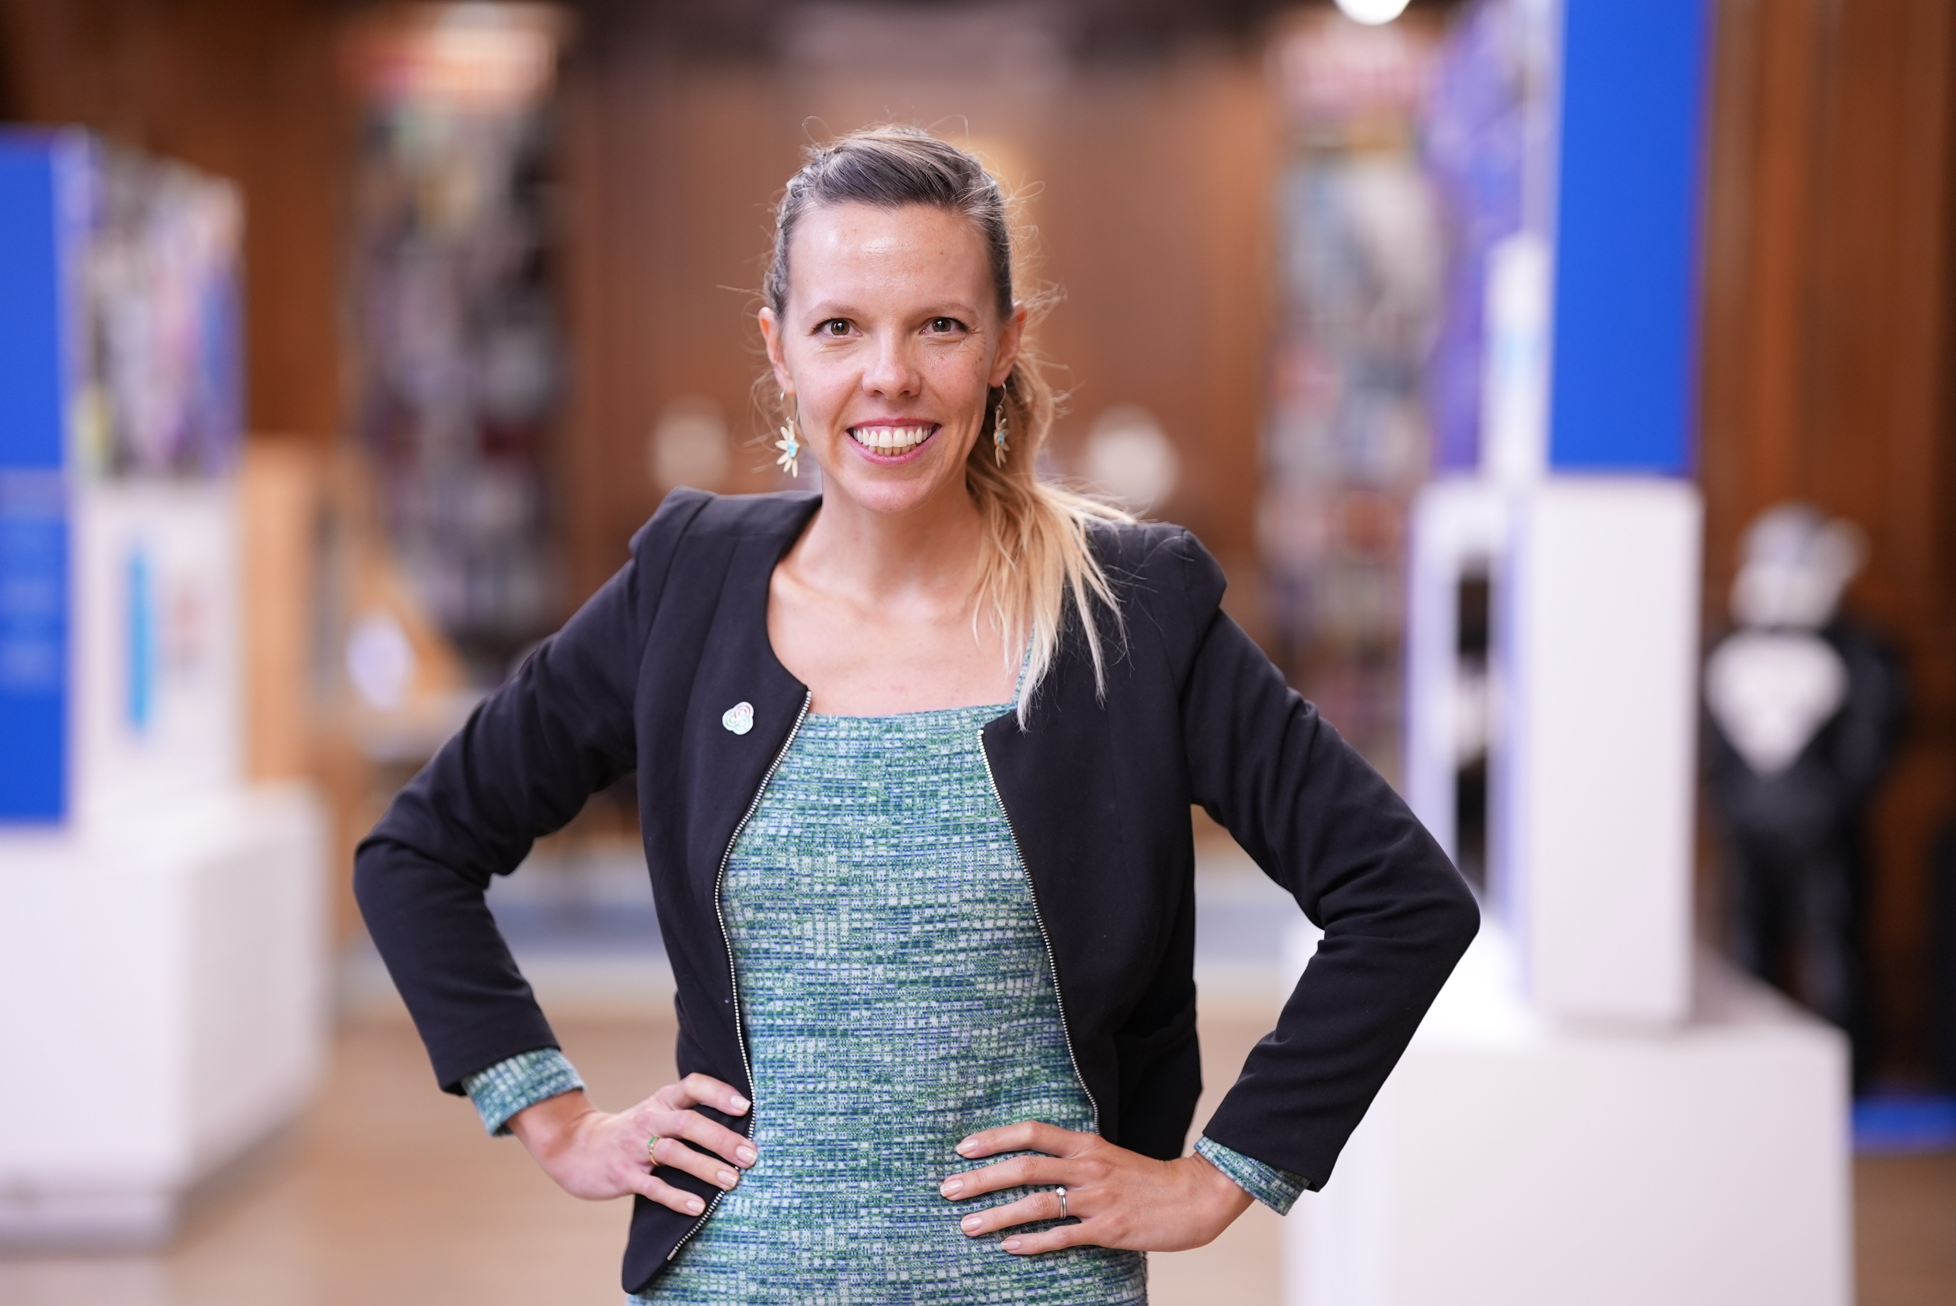
WUN Podcasts
Listen to our latest podcasts
Lily Frencham, CEO The Association for Decentralised Energy
Lily discusses the key skills needed to ensure that you are best placed to "negotiate your worth".
We discuss how you can build your confidence to navigate different scenarios at work, have quality conversations to accelerate your career and make your voice heard.
WUN Advocate Victoria Lemmon talks to four mentees Phillipa Rose, Stella Matthews, Della Newton & Karen Hosking, about their experience with the WUN Mentoring Programme. We also hear some useful tips on how to choose the right mentor & how mentoring can empower you to accelerate your career & enhance your life.
.
You can follow our podcast on Apple Podcasts, Spotify, Amazon Music and wherever else you get your podcasts – just search “WUN4ALL”.
Or just click through from the website: https://thewun.co.uk/news-blogs/

Slide 21
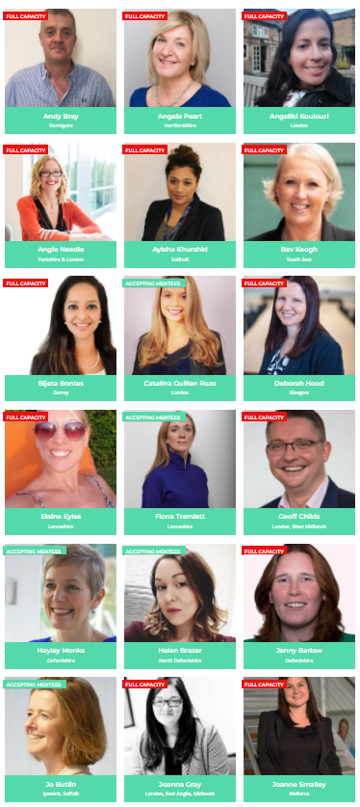
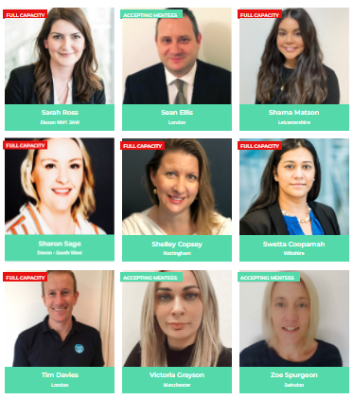
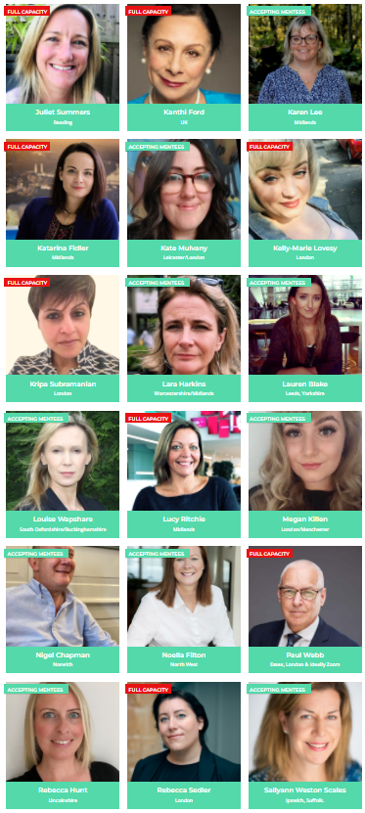
Join the free WUN Mentoring Programme
Our Mentors
WUN offers mentoring to women at any stage of their career in the utilities sector.
We are hugely privileged to have some fantastic experienced mentors within the WUN mentoring programme.
With growing numbers of Mentors and Mentees we are delighted with the community and support fostered within the mentoring programme.
If you are interested in becoming a mentor or a mentee please visit our website: https://thewun.co.uk/mentoring/

Slide 22
New WUN report reveals how women really feel about working in the utilities sector
It’s hoped the results will act as a wake-up call to leadership teams, key stakeholders, recruitment teams, and the wider industry, while setting out five clear takeaways to help transform attitudes and behaviours.
These include appointing more positive female role models in senior positions, providing greater networking and support opportunities for women working in the sector, and changing the culture and environment of utility workplaces to better meet the needs of all.
To download and view the report for free, please visit
https://thewun.co.uk/

Slide 23
2023 WUN Events calendar
– coming soon!
https://thewun.co.uk/

Slide 24
Don’t forget to join the Network
https://thewun.co.uk/join-wun/

Slide 25
Thank you to all our Partners for their ongoing support & particular thanks to both Anglian Water & Microsoft for supporting tonight's event
https://thewun.co.uk/

