Slide 1
Welcome to WUN – We will be starting shortly.
https://thewun.co.uk/

Slide 2
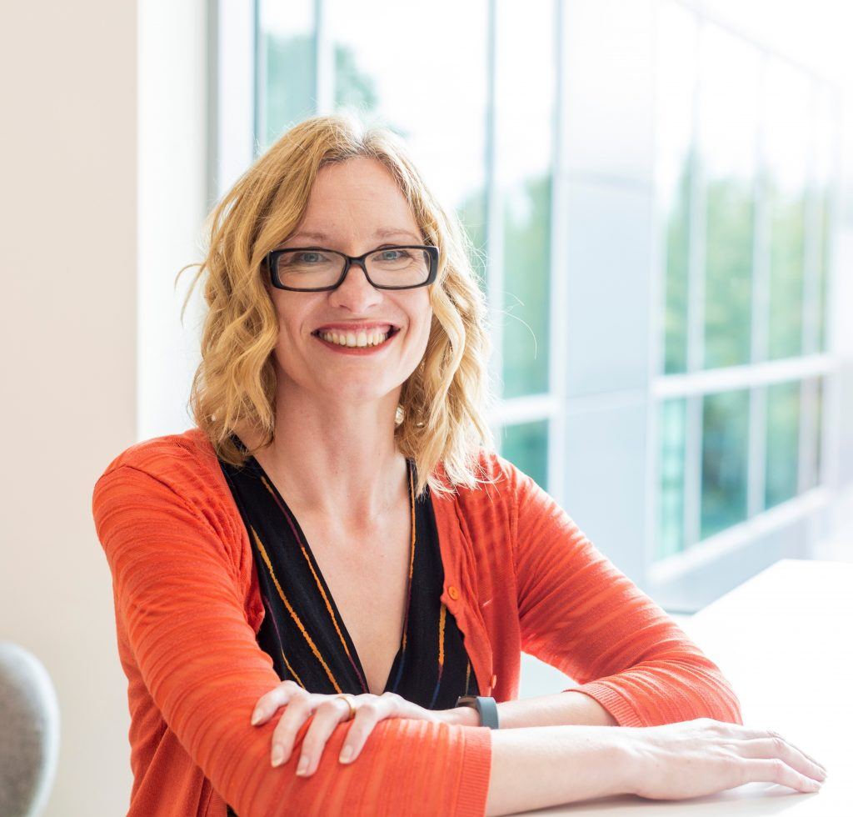
2023 WUN Events- book now
Thursday 9th March 6pm – Birmingham
WUN Founder Dr Angela Needle , Cadent Gas Ltd & a panel of other women working on the hydrogen economy discuss the role it will play in our future energy system.
Wednesday 15th March WUN For ALL ( Virtual) 1-2 pm –
Importance of data and changing behaviours
with Matthew Roderick @N3rgy- further speakers to be announced.
https://thewun.co.uk/

Slide 3
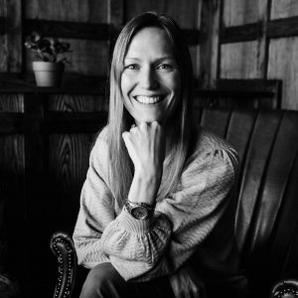
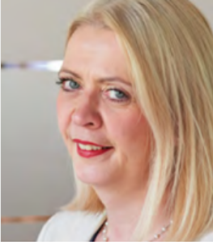
WUN Podcasts
Listen to our latest podcasts
WUN Founder Hayley Monks speaks to Karen who explains what burnout is, what the symptoms look like and what practical tips and strategies you can adopt you help you manage burnout.
Karen, a career & confidence coach specialidses in helping people build fulfilling careers and mental fitness.
#Career Stories with Angela Love
How you can identify and manage burnout with Karen Boyd, Miabo Consulting
We speak to Angela Love to hear more about her deep and varied career across the energy sector.
Angela has over 25 years of experience in the EU/UK energy market covering public affairs, finance, governance, regulation and communications. Listen in to hear more about Angela’s fascinating journey and the lessons she has learnt along the way.
.
You can follow our podcast on Apple Podcasts, Spotify, Amazon Music and wherever else you get your podcasts – just search “WUN4ALL”.
Or just click through from the website: https://thewun.co.uk/news-blogs/

Slide 4
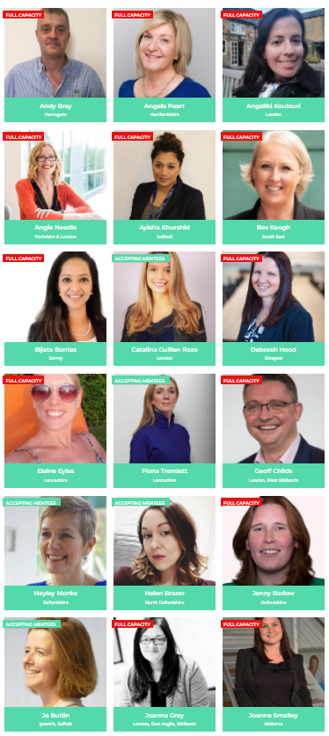
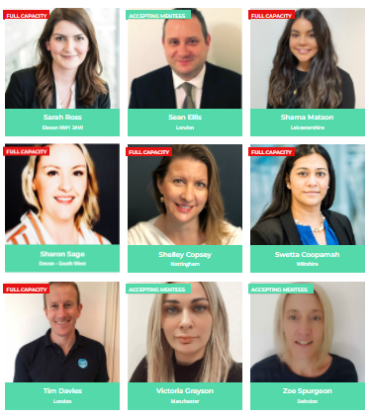
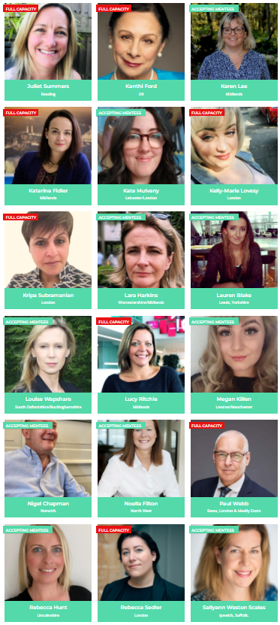
Join the free WUN Mentoring Programme
Our Mentors
WUN offers mentoring to women at any stage of their career in the utilities sector.
We are hugely privileged to have some fantastic experienced mentors within the WUN mentoring programme.
With growing numbers of Mentors and Mentees we are delighted with the community and support fostered within the mentoring programme.
If you are interested in becoming a mentor or a mentee please visit our website: https://thewun.co.uk/mentoring/

Slide 5
WANTED !
SOCIAL MEDIA ADVOCATE
https://thewun.co.uk

Slide 6
Todays Agenda
Welcome – Hayley Monks, WUN Founder & MD of Utilities Sector GoBeyond Partners
Keynote speaker: :Joanne Smalley, Cardain Communication
Wrap up and close –Hayley Monks
https://thewun.co.uk/

Slide 7
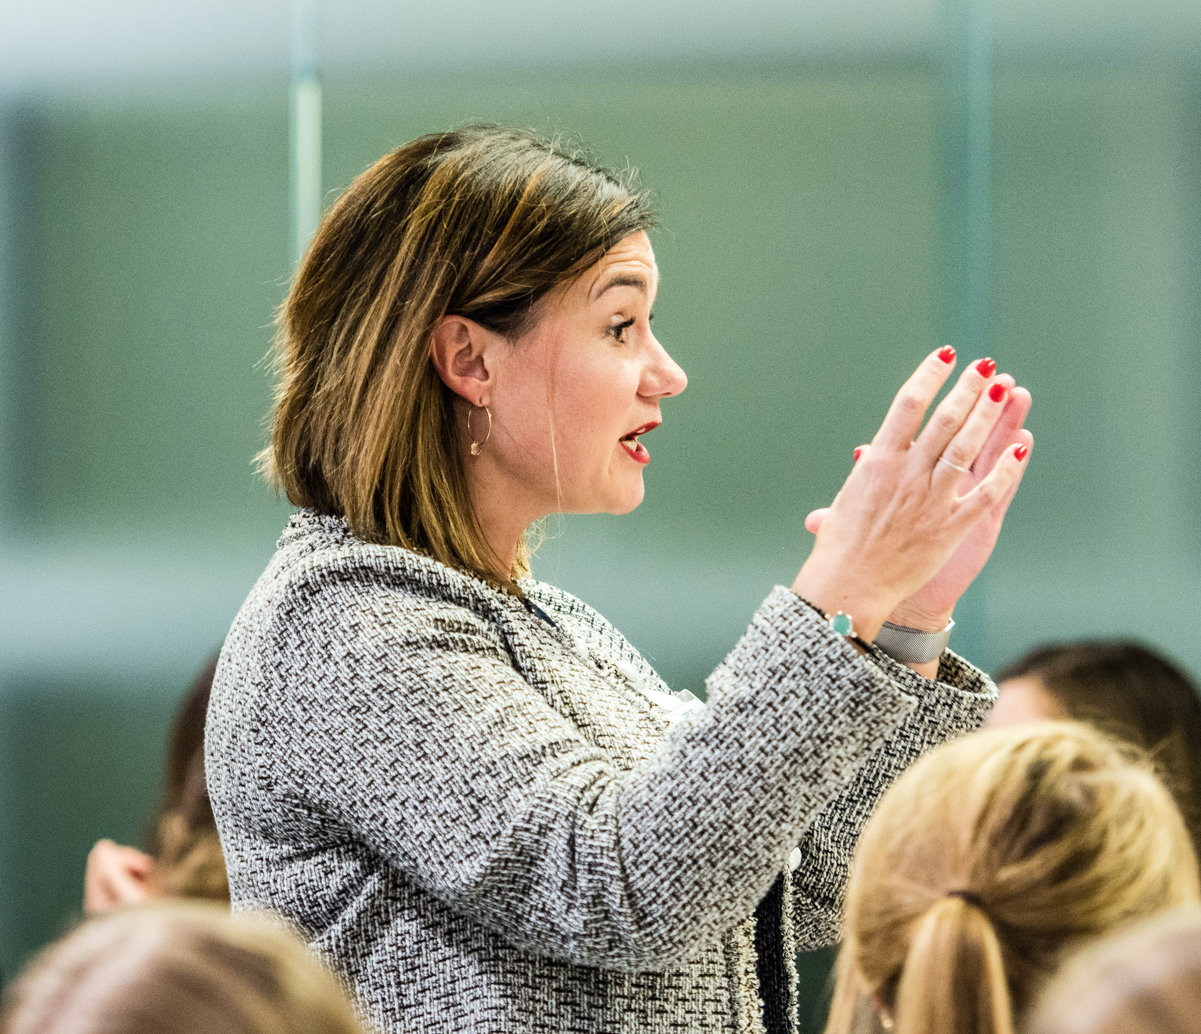
Joanne Smalley, Cardain Communication
Joanne has built a career in the energy sector, delivering comms and marketing support to a wide range of businesses from E.ONn to Elexon, and from Gentrack to the Smart DCC.
7 years ago she set up her own consultancy, and she attributes her personal brand to helping her ‘consciously create’ the life she wants – working with exciting clients around the world from her home base in Mallorca.
.
https://thewun.co.uk/

Slide 8
Don’t forget to join the Network
https://thewun.co.uk/join-wun/

Slide 9
Thank you to all our Partners for their ongoing support
https://thewun.co.uk/

Slide 10
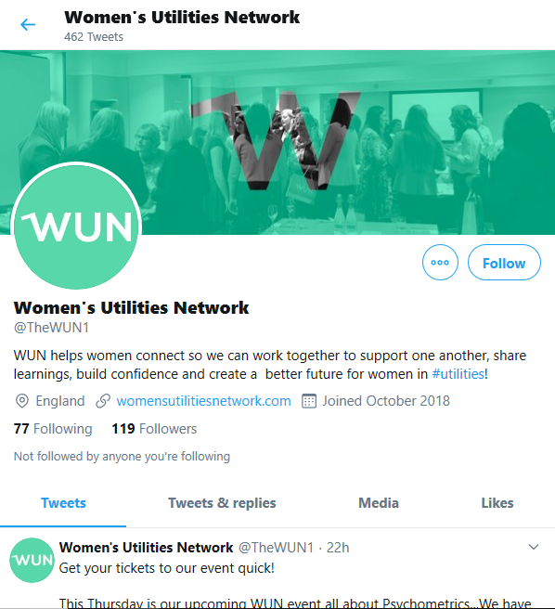
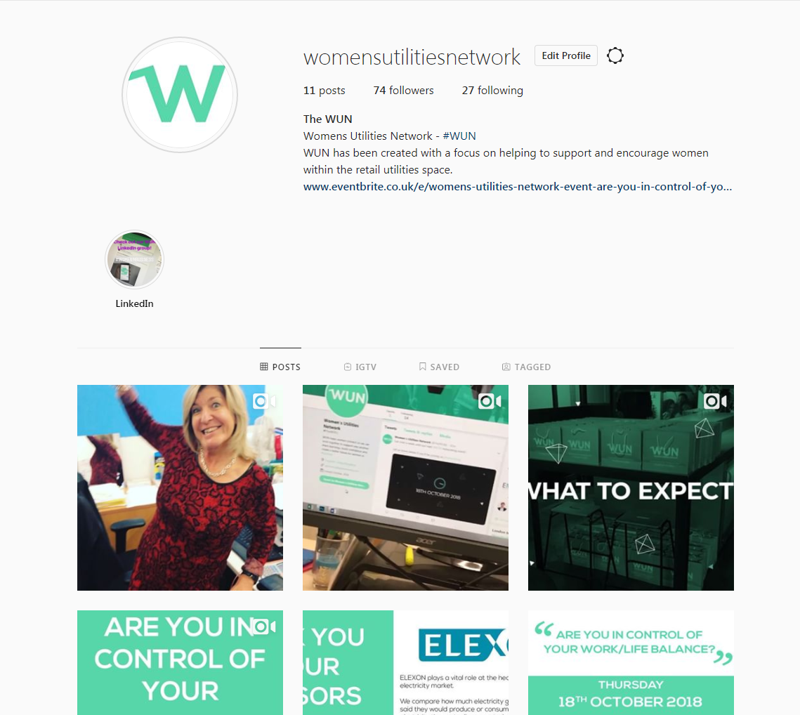
#WUN Don’t forget to follow us for the latest news and updates
https://thewun.co.uk/

