Slide 1
Welcome to WUN – We will be starting shortly.
https://thewun.co.uk/

Slide 2
Todays Agenda
Arrival & Networking
- Welcome – Hayley Monks WUN Founder & MD of Utilities
Sector Gobeyond Partners
Keynote speaker: Tom Foreman
Todays panellists:
Catharine Skinner – Cadent Gas
Monica Collings CEO – So Energy
Dhara Vyas – Energy UK
Helen Tipton – Fuel Bank Foundation
Discussion /Q&A
Further Networking opportunity
8:00pm – Wrap up and close – Hayley Monks
https://thewun.co.uk/

Slide 3
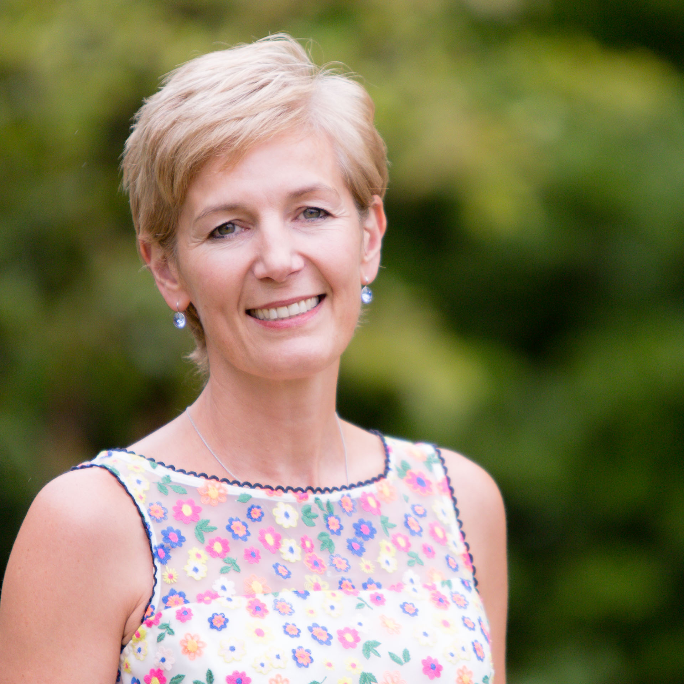
Todays Chair : Hayley Monks,
WUN Founder &
MD of Utilities Sector of Gobeyond Partners
Hayley is an experienced business leader, with over 20 years spent in roles in operations, credit management, and customer service leadership.
She is one of the founder Members of the successful Women in Utilities Network, and in 2015 launched Think, Inspire Create, a unique consultancy focused on supporting businesses to grow, evolve and drive change through working with them to develop their people. Think Inspire Create, known to colleague and customers as TICL (pronounced Tickle) work with clients across many sectors. Hayley’s experience gives her a unique perspective on what makes businesses successful, and her engaging and inspiring style means she is an influential speaker and acts as a personal coach to many senior leaders.
In November 21 Hayley joined Gobeyond Partners as Managing Director of the Utilities Sector.
.
https://thewun.co.uk/

Slide 4
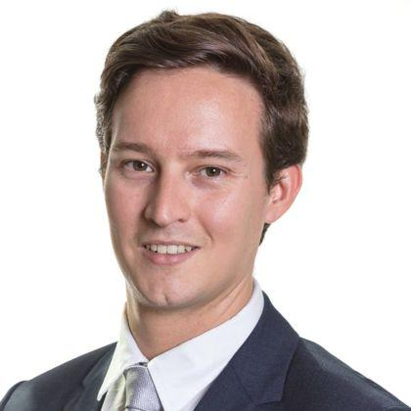
Todays Keynote Speaker – Tom Forman
Senior Associate at the international law firm CMS, focussing on Energy & Climate Change
Tom is an expert in energy regulatory and commercial matters. He has advised many industry participants on the regulatory and legislative framework that governs the industry from offshore wind to transmission networks.
In relation to the supply market he has advised on large scale M&A, customer book transactions, SoLR processes and Ofgem enforcement actions as well as day to day issues such as licence compliance and smart metering projects.
.
https://thewun.co.uk/

Slide 5
Todays Panel
Monica Collings, CEO So Energy
Monica Collings is Chief Executive Officer of So Energy, challenger retail
energy supplier and part of the ESB Group. Having worked within the
energy industry since 2018, she formerly led Vattenfall’s supplier in GB.
With a career foundation in marketing and communications, her path to leadership has seen her work in a variety of sectors including property, automotive and retail; markets clearly relevant as part of the energy transition to net zero. Monica sits as a non-executive on a number of boards in addition to her executive role, chairing a Diversity and Inclusivity Committee - a subject she is incredibly passionate about.
Monica's career highlights include an impressive track record of business transformation, innovation and NPD, scaling and growth, managing M&A processes, as well as her passion for creating strong visions and aligning organisational purpose to achieve results delivery. Monica’s leadership style can be described as progressive, empowering, people-centred and inclusive.
.
.
https://thewun.co.uk/

Slide 6
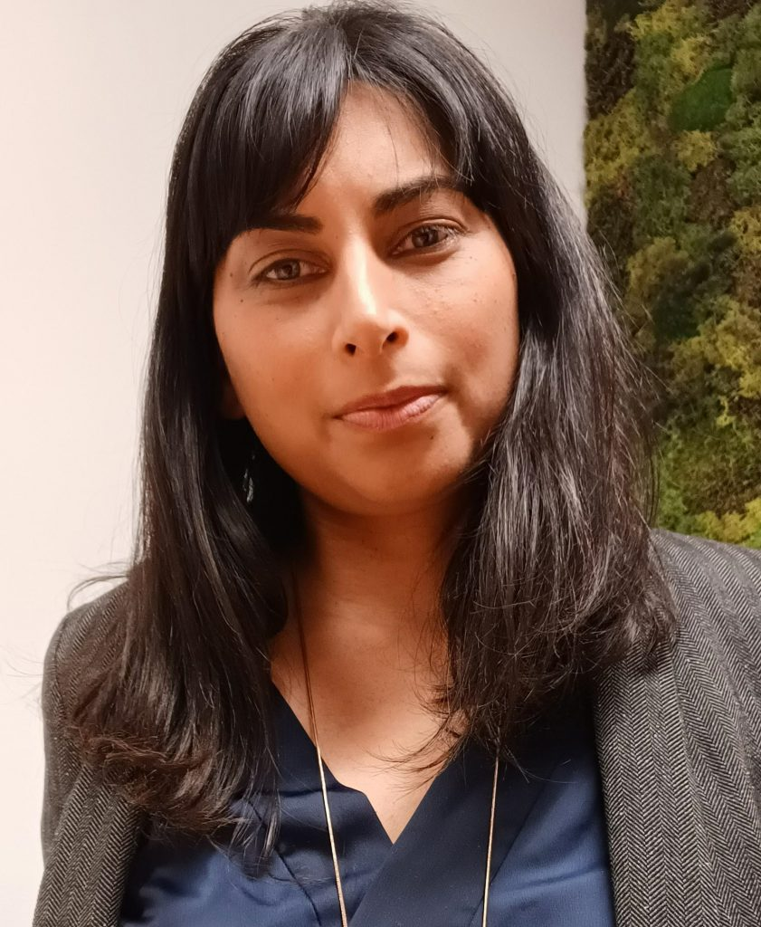
Todays Panel
Dhara Vyas, Director of Advocacy & Programmes (Interim) Energy UK
Dhara is an expert on energy consumer issues and joined Energy UK in November 2021 from Citizens Advice, where she was responsible for the consumer watchdog’s work on net zero, decarbonisation and future energy. Prior to this, Dhara led on several energy retail market issues, including customer service, vulnerability and smart energy.
Dhara began her career in local government and has worked across a broad range of policy areas from civil society and community building to scrutiny, local democracy and deliberative decision making. She has also been an active member of a number of Government and academic advisory boards and stakeholder groups.
.
.
https://thewun.co.uk/

Slide 7
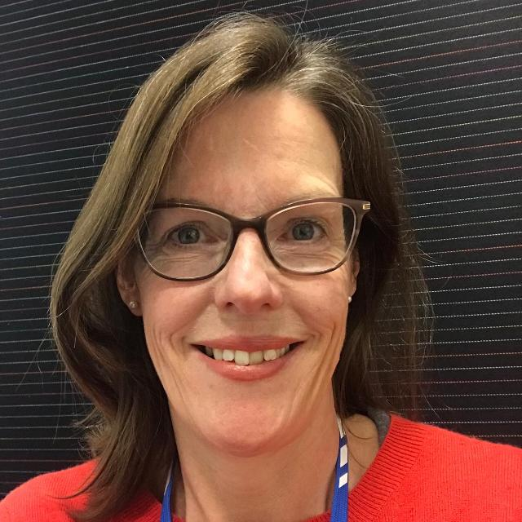
Todays Panel
Helen Tipton, Trustee of the Fuel Bank Foundation
Helen has been a trustee of the Fuel Bank Foundation for the past 5 years. The Fuel Bank Foundation helps homes in fuel crisis providing emergency funds as well as practical advice that people need to help get them back on their feet.
Helen's career has been within the Energy sector most recently at National Grid Gas Transmission & Metering holding executive roles in risk, assurance, safety and environment and sustainability.
Prior to National Grid, Helen worked for the energy supplier npower where she was Head of Retail Compliance for 6 years.
Helen is a passionate advocate for diversity and inclusion and was an active member of WiNG (Women in National Grid) and chaired Moxie the women's group at npower.
.
.
https://thewun.co.uk/

Slide 8
Panel Discussion and Q&A
https://thewun.co.uk/

Slide 9
New WUN report reveals how women really feel about working in the utilities sector
It’s hoped the results will act as a wake-up call to leadership teams, key stakeholders, recruitment teams, and the wider industry, while setting out five clear takeaways to help transform attitudes and behaviours.
These include appointing more positive female role models in senior positions, providing greater networking and support opportunities for women working in the sector, and changing the culture and environment of utility workplaces to better meet the needs of all.
To download and view the report for free, please visit
https://thewun.co.uk/

Slide 10
Coming up-
Wednesday 26th October WUN for ALL 1pm – Negotiation with
Paul Fisher, Associate Fellow Saïd Business School, University of Oxford.
Thursday 1st December 6pm, London. Innovation within Utilities.
Tickets now available via WUN website.
Save the date #IAR – 15 November 22.
tickets available shortly and
2023 Events calendar – coming soon!
https://thewun.co.uk/

Slide 11
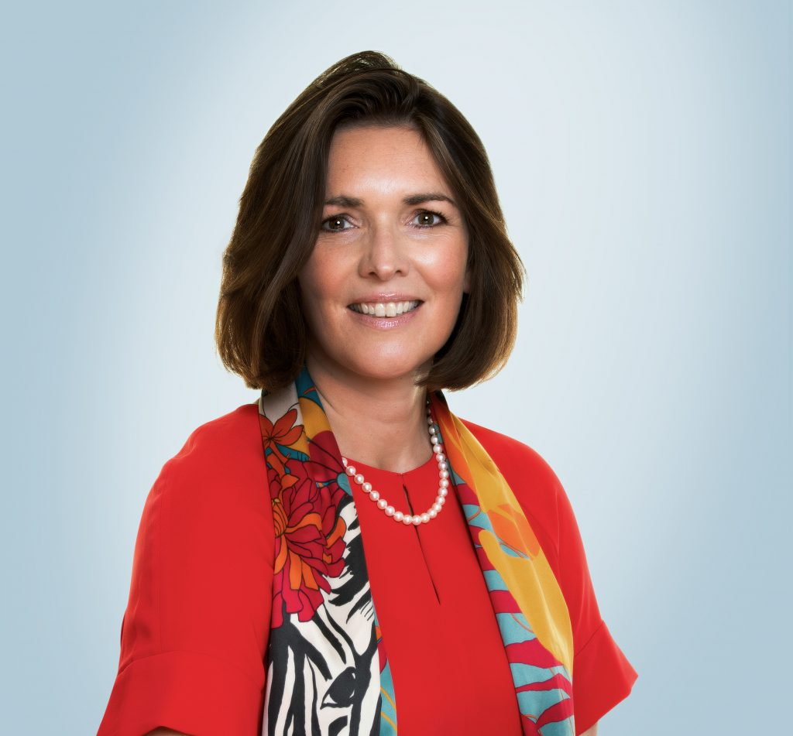
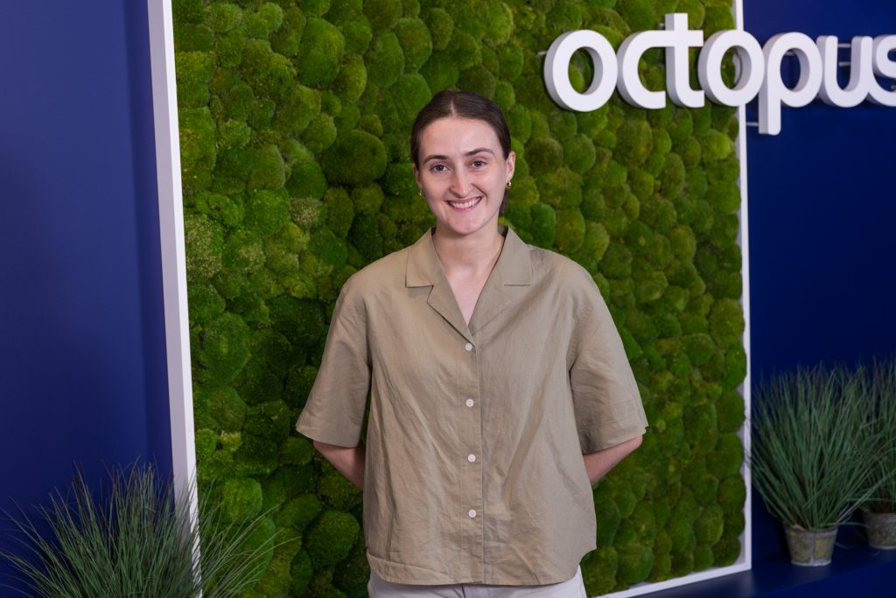
WUN Podcasts
Listen to our latest podcasts
Madelaine Brooks, Policy & Regulation Researcher Octopus Energy
We discuss some of the key barriers and opportunities in delivering net zero, the importance of effective market design in supporting net zero targets and hear more about Madelaine's career fascinating career journey so far.
Sarah Bentley, CEO of Thames Water discusses her fascinating career leading one of the largest utilities in the U.K, covering her transition from the tech sector to utilities, what it means to be a great leader and managing a busy family life outside of work.
.
You can follow our podcast on Apple Podcasts, Spotify, Amazon Music and wherever else you get your podcasts – just search “WUN4ALL”.
Or just click through for new website: https://thewun.co.uk/news-blogs/

Slide 12
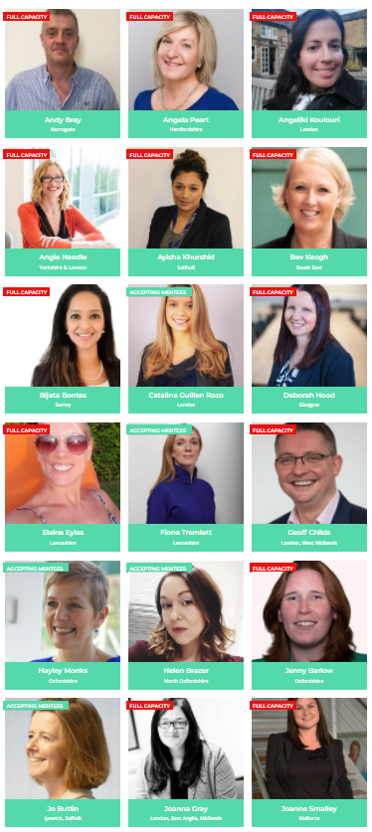
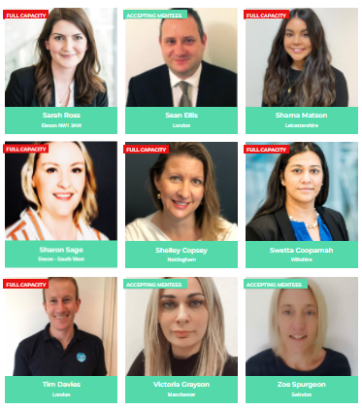
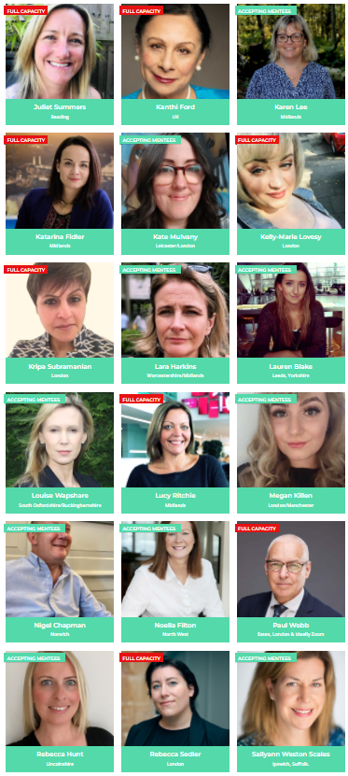
Join the free WUN Mentoring Programme
Our Mentors
WUN offers mentoring to women at any stage of their career in the utilities sector.
We are hugely privileged to have some fantastic experienced mentors within the WUN mentoring programme.
With growing numbers of Mentors and Mentees we are delighted with the community and support fostered within the mentoring programme.
If you are interested in becoming a mentor or a mentee please visit our website: https://thewun.co.uk/mentoring/

Slide 13
Don’t forget to join the Network
https://thewun.co.uk/join-wun/

Slide 14
Thank you to all our Partners for their ongoing support
https://thewun.co.uk/

Slide 15
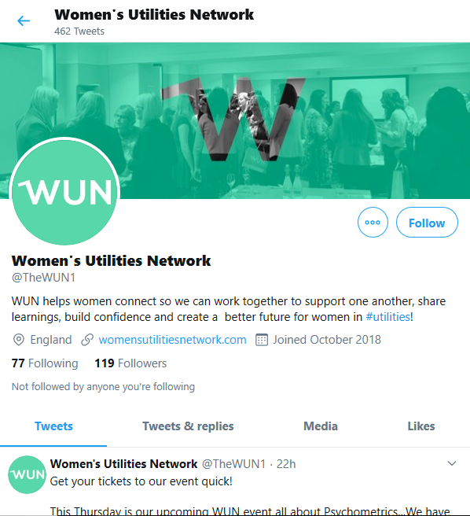
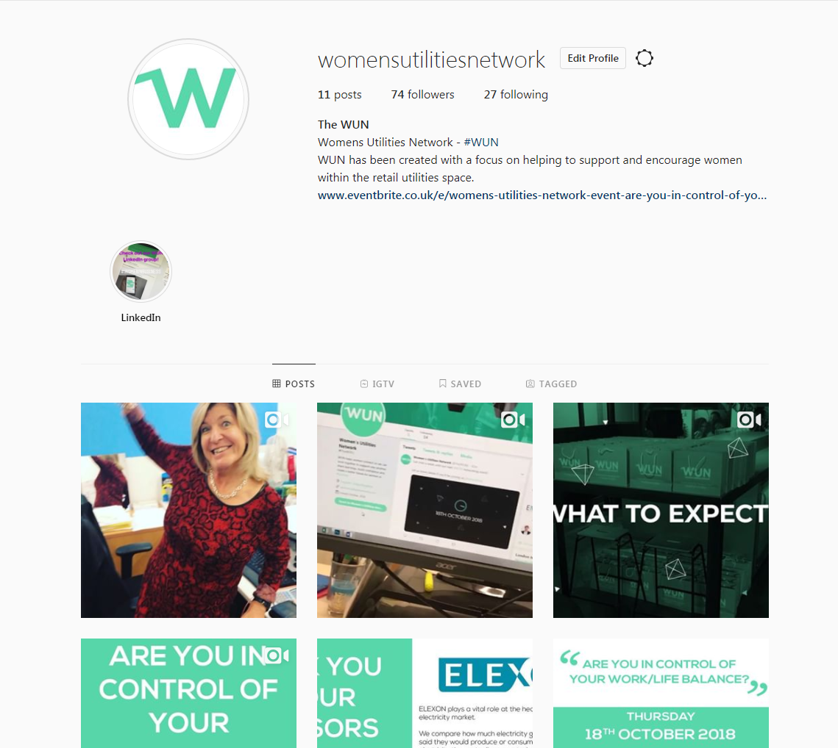
#WUN Don’t forget to follow us for the latest news and updates
https://thewun.co.uk/

