Slide 1
Welcome to WUN – We will be starting shortly.
https://thewun.co.uk/

Slide 2
Todays Agenda
Welcome – Jo Butlin WUN Founder & CEO EnergyBridge
Speaker Introduction- Lillian Philip , WUN advocate, EDF.
Todays speaker: Paul Fisher, Associate Fellow Saïd Business School, University of Oxford.
Discussion /Q&A chaired by Jo Butlin,.
Wrap up and close –Jo Butlin
https://thewun.co.uk/

Slide 3
Coming up-
15th November #IamRemarkable - 1:30-3pm Google Cloud, London
Thursday 1st December 6pm, London. Innovation within Utilities.
Speakers to include: Keynote: Danielle Lara, Client Executive in the Utilities space, Microsoft – Panel Shaunna Berendsen - Anglian Water and Yulia Lamonov, FYLD
Tickets now available via WUN website.
2023 Events calendar – coming soon!
https://thewun.co.uk/

Slide 4
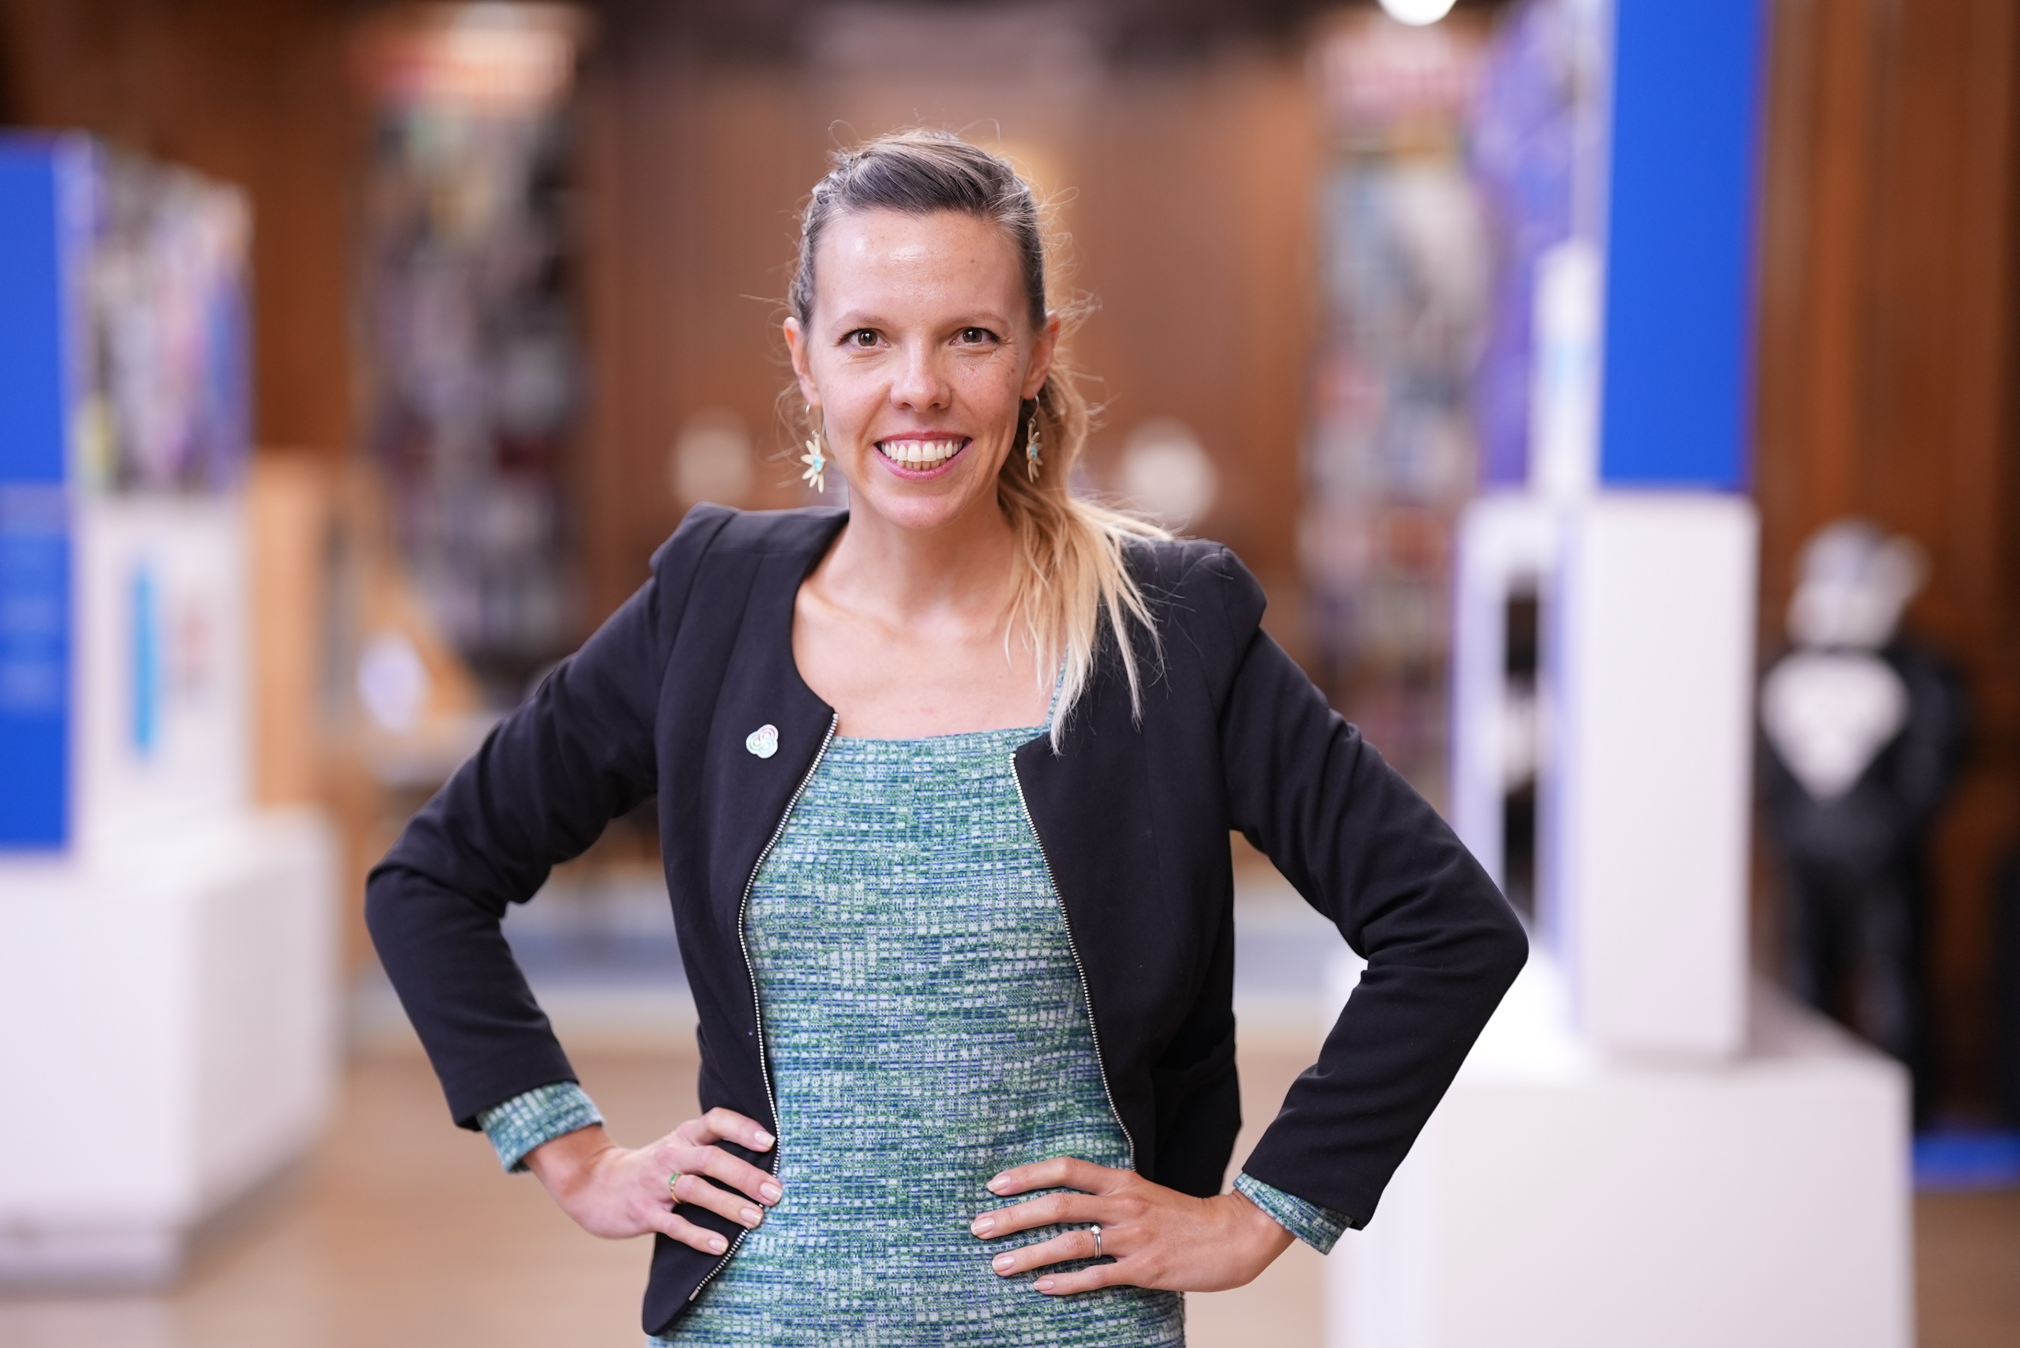
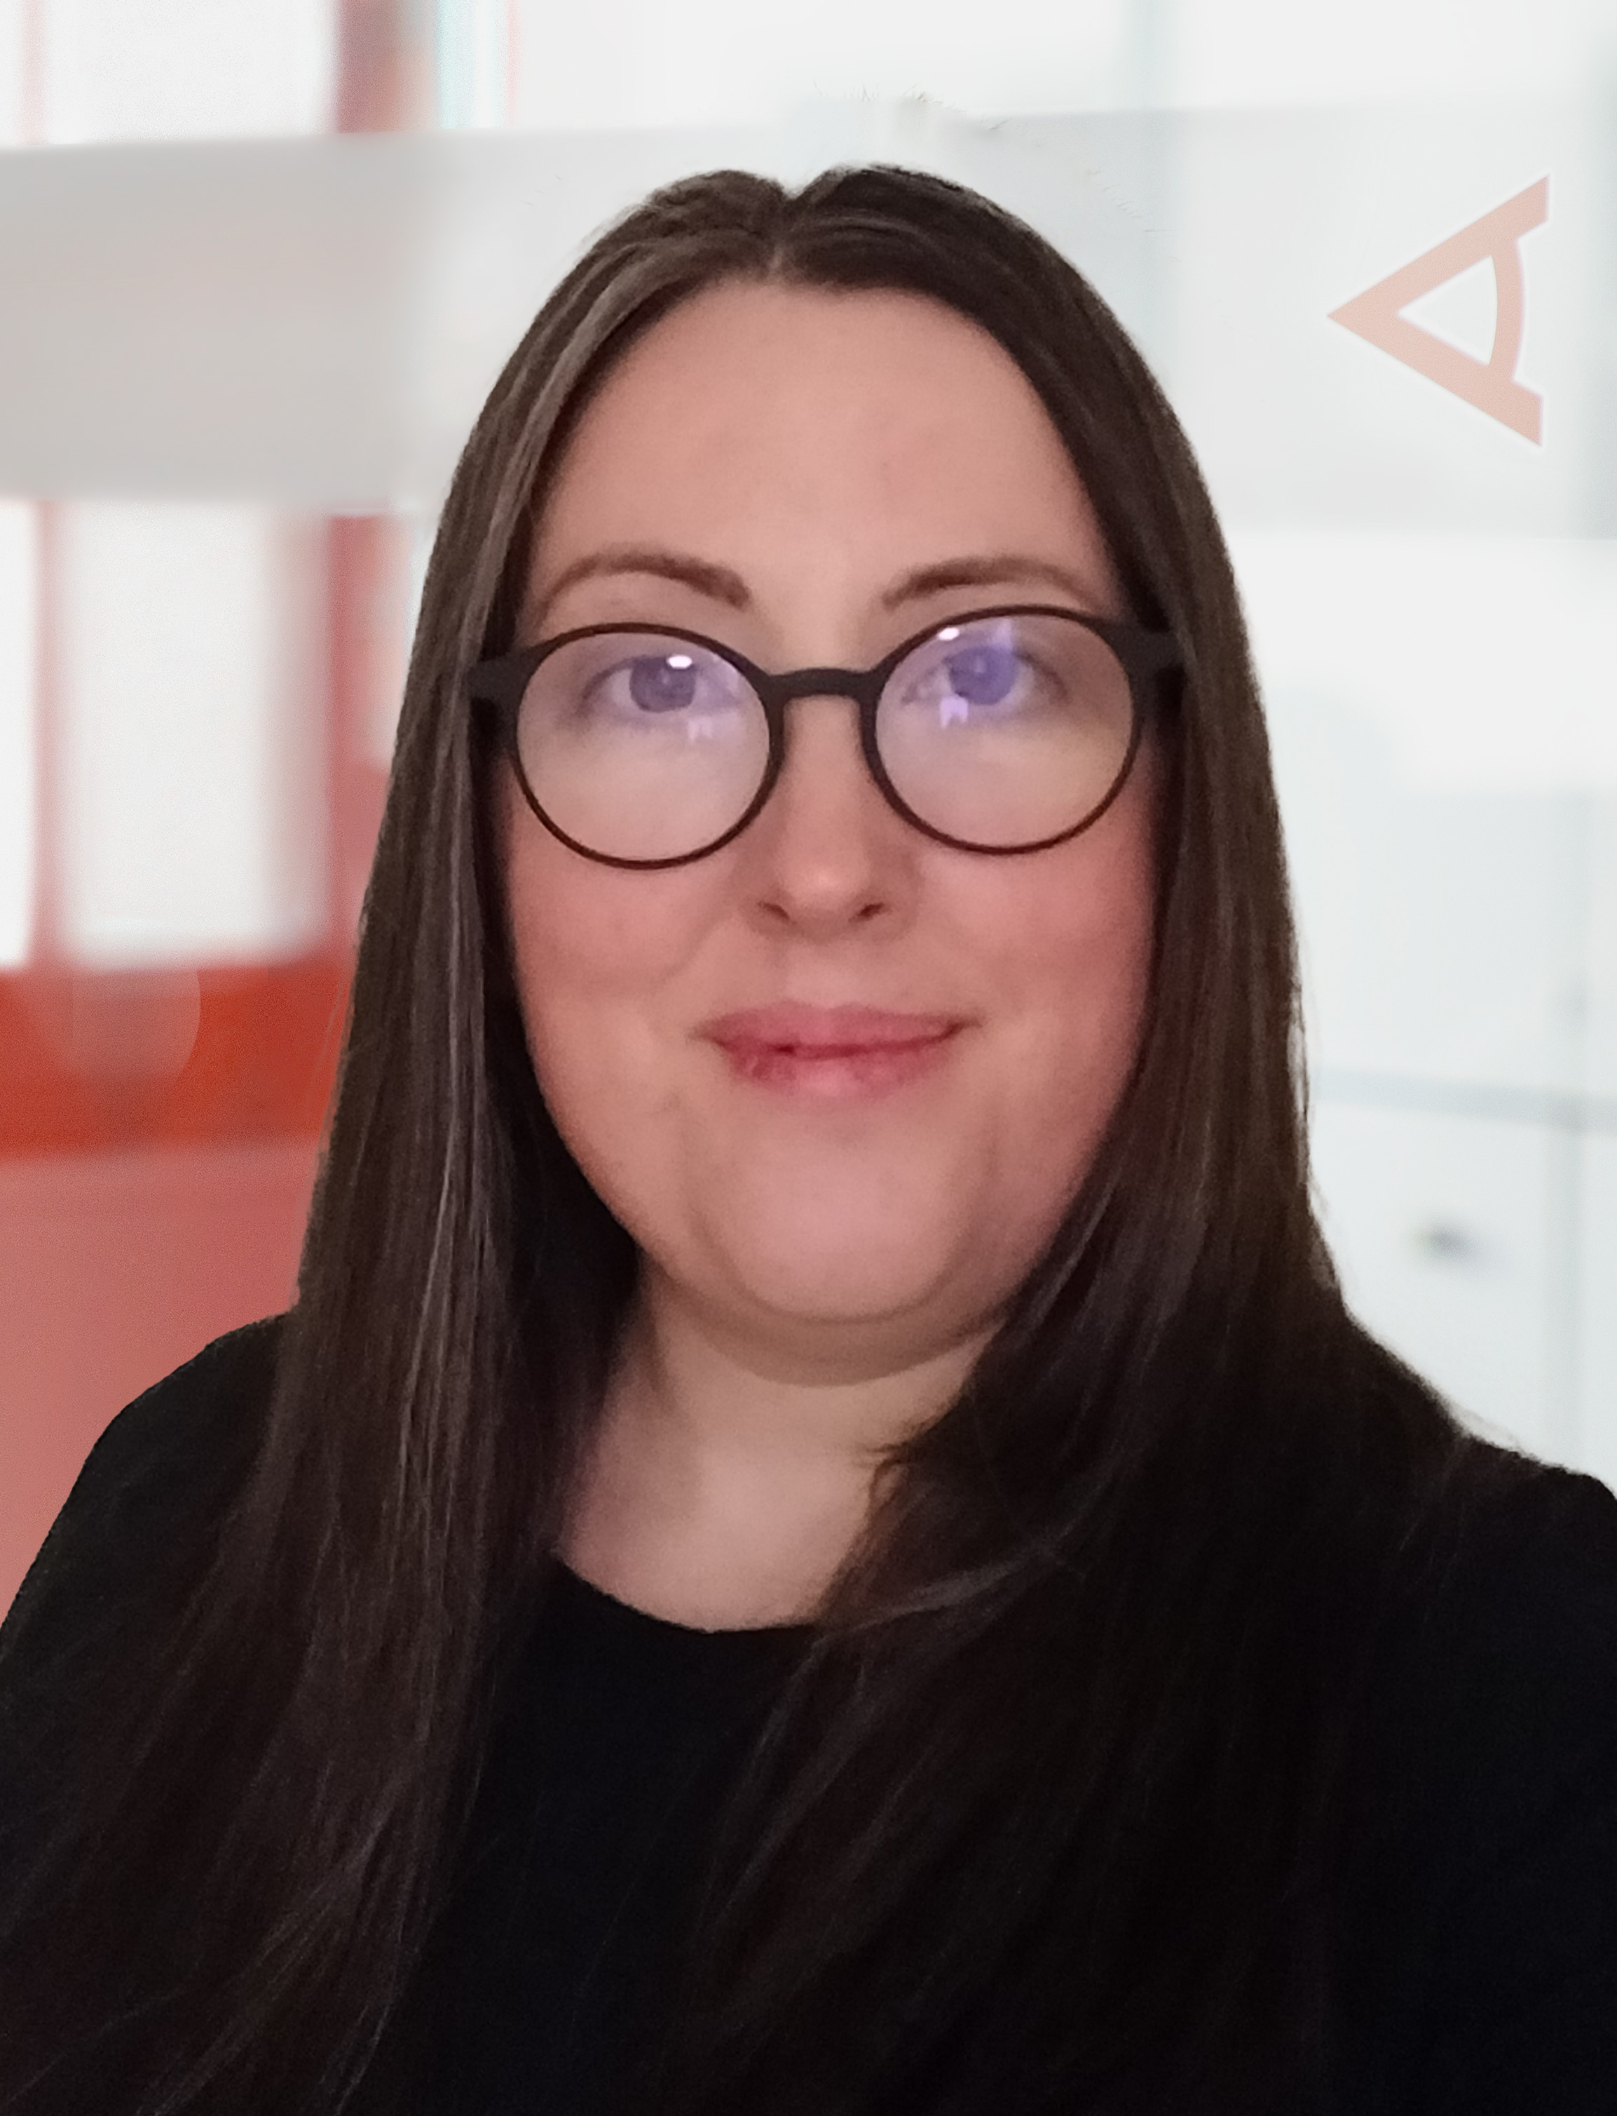
WUN Podcasts
Listen to our latest podcasts
Understanding REMA with
Kate Mulvany Cornwall Insight
Kate discusses the UK government’s
“Review of Electricity Market Arrangements” (REMA) – the UK’s biggest electricity market reform in a generation.
Kate dives into (1) the issues in the UK energy market that REMA is seeking to address; (2) the core outcomes and areas of reform put forward by REMA; and (3) what this means for the UK energy market going forwards.
Lily Frencham, CEO The Association for Decentralised Energy
Lily discusses the key skills needed to ensure that you are best placed to "negotiate your worth".
We discuss how you can build your confidence to navigate different scenarios at work, have quality conversations to accelerate your career and make your voice heard.
.
You can follow our podcast on Apple Podcasts, Spotify, Amazon Music and wherever else you get your podcasts – just search “WUN4ALL”.
Or just click through from the website: https://thewun.co.uk/news-blogs/

Slide 5
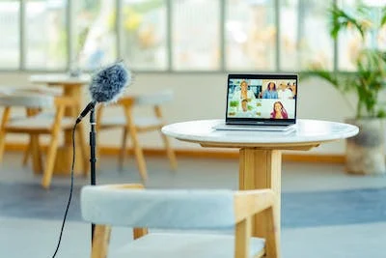
WUN Podcasters needed !
Wanted !
– would you chat informally to a WUN advocate as part of a round table discussion regarding returning to work or caring responsibilities ?
.
Please contact Helen@thewun.co.uk to get involved
https://thewun.co.uk/news-blogs/

Slide 6
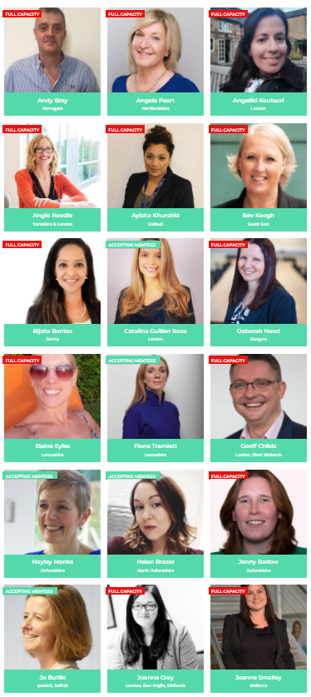
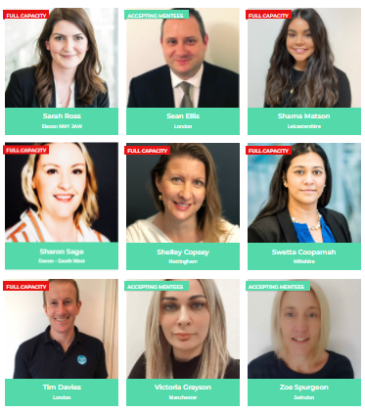
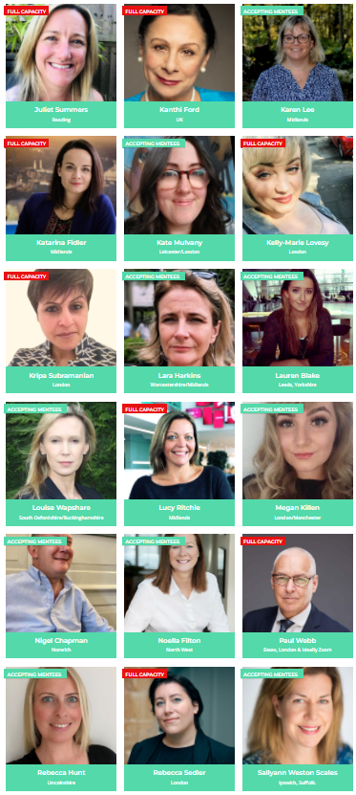
Join the free WUN Mentoring Programme
Our Mentors
WUN offers mentoring to women at any stage of their career in the utilities sector.
We are hugely privileged to have some fantastic experienced mentors within the WUN mentoring programme.
With growing numbers of Mentors and Mentees we are delighted with the community and support fostered within the mentoring programme.
If you are interested in becoming a mentor or a mentee please visit our website: https://thewun.co.uk/mentoring/

Slide 7
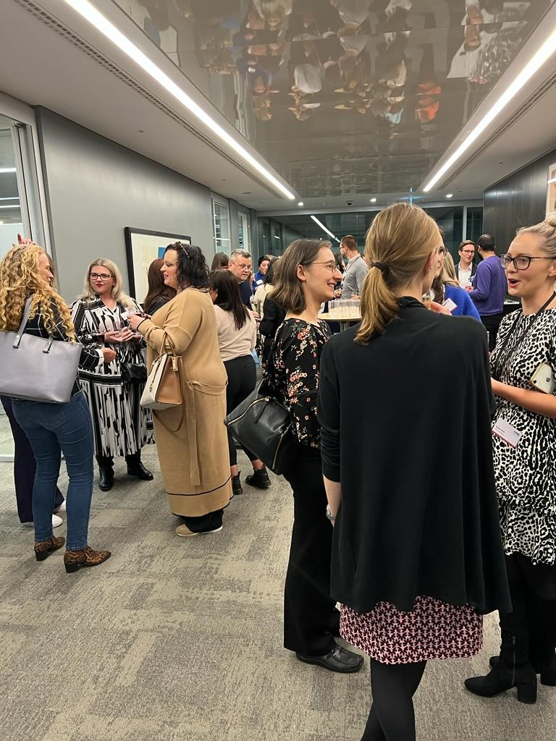
WUN is seeking a new Water Industry Advocate
This is a fantastic opportunity to work with an amazing team of advocates from across the Utilities sector to champion WUN, by writing or researching relevant water industry articles that would be of interest to the WUN members.
You will have the opportunity to take a lead role in promoting industry knowledge and the development of the water industry at WUN events and online.
We would love to hear from you if you have the passion, skills and qualities we are looking for to assist WUN as it continues its work to create a network of support, to help women develop their skills and career within the sector .
visit: https://thewun.co.uk
.

Slide 8
New WUN report reveals how women really feel about working in the utilities sector
It’s hoped the results will act as a wake-up call to leadership teams, key stakeholders, recruitment teams, and the wider industry, while setting out five clear takeaways to help transform attitudes and behaviours.
These include appointing more positive female role models in senior positions, providing greater networking and support opportunities for women working in the sector, and changing the culture and environment of utility workplaces to better meet the needs of all.
To download and view the report for free, please visit
https://thewun.co.uk/

Slide 9
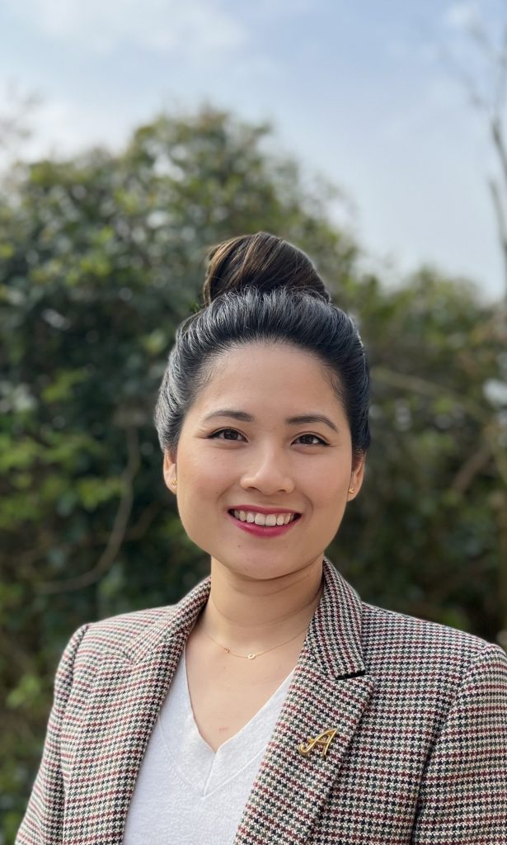
WUN Advocate Lillian Philip, EDF
Lillian is a senior manager of Business intelligence in the data team for Sales and Marketing at EDF.
She built her career in the energy industry since university and is passionate about supporting others build lasting and importantly, fulfilling careers.
She has recently returned to work following the birth of her second daughter.
Lillian is also on the Board as an Associate Non-Executive Director at University Sussex Hospitals Foundation Trust covering 7 hospitals across the South Coast and is supporting the Trust’s ambitions for Equality and inclusion and empowering teams from Board to Ward enacting change through their Patient First Programme.
.
https://thewun.co.uk/

Slide 10
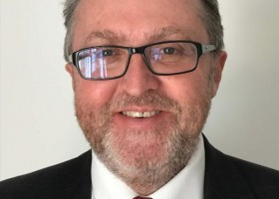
Todays Speaker Paul Fisher, Associate Fellow Saïd Business School, University of Oxford.
Paul is Programme Director of the Oxford Programme on Negotiation (OPN)
which he has helped to design and develop since its inception in 2004.
Paul also teaches on OPN and other programmes with topics including preparation in negotiations, decision-making, persuasion, stakeholder management, managing emotions, multi-party & multi-issue negotiations and virtual negotiations. Paul has co-written a number of negotiation simulations, including one on the building of a football stadium and the other designed specifically for virtual negotiations.
Paul also co-directs a number of customised negotiation programmes for major corporations and teaches on the Women of the Future programme at the School. Paul is
Programme Director of the Women’s World Banking and Alliance for
Financial Inclusion’s Leadership & Diversity Programme for Regulators, a 16-week global programme taught by Women’s World Banking and faculty from
Oxford University.
.
https://thewun.co.uk/

Slide 11
Todays Speaker Paul Fisher, Associate Fellow
Saïd Business School, University of Oxford.
Outside the School, Paul has also taught negotiation at the William J Clinton
Leadership Institute, Queen’s University Belfast, and is Programme Director of the
Small Countries Financial Management Programme, held annually on the Isle of Man and in Oxford, where the aim is to contribute to the growth and prosperity of small countries through capacity building in the government financial sector. Paul graduated from the University of Liverpool with a degree in politics and is also a certified business coach and cross-cultural trainer.
Paul has over 20 years’ experience in the field of communications, education and capacity building, helping private and public sector organisations to achieve their full potential. He has worked alongside some of the world’s best-known organisations across multiple sectors, including the World Bank, the World Commission on Dams, the 2008 Commission on Growth and Development, the inaugural 2016 UK-China Regional Leaders' Summit, the Asian Development Bank, Emerson, IBM, British Telecom, the governments of the UK and the United Arab Emirates, and various UN agencies.
.
https://thewun.co.uk/

Slide 12
Women & Negotiation - Narrowing the Gender Gap
Paul Fisher, Saïd Business School, University of Oxford
October 26 2022

Slide 13
‘Negotiation is essentially a back-and-forth communication designed to reach an agreement when you and the other side have some interests that are shared and others that are opposed’

Slide 14
Finding something in common
You have 90 seconds to find something (if possible a number of things) you have in common.
It can be shared values, shared social situations, shared friends. Anything!

Slide 15
Five Key Principles That Will Make You A Better Negotiator
1. Focus on Relationships

Slide 16
The importance of fairness

Slide 17
“Excuse me, I have 5 pages. May I use the Xerox machine, because I'm in a rush?”
“Excuse me, I have 5 pages. May I use the Xerox machine?”
94%
“Excuse me, I have 5 pages. May I use the Xerox machine, because I have to make copies?”
60%
93%

Slide 18
Five Key Principles That Will Make You A Better Negotiator
1. Focus on Relationships
2. Focus on Interests Not Positions

Slide 19
Five Key Principles That Will Make You A Better Negotiator
1. Focus on Relationships
2. Focus on Interests Not Positions
3. Listen & Question

Slide 20
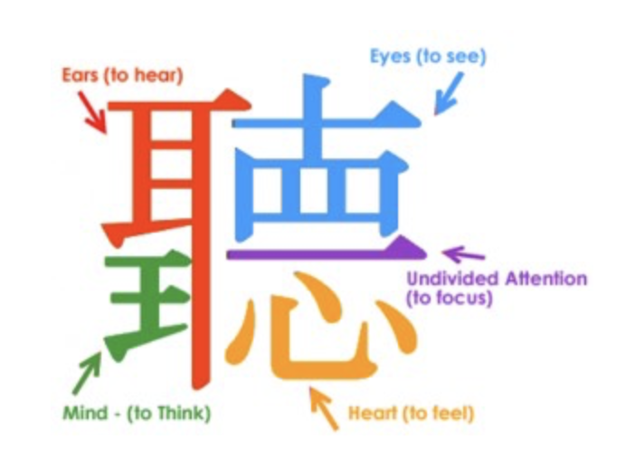

Slide 21
What would it take to….?
How can we work together to resolve this/find a solution?
Tell me what’s on your agenda at the moment….
When and how are you going to do that?
Often the worst questions are those not asked at all!

Slide 22
What is more persuasive?
‘By implementing this new smart meter, you can generate savings of X pounds per year.’
‘By failing to implement this new smart meter, you will lose X pounds per year.’

Slide 23
What is more persuasive?
Asking your boss for a raise of $500 per month
Asking your boss for a raise of $6000 per year

Slide 24
Five Key Principles That Will Make You A Better Negotiator
1. Focus on Relationships
2. Focus on Interests Not Positions
3. Listen & Question
4. How You Frame Information Can Have A Big Impact

Slide 25
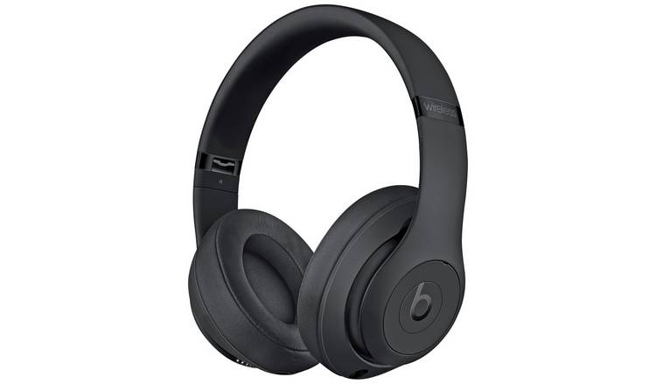
Choosing headphones
Beats Solo priced at £249.95 and rates 7 out of 10 by an independent test
Beats Studio priced at £299.95 and rates 8 out of 10 by an independent test
Beats Pro priced at £349.95 and rates 7 out of 10 by an independent test

Slide 26
What must I have?
What would I like to have?
What would I like to have in the ideal world?

Slide 27
Five Key Principles That Will Make You A Better Negotiator
1. Focus on Relationships
2. Focus on Interests Not Positions
3. Listen & Question
4. How You Frame Information Can Have A Big Impact
5. Aim High

Slide 28
What must I have?
What would I like to have?
What would I like to have in the ideal world?
When is it best not to negotiate at all….? Your BATNA

Slide 29
Five Key Principles That Will Make You A Better Negotiator
1. Focus on Relationships
2. Focus on Interests Not Positions
3. Listen & Question
4. How You Frame Information Can Have A Big Impact
5. Aim High

Slide 30
Reading Material:
Women Don’t Ask – The High Costs for Avoiding Negotiation & Positive Strategies for Change; Linda Babcock & Sara Laschever; 2007
https://www.amazon.co.uk/Women-Dont-Ask-Negotiation-Strategies/dp/0553383876
You're Not Listening: What You're Missing and Why It Matters; Kate Murphy; 2020
https://www.amazon.com/Youre-Not-Listening-Missing-Matters/dp/1250297192

Slide 31
Thank You and Good Luck! paul.fisher@sbs.ox.ac.uk www.linkedin.com/in/phlfisher/

Slide 32
Final reminder coming up-
15th November #IamRemarkable - 1:30-3pm Google Cloud, London
Thursday 1st December 6pm, London. Innovation within Utilities.
Speakers to include: Keynote: Danielle Lara, Client Executive in the Utilities space, Microsoft – Panel Shaunna Berendsen - Anglian Water and Yulia Lamonov, FYLD
Tickets now available via WUN website.
2023 Events calendar – coming soon!
https://thewun.co.uk/

Slide 33
Don’t forget to join the Network
https://thewun.co.uk/join-wun/

Slide 34
Thank you to all our Partners for their ongoing support
https://thewun.co.uk/

Slide 35
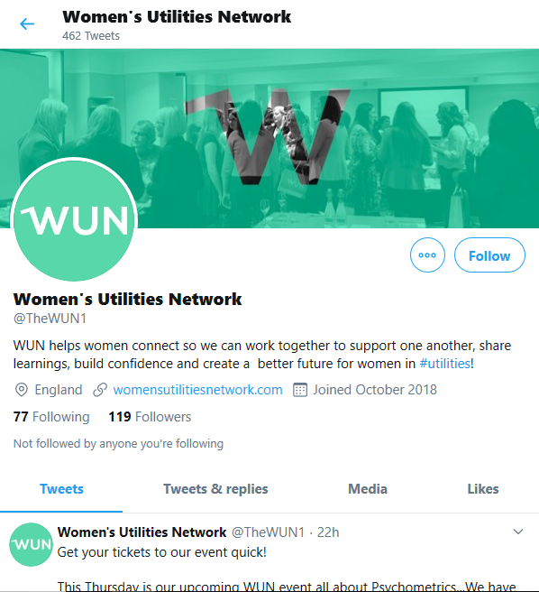
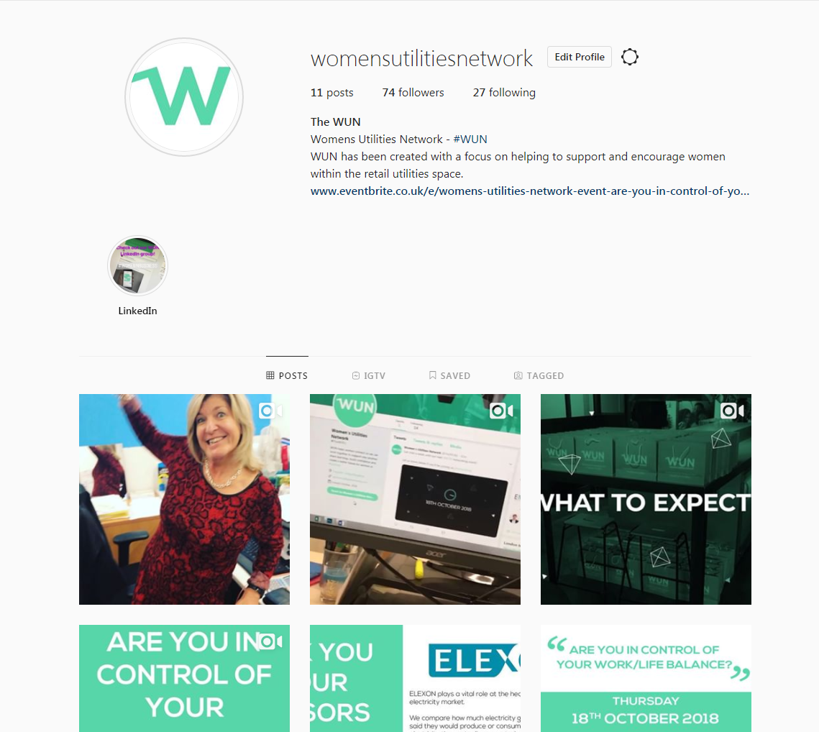
#WUN Don’t forget to follow us for the latest news and updates
https://thewun.co.uk/

